Slide 1
HOLIDAYS!!! THEN & NOW
Created By: Jason Schipper, Cassie Wucher, and Emma Dewalt

Slide 2
What is a Holiday?
What is a holiday?
A day that is specifically designated to commemorate a certain person or event.
This day is also known as a break from work and school

Slide 3
Why do we celebrate it?
We celebrate holidays by conducting a number of traditional activities to remember or honor who the day is for.
For instance, Holidays can be celebrated for
individuals (birthdays), Birthday cake, presents, candles
government (Veterans Day), Parades, fireworks
religious groups/figures (Hannakuh, Christmas)

Slide 4
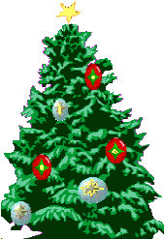
CHRISTMAS

Slide 5
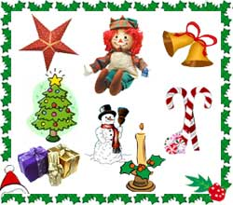

Slide 6
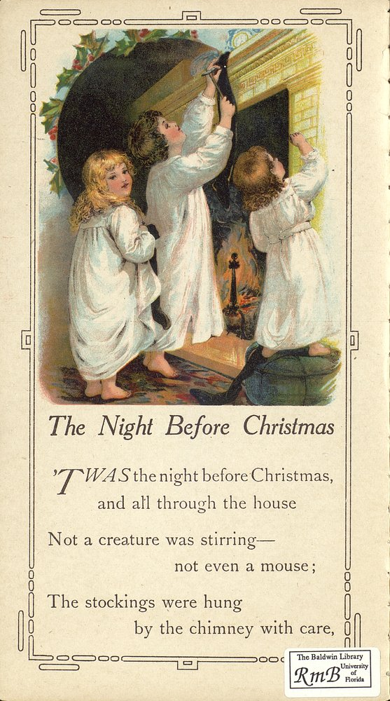
Christmas Celebrations in the Past…
Notes:
Photo: The opening page from “The Night Before Christmas” - 1870

Slide 7
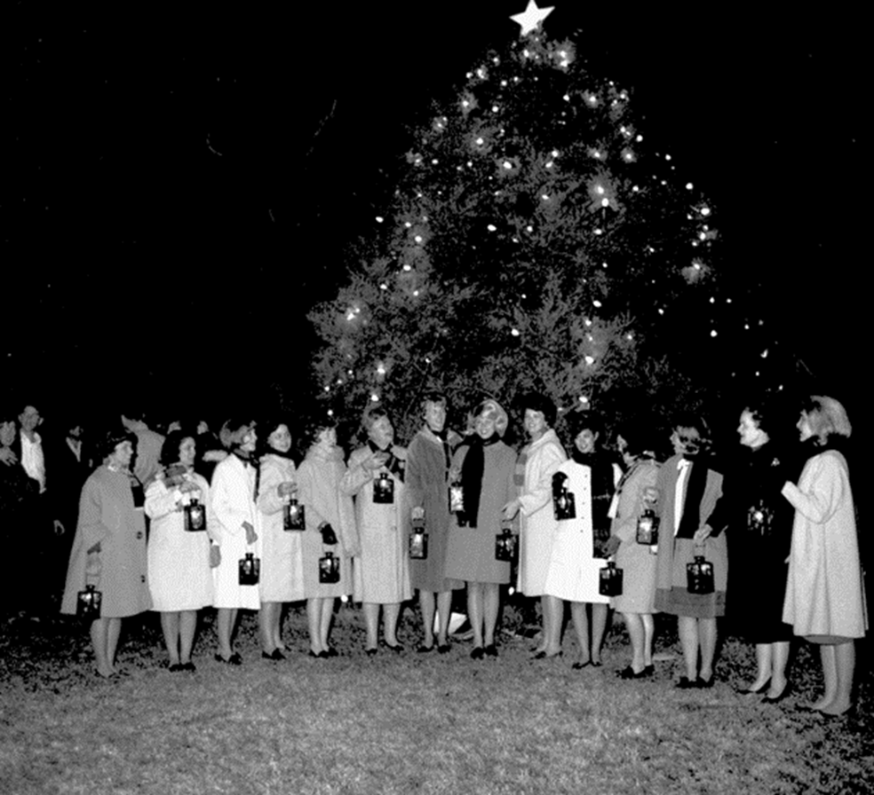
Christmas Celebrations in the Past…
Notes:
Photo: Take from a campus Christmas tree at the University of Florida- 1967

Slide 8
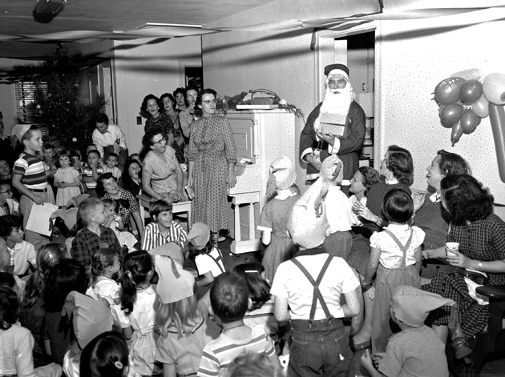
Christmas Celebrations in the Past…
Notes:
Photo 3: Christmas party at the Women’s Club (on University)- 1955

Slide 9
What similarities did you notice from the pictures and how you or someone you know may celebrate this holiday?

Slide 10
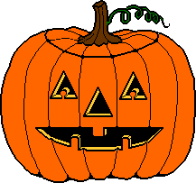
Halloween

Slide 11
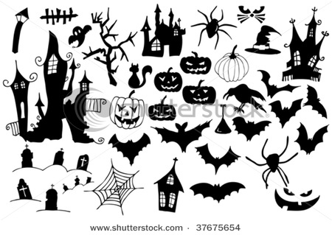

Slide 12
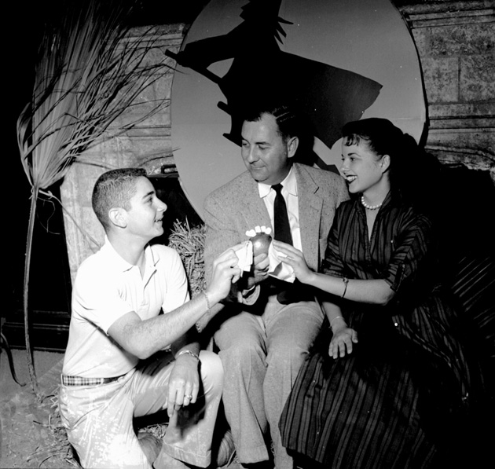
Halloween celebrations in the past…
Notes:
Photo: Halloween Tea at Univ of Florida Student Union- 1950s

Slide 13
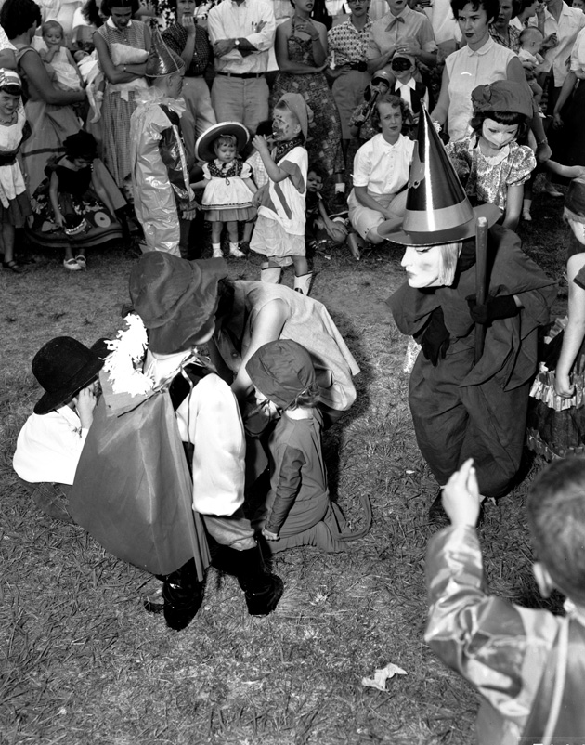
Halloween celebrations in the past…
Notes:
Photo: Halloween Party in University of Florida Flavet Field- 1955

Slide 14
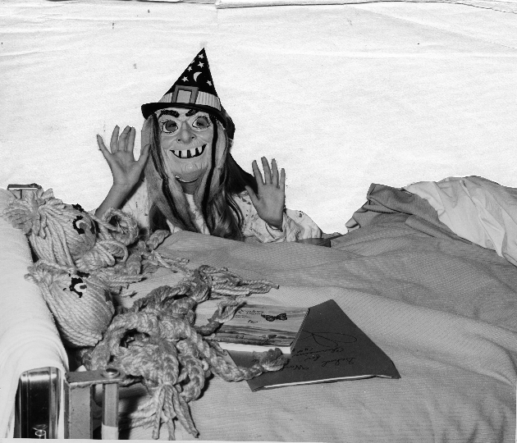
Halloween celebrations in the past…
Notes:
Photo: Date N/A

Slide 15
What similarities did you notice from the pictures and how you or someone you know may celebrate this holiday?

Slide 16
Now, turn to your friend and tell them what your favorite holiday is, and how you and your family celebrate it.

Slide 17
ACTIVITY
With your partner, your job is to act out a holiday and celebration and we will try to guess it as a class! You can use gestures and words, but make sure not to say what your holiday is!
You will have 5 minutes to plan and then the acting will begin!

Slide 18
GREAT JOB ACTORS!!
FINAL ACTIVITY-
At your tables you have paper and markers
Create a holiday and draw images to represent it
Symbols for your holiday
People doing your holiday’s celebration
A holiday in the past? Present? Or Future?
To get started, think about the different holidays we talked about:
Person- A holiday to celebrate your grandpa, mother, teacher, best friend, pet?!?
Important figure- President (past or present), teacher, businessperson
Make-believe figure or Icon- your stuffed animal, SpongeBob, iCarly, Ben10, sports team, music singer
An event or feeling- Celebrate water, happiness, sunshine, the year 2000
Be prepared to share with the class why you chose the holiday that you did and the drawings that you made! ☺

