Slide 1
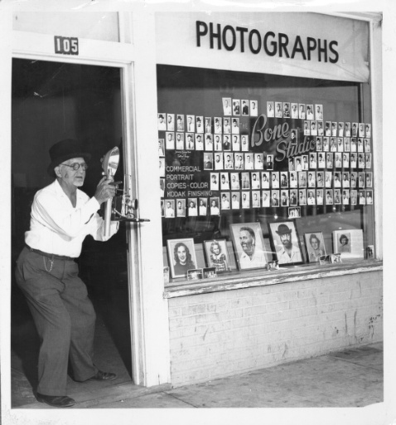
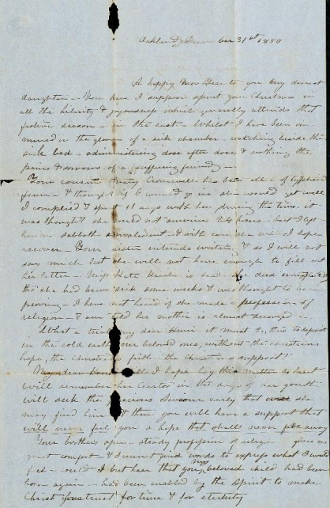
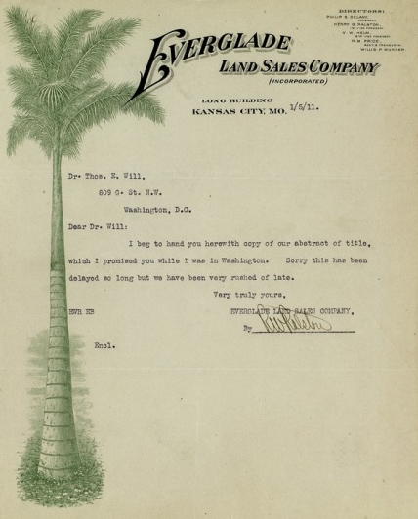
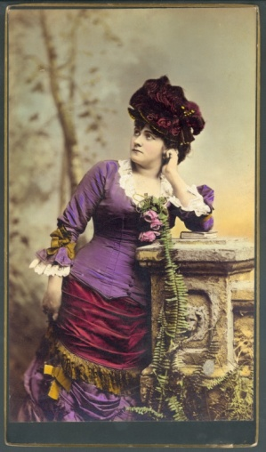
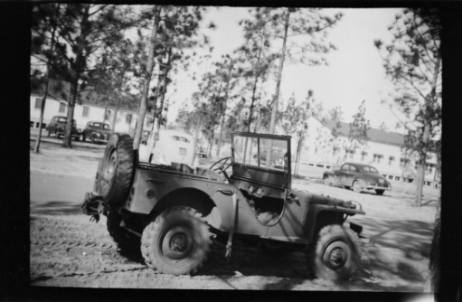
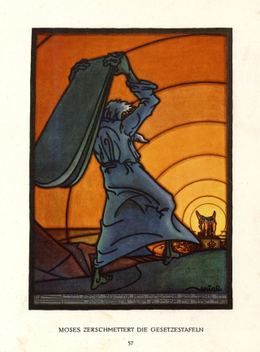
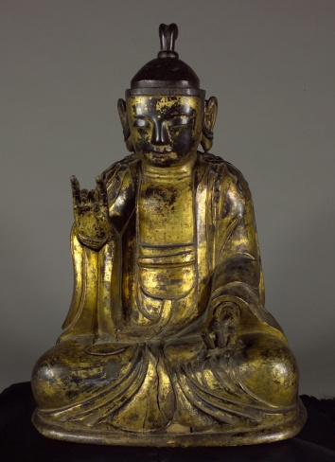
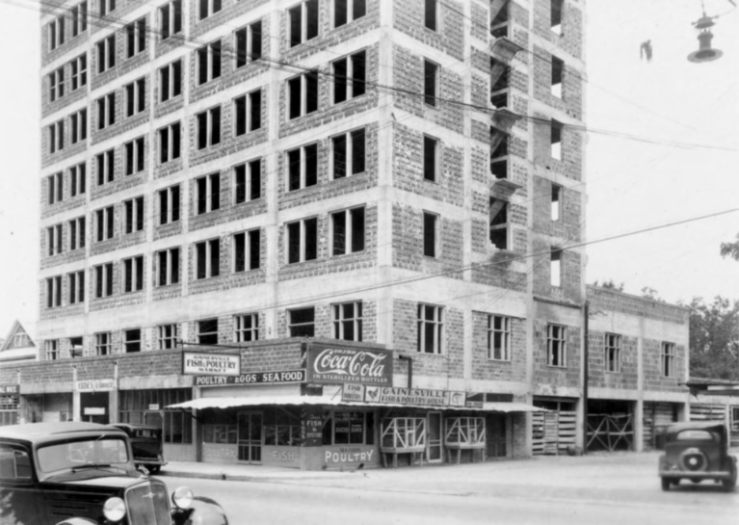
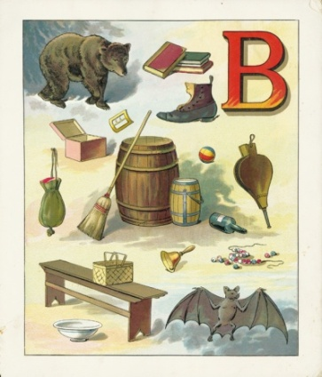
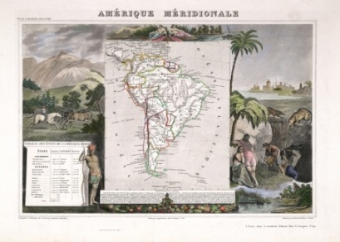
UF Digital Collections & Communities: Collections, Technologies, Collaborations, & Leadership

Slide 2
http://ufdc.ufl.edu

Slide 3
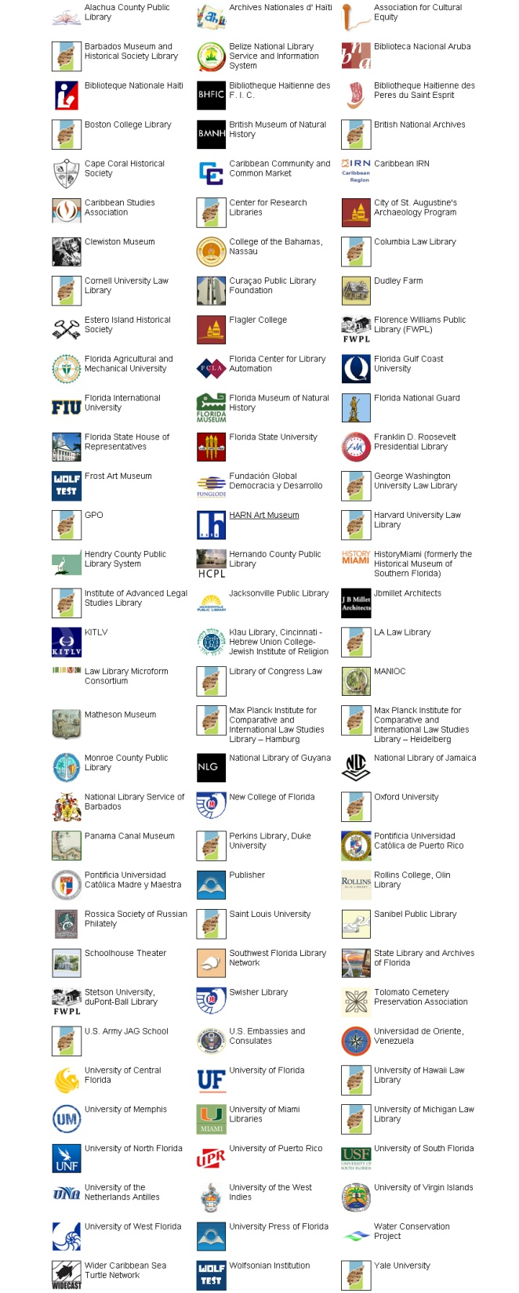
Partners
&
Contributing Institutions
(as of June 2014)
Archives Nationales d’Haïti
Caribbean Studies Association
Flagler College
Florida Agricultural and Mechanical University
Florida International University
Florida Museum of Natural History
Florida State House of Representatives
Samuel P. Harn Museum of Art
History Miami
Jacksonville Public Library
Matheson Museum
National Library of Jamaica
New College of Florida
Panama Canal Museum
Universidad de Oriente (Venezuela)
University of Miami
Notes:
3

Slide 4
Rich Collections Innovative Technologies

Slide 5
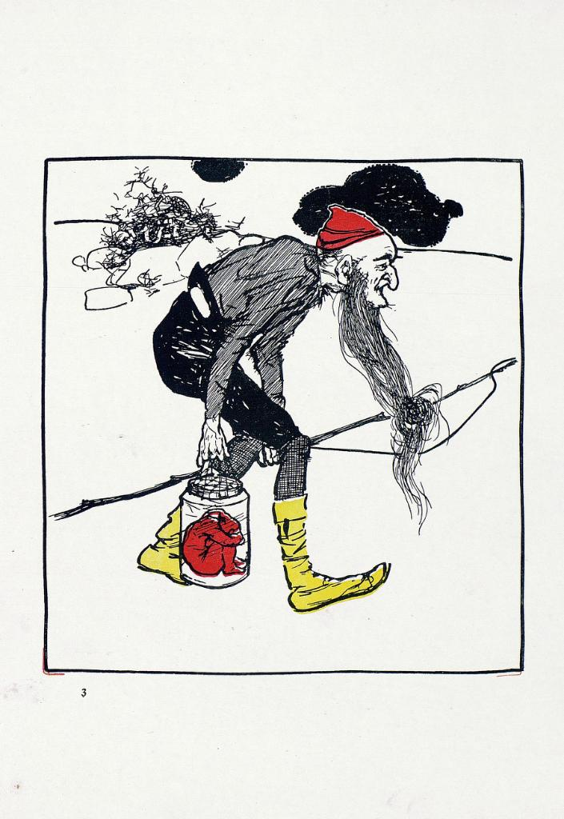
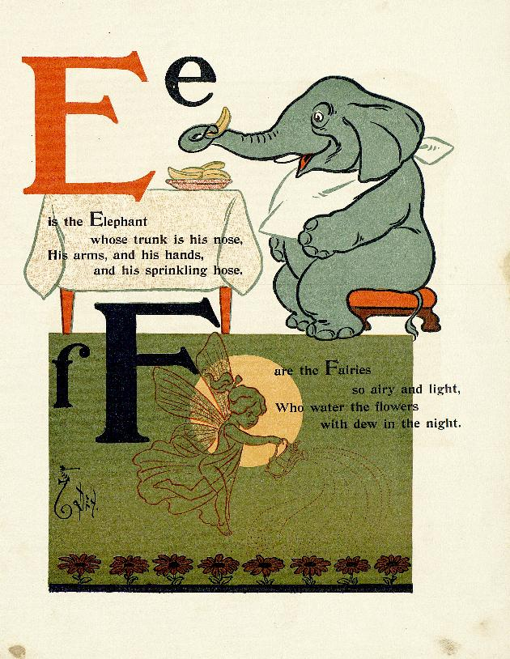
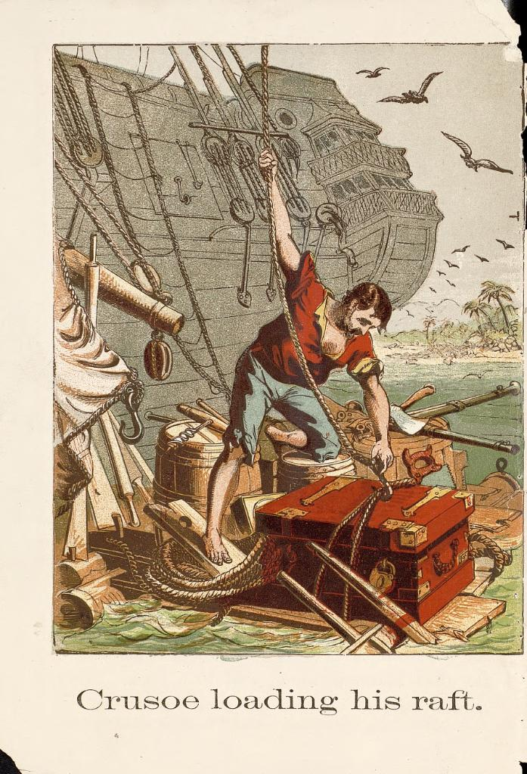
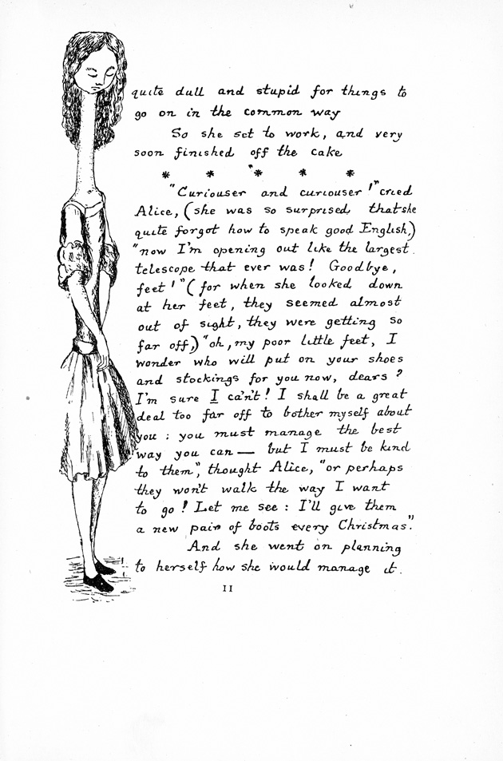
http://ufdc.ufl.edu/baldwin
Notes:
5

Slide 6
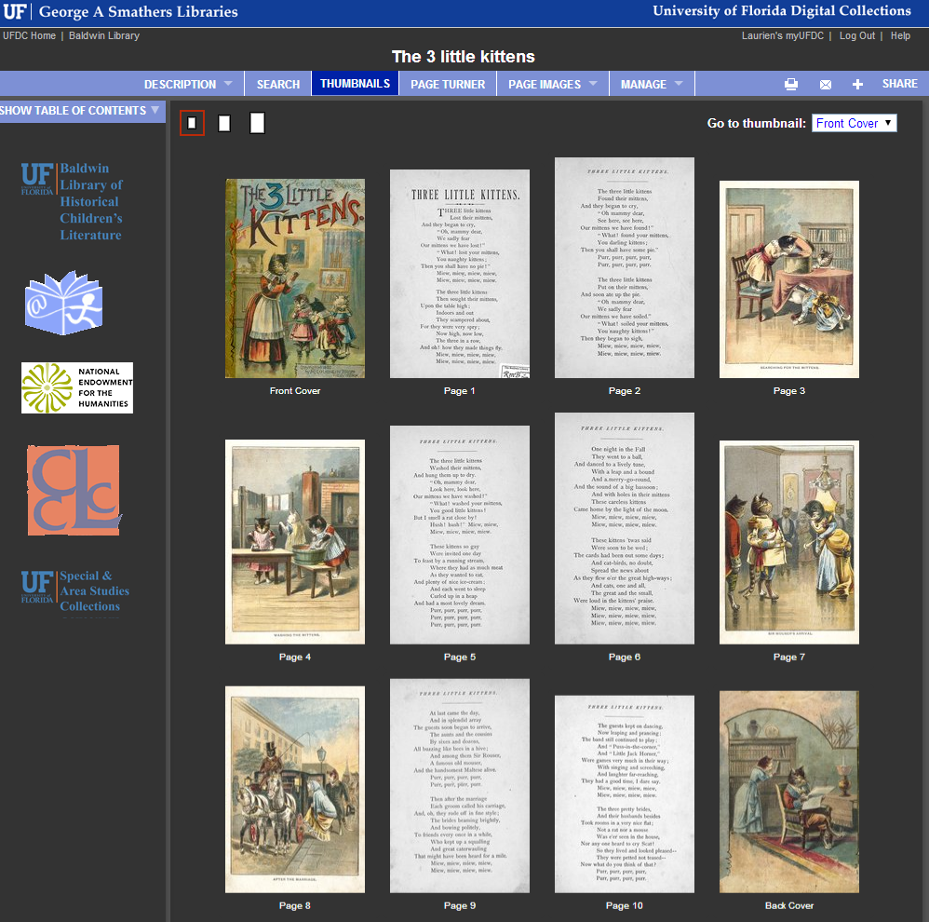

Slide 7
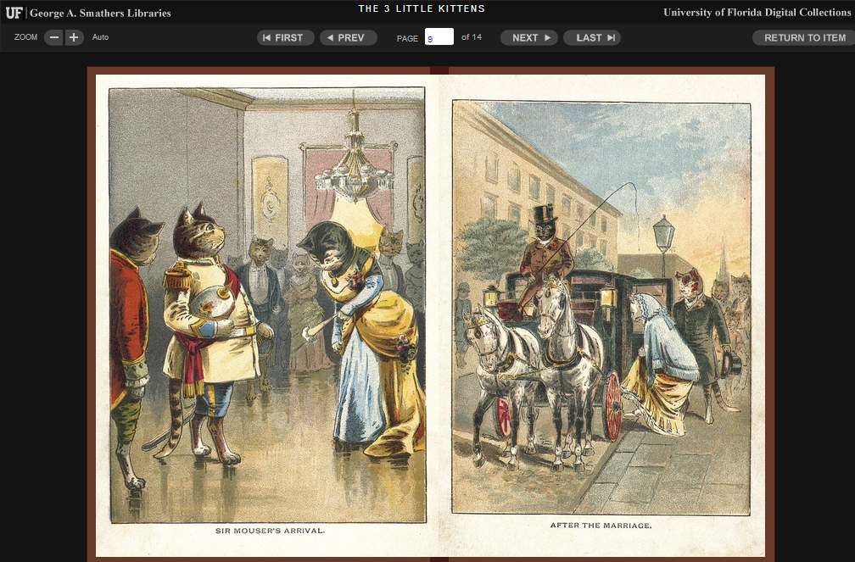
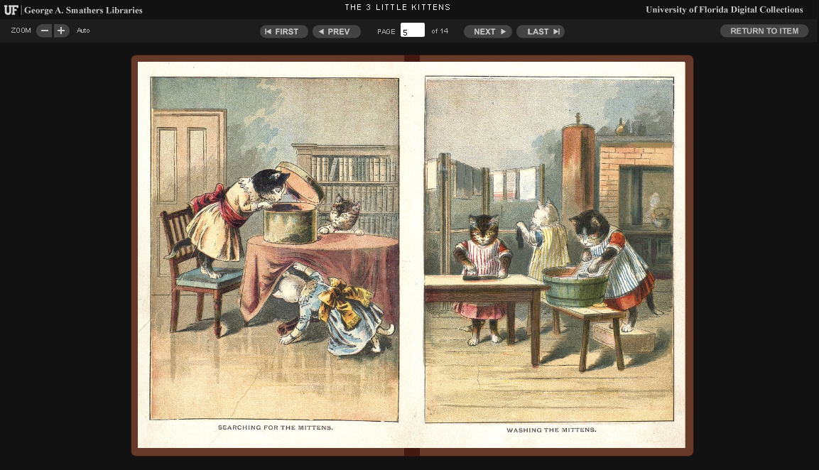

Slide 8
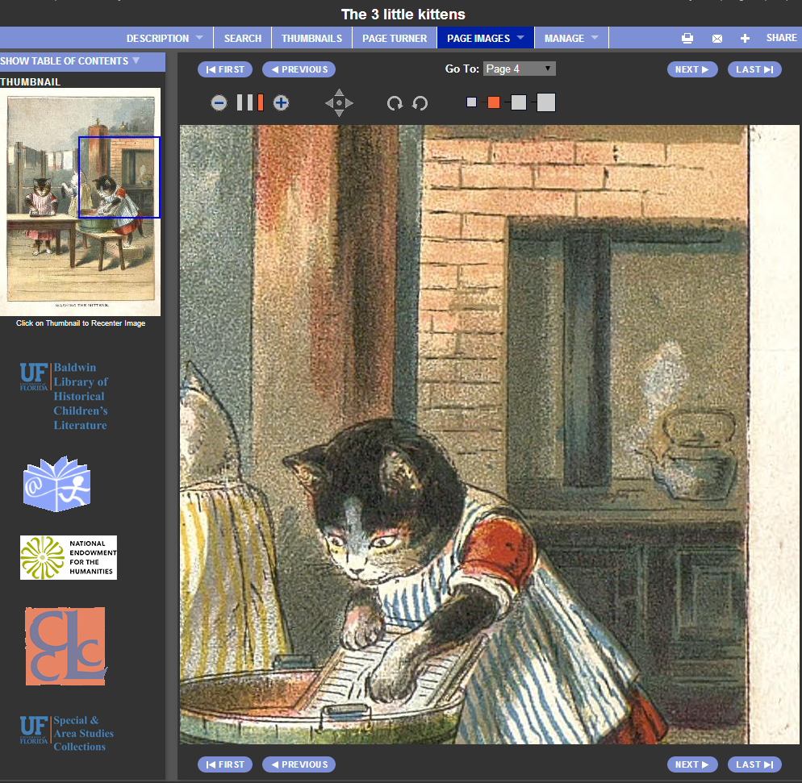

Slide 9
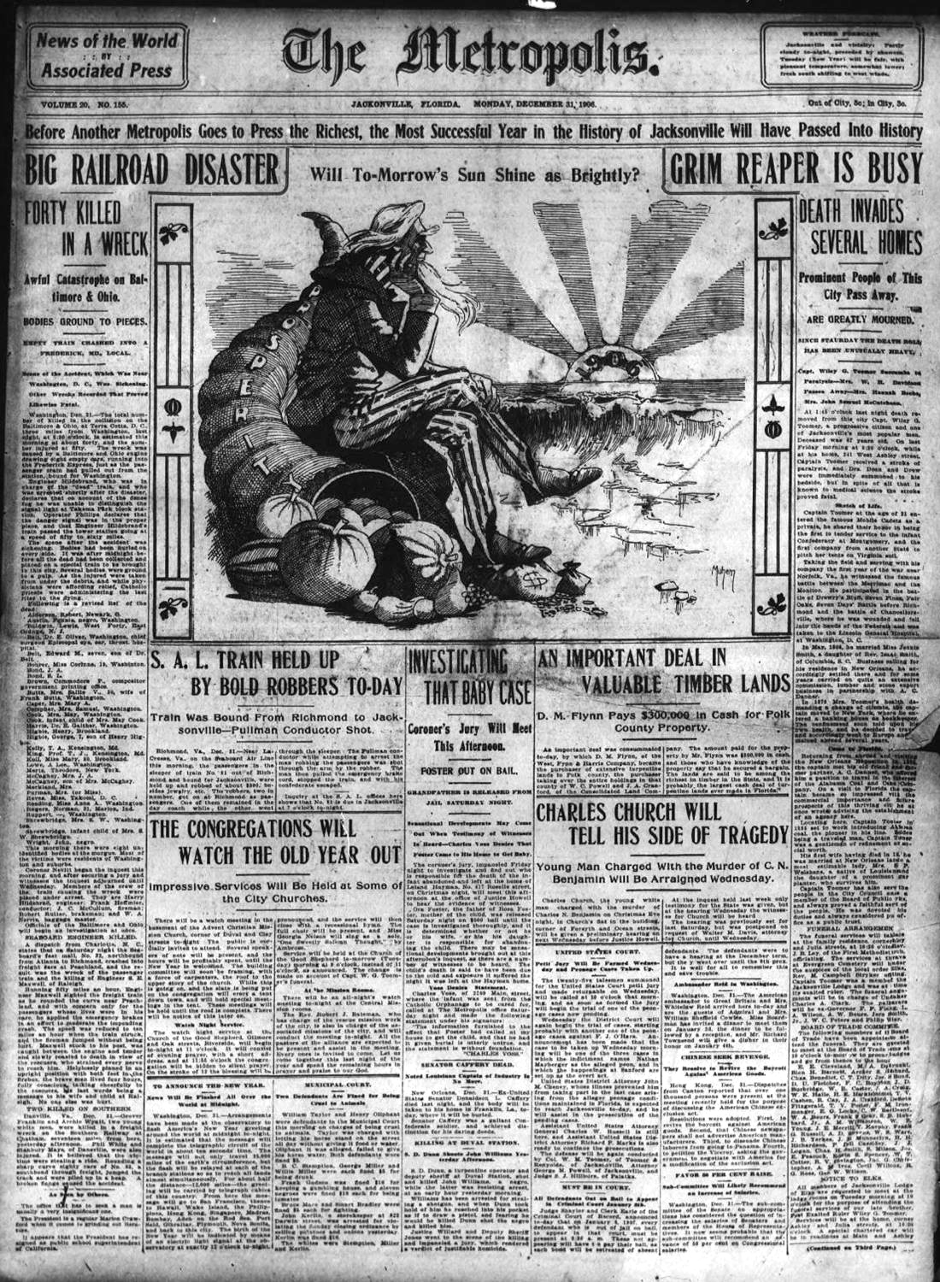
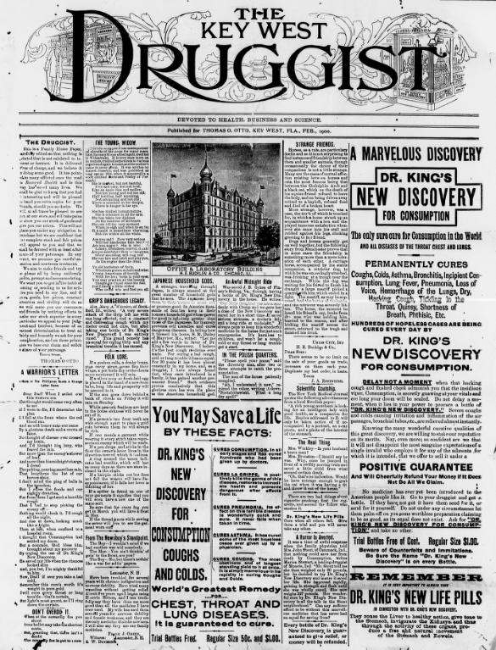
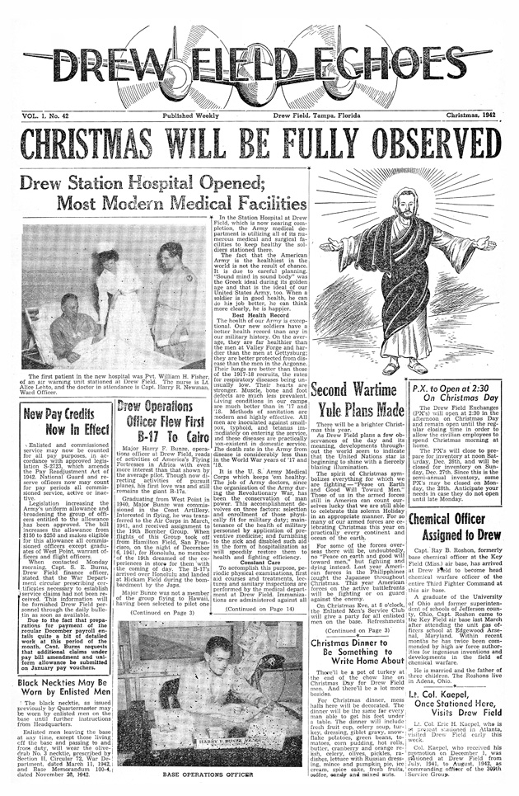
http://ufdc.ufl.edu/newspapers
Notes:
newspapers

Slide 10
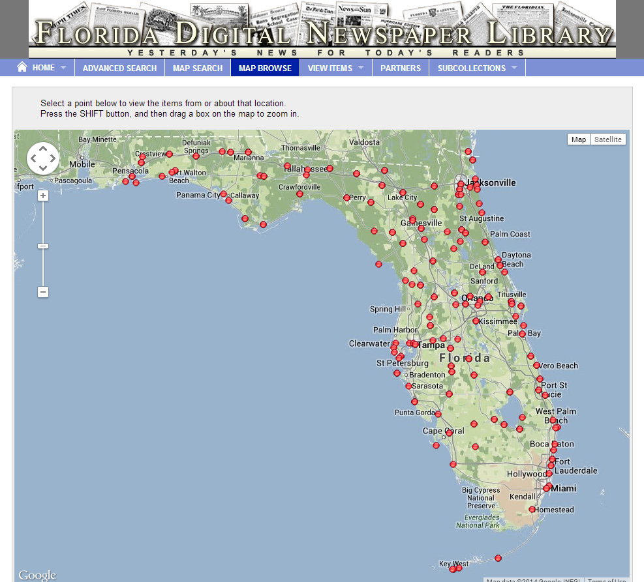
Notes:
newspapers

Slide 11
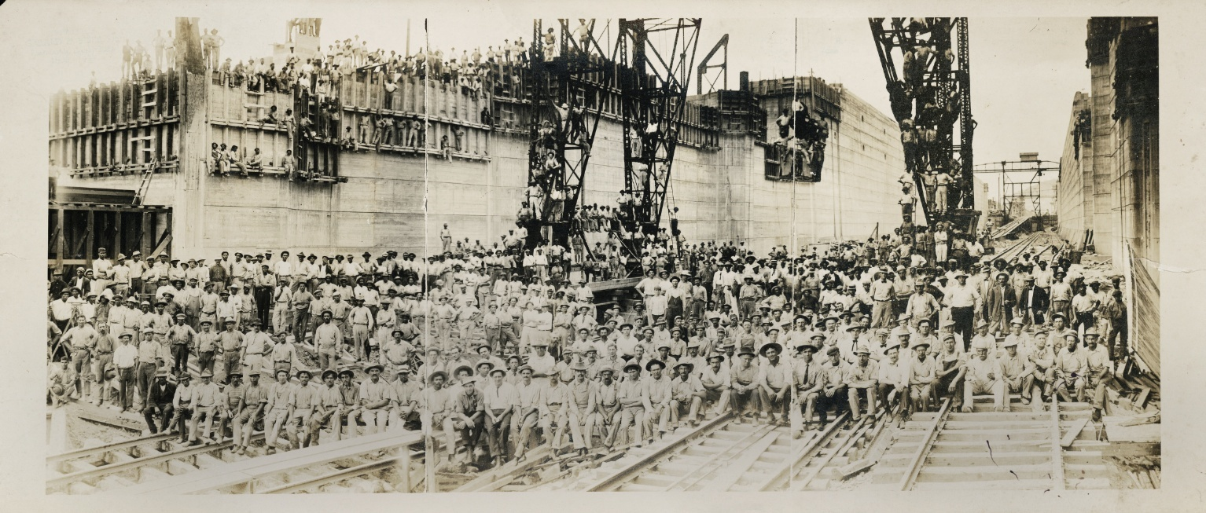
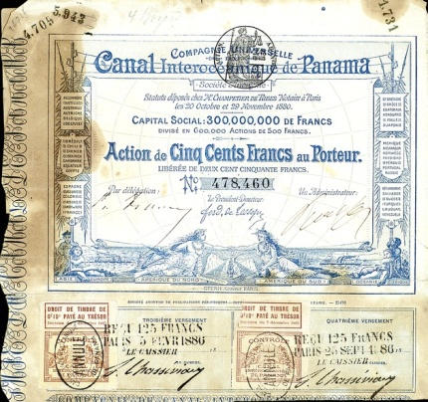
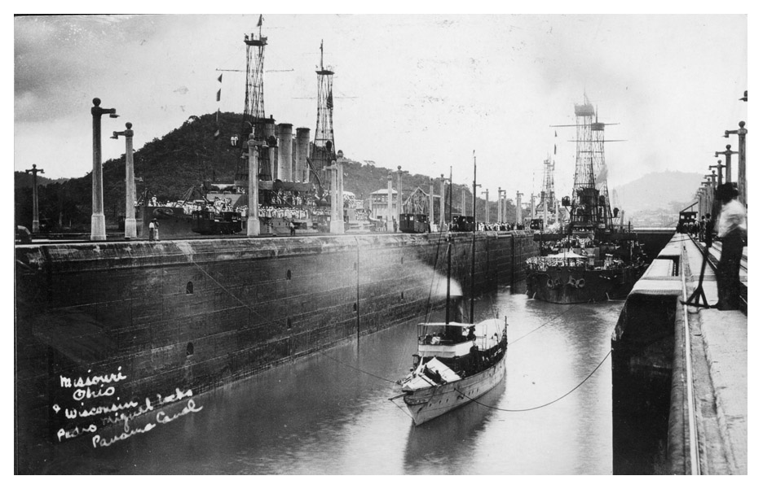
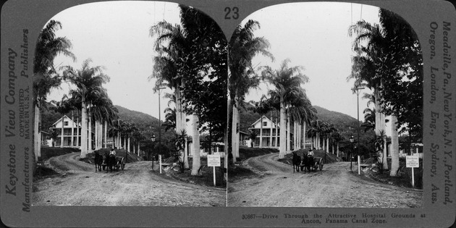
http://ufdc.ufl.edu/panama

Slide 12
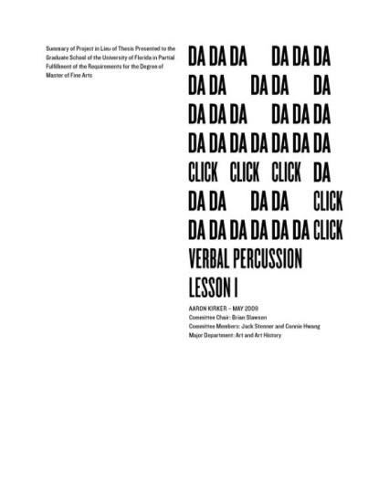
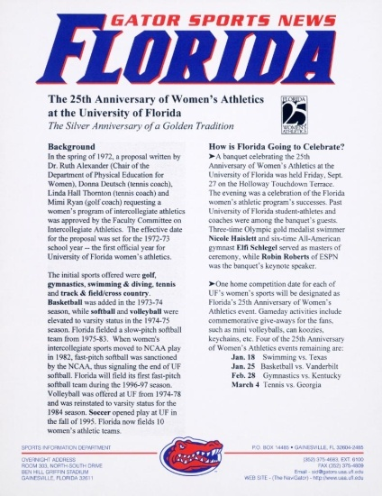
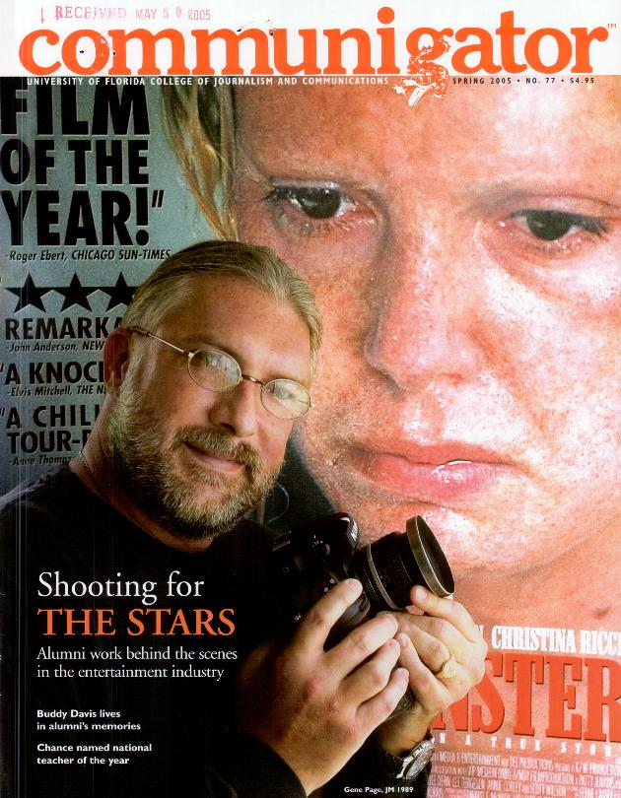
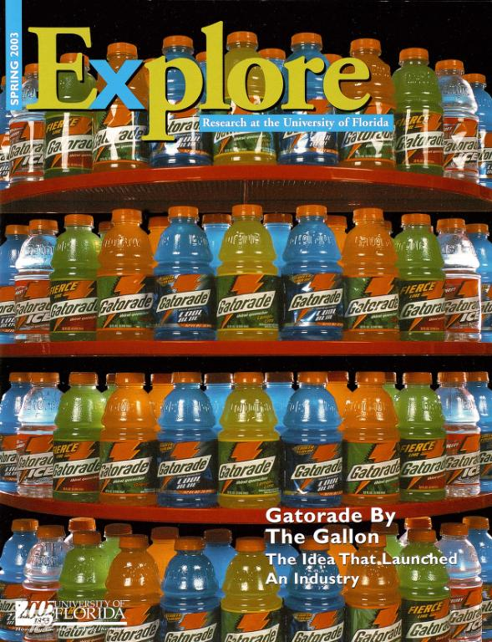
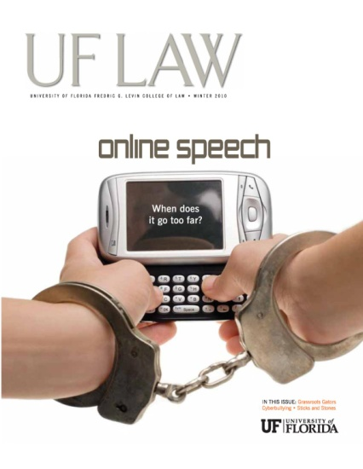
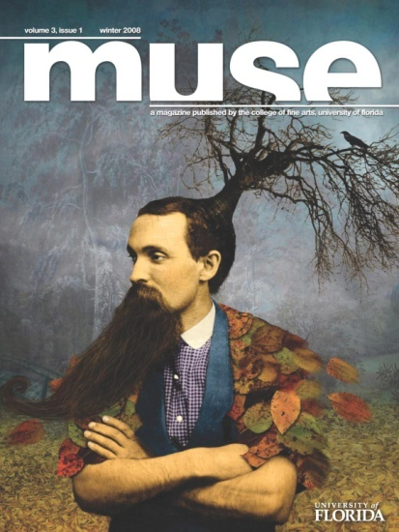
http://ufdc.ufl.edu/ir

Slide 13
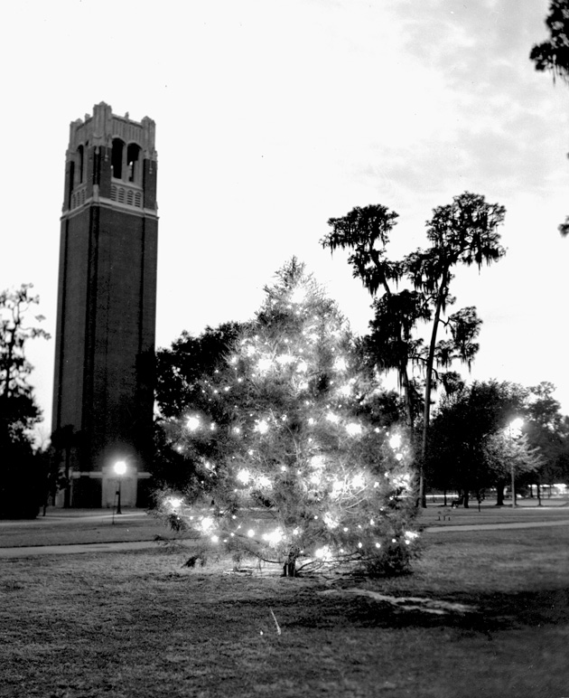
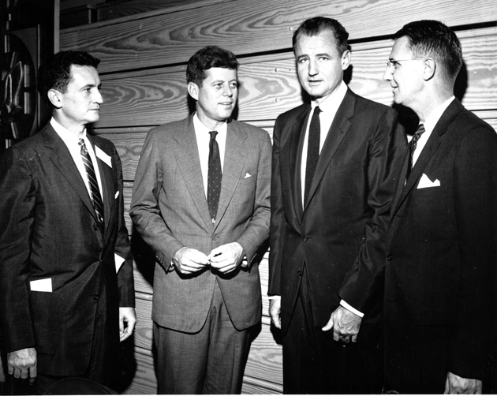
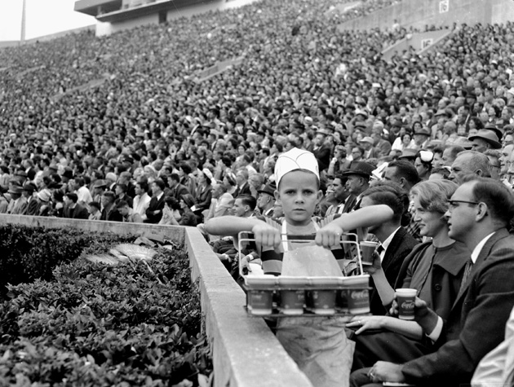
http://ufdc.ufl.edu/uaphotos
Notes:
Photos from UF Archives;

Slide 14
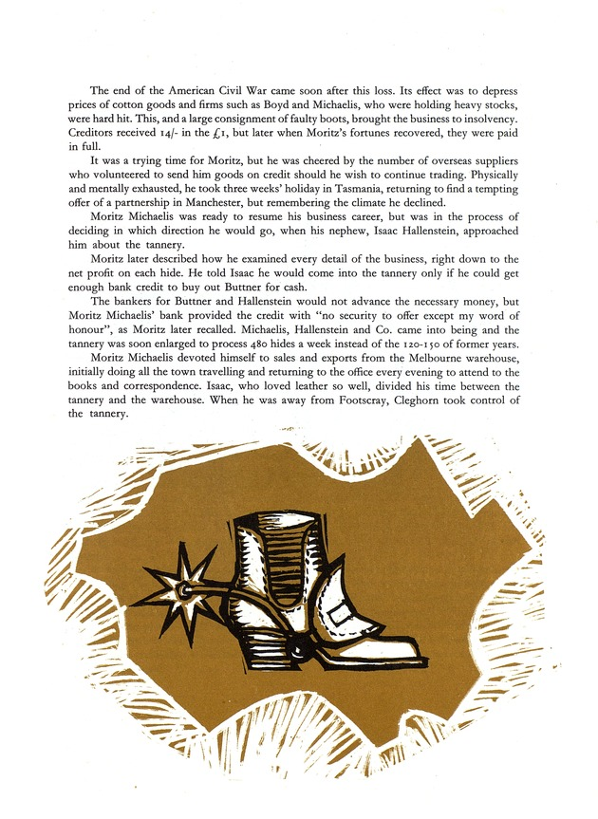
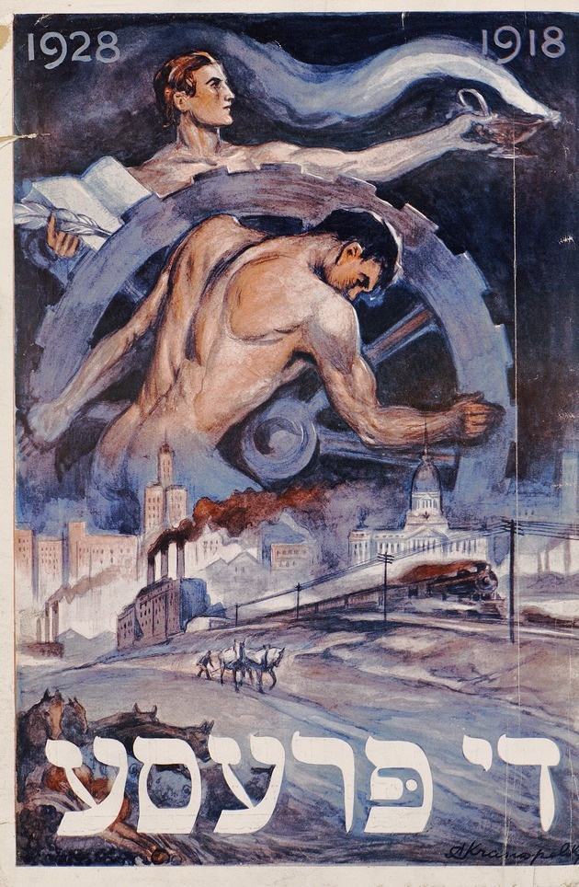
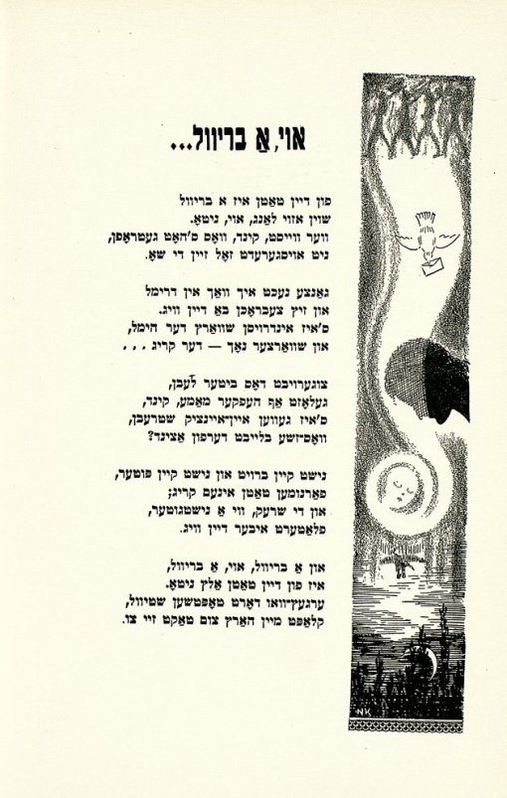
Judaica Photographs
Newspaper Collection
Anniversary Collection
Reverend Safer Collection
Pink Collection of Sheet Music
Judaica Memorial Books
The Yiddish Collection
Di prese yoyvl-numer, 1918-1928
The Michaelis, Hallenstein story, 1864-1964
one hundred years in leather
Shikhelekh in kholem 1940
http://ufdc.ufl.edu/judaica

Slide 15
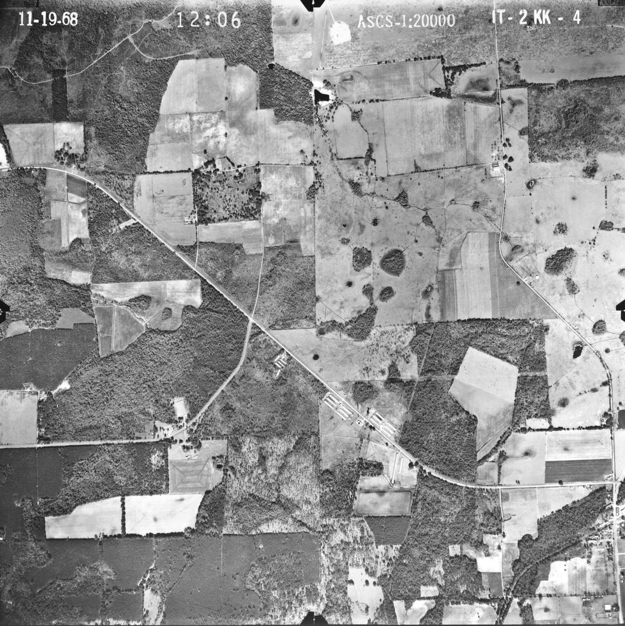
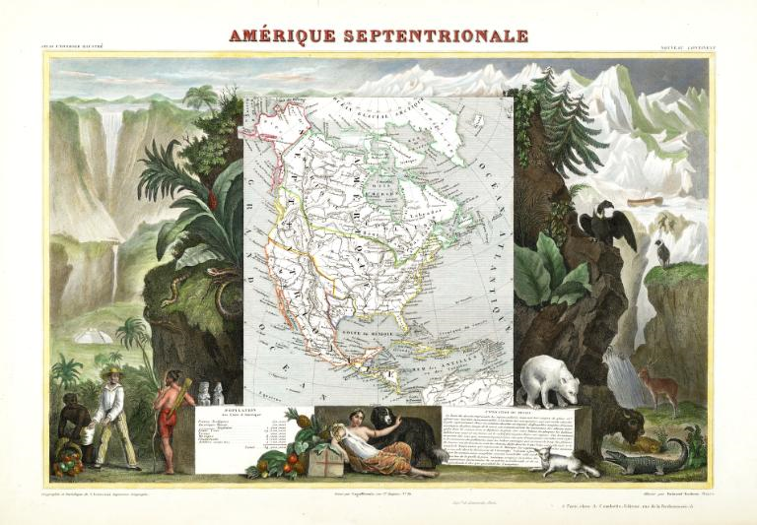
1840 Map of Northern America
1968 Aerial Photograph of Alachua County
http://ufdc.ufl.edu/maps
Notes:
Maps

Slide 16
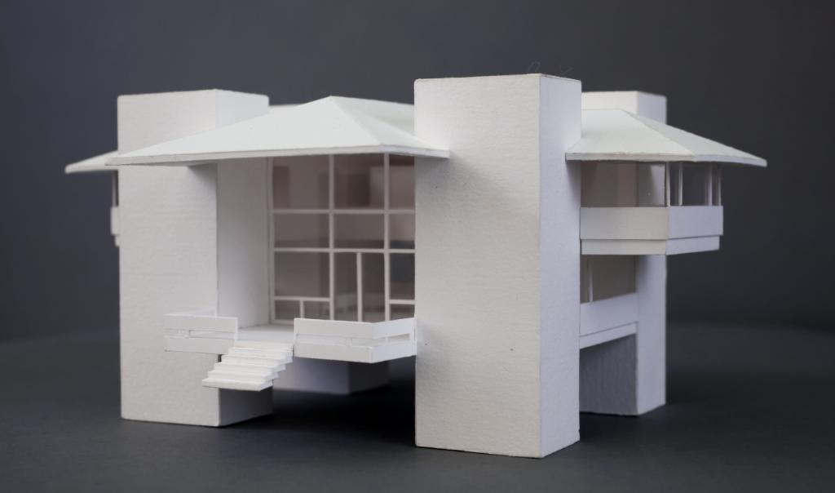
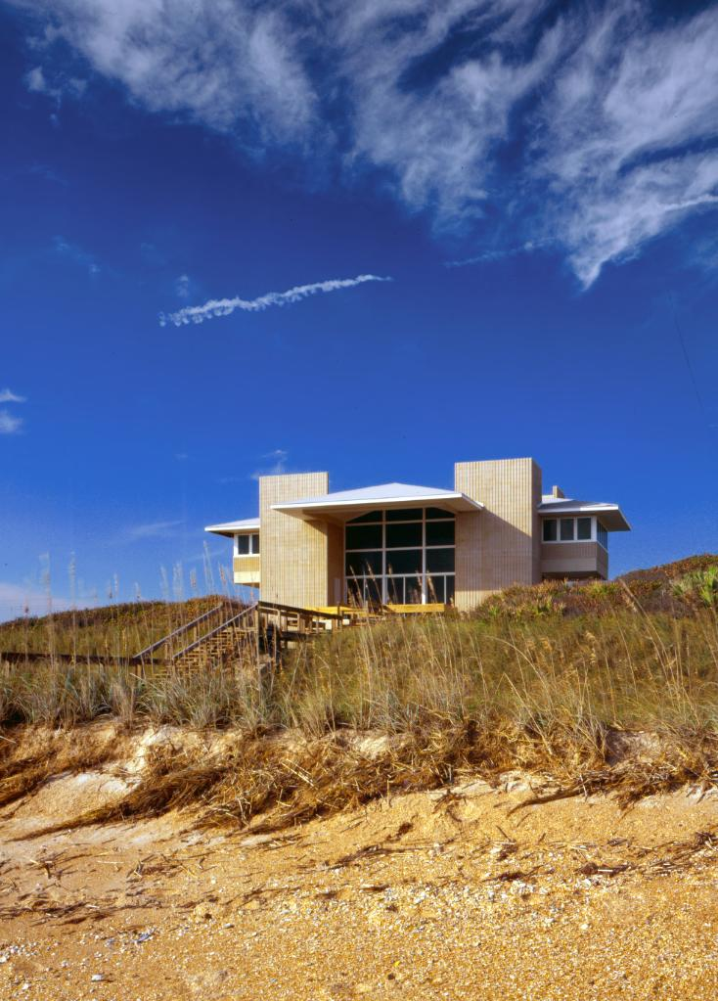
UF Architecture Archives
Alfred Browning Parker Collection
Kenneth Treister Collection
Carrère & Hastings Collection
Florida Institute of Architects Publications
Conners House by William Morgan
http://ufdc.ufl.edu/fald

Slide 17
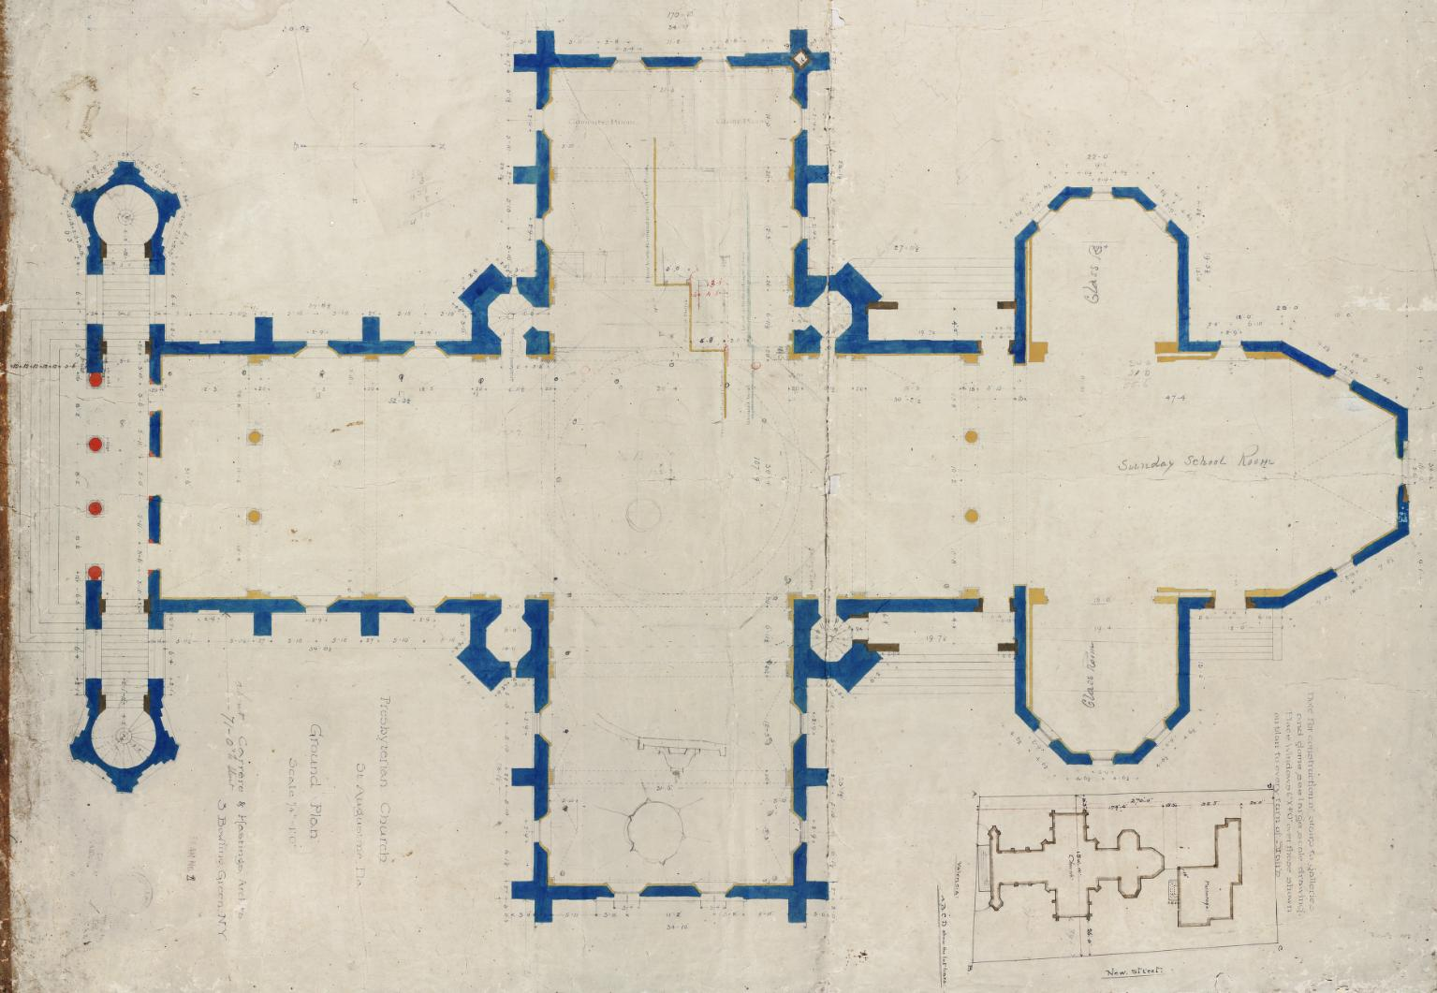
Memorial Presbyterian Church (St. Augustine, FL) - 1889
Notes:
Map / architectural drawing

Slide 18
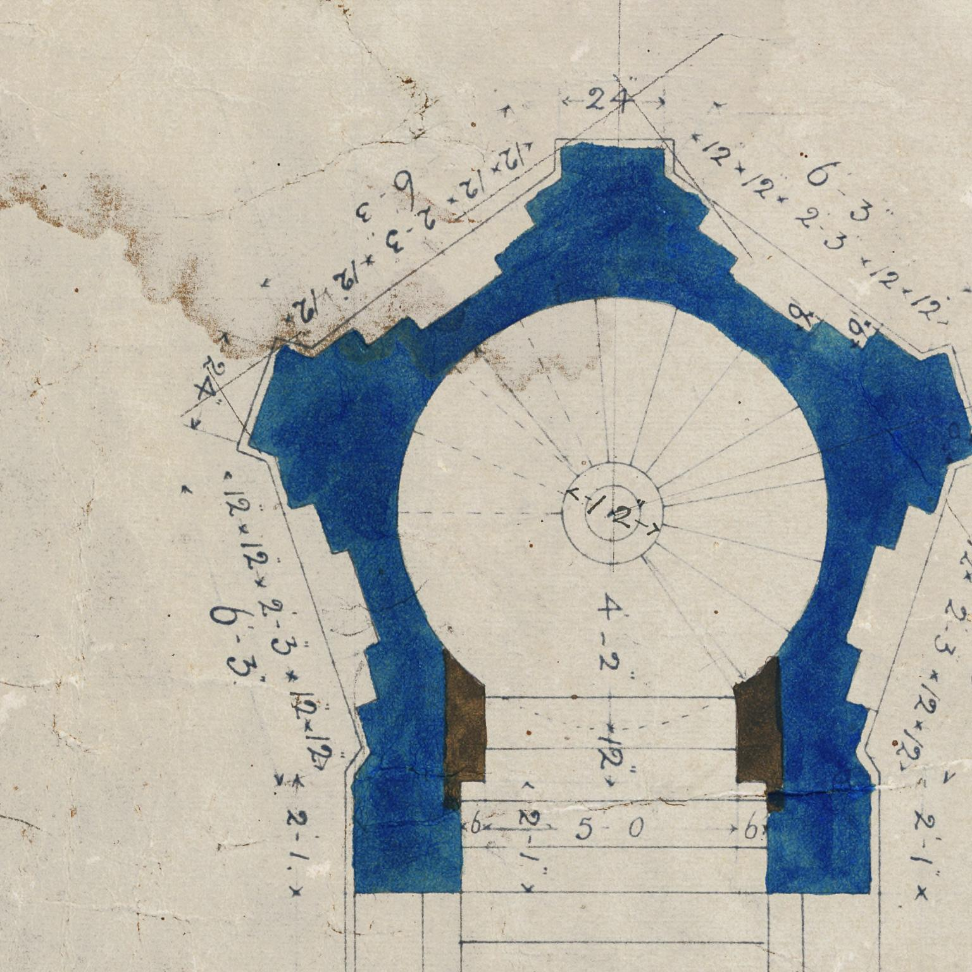

Slide 19
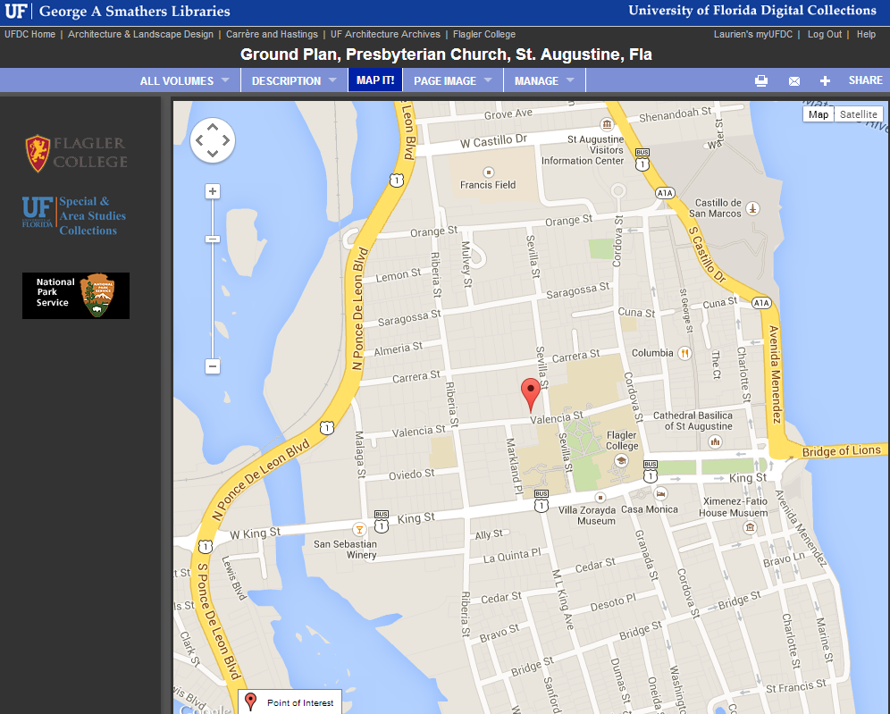
Notes:
Map It Tab

Slide 20
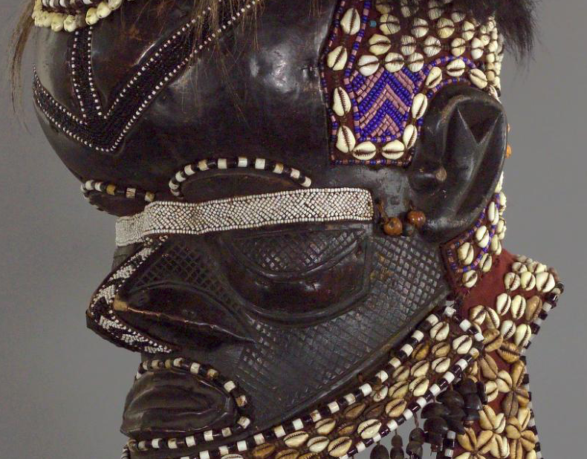
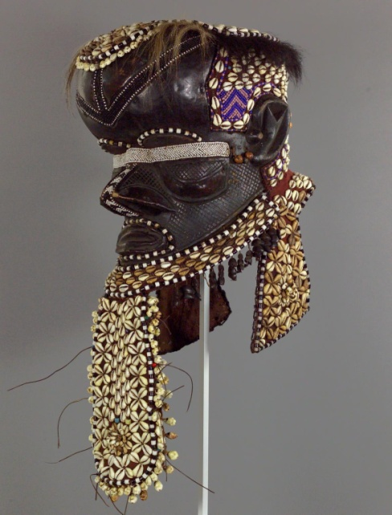
Notes:
http://ufdc.ufl.edu/UF00083074

Slide 21
Collaborations, Communities, Leveraging Capacity, Creating Virtuous Circles, Libraries as Leaders

Slide 22
DIGITAL
LIBRARY
OF THE
CARIBBEAN
BIBLIOTECA
DIGITAL
DEL CARIBE
BIBLIOTHÈQUE
NUMÉRIQUE
DES CARAÏBES
www.dloc.com
A cooperative digital library for
resources from and about the
Caribbean and circum-Caribbean.

Slide 23
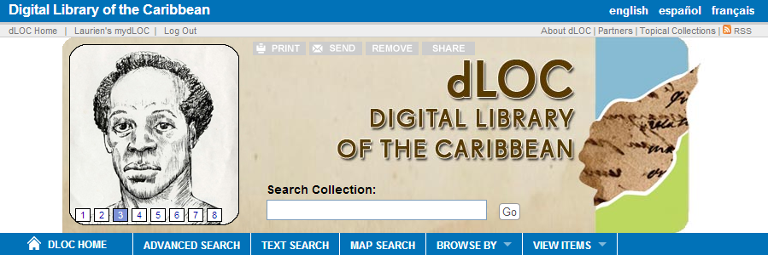
Digital Library of the Caribbean
Partner Training
Technical Infrastructure
Institutional Support
dLOC's diverse partners serve an international community of scholars, students, and peoples by working together to preserve and to provide enhanced electronic access to cultural, historical, legal, governmental, and research materials. dLOC's partners collaborate with scholars and teachers to promote and perform educational outreach for Caribbean Studies, create new works of digital scholarship, and develop other research and teaching initiatives.

Slide 24
dLOC Quick Facts
Content Management System and Long-term Preservation
39 Partners – Caribbean, Europe and US
Over 39 million hits since 2006
Over 2 million pages of open access content
14,000 titles with 87,000 items
Training Programs
Scholarly Collaborations
Educational Outreach
Shared Governance
New Initiatives

Slide 25
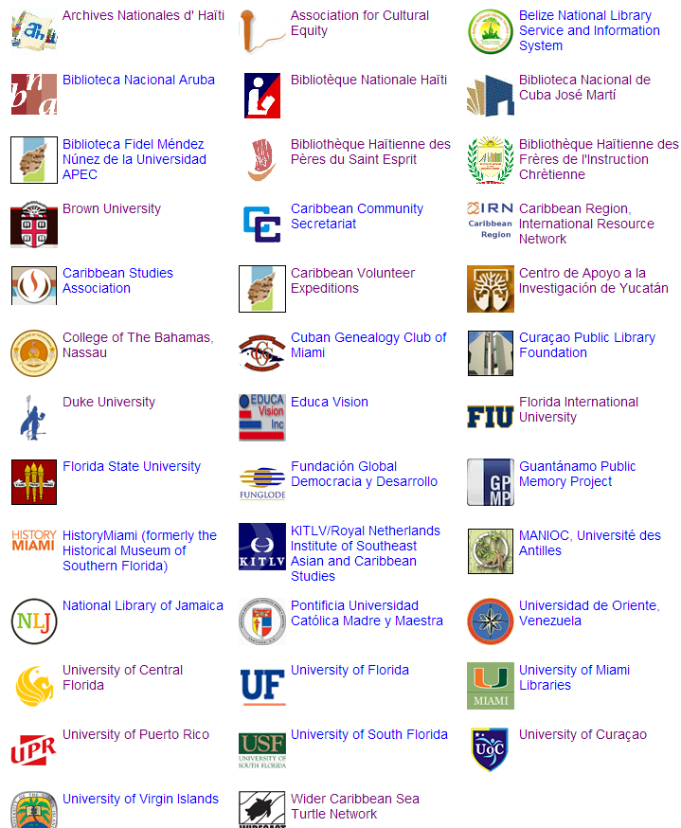
dLOC Partners
List from 2014 Jun. 19: http://dloc.com/partners

Slide 26
dLOC, Selected New Additions
Planters’ Punch from the National Library of Jamaica
The Angelus from the Belize National Library
Observador from the National Library of Aruba
El Mundo from the University of Puerto Rico
Caribbean Review from Florida International University
Cuban History research files from Dr. Lillian Guerra

Slide 27
dLOC Collaborations
Communities (Partners, Trainings, Teaching, Engagement)
Technologies
Intellectual Infrastructure

Slide 28
Technologies & Collaboration
Cyberinfrastructure: SobekCM repository, digital asset management, content management software; sustainable preservation and access, open interoperability; tools for data curation by the community
Curator tools: online tools for curators and collaborators (partners, scholars, etc.), with support for training and collaboration with different user levels, including patron user tools.

Slide 29
Collaboration: Intellectual Infrastructure
dLOC Themes, Formats, & Collections Start here to learn more about what collections are online and where we could collaborate to develop new or strengthen existing collections or exhibits.
Notes:
dLOC partners also share expertise in terms of information literacy and intellectual infrastructure as part of data curation literacy.
This is a listing of some examples in dLOC of curated collections, like special collections and exhibits, as intellectual infrastructure.

Slide 30
Haiti: An Island Luminous
An Island Luminous is a site to help readers learn about Haiti’s history.
Created by historian Adam M. Silvia and hosted online by Digital Library of the Caribbean, An Island Luminous combines rare books, manuscripts, and photos scanned by archives and libraries in Haiti and the United States with commentary by over eighty (80) experts.
www.dloc.com/exhibits/islandluminous

Slide 31
Guest Curated Exhibits
Curated by Dr. Petrine Archer and Claudia Hucke
Online: www.dloc.com/exhibits/aboutface

Slide 32
Panama Silver, Asian Gold: Migration, Money, & the Making of Modern Caribbean Literature Course
“We hope that the course will become part of a broader initiative to make visible to other teachers and scholars new ways of incorporating archival material into research on Caribbean literature and culture. […] We want to use the project to intervene more broadly in the way Caribbean literary scholarship imagines the Caribbean cultural diaspora and interrogates the ways in which both traditional and colonial archival sources shape the stories we can tell about the Caribbean region.
We hope our experiment will sow the seed for future collaborative courses involving students at institutions in the Caribbean, Panama, China, and/or India, capable of working with relevant documents from these regions in languages other than English.”
-- Rhonda Cobham-Sander

Slide 33
Collaborative Course & Communities
Developed by Rhonda Cobham-Sander, Amherst College; Leah Rosenberg, Univ. of Florida; & Donette Francis, Univ. of Miami; with their librarians
Taught:
Fall 2013; 3 collaborating classes
Spring 2014, at UF
Teaching materials added to dLOC for others teaching Caribbean Studies
Student assignments build from and enhance resources in dLOC

Slide 34
dLOC Collaboration & Communities
Meeting of Course Collaborators with SAMAAP at the West Indian Museum in Panama City, Nov. 2013

Slide 35
dLOC Collaboration & Communities
dLOC Advanced Training Institute, July 2013

Slide 36
dLOC Collaboration & Communities
April 2014: dLOC Partner Training in Haiti; and, Digital Scholarship collaboration expanding with new communities (Northeastern University, DH Data Curation Institute)

Slide 37
New Collaborations & Modes
myUFDC, myDLOC, & mySOBEK tools connect 7,000+ patrons, curators, contributors, administrators, & others
dLOC: planning for expanded scholarly board
Baldwin: Scholars Council in development
UF Library Digital Lab in St. Augustine: local hub + connector
Libraries as Leaders, especially for collaboration in the age of big data (or the digital age): Developing Librarian Grant (DH Library Group), DH Graduate Certificate, DH Working Group, Data Management/Curation Task Force, & More
Notes:
Librarians, archivists, museologists, teaching faculty, researchers, graduate and undergraduate students, campus collaborators, publics around the world

