Slide 1
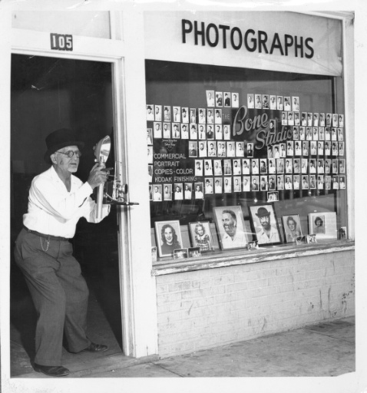
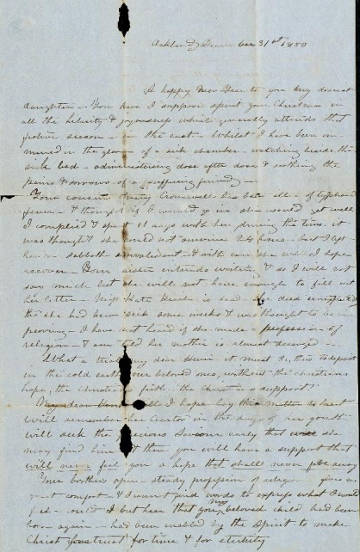
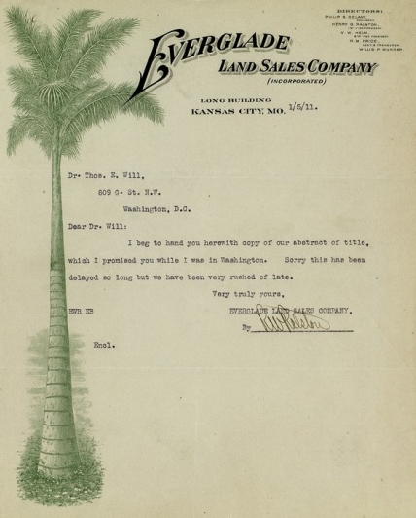
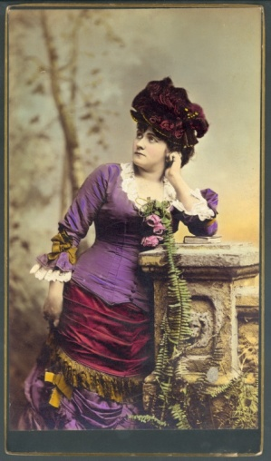
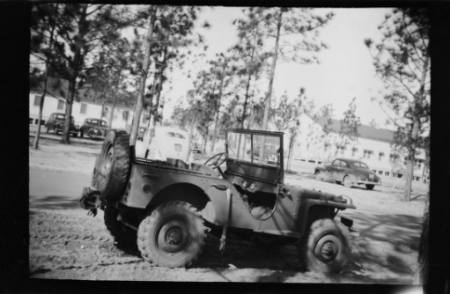
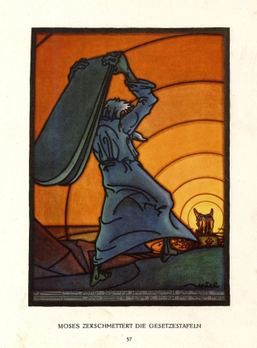
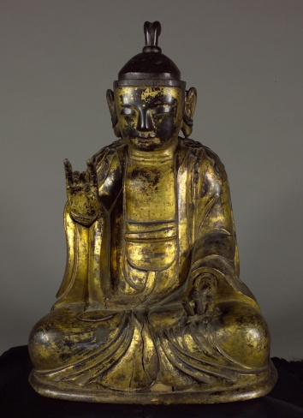
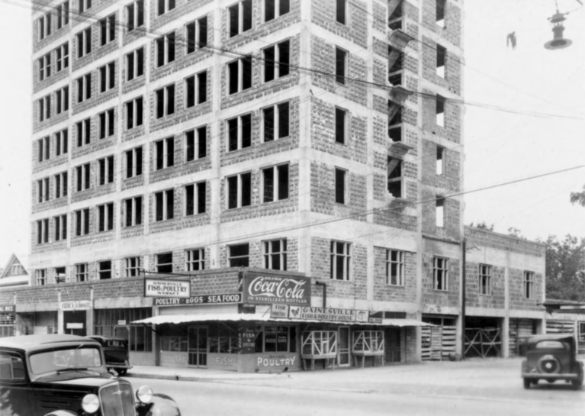
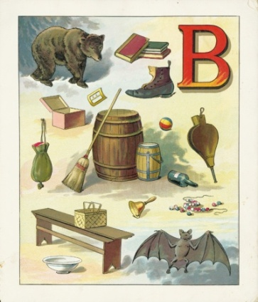
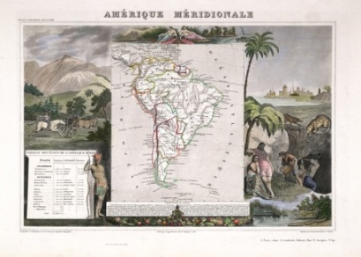
The University of Florida Digital Library Center & UF Digital Collections
Notes:
1

Slide 2
http://ufdc.ufl.edu
Notes:
DLC Donor Tour Script (rev. 6/30/2010)
Add projector to back room, and prepare slideshow to show/demonstrate (using a PPT or internet, if available):
UFDC site
Baldwin book
Map / architectural drawing
Newspaper
Art Object
Photos from UF Archives
Then, show imaging equipment:
Back room: 3D turn-style for objects
Imaging area: Copibooks
Large format area:
Large format camera and vacuum table
Book cradle
Front area by Lourdes: Book guillotine and disbound book
Briefly describe process:
A large server provides the storage for files in process, and this serves as the backbone for all processing. The processing includes:
Image processing for artifactual fidelity
Quality control to verify all images, the catalog record information, and to add chapter headings and pagination
Optical character recognition to generate full text for full text searching online
After optical character recognition creates these necessary support files, we load the materials online and we verify 100% of the items to make sure no errors were missed and that there are no errors in the loading process.
We then archive the materials to multiple redundant locations. We archive by sending files to the Florida Digital Archive which has redundant archives and to our internal archive as well. We also send files to Internet Archive, the International Children’s Digital Library, and other archives for particular projects.
Show CD/DVD cabinets and explain prior internal archive was to DVD, but that wasn’t sustainable because of sheer volume.

Slide 3
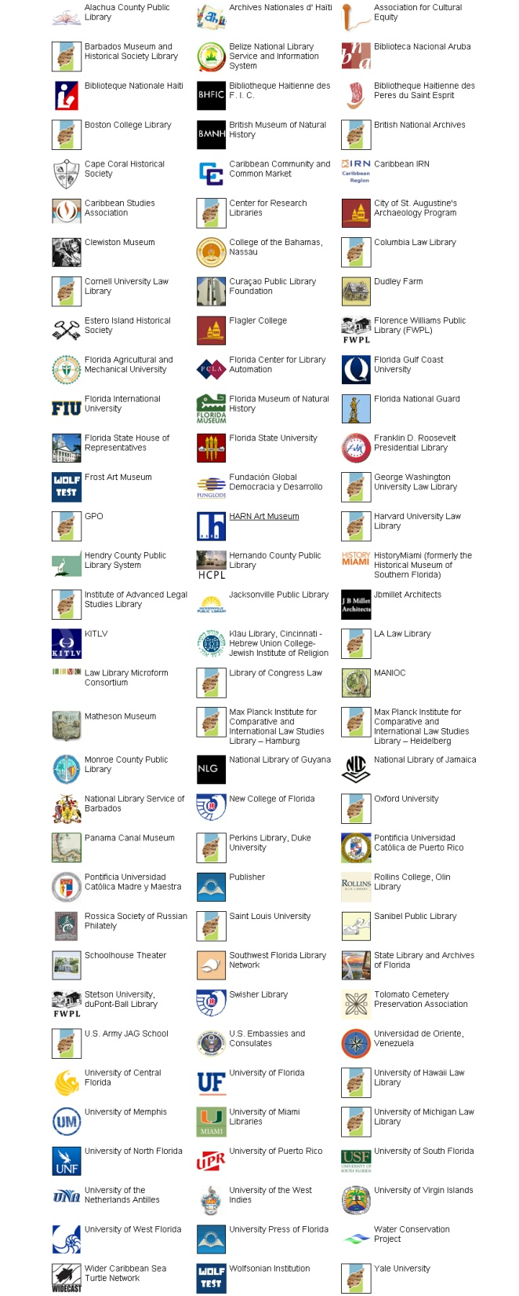
Partners
&
Contributing Institutions
(as of April 2011)
Archives Nationales d’Haïti
Caribbean Studies Association
Flagler College
Florida Agricultural and Mechanical University
Florida International University
Florida Museum of Natural History
Florida State House of Representatives
Florida State University
Samuel P. Harn Museum of Art
History Miami
Jacksonville Public Library
Matheson Museum
National Library of Jamaica
Panama Canal Museum
Universidad de Oriente (Venezuela)
University of Miami
Notes:
3

Slide 4
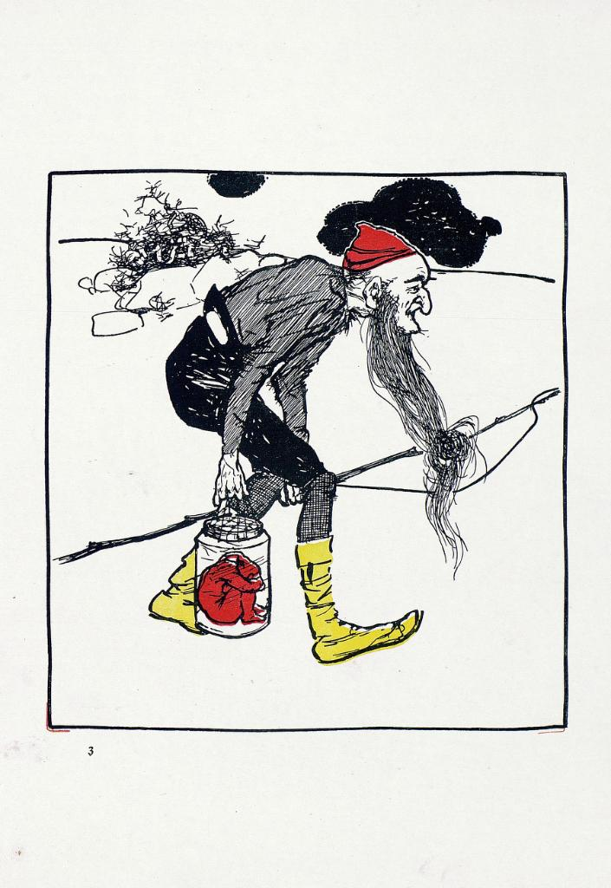
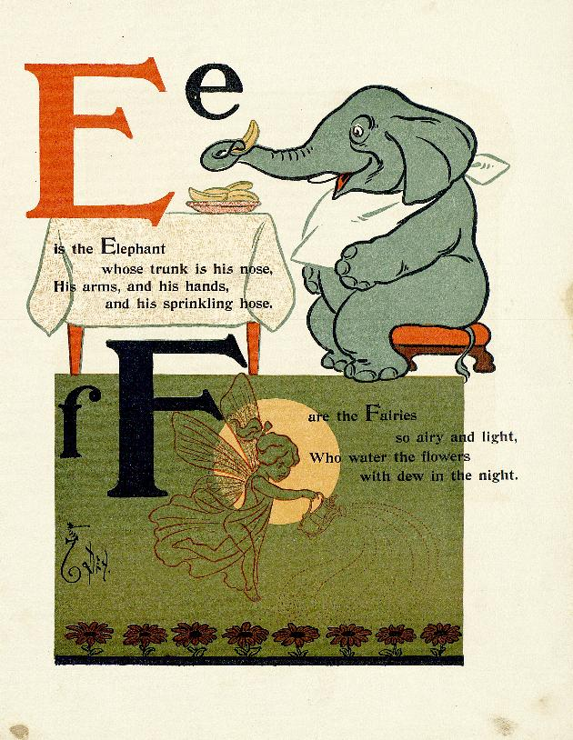
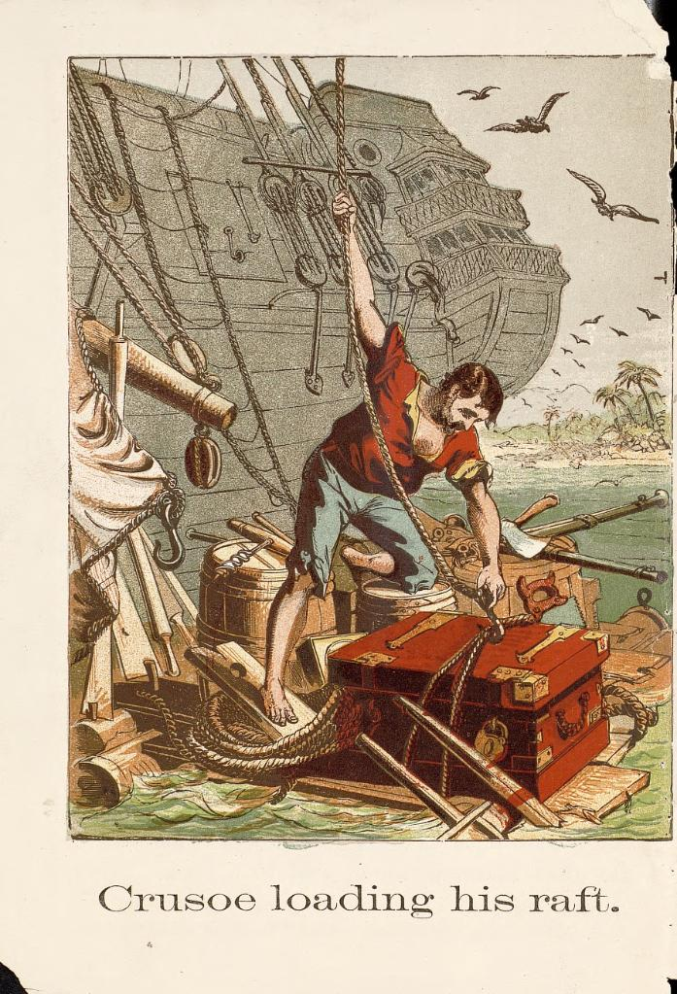
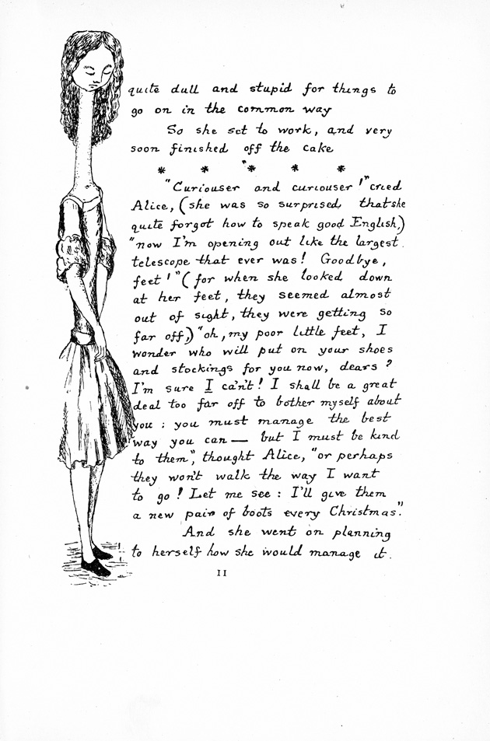
http://ufdc.ufl.edu/baldwin
Notes:
DLC Donor Tour Script (rev. 6/30/2010)
Add projector to back room, and prepare slideshow to show/demonstrate (using a PPT or internet, if available):
UFDC site
Baldwin book
Map / architectural drawing
Newspaper
Art Object
Photos from UF Archives
Then, show imaging equipment:
Back room: 3D turn-style for objects
Imaging area: Copibooks
Large format area:
Large format camera and vacuum table
Book cradle
Front area by Lourdes: Book guillotine and disbound book
Briefly describe process:
A large server provides the storage for files in process, and this serves as the backbone for all processing. The processing includes:
Image processing for artifactual fidelity
Quality control to verify all images, the catalog record information, and to add chapter headings and pagination
Optical character recognition to generate full text for full text searching online
After optical character recognition creates these necessary support files, we load the materials online and we verify 100% of the items to make sure no errors were missed and that there are no errors in the loading process.
We then archive the materials to multiple redundant locations. We archive by sending files to the Florida Digital Archive which has redundant archives and to our internal archive as well. We also send files to Internet Archive, the International Children’s Digital Library, and other archives for particular projects.
Show CD/DVD cabinets and explain prior internal archive was to DVD, but that wasn’t sustainable because of sheer volume.
4

Slide 6
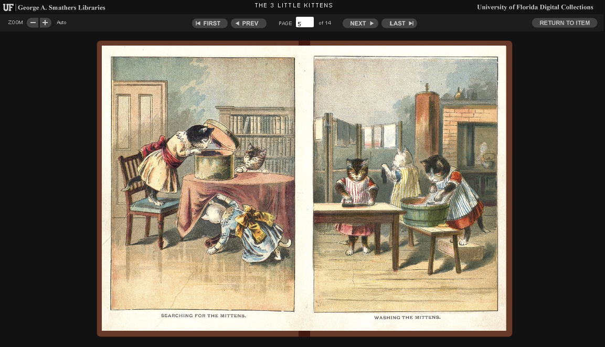

Slide 8
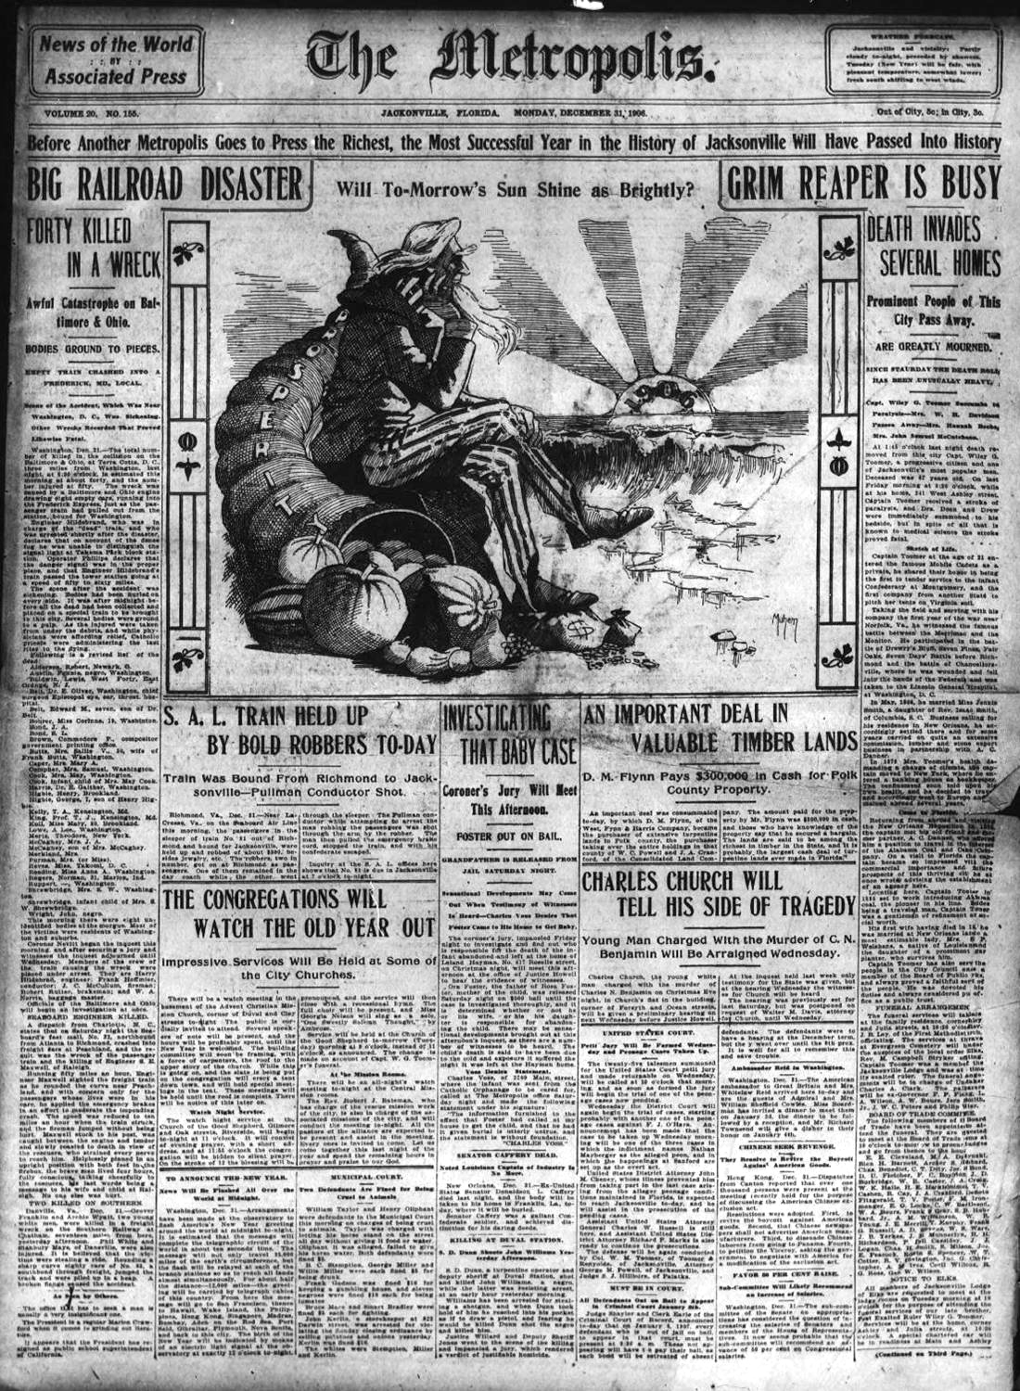
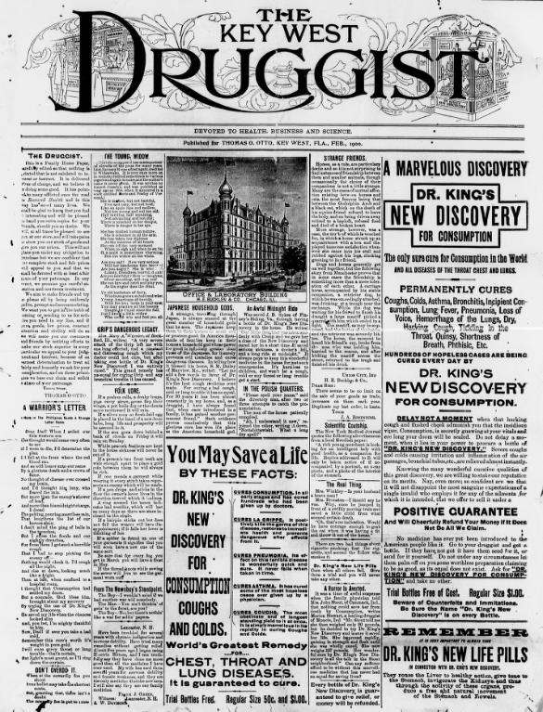
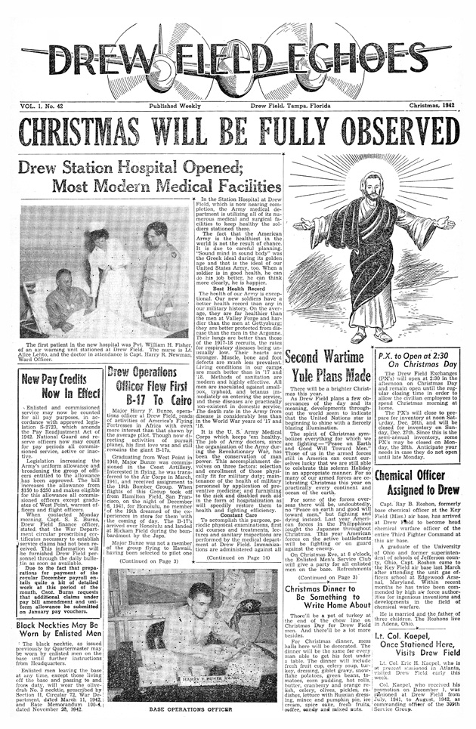
http://ufdc.ufl.edu/fdnl
Notes:
newspapers

Slide 9
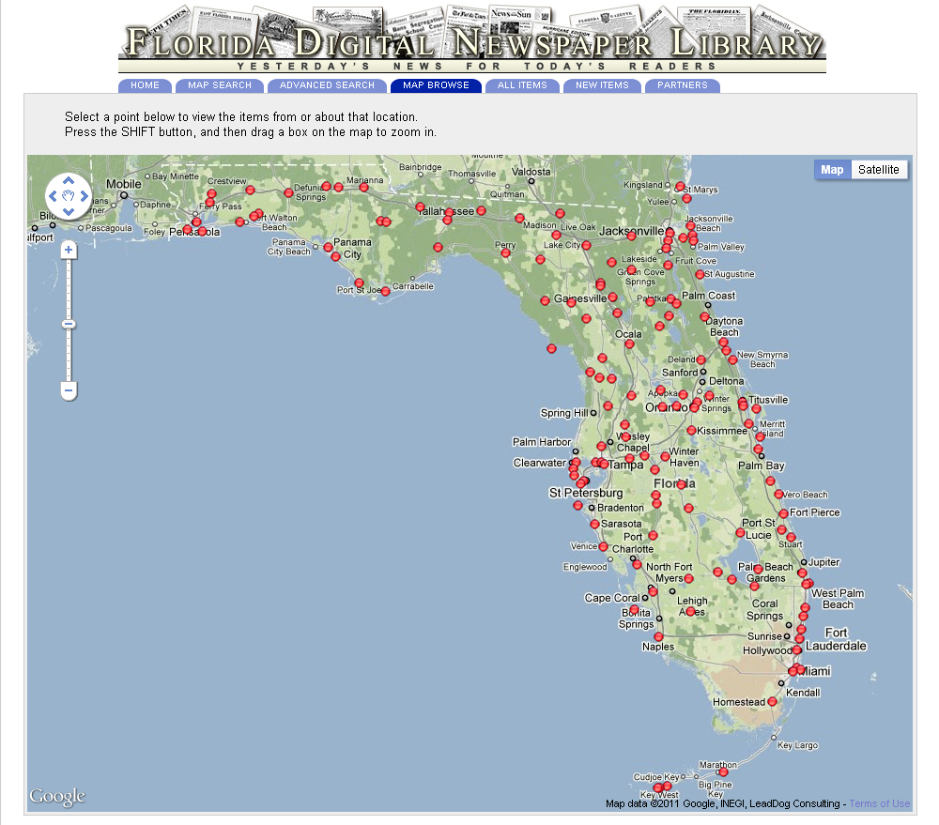
Notes:
newspapers

Slide 10
DIGITAL
LIBRARY
OF THE
CARIBBEAN
BIBLIOTECA
DIGITAL
DEL CARIBE
BIBLIOTHÈQUE
NUMÉRIQUE
DES CARAÏBES
www.dloc.com
A cooperative digital library for
resources from and about the
Caribbean and circum-Caribbean.

Slide 11
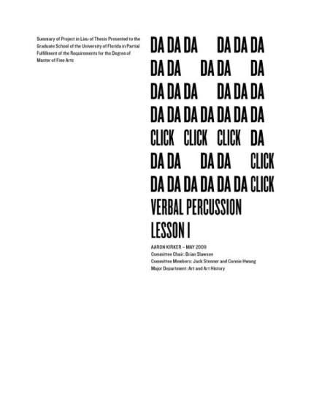
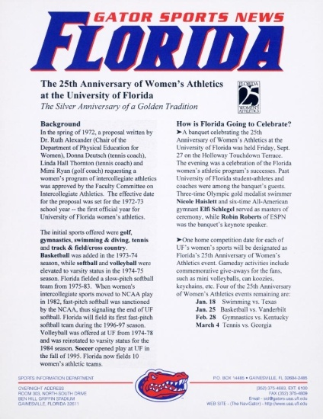
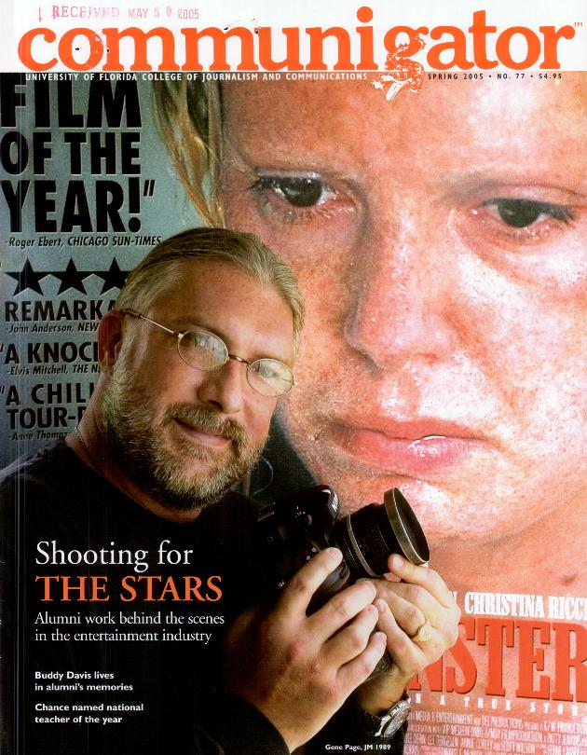
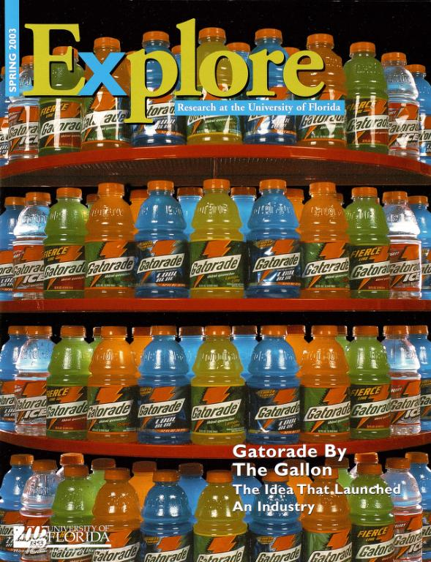
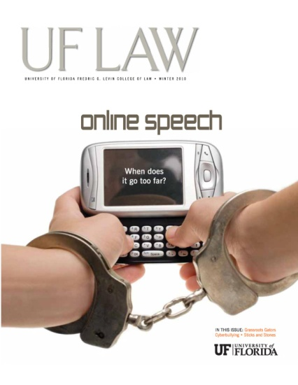
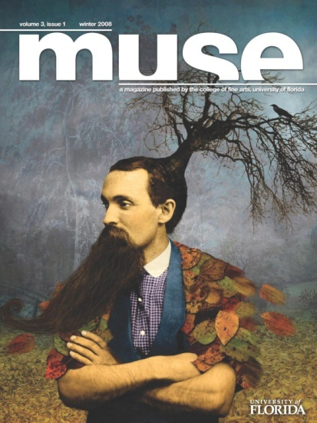
http://ufdc.ufl.edu/ir

Slide 12
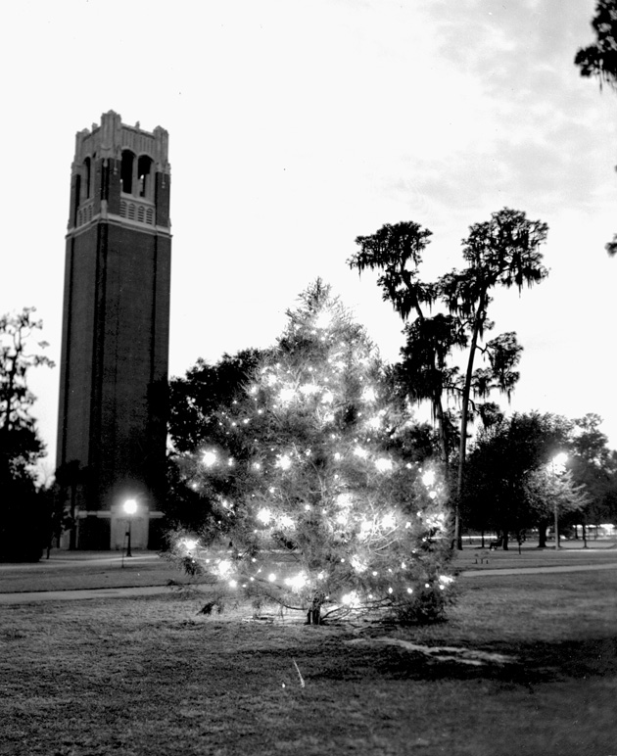
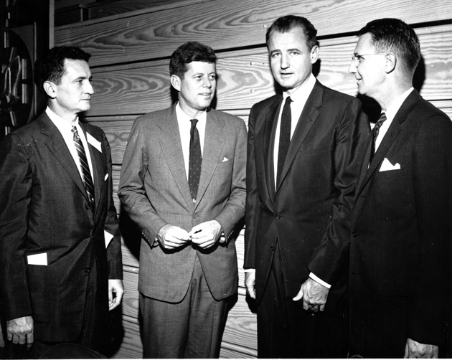
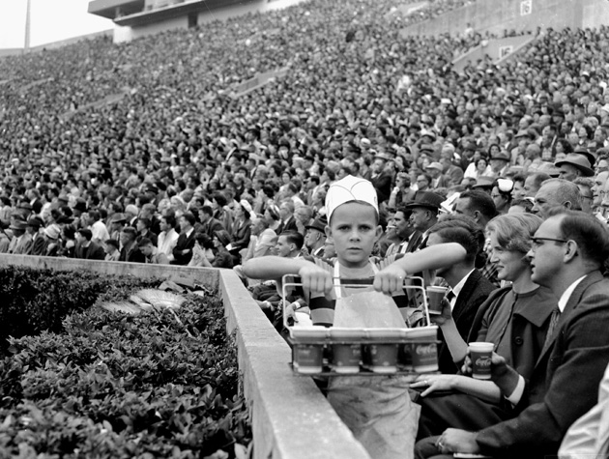
http://ufdc.ufl.edu/uaphotos
Notes:
Photos from UF Archives;

Slide 13
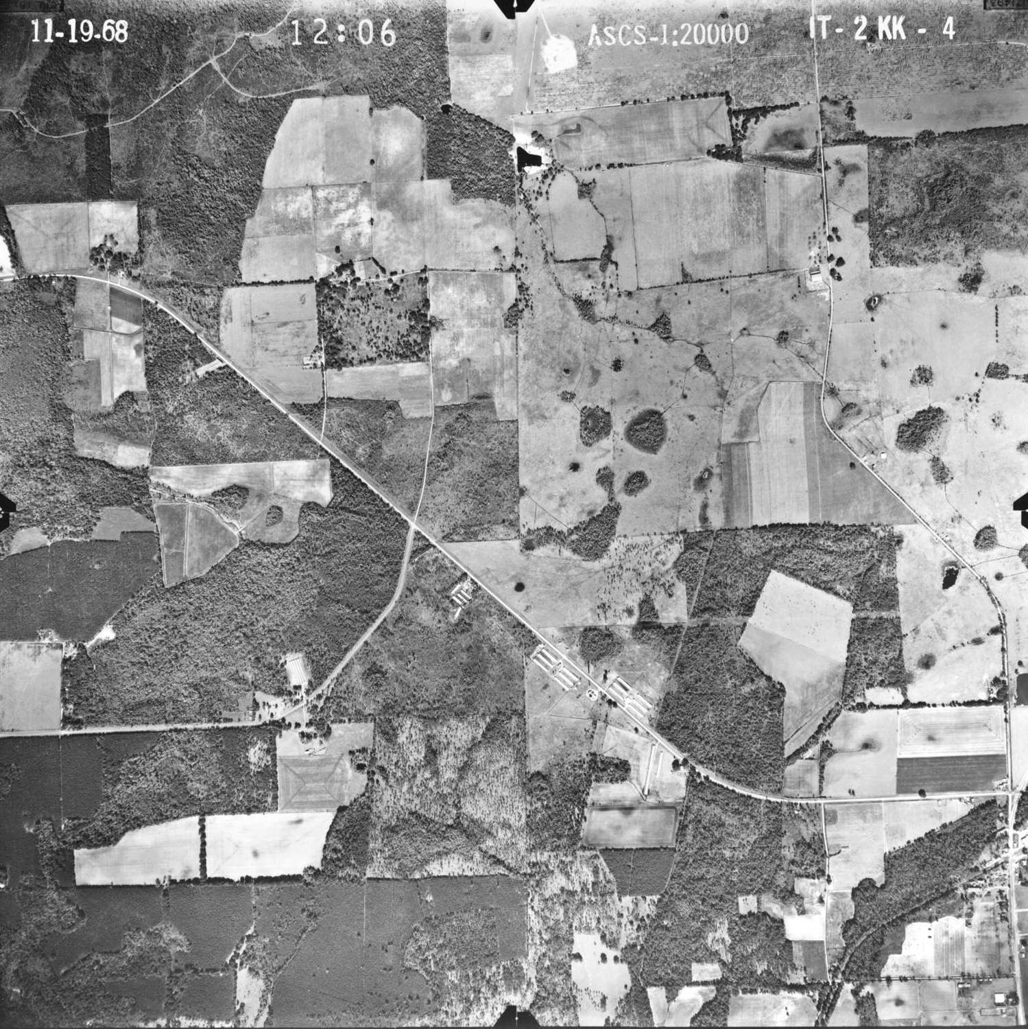
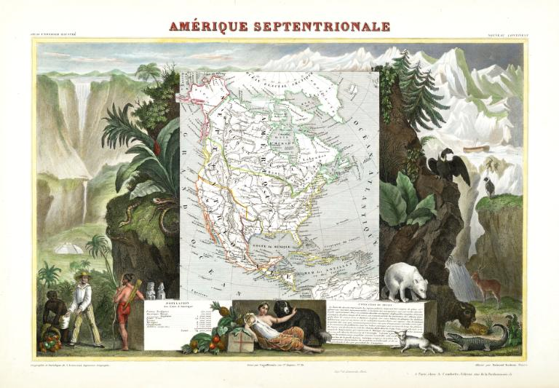
1840 Map of Northern America
1968 Aerial Photograph of Alachua County
http://ufdc.ufl.edu/maps
Notes:
Maps

Slide 14
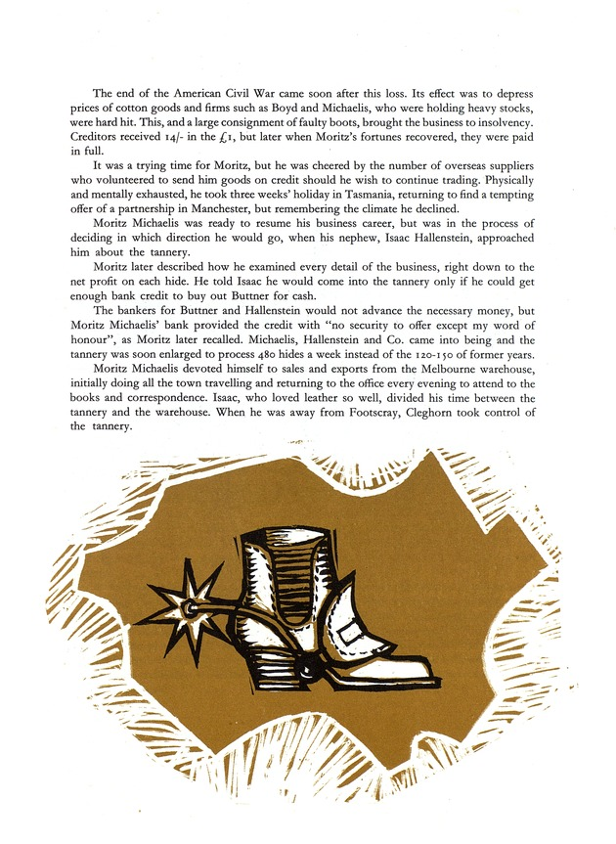
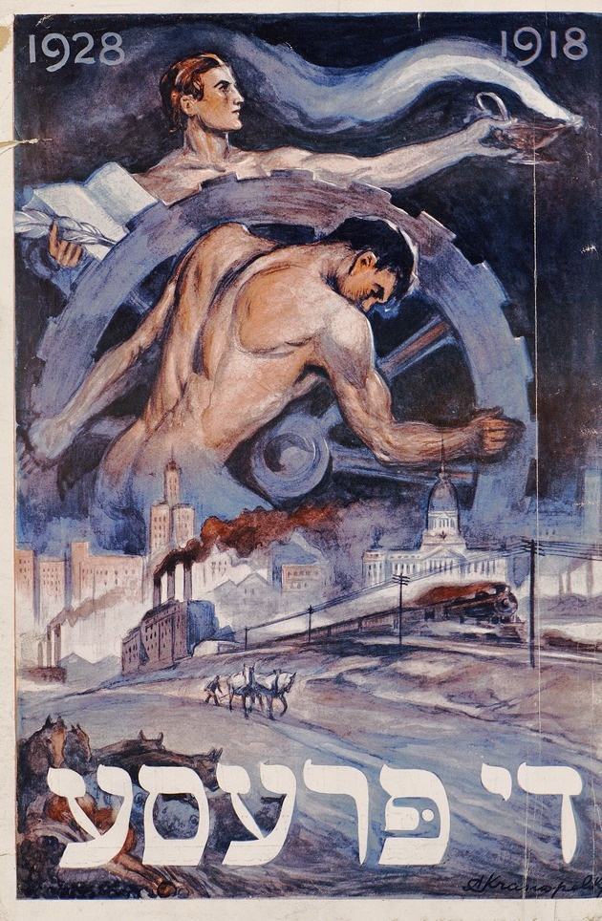
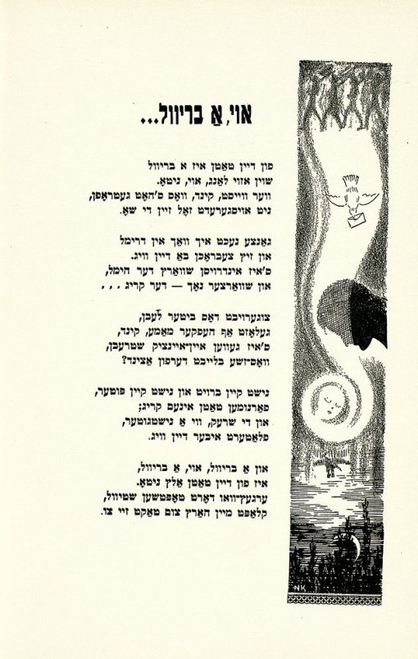
Judaica Photographs
Newspaper Collection
Anniversary Collection
Reverend Safer Collection
Pink Collection of Sheet Music
Judaica Memorial Books
The Yiddish Collection
Di prese yoyvl-numer, 1918-1928
The Michaelis, Hallenstein story, 1864-1964
one hundred years in leather
Shikhelekh in kholem 1940
http://ufdc.ufl.edu/judaica

Slide 15
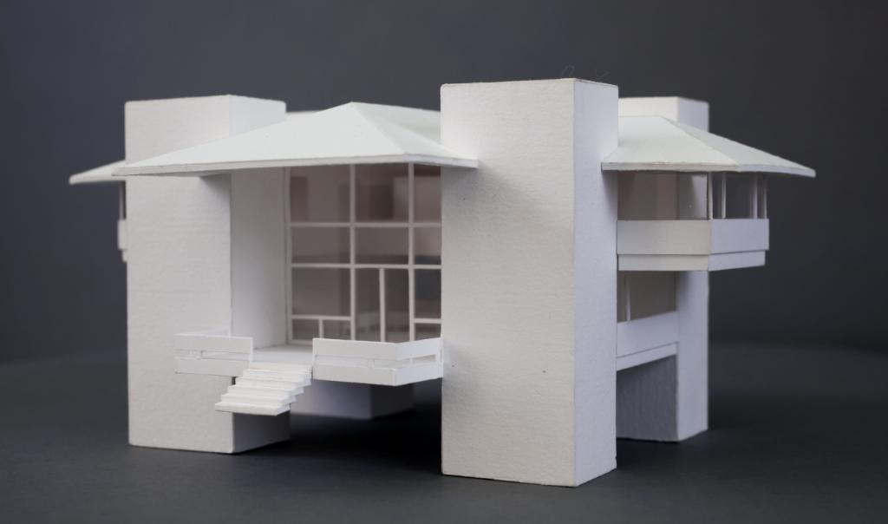
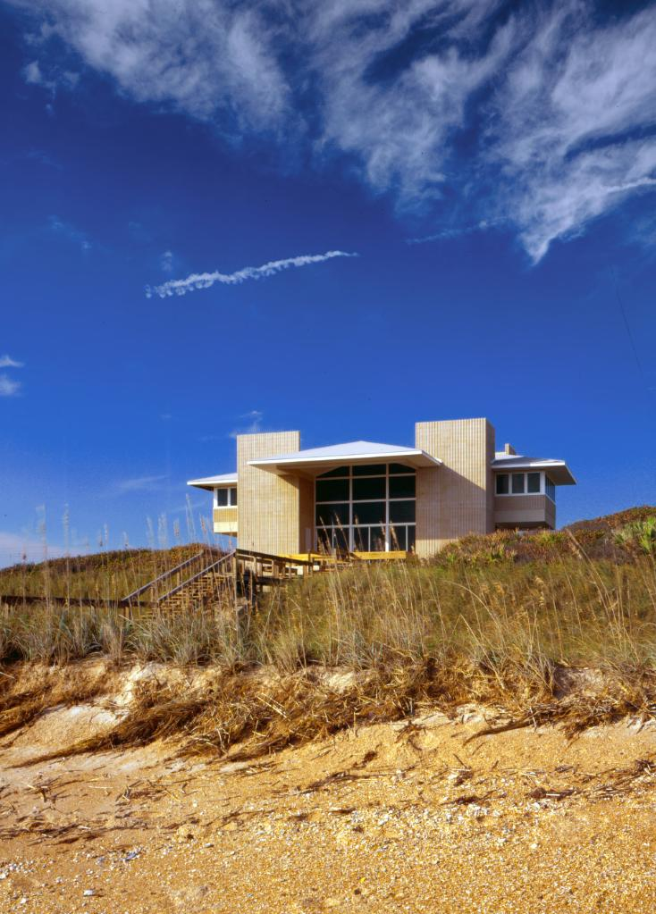
UF Architecture Archives
Alfred Browning Parker Collection
Kenneth Treister Collection
Carrère & Hastings Collection
Florida Institute of Architects Publications
Conners House by William Morgan
http://ufdc.ufl.edu/fald

Slide 16
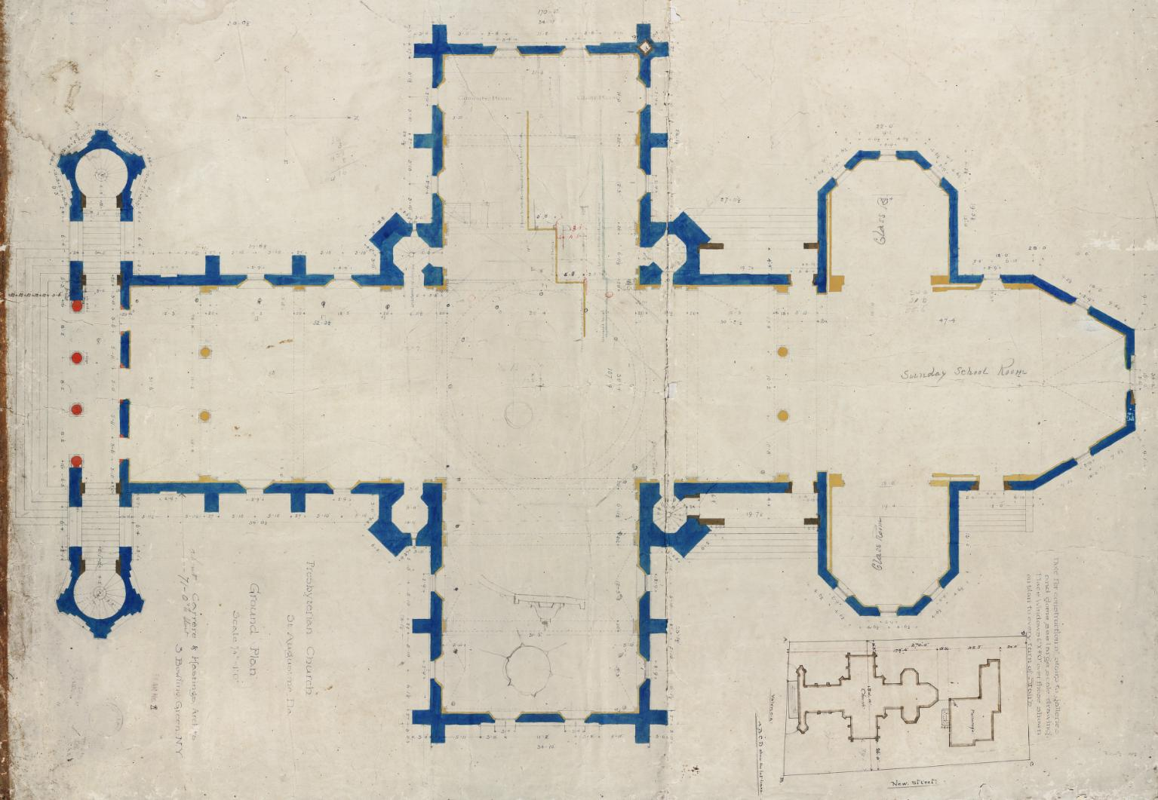
Memorial Presbyterian Church (St. Augustine, Fl) - 1889
Notes:
Map / architectural drawing

Slide 17
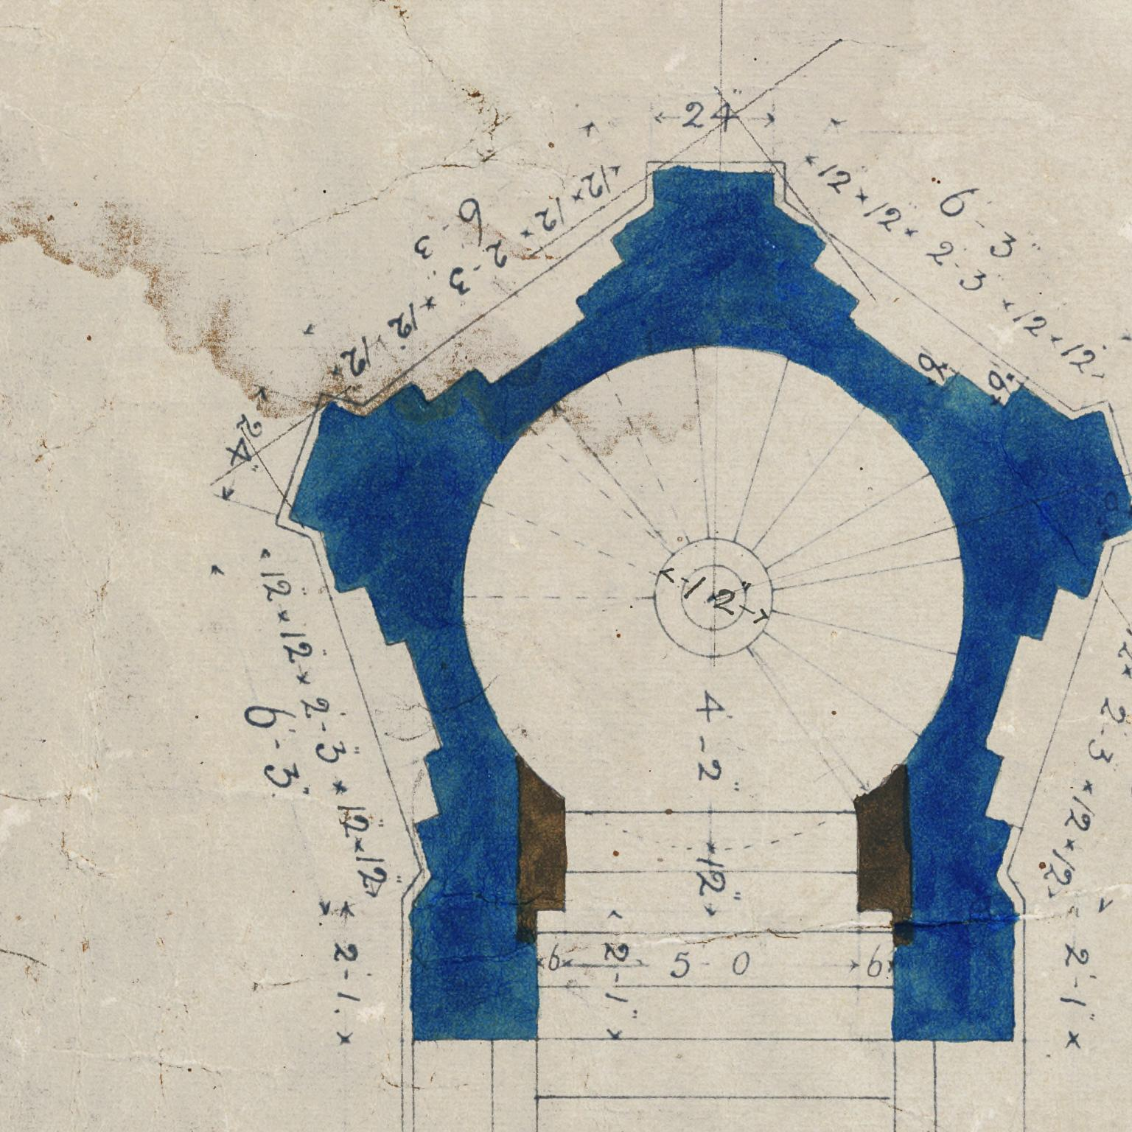

Slide 18
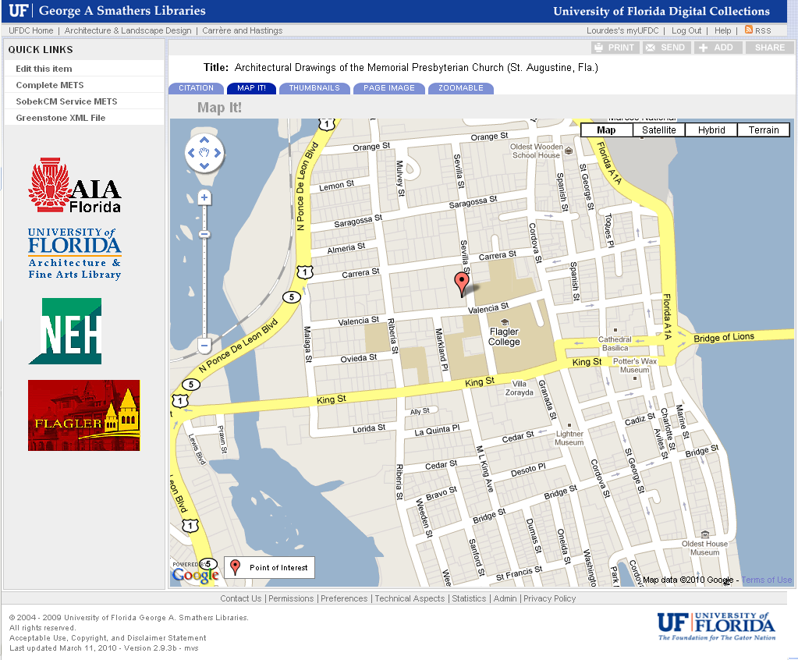
Notes:
Map It Tab

Slide 19
