Slide 1
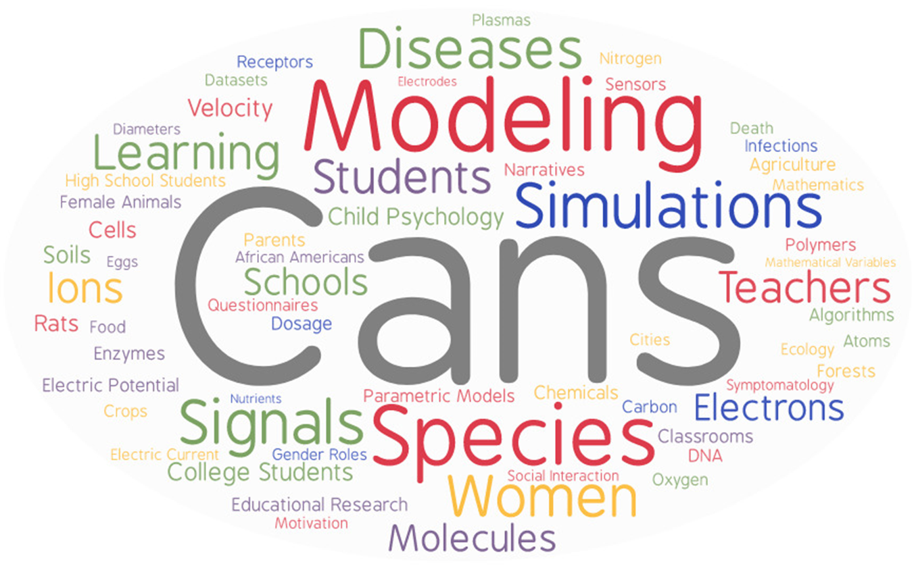
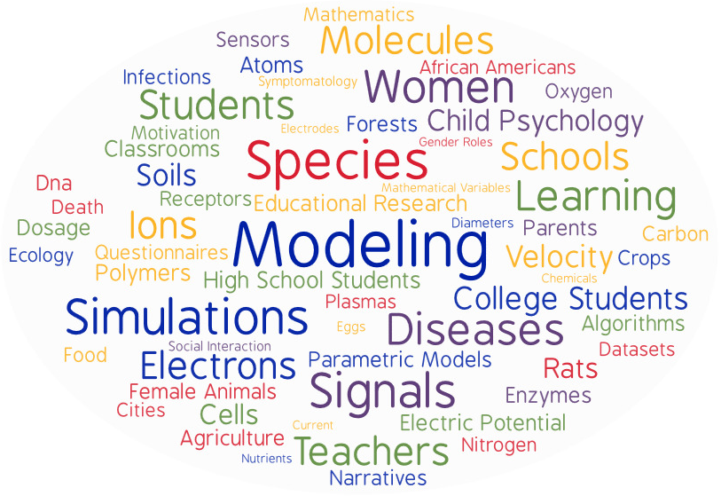
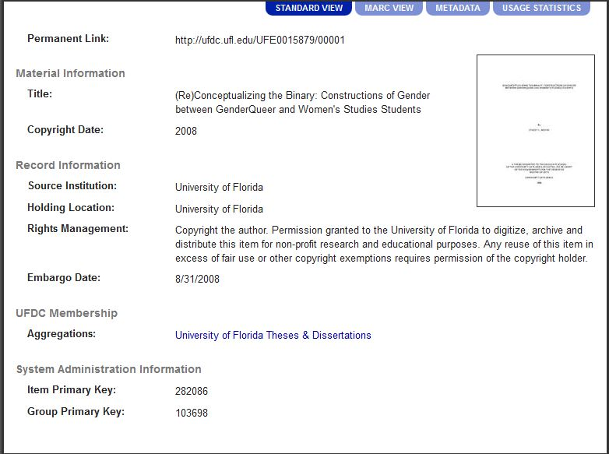
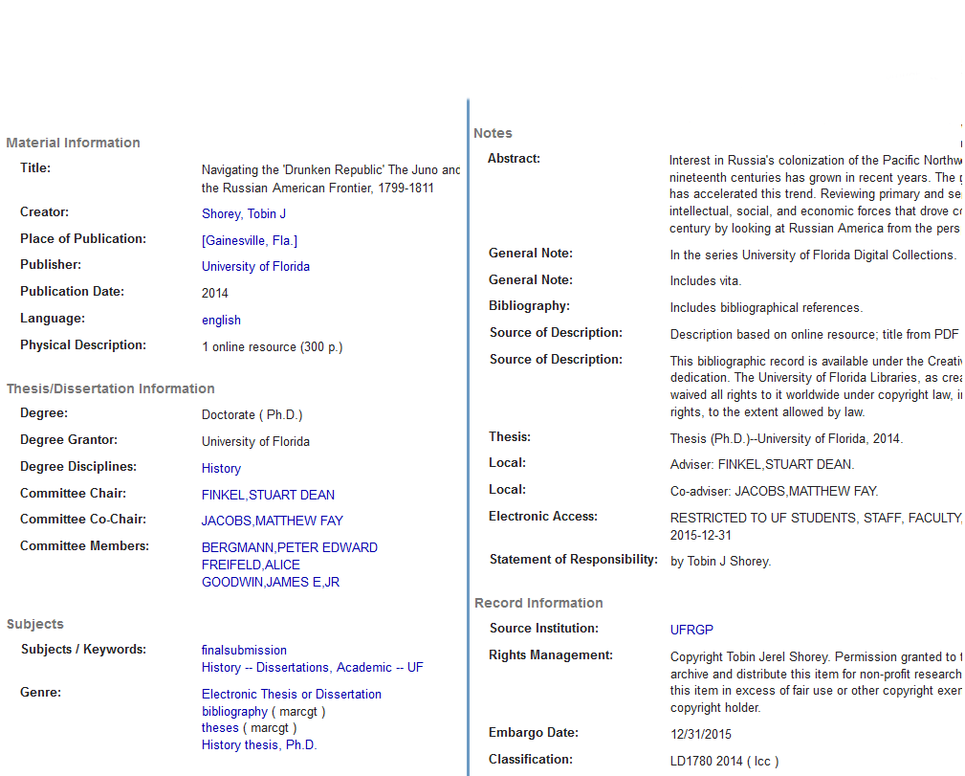
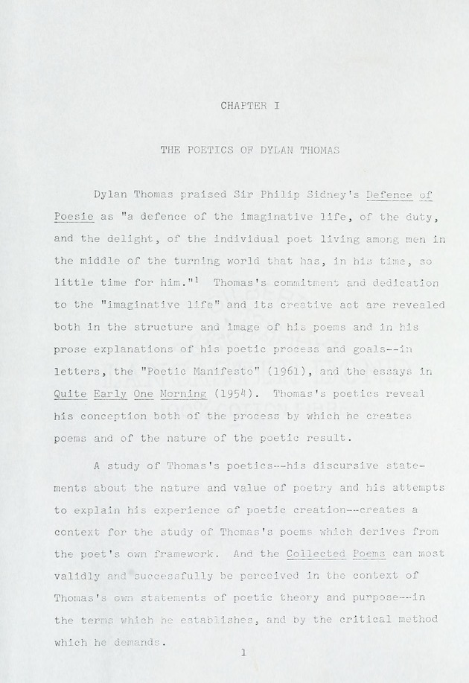
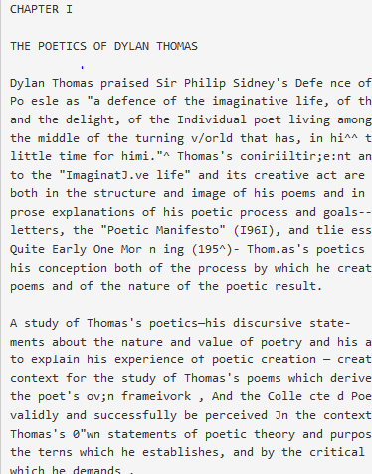
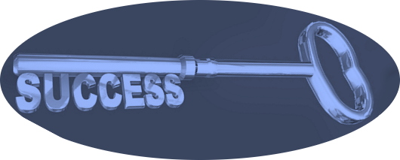
Increasing Discoverability to ETDs through Machine Assisted Indexing: A UF Case Study
By Christy Shorey and Chelsea Dinsmore September 13, 2018
USETDA 2018, Denver, CO
Overview
Pilot Project: Digital Theses and Dissertations
Building the Thesaurus and Rules Base
The University of Florida Libraries began working with Access Innovations in 2016 to build a Machine Assisted Indexing (MAI) tool for use on UF’s digital collections. Beginning with full-text scans, the system uses word frequency to suggest keywords for titles. A rules set prioritizes words and redirects to preferred terms, with human review as the final step. MAI helps minimize the time needed to identify relevant keywords, and enables us to use more natural language terms than are typical in traditional cataloging. We chose our ETD collection as our pilot project for this process.
Why ETDs?
UFETD collection good size for test (25,000 titles)
Both digitized and born digital files
Good variation in quality and formatting over the years
1934-2016 (at time of pilot)
How did we start?
Training with Access Innovations, Oct. 12-18, 2017:
Theory of Knowledge
Taxonomy Fundamentals
How does Search Work
What can I do with a Taxonomy
Introduction to Data Harmony (the MAI tool)
Top terms found in the UFETD collection.
“Cans” is a noise term that we can remove by defining more rules around the contexts where it appears.
Our Thesauri Work
Began with a thesaurus developed for Social Studies and Humanities content
Enhanced an existing Geographical thesaurus to cover more Florida terms
Developed a Florida Name Authority set to better identify relevant subject terms
Will continue as an ongoing, iterative process
Establish Workflows
Challenges
As we incorporate MAI into our daily routine,
we must decide where it will best fit in the workflow.
Inconsistent Metadata
OCR Quality
Cross System Communication
Current
Option 1
Option 2
Full Metadata Fields Standards Vary Over Years
Need:
Crosswalk from UFDC fields to Access Innovations fields
Mechanism to send XML, txt and PDF files to AI, and receive enhanced XML to ingest
Solution: Marshaling Applications Website (MAW)
In-house tool connecting UFDC and Access Innovations
Create METS XML from existing metadata (MARC or XML)
Scan or upload item
Create METS XML from existing metadata (MARC or XML)
2006
Missing & Incorrect Metadata
Improved OCR
Access Innovations had to regenerate OCR for many ETD titles
Send through MAI
Original Scan
Scans of older works vary in quality, based on factors like paper type and typist skill
Improved OCR
Access Innovations recreated OCR for many ETD titles
Metadata Mapped to Wrong Fields
OCR quality
Poor scans can result in poor OCR
Poor OCR means the full text search for terms is ineffective
Create METS XML from existing metadata (MARC or XML)
+ MAI subject terms
Scan or upload item
Lessons Learned
Future Directions
Evaluation
Success in this project is the process, not the final product.
The pilot exposed areas of our system that need more attention:
Quality changes of OCR over time
Flaws in system, such as bad field mapping
Areas that need to be updated to reflect new practices
Metadata inconsistencies
MAI is just that, machine assisted indexing, requiring humans to:
Validate selected terms
Create rules relevant to our collection
After assessing the results of our
pilot project, we plan to:
Apply MAI to more UFDC collections
Use MAW to transfer content between systems
Finalize workflow for enhancing existing digital records
Develop workflow for newly digitized items
We can measure how many records we enhanced by:
Improving subject terms based on full text
Adding “human readable” subject headings
How do we measure impact on users?
Number of views and downloads?
Increased citations?
Other?
Scan or upload item
Send through MAI
What is it?
Can we measure it?
Enhance Metadata with MAI subject terms, then as needed
Enhance Metadata as needed
Enhance Metadata as needed

