Slide 1
IR@UF Primer
Introduction to the Institutional Repository and ETDs

Slide 2
What is the IR@UF?
The Institutional Repository at the University of Florida (IR@UF) is the digital archive for the intellectual output of the University of Florida community, and includes research, news, outreach, and educational materials.
A place for an institution and its members to put their stuff for access and preservation.
A place (IR@UF)
for an institution (University of Florida)
and its members (students, faculty, staff)
to put their stuff (research, news, outreach, educational materials, other intellectual output)
for access and preservation.

Slide 3
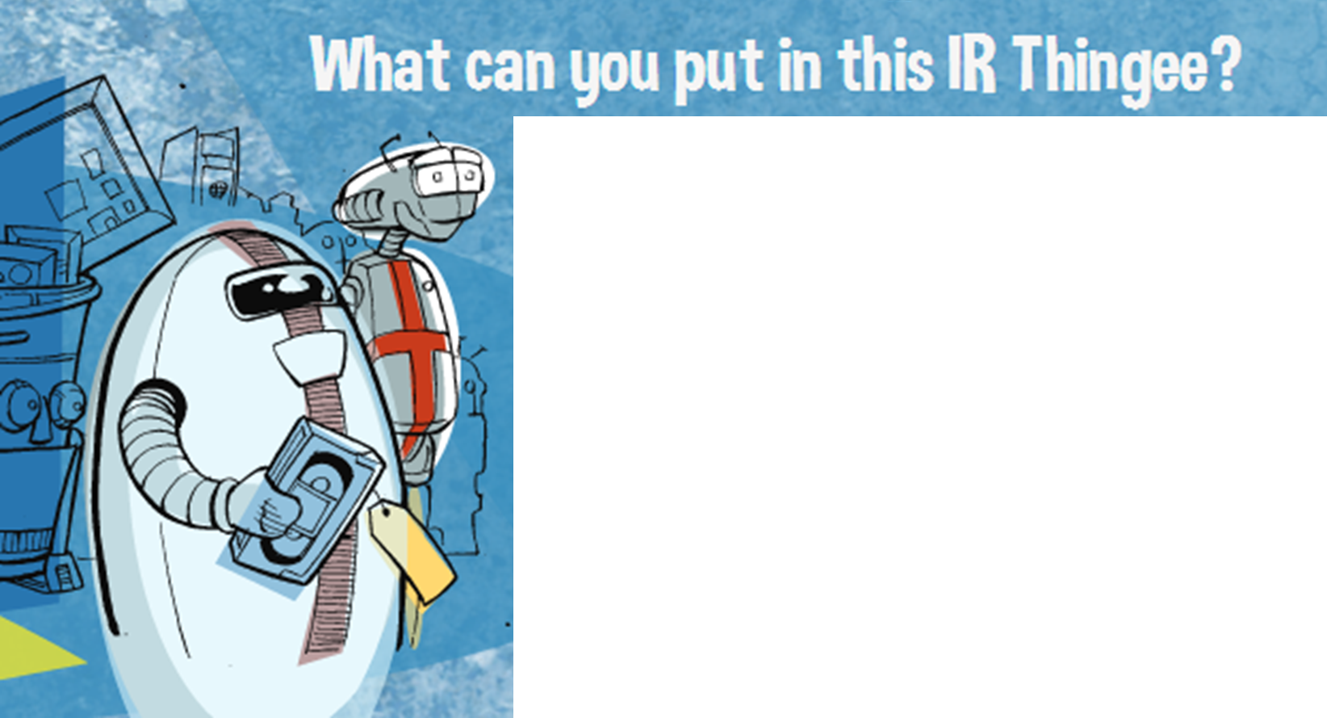
Theses and Dissertations
ETD Supplemental Materials
Data and Datasets
(standalone or with publications)
Conference Materials (posters, presentations, papers, proceedings)
Journal Articles
Book Chapters
White Papers
Grant Proposals

Slide 4
Basic Guidelines
Is the item complete? | Is it scholarly content?
Was it created by member(s) of the UF community? | Do you retain the rights to post the material?
Four criteria to determine if something belongs in the IR@UF
If you can’t answer “yes” to all of the above, additional research may be required.

Slide 5
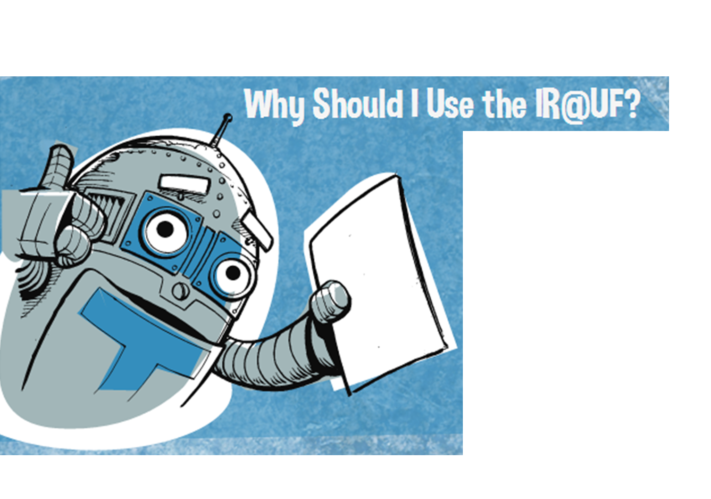
Usage Statistics
Permanence
Safe Storage
Credibility
Visibility
Findability

Slide 6
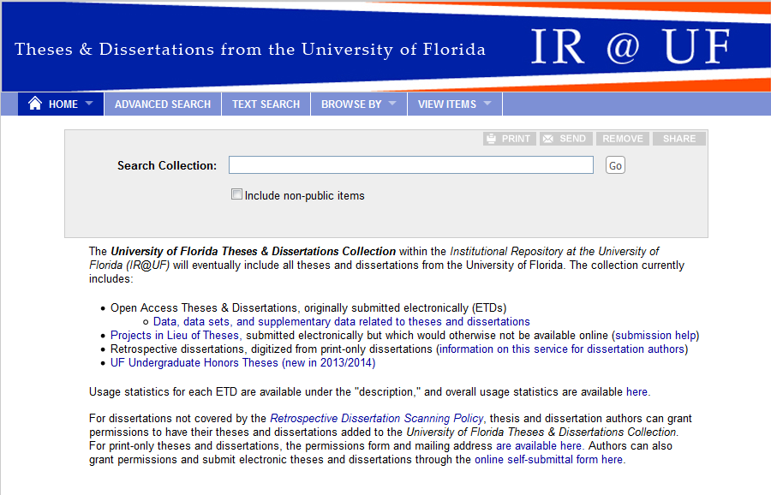
IR@UF and ETDs
Once the editorial process is complete, all ETDs are validated and transferred by the Graduate School Editorial Office staff to the library for publication.
Publication is within the IR@UF: http://ufdc.ufl.edu/l/ufetd

Slide 7
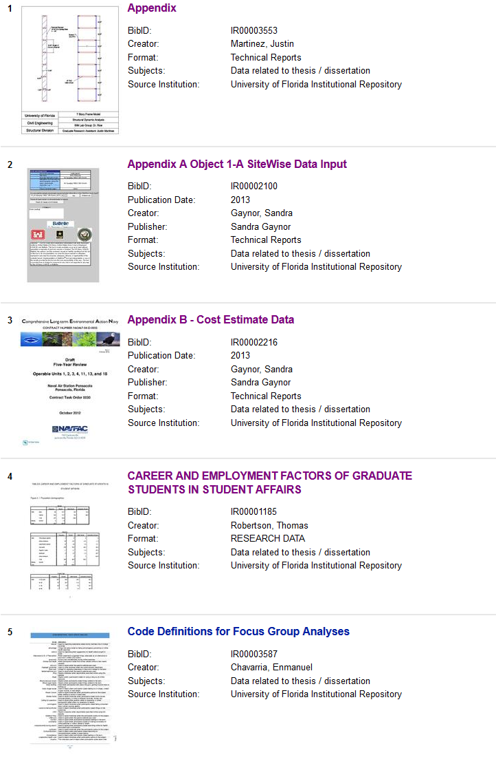
IR@UF and ETDs Supplemental Materials &Appendices
Some materials that are important for your ETD do not fit in the regular ETD format.
These can be loaded into the IR@UF prior to ETD submissions.
You get a permanent URL you can reference in your thesis or dissertation.
Great for large tables, videos, audio recordings, etc.

Slide 8
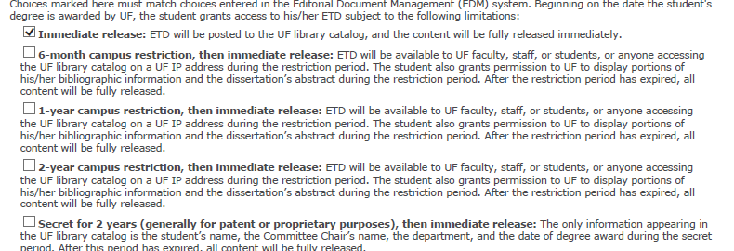
IR@UF and ETDs Restrictions: UF Publishing Agreement
Submitted to department at time of defense
Required for master’s thesis or doctorial dissertation
Restrictions are for IR@UF version
Immediate Release
6-month, 1 year or 2 year campus restriction
Limits access to UF IP ranges
Secret for 2 years (great for patent seekers)
Restriction extensions available term before restriction expires.
ETDExtensions@uflib.ufl.edu

Slide 9
IR@UF and ETDs Restrictions: UMI Publishing Agreement
UMI = ProQuest
Submission required for doctorial dissertation
Submitted to Grad Editorial at or after defense *
Two submission types
Doctoral Dissertations Publish Abstract Only Agreement
Dissertation / Masters Thesis Submission Form / UMI Publishing Agreement
* This process switched to online submission August 2018; process is still being finalized.

Slide 10
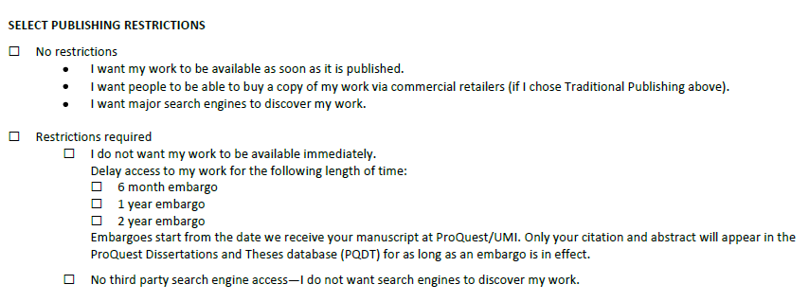
IR@UF and ETDs Restrictions: UMI Publishing Agreement
Restrictions on Dissertation Submission Form are applied AFTER restrictions from IR@UF expire.
Immediate Release
6-month, 1 year or 2 year embargo

Slide 11
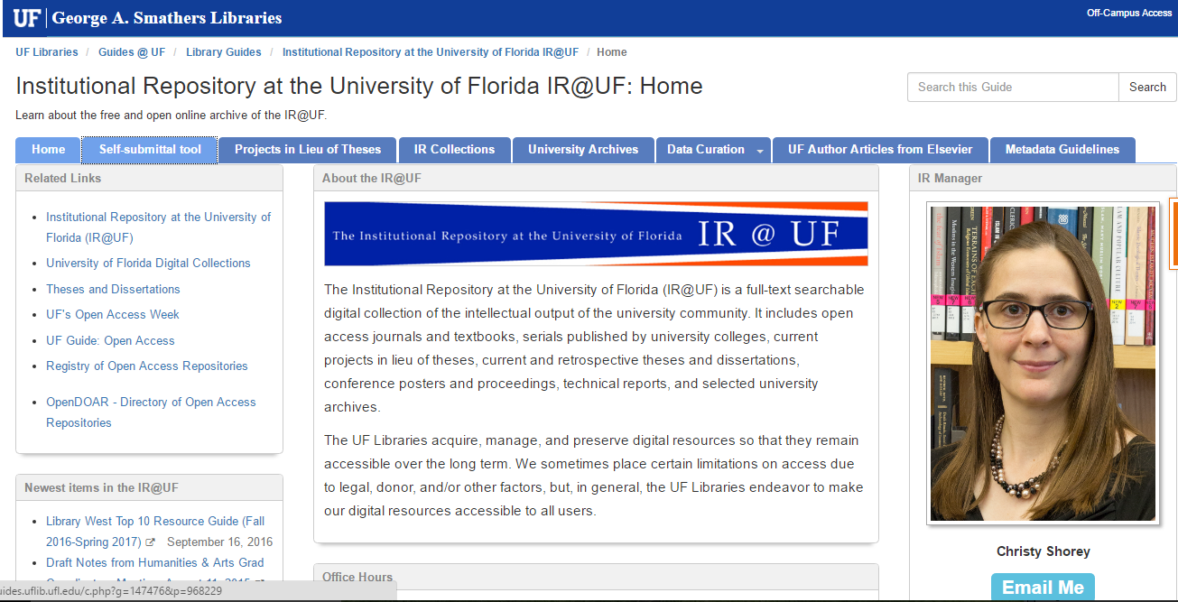
Resources
IRManager@uflib.ufl.edu
ETDExtensions@uflib.ufl.edu
http://guides.uflib.ufl.edu/ufir
http://ufdc.ufl.edu/ir
http://bit.ly/IRUFVideo
Christy Shorey (352) 294-3785
chrshor@uflib.ufl.edu
This slide show can be found in the IR@UF
http://ufdc.ufl.edu/IR00010086/00002

