Slide 1
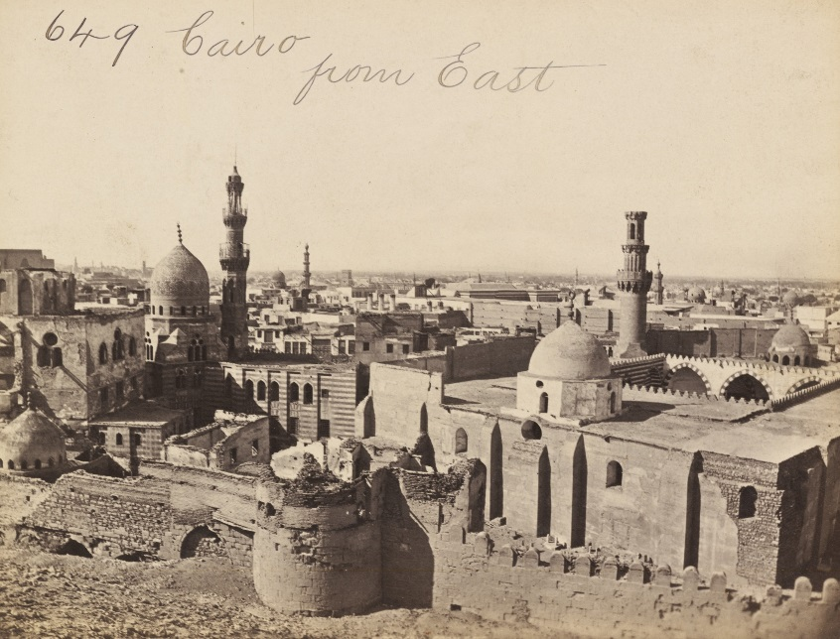
THE CAIRO GENIZAH:
Contents and Discovery
Rebecca J. W. Jefferson
University of Florida
Francis Frith, View of Cairo from the East, 1857; image courtesy of the V&A

Slide 2
WHAT IS A GENIZAH?
The word “Genizah” is derived from a Persian word ganj meaning “treasure”.
The Hebrew word is first used in the Book of Esther 3:9 to refer to the King’s “treasury” (גנזי-המלך ginze ha-melekh)
The Talmud, Megillah 26b, states that “a book of the Law in a state of decay should be hidden/buried (gonzin oto)”
The noun Genizah came to denote a special place to store worn out or defunct scrolls, manuscripts and books of the Hebrew Bible or any other sacred Jewish writings
The material set aside in a Genizah is usually buried at some point later, either together with a deceased person or in a separate ritual burial

Slide 3
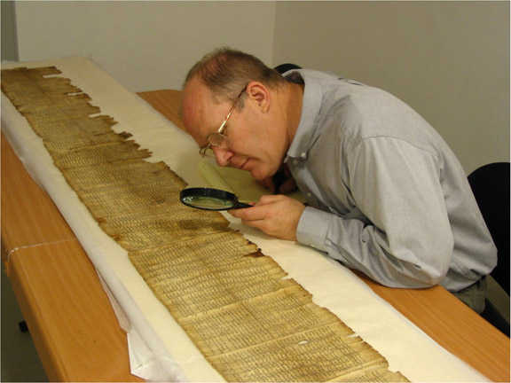
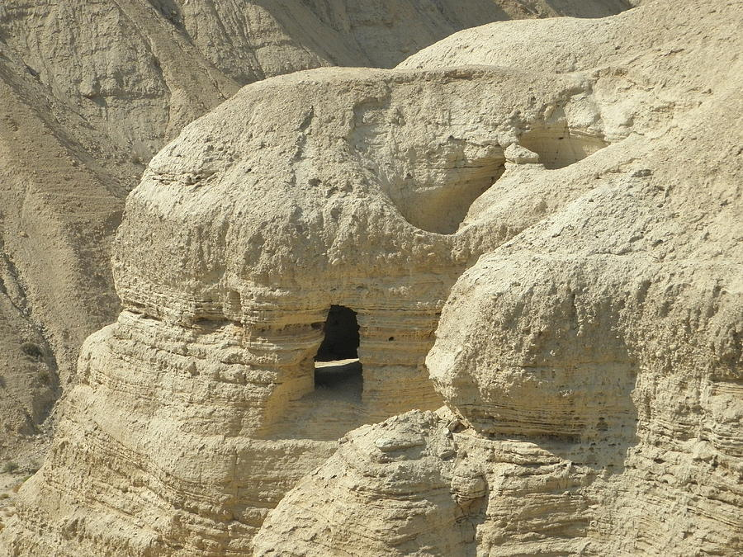
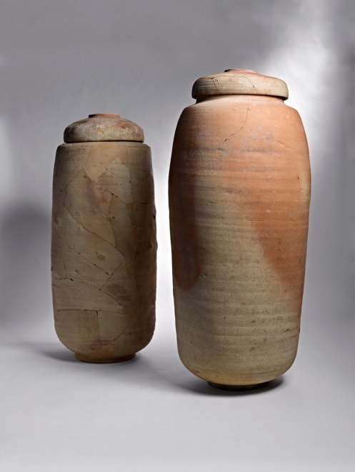
The Dead Sea Scrolls:
the earliest known surviving Biblical documents and an early example of a “Genizah”?

Slide 4
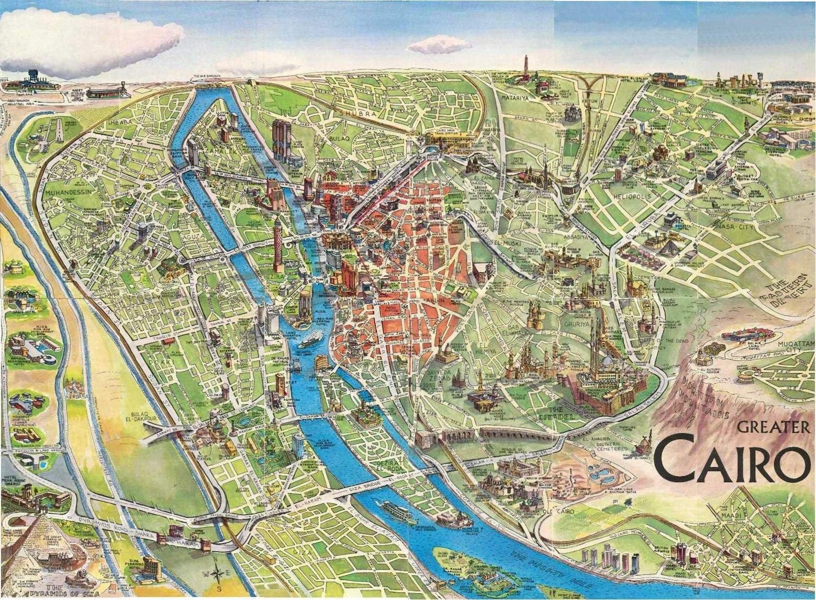
The most famous Genizah was found in Old Cairo
Map of Cairo: Old Cairo is on the lower right side adjacent to the mountain
Image courtesy of http://www.turkey-visit.com/map/cairo-map

Slide 5
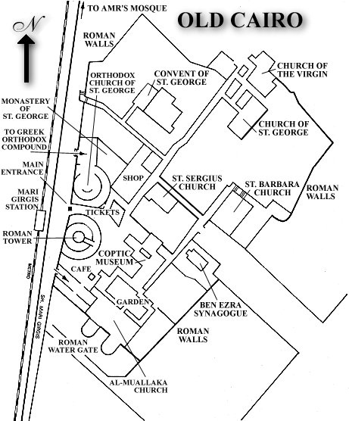
Cairo was first settled in the 7th century BCE. Under Roman occupation, the city was surrounded by a wall and fortress. Egypt’s oldest churches were built close by. The city came under Muslim rule in the 7th century CE and served as the administrative capital of Egypt. The city’s highpoint was in the early 12th century when its population reached nearly 200,000.
In 1168 the vizier ordered the city to be burned down in an attempt to thwart the Crusaders. The administrative center shifted northwards to the area that is now modern Cairo. The old city was rebuilt in part. That same year, the Jewish traveler, Benjamin of Tudela noted a thriving, well-healed Jewish community of 7,000 people.
In the Middle Ages, three synagogues served the Jewish community of Cairo: the Babylonian Synagogue, the Karaite Synagogue and the Palestinian Synagogue (each congregation adhered to separate practices).
A modern map of Old Cairo showing the location of the Palestinian Synagogue, known today as the Ben Ezra Synagogue
Image courtesy of: http://www.touregypt.net/cairo/map10.htm

Slide 6
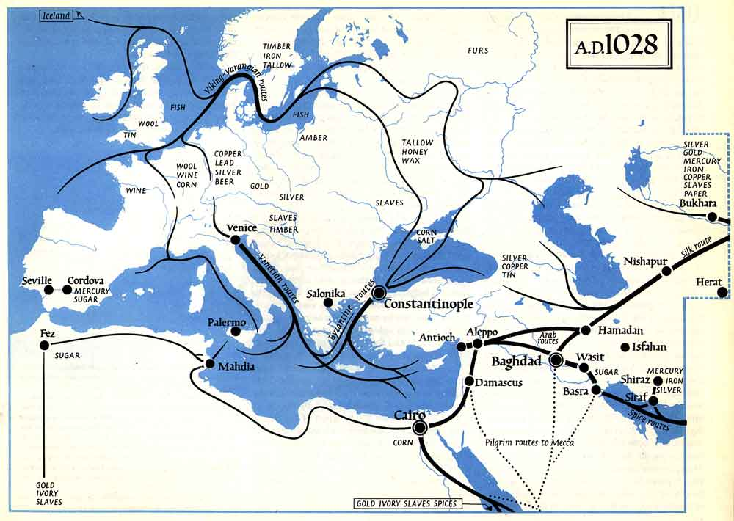
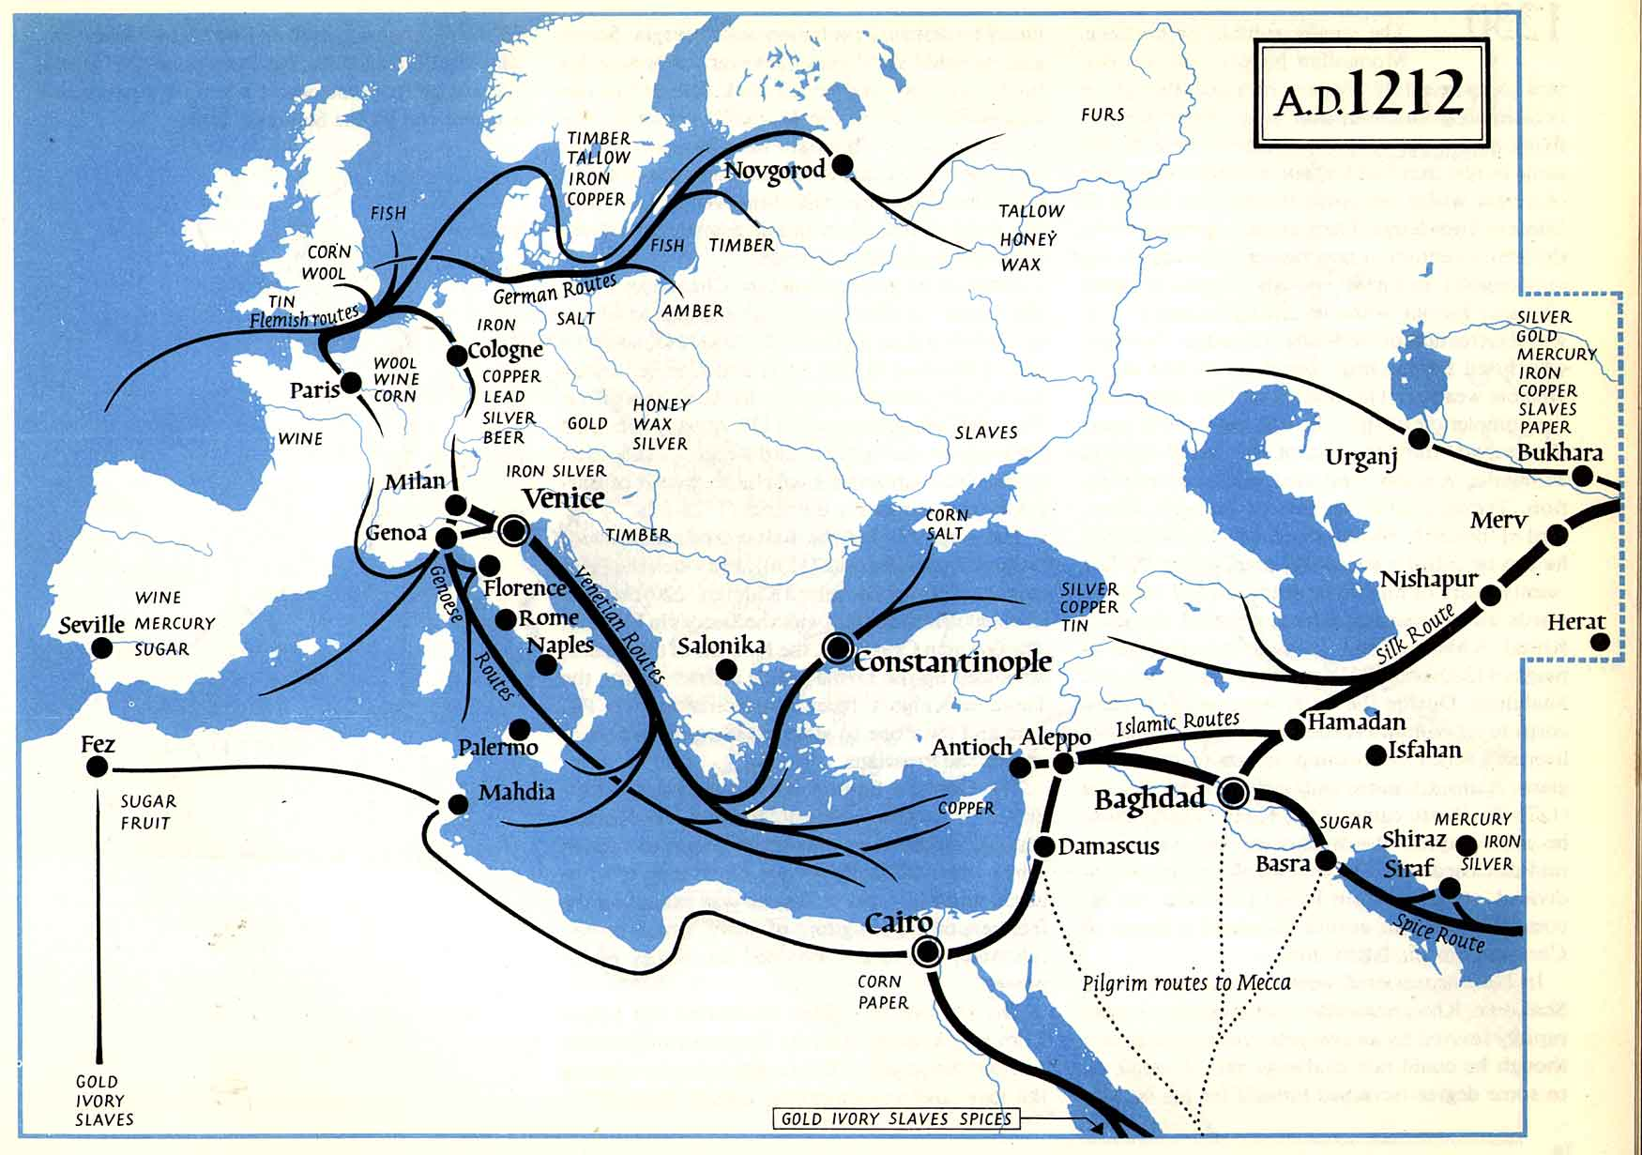
Maps showing the medieval trade routes (The Penguin Atlas of Medieval History)
Between the 11th and 13th centuries trade came from and through Cairo and out along the silk route and east into India. It also went up the Nile into Alexandria and out to the countries of the Mediterranean
Images courtesy of http://www.learn.columbia.edu/courses/medmil/pages/non-mma-pages/maps/penguin.html

Slide 7
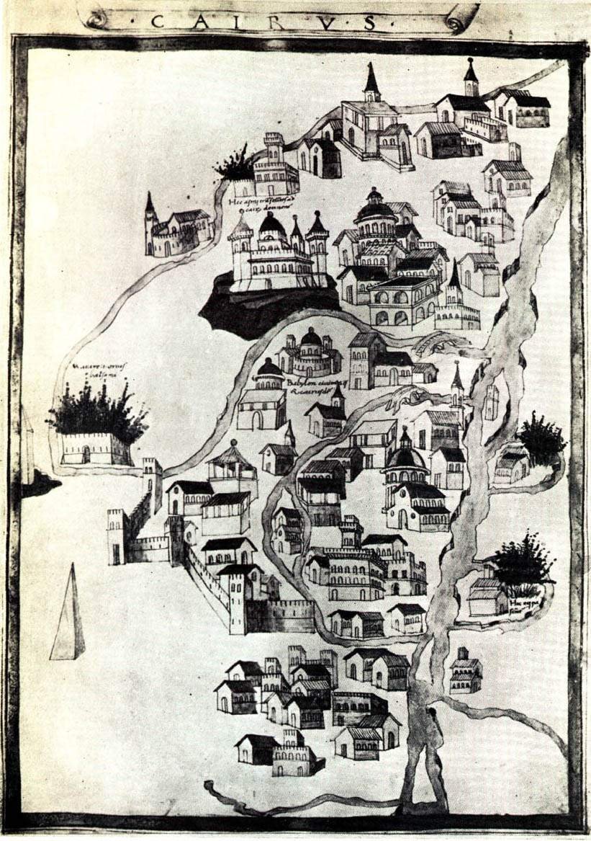
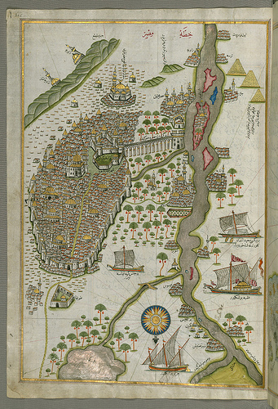
Map of Old Cairo by Hartmann Schedel (cartographer and author of the Nuremberg Chronicle) in 1492-93.
Piri Reis’ map of Cairo from the Book of Navigation presented to Sultan Suleiman the Magnificent (1525)
Cairo’s oldest synagogue, known today as the Ben Ezra Synagogue, was first established in the 9th century CE. It was called the Synagogue of the Jerusalemites (in reference to its congregants who originated from Palestine (the Land of Israel) and adhered to the practices of the Jerusalem Talmud).
The synagogue was demolished during the persecutions of the Fatimid Caliph al-Hakim in 1013 CE and rebuilt between 1039 and 1041 CE. It was damaged by a fire in 1473 but reconstructed soon after. Known thereafter as the Synagogue of Elijah, the building stood unchanged until 1889 when its poor state of repair led to a third rebuilding project.
This third reconstruction became known as the Ben Ezra synagogue. There are no known images of this building and written eyewitness accounts vary.
Images courtesy of: http://muslimheritage.com/topics/default.cfm?ArticleID=1309, and the Walters Art Museum, Baltimore, MD

Slide 8
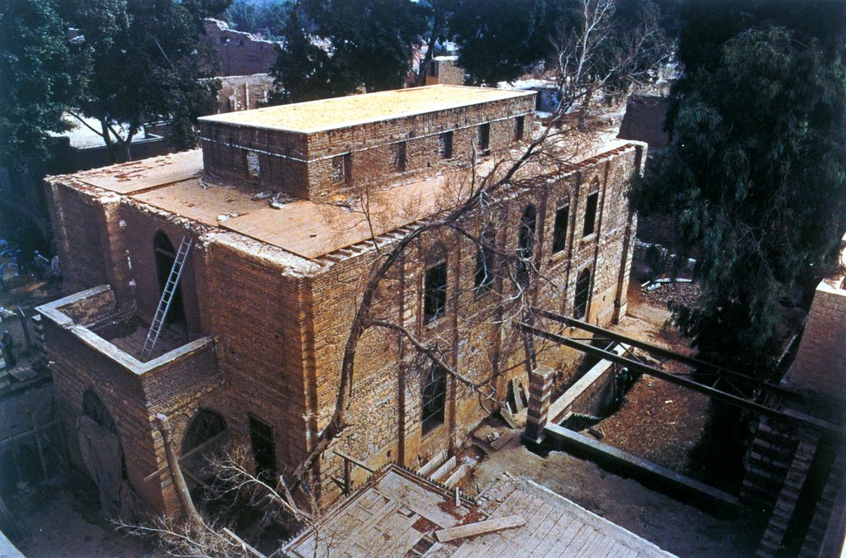
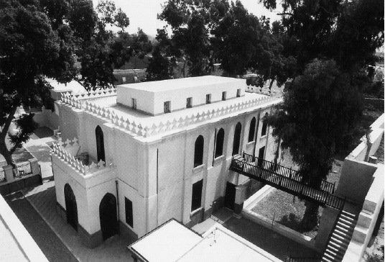
The Ben Ezra Synagogue and its Genizah
The world’s most famous Genizah was discovered in the Ben Ezra Synagogue. Between 1860 and 1912, various explorers, visitors and collectors found over 300,000 manuscript fragments stored inside the synagogue and buried in its grounds
By 1991, the synagogue was in need of further restoration
The Ben Ezra Synagogue restored in 1991 thanks to a Canadian project architect and philanthropist Phyllis Lambert and her brother Edgar Bronfman
Images from Phyllis Lambert (ed.), Fortification and the Synagogue, Weidenfeld & Nicholson, London, 1994

Slide 9
Most of the material dates from the 10th–13th century: now known as the “classical Genizah period”
The earliest manuscripts are palimpsests from the 6th century
Another significant amount of material was added after the expulsion from Spain in 1492
The latest dated document is a bill of divorce from Bombay in 1864

Slide 10
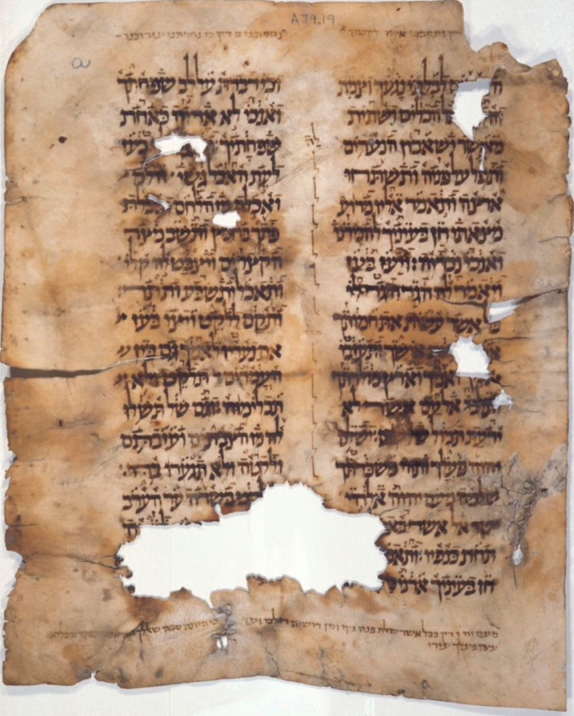
Typical Genizah contents: sacred texts
CUL MS T-S A39.19: A fragment of the Book of Ruth on vellum with Babylonian supralinear vocalization.
Image: courtesy of the Taylor-Schechter Genizah Research Unit and the Syndics of Cambridge University Library

Slide 11
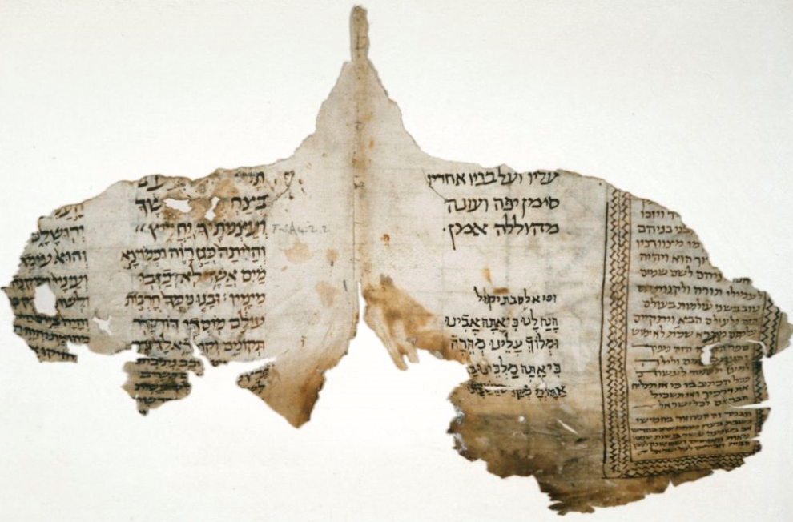
Typical Genizah contents: sacred texts
CUL MS T-S A42.2: Haftorot and liturgy dated 926 CE.
Image: courtesy of the Taylor-Schechter Genizah Research Unit and the Syndics of Cambridge University Library

Slide 12
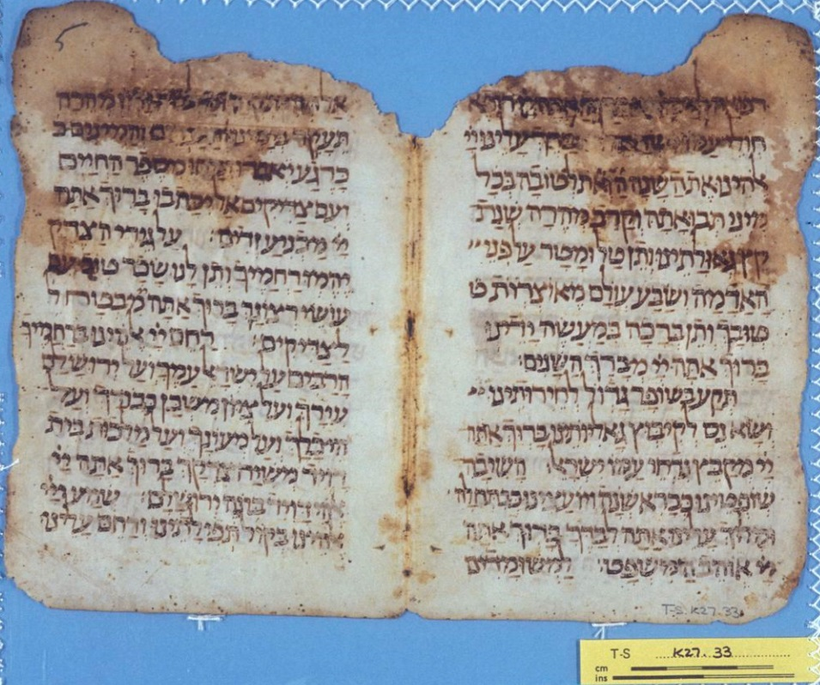
The development of the siddur (prayerbook)
CUL MS K27.33: Amidah (Nusah Eretz Israel – Palestinian rite)
Image: courtesy of the Taylor-Schechter Genizah Research Unit and the Syndics of Cambridge University Library

Slide 13
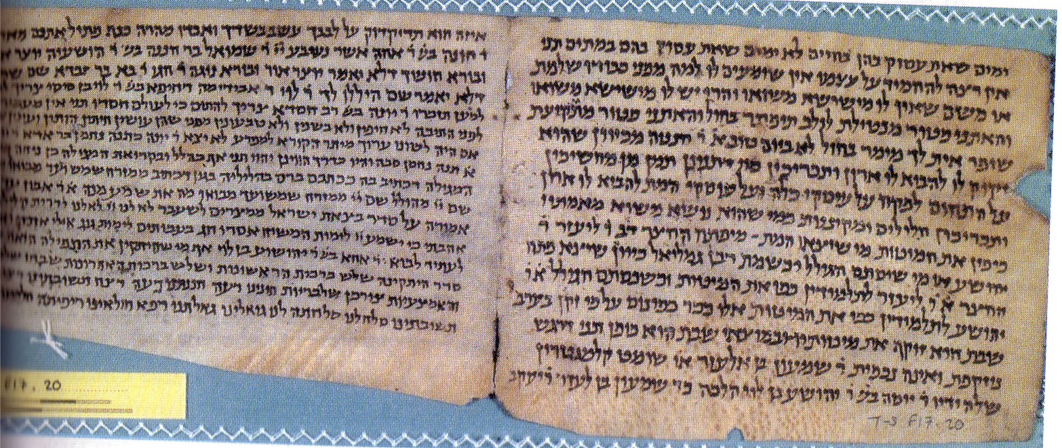
Preserving lost editions of the Talmud
CUL MS T-S F17.20: leaves of the Jerusalem Talmud
Image: courtesy of the Taylor-Schechter Genizah Research Unit and the Syndics of Cambridge University Library

Slide 14
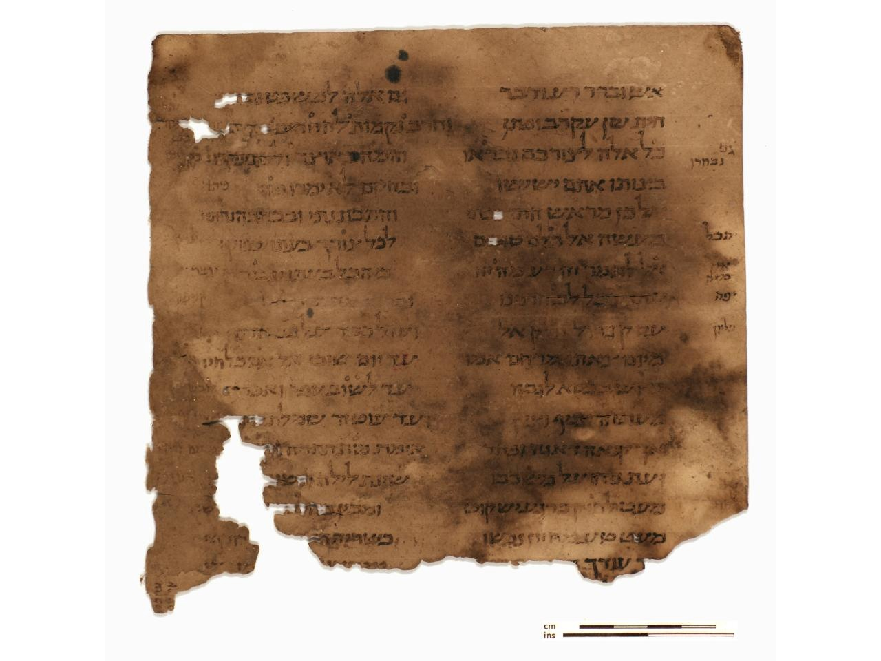
Momentous discoveries
Ben Sira fragment, MS CUL, Or.1102
Image courtesy of the Taylor-Schechter Genizah Research Unit and the Syndics of Cambridge University Library

Slide 15
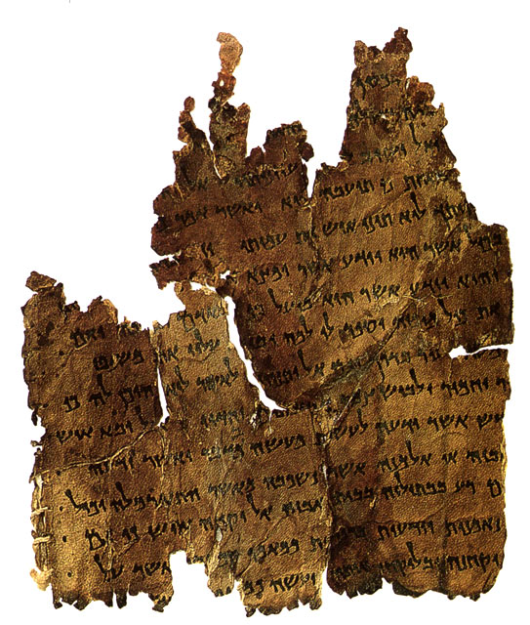
CUL MS T-S 10K6: a medieval copy of a Dead Sea Scroll
Momentous discoveries
Dead Sea Scroll, 4Q271 (www.archaeology.org.il)
Image: courtesy of the Taylor-Schechter Genizah Research Unit and the Syndics of Cambridge University Library

Slide 16
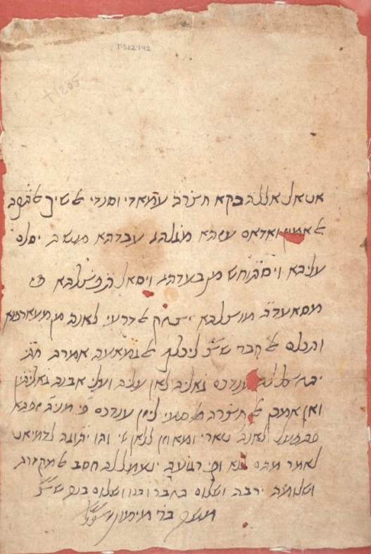
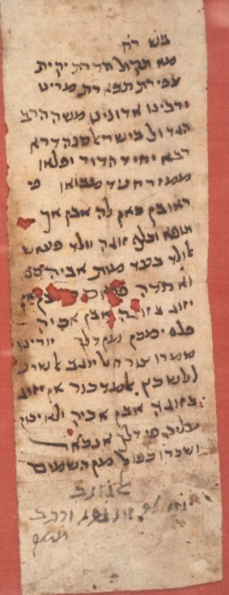
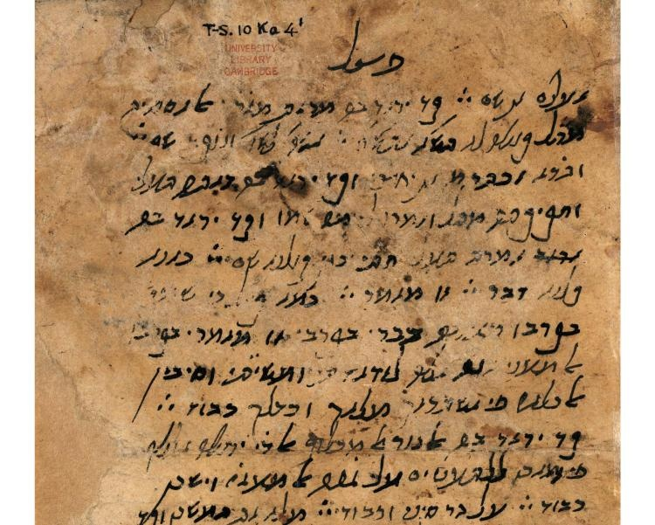
Moses Maimonides (Rambam)
CUL T-S 10Ka4.1: Moses Maimonides draft of his major philosophical work Moreh Nevukhim (Guide for the Perplexed)
Responsa: CUL MS T-S 12.192
CUL MS T-S 12.202
Image: courtesy of the Taylor-Schechter Genizah Research Unit and the Syndics of Cambridge University Library

Slide 17
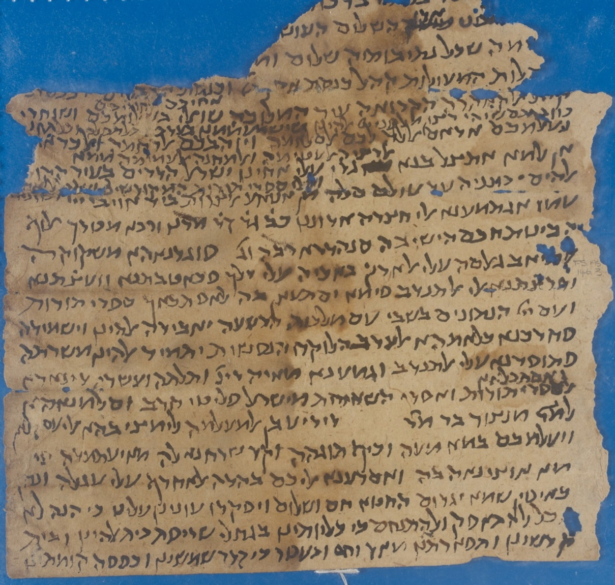
Historical documents
CUL MS T-S AS 146.3
Letter from the communities in Cairo to the community in Ascalon, Palestine, dated April 1100 CE. Mentions that at the instigation of the Nagid Mevoraḵ 123 dinars were collected and sent to Ascalon for ransoming the Torah scrolls and the captives after the invasion of the Crusaders (in 1099 CE)
Image: courtesy of the Taylor-Schechter Genizah Research Unit and the Syndics of Cambridge University Library

Slide 18
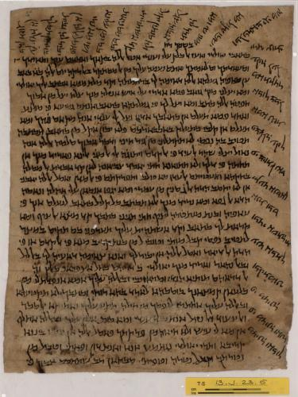
Correspondence
CUL MS T-S 13J23.5: a letter from a mother to son, Syria, 1067 CE.
Image: courtesy of the Taylor-Schechter Genizah Research Unit and the Syndics of Cambridge University Library

Slide 19
CUL MS T-S AS 159.248: UNIDENTIFIED INDIAN LANGUAGE
Trade
Image: courtesy of the Taylor-Schechter Genizah Research Unit and the Syndics of Cambridge University Library

Slide 20
CUL MS T-S AR.30.184: one of the earliest known checks
Commerce
Image: courtesy of the Taylor-Schechter Genizah Research Unit and the Syndics of Cambridge University Library

Slide 21
Jewish-Muslim relations
CUL MS T-S 8K10:
Megillat Misrayim (the Egyptian Scroll): an account of attacks on the Jews of Fustat in 1011-1012; Egypt; 11th century

Slide 22
Jewish-Christian relations
CUL MS T-S Misc.35.45: copy of a letter from the Jewish community of Provence describing the persecution of Jews in Toulouse
Image: courtesy of the Taylor-Schechter Genizah Research Unit and the Syndics of Cambridge University Library

Slide 23
Jewish-Christian cultural engagement
CUL MS T-S K5.41: early music by Obadiah ha-Ger (Johannes the Priest)
Image: courtesy of the Taylor-Schechter Genizah Research Unit and the Syndics of Cambridge University Library

Slide 24
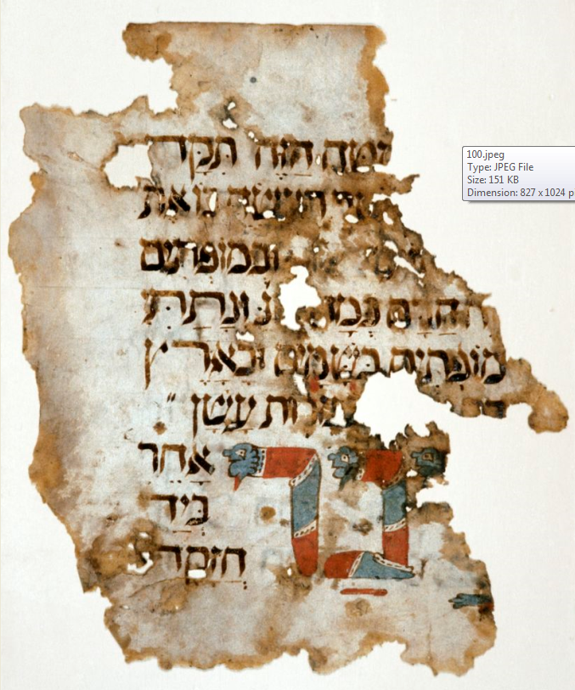
Illuminated texts
CUL MS T-S K10.1: Passover Haggadah illuminated with zoomorphic figures, Spain, 14th century
Image: courtesy of the Taylor-Schechter Genizah Research Unit and the Syndics of Cambridge University Library

Slide 25
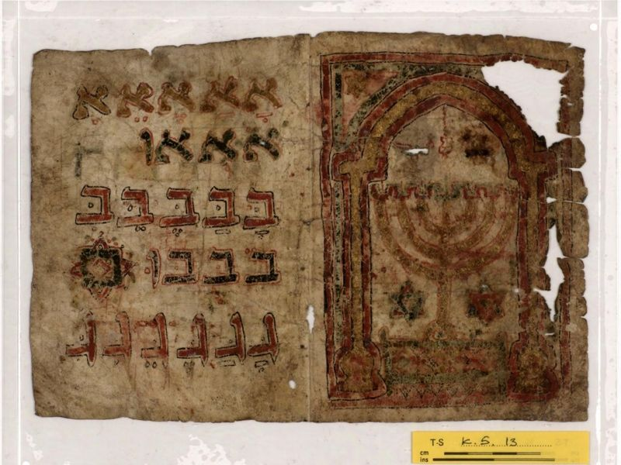
Education
CUL MS T-S K5.10: Alphabet primer
Image: courtesy of the Taylor-Schechter Genizah Research Unit and the Syndics of Cambridge University Library

Slide 26
Teachers
CUL MS T-S 8J28.7: teacher’s report
Image: courtesy of the Taylor-Schechter Genizah Research Unit and the Syndics of Cambridge University Library

Slide 27
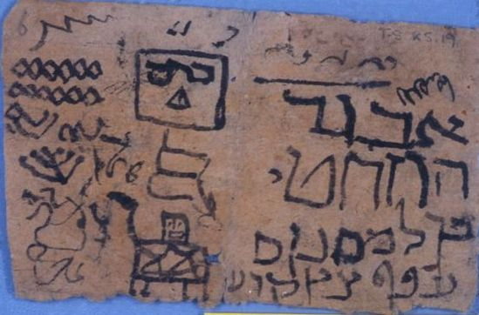
Students
Bored child? CUL MS T-S K5.19: scribblings and doodles
Image: courtesy of the Taylor-Schechter Genizah Research Unit and the Syndics of Cambridge University Library

Slide 28
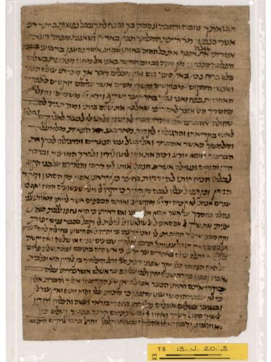
CUL MS T-S 13J20.3: man writes about teaching his son reading skills
Books
MS T-S 13J20.3
Image: courtesy of the Taylor-Schechter Genizah Research Unit and the Syndics of Cambridge University Library

Slide 29
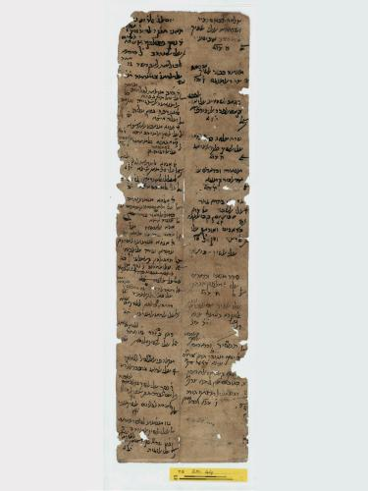
Genizah libraries
CUL MS T-S 20.44: record of sale of books
Image: courtesy of the Taylor-Schechter Genizah Research Unit and the Syndics of Cambridge University Library

Slide 30
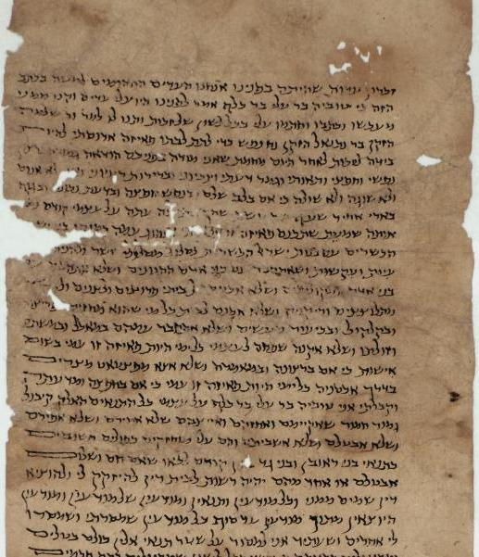
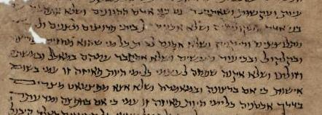
Marriage contracts
CUL MS T-S 20.60: marriage contract with a prenuptial agreement
Image: courtesy of the Taylor-Schechter Genizah Research Unit and the Syndics of Cambridge University Library

Slide 31
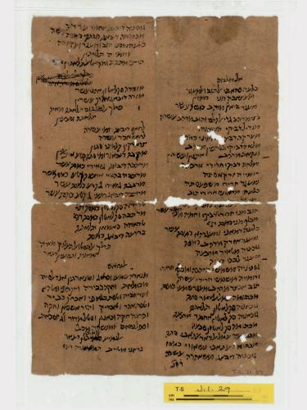
Genizah dowries
CUL MS T-S J1.29: dowry of a rich bride
Image: courtesy of the Taylor-Schechter Genizah Research Unit and the Syndics of Cambridge University Library

Slide 32
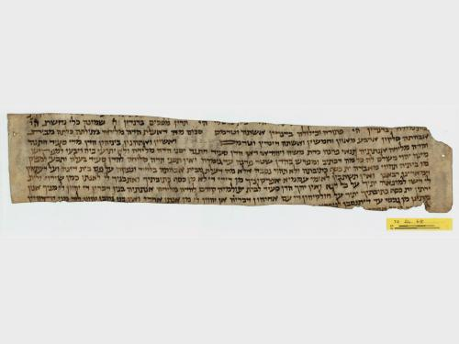
Divorce
CUL MS T-S 24.68: fragment of a marriage contract containing the divorce clause
Image: courtesy of the Taylor-Schechter Genizah Research Unit and the Syndics of Cambridge University Library

Slide 33
Women’s roles
CUL MS T-S 10J7.10: Court document concerning Wuhsha the businesswoman
Image: courtesy of the Taylor-Schechter Genizah Research Unit and the Syndics of Cambridge University Library

Slide 34
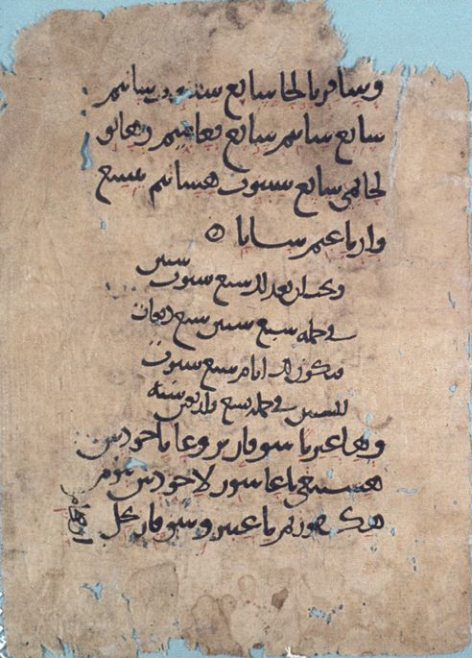
Koran in Hebrew; Bible in Arabic!
CUL MS T-S Ar.51.62: Koran in Hebrew
CUL MS T-S Ar.52.242: Hebrew Bible in Arabic
Images: courtesy of the Taylor-Schechter Genizah Research Unit and the Syndics of Cambridge University Library

Slide 35
Yiddish
CUL MS T-S Misc.36L.1: a letter in Yiddish
Image: courtesy of the Taylor-Schechter Genizah Research Unit and the Syndics of Cambridge University Library

Slide 36
CUL MS T-S Ar.30.305:prescription
Medicine
Image: courtesy of the Taylor-Schechter Genizah Research Unit and the Syndics of Cambridge University Library

Slide 37
CUL MS T-S NS 98.73: Calendrical work on the tequfa in Ashkenazi script. The manuscript includes a hand-shaped chart with instructions for calendar-calculations using the fingers.
Calendars
Image: courtesy of the Taylor-Schechter Genizah Research Unit and the Syndics of Cambridge University Library

Slide 38
CUL MS T-S Ar.42.130: Arabic text containing the rules for various mathematical and board games
Games/pastimes
Image: courtesy of the Taylor-Schechter Genizah Research Unit and the Syndics of Cambridge University Library

Slide 39
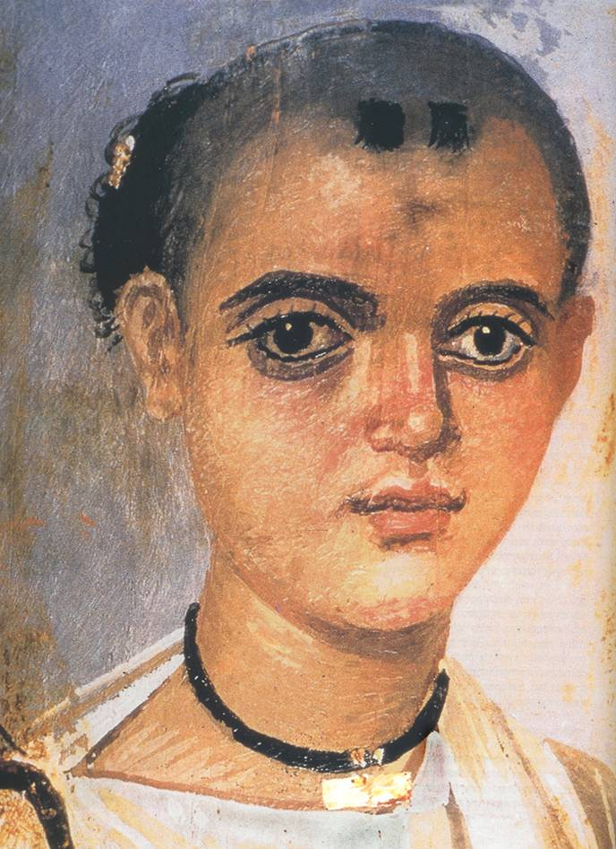
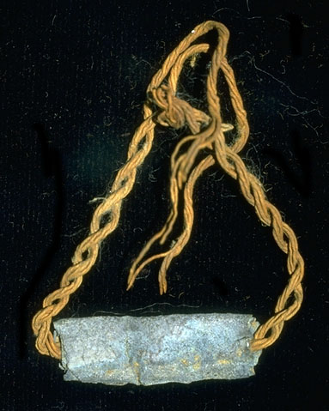
Magic
CUL MS T-S AS 143.26: amulets
Image: courtesy of the Taylor-Schechter Genizah Research Unit and the Syndics of Cambridge University Library

Slide 40
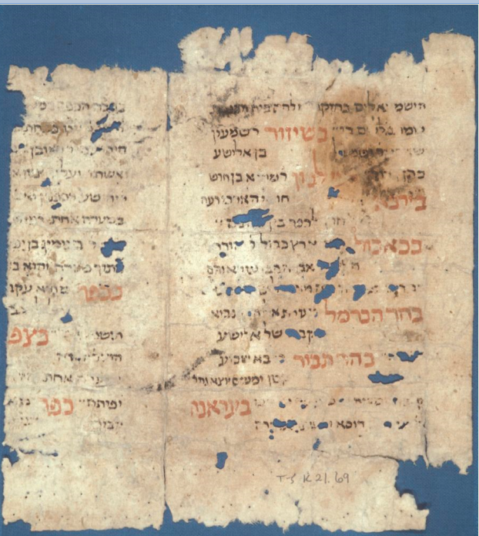
Later manuscripts
CUL MS T-S K21.69: List of holy places in Eretz Israel; Eretz Israel and its environs; c.16th century.
Image: courtesy of the Taylor-Schechter Genizah Research Unit and the Syndics of Cambridge University Library

Slide 41
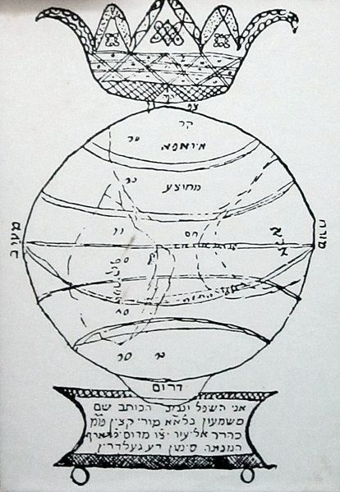
Simon Von Geldern, 1720-1774, great-uncle of Heinrich Heine (one of the most significant German poets of the 19th century), travelled to the Orient. The first allusive mention of the Genizah in the Ben Ezra Synagogue is found in his travel diary: I was in the Elijah Synagogue and searched in the Genizah. I gave 5: -
Drawing of the globe from the travel diary of Simon Von Geldern, Photo of an exhibit at the Diaspora Museum, Tel Aviv

Slide 42
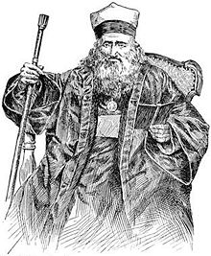
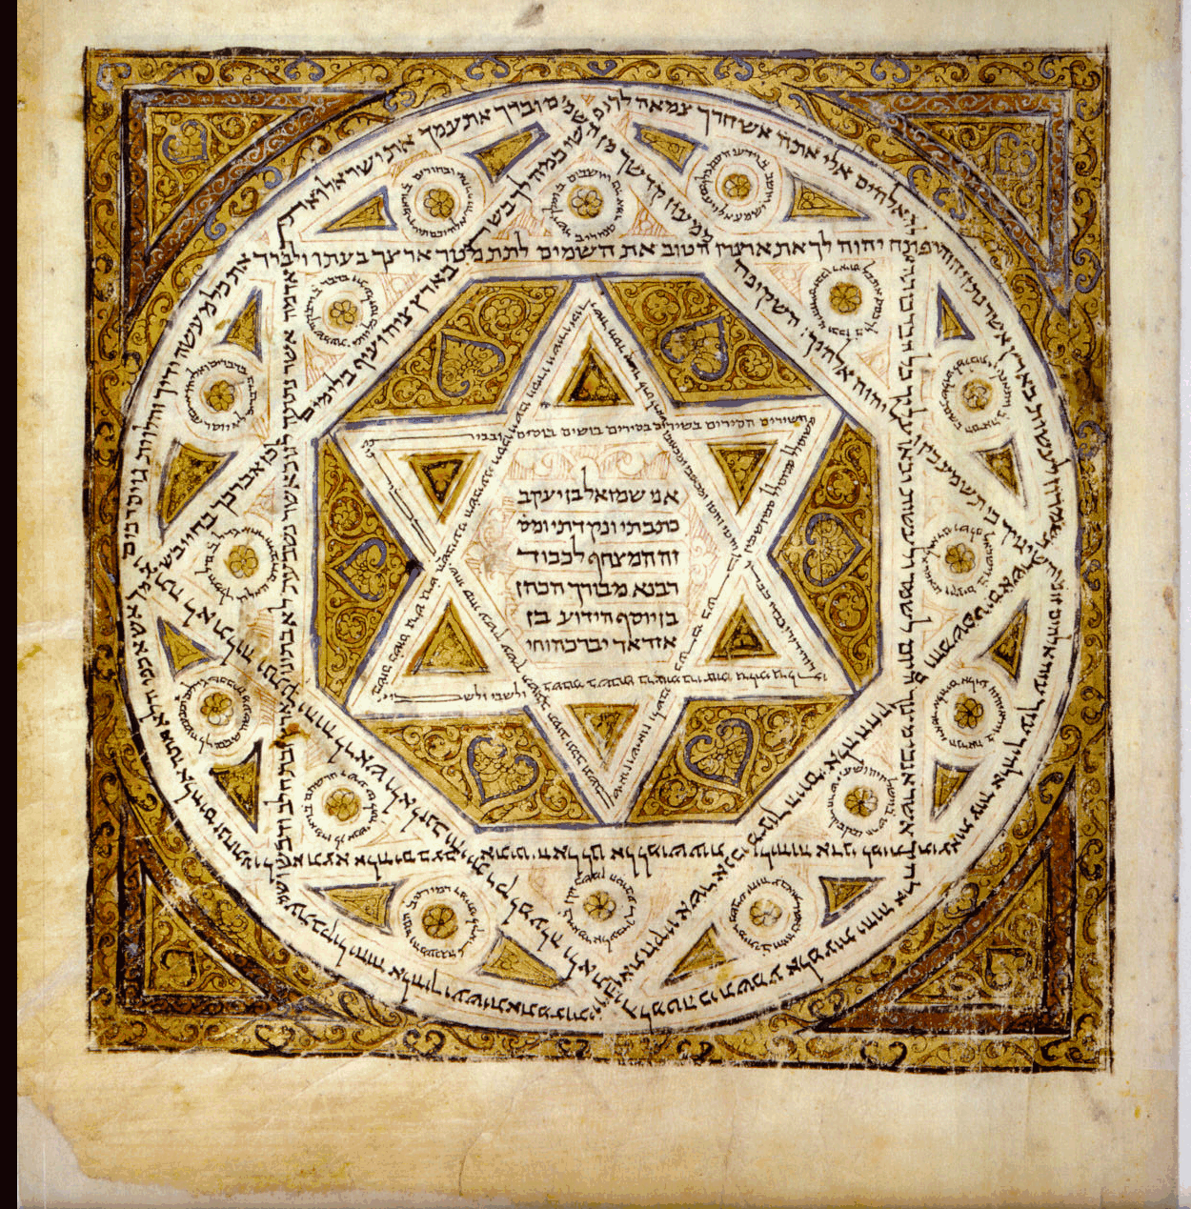
Another Genizah in Cairo
Abraham Firkovich (1786-1874) amassed an important Hebrew manuscript collection (including the Leningrad Codex) now in St Petersburg Library. He visited the genizot of Old Cairo in 1863 at the age of 77 and recovered over 15,000 manuscripts (Firkovich II collection). The bulk of the collection came from the Karaite synagogue, the Dar Simha Synagogue. There is no mention of the Ben Ezra Synagogue in Firkovich’s correspondence.
The Leningrad Codex (1008-1009 CE): the oldest complete manuscript of the Hebrew Bible in Hebrew together with the Tiberian masorah (the accompanying explanatory text, vowels and accents). Image courtesy of: http://www.bibliahebraica.com
Image of Firkovich published in the 1901-1906 Jewish Encyclopedia

Slide 43
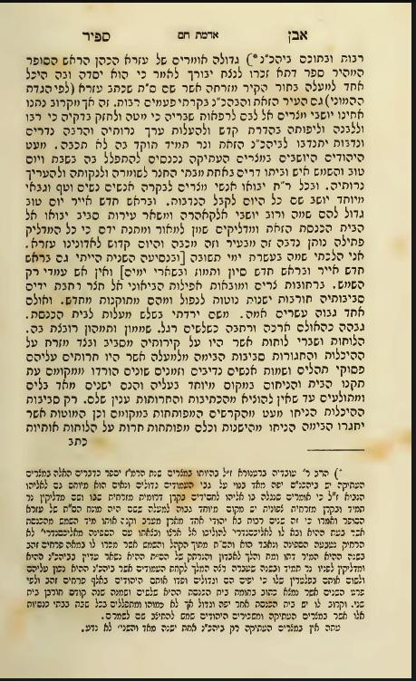
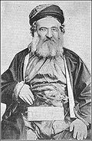
The first extensive account of the Genizah in the Elijah (Ben Ezra) Synagogue
A page from Saphir’s travelogue which recounts his visit to the Ben Ezra Synagogue in 1864. He writes about his foray into the Genizah chamber which he accessed from the synagogue roof.
Jacob Saphir, 1822-1886: traveller and emissary

Slide 44
Elkan Nathan Adler, 1861-1946, author, lawyer, historian and collector of books. Alder visited the Genizah in 1888; one year before it was due to be torn down …He is told that there is no Genizah and that the Jewish community bury their shemot

Slide 45
Count Riamo d’Hulst (?), c.1855-1920; excavated the rubbish mounds around Old Cairo in 1889 for the Egypt Exploration Fund. D’Hulst found some of the manuscripts tossed out of the synagogue during the renovation. He shipped several boxes of Hebrew manuscripts to the Egypt Exploration Fund in London.

Slide 46
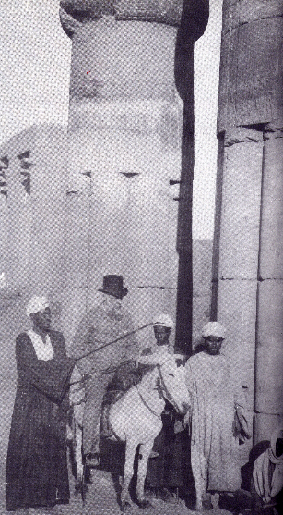
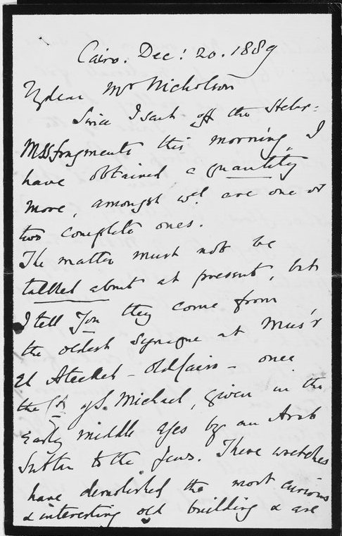
A Genizah chamber laid open ...
Rev. Greville John Chester, 1830-1892; collector; visited the Ben Ezra Synagogue in 1899 as it was being torn down.

Slide 47
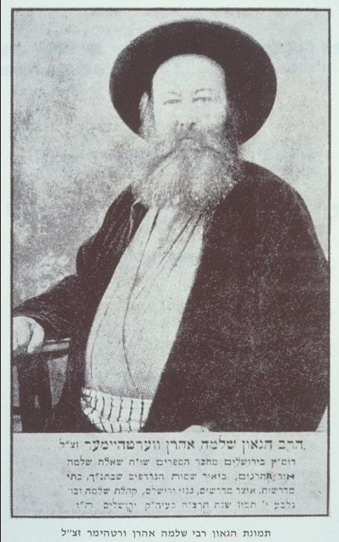
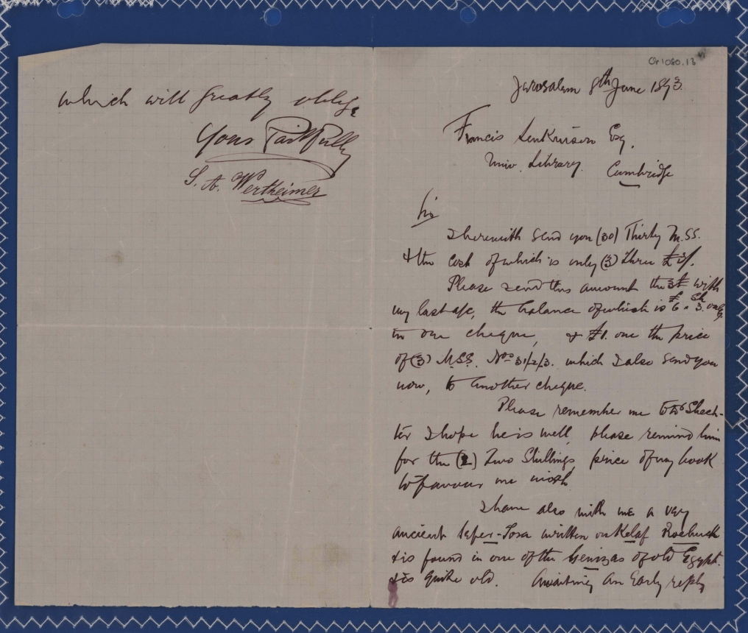
Manuscripts on the market …
One of Wertheimer’s letters to the Cambridge Librarian, 1893
Rabbi Solomon Wertheimer (1866-1935), scholar and bookseller, acquired fragments before 1890 and sold them to British institutions between 1892 and 1897.
Image of letter: courtesy of the Taylor-Schechter Genizah Research Unit and the Syndics of Cambridge University Library

Slide 48
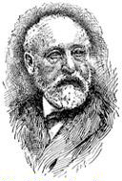
Collecting Genizah manuscripts at Oxford
Dr. Adolf Neubauer, 1831-1907, Bodleian Sub-Librarian for Hebraica
In 1890, Neubauer received some batches of Hebrew MSS from the Count d’Hulst via the Egypt Exploration Fund.
Between 1890-1892, he was sent secret shipments of Hebrew manuscripts from Old Cairo by Greville John Chester.
And between 1892-1894, he was sent Hebrew manuscripts from Old Cairo by Solomon Wertheimer.
Oxford was carefully and quietly building a “select” collection of Genizah manuscripts

Slide 49
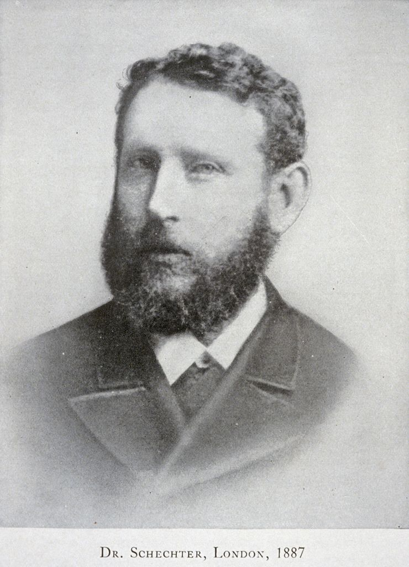
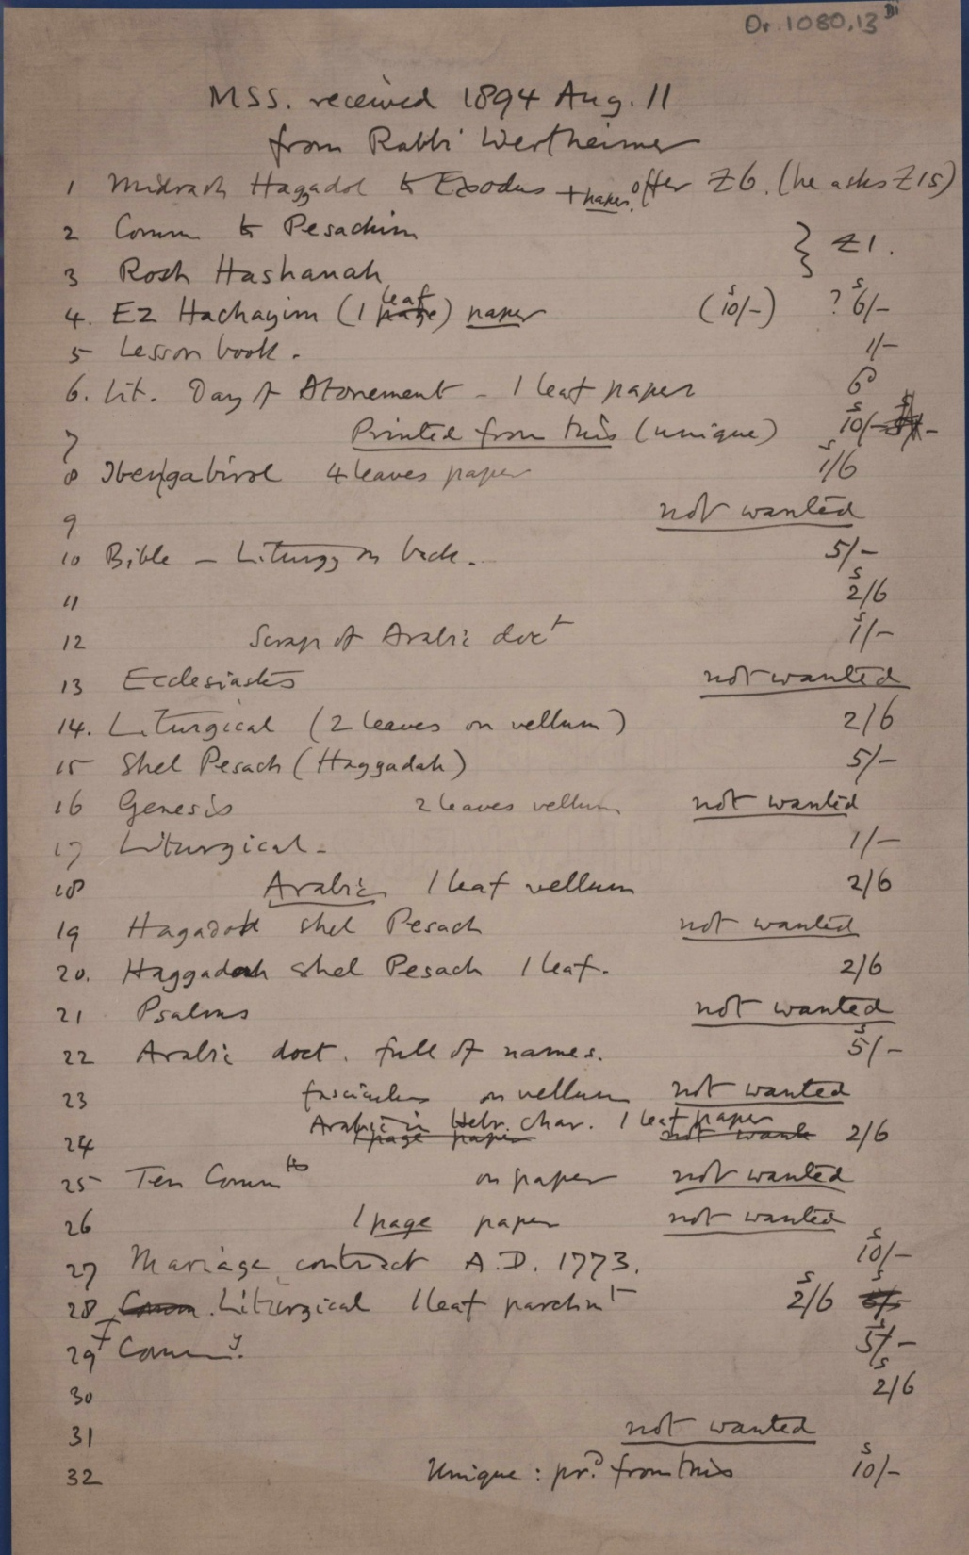
Genizah manuscripts were being sent to Cambridge too …
Genizah manuscripts were also being received at Cambridge University. They were sent from Solomon Wertheimer and examined by Dr. Solomon Schechter (1847-1915), the Reader in Rabbinics at Cambridge University and consultant to Cambridge University Library
Image: courtesy of the Taylor-Schechter Genizah Research Unit and the Syndics of Cambridge University Library

Slide 50
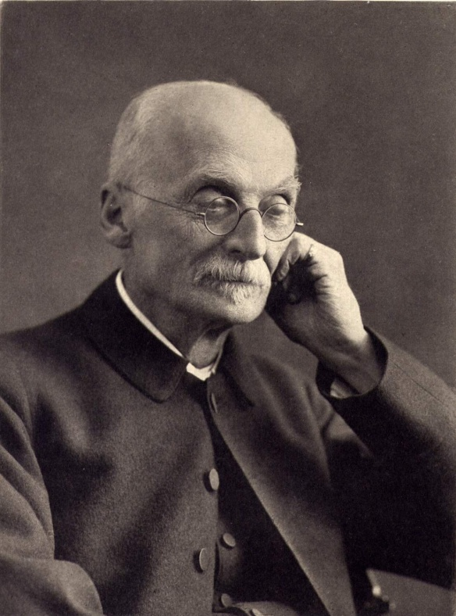
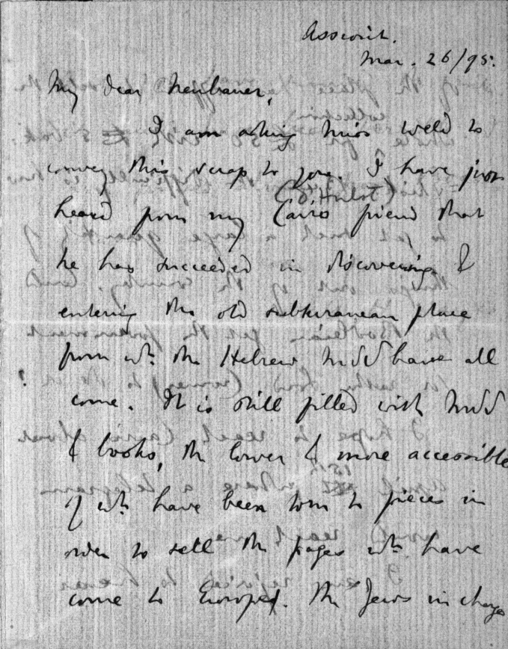
Evidence that some Genizah materials were being stored underground in the Synagogue basement
I have just heard from my Cairo friend (d’Hulst) that he has succeeded in discovering and entering the old subterranean place from which the Hebrew MSS have all come. It is still filled with MSS & books …
Letter from Archibald Henry Sayce to Adolf Neubauer, March 26, 1895
Professor Archibald Henry Sayce, 1846-1933, Assyriologist
Image: courtesy of the Bodleian Library

Slide 51
The first known collector to be granted access to the Genizah chamber above the women’s gallery in the Ben Ezra Synagogue
The bibliophile and collector, Elkan Nathan Adler visited the Genizah again in January 1896. This time he was shown the Genizah chamber and allowed to remove a sack of manuscripts.

Slide 52
Two intrepid ladies hunt for manuscripts
Agnes Lewis, 1843-1926, and Margaret Gibson, 1843-1920; twin sisters; travellers, semitic scholars, discoverers of Sinai Palimpsest, the oldest copy of the gospels in Syriac.

Slide 53
The twin sisters show one of their manuscripts to Solomon Schechter
Ben Sira fragment, CUL, Or.1102
Image courtesy of the Taylor-Schechter Genizah Research Unit and the Syndics of Cambridge University Library

Slide 54
Schechter tells the twins that this is a momentous find
Image courtesy of the Taylor-Schechter Genizah Research Unit and the Syndics of Cambridge University Library

Slide 55
Oxford discovers its own Ben Sira fragment
Heb.e.62; pages of Ben Sira in the Oxford Genizah collection; discovered ‘simultaneously’ (?)
Image: courtesy of the Bodleian Library

Slide 56
Elkan Nathan Adler shows Neubauer and Schechter his sack of manuscripts from the Genizah
Dr. Adolf Neubauer
Dr. Solomon Schechter
Neubauer and Schechter examined Elkan Nathan Adler’s Genizah collection in November 1896. Neubauer later described it as “worthless rubbish” and delayed a trip to Cairo to see the Genizah

Slide 57
In the meantime, Schechter was planning a secret trip to Cairo. His supporter, Charles Taylor, supplied personal funds to allow Schechter to go without alerting anyone to his mission
Rev. Charles Taylor, 1840-1908; Master of St John’s College, Cambridge; Mathematician and Hebraist
Image: courtesy of the Taylor-Schechter Genizah Research Unit and the Syndics of Cambridge University Library

Slide 58
Schechter went to Cairo armed with letters of introduction to the leading members of the Community. He spent several days charming the Grand Rabbi until he was finally taken to see the Genizah
Joseph Cattaui, 1861-1942, politician and leading Jewish figure in Old Cairo at the end of the 19th century
Grand Rabbi of Cairo, Aaron Raphael Ben Shim’on, 1848-1928

Slide 59
A diorama showing the synagogue officials placing the materials into the Genizah created by the Museum of the Diaspora in Tel Aviv
Schechter was allowed to spend as long as he liked in the Genizah chamber and to take as much as he liked away with him. Letters found later reveal that he paid several hundred pounds sterling for the collection
Image: courtesy of the Taylor-Schechter Genizah Research Unit and the Syndics of Cambridge University Library

Slide 60
“A battlefield of books”
Image: courtesy of the Taylor-Schechter Genizah Research Unit and the Syndics of Cambridge University Library

Slide 61
A letter from d’Hulst in Cairo to Neubauer in Oxford describing the excavation work, dated February 17, 1898
Neubauer continued to look for Genizah manuscripts after Schechter had seemingly exhausted the supply. In 1898, the Count d’Hulst was asked to carry out excavations around the Synagogue grounds for the Bodleian Library. The sacks full of fragments that d’Hulst discovered would later be sold as “rubbish” by the Bodleian and secretly bought by Elkan Nathan Adler!
Image: courtesy of the Bodleian Library

Slide 62
Other Collectors and dealers …
Cyrus Adler
Moses Gaster
David Kaufmann
Samuel Raffalovich
Reginald Henriques
Israel Abrahams
Israel Levi
David Gunzberg
Charles Freer
Jacques Mosseri

Slide 63
Genizah collections around the world
New York
Manchester
Cambridge
Heidelberg
London
Oxford
Geneva
Strasbourg
Paris
Budapest
St Petersburg
Jerusalem
Berlin
Vienna
Washington

Slide 64
Image: courtesy of the Taylor-Schechter Genizah Research Unit and the Syndics of Cambridge University Library

Slide 65
“The Living Sea Scrolls”
Q. What did scholars find in these dirty scraps of paper? A. “The single most complete archive of a society anywhere in the medieval world”
Simon Schama, The Story of the Jews (BBC documentary)
Image: courtesy of the Taylor-Schechter Genizah Research Unit and the Syndics of Cambridge University Library

Slide 66
Areas of knowledge transformed by the discovery of the Cairo Genizah
The social, economic and religious aspects of the medieval Mediterranean
Jewish law and medicine
Rabbinic literature
Famous Jewish scholars
Languages
Greek and Syriac texts
Palestinian and Babylonian customs and rites
Medieval Hebrew poetry
Jewish artistic, musical and scientific efforts

Slide 67
Image: courtesy of the Taylor-Schechter Genizah Research Unit and the Syndics of Cambridge University Library

Slide 68
Image: courtesy of the Taylor-Schechter Genizah Research Unit and the Syndics of Cambridge University Library

Slide 69
Image: courtesy of the Taylor-Schechter Genizah Research Unit and the Syndics of Cambridge University Library

Slide 70
The Friedberg Genizah Project: http://www.genizah.org

Slide 71
Image: courtesy of the Taylor-Schechter Genizah Research Unit and the Syndics of Cambridge University Library

Slide 72
Image: courtesy of the Taylor-Schechter Genizah Research Unit and the Syndics of Cambridge University Library

Slide 73
The Mosseri Collection: examples of treasures to unfold …
Image: courtesy of the Taylor-Schechter Genizah Research Unit and the Syndics of Cambridge University Library

Slide 74
The Fragment of the Month
http://www.lib.cam.ac.uk/Taylor-Schechter/fotm

Slide 75
http://www.facebook.com/pages/Genizah-Research-Unit/

Slide 76
Further reading …

Slide 77
Further reading for the real enthusiast …!
http://ufdc.ufl.edu/IR00000262/00001

