Slide 1
IR@UF: An Introduction to the Institutional Repository
Christy Shorey
Manager of the UF Institutional Repository and Theses & Dissertations Program
chrshor@uflib.ufl.edu IRManager@uflib.ufl.edu

Slide 2
What will I learn today?
Define Institutional Repository
IR@UF
How to get there
Different Collections
What goes in the IR?
What doesn’t go in the IR?
How do I use IR@UF
How to log-in
How to request permissions
How to upload items into the IR
How to make changes to an item
Notes:
Inquire how many have uploaded item into UFDC before.
How many uploaded to IR before?
Never worked with the self-submittal tool?

Slide 3
What is an “Institutional Repository”?
The Institutional Repository at the University of Florida (IR@UF) is the digital archive for the intellectual output of the University of Florida community, and includes research, news, outreach, and educational materials.
“...a set of services that a university offers to members of its community for the management and dissemination of digital materials created by the institution and its community members. It is most essentially an organizational commitment to the stewardship of these digital materials, including the long-term preservation where appropriate, as well as organization and access or distribution”¹
¹ Lynch, Clifford. "Institutional Repositories: Essential Infrastructure for Scholarship in the Digital Age". http://www.arl.org. retrieved 2014, Sept 9
Notes:
Bigger definition – set of services ; not just the thing
From recent article on Institutional Repositories;

Slide 4
What is an “Institutional Repository”?
A place for an institution and its members to put their stuff for access and preservation.
A place (IR@UF)
for an institution (University of Florida)
and its members (faculty, staff, students)
to put their stuff (research, news, outreach, educational materials, other intellectual output)
for access and preservation.
Notes:
IR@UF is a collection within the UF Digital Collections (UFDC).
For me, it here is a simpler understanding

Slide 5
How do I find the IR@UF?
Direct Links to the IR@UF
http://library.ufl.edu/ufir
http://ufdc.ufl.edu/ir
From the Library Main Page
http://cms.uflib.ufl.edu/
Open Access & Copyright >> Institutional Repository (IR@UF)
Libraries & Collections >> UF Digital Collections (includes IR@UF)

Slide 6
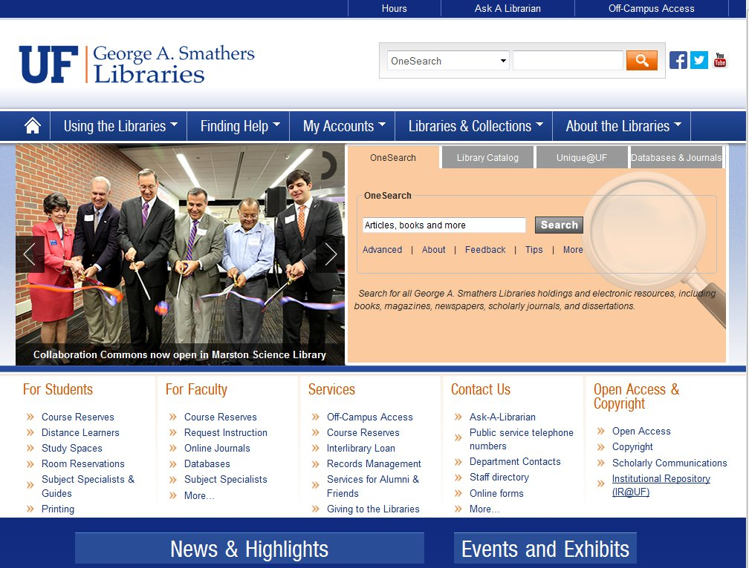
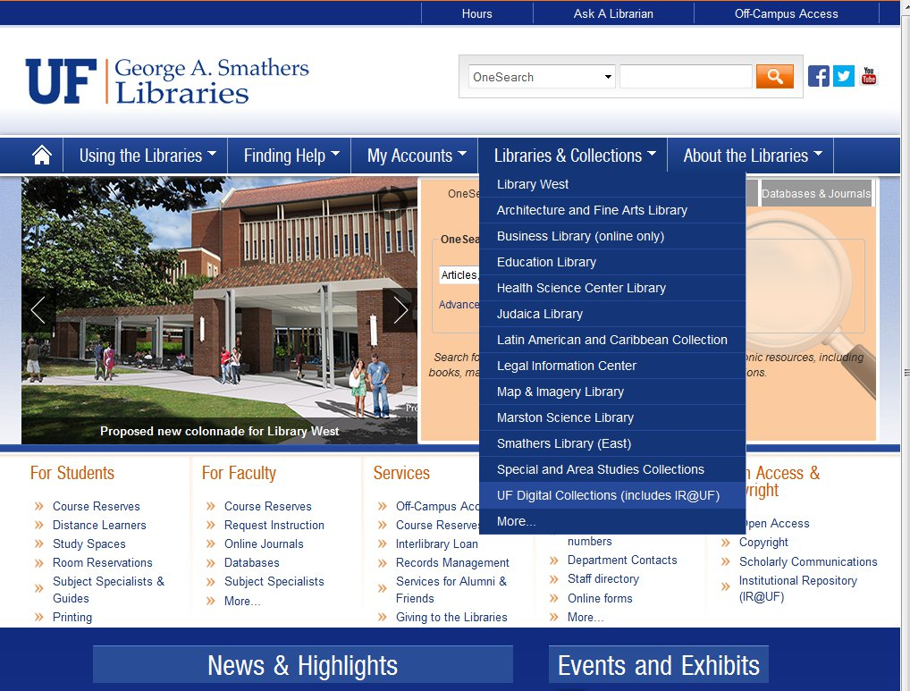
How do I find the IR@UF? From the library main page

Slide 7
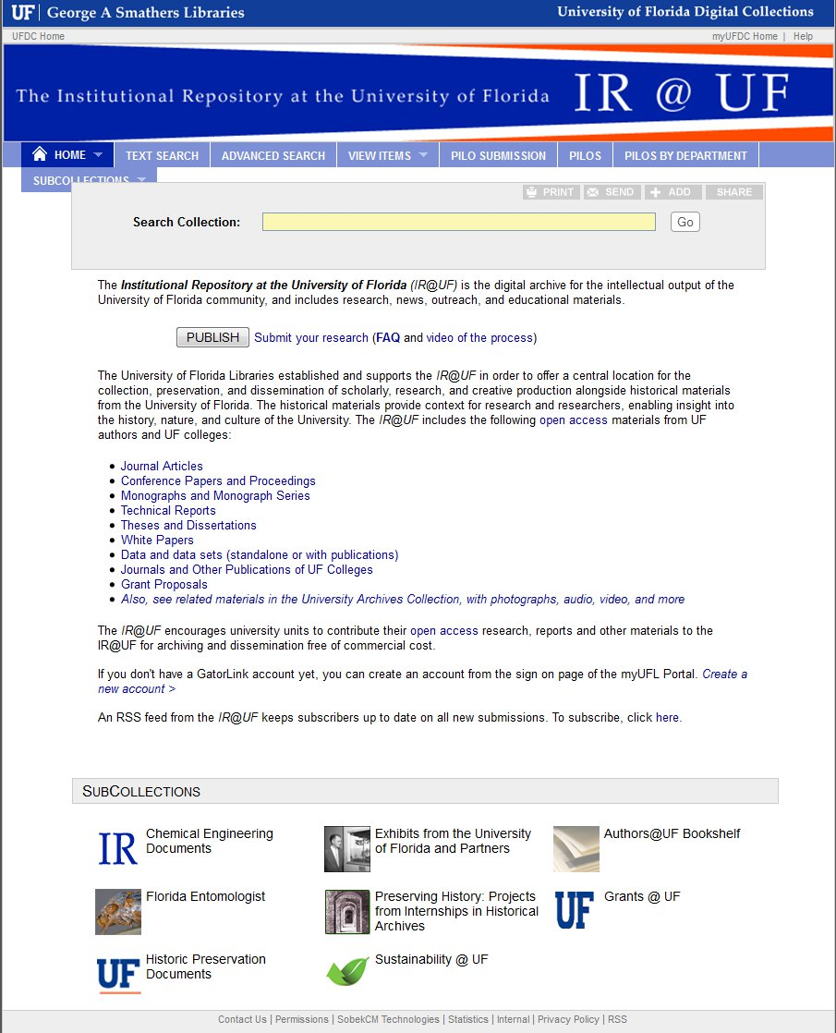
Notes:
http://ufdc.ufl.edu/ir

Slide 8
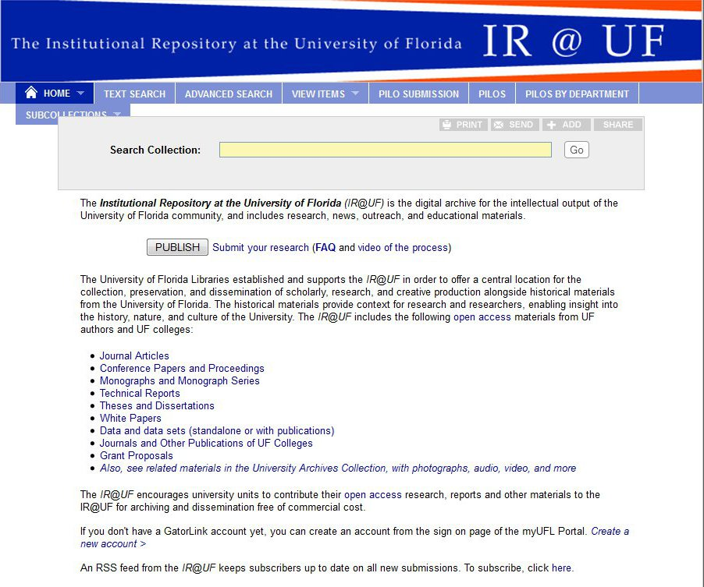
Types of Materials in IR@UF
Journal Articles
Conference Papers and Proceedings
Monographs and Monograph Series
Technical Reports
Theses and Dissertations
White Papers
Journals and other Publications of UF Colleges
Grant Proposals
>> Link to University Archives
Notes:
http://ufdc.ufl.edu/ir
Based on item type, and a few select collections (ETD for theses and Dissertations; IRGrants for grant proposals)

Slide 9
SubCollections in IR@UF
Notes:
http://ufdc.ufl.edu/ir
A separate collection – can have its’ own banner, and can be curated separately.
Example: Florida Entomologist http://ufdc.ufl.edu/flaent
Authors @ UF Bookshelf - http://ufdc.ufl.edu/facultybookshelf

Slide 10
How to Search collections in IR@UF

Slide 11
What can go in to the IR@UF?
If you can answer yes to all these questions, it is ok to be included in IR@UF.
Is the item complete?
Is it scholarly content created by member(s) of the UF community?
Do you retain the rights to post the material?
These are not the ONLY things that can go in the IR@UF, however if you can’t
answer “yes” to all these questions, additional research may be required.
Notes:
Complete – does not necessarily mean the final copy. This could be a pre-print version, etc. It does mean that the copy you are posting is as done as it is going to be, with no more changes expected. Any updates to the item would result in a new version of the item, with it’s own record. The file itself, once uploaded, is designed to stay there.
Members of the UF community, include faculty, students and staff – as long as one of the content creators is of the UF community, the IR can be it’s home.
Scholarly content is a bit harder to define, but it is something that has scholarly value. Examples include articles, research, theses and dissertations, data sets, reports, conference proceedings, posters and grant proposals. Something like departmental meeting minutes or items mandated to be retained only for a certain period of time may have a better home in the University Archives.
Rights Copyright could belong with the creator, with the institution, or, depending on the contract terms, with a publisher. Certain items, like government publications (think IFAS) do not fall under copyright. Co-creator items, each creator has rights over the item. It is up to the submitter to verify they have the rights to post the material in a public, online form.

Slide 12
What if my item is…
Incomplete or “in process” ?
Institutionally related, but a non educational item?
Important to the institution, but is not created by members of the UF Community?
Something I wrote, but I’m not sure I still have the rights to post it?
Contact Us, we’ll help you figure out your options:
Your library liaison
The IR Manager
The Scholarly Communications Librarian

Slide 13
My item is ready to be included in IR@UF... Now What?
To upload materials into the IR@UF, you need the following:
Log-in to myUFDC
File(s) you are going to upload
Description of item (Metadata)
Creator
Title
Material Type
Date
Etc.

Slide 14
How do log in to the IR@UF?
Direct Link to the IR@UF log in page
http://ufdc.ufl.edu/my/logon
From the IR@UF Main Page
http://ufdc.ufl.edu/ir
Click the “Publish” button
Click the “Submit your research” link
From any page in UFDC collection (including IR@UF)
Click on “myUFDC”

Slide 15
How to log in to IR@UF? From IR@UF main page

Slide 16
IR@UF Welcome Screen: what to expect
Notes:
If you currently see the screen on the right, please let me know, and I will update your permissions so you can submit new items.

Slide 17
How to Upload Items: Step 1: Grant of Permissions

Slide 18
How to Upload Items: Step 2: Item Description
The only required fields are Title and Material Type
However, as soon as you click “Submit” at the end of Step 3, your item is live, and available to the public
It is better to include as much description up front to aid people in finding your work

Slide 19
How to Upload Items: Step 2: Item Description - some handy tips
Material Type options include: Book Chapter / Conference Papers / Conference Proceedings / Course Material / Data Set / Journal Article / Technical Reports
If your work isn’t any of these, select “other” and use the “Specify Type” field.
Material Type is required.
Publication Status options include: In Press/ Published / Unpublished
Publication Status is optional
If you need an additional instance of a field, click the green plus next to it.

Slide 20
How to Upload Items: Step 3: Upload Files (optional)

Slide 21
How do I make changes to my item?
Log in to myUFDC
Open item
“View all my submitted items”
Use unique identifier after the base: http://ufdc.ufl.edu/
Three areas to make changes
Edit Metadata
Edit Behaviors
Manage Files
Navigate to these selections using the gray bar at top, or drop down from “Manage” tab.

Slide 22
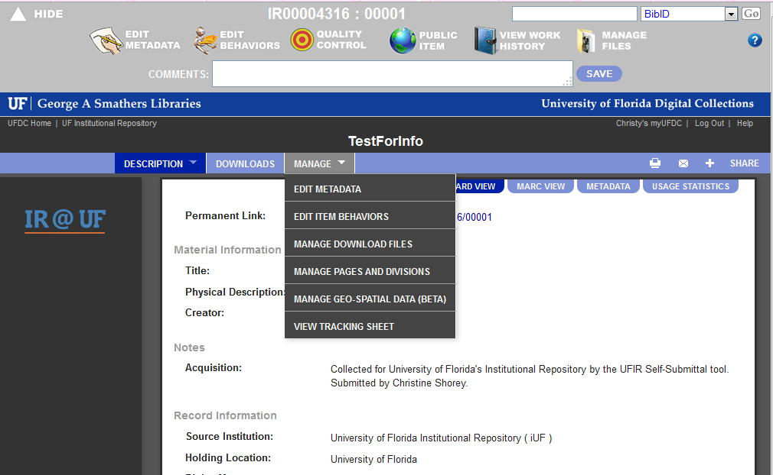
Notes:
You can access the record from the gray bar at the top, or the “Manage” drop down list. We will be looking at Edit Metadata, Edit Behaviors, and Manage Files

Slide 23
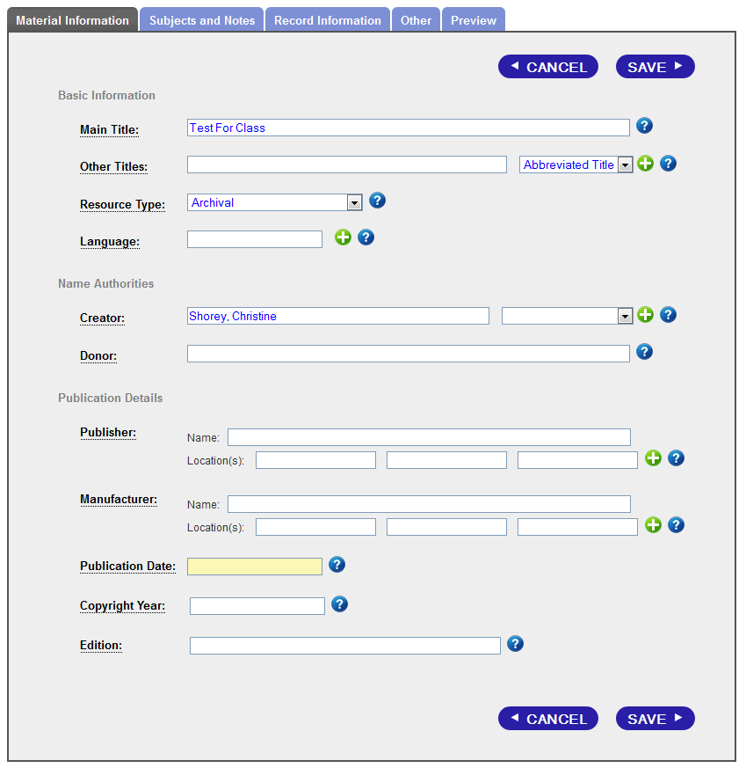
Metadata: Material Information
Describes the original work.
Some fields may have been captured on original form: Title, Creator, Resource type, Publisher Name, Publisher Location and Publication date
Other fields are new: Language, Donor, Manufacturer Name, Manufacturer Location, Copyright Year, Edition

Slide 24
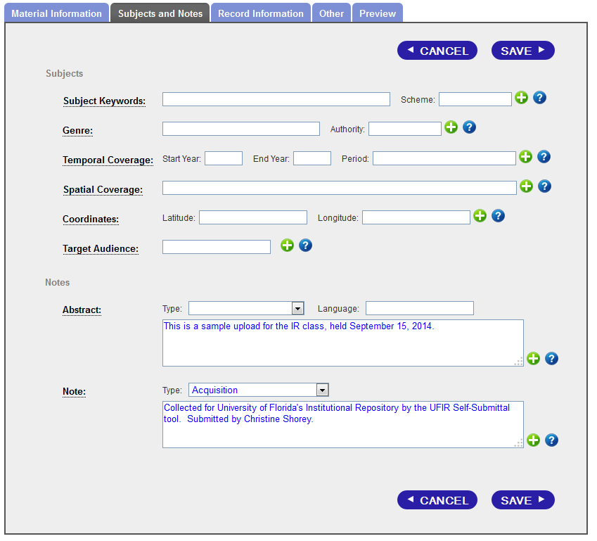
Metadata: Subjects and Notes
Describes the content.
Some fields may have been captured on original form: Abstract, Note
Some fields are filled in automatically: Acquisition Note
Other fields are new: Subject Keywords, Genre, Temporal Coverage, Spatial Coverage, Coordinates, Target Audience

Slide 25
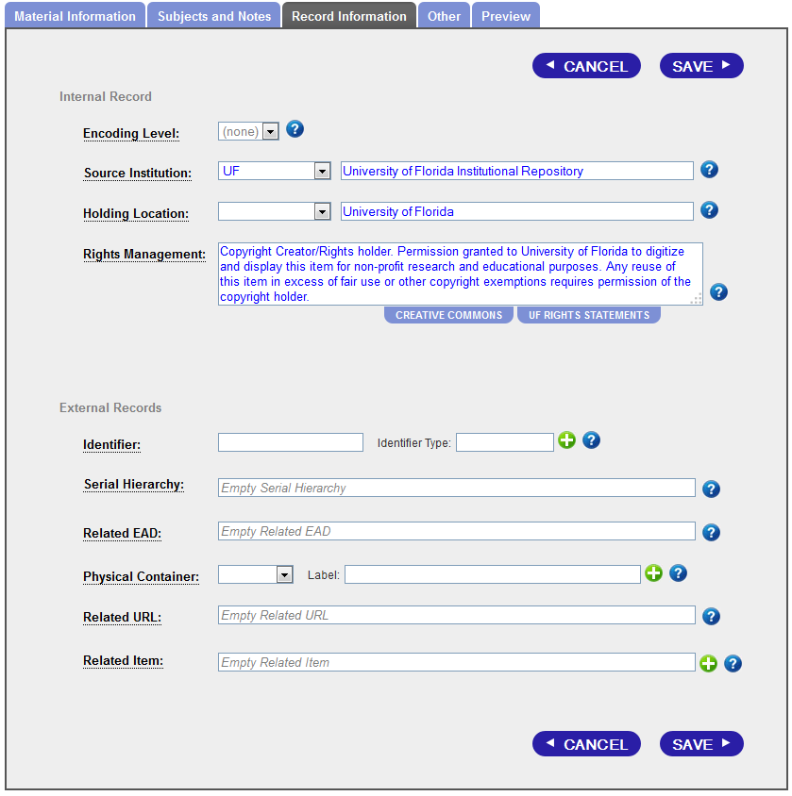
Metadata: Record Information
Describes the record.
Most of the Internal Record fields are filled in automatically
Rights Management: Tells the user who owns the rights to the material, and how they can use it. A default is in place for self-submitted items, but you can change it to a Creative Commons statement, or other UF Rights Statement.

Slide 26
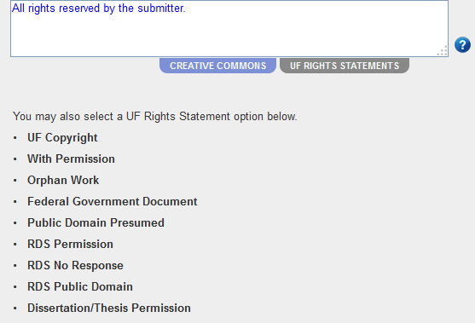
Metadata: Rights Management
Creative Commons
UF Rights Statements

Slide 27
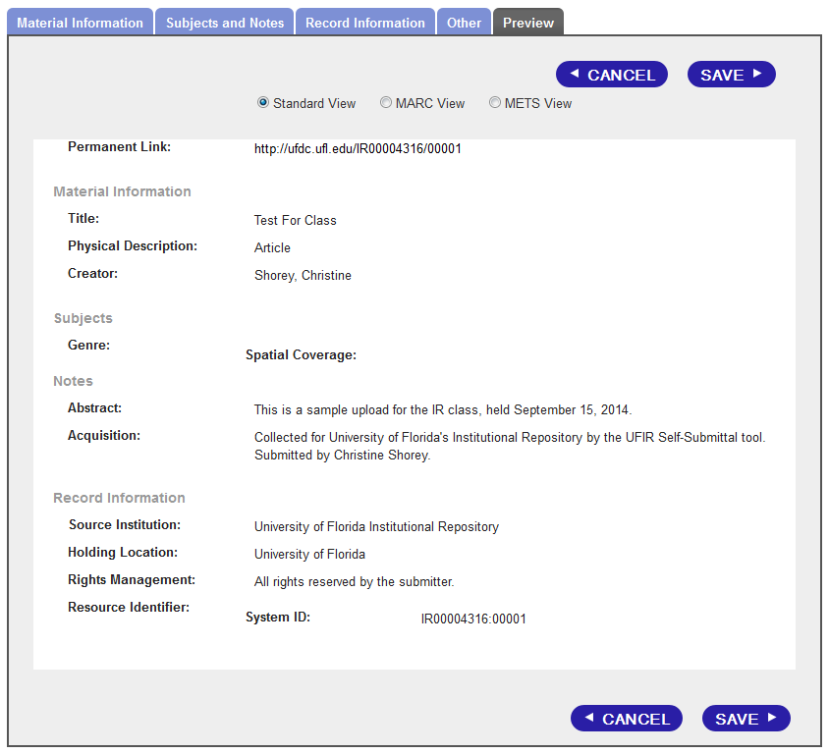
Metadata: Preview
Allows you to see what the record looks like before you save any changes you’ve made to the metadata.

Slide 28
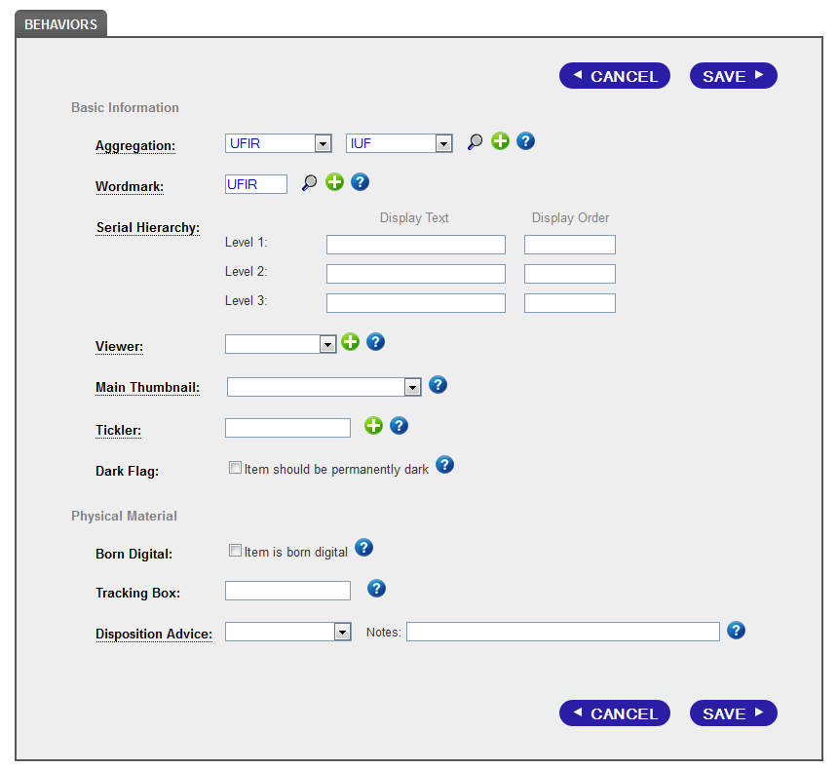
Behavior
Describes the how the item acts.
Aggregation – collections it belongs to
Wordmark – logo on the page
Serial Hierarchy – Used to describe levels of serial items.
Notes:
Many of these fields do not apply to self-submitted items, or born digital items. The same form is used for all collections in the UFDC (University of Florida Digital Collections)

Slide 29
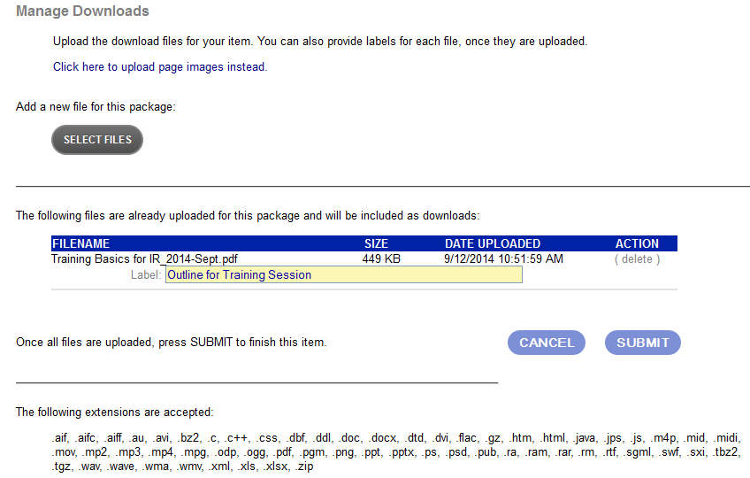
Manage Downloads
Lets you work with the files of a record.
Lets you add additional files
Lets you pick how item is called (Label) on download screen
List of accepted file types at bottom of page.
If you are submitting individual pages (e.g. TIFFs) there is a link at top of the page

Slide 30
QUESTIONS?
For more information, contact:
Your library liaison/ subject specialist
http://apps.uflib.ufl.edu/staffdir/SubjectSpecialist.aspx
IR Manager, Christy Shorey
IRManager@uflib.ufl.edu
chrshor@uflib.ufl.edu
(352) 273-2831
Scholarly Communications Librarian, Christine Fruin
christine.ross@ufl.edu

