Slide 1
Baldwin library digital collections
http://ufdc.ufl.edu/juv
Notes:
Created by: Dhanashree Thorat
For grant project: http://ufdc.ufl.edu/AA00011752/00001

Slide 2
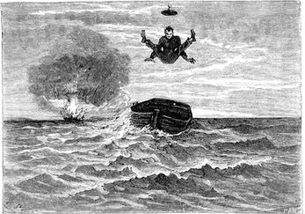
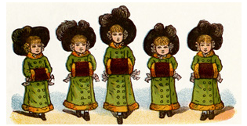
AGENDA
Current status and collection goals
Contents
Functionality
Resources for assisting students
Continuing the conversation
By The Sea
Notes:
By The Sea, St. Nicholas Magazine

Slide 3
OVERVIEW OF COLLECTIONS
Goal: supports scholarship on a variety of topics related to literature printed primarily for children
Current Status: 100,000+ volumes published in Great Britain and the United States, diversity of material
Uniqueness of Collections
Daniel Defoe’s Robinson Crusoe and the Robinsonades
Afterlife of Alice and Her Adventures in Wonderland
St. Nicholas Magazine
Notes:
GOAL: supports scholarship on a variety of topics related to literature printed primarily for children. education and upbringing, family and gender roles, civic values, racial, religious, and moral attitudes, literary style and format, and the arts of illustration and book design.
“Acquire and collect books, original artwork/proofs, and manuscript collections that support the teaching and research at the University of Florida and the Center for Children’s Literature and Culture as well as areas that are the focus of interdisciplinary departments.”
CURRENT STATUS: 130,000+ books and manuscript collections, including ephemera such board games and puzzles. Published in Great Britain and the United States, diversity of material
UNIQUENESS: Second largest collection with 800 early american imprints, English and American editions of the same work – comparative work possible. One of top two collections in the nationally and internationally. Over half of the books are unique. One of the two largest contributors to the International Children’s Digital Library.
“Based on collection holdings, manuscript holdings, digital holdings/presence, the Baldwin Library ranks second. We are second in collection holdings, with the exception of Early American books where we rank first, we are third in manuscript holdings, and we are second in digital presence.”
CURRENT COLLECTING PRIORITIES
- Manuscript collections of authors, illustrators, publishers, editors, and literary agents
- Books on illustration, illustrators, or books featuring work by prominent children’s literature illustrators
- Books produced from the British colonies
- Graphic novels

Slide 4
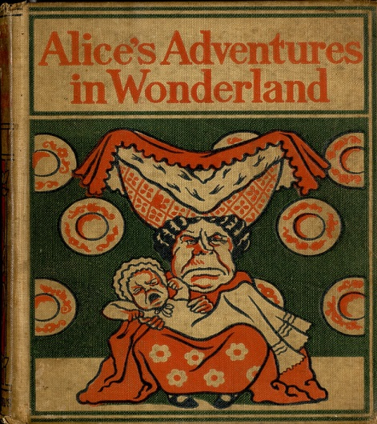
COLLECTIONS CONTENT
Material
Publishers
Scope
Time Span
Format
Location
1897, Altemus Print
Notes:
http://ufdc.ufl.edu/UF00076723/00001
Material: mainly literature: stories, fables, juvenile biography, adventure stories, alphabet books, juvenile periodicals. Also supports study of visuals, illustrations.
Publishers: American Sunday School Union, American Tract Society, Babcock, Blackie, Cassell (Cassell & Co.; Cassell Publishing Co.; Cassell, Petter & Galpin), Cromwell, Thomas Y., Darton, William (W. Darton & Son; Darton & Co.; Darton & Clark), Dean (Dean & Son), Dutton, Griffith & Farran, Harper (Harper & Brothers), Harris, John (J. Harris & Son), Lee & Shepard, Lothrop, Macmillian, McLaughlin Brothers, Massachusetts Sabbath School Society, Methodist Episcopal Church, Murray, John, Nelson, Nistor, Religious Tract Society, Routledge, Society for Promoting Christian Knowledge, Sunday School Union, Raphael Tuck, Ward, F. Warne, S. Wood, Young
Scope: supports scholarship on multiple topics. education and upbringing, family and gender roles, civic values, racial, religious, and moral attitudes, literary style and format, and the arts of illustration and book design
Time Span – early 1600s to present day. Second largest collection with 800 early american imprints
Format: text, image
Location: housed under Baldwin Library Collections. Not all material is online. All digitized material is based on print material available – comparative study possible.
300 editions of Robinson Crusoe,
100 editions of Pilgrim's Progress, fables, juvenile biography,
19th century science and natural history,
19th century alphabet books, moral tales, fairy tales,
19th century juvenile periodicals,
19th century boys' adventure stories,
20th century boys' and girls' series, Little Golden Books, and juvenile publications of the American Sunday School Union and other tract societies.

Slide 5
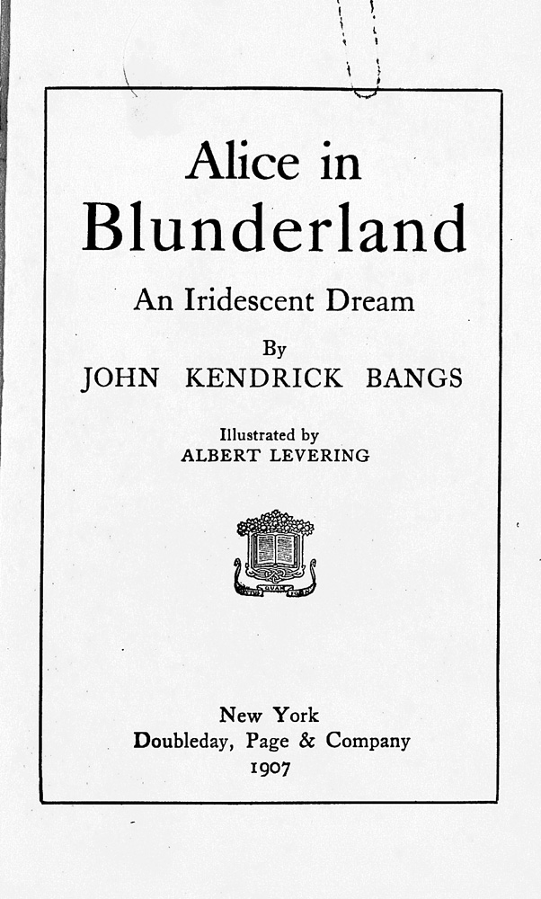
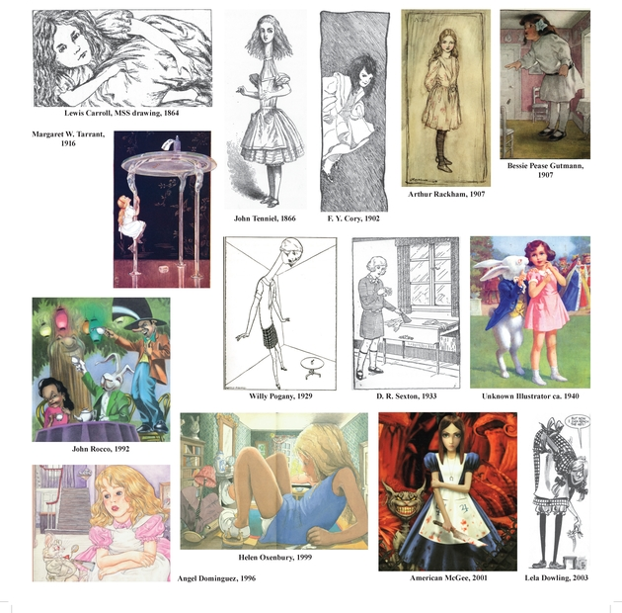
COLLECTIONS CONTENT: ALICE
Covers
Comparative study
Notes:
http://ufdc.ufl.edu/UF00077415/00003
300 editions of Robinson Crusoe,
100 editions of Pilgrim's Progress, fables, juvenile biography,
19th century science and natural history,
19th century alphabet books, moral tales, fairy tales,
19th century juvenile periodicals,
19th century boys' adventure stories,
20th century boys' and girls' series, Little Golden Books, and juvenile publications of the American Sunday School Union and other tract societies.

Slide 6
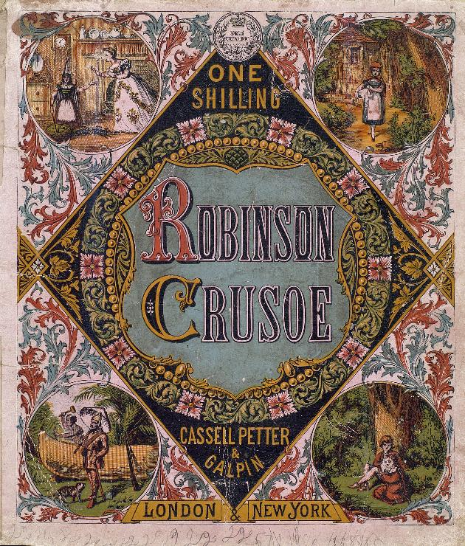
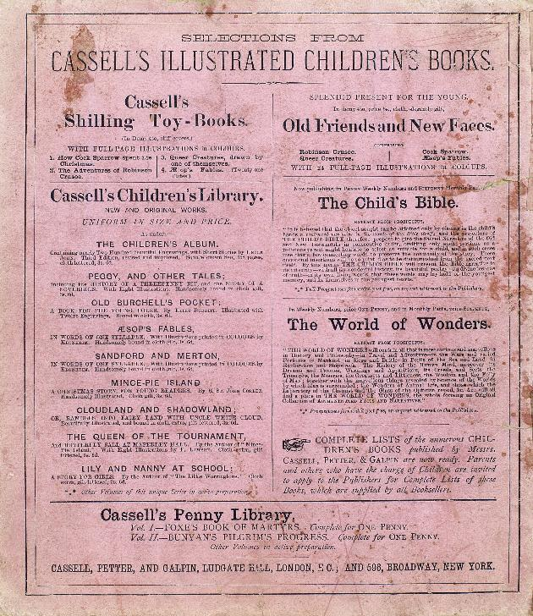
COLLECTIONS CONTENT: crusoe
Hidden Treasures:
Advertisements at the back
Notes:
http://ufdc.ufl.edu/UF00073565/00001
Robinson Crusoe, 1868-78
Hidden treasures. Book of poetry from 1860. on the back, advertisements

Slide 7
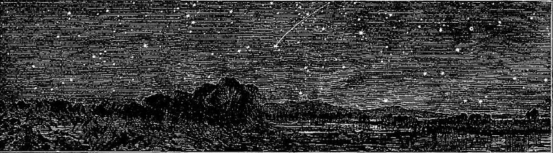
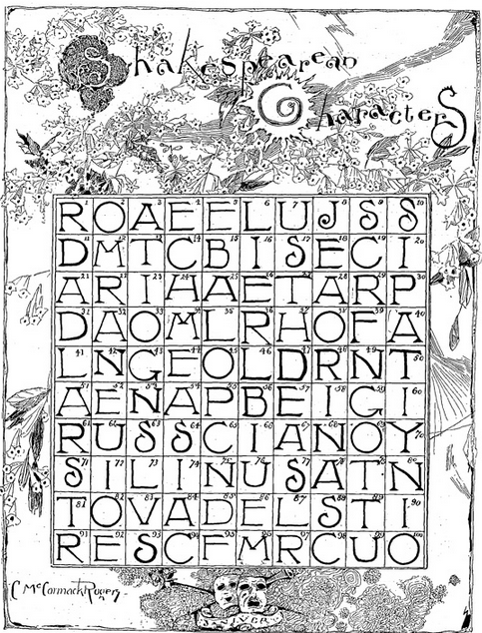
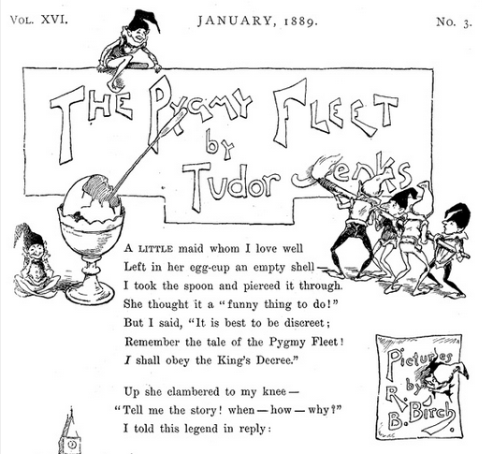
COLLECTIONS CONTENT: St. Nicholas
Notes:
http://ufdc.ufl.edu/UF00065513/00002
http://ufdc.ufl.edu/UF00065513/00208
Volumes from 1830 – 1905
Essays, poetry, stories, etc

Slide 8
SIGNIFICANCE
Rock stars: Arthur Rackham, Salvador Dali, Edward de Beaumont
Cross-continental and period studies
Publishers
Interdisciplinary
Notes:
Rock stars: nice collection of Arthur Rackham illustrated books and many from the Golden Age of Children’s Literature (exhibit), Salvador Dali’s Alice in Wonderland, Edward de Beaumont’s Cinderella
Cross-Continental and Period Studies – books are from both Great Britain and United States (often dual editions) and also from British colonies, period range from 17th century to present day, many comparative editions
Publishers: Heavy emphasis on religious tract publishers, Golden Press, J. M. Dent, Appleton Co, individual printers, Scribner’s, Harper
Interdisciplinary: Cultural studies, history, history of book/printing, women’s studies, art/art history, American and British studies, Education

Slide 9
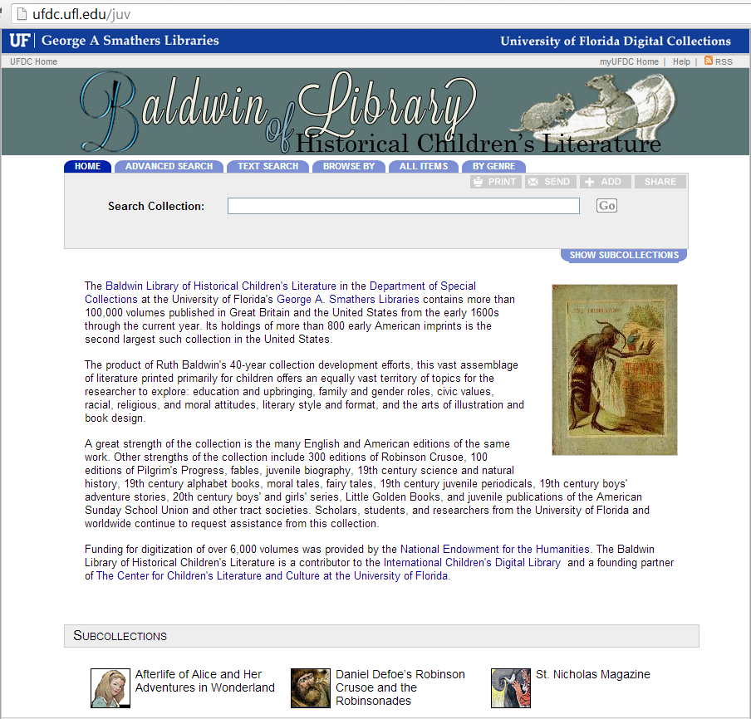
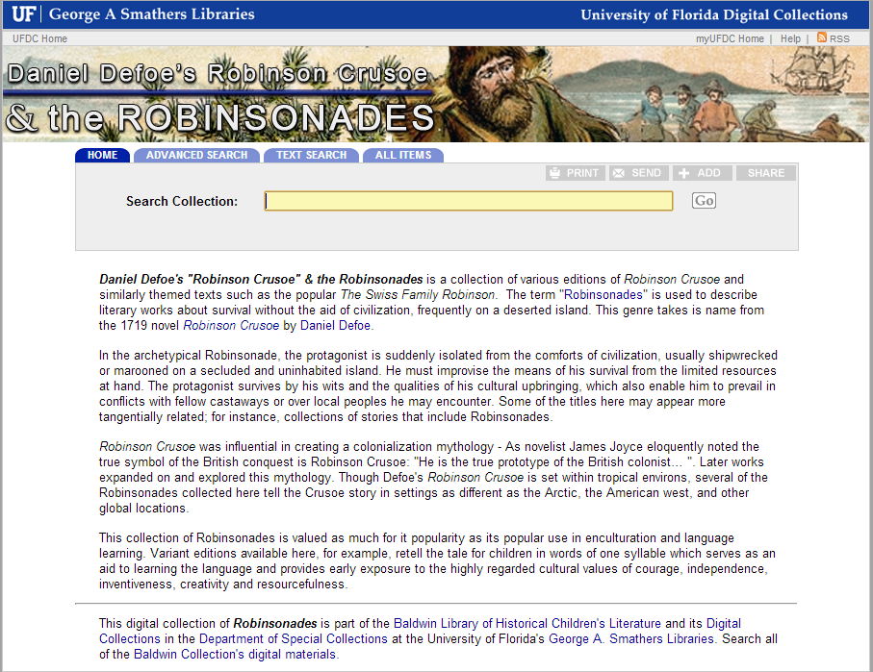
FUNCTIONALITY

Slide 10
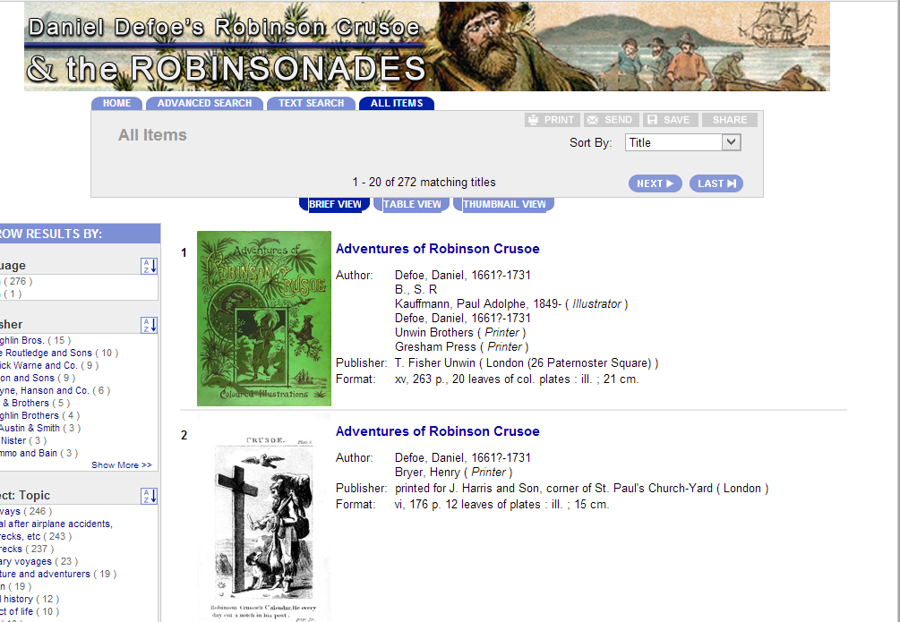
Search: ALL ITEMS

Slide 11
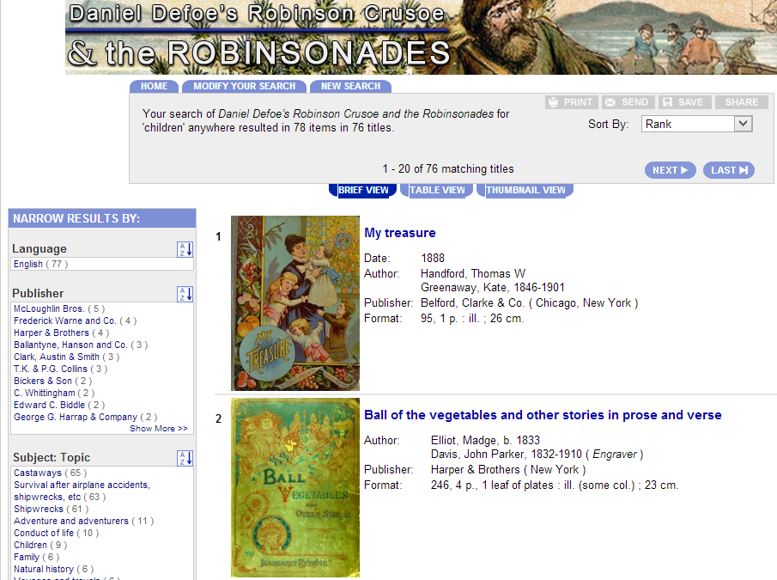
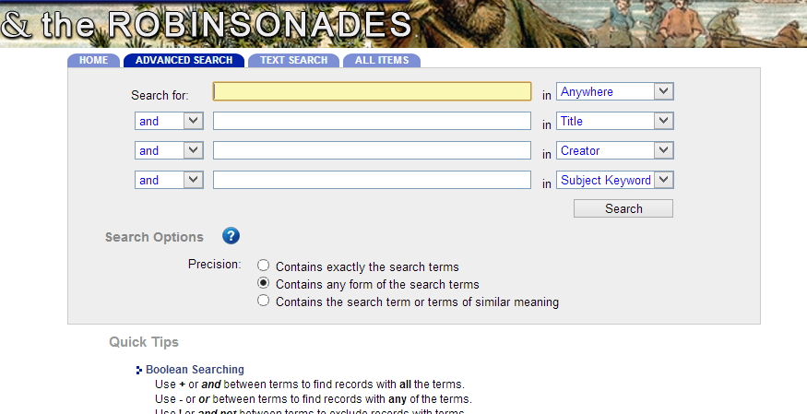
Search
Specific Search
Advanced Search

Slide 12
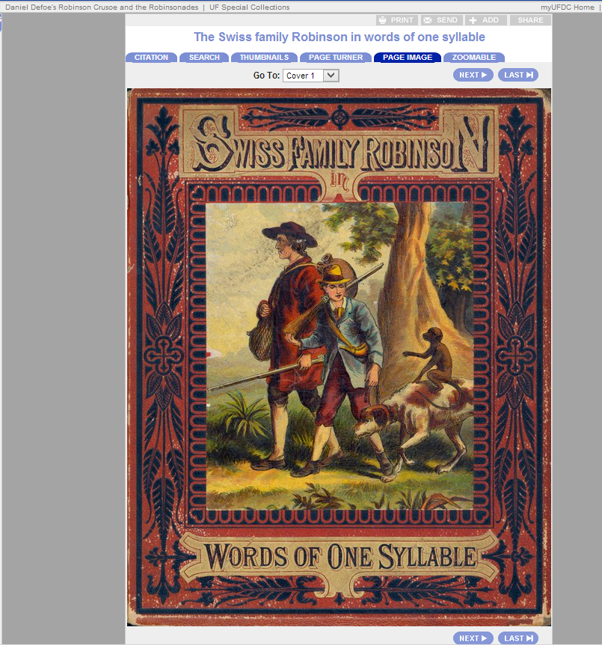
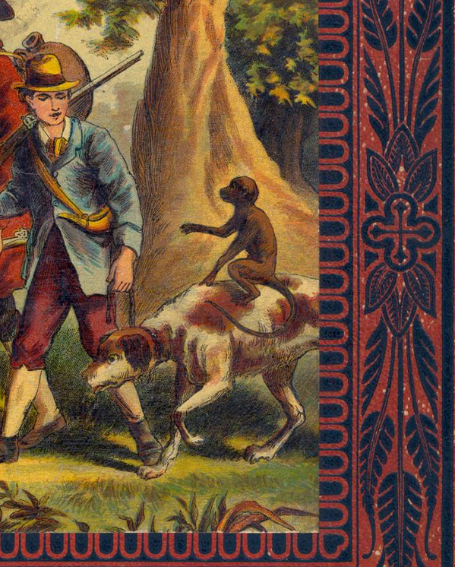
PAGE FUNCTIONALITY
Zoomable
Notes:
http://ufdc.ufl.edu/UF00053431/00001
1884, McLoughlin Print

Slide 13
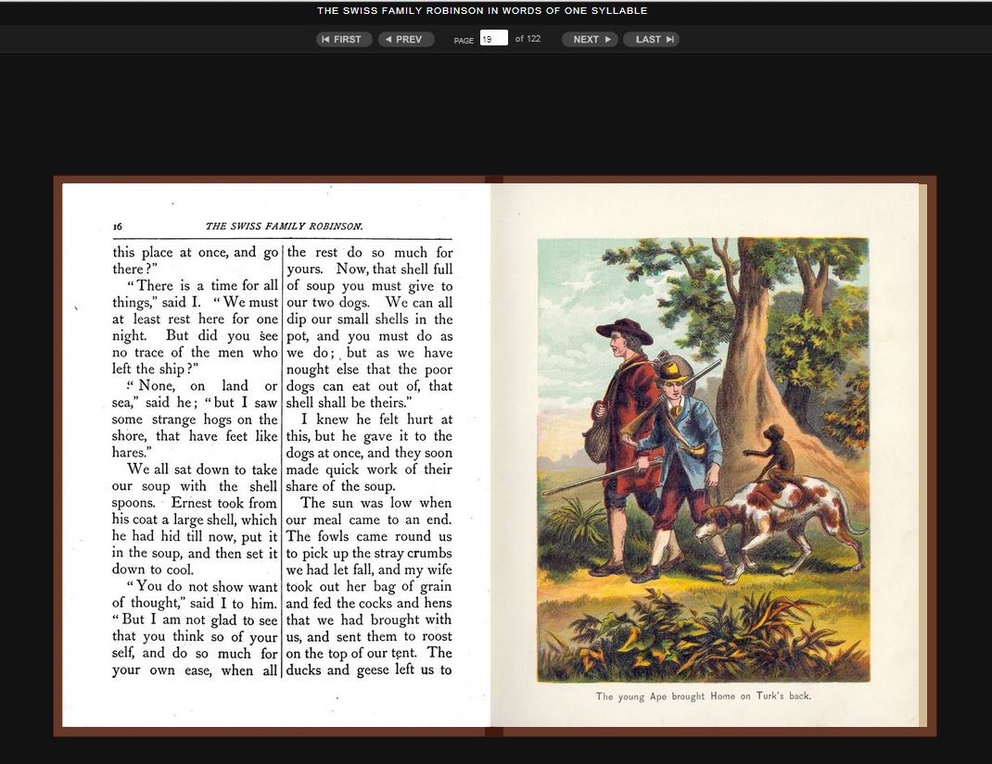
Page Turner

Slide 14
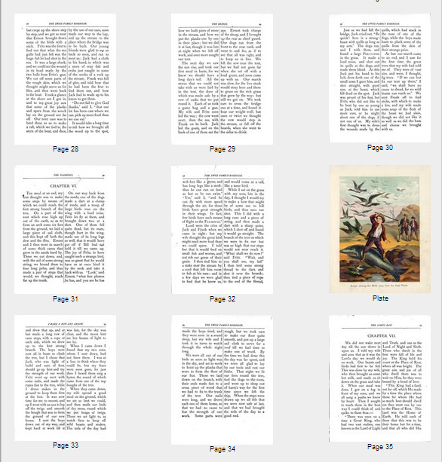
Thumbnail View
Notes:
Point out publishers, pub date, place of publication – these details are important for some scholars
(Not all items have thumbnail view available)

Slide 15
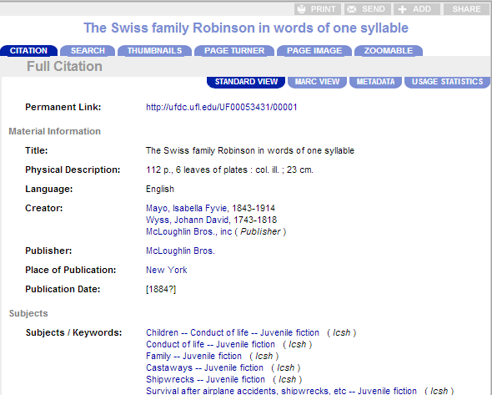
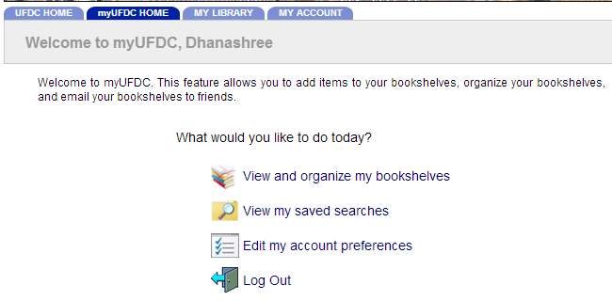
Resources For RESEARCH
Citation & myUFDC
Notes:
Point out publishers, pub date, place of publication – these details are important for some scholars

Slide 16
FAQ
Can you digitize my book? How long will it take?
Can you tell me the name of a children’s book where I don’t remember the title or author?
Can you tell me the value of my book or an item in my collection?
Can I use an image from the Baldwin in my scholarly publication? In a student project? In a newsletter?
How do I compare the digital and the print collections?
Notes:
Can you tell me the value of my book or an item in my collection?
The University of Florida cannot make such a valuation. For books, a used or rare book dealer in your area may be able to take a look and give you an idea of edition and any other pertinent information. Also, there is a website www.rbms.info that will give you some information. You could also searchwww.abebooks.com which is a site where used and rare book dealers post their books, and see if another copy is for sale and if so, what information is available. For collectibles, the Smithsonian Institution's Encyclopedia Smithsonian (http://www.si.edu/Encyclopedia_SI/id-obj.htm)provides an overview on identifying and valuing collectible objects. The page includes links to several appraisal organizations and a reference list of helpful books and magazines.
Can you tell me the name of a children's book where I don't remember the title or author?
It is very difficult to identify a book without a title or an author. There are many people who search for books from their childhood and they can only remember a character's name, or the general idea of the story. To aid with these sorts of questions some booksellers maintain archives of previous quests for remembered children's books. This site has helped others in the past with many questions already answered in the archives and new questions are shared for the community to assist with answers: http://www.loganberrybooks.com/stump.html
Can I use an image from the Baldwin in my scholarly publication? In a student project? In a departmental newsletter?
Yes. Unless additional restrictions are noted, copyrighted electronic materials in this collection may be used for research, instruction, and private study under the provisions of Fair Use. Fair Use is a provision of United States Copyright Law (United States Code, Title 17, section 107) which allows limited use of copyrighted materials under certain conditions. Under Fair Use you may view, print, photocopy, and download images from this site without prior permission, provided that you provide proper attribution of the source on all copies. For any other use of these electronic materials, including but not limited to display, publication and commercial use, permission of the copyright holder must be obtained.
Also, if this is for a publication, exhibit, event, or similar, please let us know when the publication featuring the image is published so that we can promote the use of our materials.

Slide 17
Baldwin Library Digital Collections
http://ufdc.ufl.edu/

