Slide 1
The NIH Public Access Policy
Health Science Center Libraries
University of Florida
6/05/2013

Slide 2
Outline
About the Policy
Requirements
Methods of Submission
Journal policies
Copyright & Embargo Periods
Understanding the terminology
How to Comply
Primary Systems to Use
My Bibliography (via My NCBI)
The NIH Manuscript Submission System (NIHMS)

Slide 3
The NIH Public Access Policy
Full-text articles resulting from NIH funding must be submitted to PubMed Central.
Peer-reviewed manuscripts must be
submitted to PubMed Central when accepted for publication.
accessible to the public by 12 months after publication.
Includes articles
accepted for publication after April 7, 2008.
resulting from grants active after October 2007.
Starting spring 2013, the NIH will hold processing of non-competing continuation awards if publications arising from grant awards are not in compliance with the Public Access Policy.
Publishing in an open access journal or institutional repository does not meet the Policy requirements.

Slide 4
Who Must Comply
Criteria for Submission
Peer-reviewed
Accepted for publication on or after April 7, 2008
Arises from direct NIH funding:
NIH grant or cooperative agreement active in FY2008 or beyond
NIH contract signed on or after April 7, 2008
NIH Intramural Program
NIH employee
Written using the Latin alphabet (that used for English - not Chinese, Russian, Arabic, etc.)
The grant Principal Investigator (PI) is ultimately held responsible but the author must complete the submission process.
Notes:
The NIH will hold processing of non-competing continuation awards if publications arising from grant awards are not in compliance with the Public Access Policy (starting in 2013)
If a PI is not in compliance on an earlier grant, review of any new grant proposal may be delayed.

Slide 5
Submission Methods
The journal will deposit all final published articles in PubMed Central automatically and you don’t have to do anything. http://publicaccess.nih.gov/submit_process_journals.htm
The journal will deposit your final published article, but you must request that they do so (may require a fee). http://publicaccess.nih.gov/select_deposit_publishers.htm
You deposit the final peer-reviewed manuscript yourself via NIH Manuscript Submission System (NIHMS, http://www.nihms.nih.gov/) with journal permission. All responsibility for submission is yours.
The journal will initiate the submission process for final peer-reviewed manuscripts by depositing them, but you must complete the submission process in the NIHMS. http://publicaccess.nih.gov/select_deposit_publishers.htm

Slide 6
More on Submission Methods
 | Method A | Method B | Method C | Method D
Version of Paper Submitted | Final Journal-Formatted Article | Final Journal-Formatted Article | Final Peer-Reviewed Manuscript | Final Peer-Reviewed Manuscript
Task 1: Who deposits the paper? | Publisher direct to PMC | Publisher direct to PMC after author request | Author or delegate, via NIHMS | Publisher, via NIHMS
Task 2: Who approves paper for processing? | Not Applicable | Not Applicable | Author, via NIHMS | Author, via NIHMS
Task 3: Who approves paper for Pub Med Central display? | Not Applicable | Not Applicable | Author, via NIHMS | Author, via NIHMS
Participating journal/publisher | Method A Journals | Make arrangements with these publishers | Check publishing agreement | Make arrangements with these publishers
From: http://publicaccess.nih.gov/submit_process.htm

Slide 7
Copyright Issues
Check all publication or copyright transfer agreements before signing to ensure submission to PubMed Central is allowed. Journals vary widely in how they handle this policy.
The NIH provides an example of the kind of language that can be added to a copyright agreement at http://publicaccess.nih.gov/FAQ.htm#778.
More Author Rights Resources:
The SPARC Addendum: http://www.arl.org/sparc/author/addendum.shtml
ScienceCommons and its “Addendum Generator”: http://www.sciencecommons.org/resources/faq/authorsaddendum
Author Rights In UF’s Copyright LibGuide: http://guides.uflib.ufl.edu/content.php?pid=32772&sid=2475398

Slide 8
“Embargo” Periods
The NIH allows up to 1-year post-publication for appearance of the full-text article in PubMed Central (PMC).
Many journals require that authors wait for some or all of that 12-month period before allowing the article to be made available in PMC.
Some journals pre-arrange that with PMC (i.e. Methods A & B journals), others require the author to enter the embargo period when the author does the submission process (Methods C&D journals).
Always verify this requirement with the journal.
Do NOT wait until the end of the 1-year post-publication period to submit, as there is processing time required. Submit upon acceptance for publication and inform the NIH of any required embargo period during the submission process.

Slide 9
PubMed vs. PubMed Central
PubMed and PubMed Central are two different databases.
PubMed
Is a database of article citations & abstracts.
Having your article listed in PubMed
Is not required for compliance.
Does not guarantee submission to PMC.
PubMed Central (PMC)
Is a database of full-text articles/manuscripts.
Will include articles not in PubMed.
Abstracts in PubMed that have corresponding full-text in PMC will be inter-linked.
Your article must be placed in PMC (not PubMed) for compliance.

Slide 10
Clarifying the ID Numbers
PMID = permanent PubMed abstract identifier
PMCID = permanent PubMed Central full-text article identifier
NIHMSID = temporary manuscript submission identifier given to an author who self-submits a manuscript to the NIHMS system
The PMCID is required for compliance.
Temporary NIHMSIDs will be replaced by permanent PMCIDs.
NIHMSIDs are good for 3 months.
Not all articles with PMCIDs will have PMIDs.
PMIDs do not substitute for PMCIDs.
You can use one identifier to find another on this website.

Slide 11
How to Comply
New Article
Find out in advance what the journal’s policy is and follow it.
Journal method (A, B, C, D)
Embargo period
Use My Bibliography (My NCBI) to keep track of all your articles.
Older Articles
Enter article citations into My Bibliography (My NCBI).
Link awards to articles.
Look at citation status.
For noncompliant articles:
Look up journal, find its method (A, B, C, D).
Contact journal to either have the journal submit or get permission to submit.
When needed, submit article through NIHMS system.

Slide 12
Primary Systems to Use
My NCBI – My Bibliography
Keep track of all your publications.
View and manage both grant links and compliance status simultaneously.
NIHMS – NIH Manuscript Submission System
Use for author submission of articles.
Use for author sign-off on journal-submitted articles.
Track status of articles during submission process.
For both, use your eRA Commons/NIH login!

Slide 13
Getting an eRA Commons Account At UF
For those with NIH awards, the eRA account is created by the Proposals team in the Division of Sponsored Research (DSR).
Anyone needing an eRA account can use the request form at http://apps.research.ufl.edu/research/nihera/register.cfm.

Slide 14
Sign in to My NCBI
From any NCBI page (such as PubMed.gov): click on “Sign in to NCBI” in top right corner.
Use your eRA Commons Login.
ONLY use the NIH Login.
The first time you login, you will see this.
Select ‘By email’ NOT the default!!
Then click continue.

Slide 15
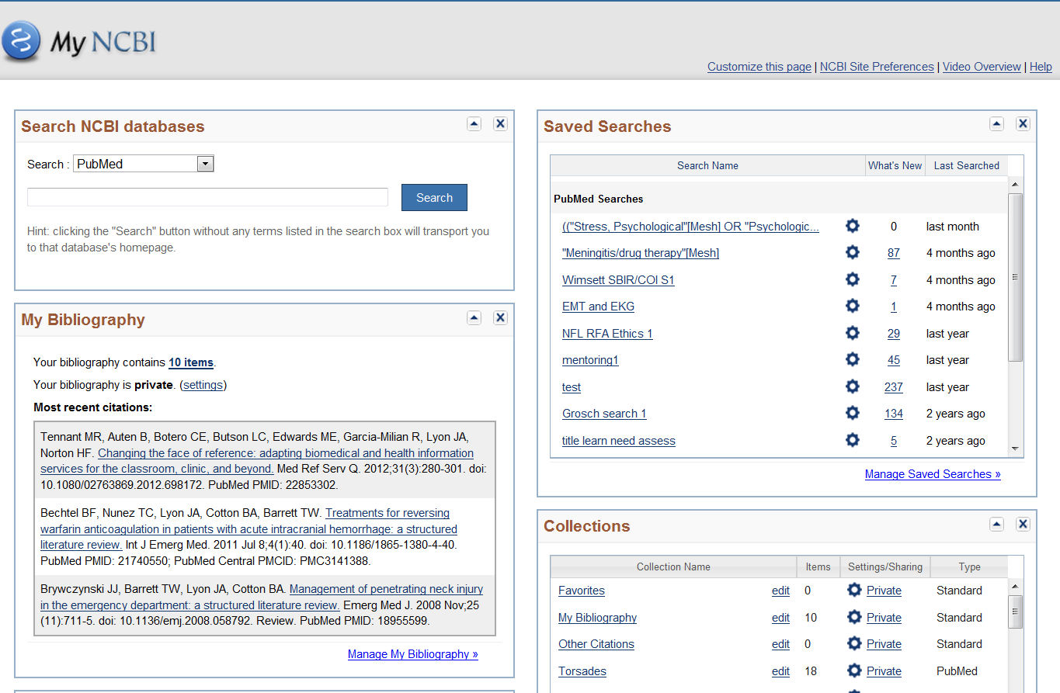
View My NCBI Page including My Bibliography.
Use the Manage My Bibliography link to view and manipulate citations, compliance status and grant links.

Slide 16
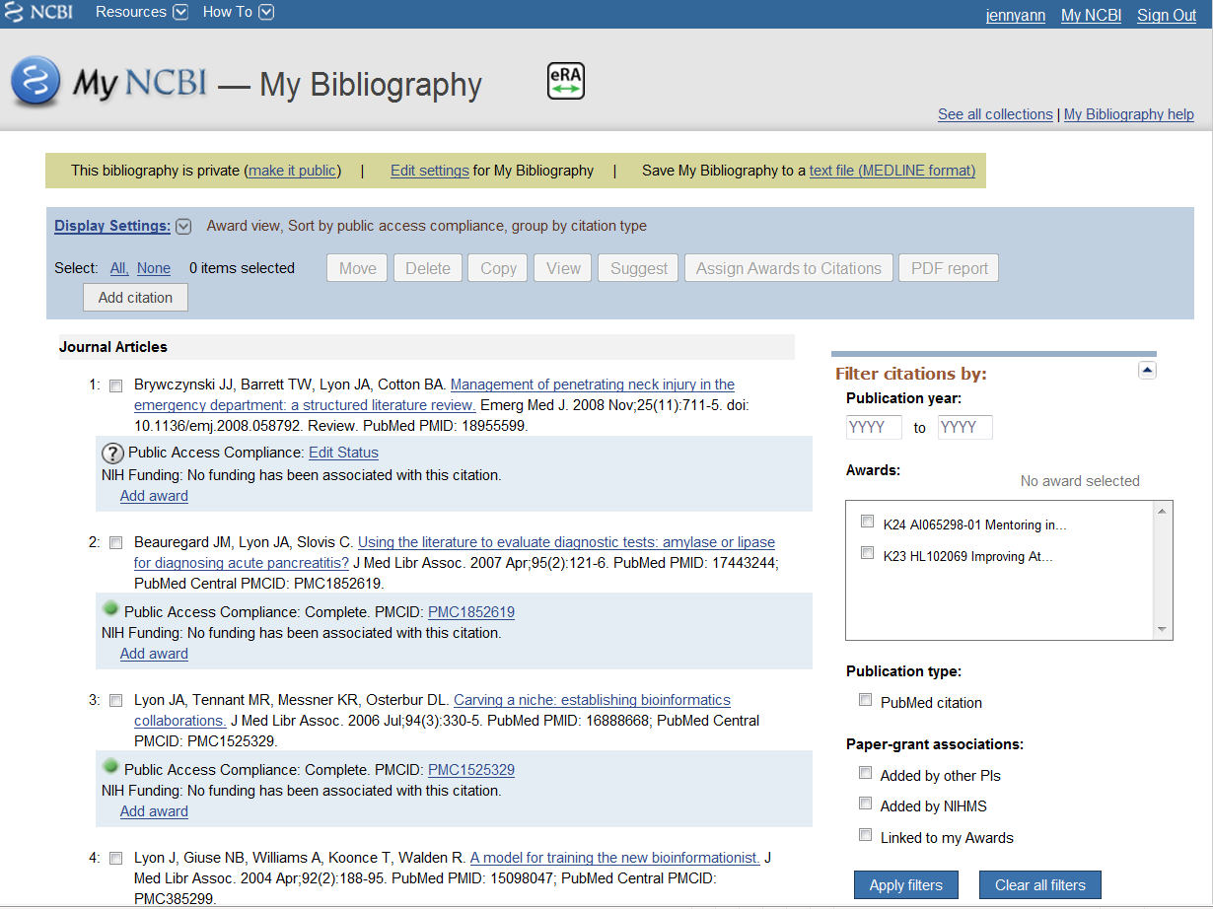

Slide 17
Adding Articles to My Bibliography
If articles are in PubMed
Be already logged in to My NCBI
Search PubMed for article
Select article(s) desired
Click on “Send to”
Click on “My Bibliography”
Save to “My Bibliography”
Go to My NCBI -> My Bibliography -> check to see if article listed
If articles are not in PubMed
At “Manage My Bibliography” website
Click “Add Citation”
From drop-down menu, select “manual citation”
Enter article information in form and click on “Add Citation”
Check to see if article is listed properly in My Bibliography

Slide 18
NIH Policy Compliance in My Bibliography
Click on Display Setting and choose:
View – Award
Sort by – Public Access Compliance
Then Click Apply
Each article will display its Compliance Status – shown in text and by symbol.

Slide 19
Compliance Status in My Bibliography
Compliance is Complete, article has a PMCID
Compliance is In Process at NIHMS, article has a NIHMSID
Non-Compliant; No PMCID
If NIHMSID available, article submission is stalled
Click on NIHMSID to enter NIHMS and check status
If no NIHMSID available, article never submitted
?
Compliance status unknown: use “Edit Status”
Compliance is not required for article; it meets exclusion criteria: use “Edit Status”
N/A

Slide 20
Edit Status
Select Yes or No for NIH funding support.
If it has support, answer the provided questions to establish compliance status.
Selecting “Begin Submission in NIHMS” will link you directly to the NIH Manuscript Submission System.

Slide 21
Linking Articles & Awards
NIH Funding section will show either
“No funding”
An Award #/Name
Use “Add award” to link funding to an article.

Slide 22
Adding an Award
Select one of your existing awards or search for another award by grant #/name or grantee name.

Slide 23
Creating an Award Compliance Report
Select the desired citations in My Bibliography.
Click “All” to select all publications.
Apply Filters
“Linked to my Awards”
Select a specific award
Select publication years
Select by paper-grant associations
Check the boxes next to the desired publications.
Click “PDF Report.”
Enter First, Middle, and Last Name and starting page number in report for the bibliography
Download the PDF.

Slide 24
Using the NIHMS
Manuscripts may be entered by
Any author
Any person delegated by the author
The author who initiated submission must perform the final approval before the manuscript is made publicly available in PubMed Central.
It is the PI who will be held responsible by NIH for lack of compliance on any specific grant award. PIs should track compliance by authors relying on their grant funding.
Slideshow demonstrations of each step of the submission process and links to FAQs are available at http://nihms.nih.gov/help/#slideshow.

Slide 25
NIHMS Login
Go to http://www.nihms.nih.gov
Click on either “Log in” or “Proceed”
Always use your eRACommons/NIH login!

Slide 26
NIHMS User Page
Submit new manuscript.
Check on status of already submitted articles or articles in process.
Search for article by NIHMSID.

Slide 27
NIHMS: Enter Basic Information
After logging in, begin submission by
Selecting the journal name
Entering the manuscript title
Selecting all appropriate (NIH and/or HHMI) funding mechanisms that supported the manuscript.
Note that grants can be linked to articles later, but at least one NIH/HHMI funding source needs to be provided at this stage

Slide 28
NIHMS: Upload Manuscript
Upload the manuscript file(s).
Include full text, figures and all edits & modifications from peer review
Layout/formatting made by the journal for the final published version is not required
The final peer-reviewed manuscript should be submitted, unless the journal publisher has given permission to submit the final published article.
The system will generate a PDF receipt that summarizes the entered information and merges the manuscript's files into one viewable document.
Confirm that the manuscript and any additional supporting documents are correct.
If author, select release date and confirm
If delegate, author will be notified to select release date and confirm
The NIHMSID will be assigned when this is done.

Slide 29
NIHMS: Processing & Final Approval
The manuscript will be processed and converted into XML and a web version created
The author must:
Review ‘final’ web version
Request any needed corrections
Give final approval
Manuscript will be made available in PMC at selected release date

Slide 30
Final author approval confirms:
authority/right to publish this version of the manuscript in PMC
peer-review has been conducted appropriately
all edits resulting from peer-review are included
the manuscript was supported at least in part by NIH funding.

Slide 31
For More Help:
See UF’s Guide to the NIH Public Access Policy
Contact your Liaison Librarian
Health Science Center Library
Borland Library (Jacksonville)
Marston Science Library
Contact your grant administrator
Contact the NIH at PublicAccess@nih.gov or the NCBI at info@ncbi.nlm.nih.gov

