Slide 1
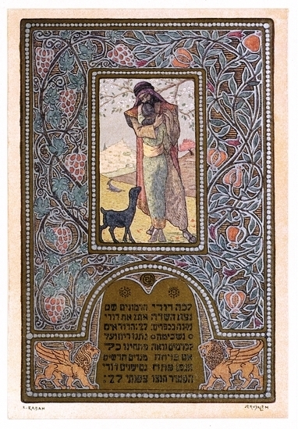
A Jewish Treasure in the Heart of Florida
The Isser and Rae Price Library of Judaica

Slide 2
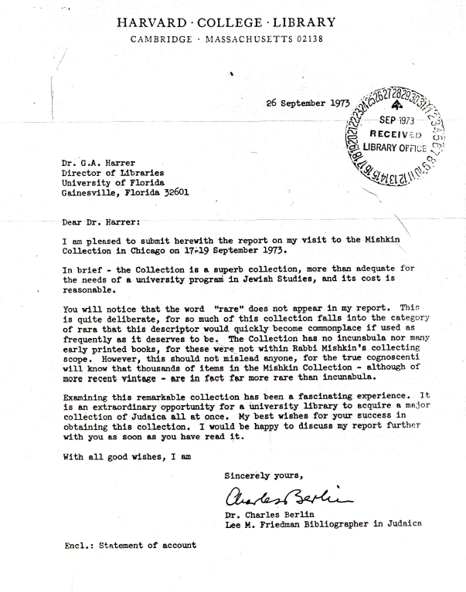
The Mishkin collection
Thousands of items in the Mishkin Collection – although of recent vintage – are in fact more rare than incunabula
In brief – the Collection is a superb collection

Slide 3
Shlomo Marenof’s library
Bereshit (In the Beginning); Moscow, 1926
illustrated by Joseph Tchaikov.

Slide 4
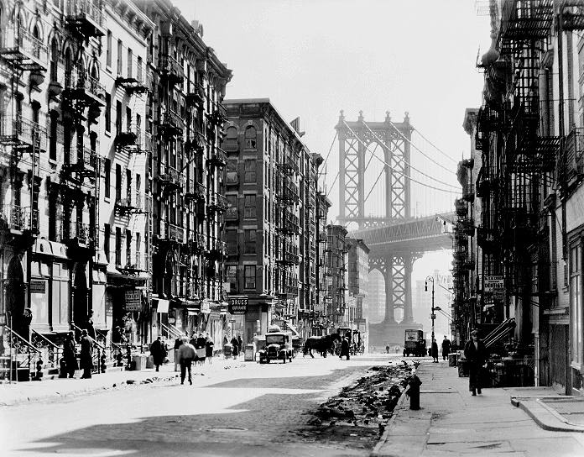
DO NOT TOUCH ANYTHING!
Morgenstern’s Bookstore

Slide 5
The Isser and Rae Price Library of Judaica
We hope our gift will be a spark
(Jack and Samuel Price)

Slide 6
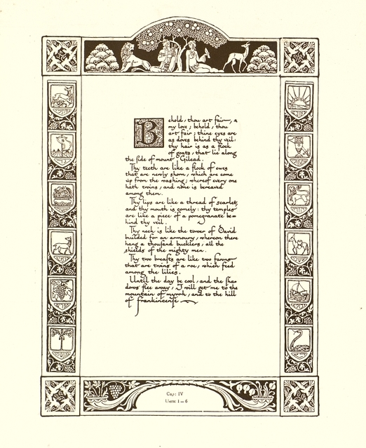
The Isser and Rae Price Library of Judaica today comprises
The 3M Collections (Mishkin,
Marenof, Morgenstern)
The Theodore H. Gaster Collection
The Rabbi Jacob H. Kaplan
Collection
Other smaller bequests, including
books from the Beth Shalom
synagogue, Jacksonville, and Rabbi
Martin Sandberg’s collection
Personal donations and gifts
Purchases made with State and
Price Endowment funds
A total of over 92,000 fully cataloged volumes

Slide 7
“The Price Library of Judaica is considered the foremost Jewish studies research collection in the southeastern United States. In terms of many of its scarce late 19th to early 20th century imprints, it ranks among the top 20 academic research libraries in the World.”
Depth
Breadth
Latin American Judaica
Florida Jewish material
Range of periodicals
Festschriften
Memorial books
Scarce imprints
Rare Judaica
Ephemera

Slide 8
The Depth of the Collection
Notes:
Palestine Statement of Policy by His Majesty’s Government in the United Kingdom
Memorandum by Leonard Stern (The Palestinian White Paper of October 1939)

Slide 9
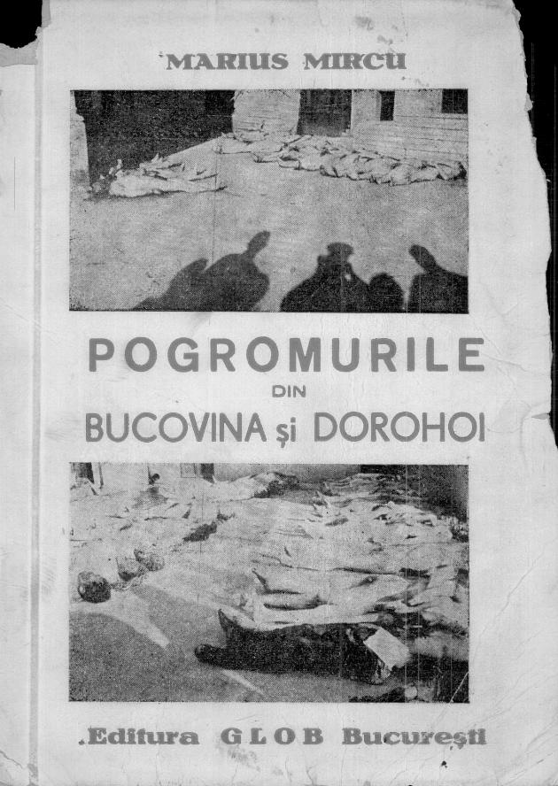
The Breadth of the Collection

Slide 10
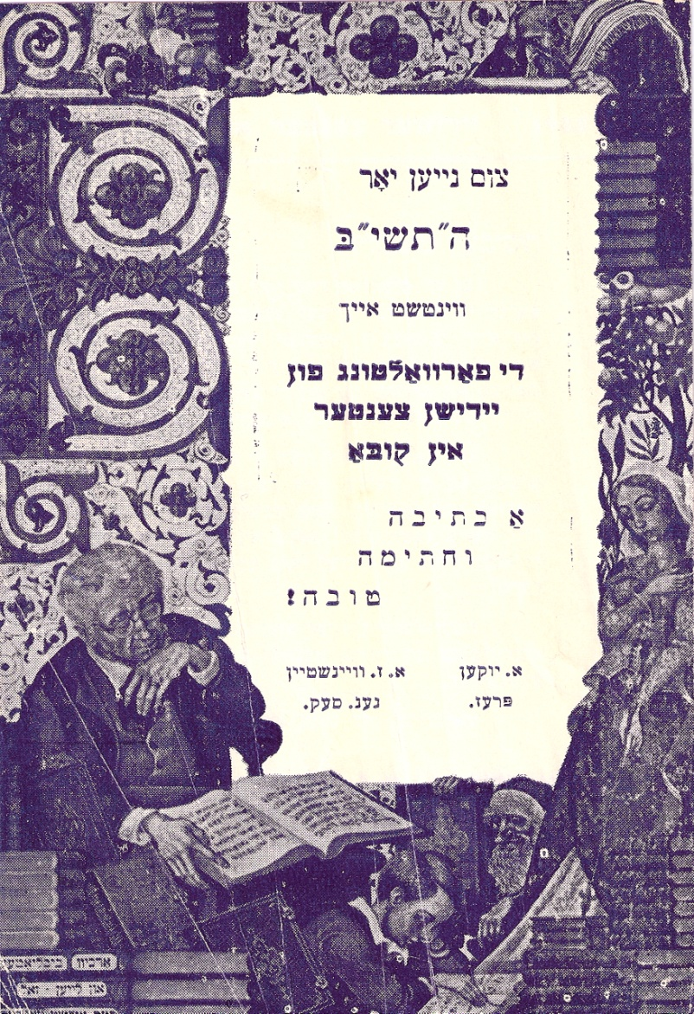
Latin American Judaica
Notes:
El Desfile de los Espectros; Havana, 196? Held by 9 US libraries
HaYoyvl-bukh fun Idishn tsenter; Havana, 1943; owned by just 3 US libraries

Slide 11
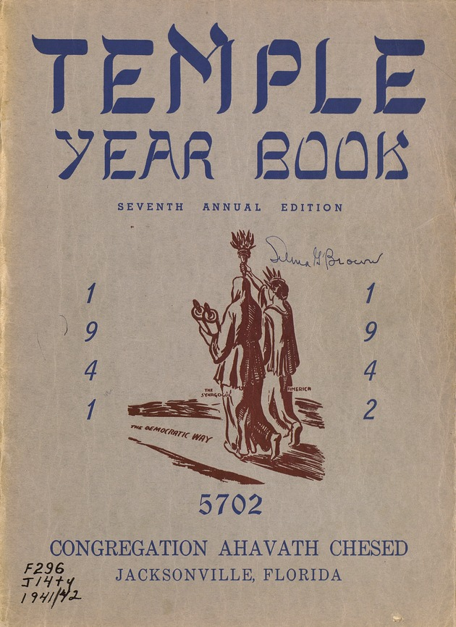
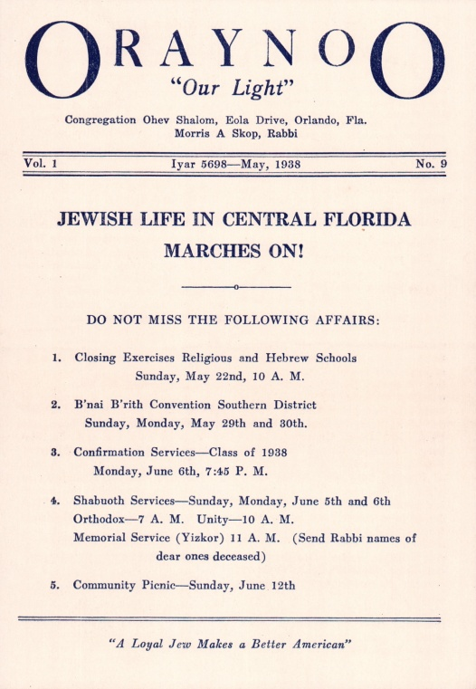
Florida Jewish Materials

Slide 12
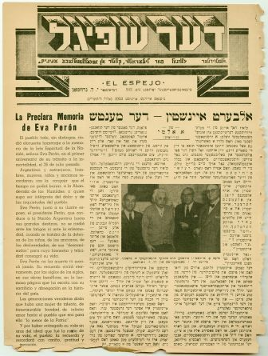
Wide Range of Periodicals
T
Notes:
Der Shpigl, Buenos Aires, 1929-; Yiddish newspaper; owned by 8 US Libraries
Teater Welt ; Warsaw, 1908-;Yiddish periodical; owned by 6 US libraries

Slide 13
Festschriften
Notes:
Dr. Maḳs Binenshṭoḳ : a zamlshrifṭ ṿegn zayn lebn un shafn; Lemberg, 1924 (tribute to Binenshtok) owned by just 6 US libraries)
The Kallah: annual convention of Texas Rabbis; Tenth Anniversary Yearbook; Houston, 1927-; entire set owned by just 5 US libraries

Slide 14
Memorial Books
Notes:
Sefer Ryki (commemorating the community of Ryki in Poland); Tel Aviv, 1973; owned by 21 US Libraries
Pinkes Varshe (a record of the Jewish community in Warsaw; Buenos Aires, 1955; owned by 27 US libraries

Slide 15
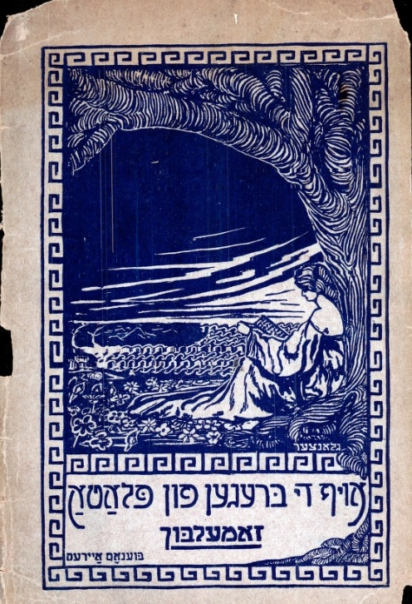
Scarce Imprints
Notes:
Jerusalem Slumbering Town; Tel Aviv, 1937; poetry illustrated with woodcuts by Jacob Steinhardt; owned by 12 US Libraries
Juedischer Almanach, Berlin, 1904; illustrated by the famous Jewish artist E. M. Lilien; owned by 15 US Libraries

Slide 16
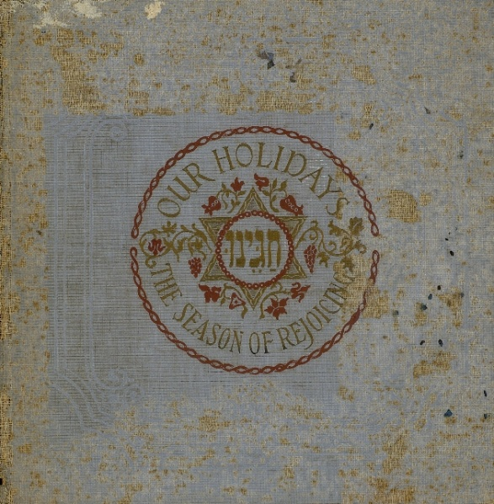
Rare Books
Notes:
Fun ale na-venadn; Buenos Aires, 1955; owned by 16 US Libraries; this edition of Yiddish poetry is a signed copy

Slide 17
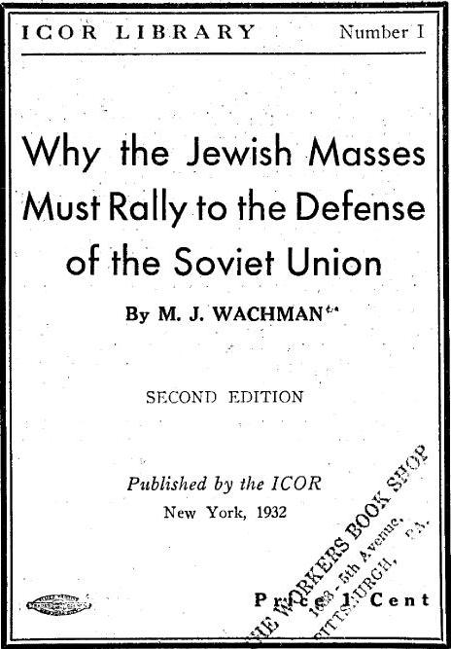
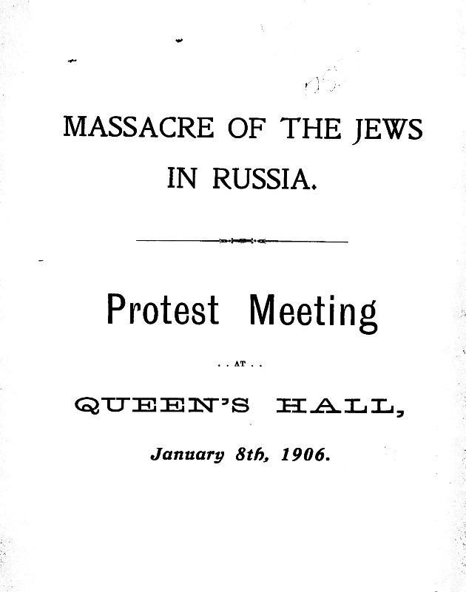
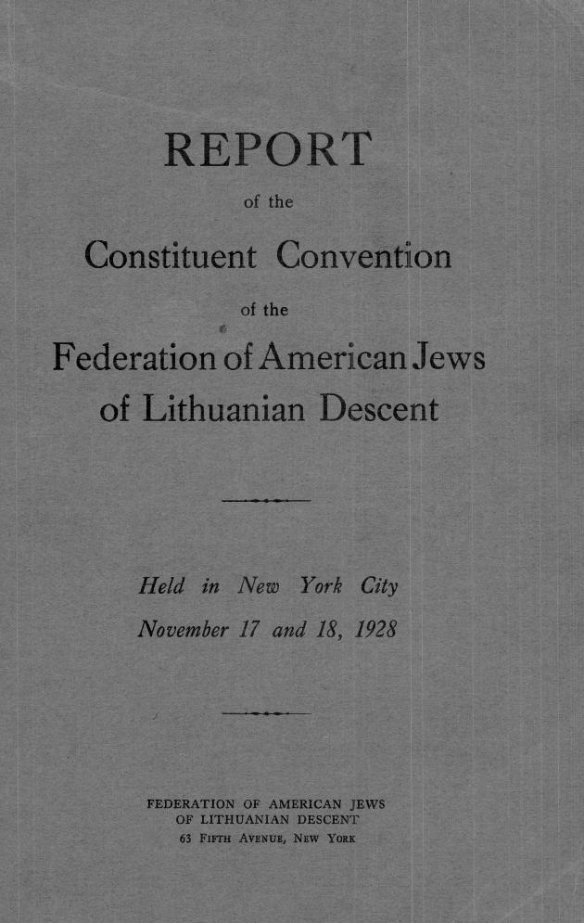
Ephemera

Slide 18
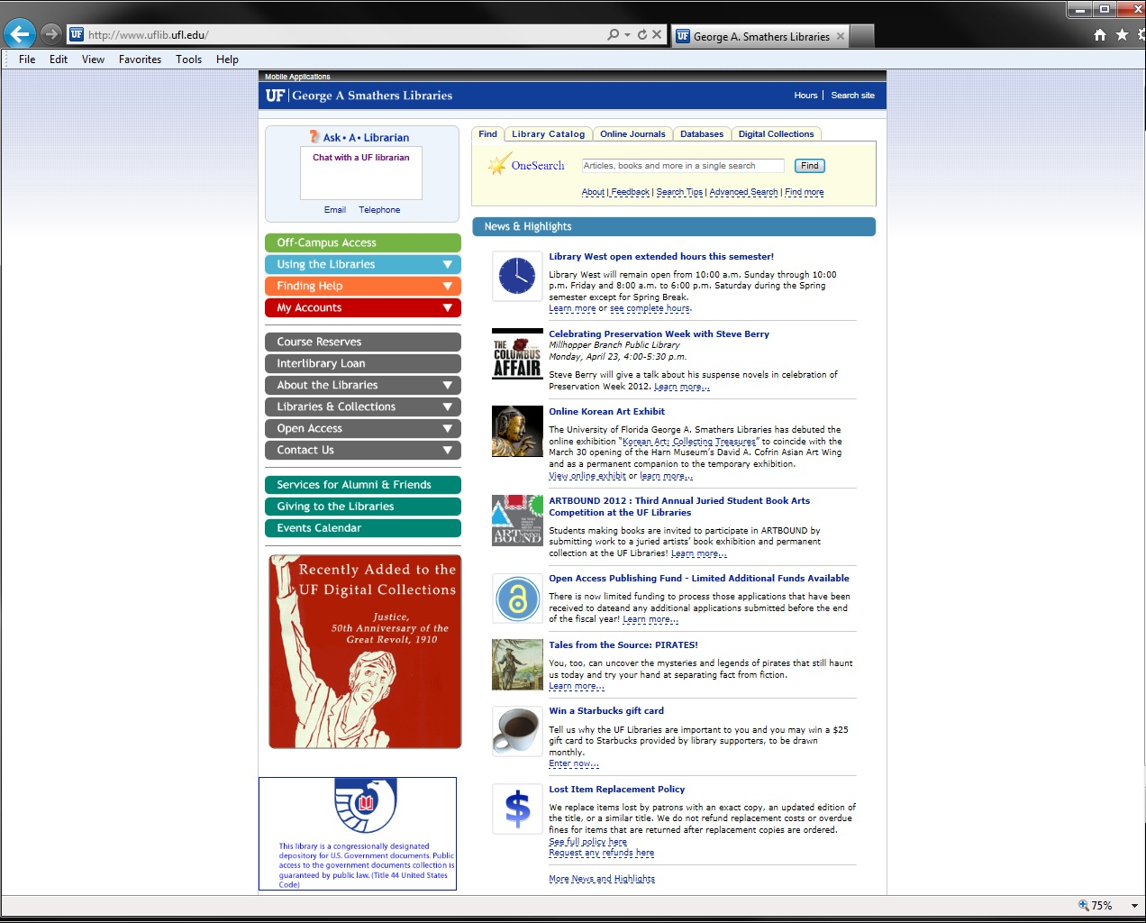
The George A. Smathers Libraries’ homepage: http://www.uflib.ufl.edu

Slide 19
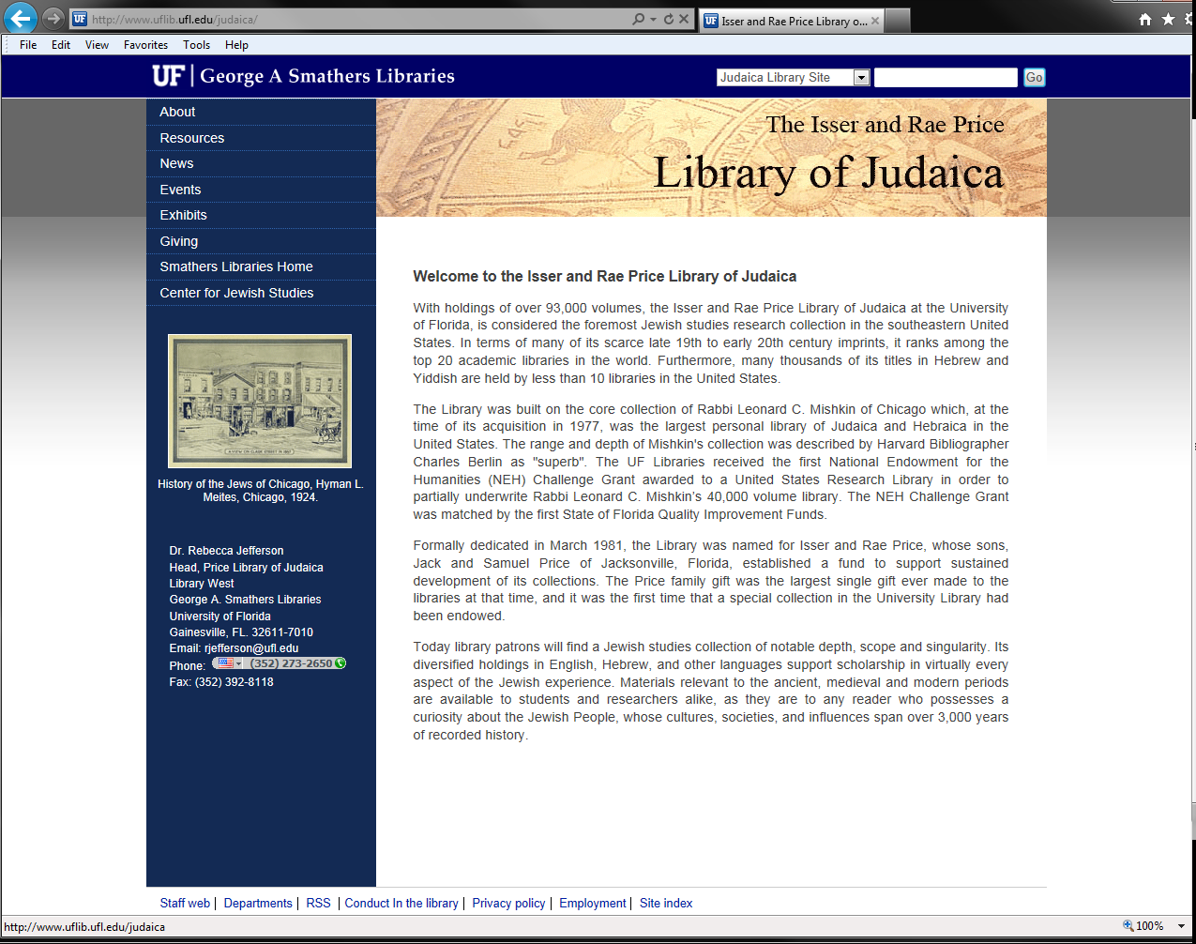
The Price Library of Judaica website
http://www.uflib.ufl.edu/judaica/

Slide 20
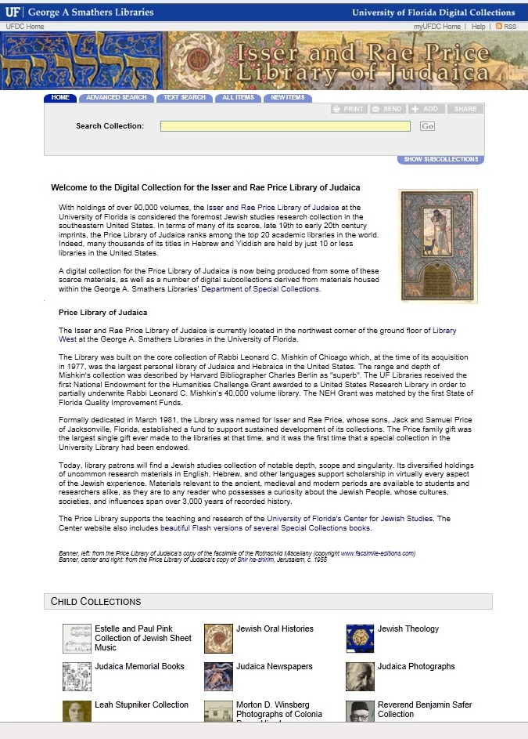

Slide 21
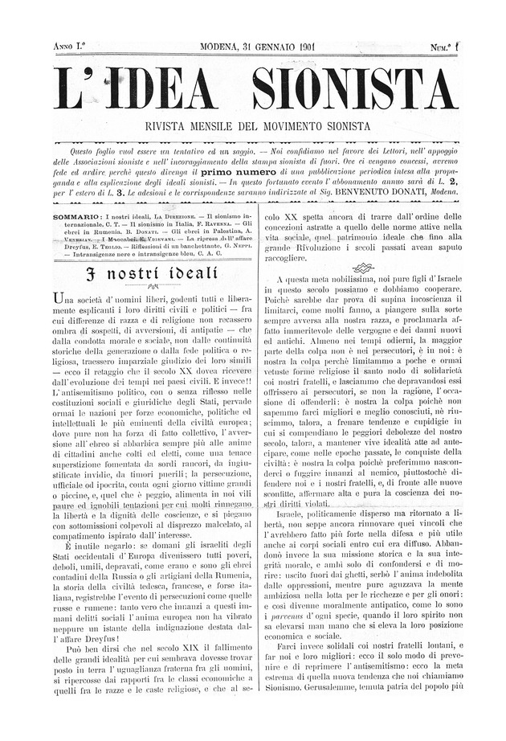
L’Idea Sionista; Modena, 1901: rare Italian Zionist journal

Slide 22
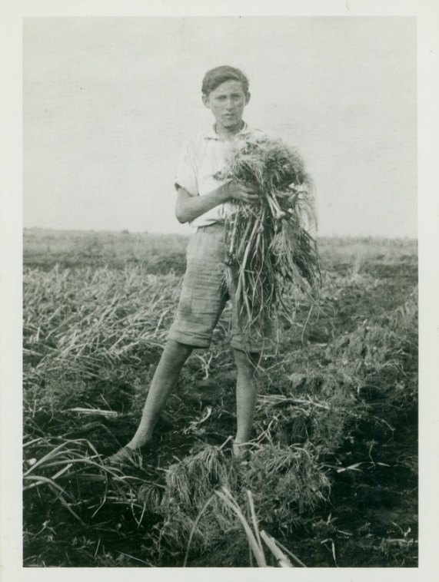
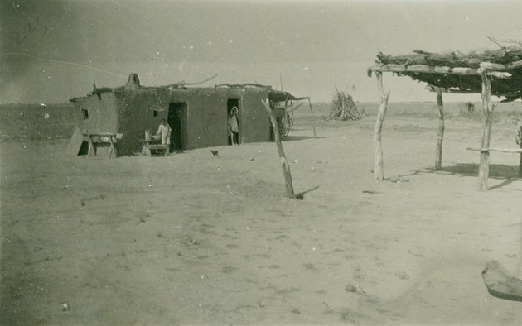
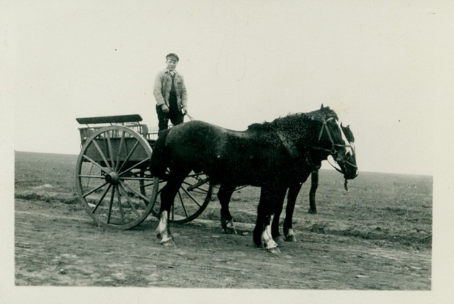

Slide 23
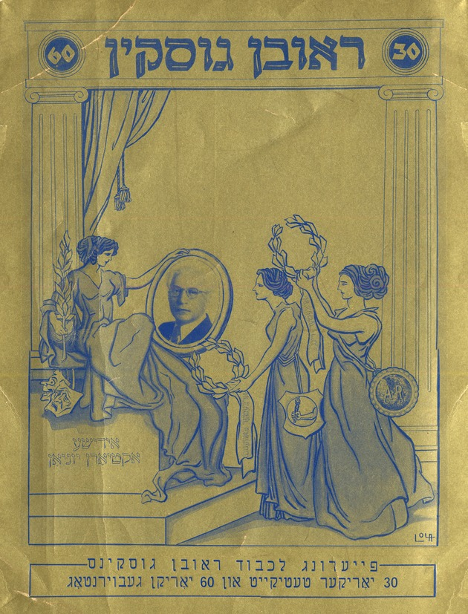
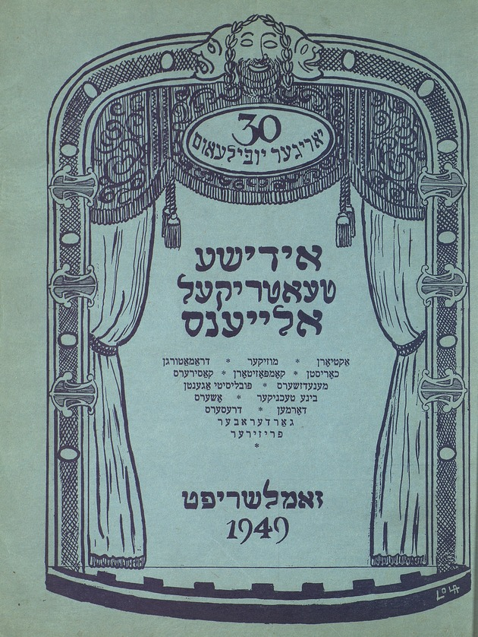

Slide 24
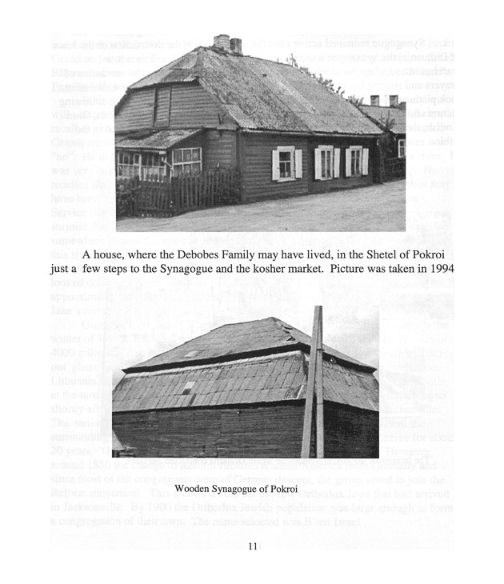
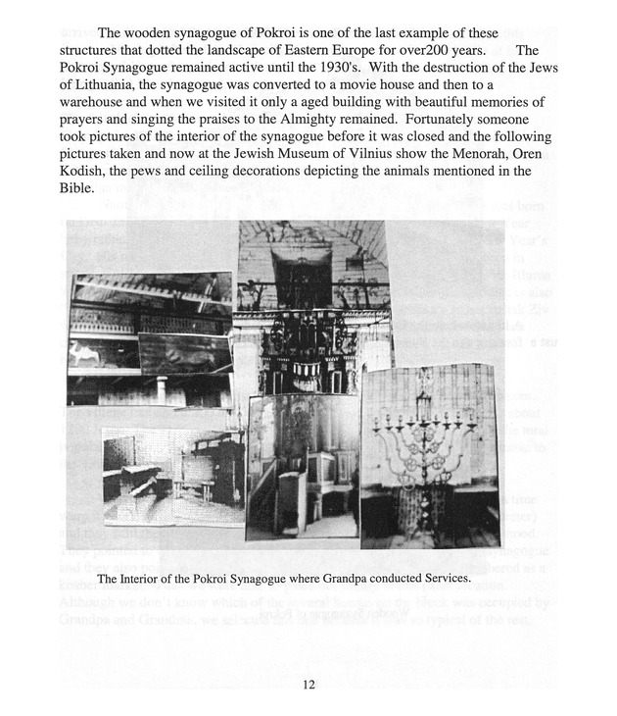

Slide 25
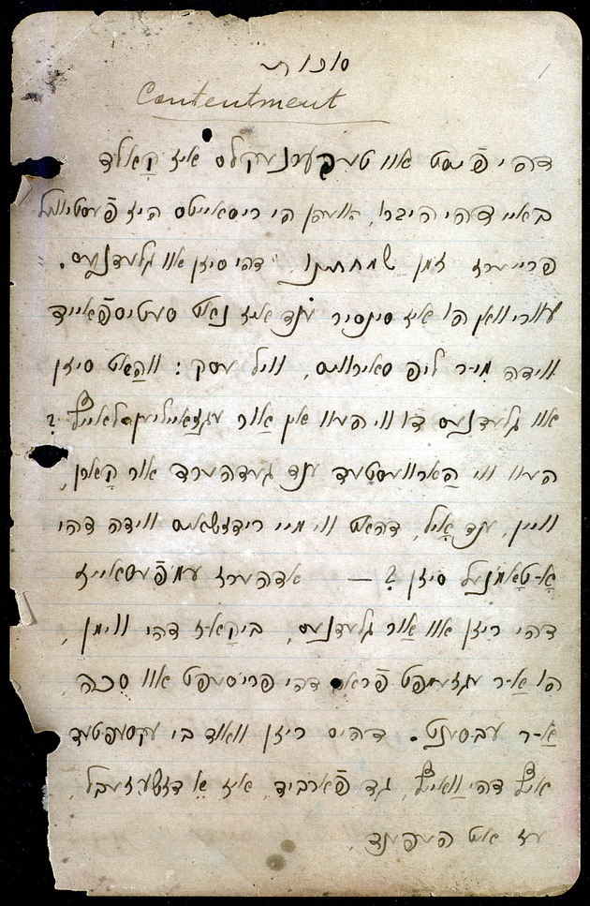

Slide 26
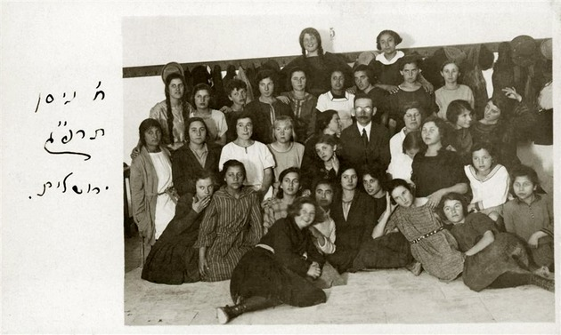
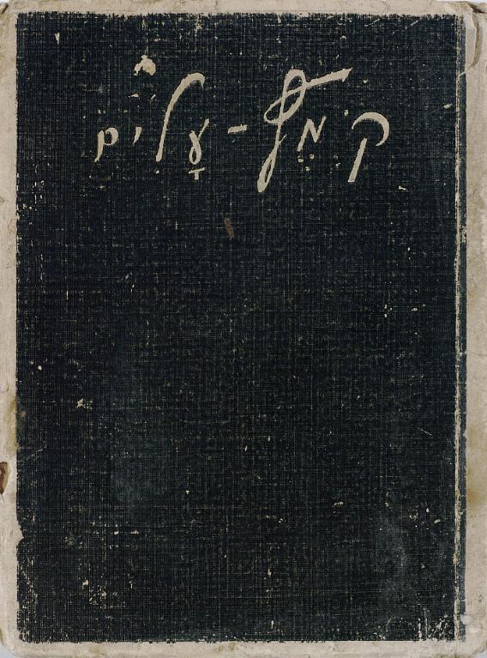

Slide 27
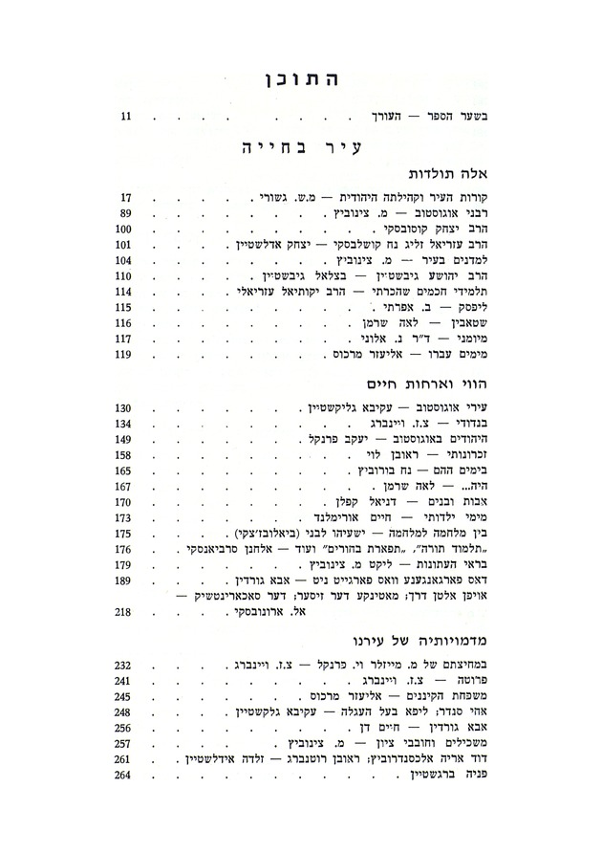
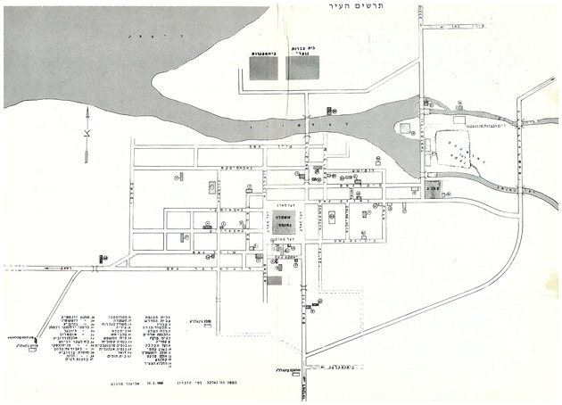

Slide 28
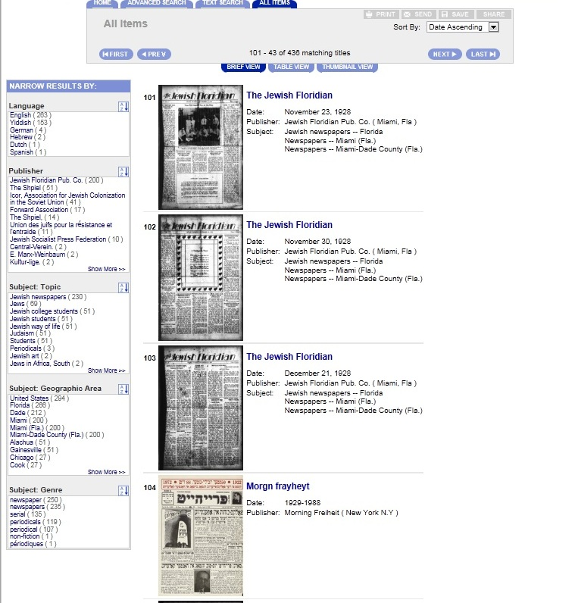

Slide 29
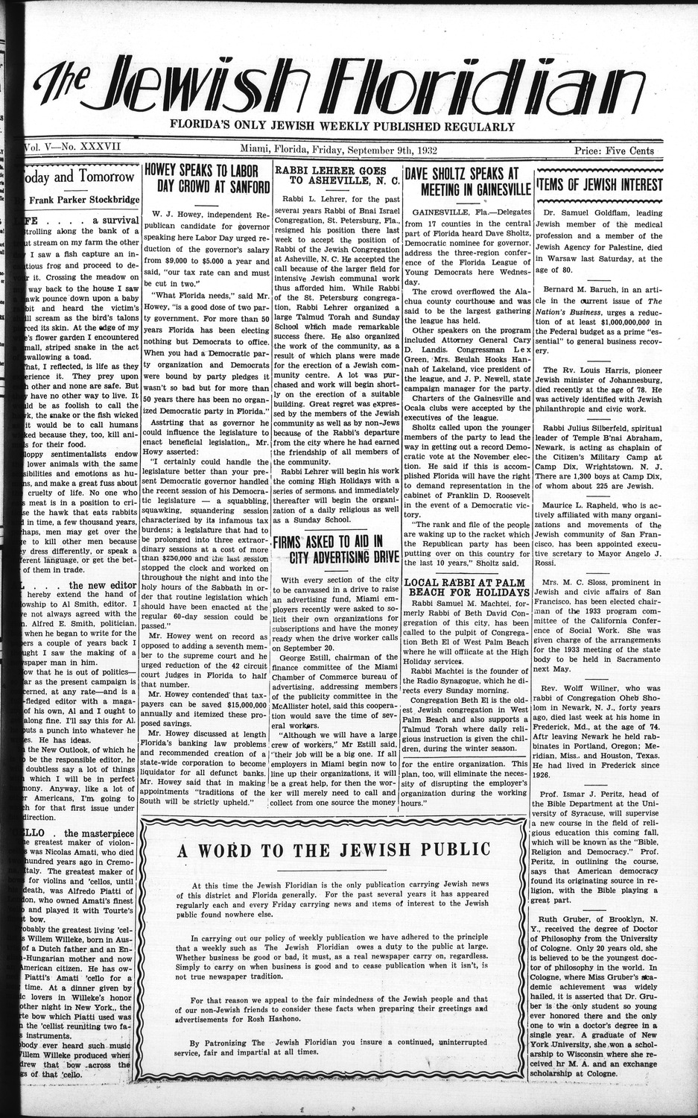

Slide 30
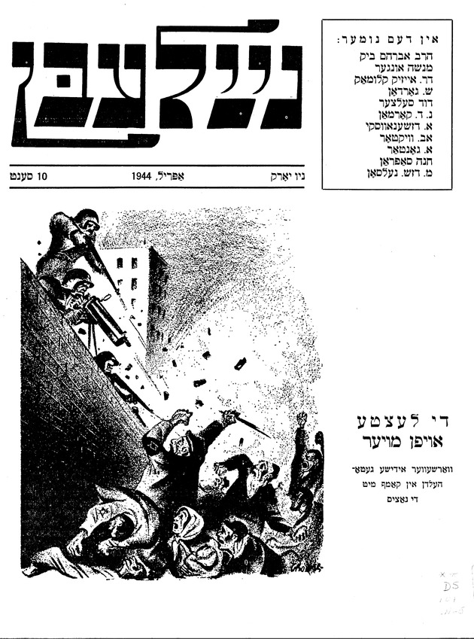

Slide 31
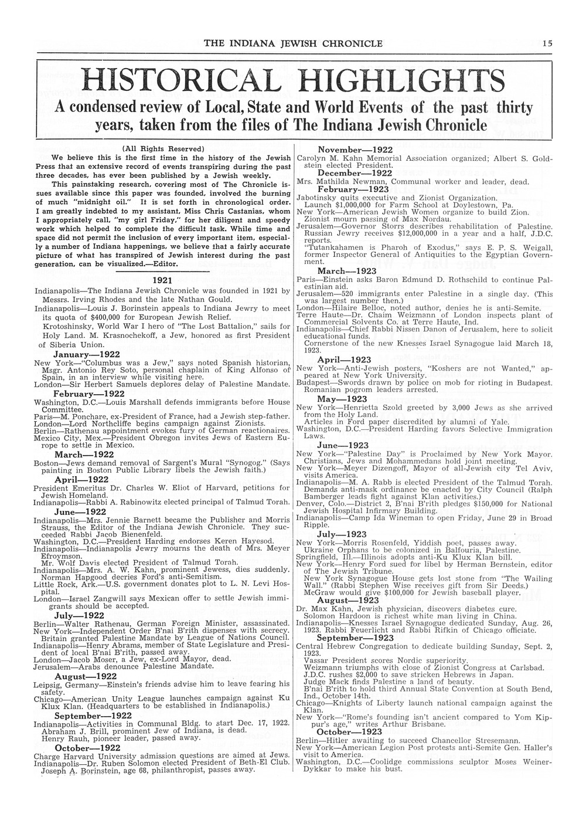
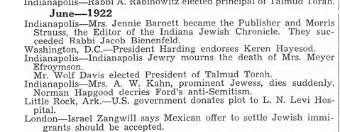
30th anniversary issue of The Indiana Jewish Chronicle, Indianapolis, 1951

Slide 32
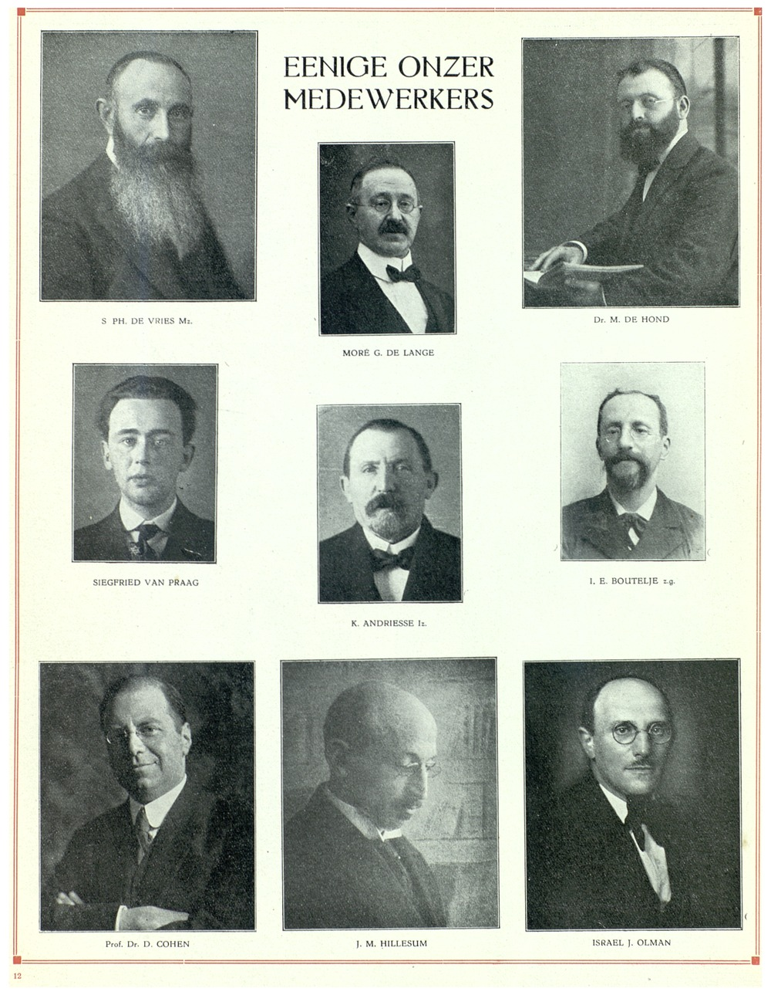
40th anniversary issue of the Central-Blad Voor
Israelieten in Nederland, Holland, 1925

Slide 33
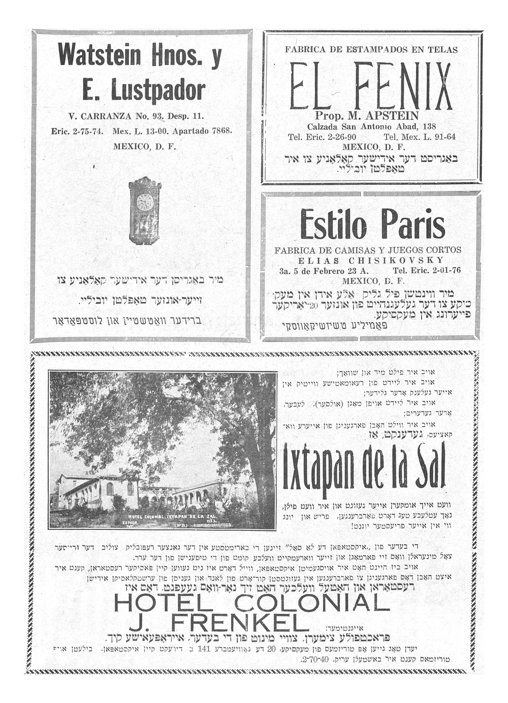
10th anniversary issue of Der Veg, Mexico, 1940

Slide 34
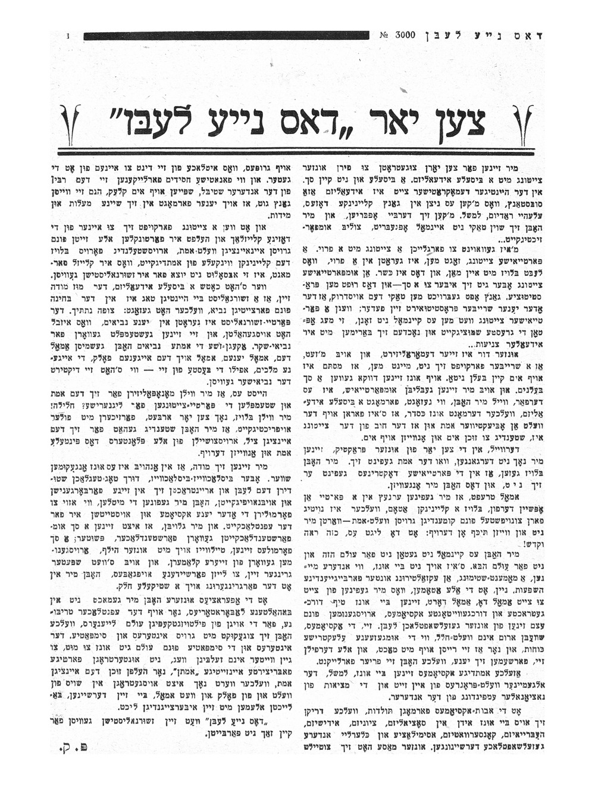
10th anniversary edition of Dos Naye Lebn, Bialystok, 1929

Slide 35
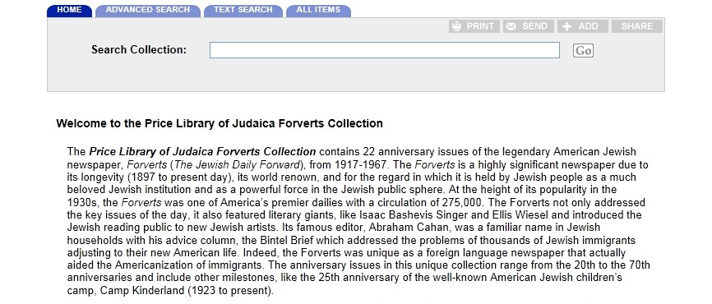
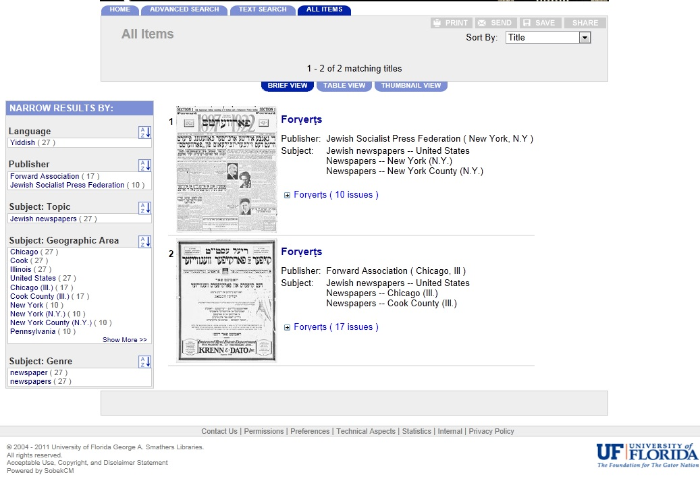

Slide 36
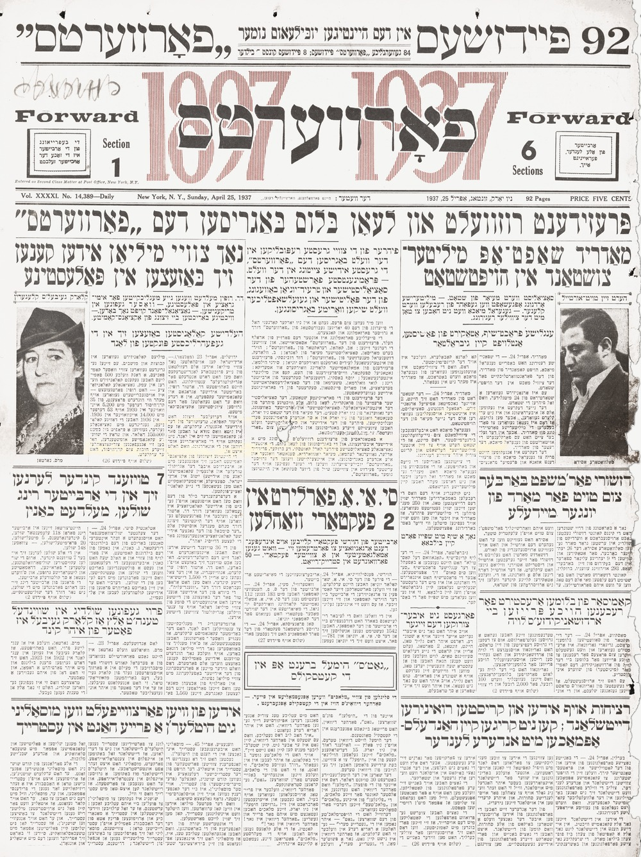

Slide 37
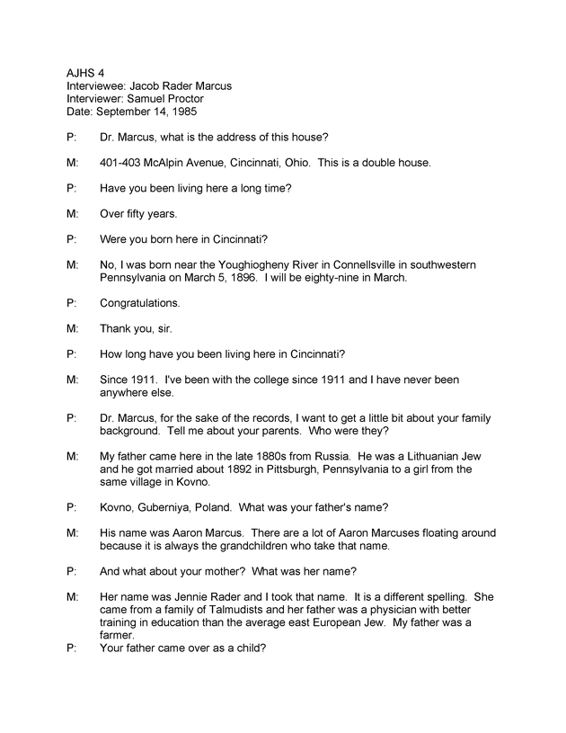

Slide 38
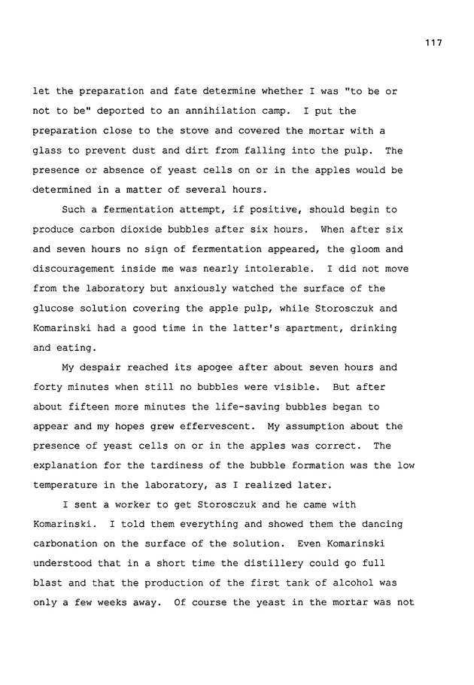
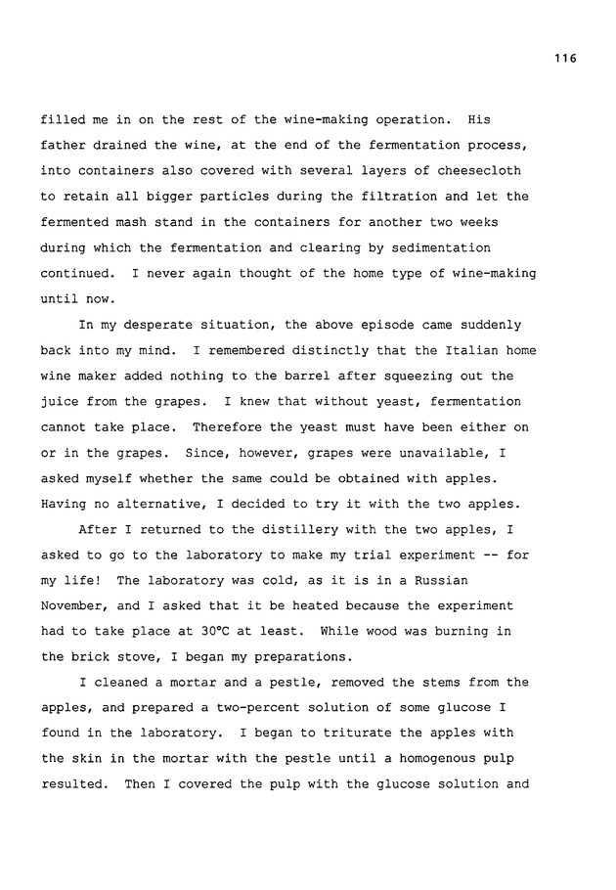
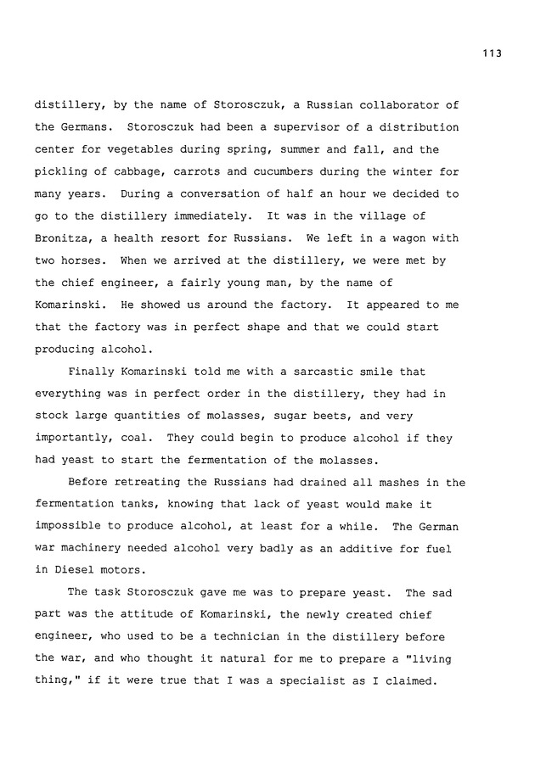
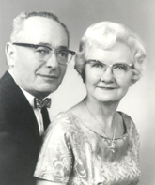
The Autobiography of Dr. Emanuel Merdinger, former Professor Emeritus of Biochemisty at the University of Florida.
Donated by Stephen M. and Renne A. Sperling and family, and Dr. Craig Henderson, 2011

Slide 39
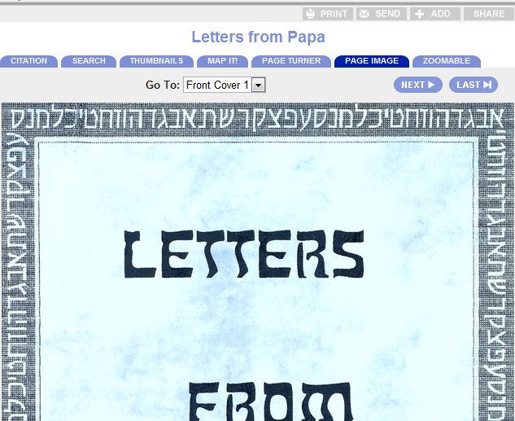
Viewing options
Citation; search; thumbnails; map it! Page turner; page image; zoomable

Slide 40
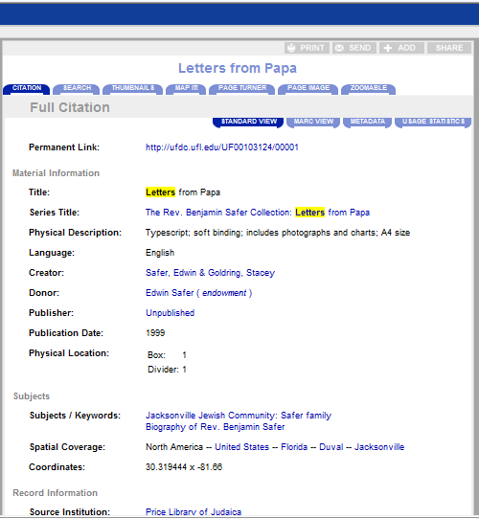
Bibliographical citation and link to catalogues

Slide 41
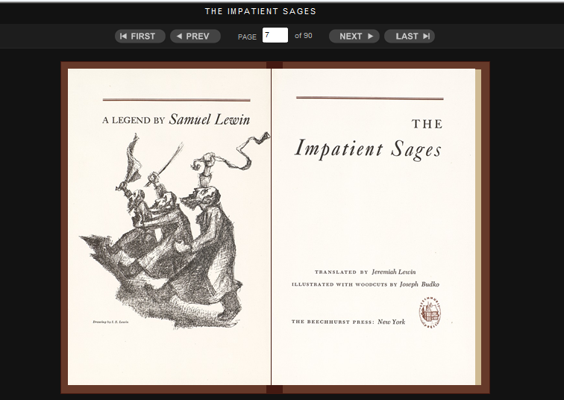
Page turner

Slide 42
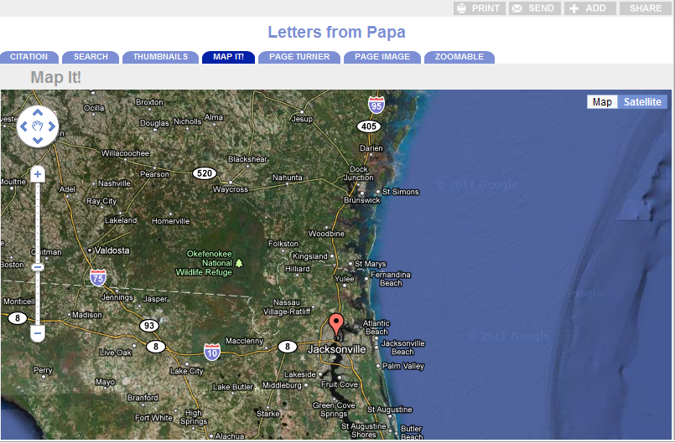
Map it!

Slide 43
Zoomable!

Slide 45
The University of Florida
Go Gators!
ANY QUESTIONS?
Rebecca J. W. Jefferson
Head, the Isser and Rae Price Library of Judaica
rjefferson@ufl.edu
Notes:
I hope that you will find time to visit the University of Florida when you come to the United States – or consider applying for one of our graduate programs or faculty appointments.
I welcome your questions today and after the Roundtable through e-mail. If there is any way in which I can assist you, please feel free to contact me.

