Slide 1
Identifying Collaborative Relationships and Interconnections Between Research Communities Using LinkedIn Maps
David Eichmann University of Iowa
Noshir Contractor, Northwestern University
Holly J. Falk-Krzesinski, Elsevier & Northwestern University
Melissa Haendel, Oregon Health Science University
Michael Conlon, University of Florida

Slide 2
Current Approaches to Team Identification
Survey the target community
  Suffers from issues of scale and detection
Quantitatively analyze a surrogate information source
  Publication/Grant co-authorship
  Temporally offset from actual collaboration
  Only the ‘winners’ are detected
  Serious information loss re true expertise

Slide 3
Some Early Data on CTSA Consortium Collaboration
Org. | Cornell | NW | OHSU | UCSF | Fla | Iowa
Cornell
NW | 0
OHSU | 0 | 66
UCSF | 0 | 1944 | 258
Fla | 0 | 25 | 4 | 40
Iowa | 0 | 267 | 52 | 353 | 36
Inter-Institutional co-authorship pair counts

Slide 4
The Path to Now
Holly comes across the new service out of LinkedIn Labs, visualization of your LinkedIn connections
  http://inmaps.linkedinlabs.com
Holly relates this coolness to Dave, who can’t resist poking about to see if he can scrape the data
Having done so, he twists arms of selected colleagues to cough up their maps

Slide 5
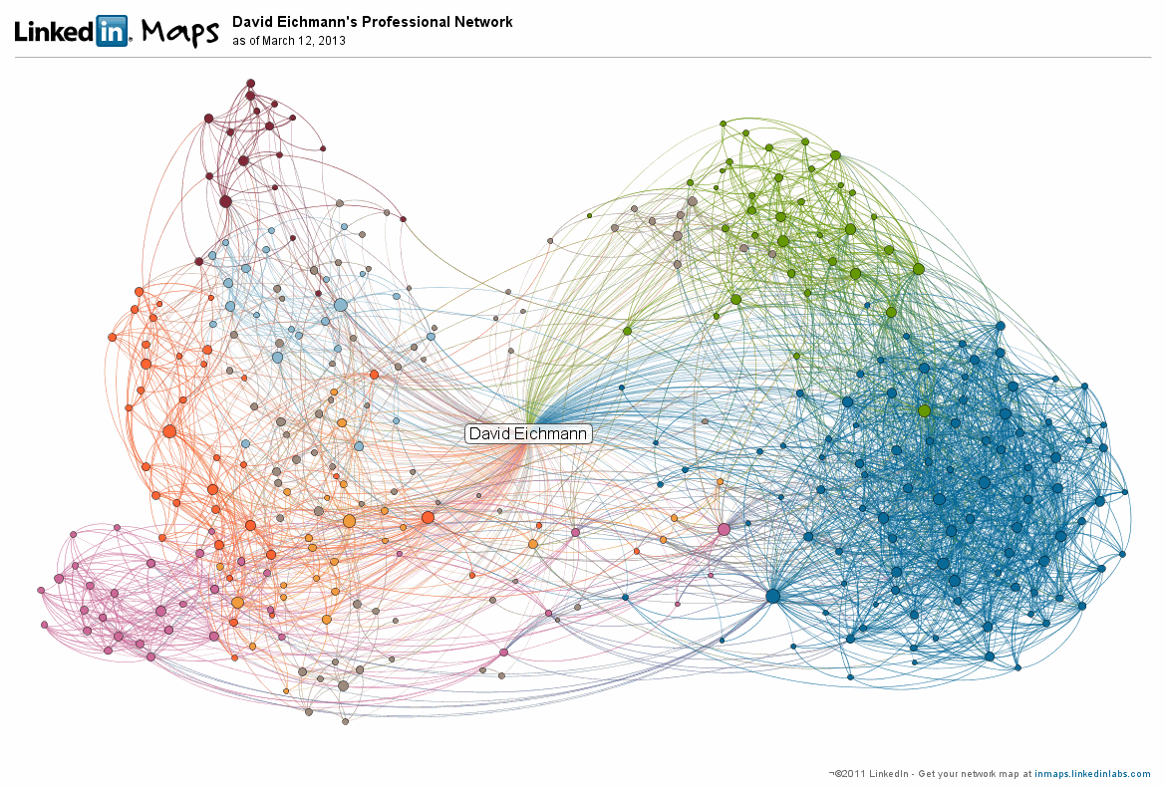
Dave’s Map

Slide 6
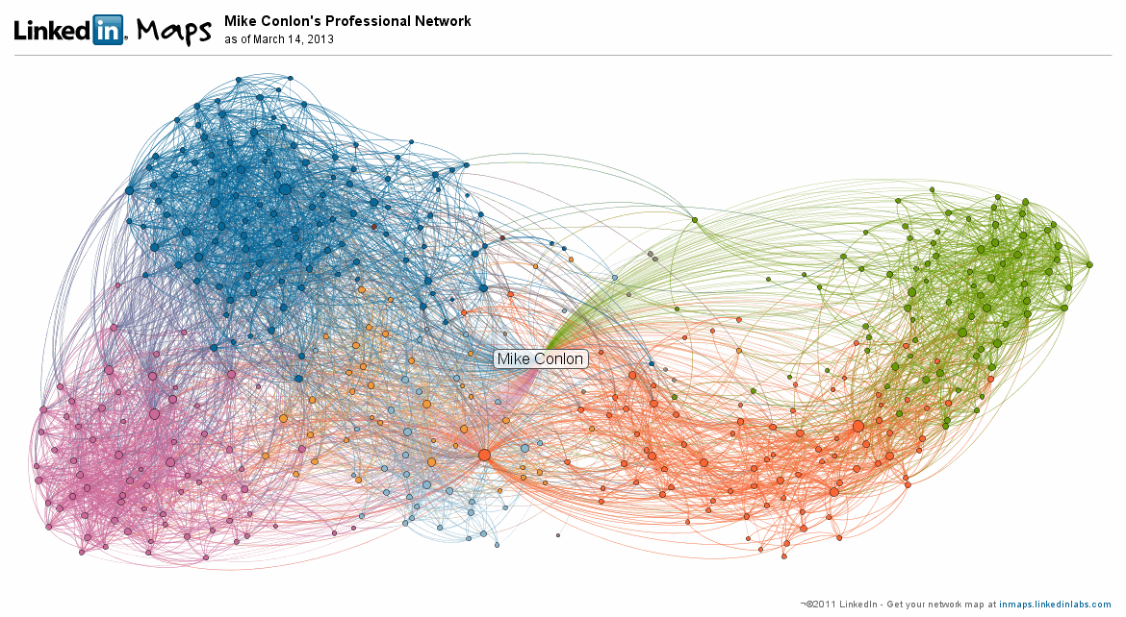
Mike’s Map

Slide 7
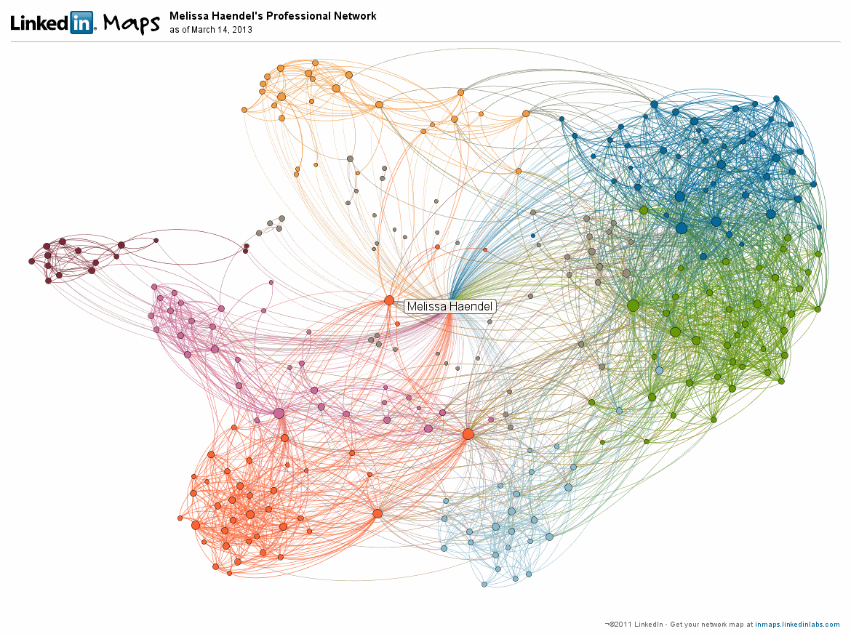
Melissa’s Map

Slide 8
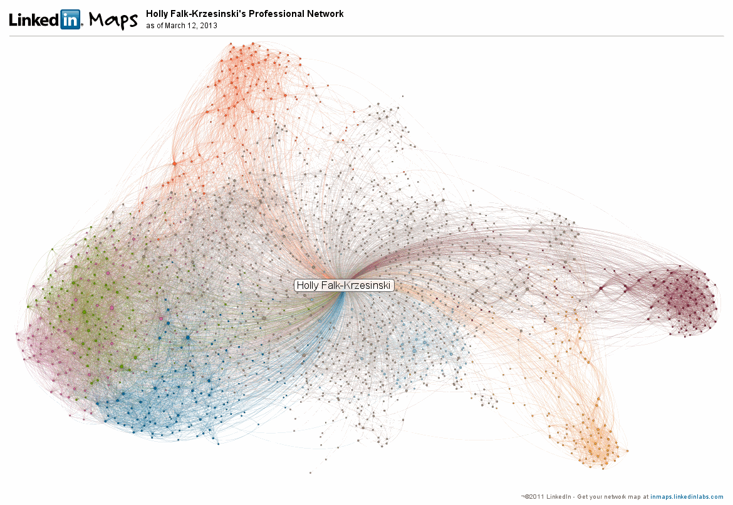
Holly’s Map

Slide 9
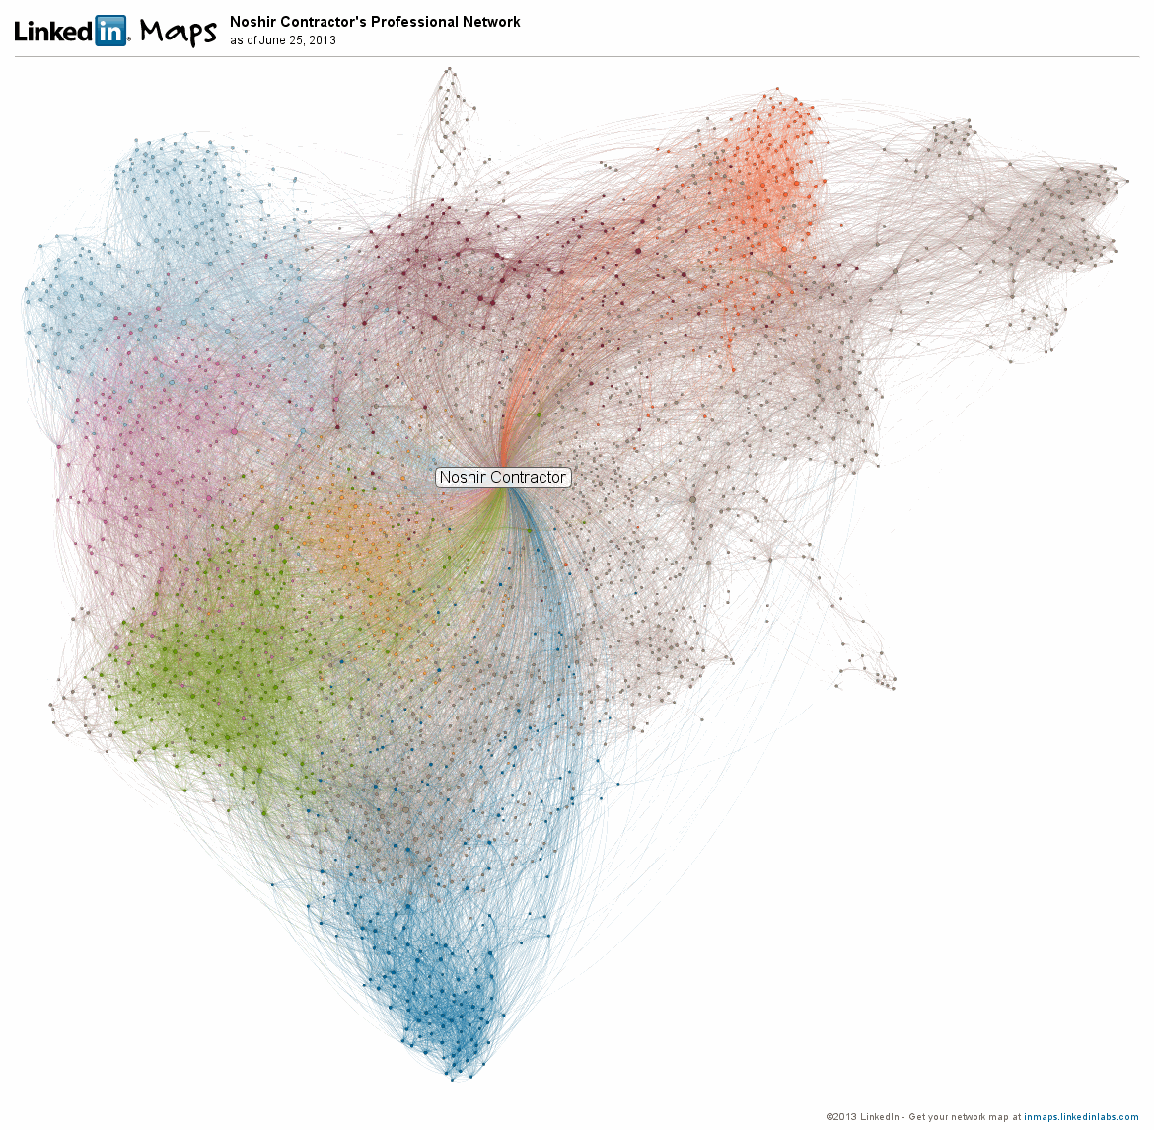
Nosh’s Map

Slide 10
Phase 1
Acquisition of graph structure
  Nodes, edges, coordinates, cluster membership
Acquisition of node characteristics
  Person name, URL, public ID

Slide 11
Aggregate Graph Statistics
Person | # Nodes | # Edges | Ave. Edges/Node
Dave | 339 | 2,816 | 8.3
Holly | 1,835 | 13,930 | 7.6
Melissa | 272 | 2,577 | 9.5
Michael | 461 | 5,571 | 12.1
Noshir | 2,373 | 27,203 | 11.5

Slide 12
Subgraph Size
Subgraph | Dave | Holly | Melissa | Mike | Nosh
0 | 96 | 127 | 45 | 96 | 189
1 | 37 | 124 | 41 | 103 | 155
2 | 36 | 123 | 40 | 69 | 217
3 | 34 | 123 | 33 | 72 | 212
4 | 25 | 108 | 26 | 81 | 143
5 | 23 | 105 | 26 | 24 | 247
6 | 18 | 102 | 15 | 4 | 144

Slide 13
Overall Population Characteristics
Total distinct individuals: 4959
  Shared by 2 or more: 246
  Shared by 3 or more: 43
  Shared by 4 or more: 22
  Shared by 5 or more: 10

Slide 14
For the 5 or more
The primary participants (except Nosh!)
Others:
  Bill Barnett
  Ying Ding
  Kristi Holmes
  Warren Kibbe
  Titus Schleyer
  Griffin Weber

Slide 15
Phase 2
Screen scrape the public page for a person
  # of connections (capped at 500)
  Organizational affiliations
  Expertise endorsements

Slide 16
Subgraph Intersection (Dave)
Subgraph | Holly | Melissa | Mike | Nosh
0 | 2 | 8 | 24 | 3
1 | - | - | - | -
2 | 6 | 14 | 25 | 2
3 | - | - | 1 | -
4 | - | - | - | -
5 | - | - | - | -
6 | - | - | - | -

Slide 17
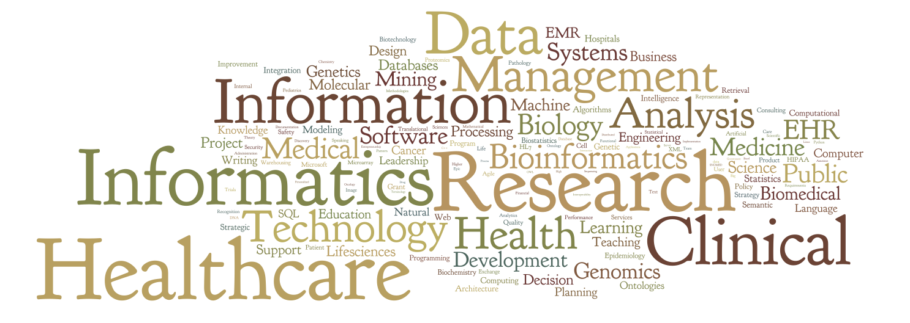
Subgraph Expertise Characterization
Cluster 0

Slide 18

Subgraph Expertise Characterization
Cluster 2

Slide 19
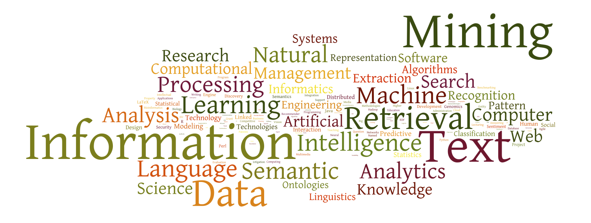
Subgraph Expertise Characterization
Cluster 3

Slide 20
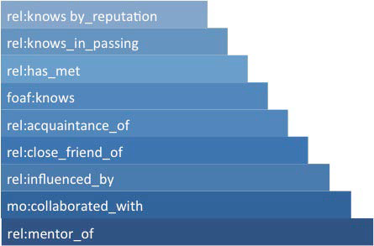
Pattuelli’s Spectrum of Relationships (2012)

Slide 21
Pattuelli’s Spectrum of Relationships (2012)
RN
Tools

Slide 22
Pattuelli’s Spectrum of Relationships (2012)
Linked
In
RN
Tools

Slide 23
Pattuelli’s Spectrum of Relationships (2012)
Ontologies used
  foaf (Friend of a Friend)
  rel (Relationship)
  mo (Music)
Echos of Trigg’s link taxonomy
  Trigg, R. 1983. Network-Based Approach to Text Handling for the Online Scientific Community. Ph.D. dissertation, Department of Computer Science, University of Maryland, technical report TR-1346

Slide 24
Observations
N = 5 !
LinkedIn expertise endorsements are an ad hoc folksonomy
  Melding this with the typically controlled vocabulary of the research networking tools should prove interesting
  These characteristics don’t show up in the RN meta-data

Slide 25
Questions?
Email: david-eichmann@uiowa.edu
Thanks to my co-authors and the Research Networking Affinity Group
Supported in part by NIH grants 2 UL1 TR000442-06 and UL1 RR024979

