Slide 1
The Clinical and Translational
Science Institute
Mike Conlon, PhD
Associate Director, UF CTSI
Presented at Research Day,
Jacksonville, Florida
May 16, 2013

Slide 2
National Institutes of Health
Clinical and Translational Science Awards
In 2006, NIH developed the Clinical and Translational Science Award (CTSA) Program
The CTSA consortium vision:
  to improve human health by transforming the research and training environment to enhance the efficacy and quality of clinical and translational research
National Strategic Goals:
  National Clinical and Translational Research Capacity
  T1 Translational Research
  The Training and Career Development of Clinical and Translational Scientists
  Consortium-Wide Collaborations
  The Health of our Communities and Nation
The 61 CTSA institutions are linked together to transform the local, regional, and national environment to increase the efficiency and speed of clinical and translational research

Slide 3
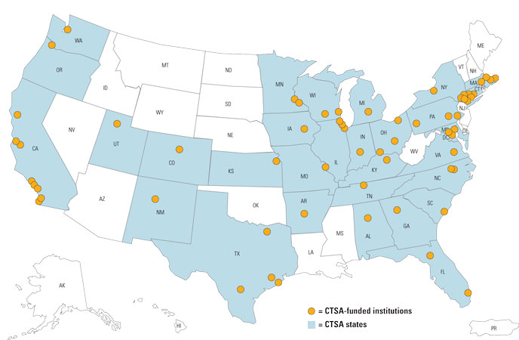
Clinical and Translational Science Award Consortium

Slide 4
The Four Translations
T4 – Translation to population health. Studies outside care settings E.g. Weight loss, access to care, behavioral studies
Population Health/
Scientific Discovery
Human Applications
Therapies
Practice
T3 – Translation to practice. How to increase uptake of new approaches. E.g. Clinical Outcomes, Health Services Research
T1 – Translation to humans. Scientific discoveries applied to human health. E.g. Genetics, engineering
T2 – Translation to patients. Demonstrate use is safe and effective. E.g. Clinical Trials

Slide 5
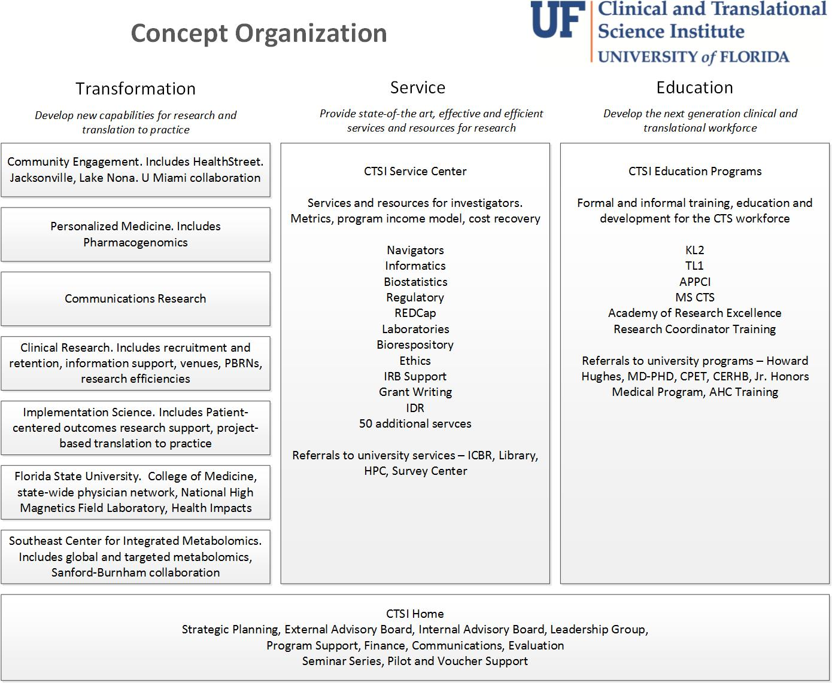
Notes:
Transformation, Services, Education. Build Understanding, Build Teams

Slide 6
Services and Resources
Biostatistics
Education Programs
Population Science
Laboratory Science
Clinical Science
Funding Programs
Informatics
Data Services
And More
In 2012, more than 900 UF investigators received services from the CTSI.
Note: Many services are provided at no-cost to investigators. Other services have charges associated. Please contact service providers regarding their charges, if any.

Slide 7
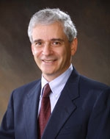
Research Design and Analysis
Overarching goal
  Consult, collaborate, conduct research, and educate on study design and biostatistical issues in CTS
Activities
  Study Design – clinical trials, observational studies, cohort, chart review, qualitative, epidemiologic
  Power Analysis
  Data Analysis
  Data presentation and visualization
  Qualitative research collaborations
  Survey design
  Data Coordinating Center Services
  Study Design Lunch Series
Jon Shuster, PhD

Slide 8
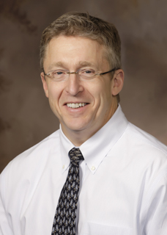
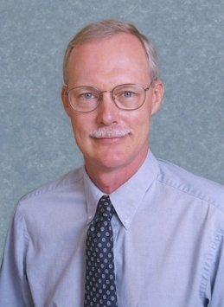
Translational Technologies and Resources Program
Overarching Goal
  Develop and Provide basic science tools and services for research
Services
  CTSI Biorepository (M. Clare-Salzer)
  Genotyping (J. Johnson)
  Biobehavioral (S. Nixon)
  Human Imaging (S. Lai)
  Biomedical Mass Spectrometry (T. Garrett)
  Global Metabolomics (D. Powell)
  Quality Assurance, GCP, GLP (C. Abernathy)
  Simulation (S. Lampotang)
Michael Clare-Salzler, MD
Jesse Gregory, PhD

Slide 9
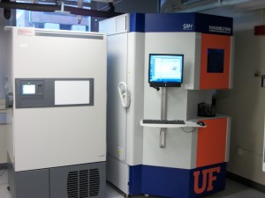
CTSI Biorepository
Biospecimen collection, processing and storage. Stored biospecimens can be used by any researcher with IRB-approved protocols.
Prospective biospecimen collection to fulfill investigator needs for IRB-approved protocols.
Storage for biospecimens collected by investigators. Stored biospecimens belong solely to the investigator.
Oversight of the release of biospecimens from the UF Department of Pathology for other IRB-approved research protocols.
Pathology services including those provided by the Molecular Pathology Core and confirmation of diagnosis by a board-certified pathologist upon request.
One of two Hamilton Storage Technologies’ SAM -80°C automated sample management systems (Robotic freezers). The biorepository also has eight Forma Thermo Scientific -80°C Freezers with back-up CO₂ and sensaphone alarm systems including back-up storage space, centrifuge for basic bodily fluid processing, QiaCube for small volume RNA, DNA and protein purification, Agilent Bioanalyzer for RNA, DNA and protein quality control analysis, OnCore BioSpecimen Management

Slide 10
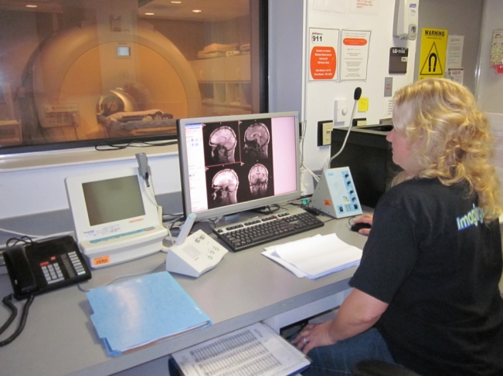
Human Imaging Core
Structural and functional MRI
Methods and protocols for MRI data acquisition
Image quality assurance and quality control
Image acquisition and transfer support
Image archive, review, and access
Teaching investigators data acquisition and analysis techniques
Assisting researchers in designing experimental protocols
Development of advanced MR imaging and spectroscopy methodology
The centerpiece of the Core is a state-of-the-art 3.0 Tesla, 32-channel Philips whole-body human MRI scanner dedicated to research. The scanner is equipped with a series of coils for imaging human organ systems, including a 32-channel head coil for neuroimaging applications with significant gains in signal-to-noise ratio and acquisition speed. An ESys® system by Invivo is available for presenting video and audio signals including functional MRI task paradigms to the subjects during scanning.

Slide 11

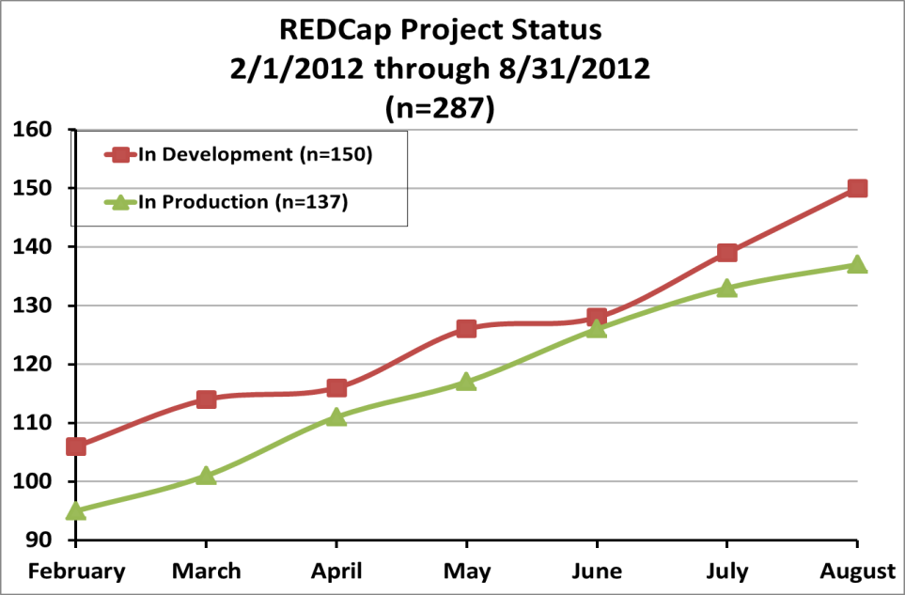
CTSI REDCap Services
No-charge, unlimited self-service access to REDCap and REDCap Survey
Training in REDCap data entry and study set-up
Support Services
Configuration Service
Participation in the national consortium
Augmented REDCap to use standard sign-on methods (GatorLink)

Slide 12
Informatics
Clinical and Translational Science IT (Felix Liu, PhD)
  Software development
  Web site design
  Database design
  Equipment interfaces
  Hosting and application support (60 systems including REDCap, Health IMPACTS,
  CTSI Portal, Personalized Medicine,
  Study Registry, investigator systems)
Collaborate with
  Academic Health Center IT (Kari Cassel)
  Integrated Data Repository (Gigi Lipori)
  UF Research Computing (Paul Avery, Erik Deumens)
  Investigative groups across UF and beyond
CTS IT
CTSI
UF Research Computing
IDR
UF AHC IT

Slide 13
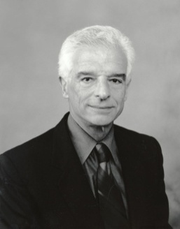
Clinical Research Program
Overarching goal
  Create new opportunities for clinical research
Clinical Research Units
  Locations: Gainesville (UF and VA), Jacksonville, Orlando
  Disease expertise: Aging, Cancer, Cardiovascular, Dental, GI/Hepatobiliary, Neuromedicine, Pain and Sensory Testing, Sleep Disorders, Tuberculosis and Emerging Pathogens
  UF Clinical Research Center moving to the CTRB in June 2013
Carl Pepine, MD

Slide 14
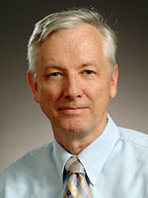
Pilot Projects Program
Overarching Goal
  Support emerging research via institution-wide competitive funding for CTS, targeting trainees, junior faculty; methods (IP) development; and multi-discipline, trans-college initiatives.
Activities
  Two annual general RFAs, 36 awards, $530K in 2012
  Service vouchers
  CTSI Seminar Series
  Design Series
Chris Batich, PhD

Slide 15
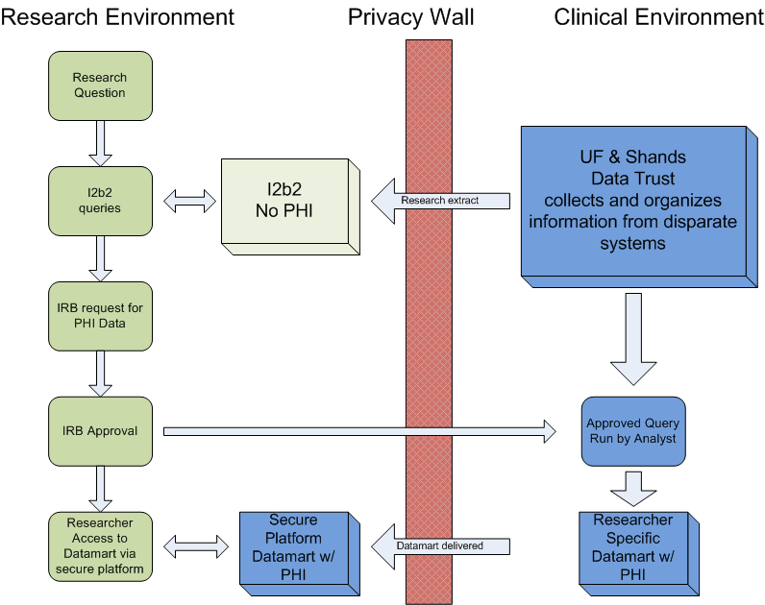
Integrated Data Repository

Slide 16
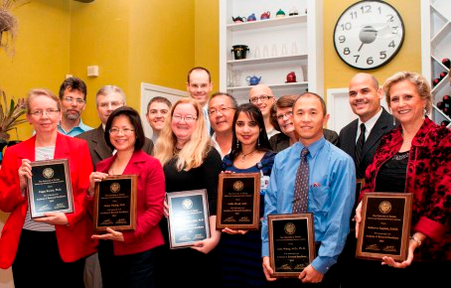
Academy of Research Excellence
Launched in 2012 as part of UF’s continuing commitment to excellence in health science research, the CTSI Academy of Research Excellence will help promote high-quality, innovative clinical research, with the highest regard for research integrity, ethics, professionalism and regulatory requirements.
The academy is dedicated to promoting an atmosphere of professional collegiality and openness, including active role-modeling and the mentoring of junior faculty and health science students.
Inaugural members of the CTSI Academy of Research Excellence include (bottom row, left to right): Peggy Borum, Emina Huang, Jacqueline Hobbs, Latha Stead, Gary Wang, Katherine Karpinia. (Top row, left to right): Michael Bubb, Reginald Frye, Thomas George, David Winchester, Samsun Lampotang, Todd Manini, Barbara Lutz and Ramon Rodriguez

Slide 17
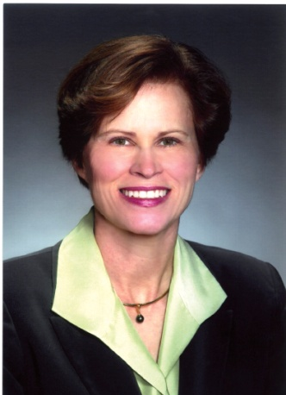
CTSI Education Programs
Overarching Goal
  Train a new generation of multi-disciplinary CTS researchers and leaders in academia, industry and government
Programs
  KL2 Multidisciplinary Program for Junior Faculty
  TL1 Pre-doctoral training program
  Advanced Postgraduate Program in Clinical Investigation
  Research Coordinator Training
  Masters in CTS
  Academy of Research Excellence
Affiliated Programs
  Junior Honors Medical Program
  Center for Precollegiate Education and Training
  Center of Excellence for Regenerative Health Biotechnology
  MD-PhD
  HHMI Science for Life
  Health Science Center Training
  Interdisciplinary Program in Biomedical Sciences
Marian Limacher, MD

Slide 18
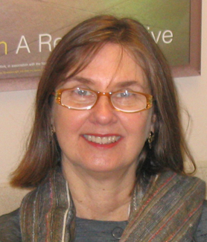
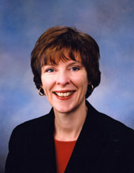
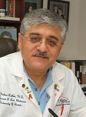
Community Engagement and Research
Linda Cottler, PhD
Elizabeth Shenkman, PhD
Mobeen Rathore, MD
Overarching Goal
  To promote collaborative relationships with communities to address the health and well-being of community members
Resources
- Community Advisory Boards
- Community Research Associates
- HealthStreet
- Health Impacts
- Research Networks

Slide 19

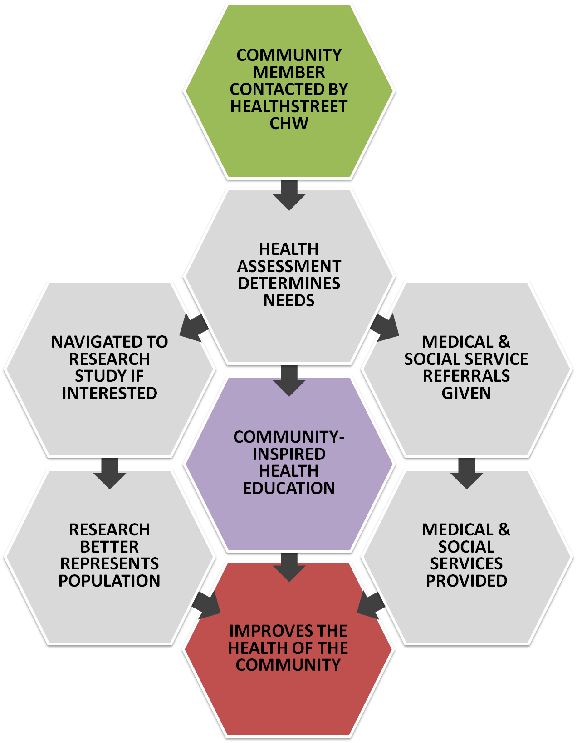
Assessment: Assess health issues and concerns from community residents
Education: Provide informational materials and resources tailored to health promotion, wellness and dissemination of new research knowledge for community stakeholders
Service: Link individuals who have been underrepresented in services and research to social services, health care and research opportunities
Communication: The HealthStreet site will serve as an anchor for community groups and investigators to engage in bidirectional, health-focused communications with the goal of increasing community engaged research partnerships

Slide 20
Personalized Medicine Program
Background
  Human genome project completed in 2001
  Collins (NIH): expectation that an individual’s personal genome will be part of their medical record, from which information can be pulled to determine disease risk or guide treatment decisions
Challenge
  Despite the substantial number of important genetic discoveries made, there are limited examples of clinical translation to practice
UF Objectives for Personalized Medicine Program
  Position UF&Shands Health System as leaders in genetic-guided care
  Pre-emptively genotype on broad panel (256 SNPs) to mimic eventual reality of genomic data in EMR
  Prepare health informatics systems to handle increasing amounts of genetic data linked into EMR
  Define when and how to use genetic data in patient care

Slide 21
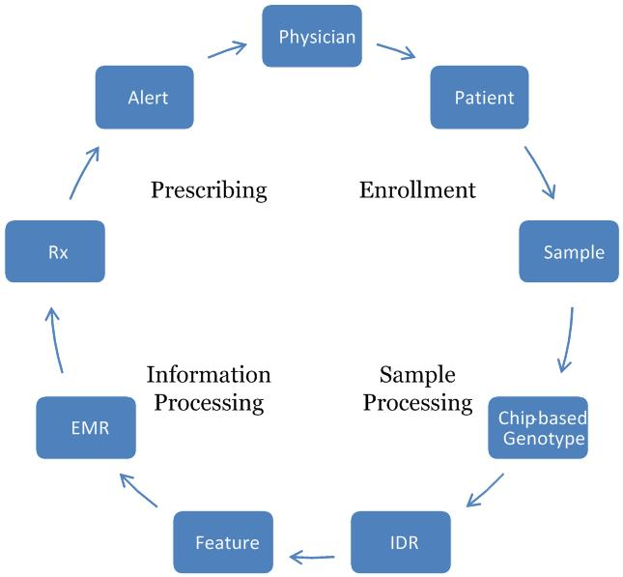
Personalized Medicine Information Flow
Challenge: genetic polymorphism of CYP2C19 leads to reduced ability to activate clopidogrel (Plavix) and increased risk of cardiovascular complication
CER, Economic Impact
Research and clinical consent; Bioethics; Communications Research
Biorepository
BMI; Hospital IT; Epic
Genotyping Core
IDR; Bioinformatics; Research IT

Slide 22
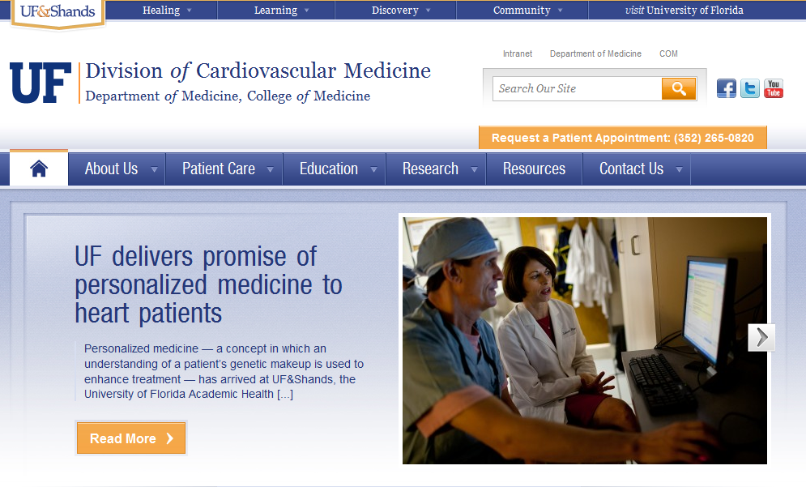
Personalized Medicine Program-
Launched June 25, 2012
https://ufandshands.org/news/2012/uf-delivers-promise-personalized-medicine-heart-patients#!/-1/

Slide 23

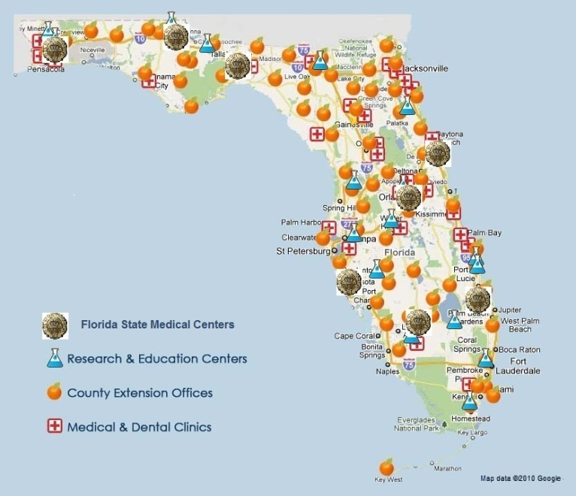
Goals
Test interventions in physician practices;
Translate research findings into improved health care quality; and
Mentor medical students and trainees in conducting research and implementing research findings in practice.
Two pilot projects
Sports related concussion surveillance and management (PI: Bauer)
Health risk assessment among adolescents in primary care (PI: Shenkman)
Funding
UF/FSU ($500,000)
State of Florida ($600,000)
NIH ($ 473,000)

Slide 24
UF-Affiliated Research Networks
Local/ Regional
  North Florida Pediatric Community Research Network (Jacksonville area)
  Jacksonville Health Equity Research Organization Practice-Based Research Network (JaxHERO)
Statewide
  Health IMPACTS for Florida (UF-FSU statewide research network)
  Florida Neonatal Neurologic Network
National
  NHLBI Cardiovascular Cell Therapy Research Network (Carl Pepine)
  NIDCR Dental Practice-Based Research Network (Valeria Gordan)
  Hepatitis C Therapeutic Registry and Research Network (David Nelson)
  Network for Pancreatic Organ Donors with Diabetes (Mark Atkinson)
  NIH Pharmacogenomics Research Network (Julie Johnson)
  Sentinel Network for Community-Based Participatory Research (Linda Cottler)

Slide 25
  Consent2Share
Initiated on 9/11/12
Consent form given with admissions packet (pt. specific bar code)
Consent asks 2 questions
  Can we store your excess tissue with protected health information?
  Can we re-contact you for a future study?
Collected by admissions clerk, data entered into EPIC, consent form scanned with other documents
Patient’s physician can access pt response, answer questions
Informed Consent Hotline to answer initial questions
  CTSI patient research advocate for more detailed queries
Results to date (>10,000):
  86% patients returned signed forms
  85% checked “yes” for samples
  79% checked “yes” for recontact

Slide 26
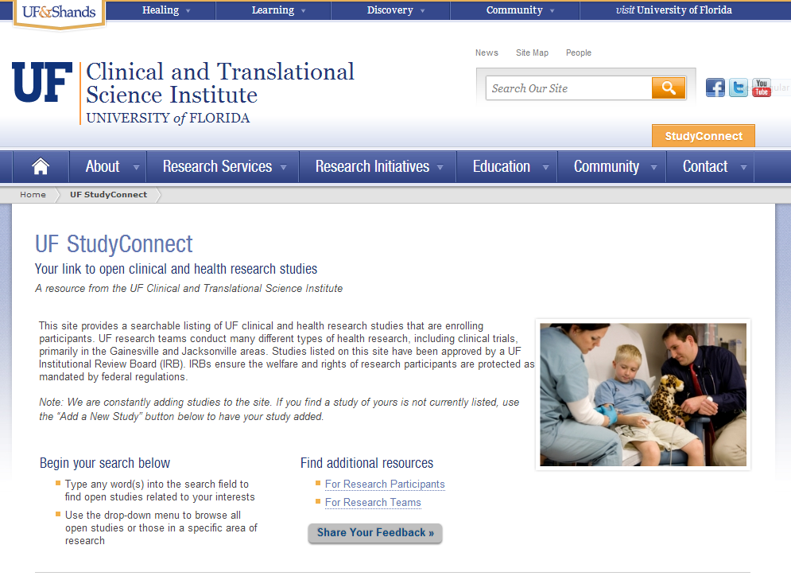
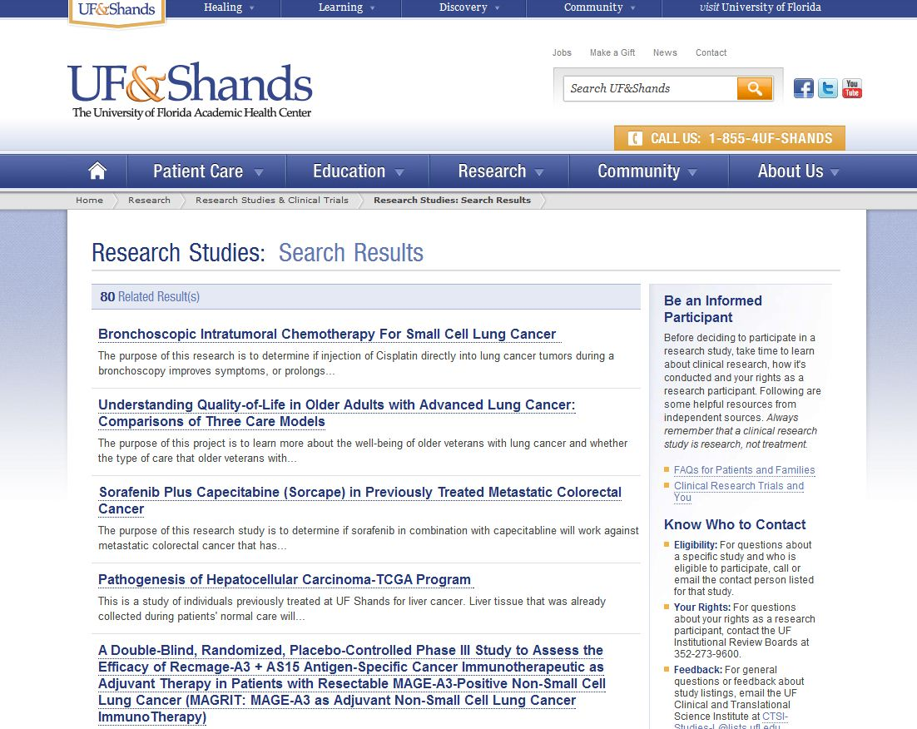
Study Registry and StudyConnect
Study Registry: All (10,200) human subject studies approved by 4 UF IRBs from 2008 to date.
StudyConnect: Web site with 400 active studies for potential research participants to find opportunities

Slide 27
Implementation Science
New Program in 2013
Develop and implement reproducible processes for translating research findings into improvements in health care practice and health
Examples:
  Personalized medicine
  Reduction in readmissions following CHF

Slide 28
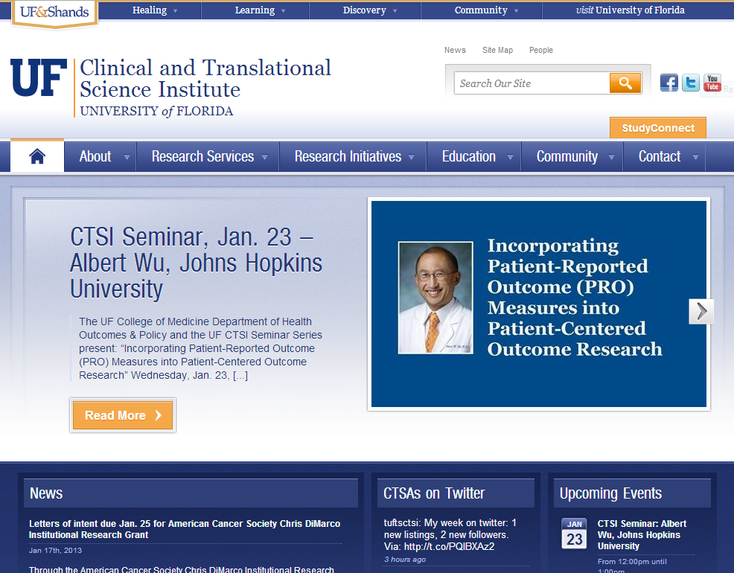
For More Information
On the web
  www.ctsi.ufl.edu
Call
  352-273-8700
Email
  info@ctsi.ufl.edu

