Slide 1
Using ArchiveGrid to Promote Archival Collections
John R. Nemmers
Descriptive & Technical Services Archivist
Department of Special & Area Studies Collections
University of Florida George A. Smathers Libraries
Future of Collections Part 1: Creating and Managing Digital Content – LYRASIS Online Meeting – April 26, 2013

Slide 2
What is ArchiveGrid?
Developed by OCLC Research
A free discovery system used by researchers and scholars to locate primary source materials in archives, libraries,etc.
Researchers can identify pertinent holdings at one or more archival repositories, and ArchiveGrid provides links/contact points for more information.

Slide 3
Development of ArchiveGrid
1999- EAD proving ground:
Archival Resources
2006- Aggregated discovery system for subscribers:
ArchiveGrid
2011- Freely available discovery system from OCLC Research
2012- Basis for more research into improving archival description and access
ARCHIVEGRID

Slide 4
Aggregated Descriptions
Descriptions of archival collections
WorldCat MARC records
Finding aids harvested from websites (EAD XML, HTML, PDF, Word)
Any repository can contribute (not exclusive to OCLC members)

Slide 5
Harvesting Finding Aids
Easiest to maintain a machine-readable web page for crawlers (e.g., http://web.uflib.ufl.edu/spec/FindingAids/findingaids.htm)
ArchiveGrid can harvest from browse/directory pages (e.g., http://web.uflib.ufl.edu/spec/browset.htm) with some caveats
To ensure good content in ArchiveGrid, follow descriptive standards to ensure that necessary elements are present
Also, follow best practices when using a flexible standard like EAD (better chance of uniformity across repositories)

Slide 6
Identifying MARC Records for Archival Materials
One Holding
No MARC Leader indicators for manuscripts, collections, realia
Theses and dissertations, bibliographies
Published works
Reference materials

Slide 7
ArchiveGrid Updates
About every 6 weeks
They get a fresh extract of MARC collection records from WorldCat
And they completely reharvest all the finding aids from contributor websites
The only way to ensure that they account for adds, updates and deletes

Slide 8
MARC Records and/or Finding Aids?
Common practice for repositories to routinely produce both (UF does)
Some opt to have only MARC records in ArchiveGrid
Others prefer finding aids only
Many include both, even if they may appear in search results as near duplicates
When there are links from a MARC record to a finding aid (856 field), ArchiveGrid can identify a single collection

Slide 9
Using ArchiveGrid
http://beta.worldcat.org/archivegrid

Slide 10
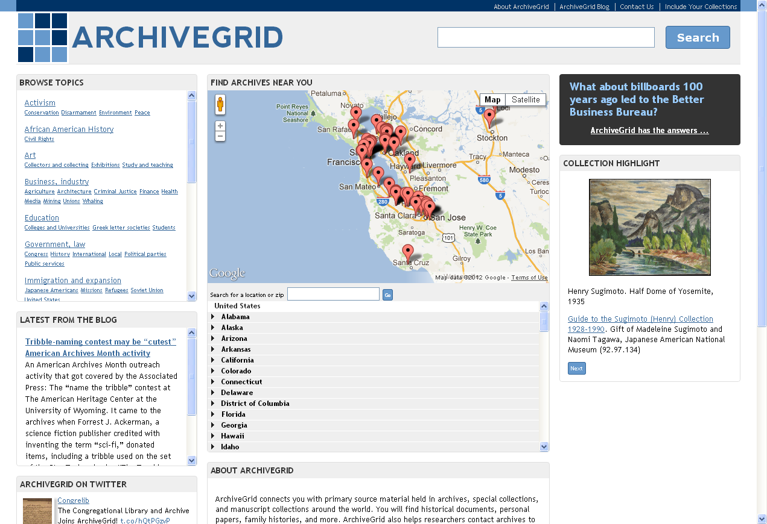

Slide 11
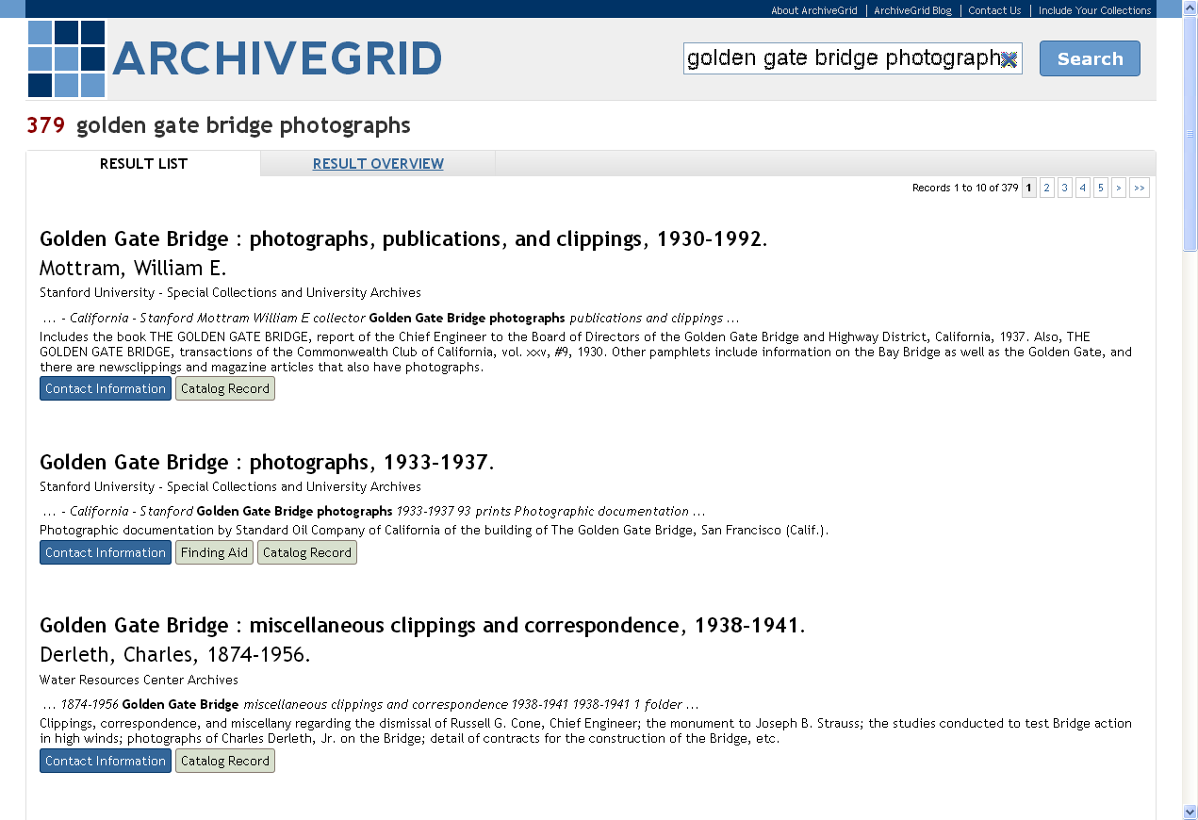

Slide 12
Title
Collection Creator
Archives/Library
Keywords in Context
Scope/Content

Slide 14
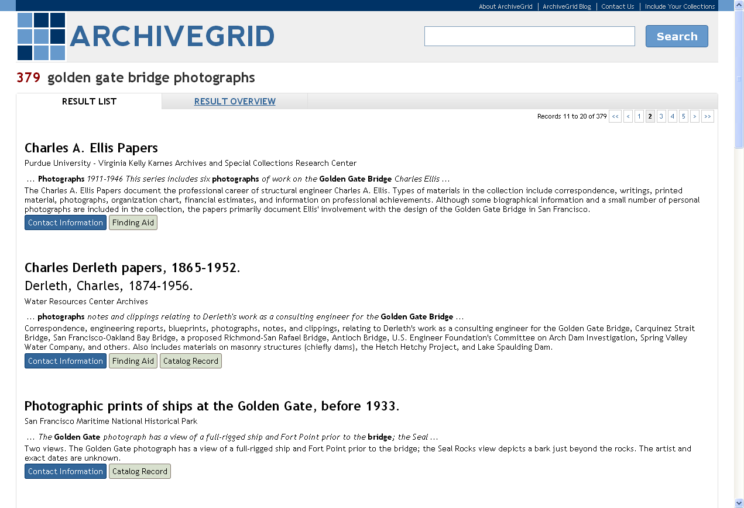
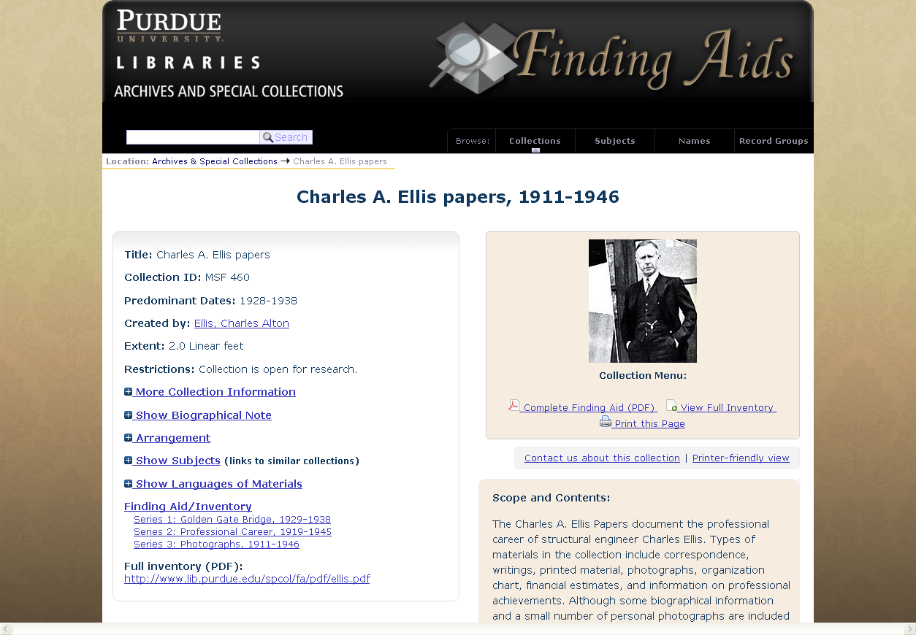

Slide 16
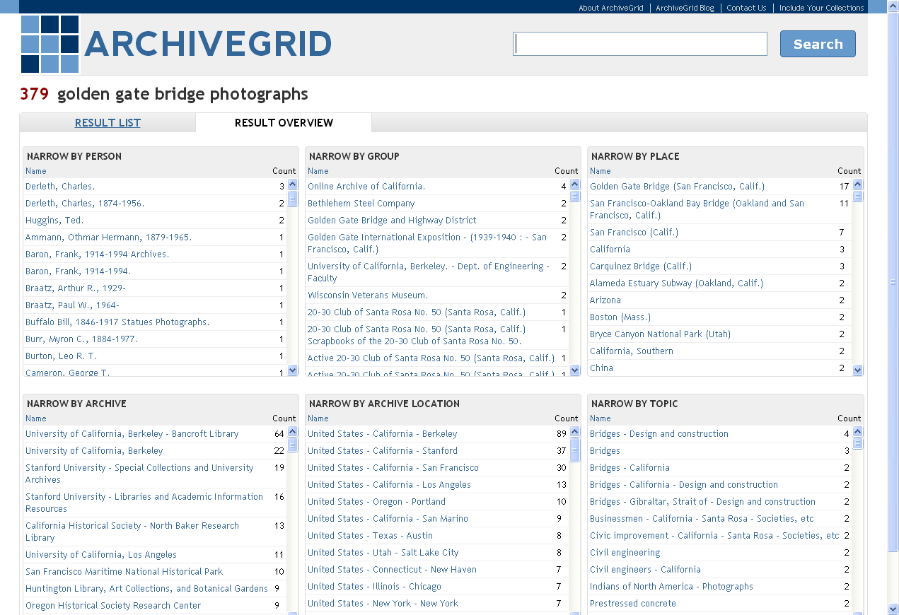

Slide 17
Who uses ArchiveGrid?
Researchers
Independent Scholars
Genealogists
Faculty
Dr. Matthew Simon
Age: 49
University History Dept.
Writing a book on the California Gold Rush
Amy Powell
Age: 27
Post-graduate study in Political Science
Writing her thesis on rural to urban labor migration
John Stevenson
Age: 35
Mechanical Engineer
Studying the history of pipe organs
Catherine Andrews
Age: 61
Former K-12 Teacher, Retired
Researching her family history

Slide 18
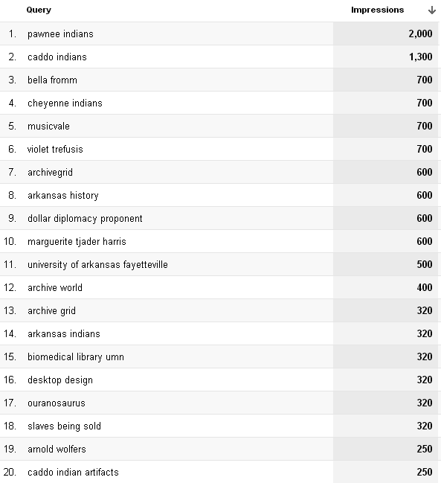
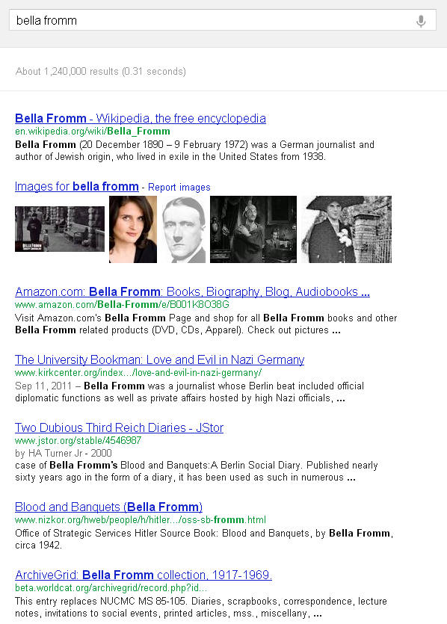
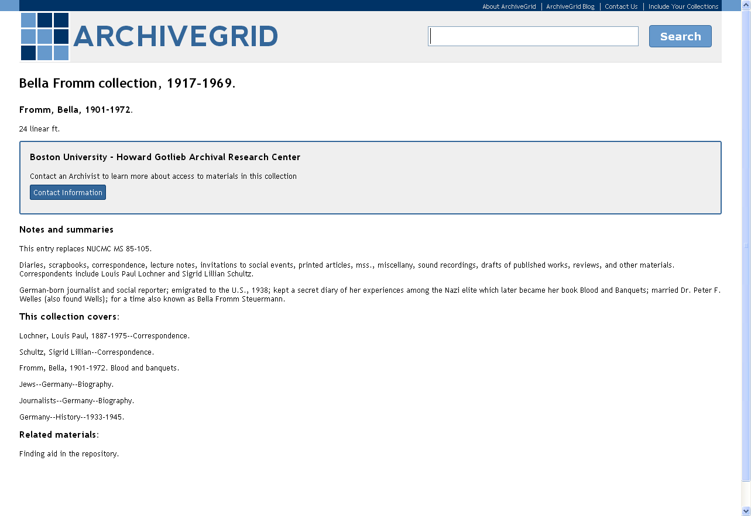
How do users find ArchiveGrid? Usually through search engines.

Slide 19
ArchiveGrid Traffic
85% of traffic comes from search engines
8% of traffic comes from referrals from other websites
6% of traffic comes “direct” … a bookmark, typing the URL in the browser, etc.

Slide 20
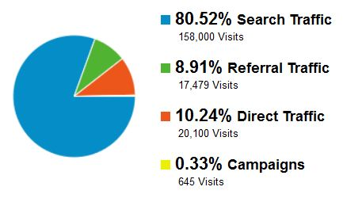
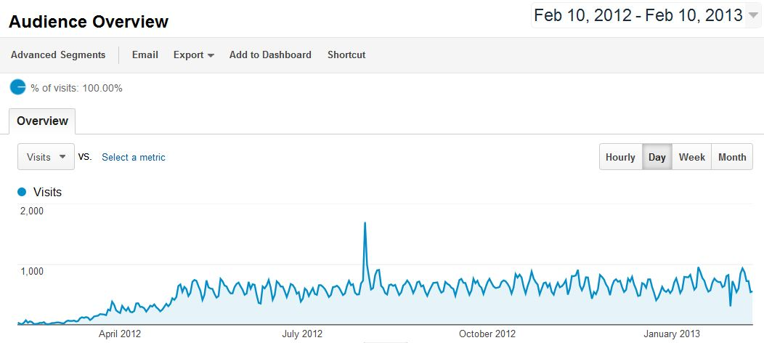
ArchiveGrid Visitors

Slide 21
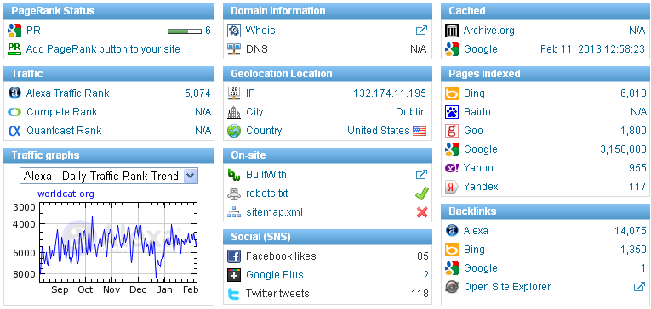
Making ArchiveGrid Discoverable in Search Engines

Slide 22
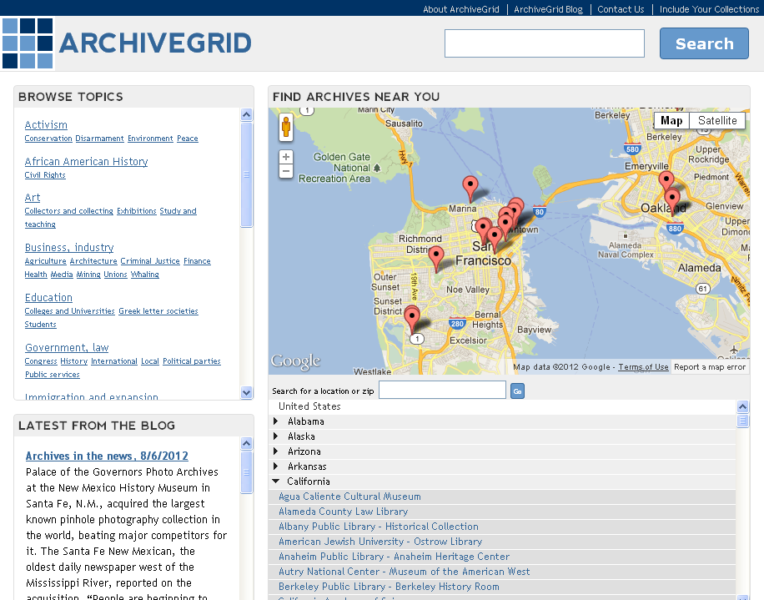
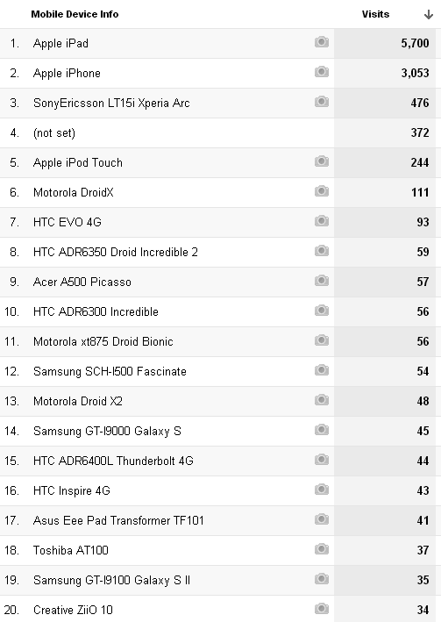
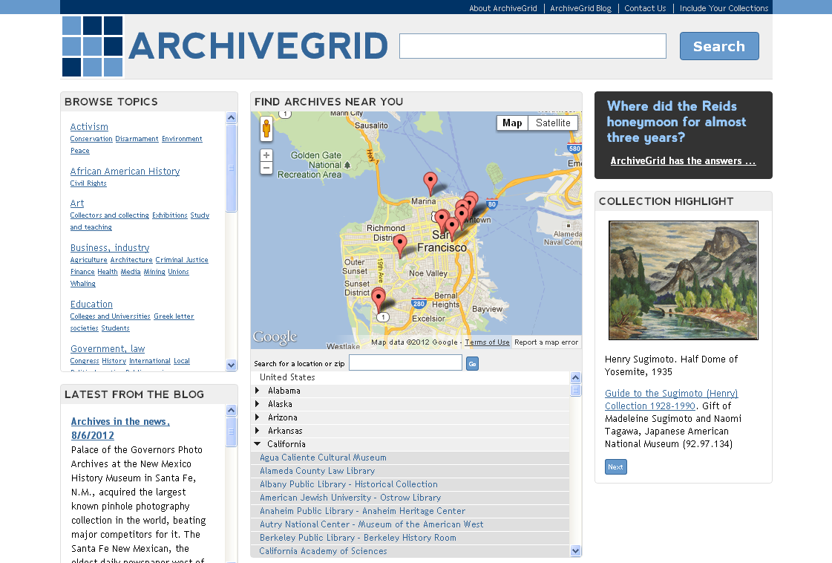
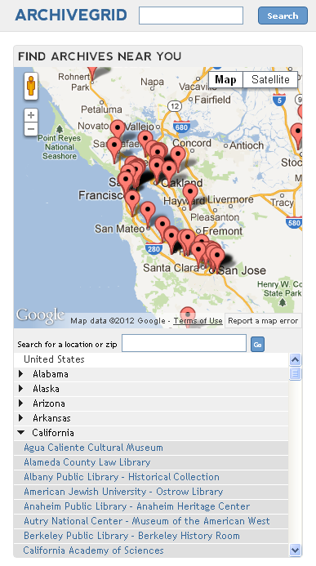
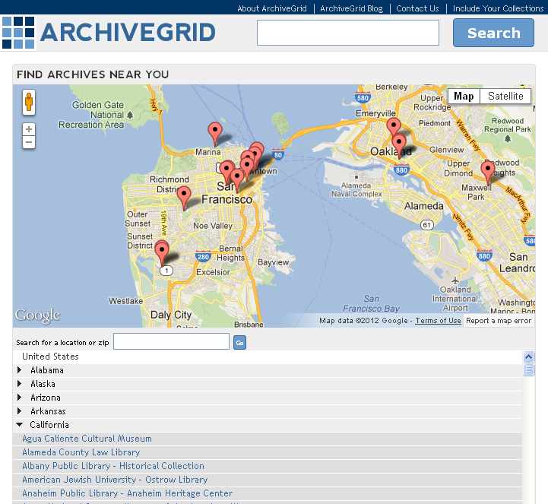
A responsive and open website maximizes access and accessibility

Slide 23
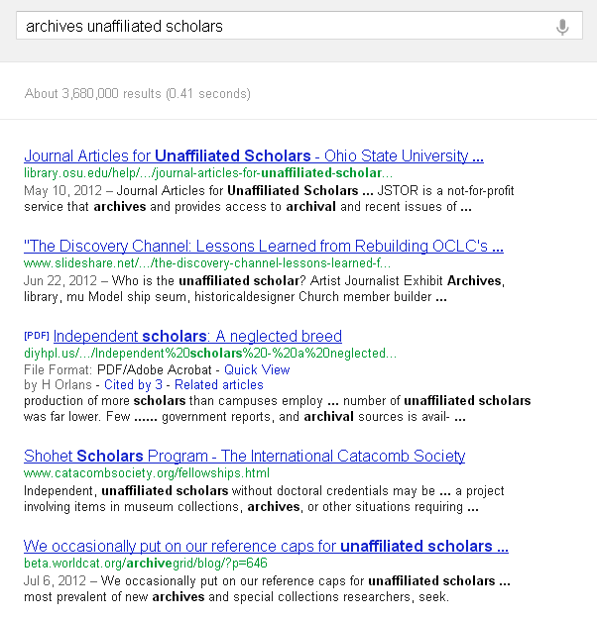
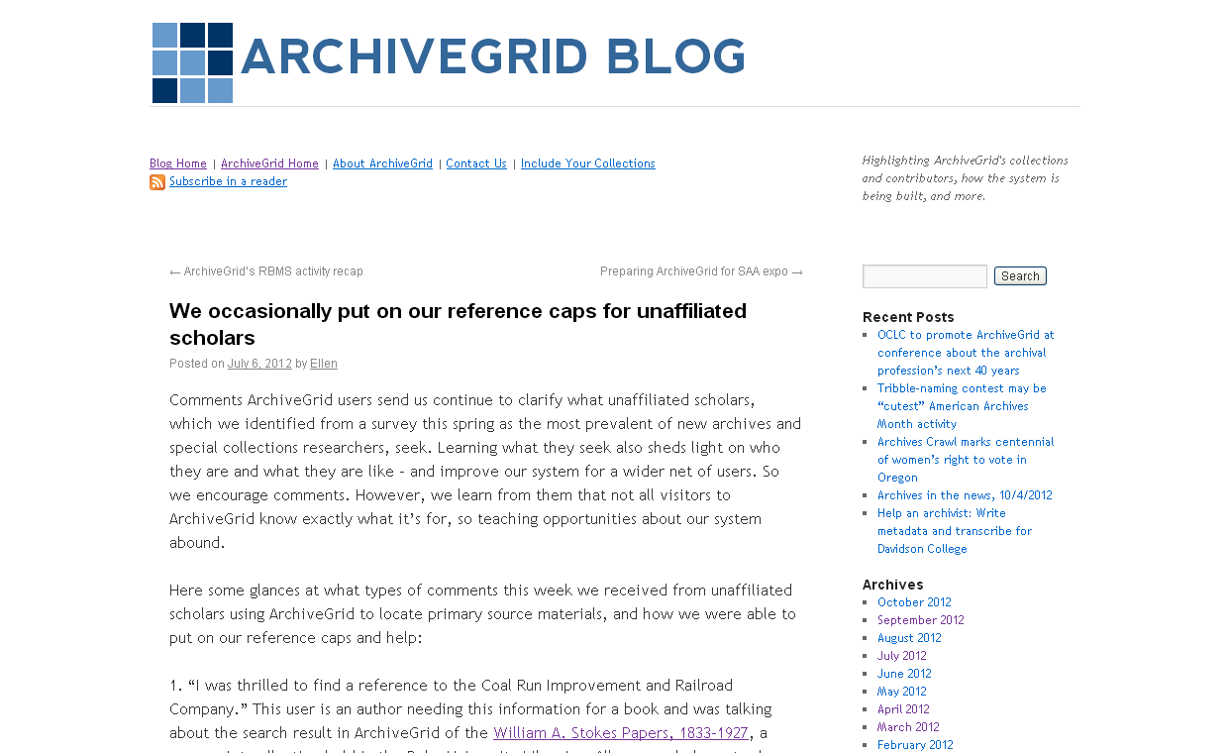
The ArchiveGrid Blog

Slide 24
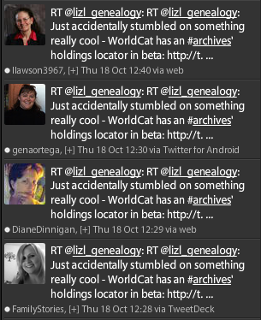
Getting the Word Out via Twitter

Slide 25
Who is working on ArchiveGrid?
The ArchiveGrid Team in OCLC Research
Bruce Washburn
Software Engineer
San Mateo, CA
Jennifer Schaffner
Program Officer
San Mateo, CA
Ellen Eckert
Research Assistant
Portland, OR
Jackie Dooley
Program Officer
San Mateo, CA
Merrilee Proffitt
Program Officer
San Mateo, CA

Slide 26
Understanding Special Collections
A survey conducted in April and May 2012
To learn how special collections are used by faculty, graduate students, unaffiliated scholars, and genealogists
695 survey responses
A selected finding: Over 80% of survey respondents identified librarians and archivists, when answering the question “Is there a particular type of user whose comments, recommendations, etc. you find most valuable?”
More details on the blog: http://beta.worldcat.org/archivegrid/blog/?p=631

Slide 27
ARCHIVEGRID
http://beta.worldcat.org/archivegrid
Thank you!
John Nemmers – jnemmers@ufl.edu

