Slide 1
Integrated Data Repository
Mike Conlon, PhD Associate Director, UF CTSI

Slide 2
What if we had a repository …
That contained clinical data from Epic for all patients in the health care system
Combined that data with information regarding the patient’s willingness to participate in research
Had information on labs, procedures, diagnoses, medications, biospecimens, genetic markers
Had information over care events

Slide 3
How we’d like to have the answers
Quickly – at our desks, interactive
Professionally – with full consideration of the complexity of clinical data, translating our ideas into the details necessary for a an accurate result
Securely –protecting patient privacy
Accurately
Across clinics and hospitals
Data available for analysis via appropriate protocols, combined with additional research data

Slide 4
The 2008 Plan
Data integration lowers the barriers to using and more importantly, reusing data. By anticipating researcher needs building and operating interfaces between source systems and access for clinicians and researchers, we serve all goals of the CTSI: 1) barriers to interaction are reduced by providing data in easily accessible, standardized formats; 2) training programs are enhanced by providing access to substantial data resources; 3) access to advanced technologies is facilitated by making data from these systems available for analysis; and 4) new opportunities are created for collaboration by making standardized data available to all members of the CTSI across the state. Data integration work consists of collaborating with data source system providers and computational resource providers to develop data pathways leading to reusable, standardized formats available through access systems such as the CTSI Portal. CRU and TTRP source systems often must be integrated to intermediate computational resources for processing (Fig. 3). Molecular data and imaging data often require significant computation whose results must then be transformed into standard formats for access. Data format standards exist and are emerging across research and health informatics (83).
Once data are transformed they can then be organized for search and secured with access control standardized through IAM processes in an IDR. To integrate data in support of translational research we will adopt national standards for security, software and a data interchange (C.2.a), provide integration to emerging national repositories (C.2.b) and establish an enterprise architecture for informatics (C.2.c). The resulting integration of TTRP (C.2.d) and CRU (C.2.e) resources will result in integrated research database delivery (C.2.f). Using standardized access methods for data we will transform our practice of reusing data, thereby encouraging data reuse and sharing (C.2.g).

Slide 5
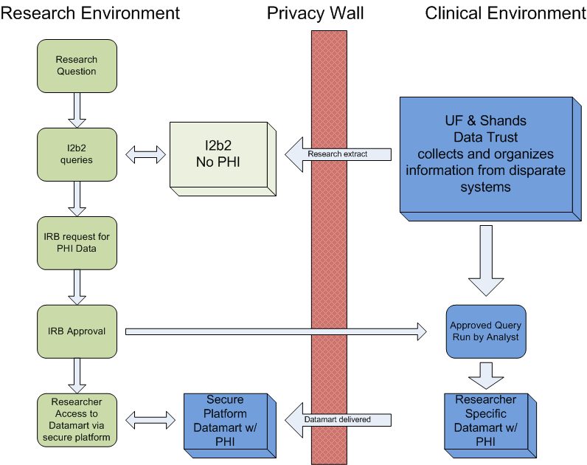
Integrated Data Repository

Slide 8
I2B2 Cohort Discovery
Patients 329,986
Visits 1,786,999
Procedures 9,957,757
Diagnoses 12,388,053
Adding 600K procedures per month
IDR will double in size when Jacksonville is added in summer, 2013

Slide 9
Virtual Desktop Interface (VDI)
PHI from the IDR may be released to the investigator
Under IRB approval
With a Data Use Agreement
Data released from the IDR will be provided in a secure environment – a VDI that enable the investigator to analyze the data without having to move the data to insecure environments
See http://vdi.ahc.ufl.edu to get started

Slide 10
IDR Timeline

Slide 12
IDR support and governance
The IDR is jointly sponsored by Shands and the CTSI
The support team includes data modelers, analysts, programmers, DBAs, ETL experts
A steering committee meets regularly to set direction and monitor progress
For more information, please contact the IDR project lead, Gigi Lipori (pflugg@shands.ufl.edu)

Slide 13
I2B2 Training and Sign on
I2B2 training is available on-line at the IDR web site:
http://idr.ahc.ufl.edu/i2b2/i2b2-training-module/
Once training is complete (10 minutes), you can apply for sign on to i2b2
Once approved (next day), you can sign on to i2b2 at:
http://i2b2.idr.ahc.ufl.edu

Slide 14
Professional Services
Professional services are available if your queries are complex, or you are unfamiliar with Shands clinical data, its coding and its nuances
Professional services for developing cohorts and creating datasets is available at cost ($$)
Contact Dr. Felix Liu (felix.liu@ufl.edu) for an appointment regarding your IDR needs.

Slide 17
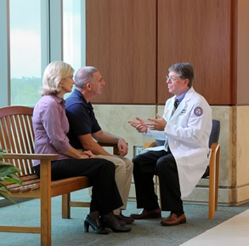
Consent2Share
Initiated on 9/11/12
Consent form given with admissions packet
Consent asks 2 questions
Can we store your excess tissue with protected health information?
Can we re-contact you for a future study?
Collected by admissions clerk, data entered into EPIC, consent form scanned with other documents
Patient’s physician can access pt response, answer questions
Informed Consent Hotline to answer initial questions
CTSI patient research advocate for more detailed queries
Results to date (>10,000)
85% “yes” for samples
79% “yes” for recontact

Slide 18
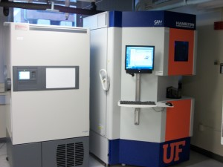
CTSI Biorepository
Biospecimen collection, processing and storage. Stored biospecimens can be used by any researcher with IRB-approved protocols.
Prospective biospecimen collection to fulfill investigator needs for IRB-approved protocols.
Storage for biospecimens collected by investigators. Stored biospecimens belong solely to the investigator.
Oversight of the release of biospecimens from the UF Department of Pathology for other IRB-approved research protocols.
Pathology services including those provided by the Molecular Pathology Core and confirmation of diagnosis by a board-certified pathologist upon request.
One of two Hamilton Storage Technologies’ SAM -80°C automated sample management systems (Robotic freezers). The biorepository also has eight Forma Thermo Scientific -80°C Freezers with back-up CO₂ and sensaphone alarm systems including back-up storage space, centrifuge for basic bodily fluid processing, QiaCube for small volume RNA, DNA and protein purification, Agilent Bioanalyzer for RNA, DNA and protein quality control analysis, OnCore BioSpecimen Management

Slide 19
Genetic Information from the UF & Shands Personalized Medicine Program
Challenge: genetic polymorphism of CYP2C19 leads to reduced ability to activate clopidogrel (Plavix) and increased risk of cardiovascular complication

Slide 20
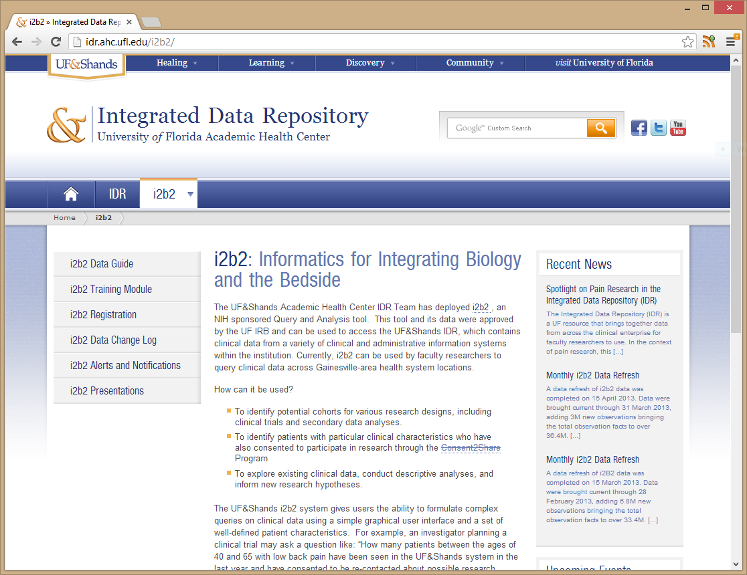
For More Information
On the web:
http://idr.ahc.ufl.edu

