Slide 1
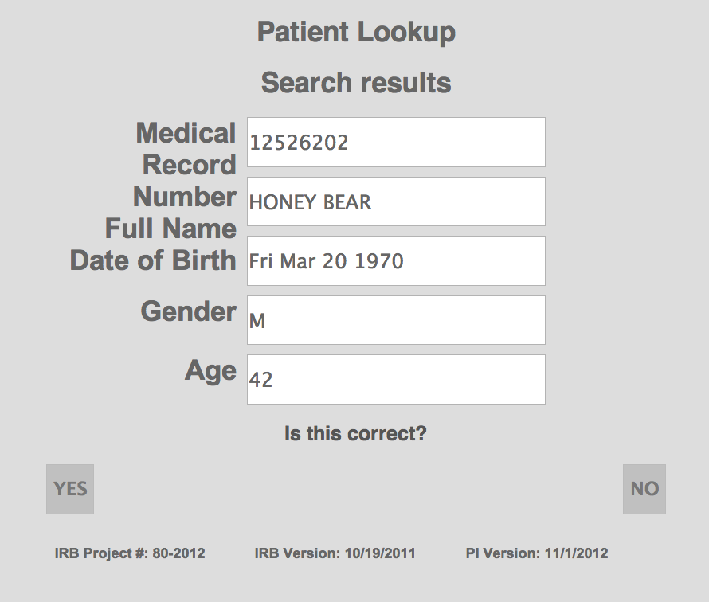
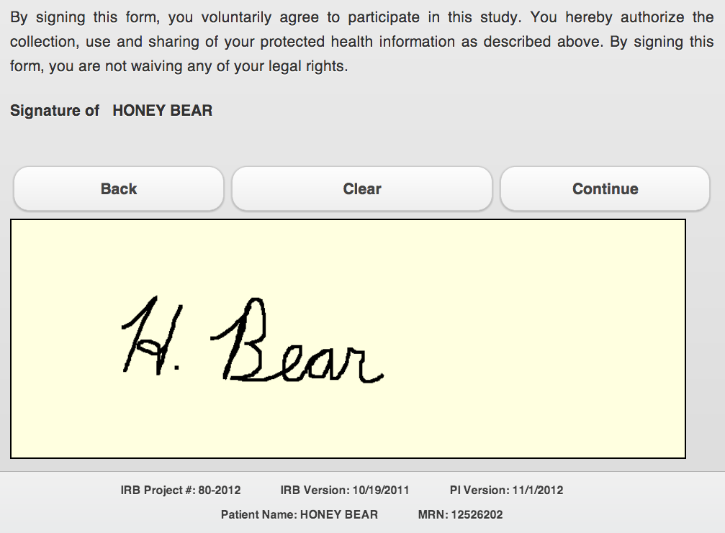
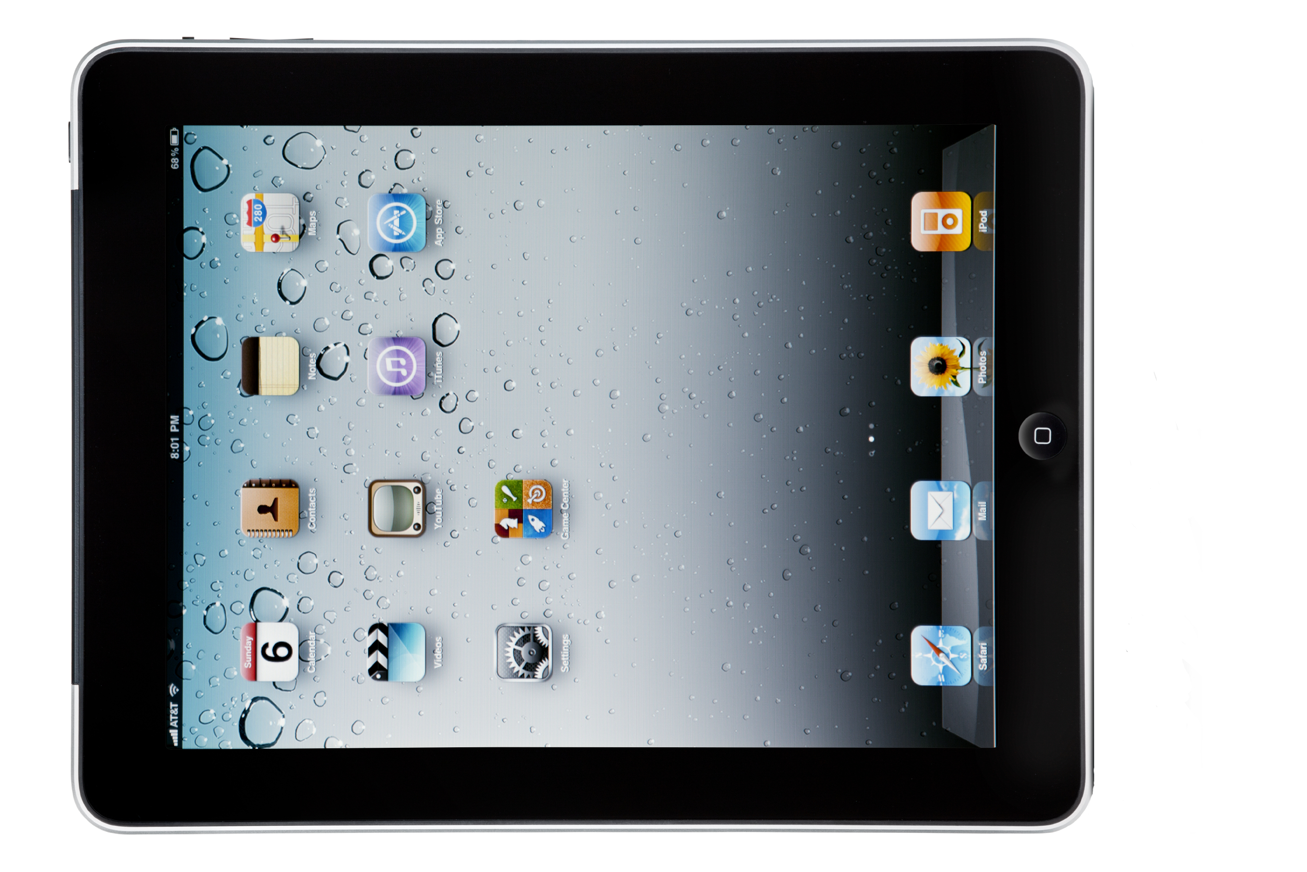
Electronic Research Consent Capture
Philip B Chase, BS¹, Amanda Elsey, MHA¹, Xiuyao Song, PhD², Francesca Levey, MBA³, Felix Liu, PhD¹
¹ Clinical and Translational Science Institute, University of Florida, Gainesville, FL, U.S.A.; ² Enterprise Software Engineering, University of Florida, Gainesville, FL, U.S.A.; ³ University of Michigan, Ann Arbor, MI, U.S.A.
Background
Piloted with the Personalized Medicine Program at the University of Florida, research consents are captured electronically at the point of care to improve the quality of consent data and make it more accessible to processes that need timely and accurate consent data. This is achieved by real-time integration with the clinical systems and subsequent data flow to a research data warehouse.
Introduction
The Personalized Medicine Project at the University of Florida introduced inexpensive, rapid genetic testing to determine if patients receiving cardiac catheterizations are good candidates for clopidogrel. The PMP project team selected a large assay of genetic tests of interest to researchers to exploit the unused capacity of the testing process. These tests are performed with the clinical tests and stored for research and potential clinical use if the patient consents to the research project. Data collection and use for the research component requires explicit consent from patients. We have implemented the Research Permissions Management System (RPMS) designed and written by the Medical University of South Carolina (MUSC).¹
Implementation
Using a mobile device, patients can review the consent documents and decide to have their additional genetic data included or excluded in research studies. Answers to consent questions and signature are collected and stored electronically in the consent database.
Patient identifiers, such as MRN, name, and date of birth, are verified via a lookup against real-time patient ADT data.
Patient identifiers are used within RPMS to assure the consent data can be reliably, and automatically joined with the lab data to determine if the non-clinical portion of the genetic assay should be preserved for research use and forwarded to the Integrated Data Repository.
Discussion
Compared with a paper-based consent process, an electronic consent process provides benefits in both data accuracy and accessibility since data quality checks can be made in real time in an electronic system while the subject candidate is available to review the feedback and respond to errors. Another benefit is that patients will always be consenting to the most current version of the consent form.
Of the patients contacted, 91% have agreed to participate in the study. 95% of study participants have been consented through RPMS. The study consents 59 participants per month.
Future Work
The UF pilot used the first version of RPMS. UF is reviewing the value of RPMS Version 2 as an institutional service.
Cohort Discovery
Research DB (IDR)
Verify Clinical Identifiers
Completed Consent Record
Records preserved for future clinical use
Collect data and sign electronically
Lab Genetic Data Store
Study reporting
Subject recontact
Study DB (REDCap)
Consent responses
Consent questions
New consent responses
Consent consumers
Demographic data
Request for new consents
Is MRN valid?
References
¹ Obeid J, Gerken K, Madathil K, Rugg D, Alstad C, Fryar K, Alexander R, Gramopadhye A, Moskowitz J, Sanderson I. Development of an Electronic Research Permissions Management System to Enhance Informed Consents and Capture Research Authorizations Data. Accepted for 2013 AMIA Summit on Clinical Research Informatics. March 20-22, 2013.
This work supported in part by the NIH/NCRR Clinical and Translational Science Awards to the University of Florida UL1 RR029890, KL2 RR029888 and TL1 RR029889.

