Slide 1
National Data Management Trends and Challenges
Mike Conlon, PhD
Director of Biomedical Informatics,
Chief Operating Officer
UF Clinical and Translational Science Institute
The UF CTSI is supported in part by NIH awards UL1 TR000064, KL2 TR000065 and TL1 TR000066

Slide 2
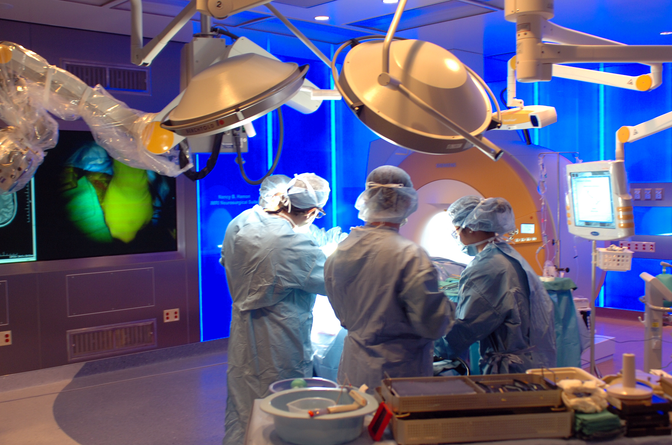
Data Production
Notes:
Data producers – labs, hospitals, “clipboards”. Get ready to archive – what should be saved, semantics, technology

Slide 3
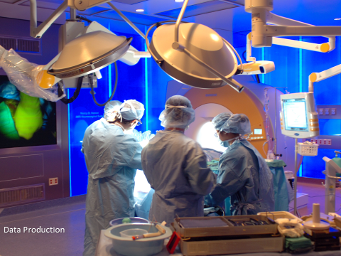
We represent the natural world in computer systems as data
Provider | Name | Speciality | Cert
1640 | Anansi, … | Urology | 872312
1751 | Abbot, … | OBGYN | 909832
453123123 | Park, … | PO Box … | None
MRN | Lab | Order | Fulfill
333234432 | 33214-7 | 20130212 | 20130214
434234234 | 36637-1 | 20130213 | 20130214
453123123 | 23322-1 | PO Box … | 20130214
MRN | Diagnosis | Date | Provider
123123132 | J41.1 | 20130112 | 1640
123123132 | H18.12 | 20100714 | 1751
453123123 | Park, … | PO Box … | 1834
MRN | CPT | Date | Assess
123123132 | 99396 | 20130312 | Normal
123123132 | 99321 | 20130312 | Poor
453123123 | Park, … | PO Box … | Normal
MRN | Name | Address | Insurer
123123132 | Johns, … | 1234 W … | 23423
432342342 | Smith, … | Apt 6, … | 34433
453123123 | Park, … | PO Box … | None

Slide 4
We collect data for a purpose
In research: to answer a question
In mining: to find patterns
In clinical settings: to treat and bill

Slide 5
Data Management
Data Representation
Data Capture
Data Flow
Data Preservation
Data Curation
Data Citation
Data Management Plans

Slide 6
Data management (and data management plans) have a presumption of reuse. Perhaps we should call the plans data reuse plans.

Slide 7
Data Representation
Is the key to reuse
Use Standard vocabularies and ontologies
The development and choice of vocabularies and ontologies is difficult

Slide 8
Data Preservation is typically beyond the capability of the research team.
Engage specialists (Data Coordinating Center, Informatics Team, Library, Research Computing, …)
The economics of preservation are troubling.

Slide 9
Data Curation
Improving the quality of the data – correcting errors, resolving discrepancies, matching to vocabularies
Making decisions about on-going preservation
Requires domain expertise/collaboration

Slide 10
Data Curation
does not end when the project ends
The economics of data curation are very troubling

Slide 11
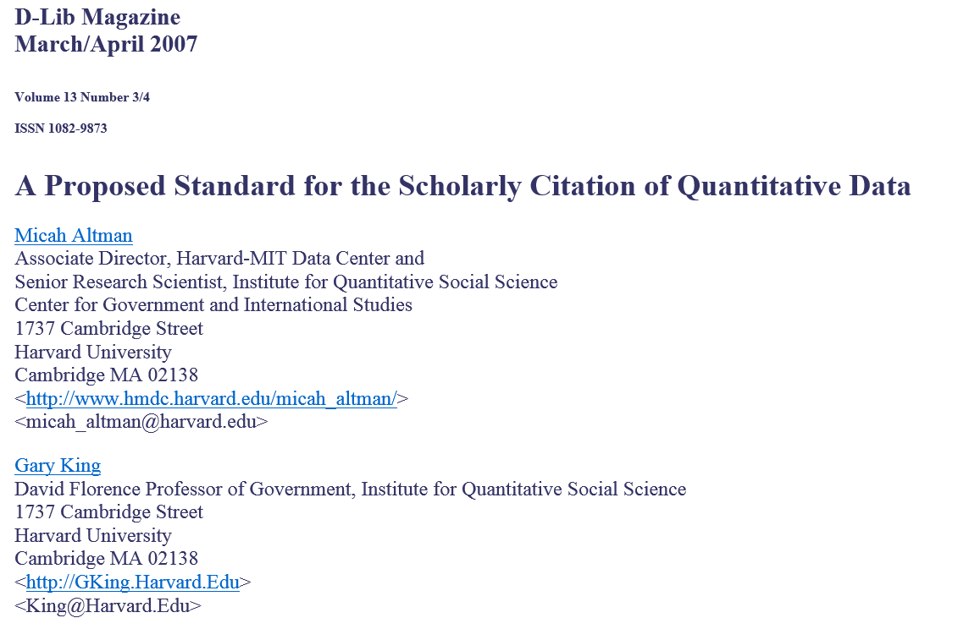
Data Citation

Slide 12
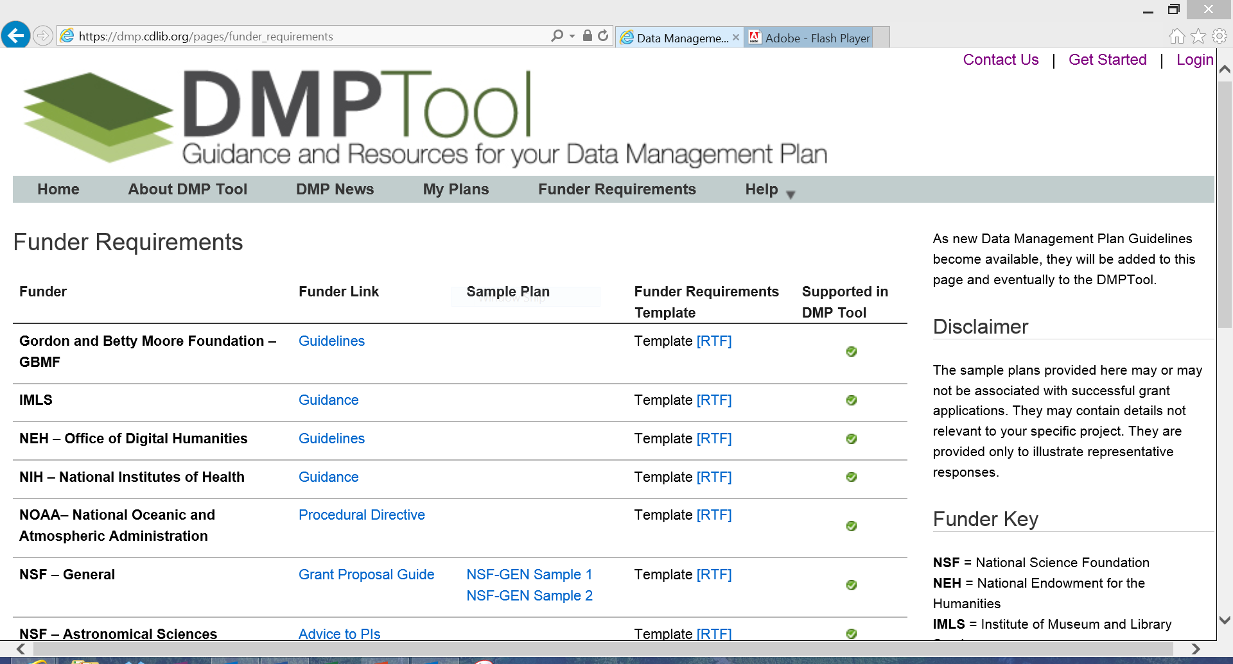

Slide 13
Some Projects

Slide 14
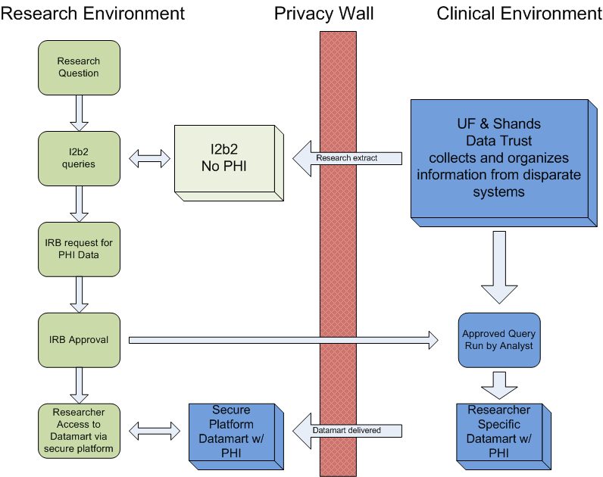
Integrated Data Repository

Slide 15
I2B2 for Cohort Discovery

Slide 16
Consent2Share
Initiated on 9/11/12
Consent form given with admissions packet (pt. specific bar code)
Consent asks 2 questions
Can we store your excess tissue with PHI?
Can we re-contact you for a future study?
Collected by admissions clerk, data entered into EPIC, consent form scanned with other documents
Patient’s physician can access patient response, answer questions
Informed Consent Hotline to answer initial questions
CTSI patient research advocate for more detailed queries
Results to date (>8,000):
86% patients returned signed forms
85% checked “yes” for samples
79% checked “yes” for recontact

Slide 17
Data Flow for Consent2Share
Clinic
Paper Form
EMR
Scanned Image
IDR
Data Elements and Dates
Next: Continue roll-out to additional clinics

Slide 18
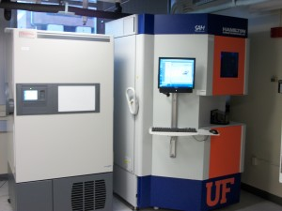
CTSI Biorepository
Biospecimen collection, processing and storage. Stored biospecimens can be used by any researcher with IRB-approved protocols.
Prospective biospecimen collection to fulfill investigator needs for IRB-approved protocols.
Storage for biospecimens collected by investigators. Stored biospecimens belong solely to the investigator.
Oversight of the release of biospecimens from the UF Department of Pathology for other IRB-approved research protocols.
Pathology services including those provided by the Molecular Pathology Core and confirmation of diagnosis by a board-certified pathologist upon request
One of two Hamilton Storage Technologies’ SAM -80°C automated sample management systems (Robotic freezers). The biorepository also has eight Forma Thermo Scientific -80°C Freezers with back-up CO₂ and sensaphone alarm systems including back-up storage space, centrifuge for basic bodily fluid processing, QiaCube for small volume RNA, DNA and protein purification, Agilent Bioanalyzer for RNA, DNA and protein quality control analysis, OnCore BioSpecimen Management

Slide 19
Biorepository Data Flow
Sample Vials & worksheets
Bar codes
Oncore BMS
IDR
All sample information
Sample information linked to phenotypic information
Collection information

Slide 20
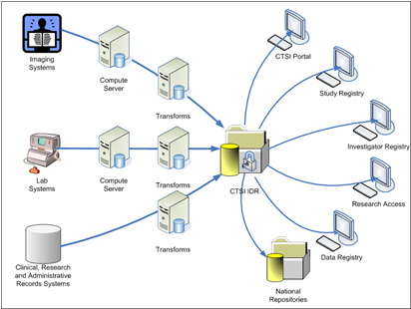
Continue to build integrated data repository
Three in One

Slide 21
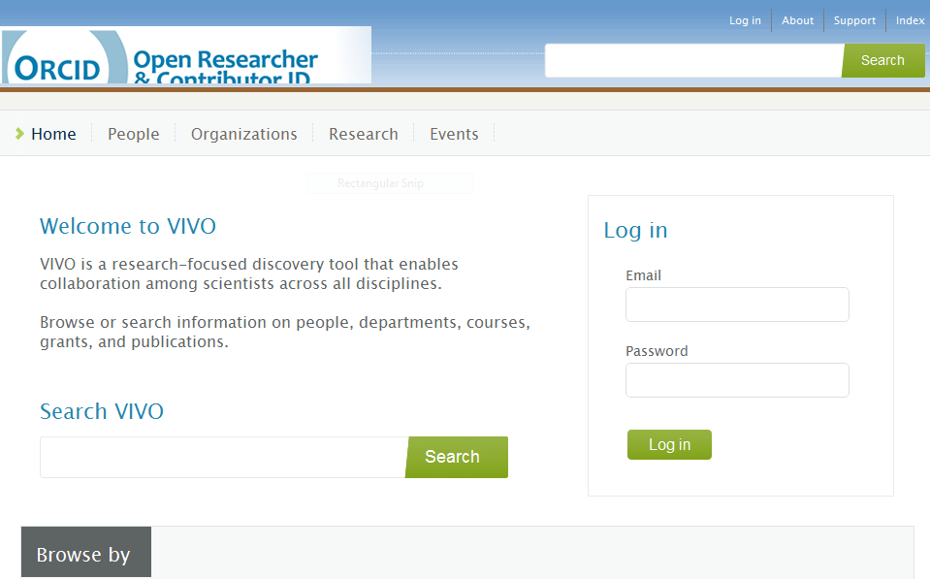
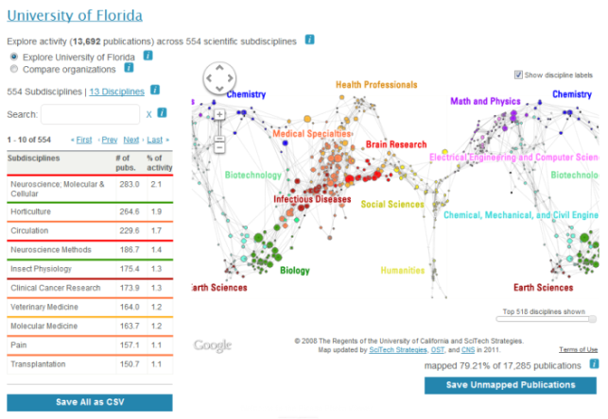
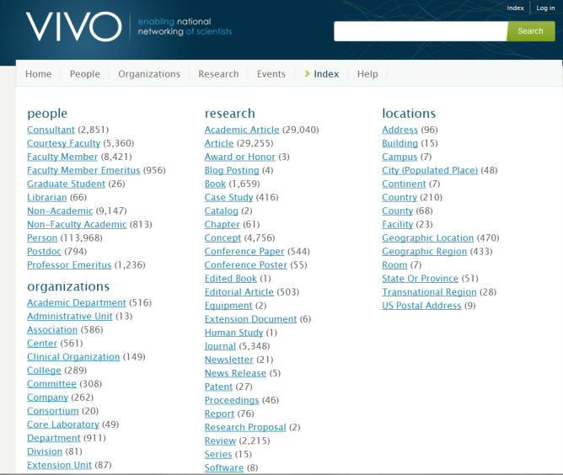
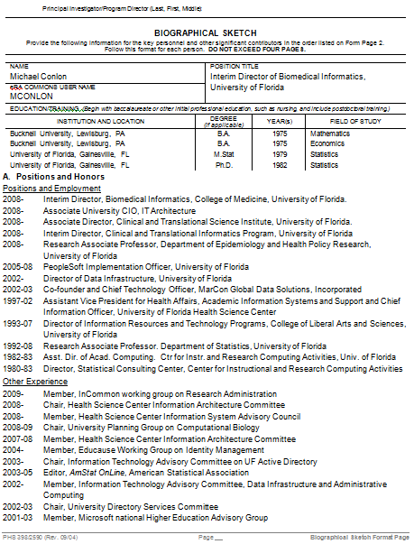
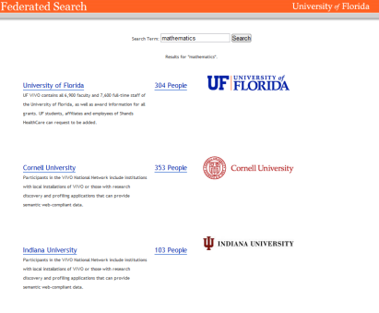
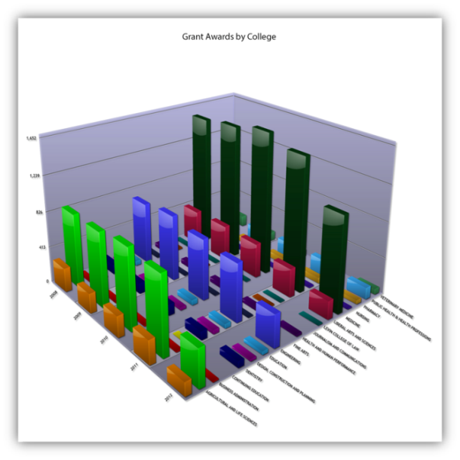
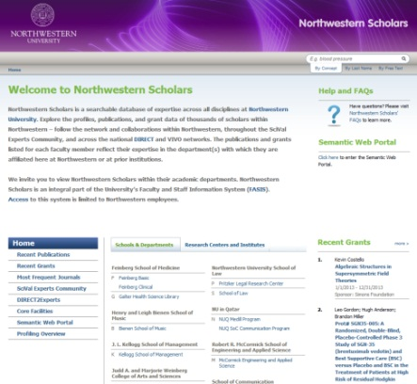
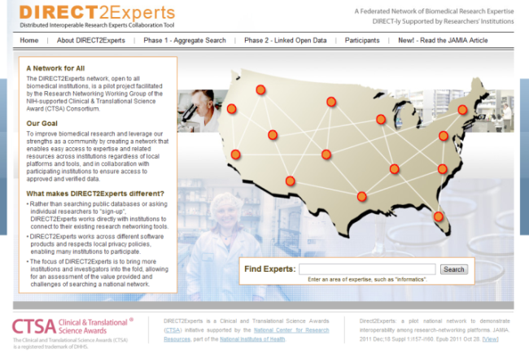
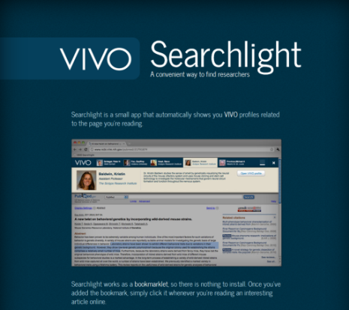
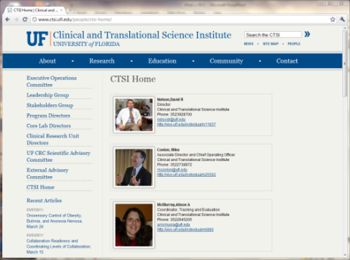
VIVO: An International Resource for Scholarship
Notes:
Data is then reused in a wide array of tools and setting. Data in eThority. To be used for APR.

Slide 22
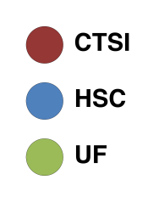
UF Co-Funded Network
Chris McCarty & Raffaele Vacca, UF Bureau of Business and Economic Research
2008
2012
Data source: UF Division of Sponsored Research (DSR) database
Each node represents one Contract PI, Project PI or Co-PI linked by a common PeopleSoft Contract number
Nodes are sized by Total Awarded in UF fiscal year (July-June)
Main Component: what changes have occurred between 2008 and 2012?
More of Health Science Center comes under the CTSI umbrella
The CTSI has a broader reach in the whole network
Increasingly the CTSI incorporates all researchers in relevant areas (areas not relevant to CTSI research fields naturally remain out of its network)

Slide 23
Collaboration and Coordination
At UF – Libraries, CTSI, AHC IT, Office of Research, Enterprise Systems, Registrar, Business Services
Federal – OSTP, NIH, NLM, NSF, USDA, EPA, FDA, NASA, FDP, …
Partners -- Symplectic, Pivot, Elsevier, Thomson-Reuters, ORCID, CiteSeer, CrossRef, OCLC, DuraSpace, CNI, Total-Impact, …
Ontology– EuroCRIS, CASRAI, NCBO, Eagle-I, CTSAconnect, …
Professional Societies – APA, AAAS, AIRI, AAMC, ABRF, …
International – Australia, China, Netherlands, UK, Canada, Brazil, …
Semantic Web community – DERI, Tim Berners-Lee, MyExperiment, Concept Web Alliance, Open Phacts (EU), Linked Data, …
Social Network Analysis Community – Northwestern, Davis, UCF, …
Universities -- Melbourne, Duke, Penn, Colorado, Eindhoven, Pittsburgh, Leicester, Cambridge, Stony Brook, Weill, Indiana, Scripps, Washington U, Ponce, Northwestern, Iowa, Harvard, UCSF, Florida, Stanford, MIT, Brown, Johns Hopkins, OHSU, Minnesota, and the CTSA consortium
Application and service providers – over 100
Software downloads (over 30,000) and contact list (over 1,600)

Slide 24
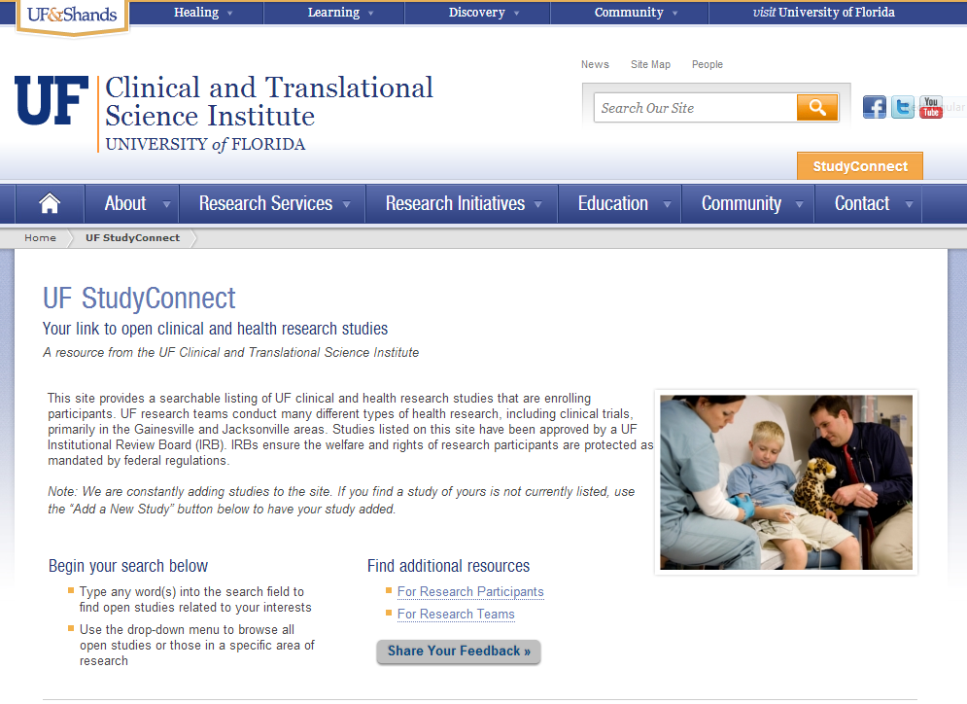
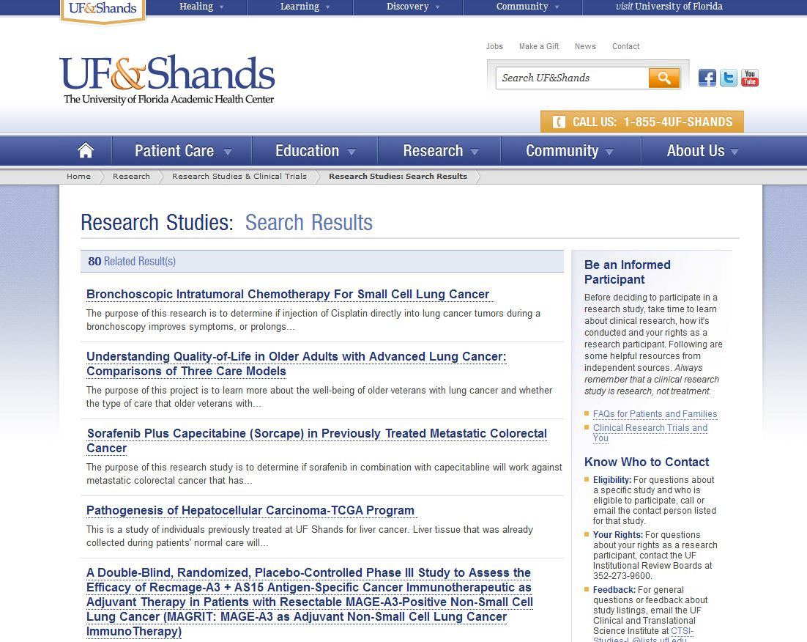
Study Registry and StudyConnect
Study Registry: All (9,400) human subject studies approved by 4 UF IRBs from 2008 to date.
StudyConnect: Web site with 400 active studies for potential research participants to find opportunities

Slide 25
Two Purposes:
1) Research management: understand the collection of human subject studies
2) Clinical research: facilitate recruitment

Slide 26
The Translational Research Continuum at UF: An Expansion of T3 and T4 Research
What works under
controlled conditions?
(Translation to Humans)
Basic Discovery
T1
Clinical
Efficacy
What is the effect
on population health?
(Translation to Population Health)
What works in
real world settings?
(Translation to Patients)
T4
T2
2008
^{(n= 862)}
2011
^{(n=912)}
Clinical Practice
T3
Clinical
Effectiveness
How can we
change practice?
(Translation to Practice)
CTSI Study Registry includes 9,401 human subject research protocols across four IRBs (medical and non-medical)
4,229 / 9,401 are considered medical and/or health related protocols
3,422 / 4,229 are categorized as translational research (T1 – T4)

Slide 27
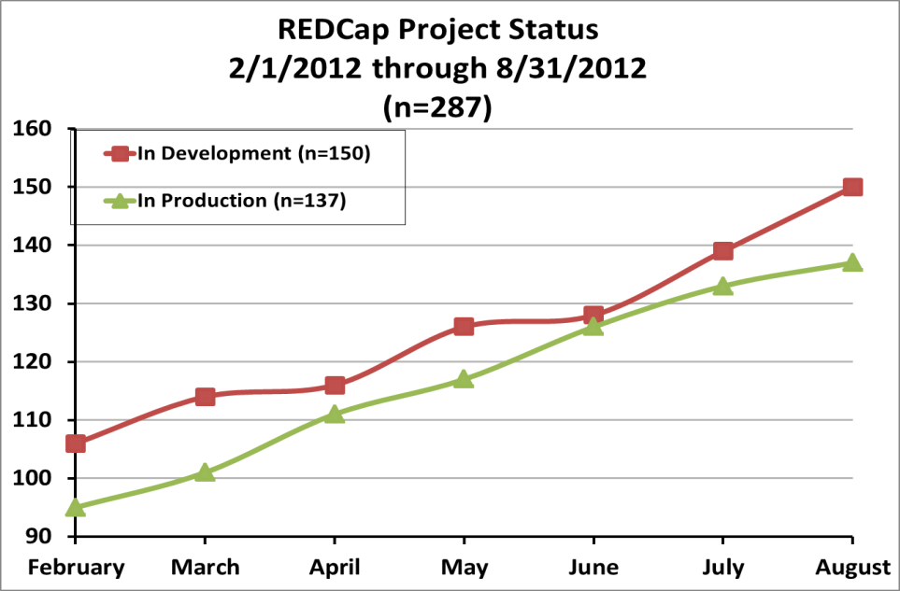
CTSI REDCap Services
No-charge, unlimited self-service access to REDCap and REDCap Survey
Training in REDCap data entry and study set-up
Support Services
Configuration Service
Participation in the national consortium
REDCap created for standard sign-on method (GatorLink, Incommon/Shibboleth)

Slide 28
REDCap and data management
“Makes it easy to do the right thing”
Time and event calendar, case report forms represent research visits and primary capture naturally
Future work will introduce vocabularies and ontologies
Future work will interface REDCap to electronic medical records
Future work will interface REDCap to devices for data capture

Slide 29
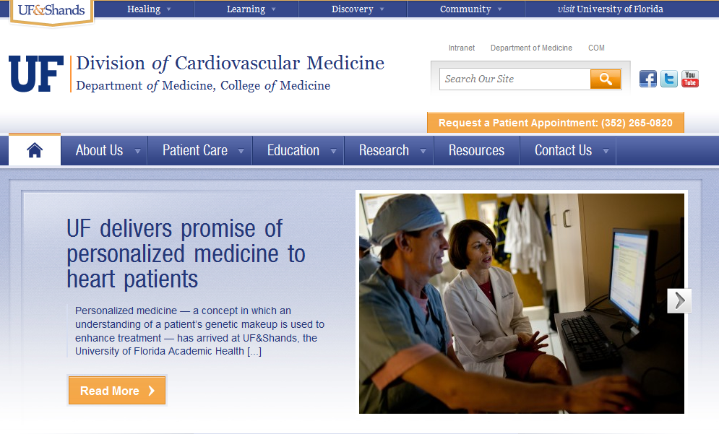
Personalized Medicine Program- Launched June 25, 2012
https://ufandshands.org/news/2012/uf-delivers-promise-personalized-medicine-heart-patients#!/-1/

Slide 30
Personalized Medicine Information Flow
Challenge: genetic polymorphism of CYP2C19 leads to reduced ability to activate clopidogrel (Plavix) and increased risk of cardiovascular complication
Hospital Best Practice Alerts Team
Hospital Orders
& Receipts
CTS IT
IDR Team
UF Pathology Lab IT

Slide 31
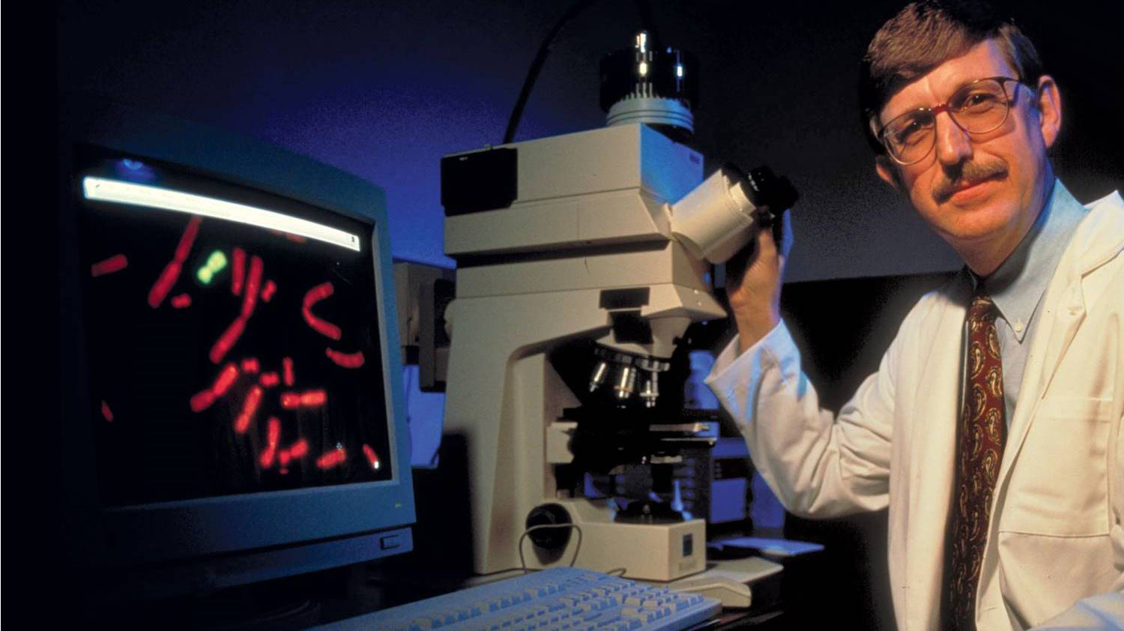
Molecular Medicine
Notes:
The rise of the molecular. Personalized medicine. Full base pair sequencing. Mars Curiosity lander. Nanotechnoloy. Metabolomics.

Slide 32
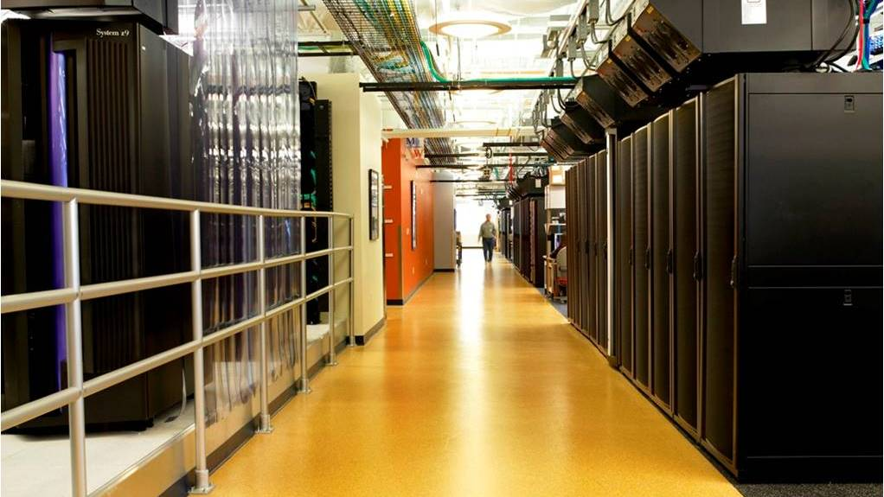
Data Got Big (IDR Slide)
Big Data Management
Notes:
Data got big. Terabytes, Petabytes, Exabytes.

Slide 34
Clinical research challenge
Create a connected, accessible, efficient, effective, compliant environment for CR that speeds development, execution and reporting of CR studies
Weill Cornell reported that their clinical research faculty were required to use more than 40 systems to conduct a CR study

Slide 35
Clinical Research Environment Focus CTSAs on conducting only high-quality translational research
Increase efficiency and decrease cost through institution-wide accountability and transparency
Clinical study oversight, timely recruitment, effective enrollment, and follow up, retention of participants, data quality and security, availability of highly trained study staff and ancillary services, and timely submission of adverse events
Broad culture of responsibility for safe and ethical conduct of human subjects research throughout the institutions participating in the CTSA
Appropriateness of specific study designs
Development of realistic recruitment goals
Steps to ensure timely feasibility assessment and closure of studies that don’t meet goals
Efficient institutional workflows for conduct of translational studies
Expectation of prompt analysis of results and dissemination of those results
Address tracking of all clinical studies at participating institutions from inception through review, activation, conduct, closure, analysis, and dissemination of results
Identify and address inefficiencies, troubled studies and bottlenecks
Ensure registration of all applicable trials with ClinicalTrials.gov
Facilitate participation by their research teams in multi-site studies, including willingness to adopt centralized IRB arrangements similar to those utilized in many NIH networks
Describe processes for clinical trial agreements and contracts and timelines for completion

Slide 36
Next Step:
Internal Planning Grant,
The Clinical Research Initiative

Slide 37
Data Sharing

Slide 38
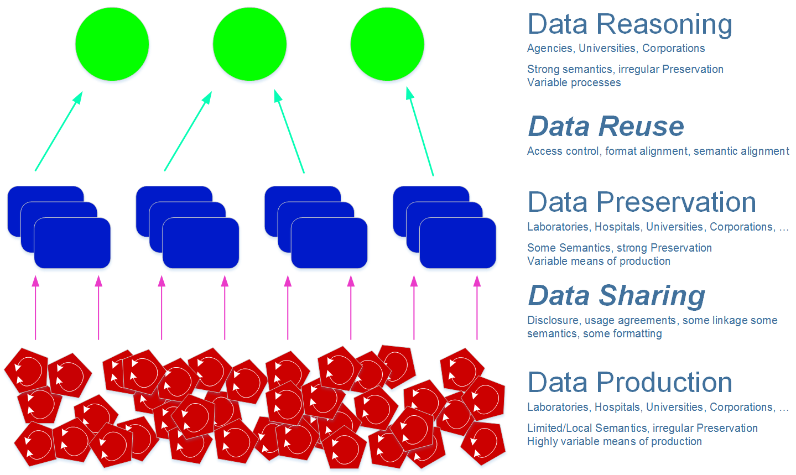

Slide 39
A Web of Data – The Semantic Web
Information is stored using the Resource Description Framework (RDF) as subject-predicate-object “triples”
Dept. of Genetics
College of Medicine
professor in
Jane Smith
has affiliation with
Genetics Institute
author of
Journal article
Book
Book chapter
Subject
Predicate
Object
Notes:
VIVO 1.2 includes a new ontology module representing research resources including biological specimens, human studies, instruments, organisms, protocols, reagents, and research opportunities. This module is aligned with the top-level ontology classes and properties! from the NIH-funded eagle-i Project (https://www.eagle-i.org/home/).

Slide 40
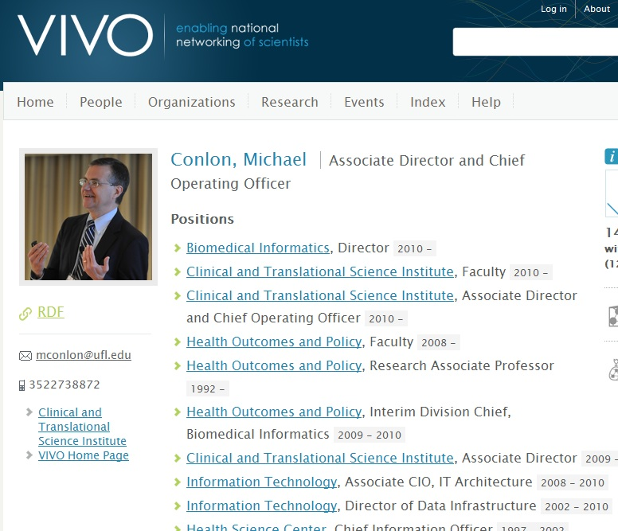
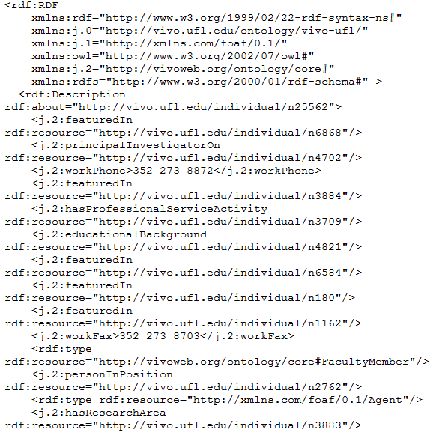
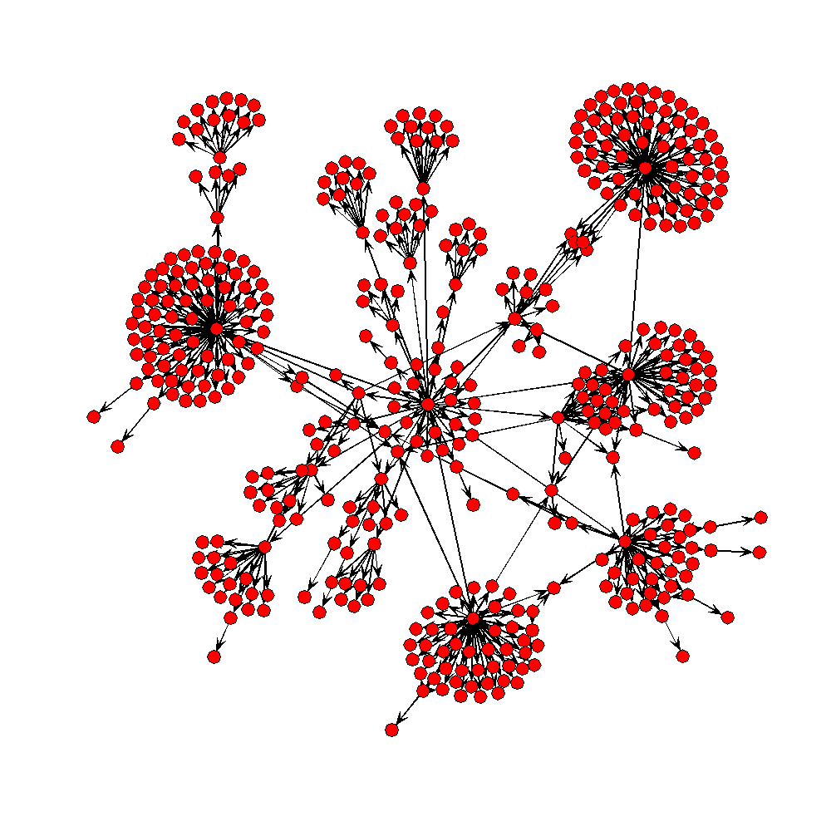
Software reads RDF from VIVO and displays
processOrg<-function(uri){
x<-xmlParse(uri)
u<-NULL
name<-xmlValue(getNodeSet(x,"//rdfs:label")[[1]])
subs<-getNodeSet(x,"//j.1:hasSubOrganization")
if(length(subs)==0) list(name=name,subs=NULL)
else {
for(i in 1:length(subs)){
sub.uri<-getURI(xmlAttrs(subs[[i]])["resource"])
u<-c(u,processOrg(sub.uri))
}
list(name=name,subs=u)
}
}
VIVO produces human and machine readable formats
Notes:
The open architecture of VIVO and linked data supports development of applications outside VIVO that consume VIVO data. VIVO data is accessible via HTML (for humans) and RDF (for machines). Simple software can process the RDF resulting in powerful cross-site applications. The figure depicts the organization of the University of Florida.

Slide 41
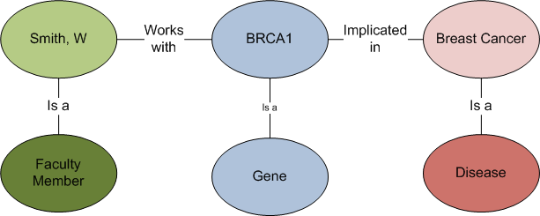
A Consumption Scenario
Find all faculty members whose genetic work
is implicated in breast cancer
VIVO will store information about faculty and associate to genes.
Diseaseome associates genes to diseases.
Query resolves across VIVO and data sources it links to.

Slide 42
Data Reasoning
“Linked Life Data” integrates common public datasets that describe the relationships between gene, protein, interaction, pathway, target, drug, disease and patient and currently consist of more than 5 billion RDF statements. The dataset interconnects more than 20 complete data sources and helps to understand the “bigger picture” of a research problem by linking previously unrelated data from heterogeneous knowledge.
From the LarKC (Large Knowledge Collider) http://www.larkc.eu/overview/

Slide 43
Notes:
Transformation, Services, Education. Build Understanding, Build Teams

Slide 44
Questions?
mconlon@ufl.edu

