Slide 1
RCM 2013-2014 BUDGET REVIEW
George A. Smathers Libraries
Judith C. Russell
March 12, 2013

Slide 2
BACKGROUND
The George A. Smathers Libraries have two main components under RCM
The Health Science Center Libraries
The University Libraries
The HSC Libraries are funded through units of the Health Science Center
The University Libraries are funded through the other academic and research units, with the exception of the College of Law
Notes:
Legal Information Center is funded through the budget for the College of Law.

Slide 3
BACKGROUND
The Smathers Libraries embody the distinct characteristics of the University and its mission across all disciplines: to develop the human intellect through teaching and learning and to contribute through research to the expanding body of human knowledge
The Smathers Libraries are dedicated to supporting the University’s threefold mission of teaching, research, and service
Notes:
Comprehensive university with unique scale and scope.
Extremely high demand for content and services to serve a diverse population.

Slide 4
BACKGROUND
Flat Funding Request: $28,225,829
$26,599,749 (2012-2013 actual with $300,000 increase from HSC for HSC Libraries) plus $1,626,080 for essential library materials
Optimal Funding Request: $32,044,217

Slide 5
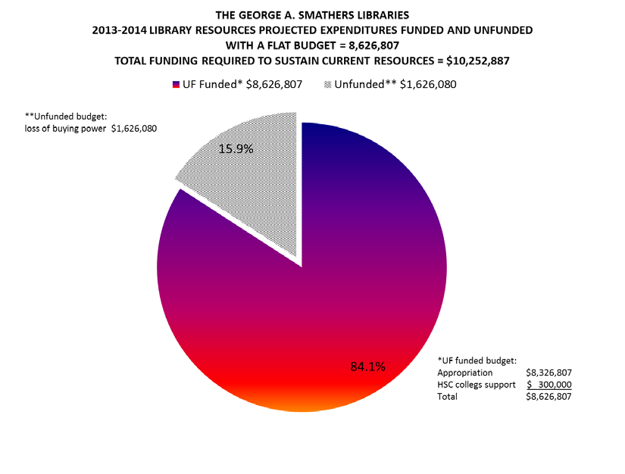
Notes:
This pie chart is in the Smathers Libraries 2013-1024 RCM Budget Review and was also included in the cover e-mail message transmitting the budget review to the committee.
You will see this slide again later in the presentation, and I think it’s significance will be clearer at that time.
The Libraries current materials budget is $8.6 million, which is $1.6 million below the amount needed to maintain the content we currently provide to students, faculty, researchers, and clinicians.
This will not restore the depth and breadth of library materials to the levels that we had even five years ago, but it is essential to avoid significant additional cuts.

Slide 6
AGENDA FOR TODAY
Peer Analysis: UF Libraries funding compared to peer AAU universities
Greatest Need: Funding for library materials essential to students, faculty, researchers, and clinicians
2013-2014 Budget Request
Flat Funding plus $1.6 million for materials
Optimal Funding to improve collections and services

Slide 7
PEER ANALYSIS
Compared UF to 8 Public AAU Universities
All with 4 or more Health Colleges
All with a College of Law
All with U.S. News Ranking above 30
All members of the Association of Research Libraries (ARL)
4 are land grant universities
Notes:
Prepared for the 2010-2011 RCM budget review

Slide 8
PEER ANALYSIS, continued
Peer Universities
University of Michigan (#4)
University of North Carolina, Chapel Hill (#5)
University of Wisconsin, Madison (#9)
University of Washington (#11)
University of Florida (#15)
Ohio State University (#18)
University of Pittsburgh (#20)
University of Minnesota (#22)
Michigan State University (#29)
Notes:
Rankings by U.S. News & World Report current as of June 2010.

Slide 9
PEER ANALYSIS
ARL data for 7 factors that report library RESOURCES for materials and staff (2008)
NCES data for 7 university factors that correlate with DEMAND for library resources & services (2008)
Notes:
ARL data reports for all libraries, so the legal information center statistics are included in the peer analysis.
Appropriate due to collaborative purchasing and other resources sharing at ARL institutions.

Slide 10
LIBRARIES | Avg. Excluding UF | UF as % of Non-UF Avg.
EXPENDITURES
Library Materials Expenditures | $14,820,857 | 84%
Total Library Expenditures | $39,116,382 | 73%
PERSONNEL-SALARIES
Salaries & Wages Professional Staff | $9,602,922 | 63%
Total Salaries & Wages | $18,656,818 | 75%
PERSONNEL-FTE
Professional Staff (FTE) | 149 | 68%
Support Staff (FTE) | 192 | 99%
Total Staff (FTE) | 454 | 84%
Notes:
HANDOUT 1

Slide 11
UNIVERSITY | Avg. Excluding UF | UF as % of Non-UF Avg.
PhDs Awarded | 635 | 135%
Prof Degrees Awarded | 626 | 200%
Total PhDs and Prof Degrees | 1,261 | 167%
PhD Fields | 95 | 131%
Faculty (Full-Time) | 3,449 | 128%
Total Student Enrollment | 43,195 | 119%
Total Graduate & Prof Students | 12,579 | 134%
Notes:
HANDOUT 1

Slide 12
PEER ANALYSIS, continued
UF Libraries are BELOW average for every library RESOURCE factor for materials and staffing
UF is ABOVE average for every university factor correlating with DEMAND for library resources and services

Slide 13
PEER ANALYSIS, continued
More useful comparison by accounting for differences in scale at the peer institutions
Analyzed correlations between ARL data on library expenditures and NCES data on university factors
The highest correlation was with total university budget (R² = 0.8278)

Slide 14
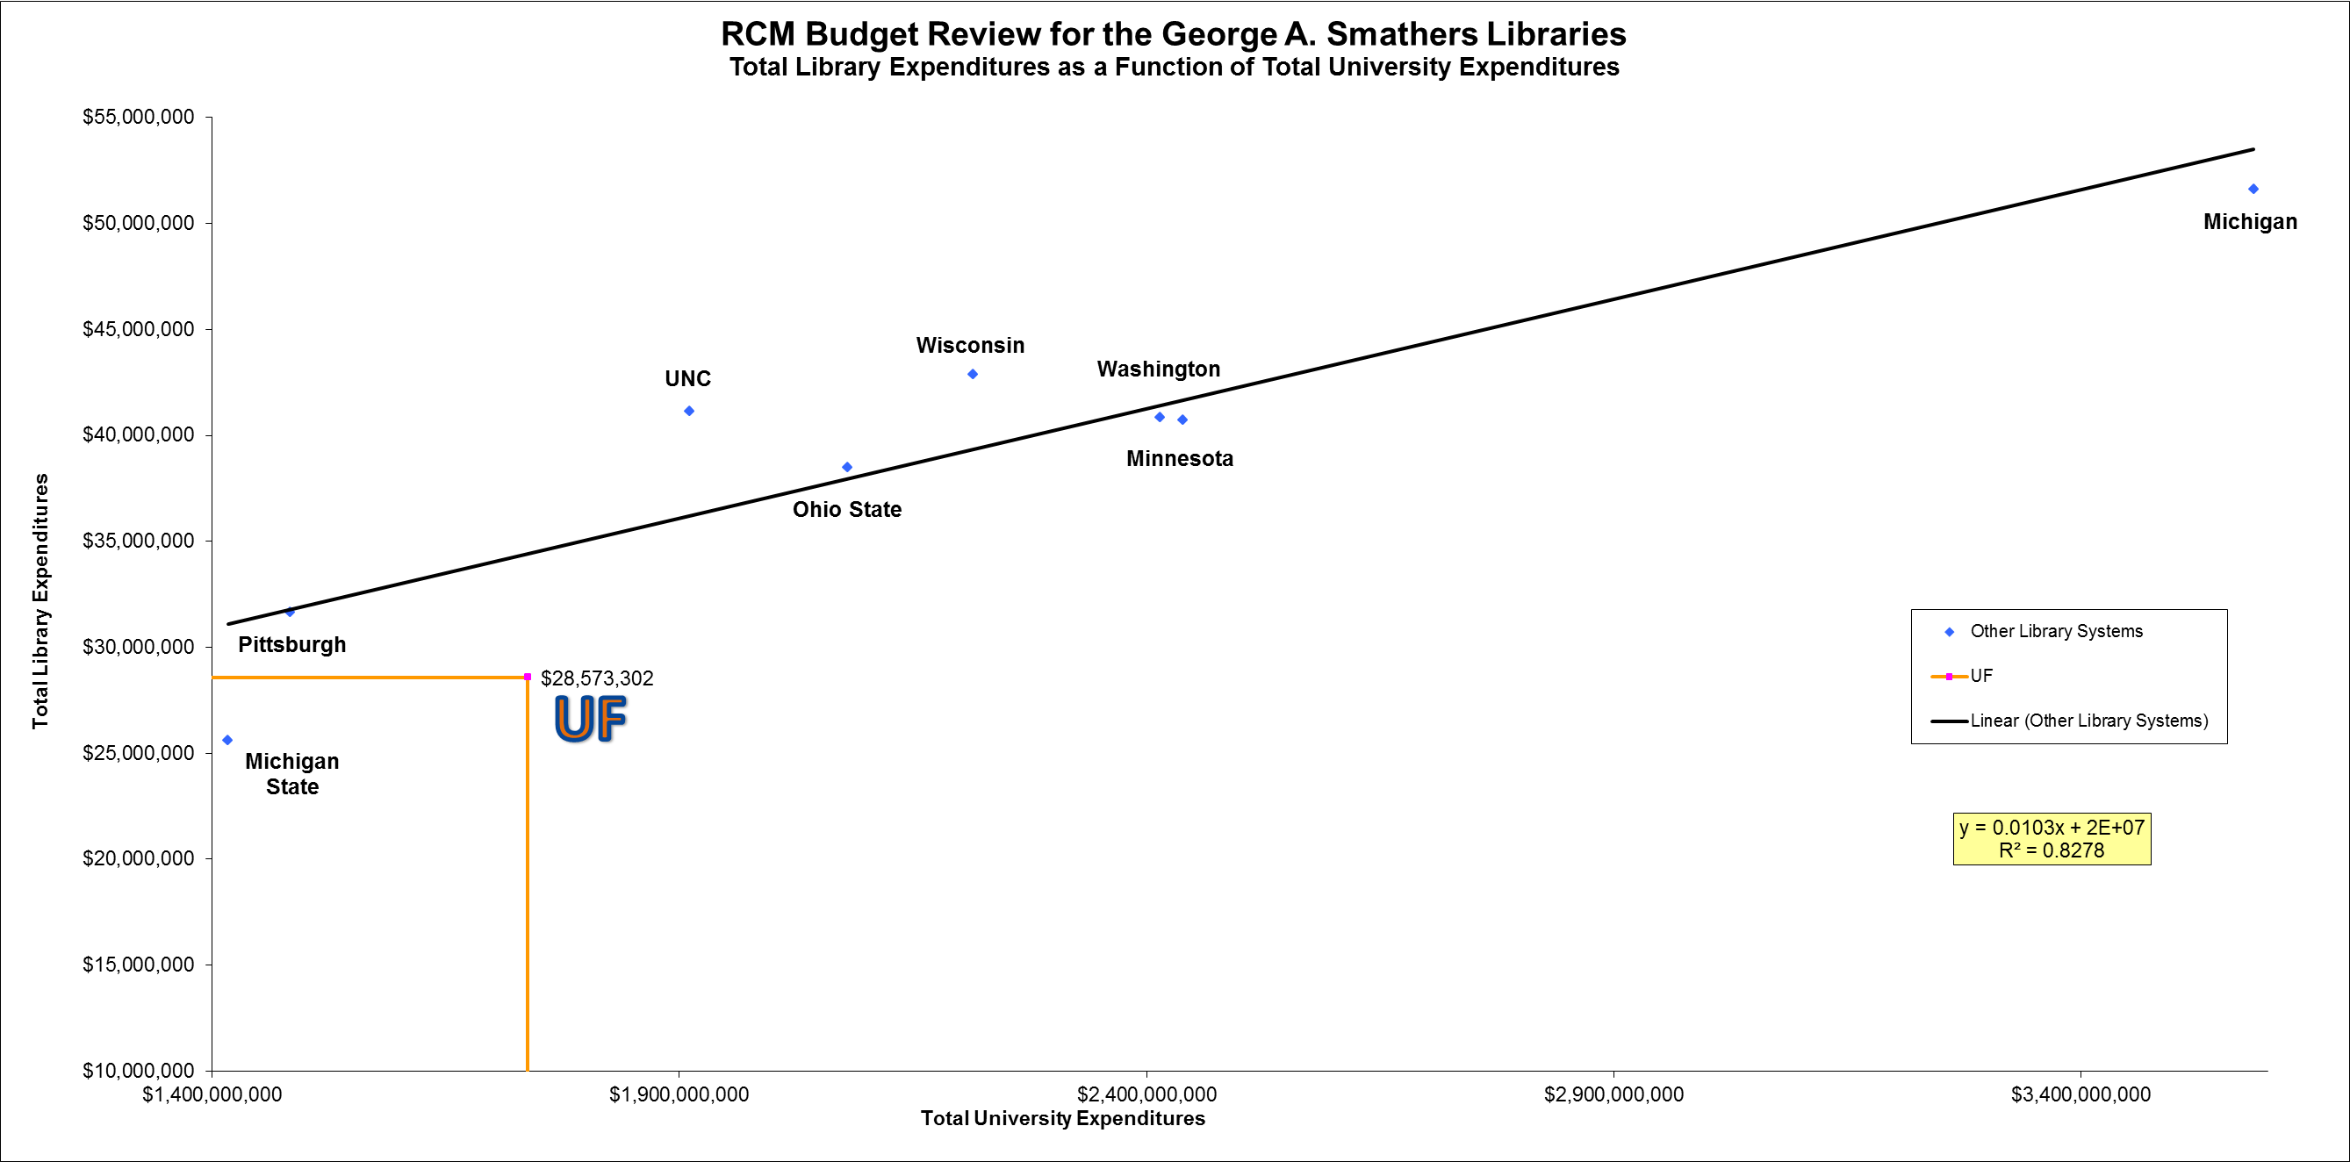
Notes:
HANDOUT 2
To account for differences in scale at the peer institutions, we analyzed correlations between ARL data on library expenditures and NCES data on university factors that correlate with demand for library resources and services.
The highest correlation was with total university budget, and it was a very high correlation (R² = 0.8278).

Slide 15
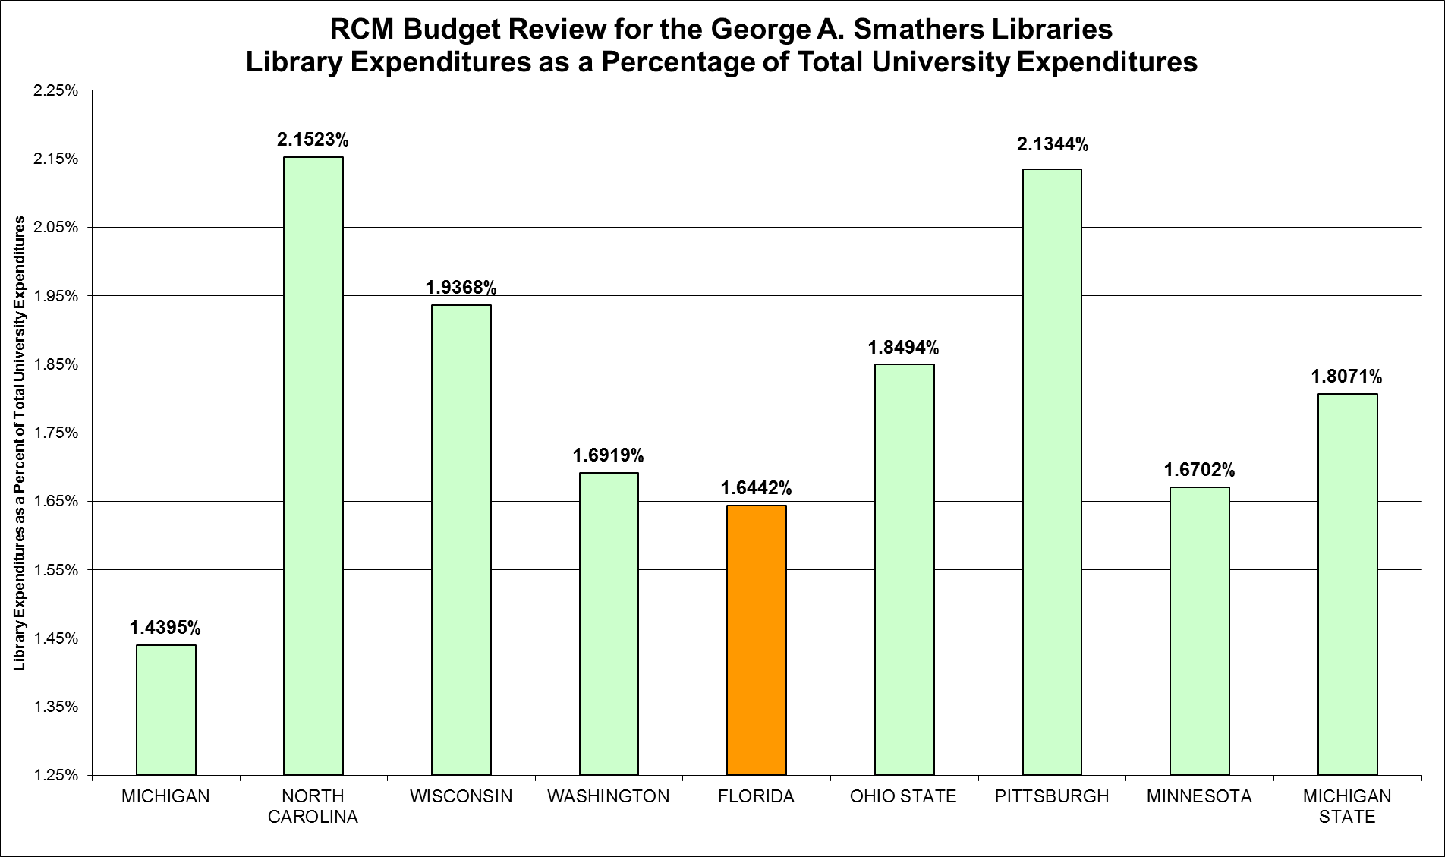
PEER ANALYSIS, continued
Notes:
HANDOUT 3
University of Michigan Libraries are very well funded, although the total university budget is so high that the library budget is a lower percentage of the total university budget than the other peer institutions.
With the exception of Michigan, the UF Libraries funding is the lowest percentage.

Slide 16
PEER ANALYSIS, continued
Average library expenditures as % of university budget (8 peers without UF): 1.8352%
Library expenditures as % of university budget (UF): 1.6442%

Slide 17
PEER ANALYSIS, continued
Application of Linear Regression Formula to UF
Total UF Expenditures | Projected Library Expenditures | Actual Library Expenditures | Difference
$1,737,832,000 | $37,899,670 | $28,573,302 | $9,326,368
Data from 2008
Notes:
Conclusion based on peer analysis: UF Libraries are significantly underfunded compared to the libraries at these peer institutions.

Slide 18
PEER ANALYSIS, updated
Application of Linear Regression Formula to UF
Using 2009 Data
Total UF Expenditures | Projected Library Expenditures | Actual Library Expenditures | Difference
$2,121,460,000 | $41,851,038 | $28,147,202 | $13,703,836
Notes:
Initial Peer Analysis used 2008 data from ARL and NCES (the latest available at the time).
2009 NCES data is now available and the linear regression analysis shows the gap is widening, not closing

Slide 19
PEER ANALYSIS, updated
The average Total Library Expenditures for the 8 peer institutions increased by $1,027,589 from 2008 to 2012
The Total Library Expenditures for UF Libraries increased by $7,858 from 2008 to 2012

Slide 20
PEER ANALYSIS, updated
PROPORTION OF LIBRARY EXPENDITURES | Materials and Operations | Staffing
Median for Peers | 50% | 48%
Average for Peers | 54% | 46%
University of Florida | 53% | 47%
Notes:
Ratio of spending on materials and personnel is consistent with our peer libraries.
This does not mean that the budget amount is appropriate. The UF staffing is 68% of the average staffing for our peer libraries and the UF materials budget is 84% of the average for our peer libraries.

Slide 21
Smathers Libraries Staffing
Decrease in Smathers Libraries Staffing 2009-2010 Through 2011-2012
 | Faculty & Other Professionals | Non-Professional Staff | Total
2010 | 97 | 186 | 283
2011 | 85 | 172 | 257
2012 | 81 | 167 | 248
Notes:
Salaries and Benefits are currently 47% of the Total Library Budget. Median for the 8 Peer Institutions is 48%.
To protect the Materials Budget, the Libraries have given up vacant positions in response to budget cuts.

Slide 22
GREATEST NEED
Notes:
This pie chart is in the Smathers Libraries 2013-1024 RCM Budget Review and was also included in the cover e-mail message transmitting the budget review to the committee.

Slide 23
Notes:
HANDOUT 4

Slide 24
Notes:
HANDOUT 4

Slide 25
Notes:
HANDOUT 5
2011-2012 drop in carry forward includes $428,000 recall by the University.

Slide 26
2013-2014 Budget Request
Flat Funding Request: $28,225,829
$26,599,749 (2012-2013 actual with $300,000 from HSC for HSCL) plus $1,626,080 for essential library materials
To avoid loss of core content for students, faculty, researchers, and clinicians, a “Flat Budget” MUST include an additional $1,626,080 for materials

Slide 27
2013-2014 Budget Request
Optimal Budget includes a total increase of $5.5 Million, which would protect core content and allow acquisition of new content and provision of high-demand services
This is still $3.8 million below the 2008 gap of $9.3 Million relative to peer institutions
$8.2 million below the 2009 gap of $13.7 Million

Slide 28
Additional Information:
− Judy Russell, Dean of University Libraries: jcrussell@ufl.edu; 352-273-2505
− Brian Keith, Associate Dean for Administrative Services & Faculty Affairs: bwkeith@ufl.edu ; 352-273-2595

