Slide 1
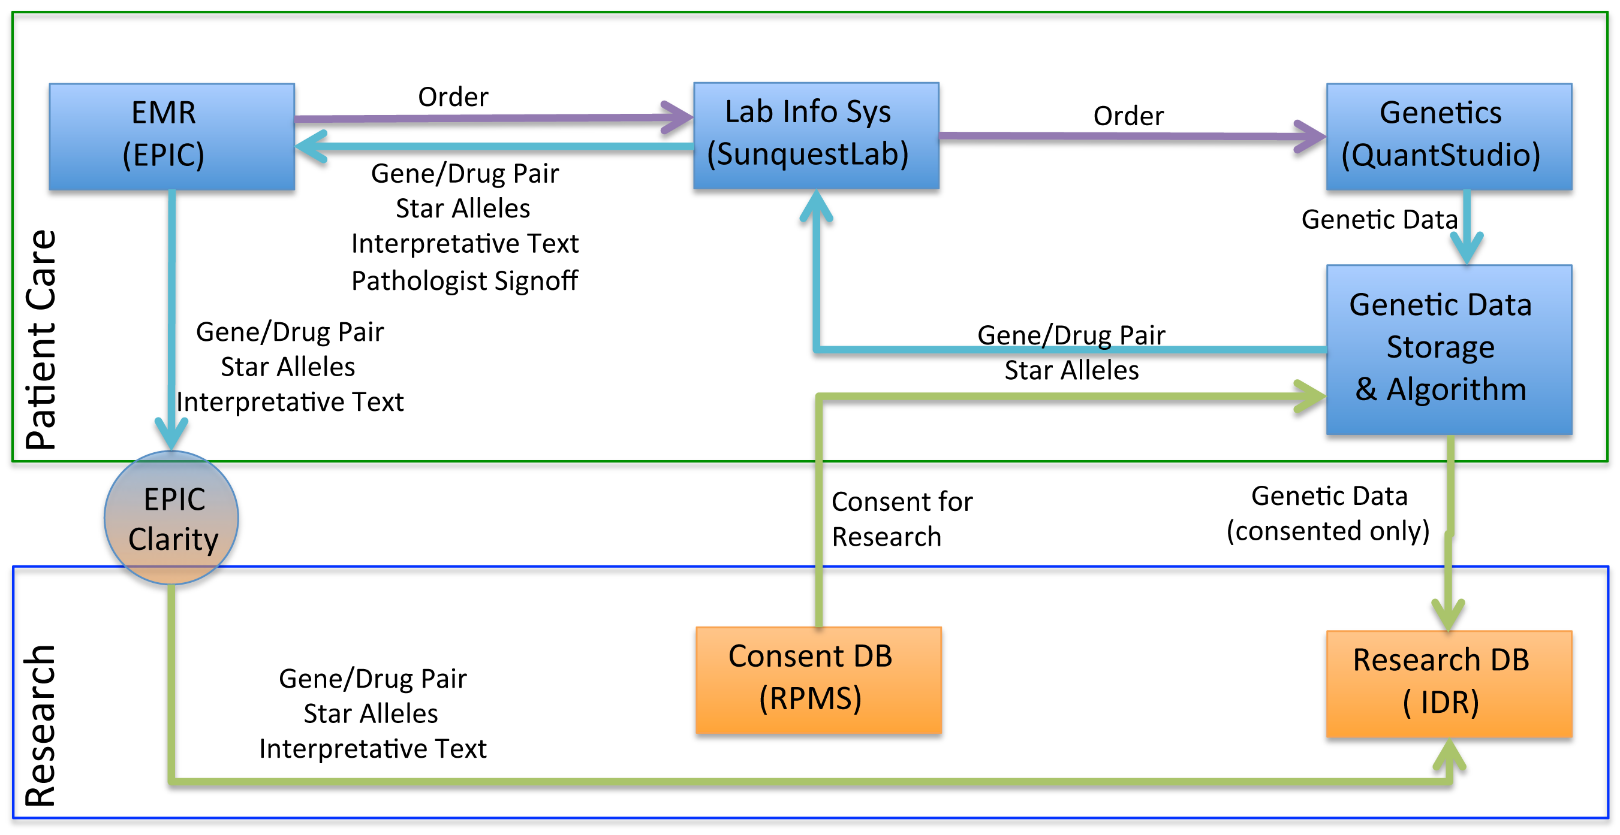
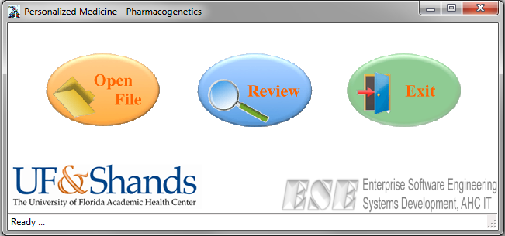
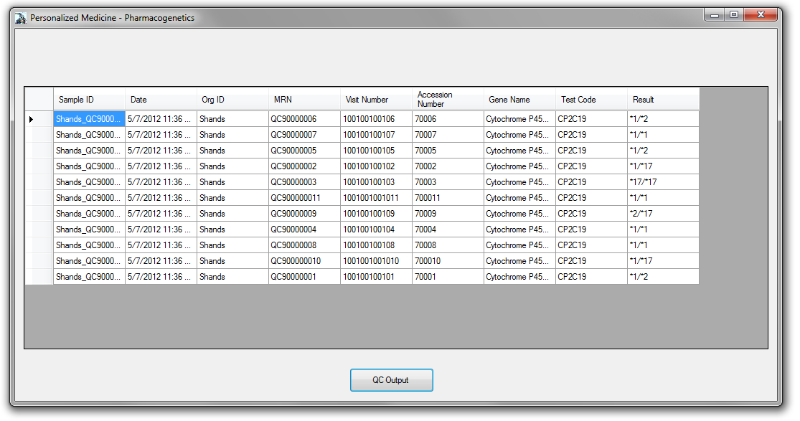
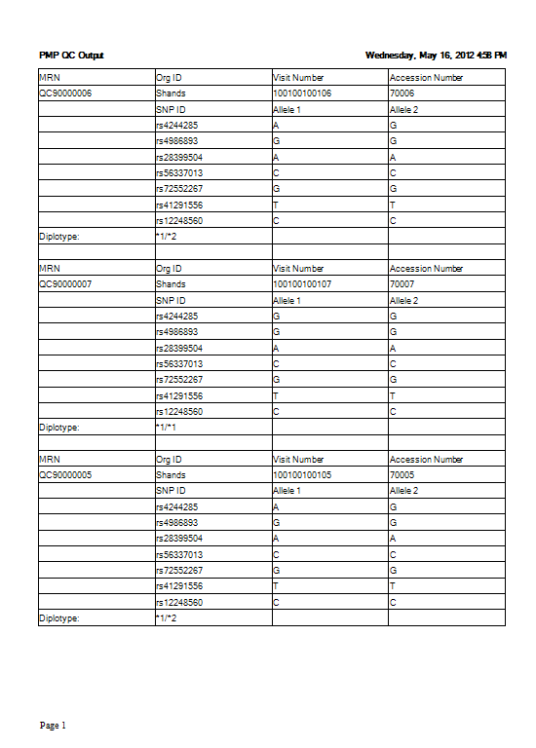
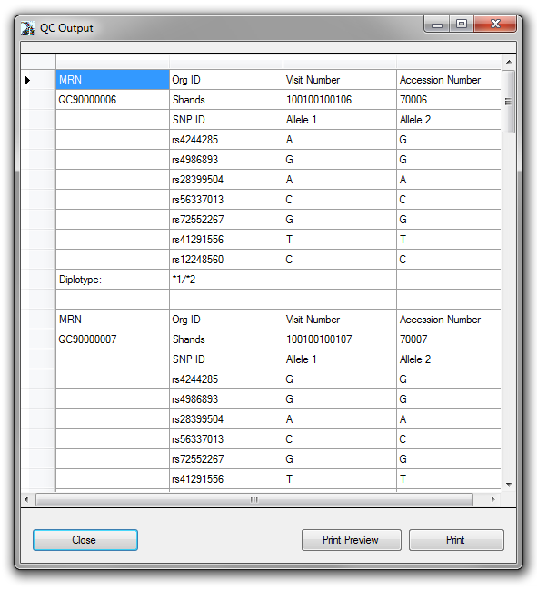
Facilitating Genetic Testing for both Clinical Care and Research
J. Felix Liu, PhD^{1,2}; David Nessl, MBA²; Amanda Elsey, MHA¹; Alberto Riva, PhD³; Taimour Langaee, PhD⁴, Yang Li, MS⁵, Narayan Raum⁵;
Michael Conlon, PhD¹; Michael Clare-Salzler, MD², Julie Johnson, Pharm.D⁴
¹ Clinical and Translational Science Institute; ² Department of Pathology, Immunology, and Laboratory Medicine; ³ Department of Molecular Genetics and Microbiology; ⁴ Department of Pharmaceutics; ⁵ Enterprise Software Engineering
University of Florida, Gainesville, Florida
Introduction
With the FDA adding a boxed warning to the label for Plavix (March 2010), Shands hospital at University of Florida began to incorporate CYP2C19 genetic testing as a routine clinical procedure for patients undergoing a percutaneous coronary intervention who may be prescribed with Clopidogrel¹. Patient samples are tested using a custom array of 256 carefully selected SNPs that include the clinically necessary ones to derive patient’s ability to metabolize Clopidogrel, with the remainder selected for research purposes. Genetic data for research portion from patients with explicit consent is then stored in the research data warehouse to facilitate further clinical and translational research².
System Description
As shown in Figure 1, when a patient is scheduled to visit the cardiac catheterization lab, the CYP2C19 genotyping test is ordered from EMR as a regular lab test. At the same time, patient is asked to consent for research studies using a mobile device. Regardless the consent status, the genotyping test is conducted and data collected and stored in a specialty database within the clinical care environment. Star-alleles are extracted using a custom software package and results transferred into the Lab Information System, which, combined with clinical recommendations, sent to the EMR for physician to make an informed decision. If a patient does not consent for research studies, genetic data other than the ones used in clinical care are destroyed. Genetic data from patients who provided positive consent are transferred into a research data warehouse that is linked to other clinical data such as diagnoses, procedures, and lab values. If positive patient consent is not received within 7 days, the system assumes negative consent and all research data deleted from the clinical database, preventing it from ever getting into the research data warehouse.
The software that extracts star-alleles is designed to be flexible for future additions of new SNPs to be tested (Figure 2). Initially, UF custom panel initially targets 7 star-alleles. Recently, one more star-allele (*10) has been added into the panel and the software successfully included the new addition in its output.
Time | Ordered |  | Resulted
Week 1 | 10/24 | 42% | 9/24 | 38%
Week 2 | 18/26 | 69% | 15/26 | 58%
Week 3 | 27/31 | 87% | 18/31 | 58%
Week 4 | 9/18 | 50% | 8/18 | 44%
Week 5 | 12/37 | 32% | 11/37 | 30%
Week 6 | 12/33 | 36% | 11/33 | 33%
Week 7 | 7/22 | 32% | 3/22 | 14%
Week 8 | 15/26 | 58% | 11/26 | 42%
Week 9 | 27/33 | 82% | 22/33 | 67%
Week 10 | 16/24 | 67% | 14/24 | 58%
Week 11 | 29/37 | 78% | 26/37 | 70%
Table 1: Genetic Testing Ordered and Resulted (11-week statistics)
Figure 1: System Architecture and Data flow diagram.
Results and Discussion
Data are collected two months after UF has been clinically reporting this test (Table 1). The research portion has start roughly 12 weeks after the clinical process. For the first two months, 150 patients genotype were reported into the EMR. The portion of patients with the test ordered reached 87% at week 2, dived to a low point of 32% at weeks 7, and climbed to 78% at week 11. This variation in ordering is in proportion with the level of awareness of clinicians about this test.
Limitations
Currently the star-allele extraction software only deals with CYP2C19 and takes input from one specific model of instrument.
Future Work
With CYP2D6 and other gene implementations on the horizon we are planning to produce a modular version the software to handle data input from multiple instruments, introducing a rule engine that can handle reasoning from multiple SNPs, and HL7 output to interface with LIS and EMR.
References
Johnson JA, Klein TE, Langaee TY, Burkley BM, Clare-Salzler MJ, Altman RB, Implementing personalized medicine: development of a cost-effective customized pharmacogenetics genotyping array. Clinical pharmacology and therapeutics 2012;92(4):437-9.
Nelson, DR, Conlon, M, Baralt, C, Johnson, JA, Clare-Salzler, M, Rawley-Payne, M, UF Clinical and Translational Science Institute: Transformation and Translation in Personalized Medicine. Clinical and Translational Science. 4(6), 400-402.
User Interface
Quality Control Interface
Result Display and Search
Built-in report
Printable report
Figure 2: Star-Allele Translation Software.
This work supported in part by the NIH/NCRR Clinical and Translational Science Awards to the University of Florida UL1 RR029890, KL2 RR029888 and TL1 RR029889.

