Slide 1
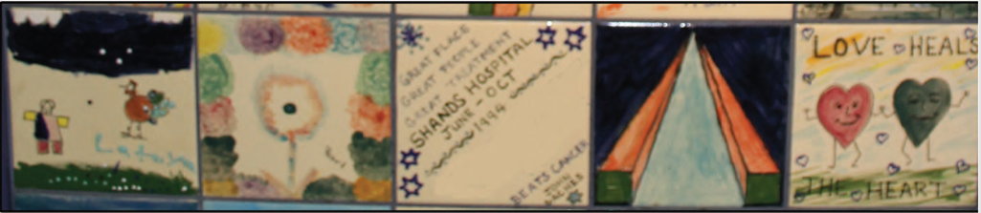
Librarians with Tablets: Connecting patient and family-centered pediatric rounding teams with information
Contributed Paper Session – October 14th, 2012
2012 MLA Quad Chapter Meeting – Baltimore, MD

Slide 2
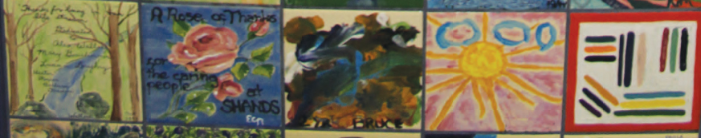
Beth Auten, Mary E. Edwards,
Linda C. Butson,
Michele R. Tennant
University of Florida Health Science Center Libraries

Slide 3
Outline
This presentation will cover:
The context of the project and our research question
The objectives of the project
The setting—the academic health center, the UF Pediatrics program, and the family-centered rounding model
Our preparation for the project
Study methods
What we found out
Next steps

Slide 4
Context and research question
Developed a proposal to evaluate the use of tablet computers on rounds based on positive responses to a pilot rounding project in 2010
Two librarians rounded with the Department of Pediatrics and a survey was distributed to rounding teams
Research Question:
How does use of tablets by librarians affect the provision of a clinical rounding service in Pediatrics?

Slide 5
Objectives
Assess clinician satisfaction with the clinical rounding service.
Describe clinicians’ perceptions of tablet use by clinical librarians.
Evaluate tablet capabilities for support of the clinical rounding service.
Identify areas for continual improvement.

Slide 6
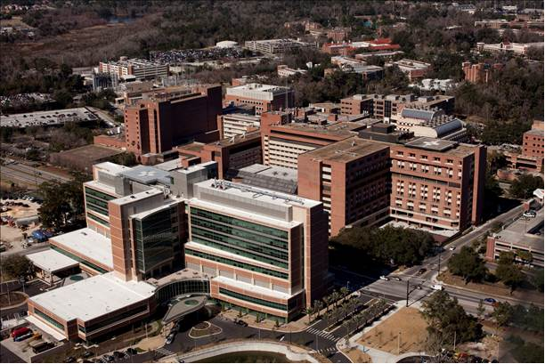
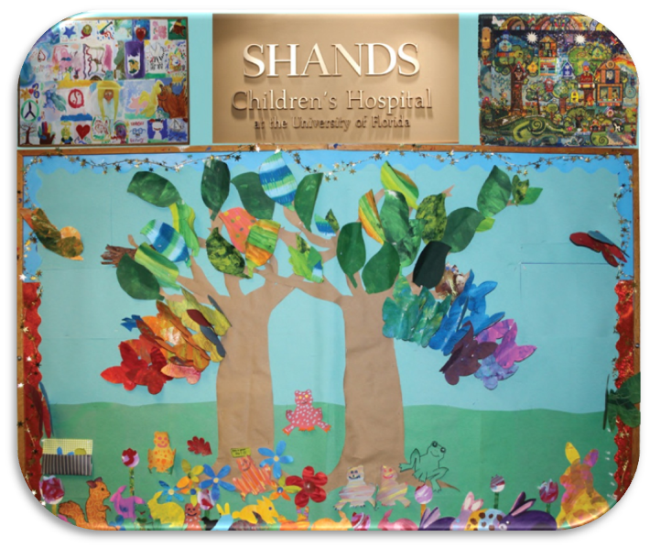
Setting – Shands at UF
Health Science Center includes 6 colleges:
  Dentistry, Medicine, Nursing, Pharmacy,
  Public Health and Health Professions, Veterinary Medicine
Most colleges work closely with Shands HealthCare system.
Shands Hospital for Children
  Located within Shands at the
  University of Florida
  167 beds

Slide 7
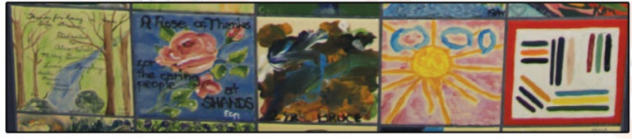
Setting – Family-Centered
General Pediatric Rounds
UF Department of Pediatrics includes:
  747 faculty and staff members
  90 residents, fellows, graduate students and post-docs
Patient and Family-Centered Rounding model
  Intended to communicate information effectively with family members
  Invites the family to participate in discussion
  Encourages family to give information and ask questions
Teams usually include:
  An attending physician
  Medical residents
  Medical students on rotation
  Pediatric nurse practitioners
  Nurses
Teams sometimes include:
  Pharmacists
  Social workers
  Specialty physicians
  Nursing students
  Allied health students

Slide 8
Preparation for the project
Both librarians involved in this project were new to clinical rounding—some groundwork was necessary.
Preparation included:
  Training with experienced clinical librarians
  Planning with pilot project coordinator to re-institute rounding service
  Meeting with Pediatrics faculty—hospitalists and/or attendings
  Introducing ourselves at new resident orientation
  Presenting a journal club session on EBM and library resources

Slide 9
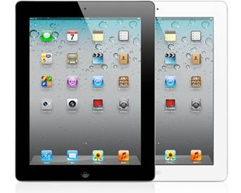
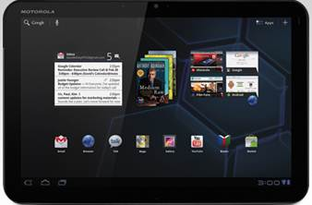
The Tools – iPad and Android tablet
Two tablets were purchased using
  grant funding.*
Two tablet platforms:
  iPad 2
  Motorola Xoom—an Android OS tablet

Slide 10
Methods
Both librarians rounded once per week for ~8 weeks with one of two general pediatrics teams.
During the initial phase—July-September, 2012—librarians alternated use of the tablets so each librarian used both devices.
A 13-question survey was distributed to attending physicians, chief residents, and residents on both rounding teams.
An evaluation rubric was completed by each librarian for both tablets.

Slide 11
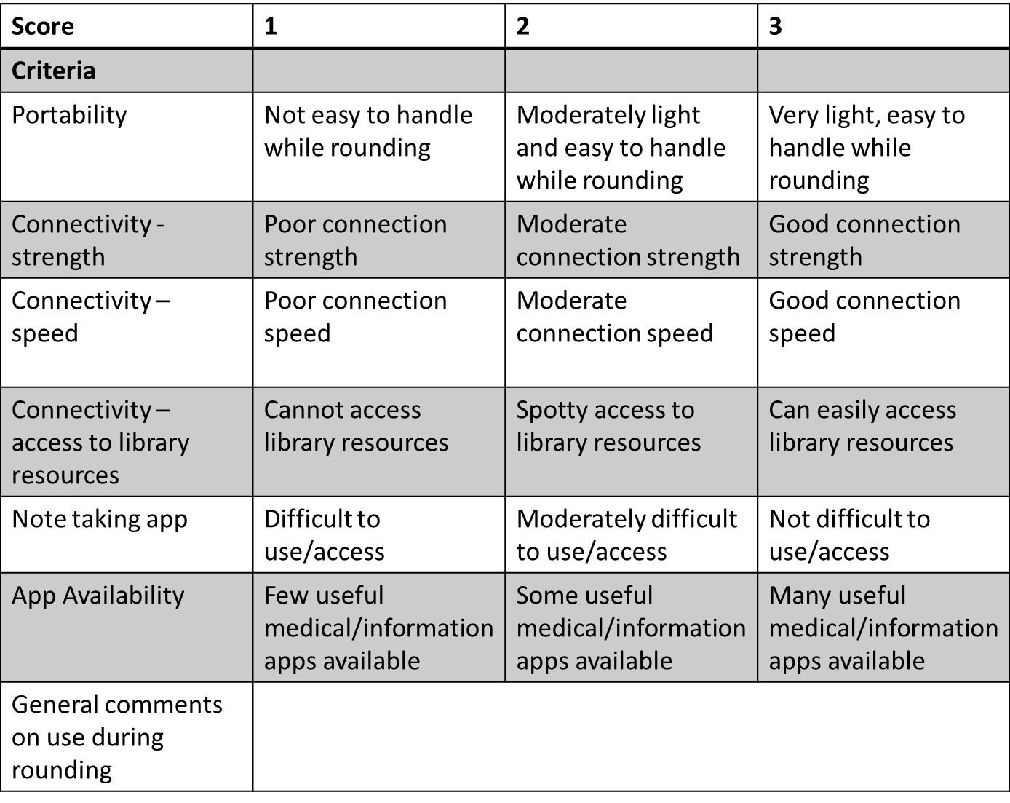
Tablet evaluation rubric

Slide 12
Results – Number of responses
Surveys were distributed to 25 attendings and residents.
There were 11 responses to the survey (44% response rate.)
Ten respondents had rounded with a librarian.
Eight of the 11 respondents had rounded with a librarian more than once.

Slide 13
Results – Questions for the librarians
Nine of the 10 respondents said their teams had generated questions for the librarian during rounds.
Six respondents reported that they received search results after rounds.
Three respondents reported that they received search results during and after rounds.

Slide 14
Results –How information was used
We asked how the results were used by the rounding teams—responses could be in multiple categories
Eight responses were received

Slide 15
Results – Perceptions of tablet use
We received 8 responses to the question “Do you think that the librarians' use of tablets impacted the information service provided?”

Slide 16
How tablets impacted the information service
Comments from the clinicians:
  Much faster at getting the information
  Able to do it on the fly
  Librarians could gather real-time information
  Able to do searches during rounds and take notes on them
  Provided librarian a means to take notes for points to look up, enabled quick search on rounds, helped librarian to become more familiar with patients as well
  Quick and easy!

Slide 17
Results – Tablet evaluation rubric
iPad
Mean Total Score – 17.5
Portability – 3
Connectivity Strength – 2.5
Connectivity Speed – 3
Access to Library Resources – 3
Note taking App – 3
App Availability – 3
Motorola Xoom
Mean Total Score – 14
Portability – 2.5
Connectivity Strength – 3
Connectivity Speed – 3
Access to Library Resources – 2.5
Note taking App – 2.5
App Availability 2
Notes:
All individual criteria scores are reported as means. The total score is out of 18 possible points. Criteria were scored on a scale of 1 to 3, with 3 being the highest score.

Slide 18
Results – Tablet evaluation rubric
Comments from the librarians:
  Connectivity was an issue with the Motorola tablet.
    There was no VPN app available so the UF tech help had to set up an L2TP connection
  Connectivity strength was an issue with the Motorola, but this could have been due to a network problem.
  One librarian commented that the location of the power and user buttons on the Motorola made it more difficult to use during rounds.

Slide 19
Improving the service – feedback from clinicians
Continue the rounding service; what we are doing is appreciated!
Be more vocal; seek our the clinical questions during patient discussions.
Be more selective, rather than comprehensive, when providing results.
Improve communication and delivery method of results to all rounding teams members.
Expanding rounding service is desired to daily as well as to pediatric specialty teams.

Slide 20
Continuing assessment
In the future, we plan to:
  Assess the types of questions best answered using mobile devices.
  Continue gathering feedback from clinicians on rounding teams.
The initial feedback we received may also provide new avenues for us to investigate.

Slide 21
Acknowledgement
This project has been funded in whole or in part with Mini-grant funds from the Smathers Libraries.
Thank you !

