Slide 1
Research Discovery, Social Networks and VIVO
Chicago, October 8, 2012
Michael Conlon, PhD
Clinical and Translational Science Institute
University of Florida

Slide 2
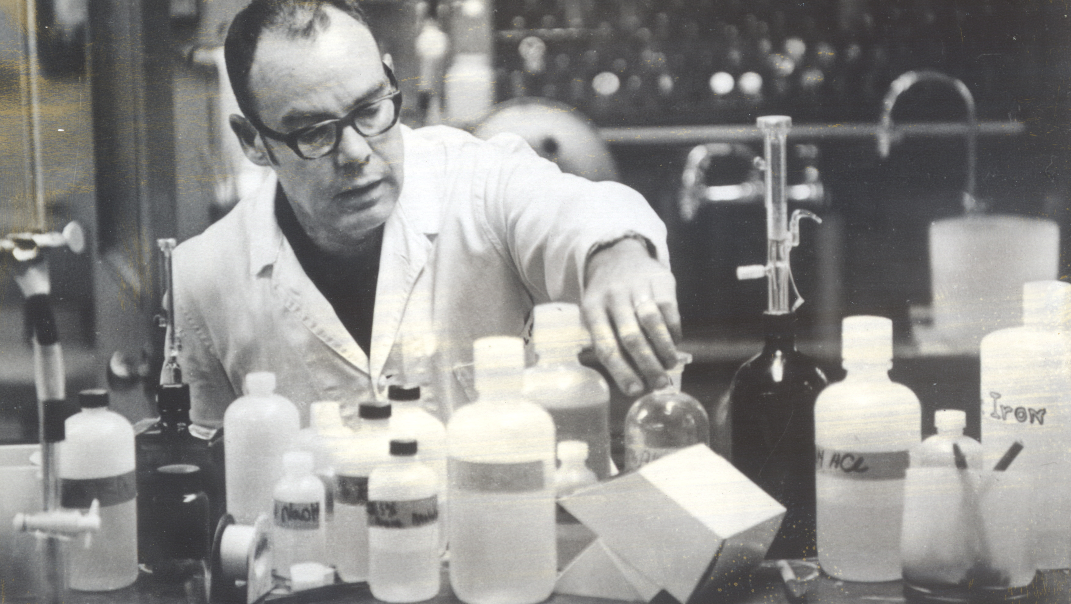
Learned a field, learned the scientific method, did science
Notes:
Learned a field, learned the scientific methods, did science, wrote papers

Slide 3
Research Process 1972
Hypothesis
Experiment
Publication

Slide 4
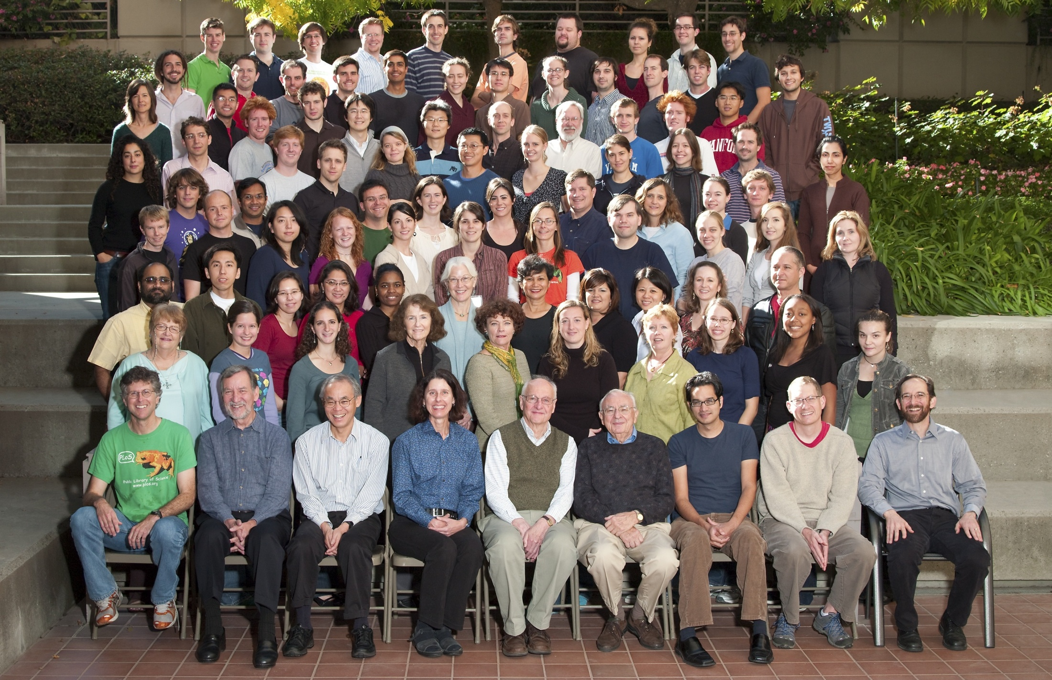
Science and Scientists
Notes:
Science and scientists. Biochemistry at Stanford. They look happy.

Slide 5
Research Process 2012
Hypothesis
Consults
Assemble Team
Write proposal
Get Funded
Create Virtual Organi-zation
Augment Data Systems
Conduct Experi-ments
Publish results
Archive data

Slide 6
Six Trends
Notes:
The rise of molecular medicine

Slide 7
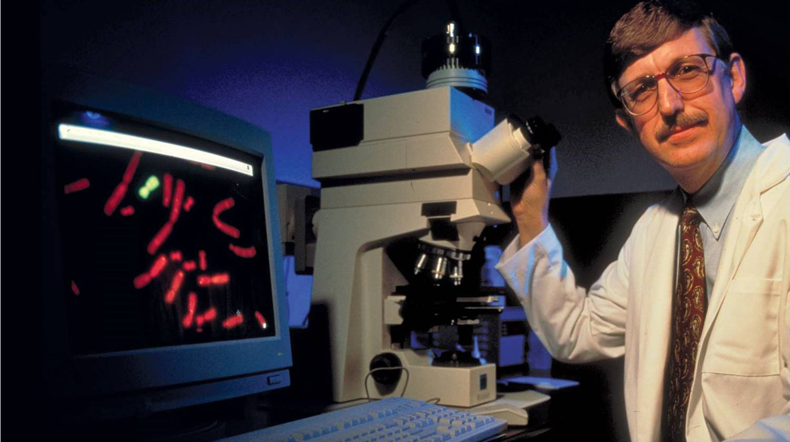
1. Rise of the small
Notes:
The rise of the molecular. Personalized medicine. Full base pair sequencing. Mars Curiosity lander. Nanotechnoloy. Metabolomics.

Slide 8
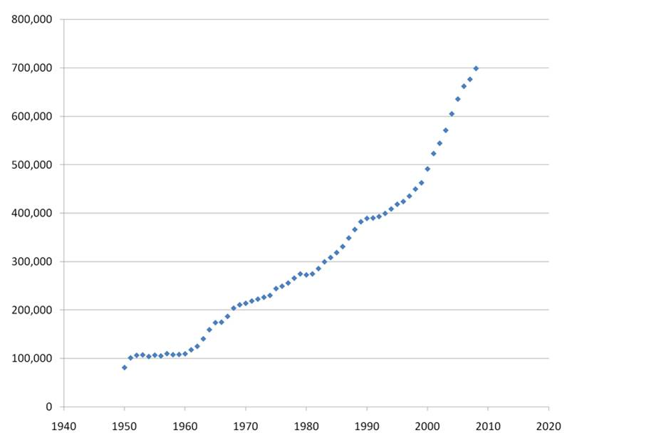
PubMed new publications per year
2. Increasing volume of science
Notes:
Rapid increase in volume of scientific output. Brazil, Russia, India, China.

Slide 9
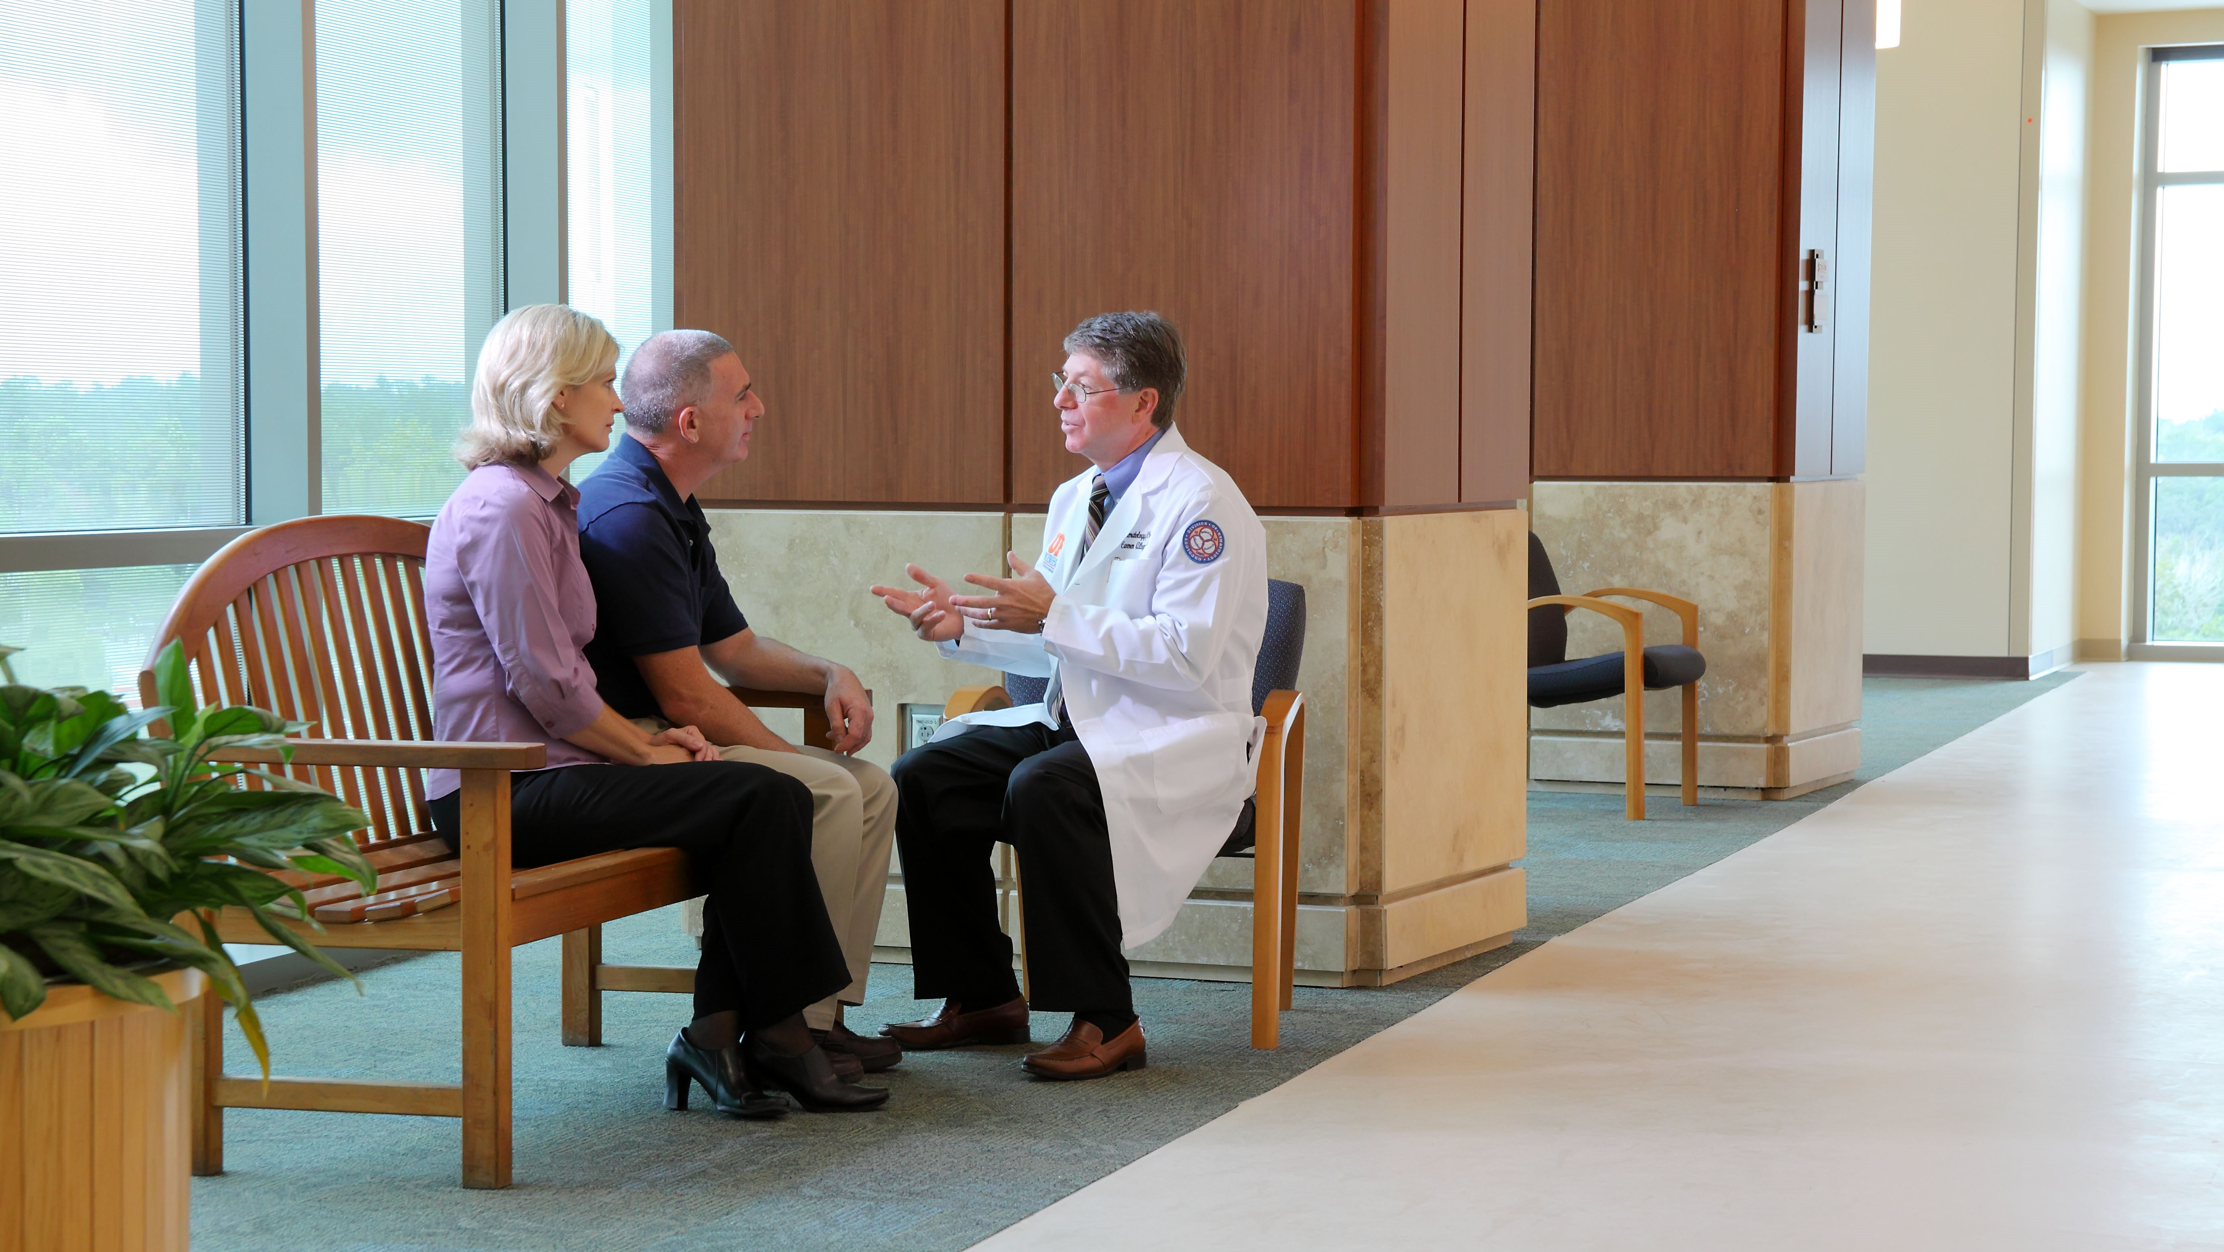
The Problems Got Hard
3. Increasing complexity of scientific problems
Notes:
More difficult problems. We work to cure cancer. Risk factors, genetics, metabolics, surgical procedures, radiology, chemotherapy, life style changes.

Slide 10
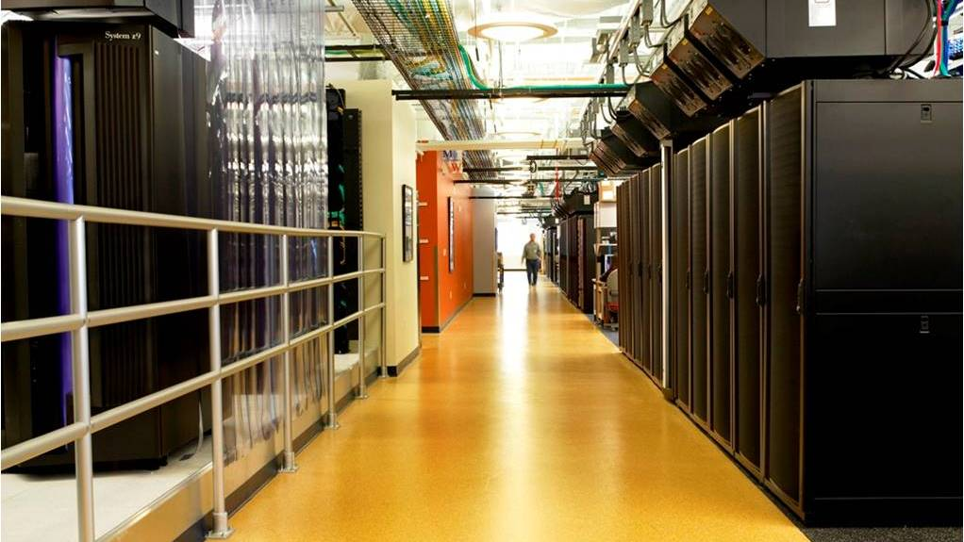
Data Got Big (IDR Slide)
4. Data reuse grows
Notes:
Data got big. Terabytes, Petabytes, Exabytes.

Slide 11
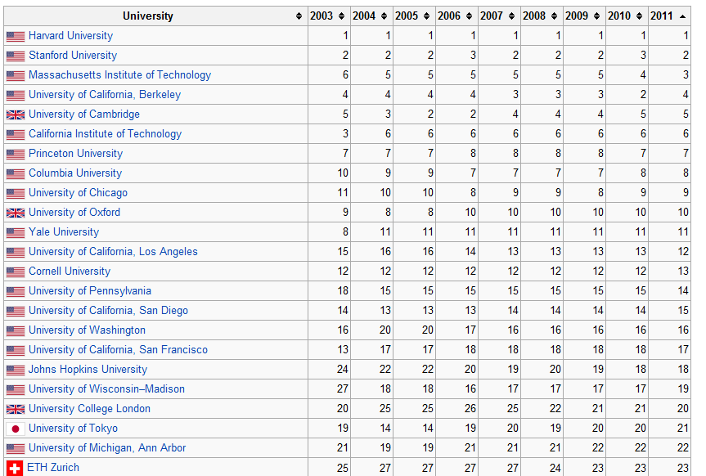
Lots of Competitors
5. Competition rises
2011 Shanghai ranking of world universities
http://en.wikipedia.org/wiki/Academic_Ranking_of_World_Universities
Notes:
Competition got stiffer

Slide 12
6. Internet disintermediation of science continues
Notes:
Internet speed and disintermediation. Expectations changing, openness, commonality, reuse, altmetrics (“downloads and citations”)

Slide 13
How can we know what is going on, build teams, solve data-driven problems?

Slide 14
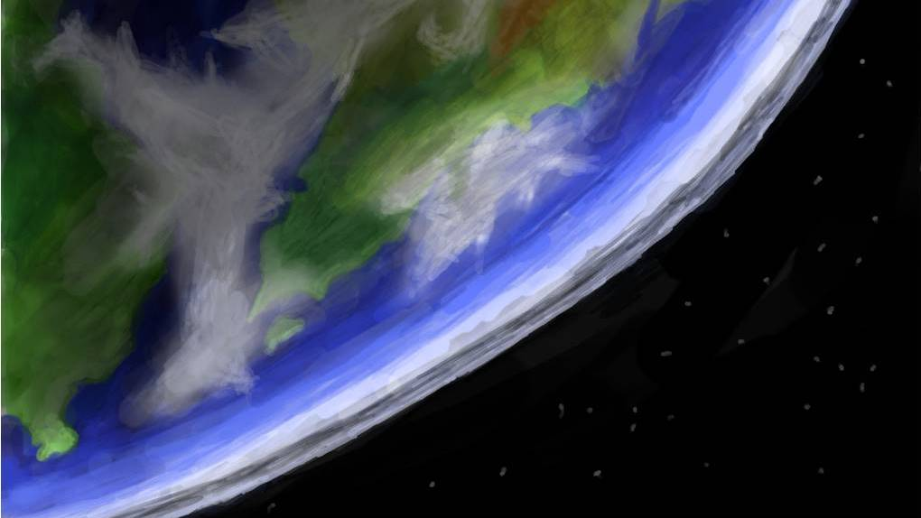
Research Discovery
Research
Discovery
Notes:
Research Discovery. What is going on? Where? By Whom?

Slide 15
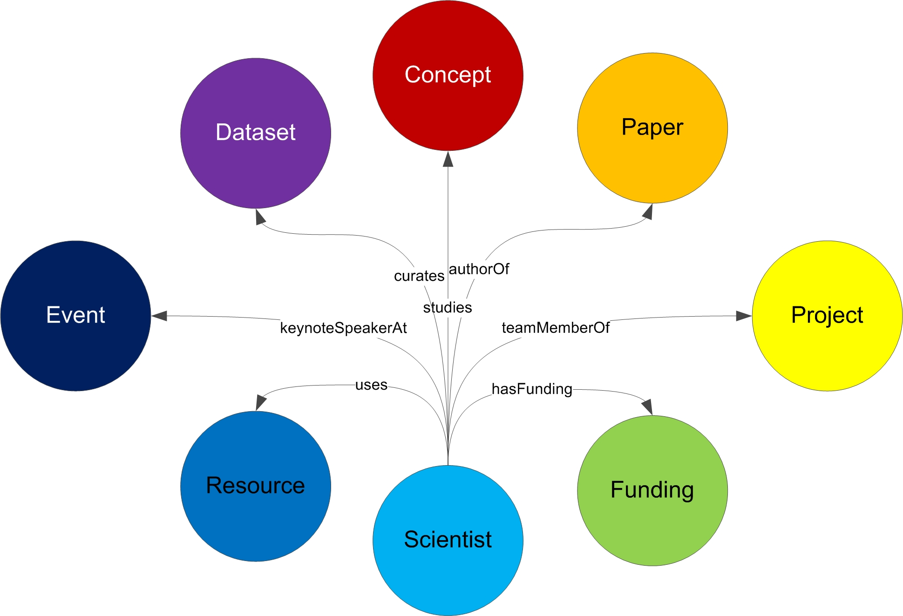
… And the connections between them
Notes:
Sounds, common data models for the things of science and the connections between them. Many kinds of connections between each type of object. Objects have significant complexity. What do we mean by “project” – a human subject study? A clinical trial?

Slide 16
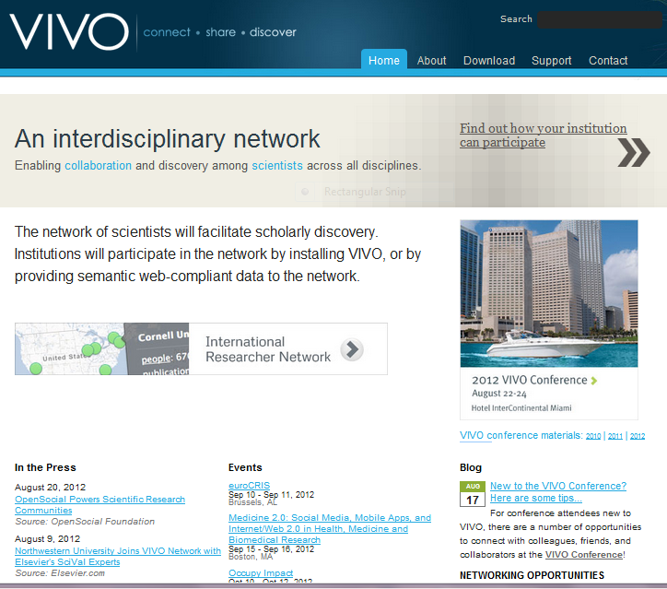
VIVO: Data, Tools and Community
Notes:
So that’s what we are doing. Open software, community and data model for research discovery. Model people, data, projects, papers, etc. Work across boundaries. Sponsor supported.

Slide 17
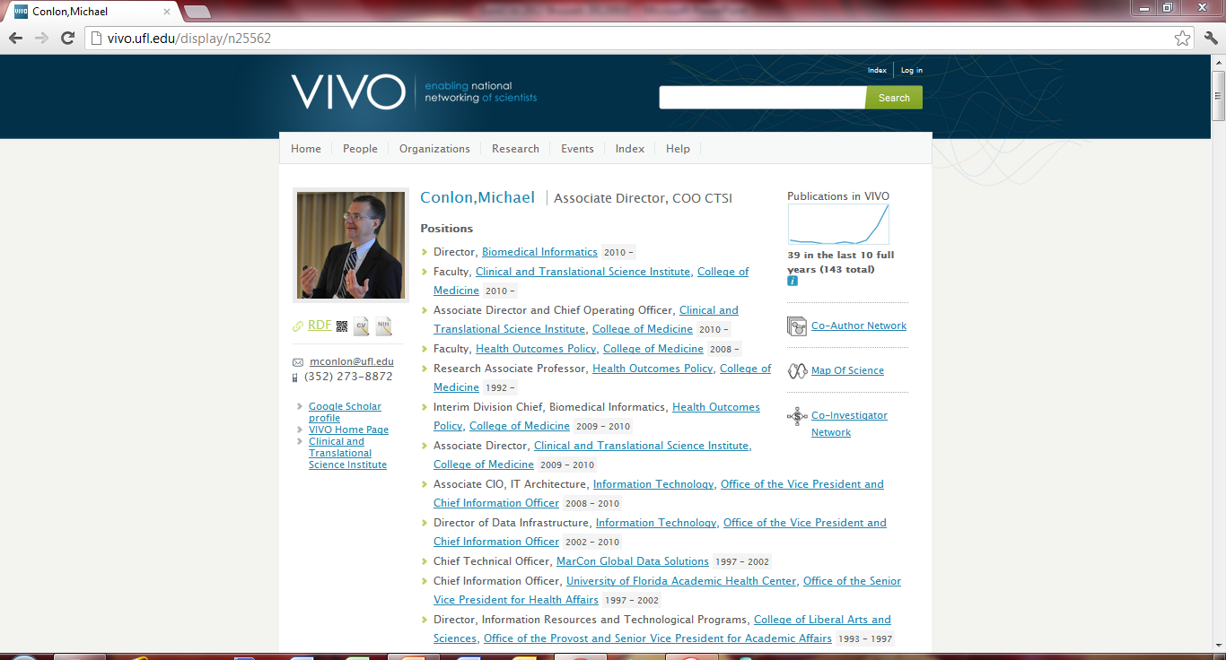
Simple tools for presentation, traversal, search
Notes:
So here’s the simple view – a faculty profile. Assembled by machines. Can be finished off by the faculty member. All links are to other objects in the semantic web. Positions, visualizations, organizations, people, web sites. Navigation via search, facets, link traversal. Note the RDF link for techno guys.

Slide 18
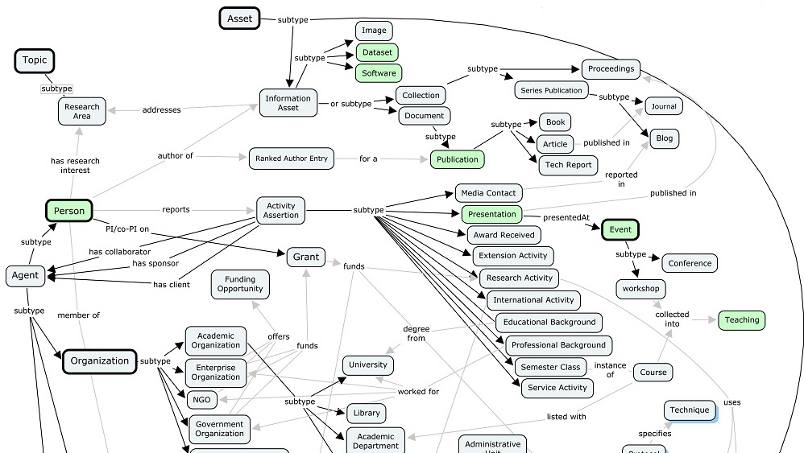
Ontology Process
Notes:
A fragment of the VIVO ontology. Open ontology process. Working group. Plug-in ontologies (BIBO, SKOS, FOAF) support local extension. Terminology extensions.

Slide 19
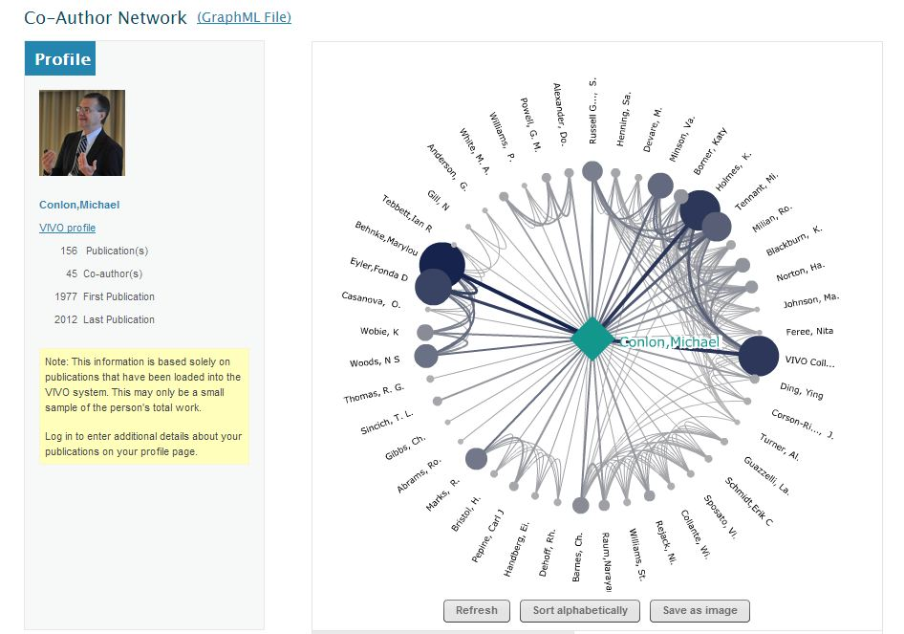

Slide 20
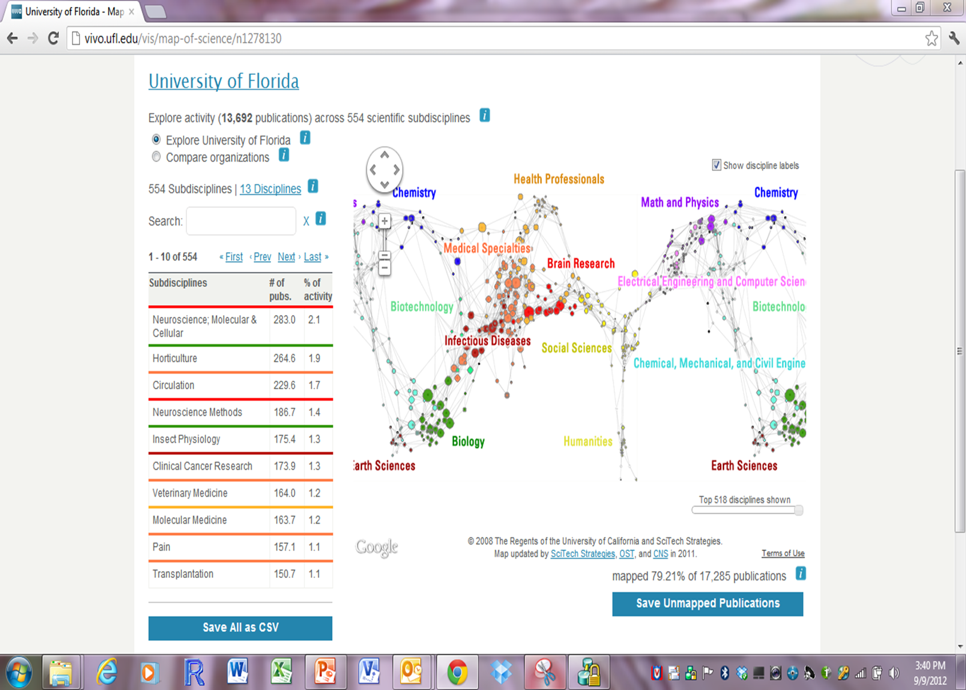
ScienceMap. Examine collections of publications for individuals, work groups, institutions
Notes:
Tools for discovering research. Here, sample of University of Florida publications plotted on the UCSD science.

Slide 21
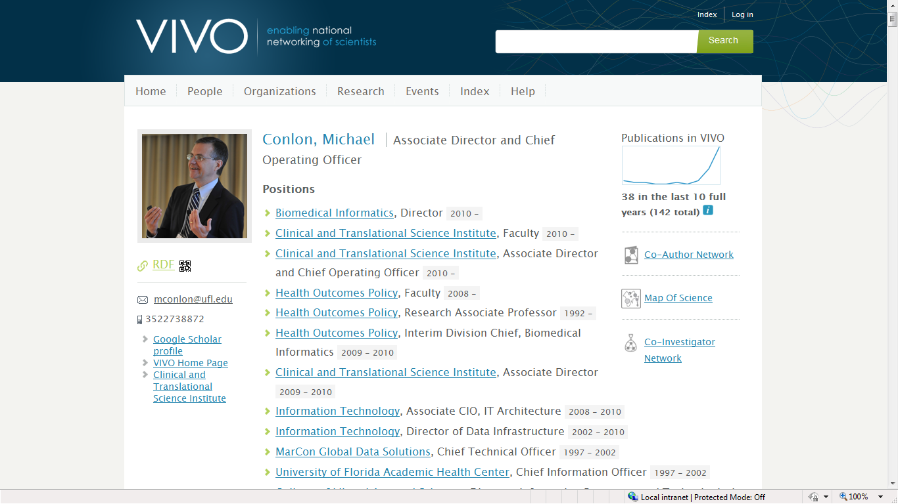
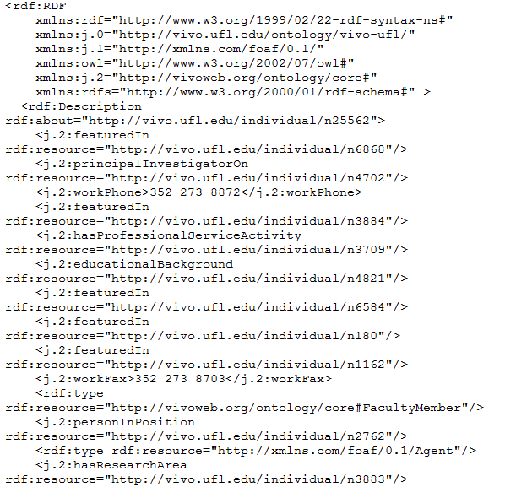
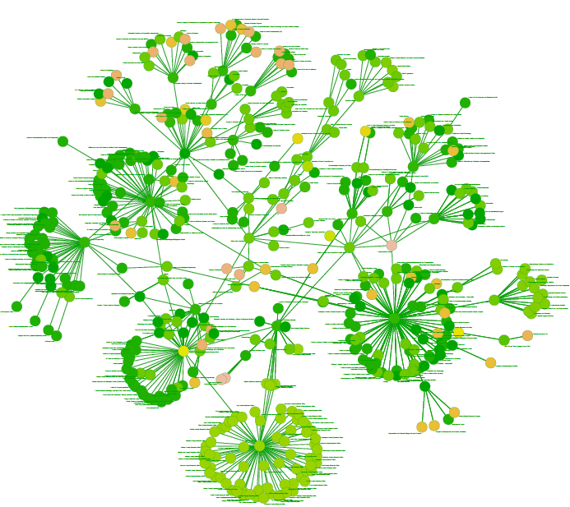
Software reads VIVO RDF and displays
processOrg<-function(uri){
x<-xmlParse(uri)
u<-NULL
name<-xmlValue(getNodeSet(x,"//rdfs:label")[[1]])
subs<-getNodeSet(x,"//j.1:hasSubOrganization")
if(length(subs)==0) list(name=name,subs=NULL)
else {
for(i in 1:length(subs)){
sub.uri<-getURI(xmlAttrs(subs[[i]])["resource"])
u<-c(u,processOrg(sub.uri))
}
list(name=name,subs=u)
}
}
VIVO produces both HTML and RDF
Notes:
The open architecture of VIVO and linked data supports development of applications outside VIVO that consume VIVO data. VIVO data is accessible via HTML (for humans) and RDF (for machines). Simple software can process the RDF resulting in powerful cross-site applications. The figure depicts the organization of the University of Florida.

Slide 22
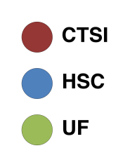
Co-Author Network
Chris McCarty, Assoc. Prof. & Raffaele Vacca
2008
2012
Data source: Thomson Reuters via UF VIVO
Each node represents one author
Nodes are sized by Total Publications and linked by a common VIVO publication URI
Main Component: what changes have occurred between 2008 and 2012?
In 2008 the network is split into two groups of approximately the same size – CTSI/HSC versus everything else
In 2012 the network consists of one big connected region, with the CTSI acting as a broker between several more marginal subgroups
In 2012 more of the authors with the highest number of publications are under the CTSI umbrella (note that 2012 publications data are incomplete)
Notes:
Mention that 2012 data come from only half of the year. As a consequence: (1) Less nodes in 2012 network (less authors in 2012 data); (2) Node sizes smaller on average in 2012 (less publications in 2012 data)

Slide 23
Co-Funded Network
Chris McCarty, Assoc. Prof. & Raffaele Vacca
2008
2012
Data source: UF Division of Sponsored Research (DSR) database
Each node represents one Contract PI, Project PI or Co-PI linked by a common PeopleSoft Contract number
Nodes are sized by Total Awarded in UF fiscal year (July-June)
Main Component: what changes have occurred between 2008 and 2012?
More of Health Science Center comes under the CTSI umbrella
The CTSI has a broader reach in the whole network
Increasingly the CTSI incorporates all researchers in relevant areas (areas not relevant to CTSI research fields naturally remain out of its network)

Slide 24
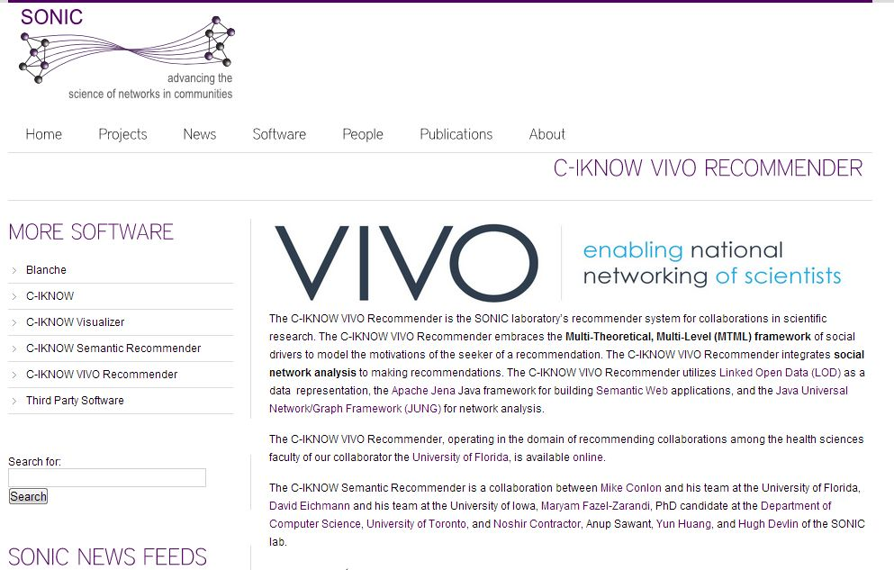

Slide 25
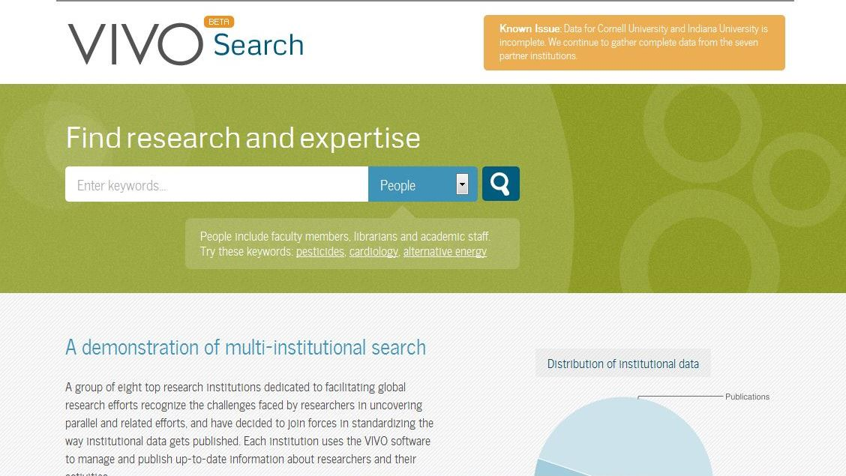
Augmenting data
Notes:
Vivosearch (beta) indexes vivo sites and provides faceted search across the collection with linking to individual objects

Slide 26
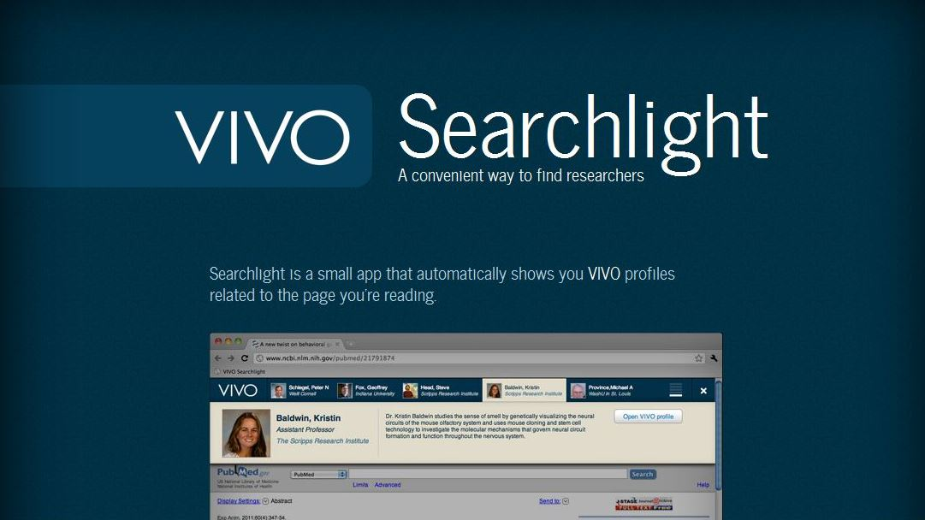
VIVO Searchlight
Notes:
VIVO searchlight. For any page on the web, find people whose work is similar to a page you are reading.

Slide 27
Collaboration and Coordination
At UF – Libraries, CTSI, AHC IT, Office of Research, Enterprise Systems, Registrar, Business Services
Federal – OSTP, NIH, NLM, NSF, USDA, EPA, FDA, NASA, FDP, …
Partners -- Symplectic, Pivot, Elsevier, Thomson-Reuters, ORCID, CiteSeer, CrossRef, OCLC, DuraSpace, CNI, Total-Impact, …
Ontology– EuroCRIS, CASRAI, NCBO, Eagle-I, CTSAconnect, …
Professional Societies – APA, AAAS, AIRI, AAMC, ABRF, …
International – Australia, China, Netherlands, UK, Canada, Brazil, …
Semantic Web community – DERI, Tim Berners-Lee, MyExperiment, Concept Web Alliance, Open Pharma Space (EU), Linked Data, …
Social Network Analysis Community – Northwestern, Davis, UCF, …
Universities -- Melbourne, Duke, Penn, Colorado, Eindhoven, Pittsburgh, Leicester, Cambridge, Stony Brook, Weill, Indiana, Scripps, Washington U, Ponce, Northwestern, Iowa, Harvard, UCSF, Florida, Stanford, MIT, Brown, Johns Hopkins, OHSU, Minnesota, and the CTSA consortium
Application and service providers – over 100
Software downloads (over 30,000) and contact list (over 1,600)

Slide 28
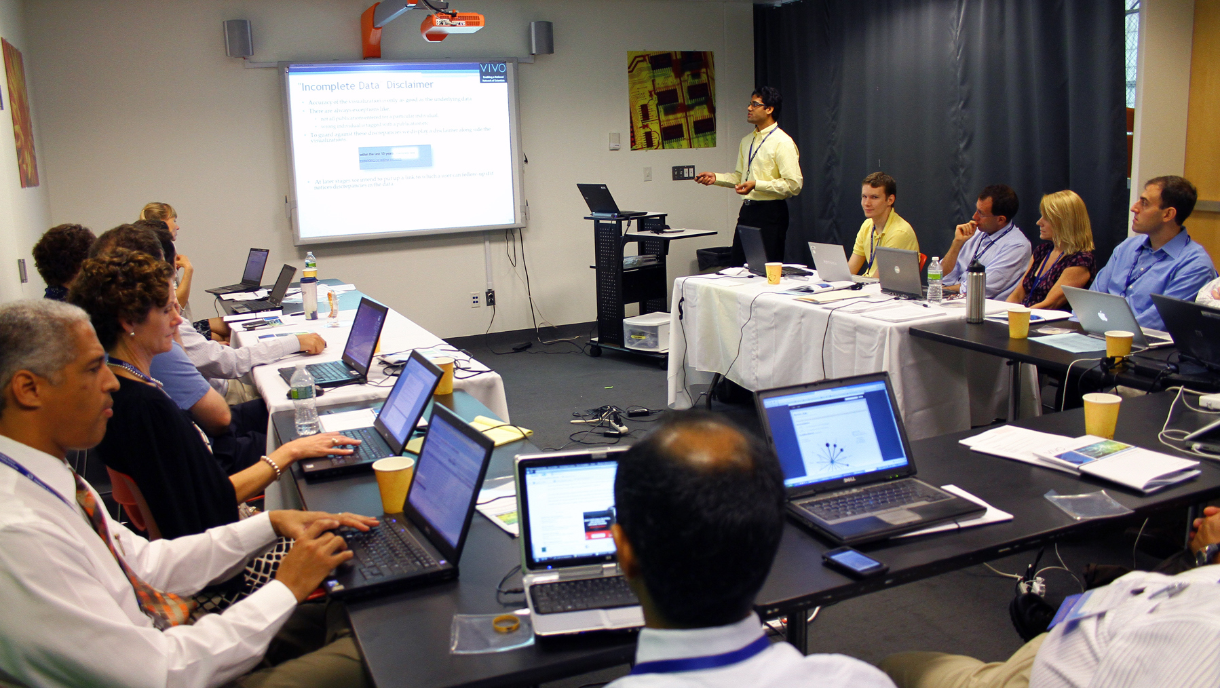
Community
Notes:
We are going to need a community of people who share a common interest in research discovery.

Slide 29
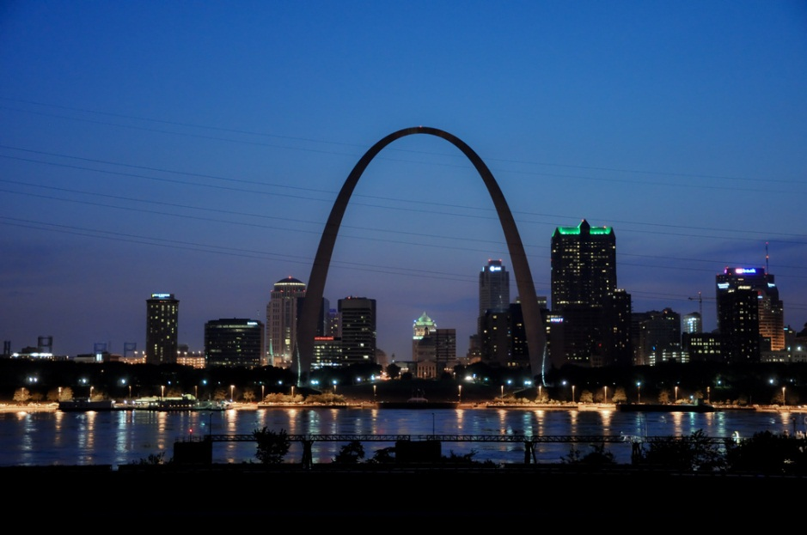
4th Annual VIVO Conference
August 14-15, 2013
St. Louis, Missouri, USA
http://vivoweb.org/conference

