Slide 1
CTRC: Defining the Goals, Building the Leadership Team, and Developing the Governance Structure; Role of the External Advisory Boards
Susan Autry, University of Southern California
Mike Conlon, University of Florida

Slide 2
Goals
The goal is transformation
Planning Grant
Proposal
Strategic Planning
Tactical Planning
Renewal

Slide 3
Institutional Setting
Three missions of CTRC
Research, Education, Community
Three domains of CTR
Laboratory, Clinical, Population
Four Translations
Translation to human
Translation to patient
Translation to practice
Translation to health
Internal Assessment
Environmental Scan
Strengths, Weaknesses, Opportunities, Threats

Slide 4
CTSI Provides
TRAINING
INFRASTRUCTURE
CAREER ADVANCEMENT
Consultation Services
Resources / Cores
Navigational Assistance
Pilot funding
Career development
Career advancement
Research education & training
Training in other functions

Slide 5
Building the Leadership Team
Institutional Leadership
Research, Medicine, Hospital, Partners
Institute Leadership
Principal Investigator
Executive Director
Program Leadership
Clinical, Education, Laboratory, Informatics, Regulatory, Community, others

Slide 6
Choosing Leaders
Vision
Commitment
Balance – personal research interests vs CTSI pragmatic needs
Accountable
Team player vs individual contributor
This is a shift from tradition PI research role
Trustworthy
Character – intent, integrity
Competence – capabilities, results
Transparency

Slide 7
Governance – “Doing the Right Things”
Alignment with Institutional Leadership
Alignment with Consortium Leadership
Alignment between Institute and program leadership
Internal Advisory Board
External Advisory Board

Slide 8
Management – “Doing Things Right”
Planning
Objectives/deliverables
Budgeting
Personnel
Execution
Measurement
Assessment/accountability

Slide 9
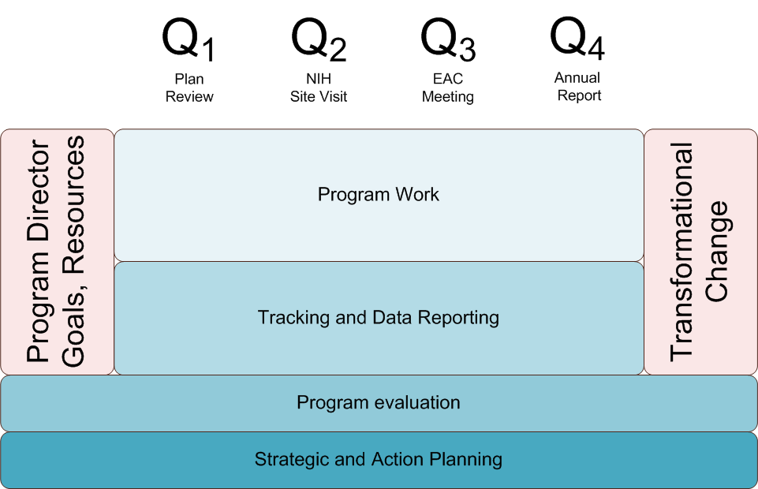
Goals, Time, Change
Notes:
This would be titled Strategic Timeline or something

Slide 10
Create Transformational Change
Notes:
What are the points you want to make on this and next 2 slides?

Slide 11
Create Continuous Improvement

Slide 12
Transparent, open communication to, from and among all stakeholders

Slide 13
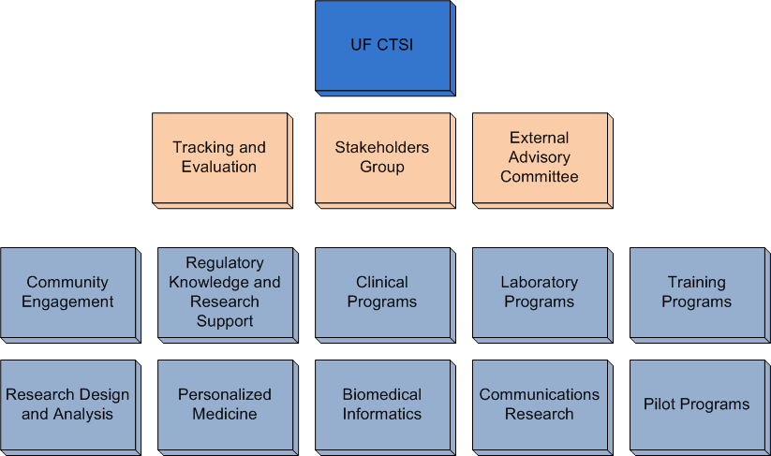
UF CTSI Organization

Slide 14
UCSF CTSI Organization Chart

Slide 15
Internal Advisory Board (IAB)
Purpose
Review progress, recommend improvements
Participate in strategic planning
Meeting frequency
Agendas and Support
Meet every two months
Types of decisions made
Focus meetings on mission, domain, translations

Slide 16
External Advisory Board
Purpose
Assessment of progress, tactics and strategy
Assist CTSI leadership in providing perspective to program leaders
Renewal prep: strengths/weaknesses
Alignment with national program
Advocate with institutional leadership
Annual Meeting
Introduction by institutional leaders
Overview by Principal Investigator and Executive Director
Presentations by each of the programs
Executive session
Presentation of findings
Written report

Slide 17
Advisory Board Members
Recognized experts in mission, domain, translation
Expert knowledge of the CTSA program
Thought leaders and advocates
Available
Engaged
Outspoken

Slide 18
Challenges in Leadership
Highest level executive decision-making group
Ultimately responsible for CTSI success
Has to hold program leaders accountable
Must make leadership changes when necessary
Program leaders and co-leaders
Must make their program successful/productive
Responsible for cross-pollination with other programs
Notes:
Added this slide – some of the toughest governance issues are at this level…. The wording may not be right but you know what I mean….

Slide 19
Challenges in Governance
Internal Advisory
External Advisory
May feel conflicted in advising a group that supports them
May lack motivation to participate
The CTRC is complex, IAB members may not be fully engaged
May be focused on their own science
They can’t know your institution well enough to comment on tactics
May not be able to cover the range of CTRC activities
May be biased by their own institutional experiences
May not share their concerns

Slide 20
Questions and Discussion

