Slide 1
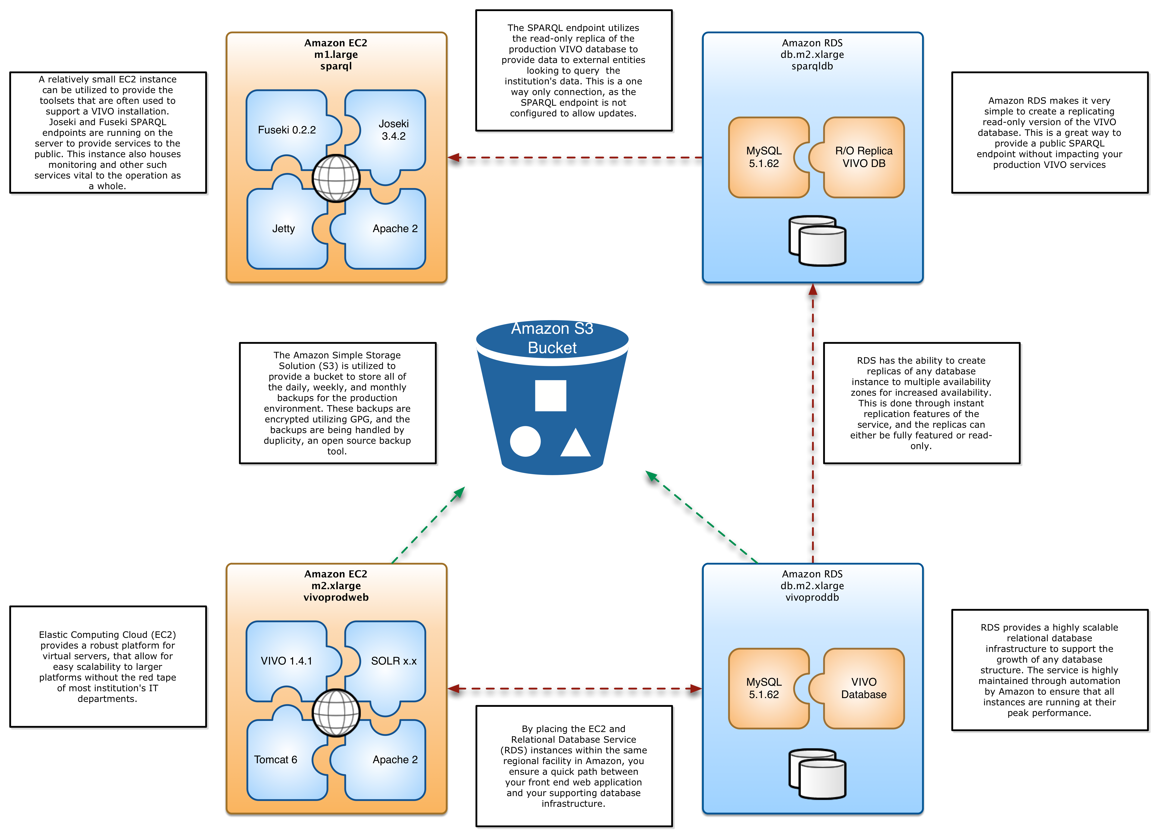
Utilizing Amazon Cloud Infrastructure for low-cost Evaluation or Robust Production Performance of the VIVO Application
Abstract
Discussion
When an institution wants to evaluate the adoption of a new server based application, there is usually a long delay between the initial idea and getting an environment set up for the actual evaluation. Delays in evaluating solutions can result in a reallocation of previously available resources or a general loss of interest. A faster deployment solution for VIVO is needed.
Current evaluation methods require IT intervention and approval to set up or use of a localized virtual machine (VM). Both of these methods have their pros and cons, however with the use of cloud services such as Amazon AWS we can eliminate the red tape and make the evaluation available to a wider audience than a localized VM allows. The development of an Amazon Machine Image (AMI) that has all of the basic services required to truly evaluate a full VIVO environment, including VIVO, Harvester ETL toolset, Fuseki SPARQL endpoint, and all supporting dependencies will allow us to produce a quick and robust environment.
Why EC2?
The Amazon EC2 infrastructure provides a low-cost, instant evaluation environment that is easily scalable to become your production VIVO environment. The underlying systems that make up the Amazon AWS ecosphere allow performance tuning in ways that most institutions would never be able to undertake.
On-Demand vs. Reserved
The on-demand instances on Amazon on very good for evaluating, testing, and other cases where you are not ready to make a significant commitment to the server infrastructure. However, once the decision has been made to make Amazon your production, long-term home then reserved instances need to play a role. The reserved instances offer a significant cost reduction per hour, and therefore a huge reduction in overall cost of your environment. While they do require an initial down payment, that amount does very little in the way of affecting your overall cost savings.
Introduction
During the 2010 VIVO conference the publicly available VIVO VirtualBox image was used as teaching tool for setting up VIVO and ingesting data. The VirtualBox image had issues, as some users had security restrictions that did not allow them to use the image and the image didn’t contain all of the tools that were available for VIVO due to size constraints. The size of the VirtualBox image, while smaller than it could be, caused additional problems for those who hadn't downloaded it prior to attendance at the conference. For the next conference the Instructors needed a method to quickly create a complete VIVO environment at low cost. With this goal in mind, the Enterprise Software Engineering group began work on an Amazon Machine Image (AMI) that would combine all of the most beneficial tools and applications to provide the best evaluation of the VIVO application. The AMI was modeled after the UF implementation, which utilizes Amazon AWS, and allows the institution to create an EC2 instance that fits their budgetary and performance requirements.
Contact Us
Vincent Sposato
vsposato@ufl.edu
Stephen V. Williams
drspeedo@ufl.edu
Narayan Raum
nraum@ufl.edu
Chris Barnes
cpb@ufl.edu
Mike Conlon
mconlon@ufl.edu
Nicholas Rejack
nrejack@ufl.edu
Erik Schmidt
cavedivr@ufl.edu
Laura Guazzelli
laura2@ufl.edu
Will Collante
wjc813@ufl.edu
Vincent J. Sposato¹, Stephen V. Williams¹,Narayan Raum², Chris Barnes², Mike Conlon³, Nicholas Rejack³,
Erik C. Schmidt³, Laura Guazzelli³, Will Colante³
¹ Enterprise Software Engineering, Academic Health Center IT, University of Florida, ² Clinical and Translational Science IT Group, Academic Health Center IT, University of Florida, ³ Clinical and Translational Science Institute, University of Florida

