Slide 1
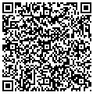
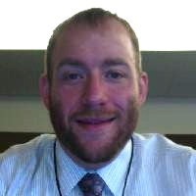
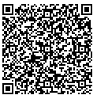
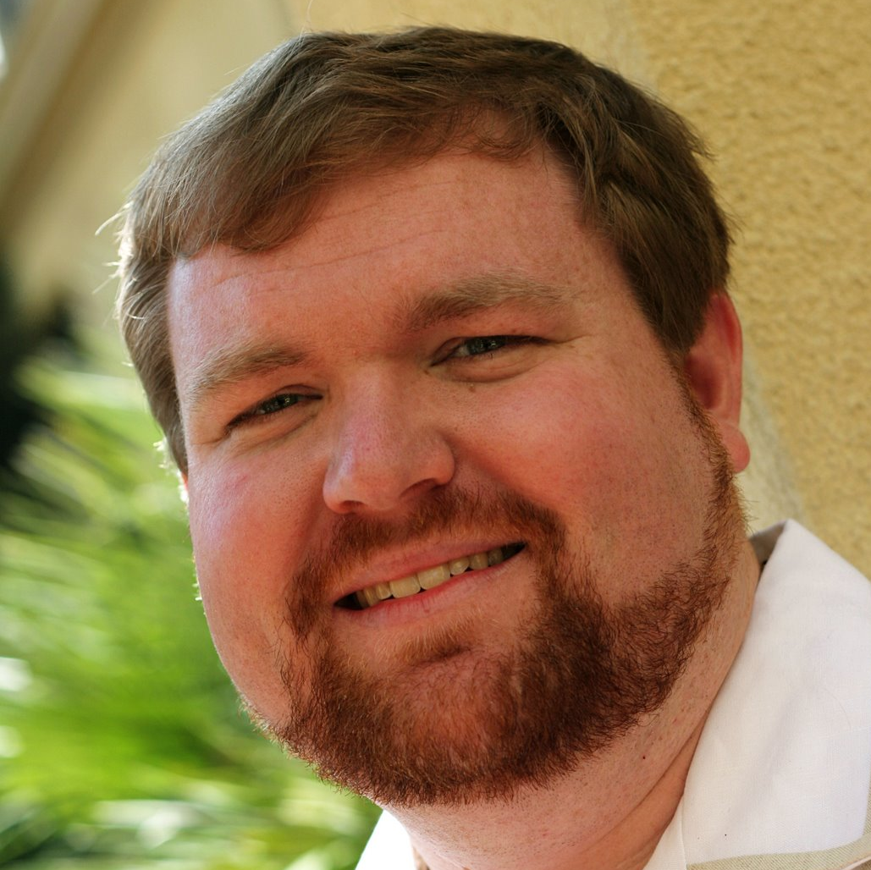
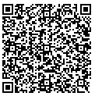
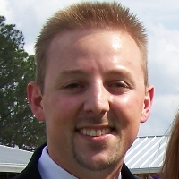
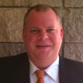
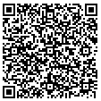
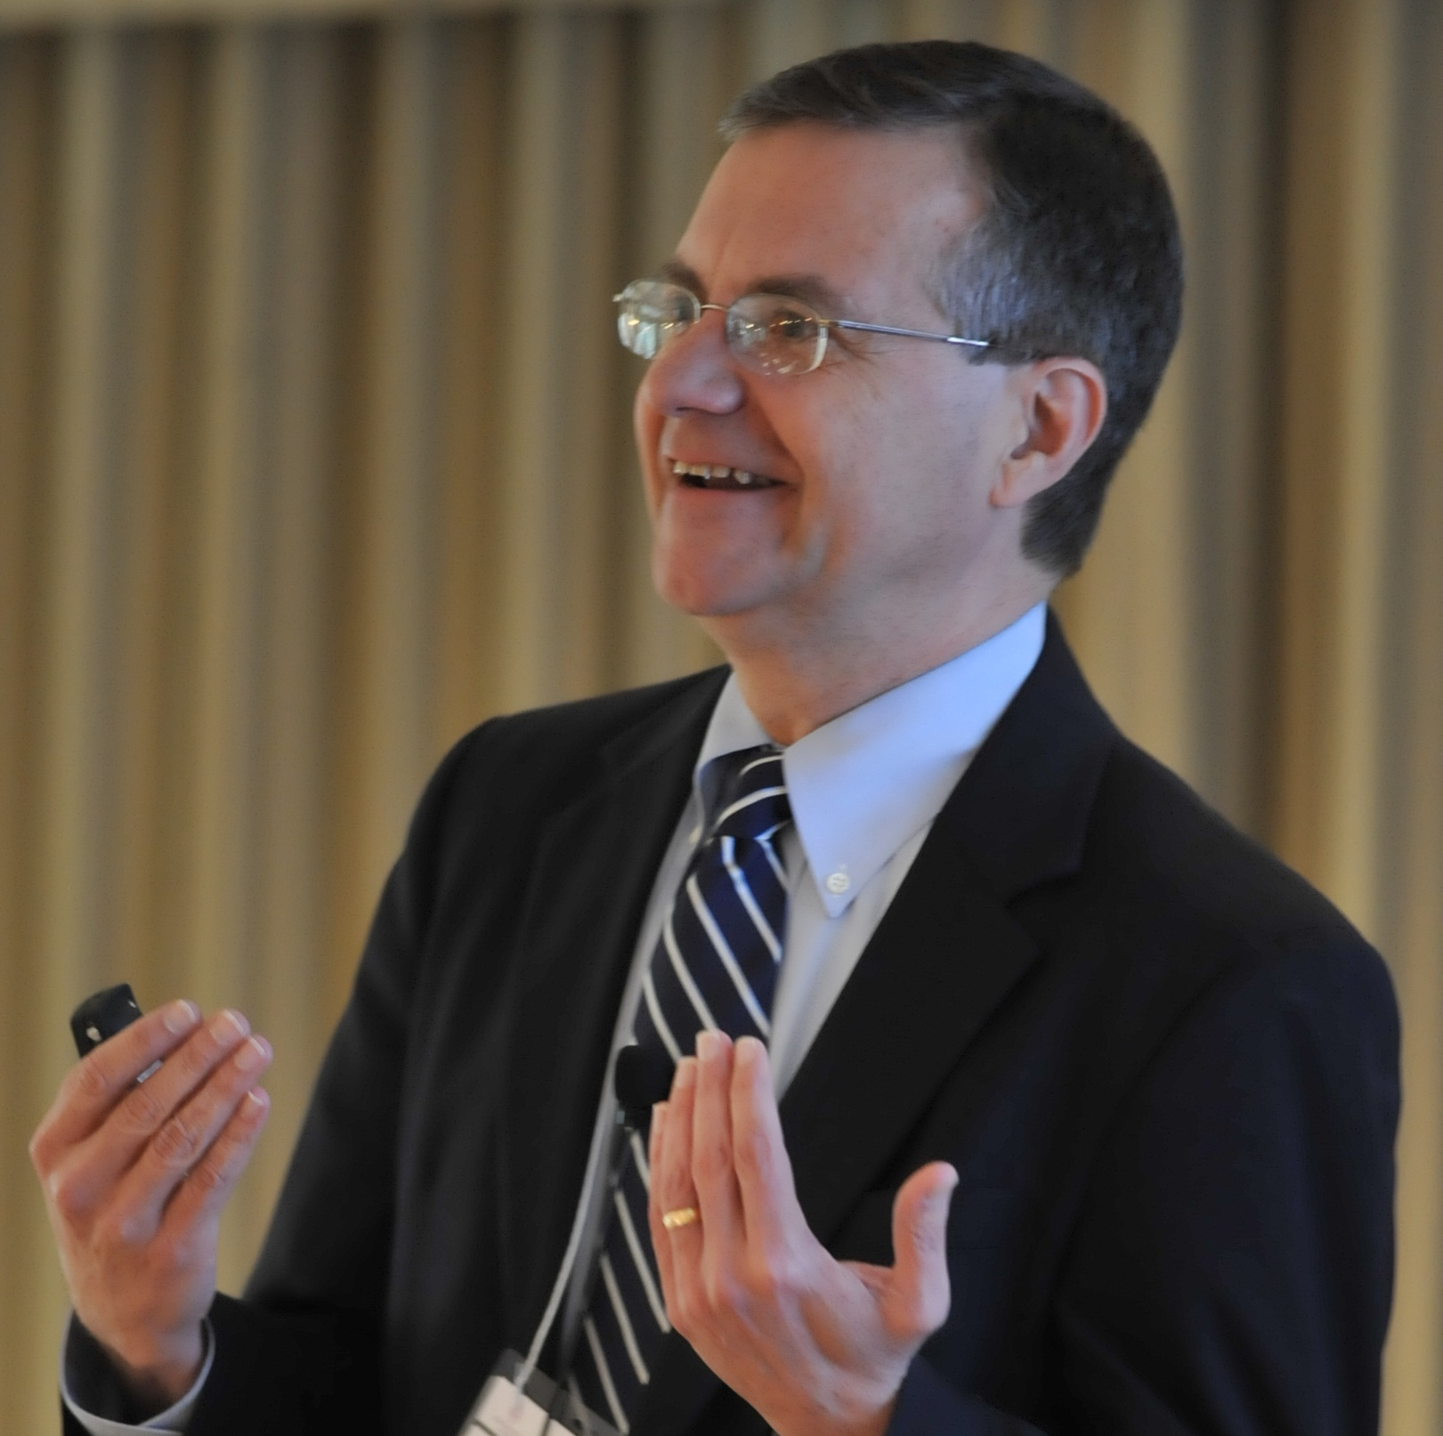
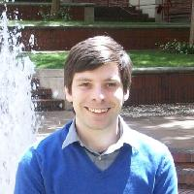
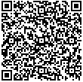
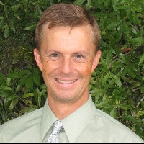
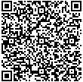
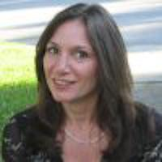
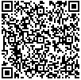
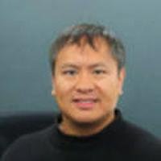
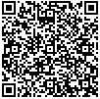
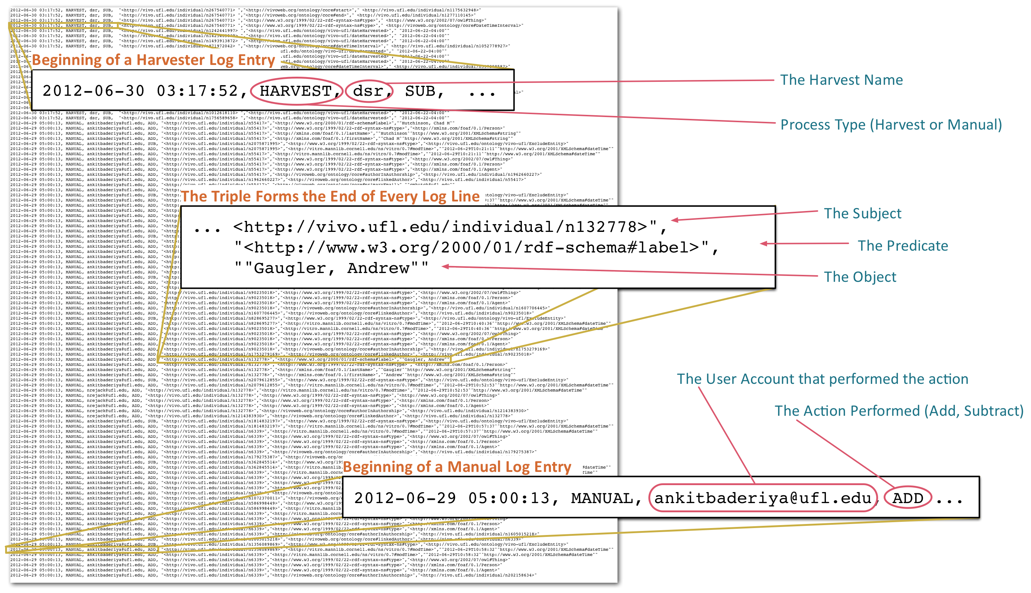
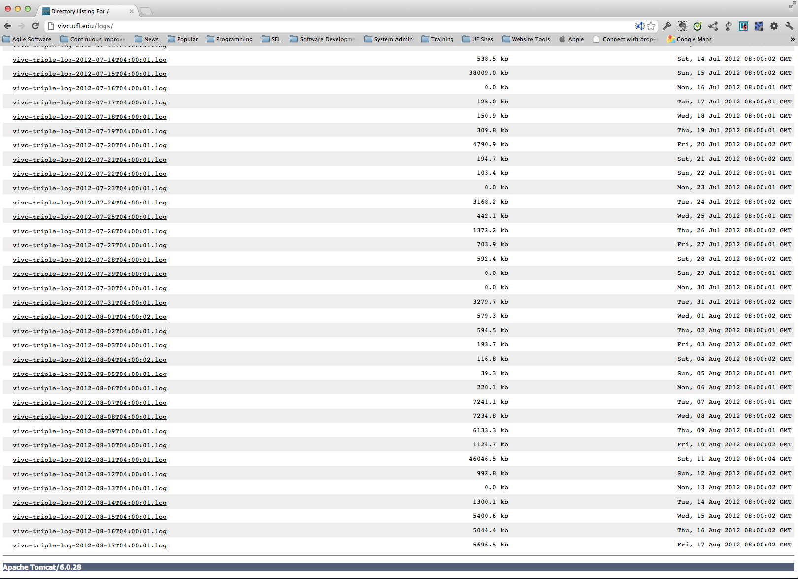
Implementing Logging for Activity Monitoring in VIVO
Contact Us
Vincent Sposato
vsposato@ufl.edu
Stephen Williams
drspeedo@ufl.edu
Narayan Raum
nraum@ufl.edu
Chris Barnes
cpb@ufl.edu
Mike Conlon
mconlon@ufl.edu
Nicholas Rejack
nrejack@ufl.edu
Erik Schmidt
cavedivr@ufl.edu
Laura Guazzelli
laura2@ufl.edu
Will Collante
wjc813@ufl.edu
Introduction
The Clinical and Translational Science Institute (CTSI) at the University of Florida had a need to develop a logging system that would allow daily review of all data additions and subtractions occurring within VIVO. This system would need to identify the date & time, the process, the ‘user’, the direction (addition / subtraction), and the actual triple itself. The process needed to be automated and place the resulting logs into a location that could be gathered either manually by the stakeholders, or through some automated ‘harvesting’ process for metrics to be run. The logging functionality utilizes a Java class added to the VIVO context, an additional configuration on the log4j properties, and a handful of bash scripts to account for clean up and combining of the separate logs. All harvests have an additional step added at the end that gathers the additions and subtractions files, and moves them into a specific location for combination with the VIVO context listener.
Why Log?
Cloud the logs!
Ease of Debugging Data Issues
Quickly answer data modification questions
Quickly answer questions of data provenance
An additional layer of data backup
Analyze the harvest data sources
Show the active hours of the application
Show the active Self Editors
Record Data Ingest Hours
The Combined Log
Vincent J. Sposato¹, Stephen V. Williams¹,Narayan Raum², Chris Barnes², Mike Conlon³, Nicholas Rejack³,
Erik C. Schmidt³, Laura Guazzelli³, Will Collante³
¹ Enterprise Software Engineering, Academic Health Center IT, University of Florida, ² Clinical and Translational Science IT Group, Academic Health Center IT, University of Florida, ³ Clinical and Translational Science Institute, University of Florida

