Slide 1
Identifying and Approaching Data Providers; Full Life Cycle Data Management
Mike Conlon
Kristi Holmes

Slide 2
Data for VIVO
What data will you need?
Authoritative Sources
Data owners, holders, stewards, providers
Examples, pitfalls, successes
The role of IT

Slide 3
What Data will You Need?
Data on People – current and past positions, contact information, photos, awards, service activities, identifiers
Organizations – structure, identifiers, web sites
Papers
Grants
Other scholarly works – books, chapters, abstracts, posters, presentations, art, music
Mentoring relationships
Patents
Courses

Slide 4
Automated Data Feeds
Some data (most?) will come from automated feeds from existing systems
Registrar, Faculty Reporting, Grants Management, Institutional Repository
Some systems are relatively complete (all faculty, all data elements regarding positions), many are not
Some systems have good data, many do not
What is the tolerance for incomplete, incorrect data? What can be done to improve data quality?

Slide 5
Manual Data Entry
Some institutions can implement VIVO by “typing in” the data
Scripps Research Institute (250 faculty)
Ponce Medical School (35 faculty)
UF Agriculture (800 faculty)
Some faculty will want to review/edit their data
Central proxy edit
Distributed proxy edit
Self-edit

Slide 6
How Will You Decide?
Planning Committee
Identify and engage stakeholders
Create a governance structure
Strategy
“Shallow, wide and grow”
“Narrow, deep and grow”
“All at once”
Lots of others

Slide 7
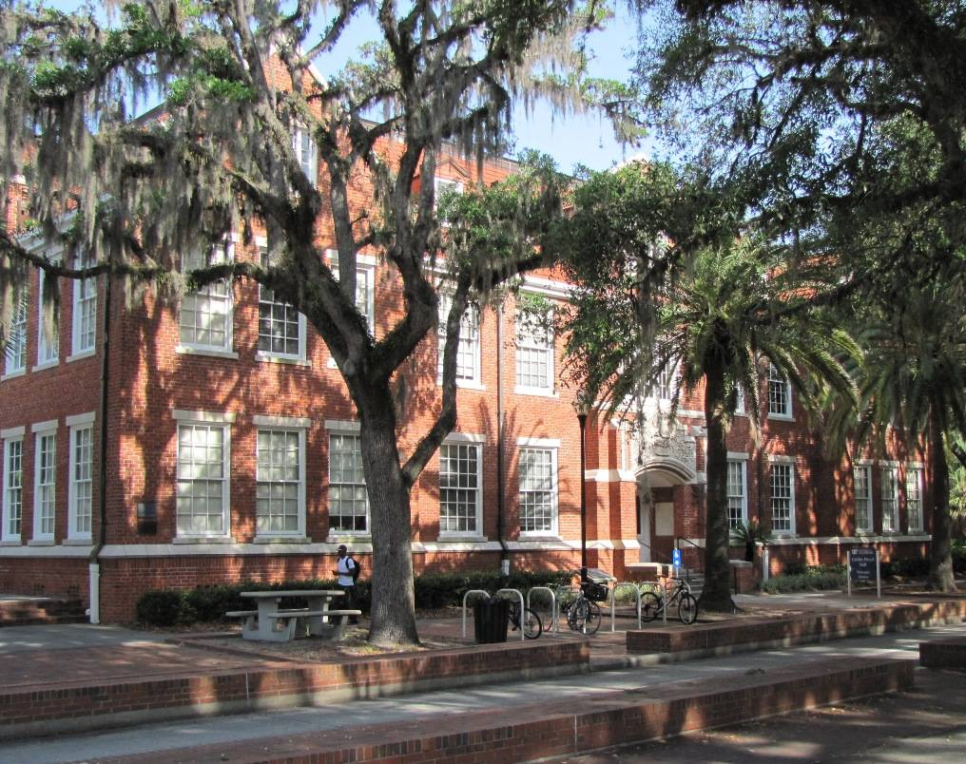
Example: University of Florida

Slide 8
University of Florida Data
People – from the University directory, UFID
Positions – from HR, PositionID
Organizations – from PeopleSoft, manual, DEPTID
Grants – from Division of Sponsored Research – SponsorIDs, AwardID
Papers – from PubMed, PubMedID, from Thomson Reuters, DOI
Photos – from ID Cards, Business Services Division, UFID
Courses – from Registrar via Enterprise Data Warehouse, Course and Section Numbers
Overview, research areas, awards, research interests, memberships, posters, abstracts, presentations, patents, software, featured in, teaching overview, service, education, keywords – entered manually via central proxy, local proxies and self edit

Slide 9
Talking to Data Stewards
What motivates the data steward?
We understand university procedure, policy, culture
We’re improving the quality of the data
We have the support of the university
You’ll get full credit
We’re making the data more valuable for faculty, staff and students
We’re not involved with private data
We’re not a system of record for your data
We love, understand and respect data

Slide 10
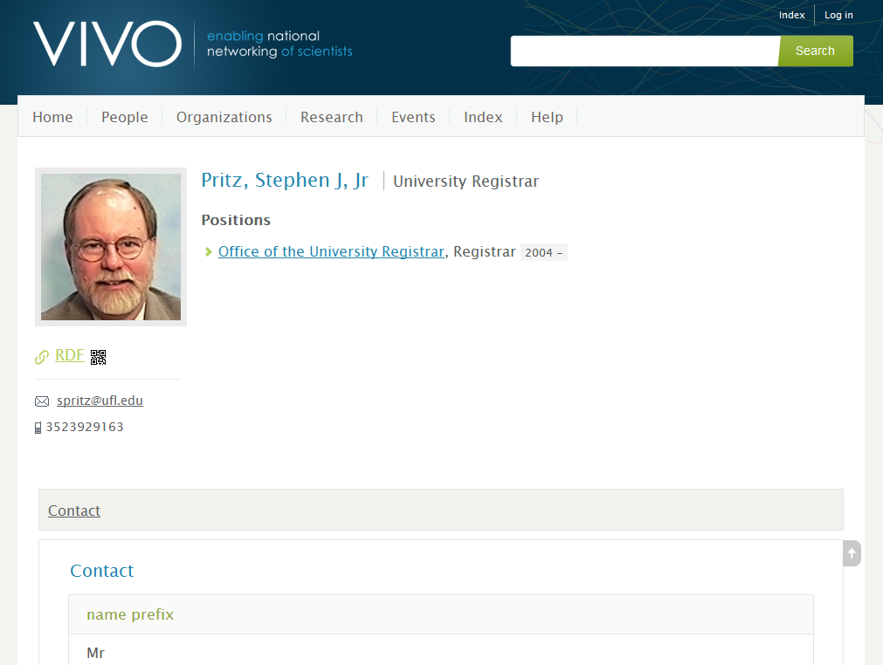
Example: University Registrar
History
Relationship
Relationship to VIVO
Providing Data
Notes:
History, Relationship, Relationship to VIVO, Providing Data

Slide 11
Data Management
Valid and invalid
mconlon@ufl.edu is a valid email address
jackie@@ufl.edu is not
Validity can sometimes be defined by rules which can be checked by machines
But names are difficult
Mike Conlon (a valid name)
A J Smith X (a valid name?)

Slide 12
Correct and Incorrect
“Dr. Smith is a faculty member in the English Department”
Is this knowable? That is can we determine whether it is a correct or incorrect statement?
Who can determine if this is knowable?
Who can determine if this is correct?
Most institutions have processes for providing authoritative sources for some data elements

Slide 13
Authoritative Sources
Who is authoritative for a person’s name?
Hint: Trick question

Slide 14
Two “Names”
Legal Name
HR is authoritative for legal name. HR must record and process the legal name for federal tax purposes. Legal names are changed through a court process and recorded via a W4 form by HR.
Ex: James Bernard Machen, President of UF
Preferred Name
The individual is authoritative for preferred name (but mediated by the institution?)
Ex: Bernie Machen

Slide 15
Who is authoritative?
For each field in VIVO, determine who is authoritative – a data provider, the individual
The two field pattern often recurs:
UF Business Email – Enterprise Systems is authoritative
Alternate Email – Individual is authoritative (and VIVO becomes the system of record for this field)

Slide 16
VIVO as a System of Record
VIVO is a system of record for any data element for which the institution has no system of record.
Faculty member’s eraCommons ID
Faculty member’s research interests
Faculty member’s awards
VIVO “mirrors” data elements of other systems of record
Names
Email addresses

Slide 17
Editing Data values
Data values should be edited in the systems of record
When VIVO is not the system of record, the data element should not be editable in VIVO
When data elements are not editable in VIVO, data flows should be in place to insure that values changed in source systems are mirrored in VIVO

Slide 18
The Source System is Always Right
The university maintains an official directory of business phone numbers. Business Phone numbers can not be changed in VIVO. Business phone numbers are changed in the UF Directory. These changes are passed to VIVO so that VIVO is always up to date.
Business Phone Number changed in University Directory
IT process detects change, passes to VIVO
Change is mirrored in VIVO within 60 minutes

Slide 19
The Source System is Always Right, Part 2
The university registrar maintains official records of which person(s) taught which instances of which courses each term. Such information can not be edited in VIVO. Teaching information is produced each term. This data is loaded into VIVO and cross linked to the instructors, courses.
Office of the Registrar produces data on teaching each term
IT process loads the data into VIVO
Faculty profiles are updated in VIVO with teaching records
The Registrar amends the teaching records well after the term is complete – sometimes as much as six months after the term is complete, based on department reports, effort tracking and other input. These amendments are then made to VIVO.

Slide 20
The Role of IT

Slide 21
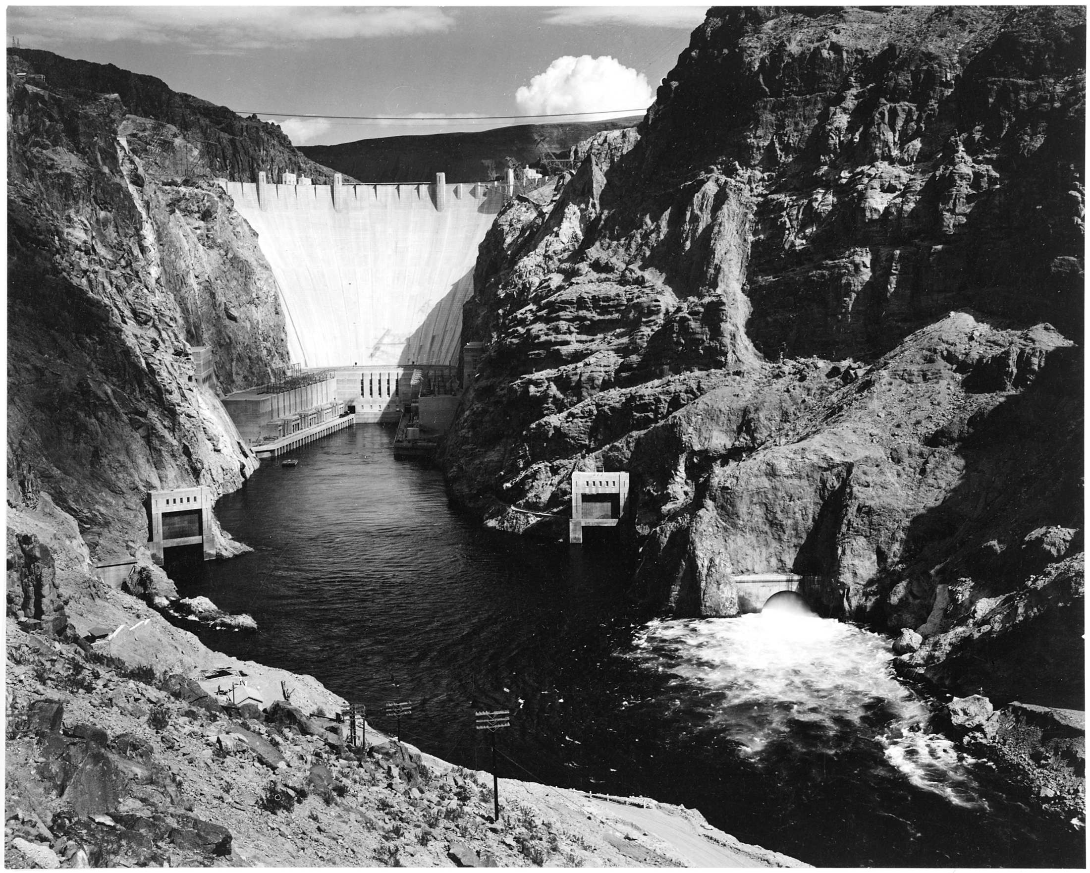

Slide 22
Data Flows at UF

Slide 23
Does VIVO Give Back?
All VIVO data is readily accessible via a “SPARQL Endpoint” – a semantic web technology that allows programmers to “query” VIVO and receive “results”
When VIVO has data of interest to the institution, the institution can query VIVO to get the data

