Slide 1
Data, Tools and Community for
Research Discovery and Networking
Boulder, CO May 14, 2012
Michael Conlon, PhD, Principal Investigator, VIVO: Enabling National Networking of Scientists, NIH/NCRR U24 RR029822, University of Florida
Jon Corson-Rikert, PhD, VIVO Development Lead,
Cornell University
Kristi L. Holmes, PhD, VIVO Outreach Lead,
Washington University at St. Louis

Slide 2
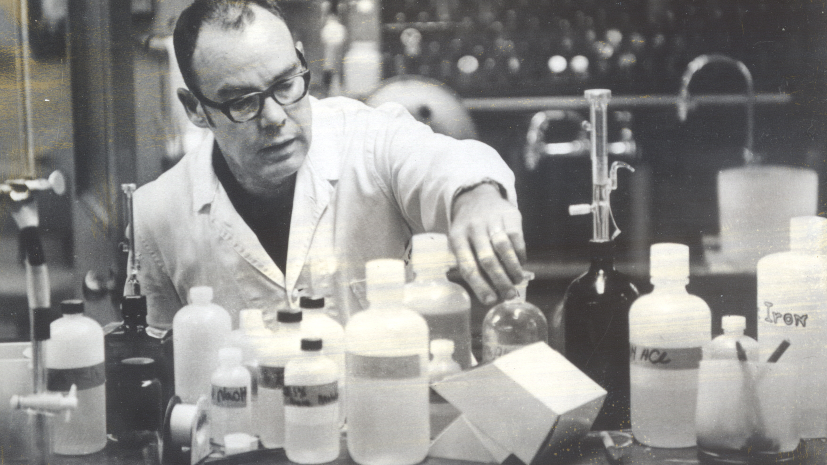
Learned a field, learned the scientific method, did science
Notes:
Learned a field, learned the scientific methods, did science, wrote papers

Slide 3
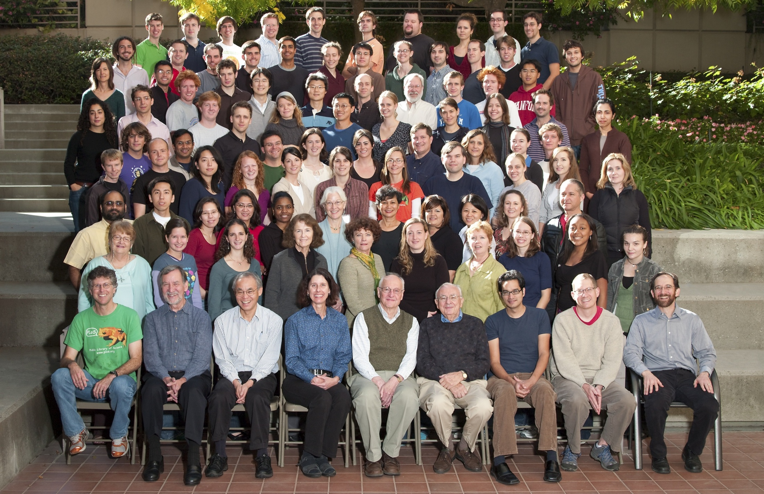
Science and Scientists
Notes:
Science and scientists. Biochemistry at Stanford. They look happy.

Slide 4
But then …

Slide 5
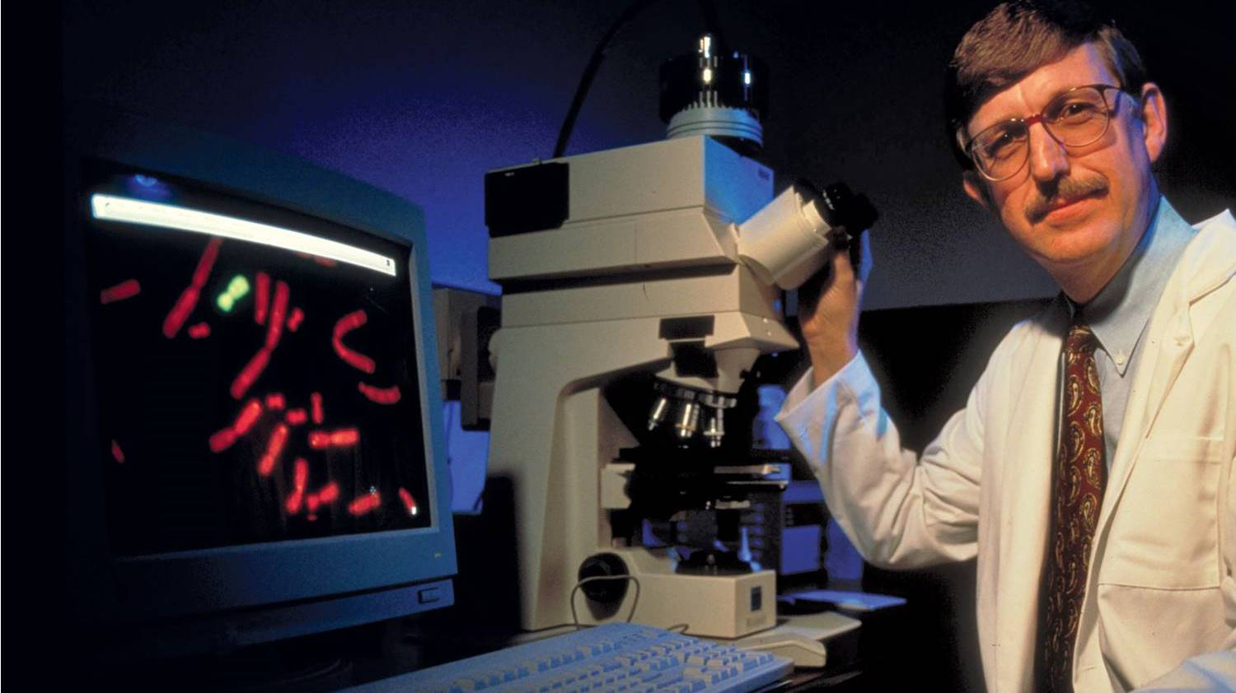
Notes:
The body of knowledge got bigger. And its about to get much bigger. Personalized medicine. Full base pair sequencing.

Slide 6
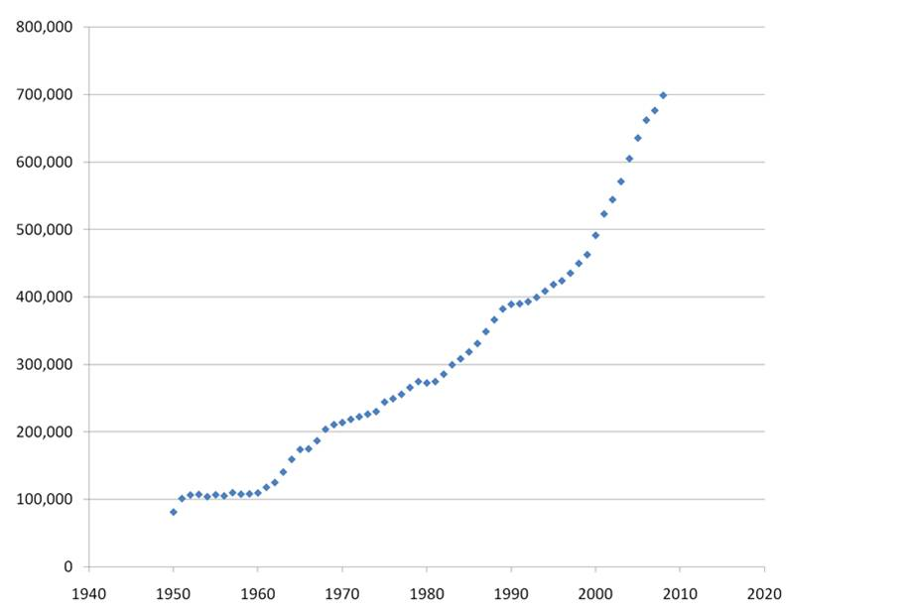
PubMed adds 700,000
articles
each year

Slide 7
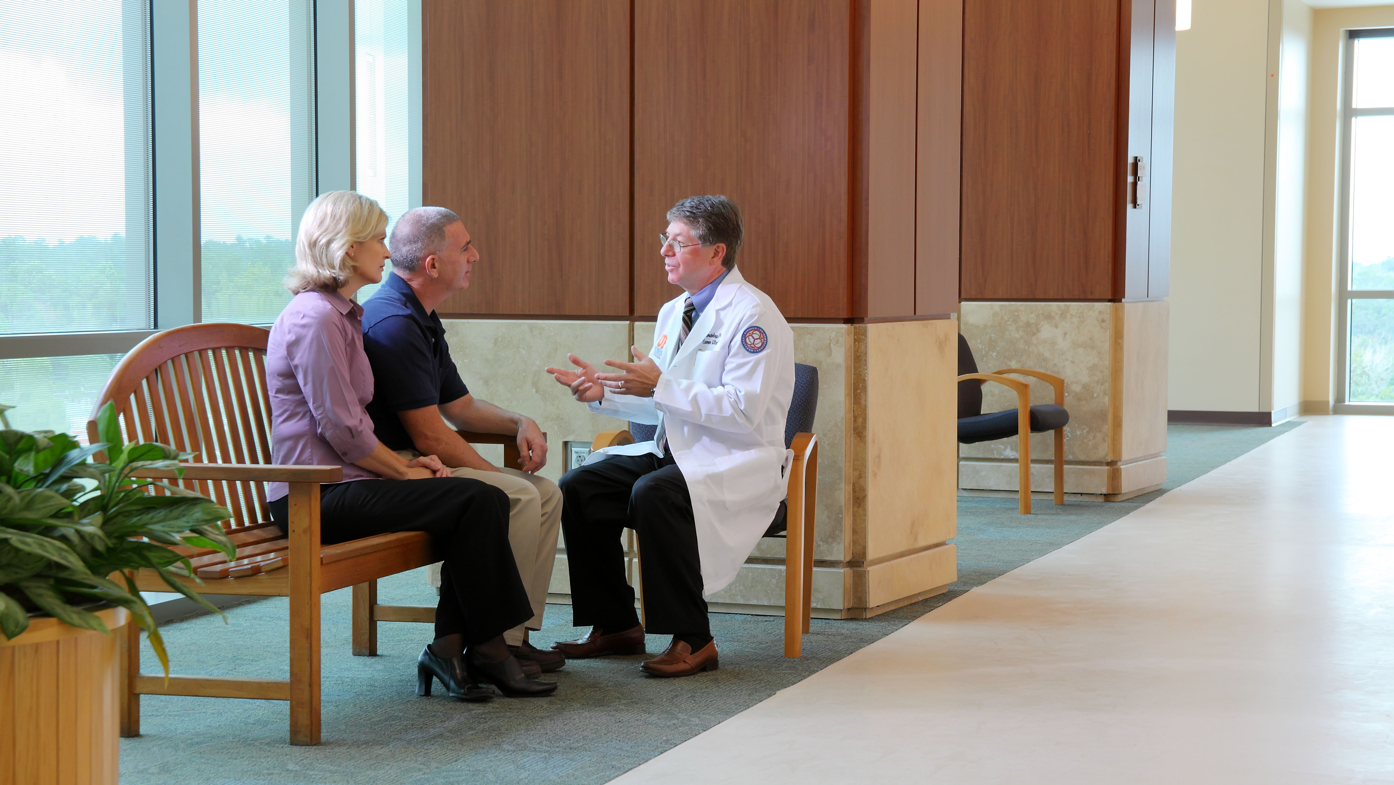
The Problems Got Hard
Notes:
The problems got more difficult. We work to cure cancer. 60 comprehensive cancer centers. Risk factors, genetics, surgical procedures, radiology, chemotherapy, life style changes.

Slide 8
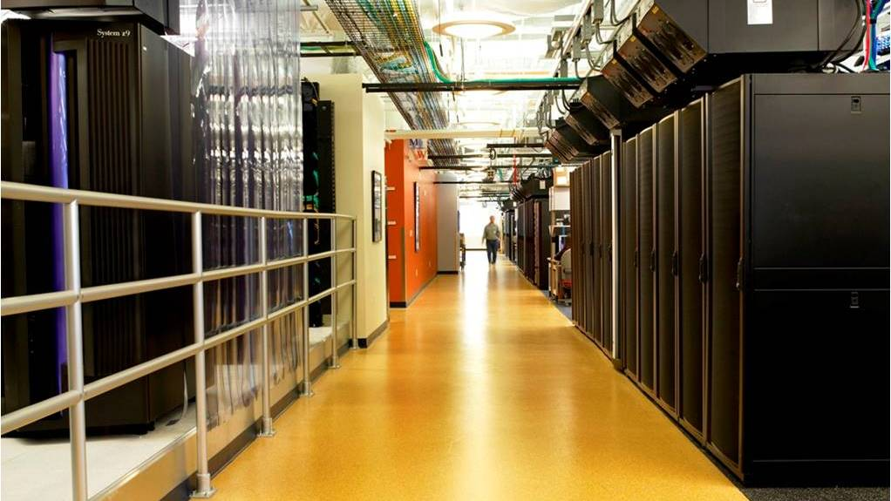
Data Got Big (IDR Slide)
Notes:
Data got big. Terabytes, Petabytes, Exabytes.

Slide 9
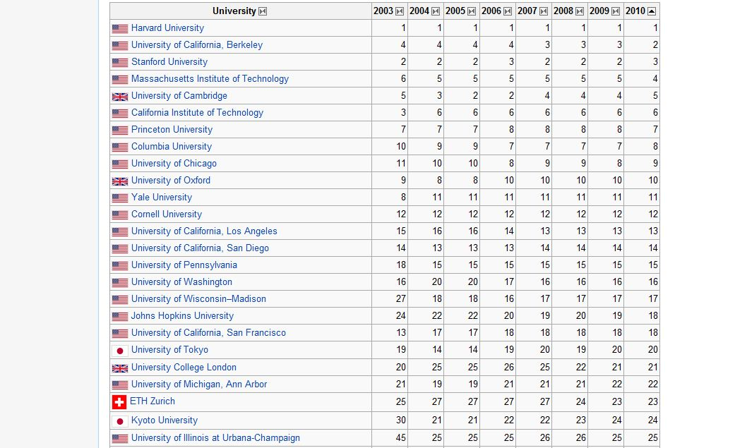
Lots of Competitors
2010 Shanghai ranking of world universities
http://en.wikipedia.org/wiki/Academic_Ranking_of_World_Universities
Notes:
Lots of competitors.

Slide 10
Notes:
Internet speed

Slide 11
How do we respond?

Slide 12
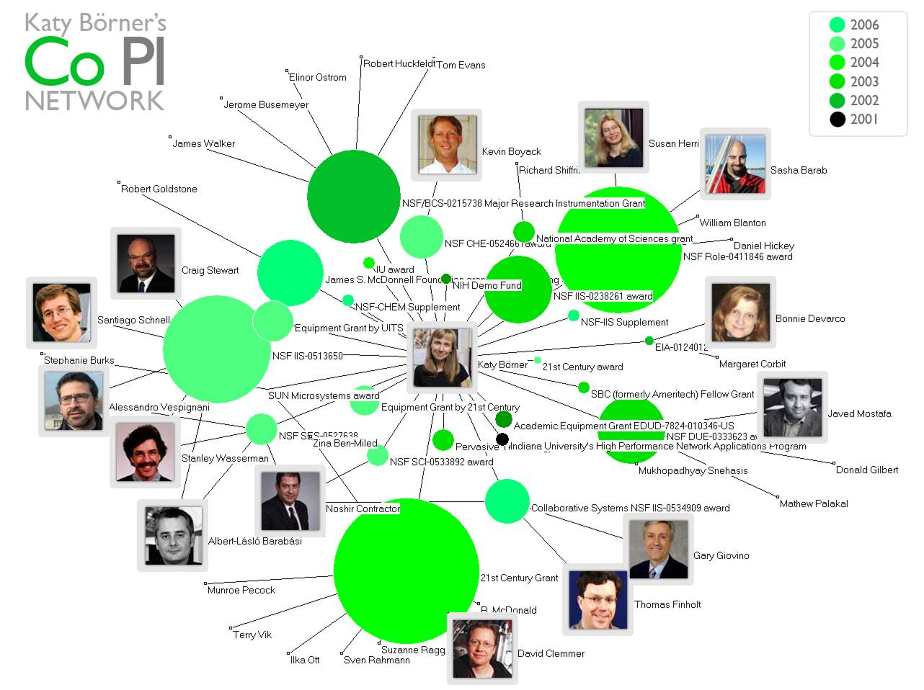
Notes:
Study science itself. Science of Team Science. Who publishes with who? Who is funded with who? What teams produce innovations? What teams struggle? Why?

Slide 13
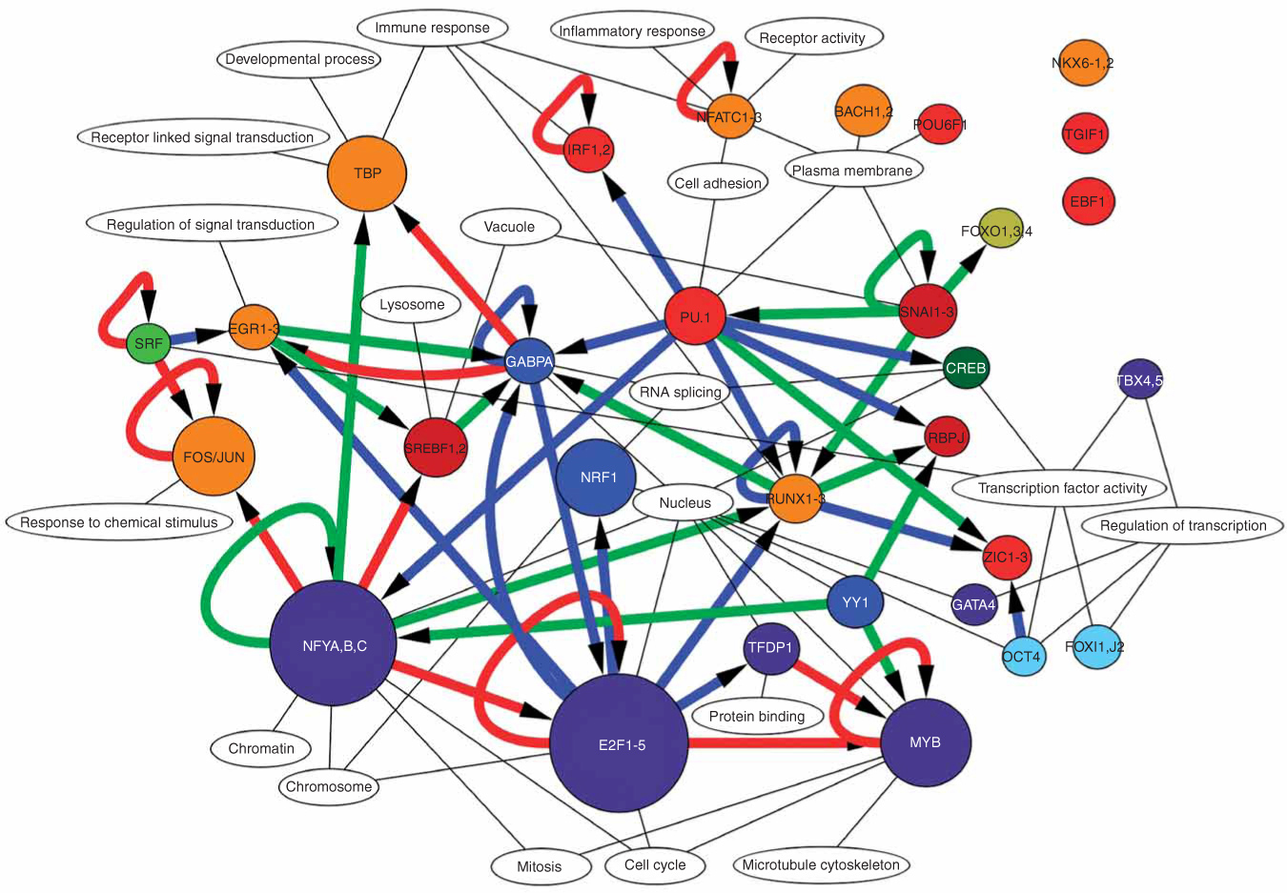
The FANTOM Consortium & Riken Omics Science Center, The transcriptional network that controls growth
arrest and differentiation in a human myeloid leukemia cell line Nature Genetics 41, 553 - 562 (2009)
Notes:
Build teams

Slide 14
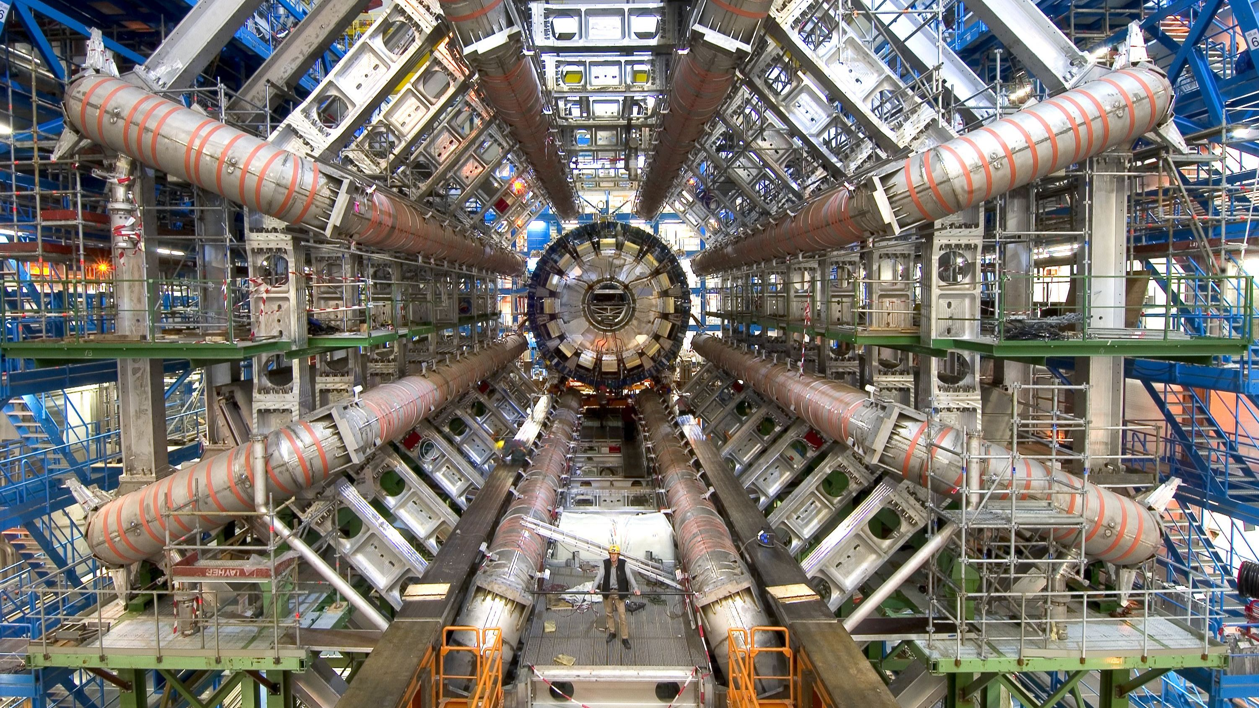
Clinical Trial
Notes:
Build big things

Slide 15
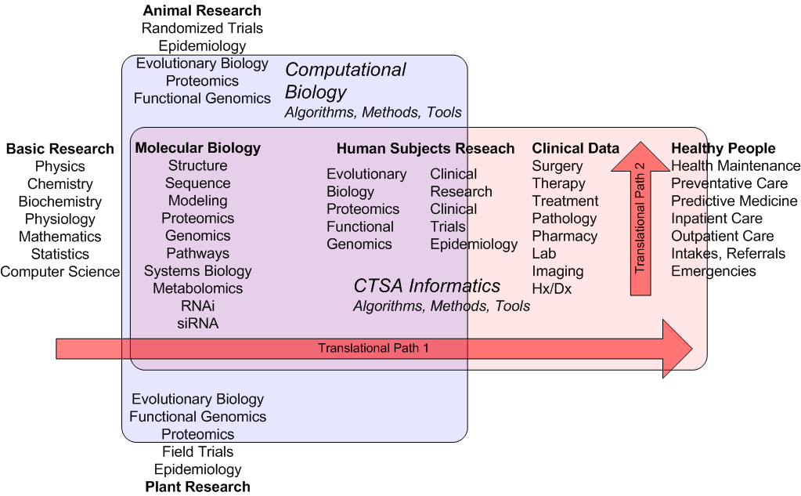
Collaboration
Notes:
Collaboration – the sciences fit together to advance human health. But that’s just one science domain

Slide 16
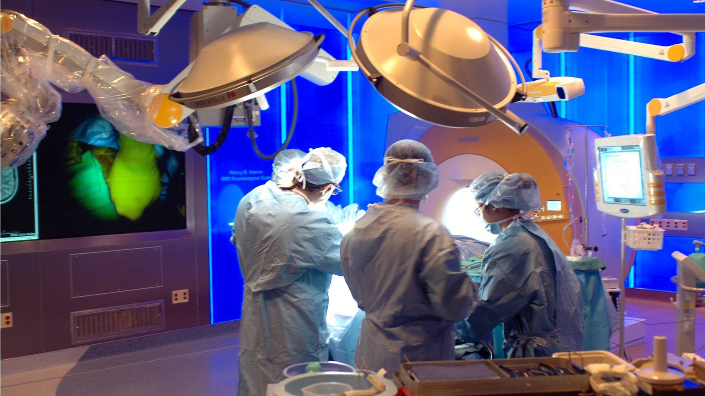
Implementation Research
Notes:
Implementation research. Changing medical practice. Operations research, medical economics, medical anthropology, epidemiology, biostatistics, health services research, health outcomes policy, and a medical discipline undergoing change.

Slide 17
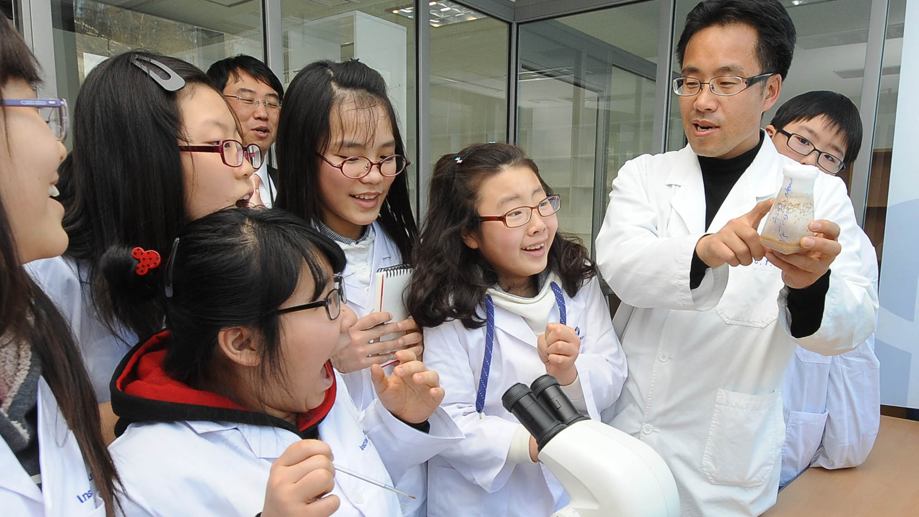
Mentoring
Notes:
Mentoring. Teach, shape, lead, build. While retaining the joy and excitement of science.

Slide 18
How can we know what is going on, build teams, solve problems?

Slide 19
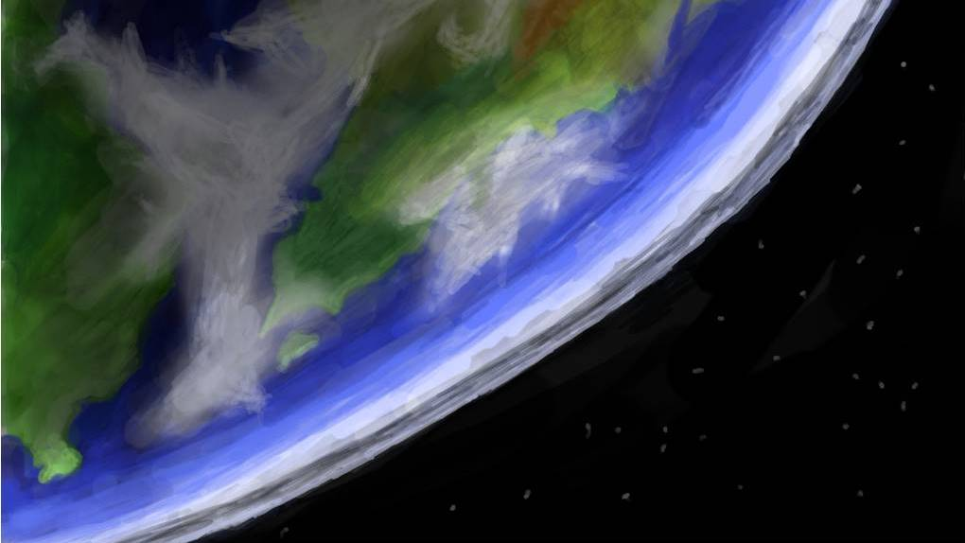
Research Discovery
Research
Discovery
Notes:
Research Discovery. What is going on? Where? By Whom?

Slide 20
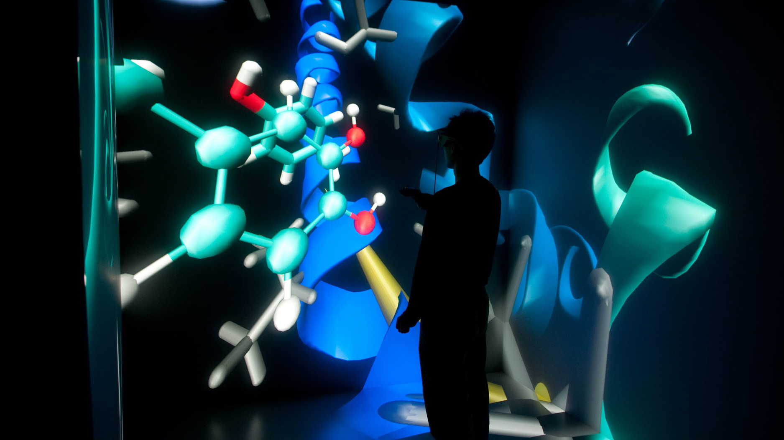
Notes:
People, Events, Resources, Projects, Funding, Datasets, Concepts, Papers

Slide 21
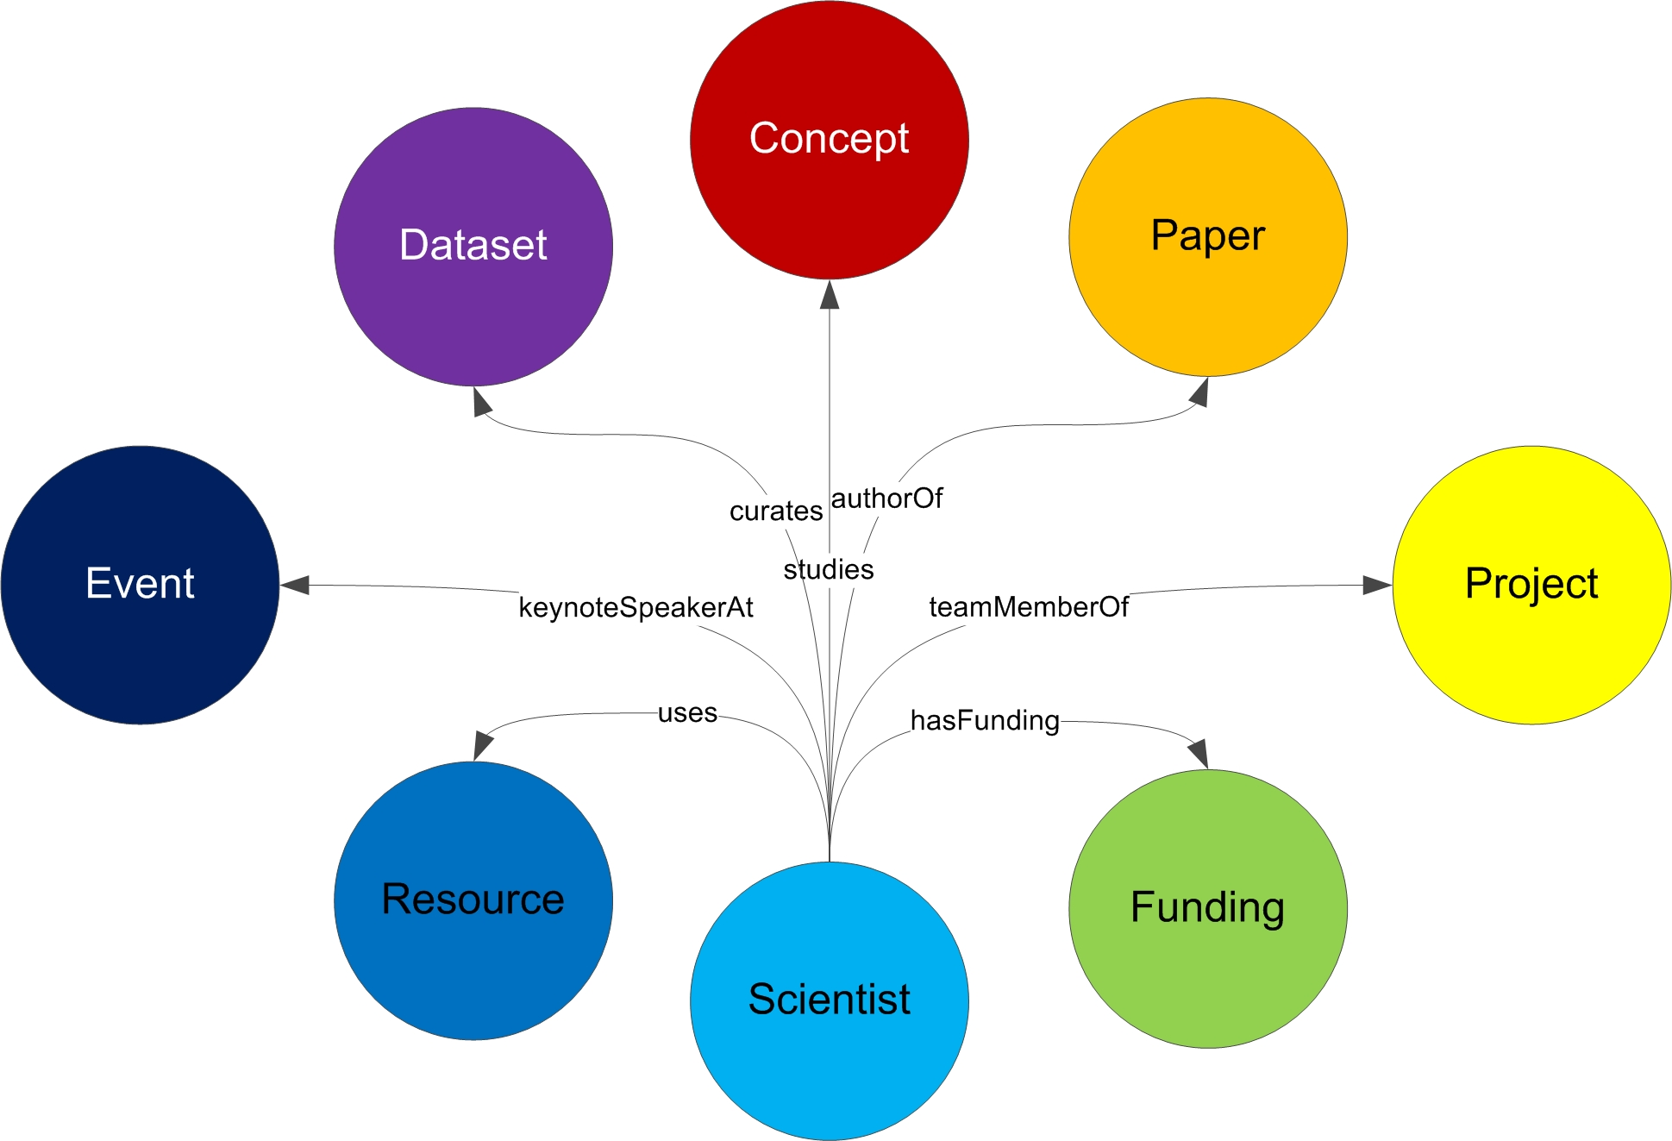
… And the connections between them
Notes:
And the connections between them. Many kinds of connections between each type of object. Objects have significant complexity. What do we mean by “project” – a human subject study? A clinical trial?

Slide 22
How can we create a world platform for research discovery?

Slide 23
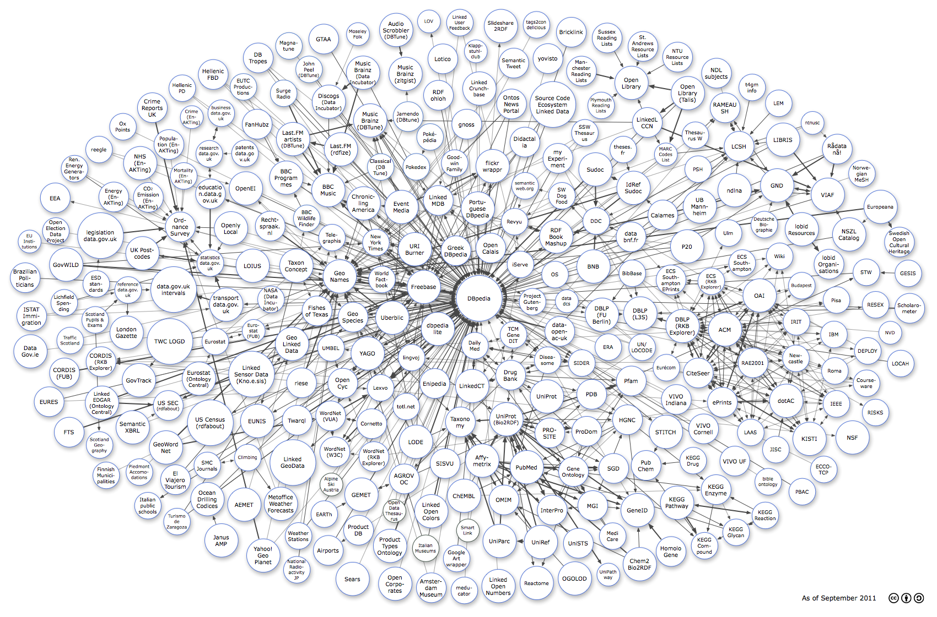
Data
Notes:
We are going to need data. Linked open data on the semantic web. Some exists. Much to be created. From systems built to support operations, to systems built to support sharing and discovery.

Slide 24
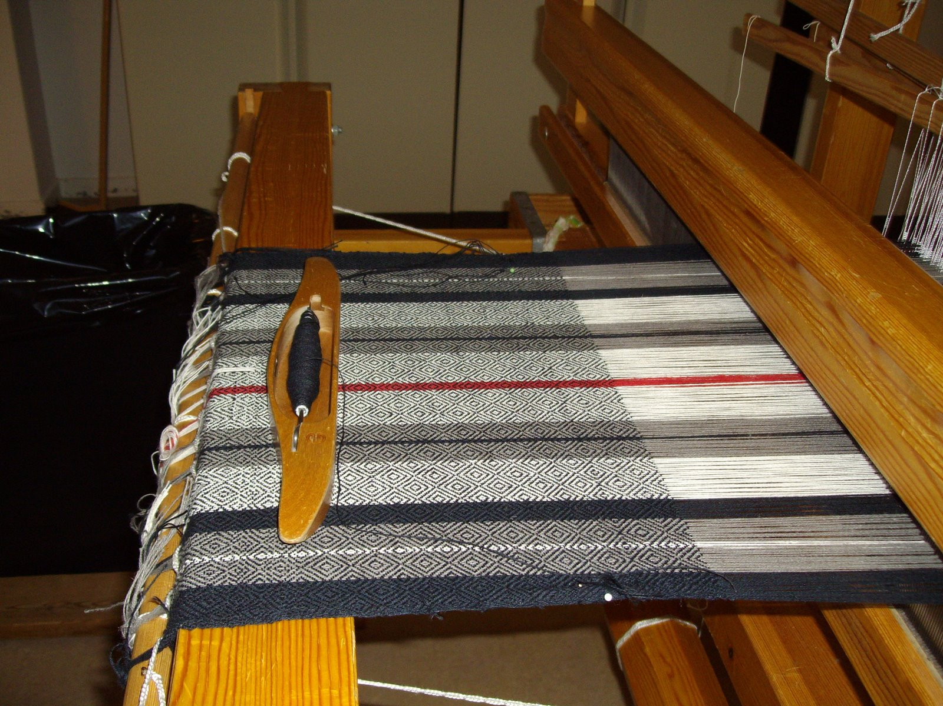
Tools
Notes:
We are going to need tools. Tools for collecting, identifying, cleaning, organizing, making sense of and giving away data.

Slide 25
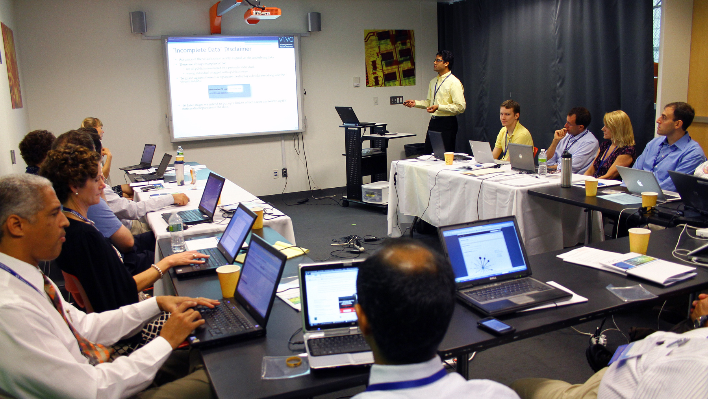
Community
Notes:
We are going to need a community of people who share a common interest in research discovery.

Slide 26
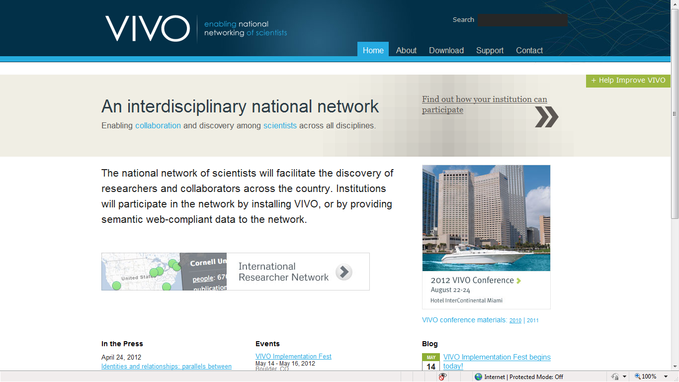
VIVO: Data, Tools and Community
Notes:
So that’s what we are doing. In 2009, as part of the ARRA, the NIH funded VIVO: Enabling National Networking of Scientists. Seven schools came together – Florida, Cornell, Indiana, Weill, Wash U, Scripps, Ponce – to expand on pilot work done at Cornell.

Slide 27
VIVO is open standards and open linked data regarding scholarship – people, papers/works, funding, events/presentations, resources, projects/studies, data, concepts – and the relationships between them VIVO is open source, community maintained software tools for research discovery and networking VIVO is a world community of collaborators – scientists, implementers, developers
Notes:
What is VIVO?

Slide 28
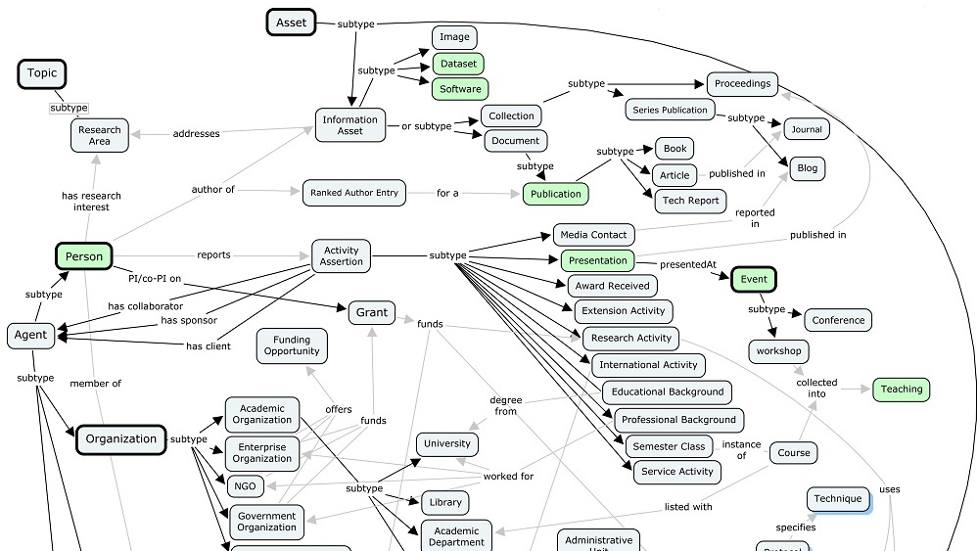
Ontology Process
Notes:
A fragment of the VIVO ontology. Open ontology process. Working group. W3C proposed standard. Plug-in ontologies (BIBO, SKOS, FOAF) support local extension

Slide 29
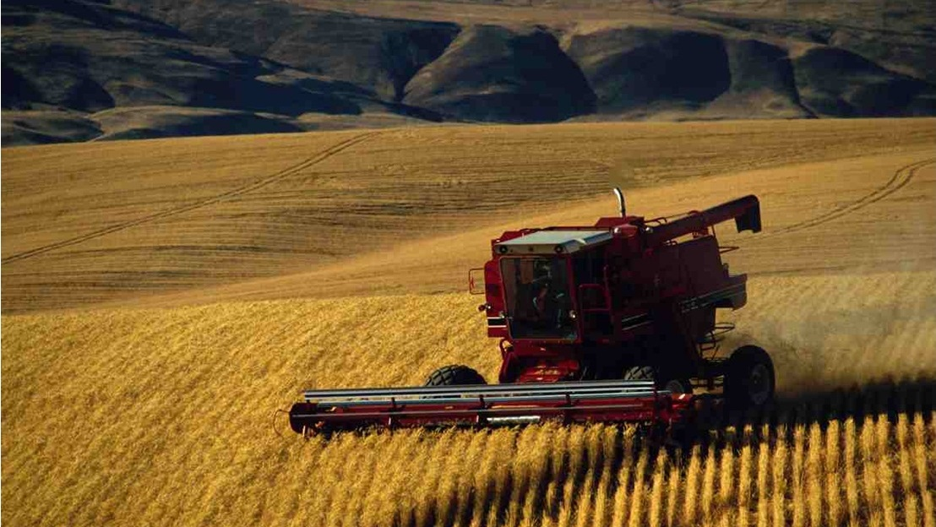
Harvesting Data
Notes:
And then we harvest data. Using the VIVO Harvester, develop scripts and templates for gathering data from source systems – people, pubs, grants, photos, courses taught. Automated ingest to spreadsheet upload. Google Refine for improvements in data quality and matching objects with disparate identification schemes.

Slide 30
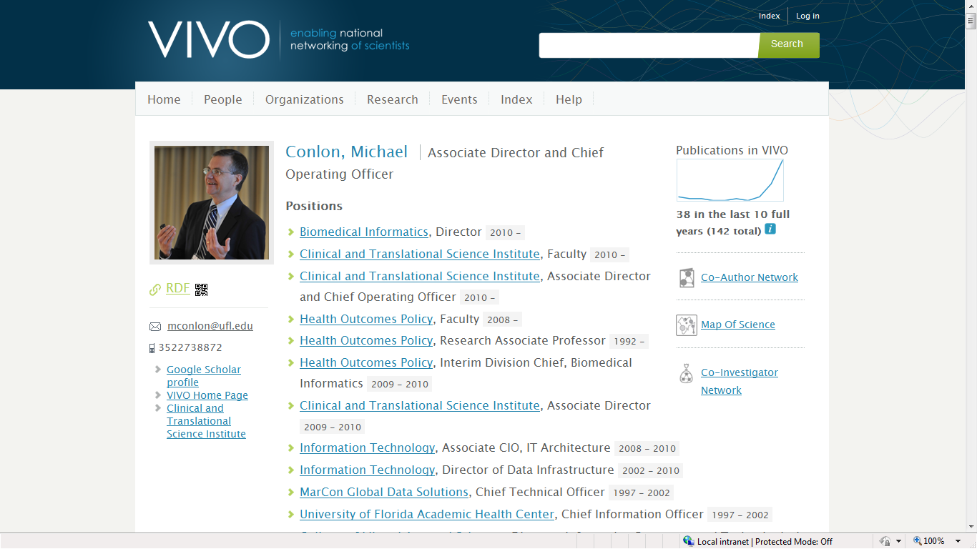
Simple tools for presentation, traversal, search
Notes:
So here’s the simple view – a faculty profile. Assembled by machines. Can be finished off by the faculty member. All links are to other objects in the semantic web. Positions, visualizations, organizations, people, web sites. Navigation via search, facets, link traversal. Note the RDF link for techno guys.

Slide 31
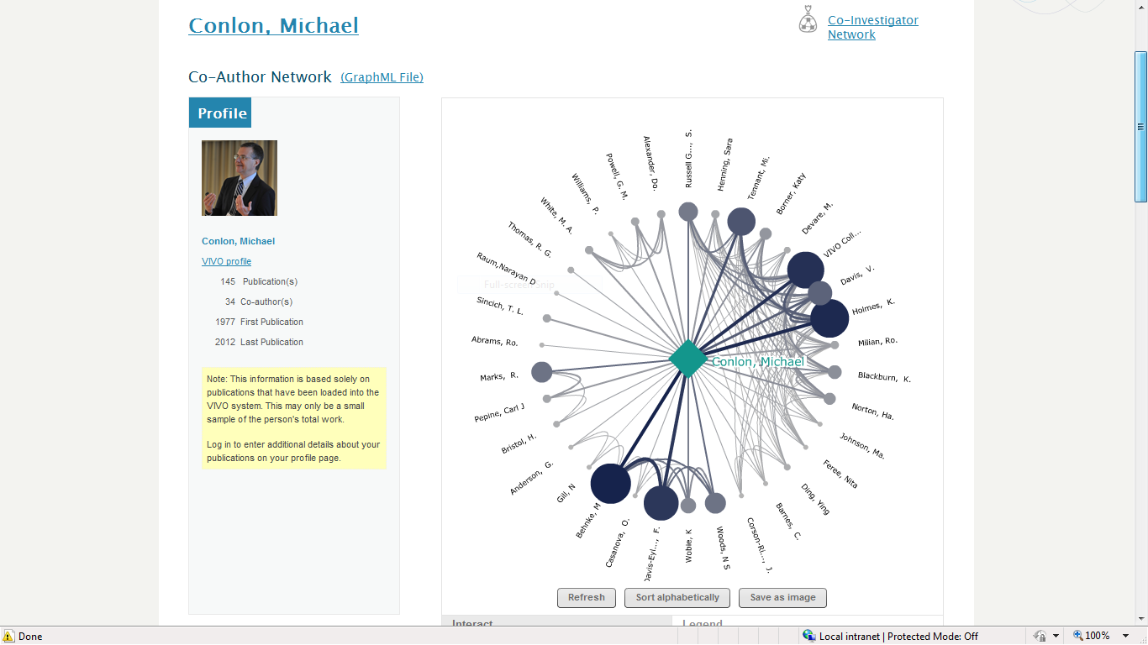
Tools using linked open data
Notes:
Co-author network. Visualizations for time, geography, concept, person linkages. Co-funded visualization as we saw before, not hand drawn, but machine drawn and available to everyone in an instant.

Slide 32
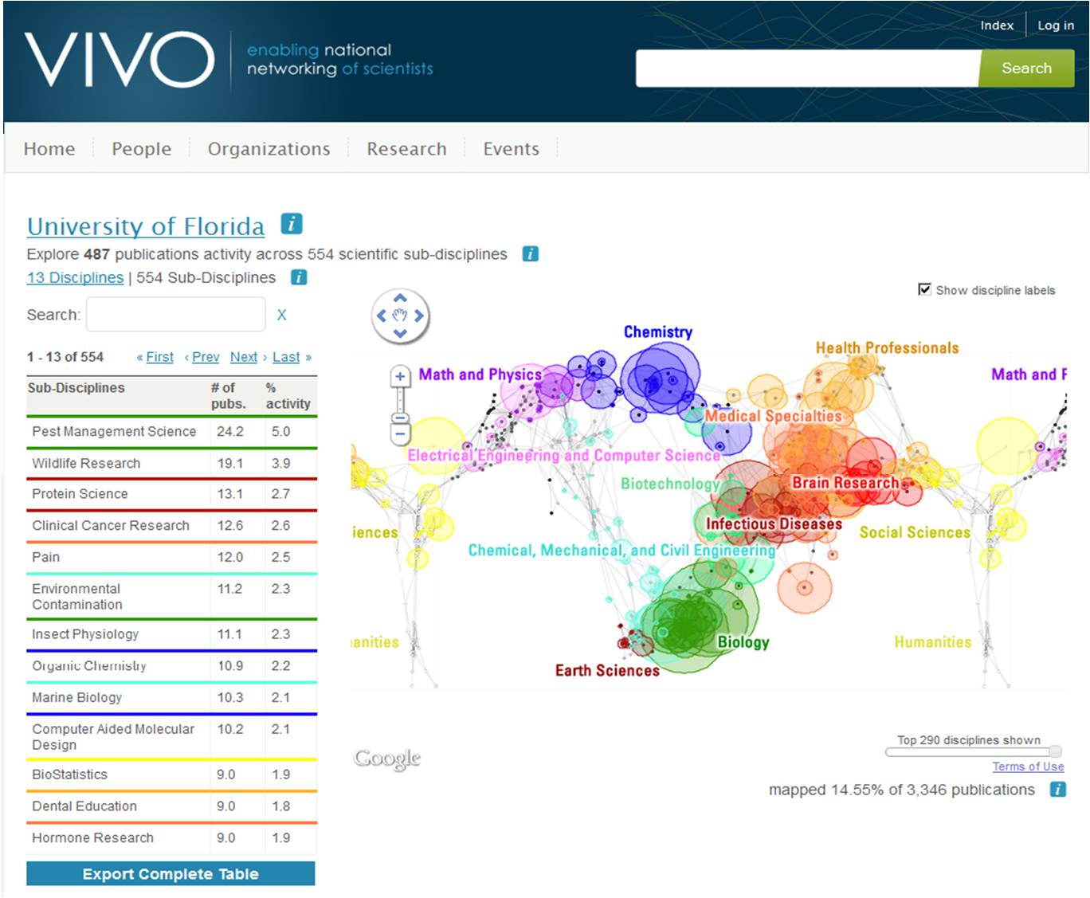
ScienceMap.
Examine
collections
of publications
for individuals,
work groups,
institutions

Slide 33
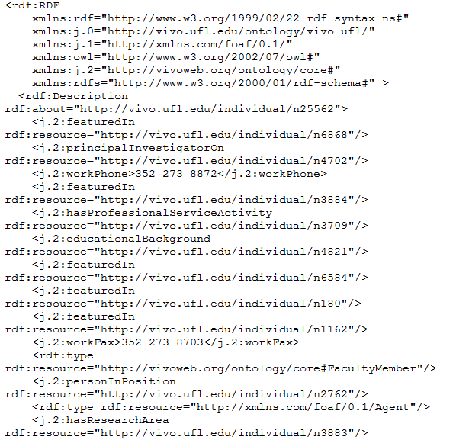
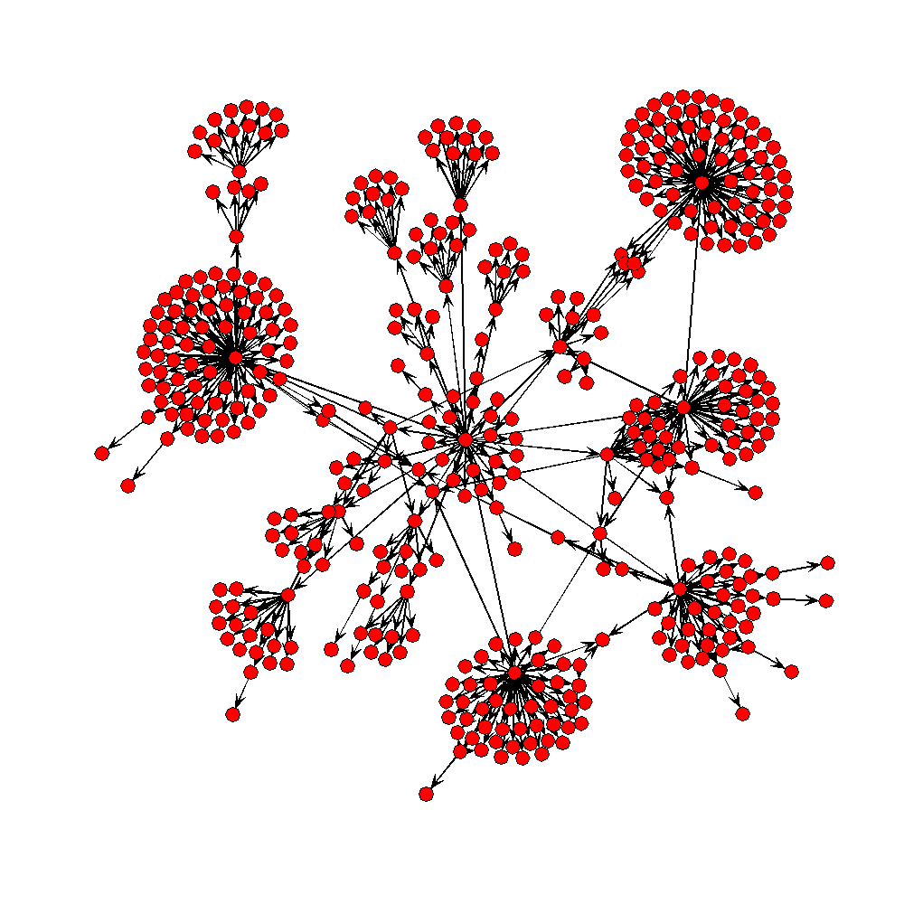
Software reads VIVO RDF and displays
processOrg<-function(uri){
x<-xmlParse(uri)
u<-NULL
name<-xmlValue(getNodeSet(x,"//rdfs:label")[[1]])
subs<-getNodeSet(x,"//j.1:hasSubOrganization")
if(length(subs)==0) list(name=name,subs=NULL)
else {
for(i in 1:length(subs)){
sub.uri<-getURI(xmlAttrs(subs[[i]])["resource"])
u<-c(u,processOrg(sub.uri))
}
list(name=name,subs=u)
}
}
VIVO produces both HTML and RDF
Notes:
The open architecture of VIVO and linked data supports development of applications outside VIVO that consume VIVO data. VIVO data is accessible via HTML (for humans) and RDF (for machines). Simple software can process the RDF resulting in powerful cross-site applications. The figure depicts the organization of the University of Florida.

Slide 34
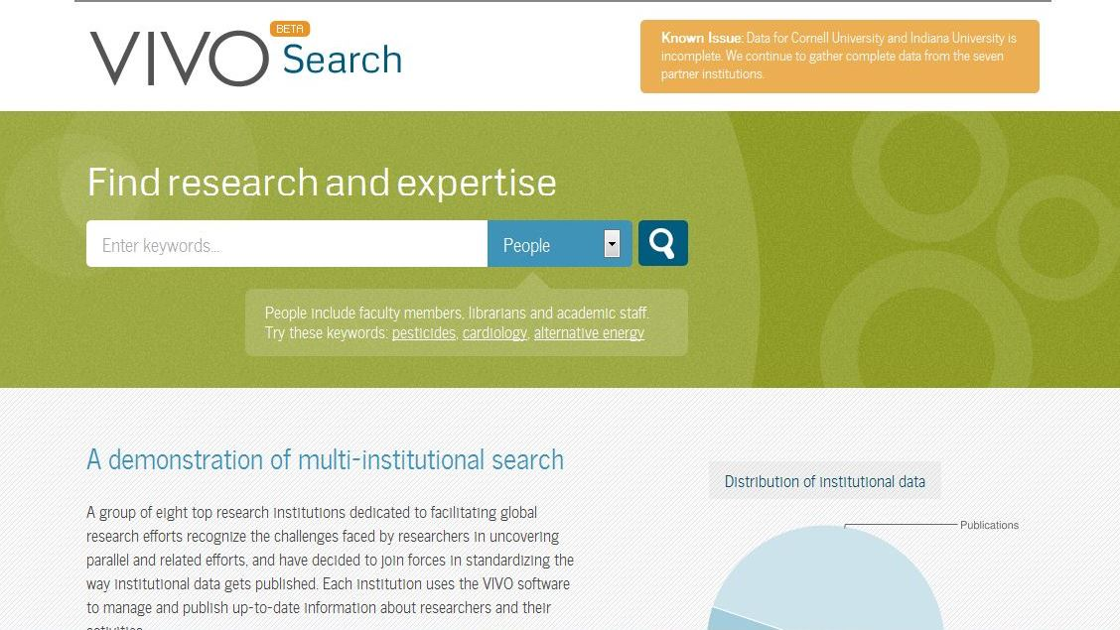
Augmenting data
Notes:
Vivosearch (beta) indexes vivo sites and provides faceted search across the collection with linking to individual objects

Slide 35
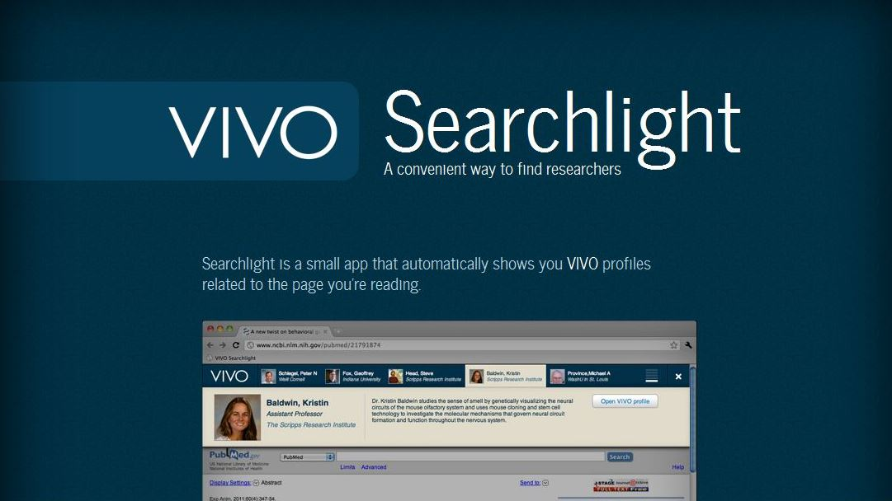
VIVO Searchlight
Notes:
VIVO searchlight. For any page on the web, find people whose work is similar to a page you are reading.

Slide 36
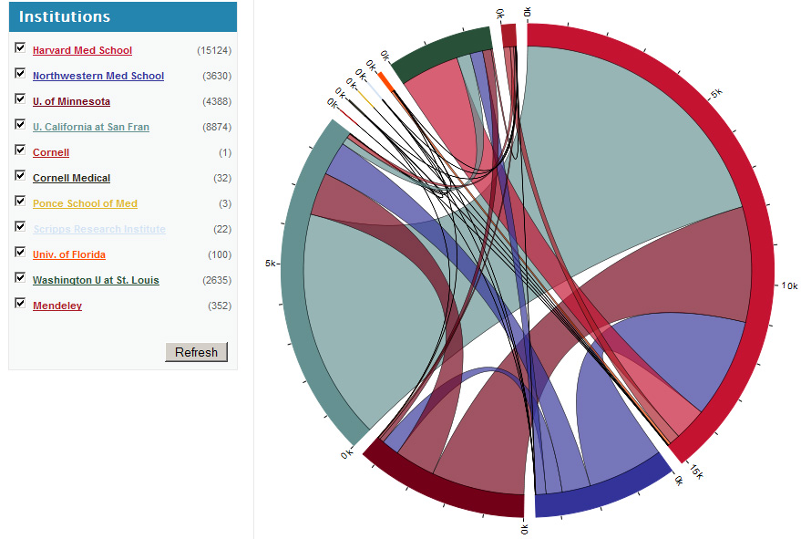
Inter-institutional Collaboration Explorer
This figure at right displays “collaborative publications” found at 2 or more Researcher Networking websites.
The idea that institutions don't work together and that biomedical research is conducted in silos is not true. Researchers, even when separated by great distances, are in fact willing to work together, and this visualization demonstrates that they often do.
Contact: Nick Benik (nbenik@gmail.com), Harvard Medical School, Boston, MA.
URL: http://xcite.hackerceo.org/VIVOviz
Notes:
Harvard developed inter institutional collaboration explorer. An outgrowth of the VIVO Hackathon.
So back to data, who will adopt VIVO and provide VIVO ontology RDF-compliant data?

Slide 37
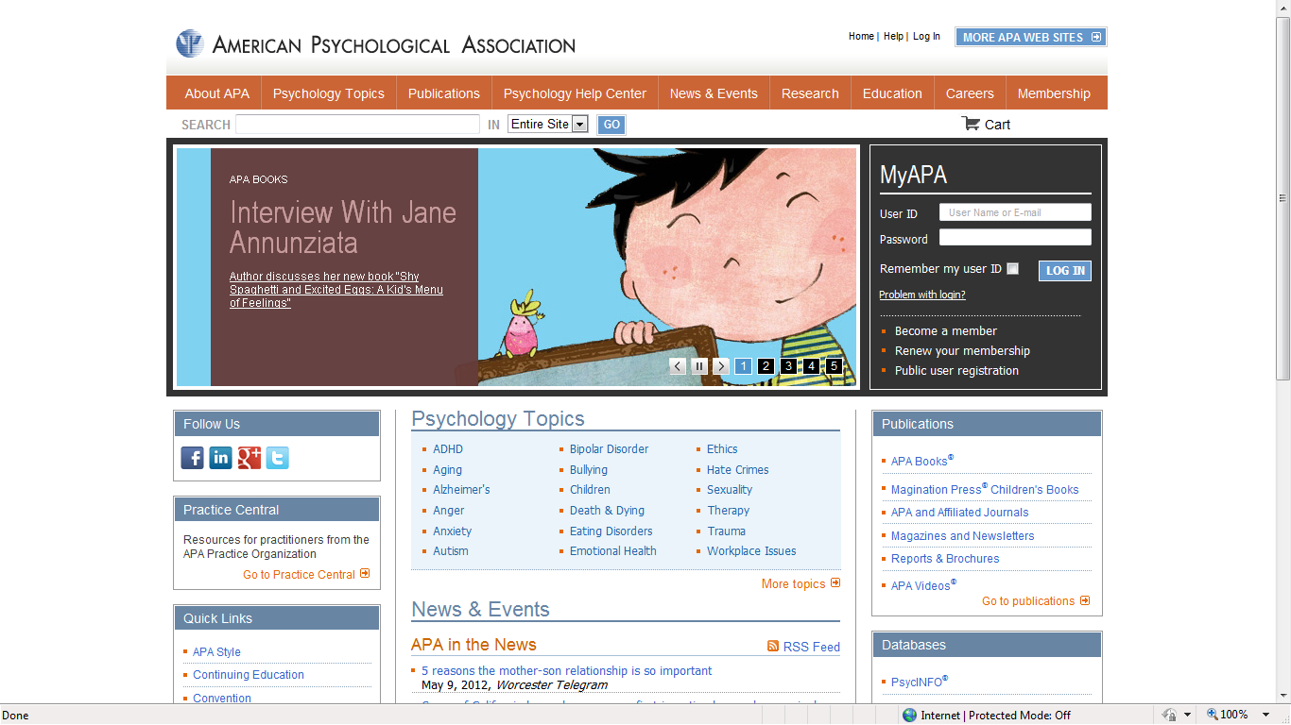
APA
Notes:
The American Psychological Association. 154,000 members, the largest scholarly association in the United States.

Slide 38
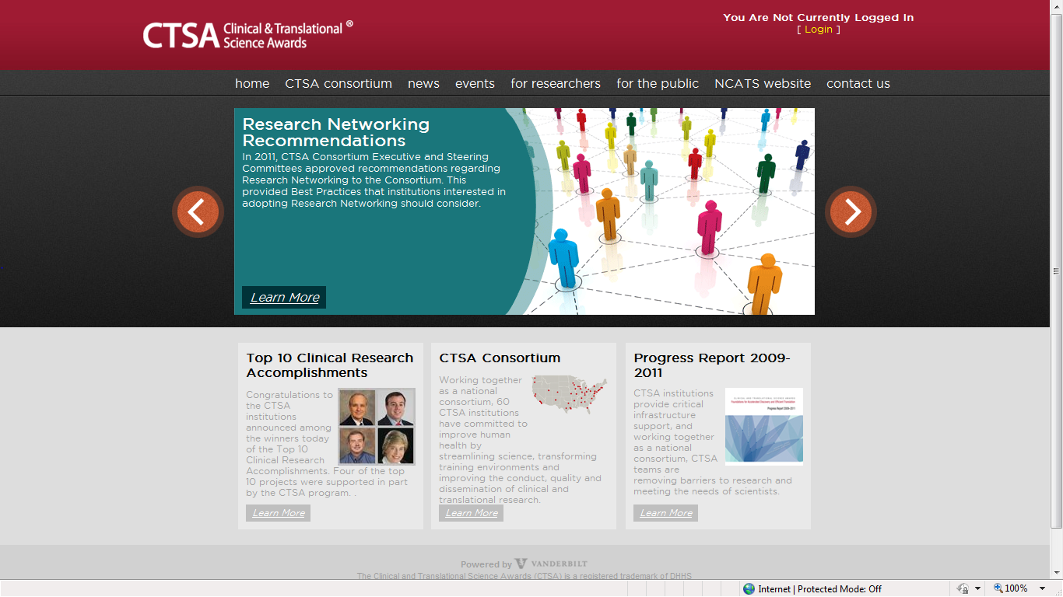
CTSAs
Notes:
The CTSA Consortium. 60 of the top biomedical research institutions in the United States. 60*5,000 = 300,000

Slide 39
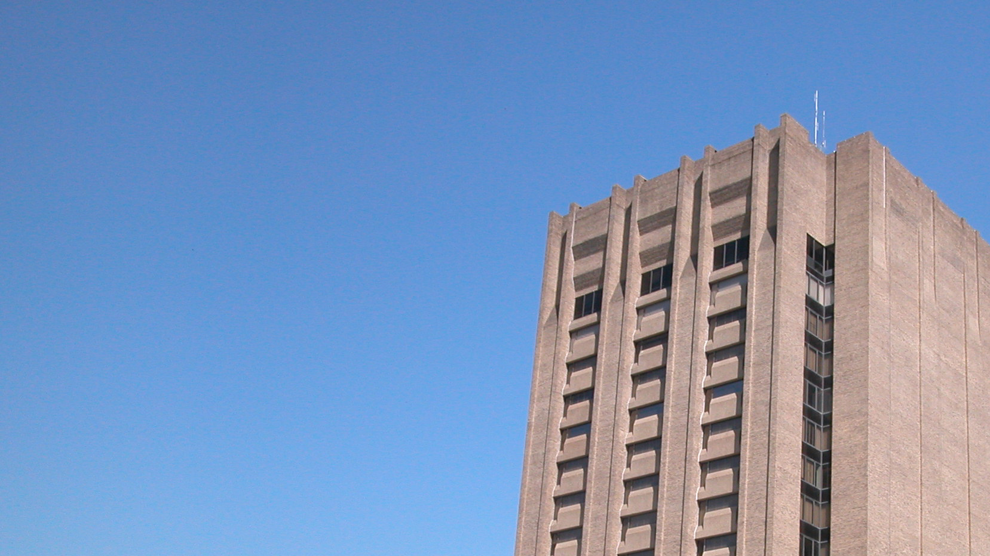
USDA
USDA
Notes:
US Department of Agriculture. 40,000 intramural scientists, 80,000 staff. 106 land grant universities. 400,000 researchers and staff

Slide 40
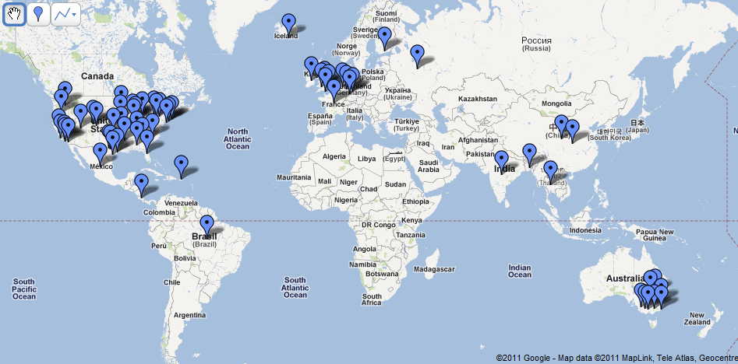
China
Notes:
International partners. China, Australia, Mexico, Costa Rica, Puerto Rico, Netherlands, UK, Russia, Iceland, Thailand, India

Slide 41
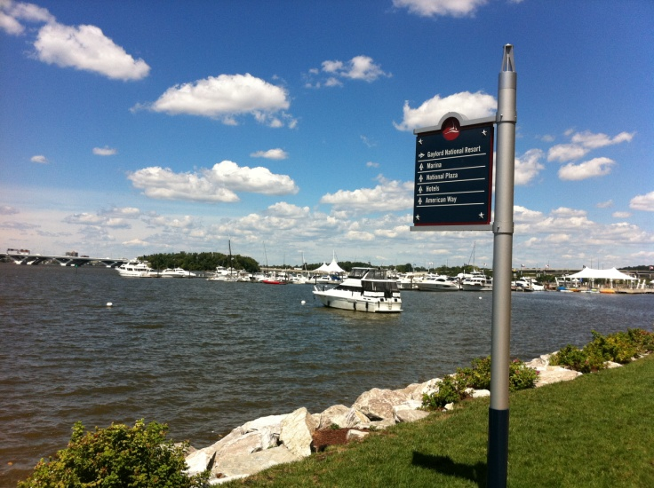
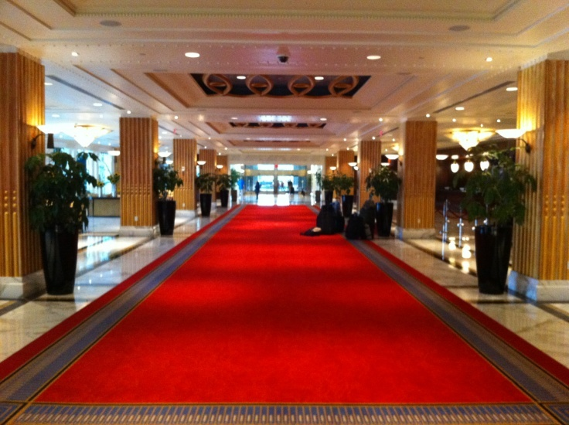
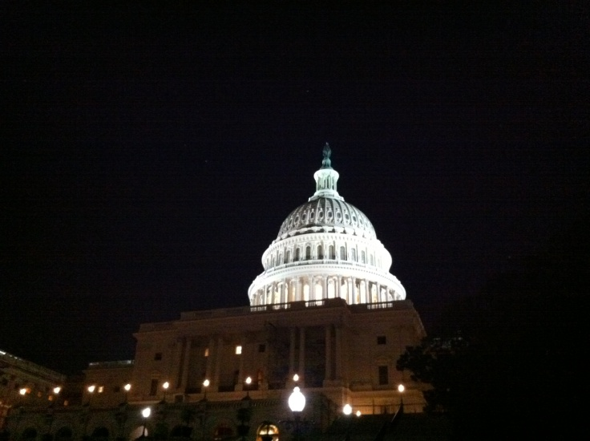
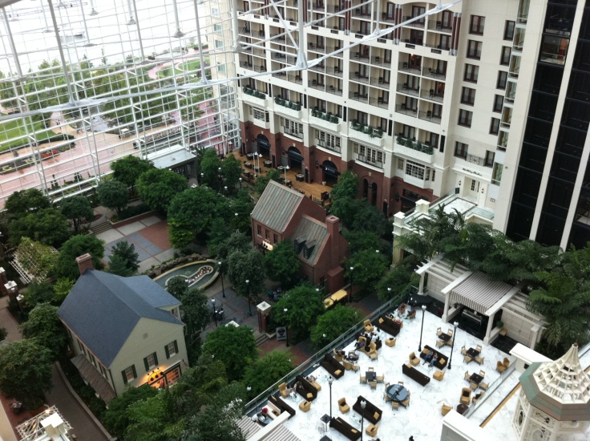
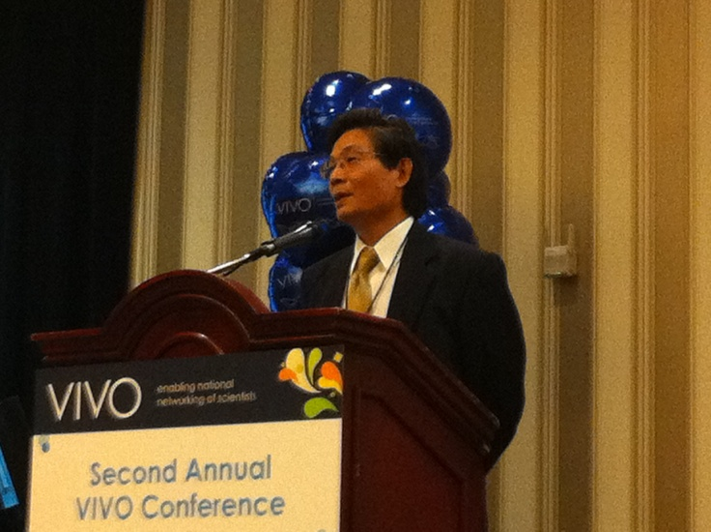
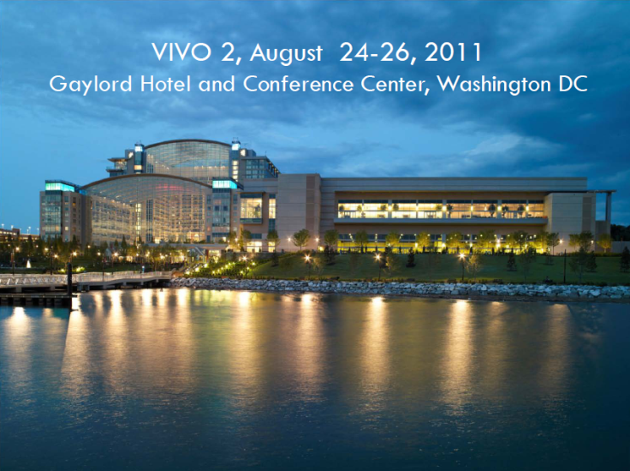
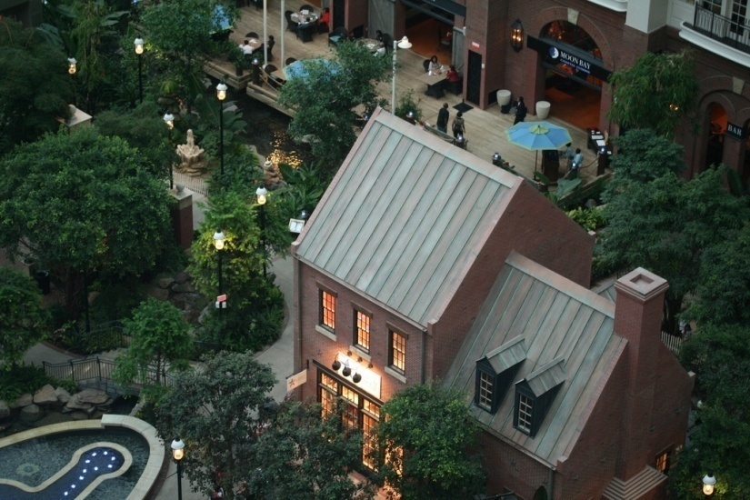
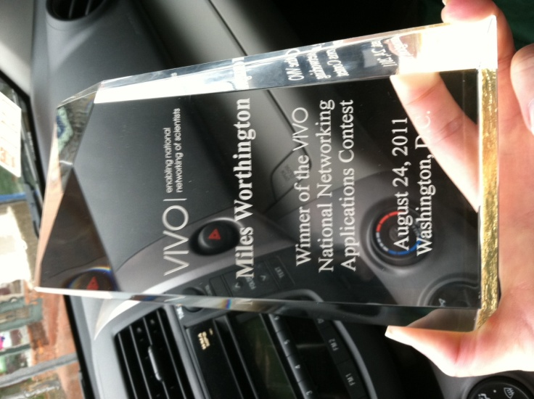
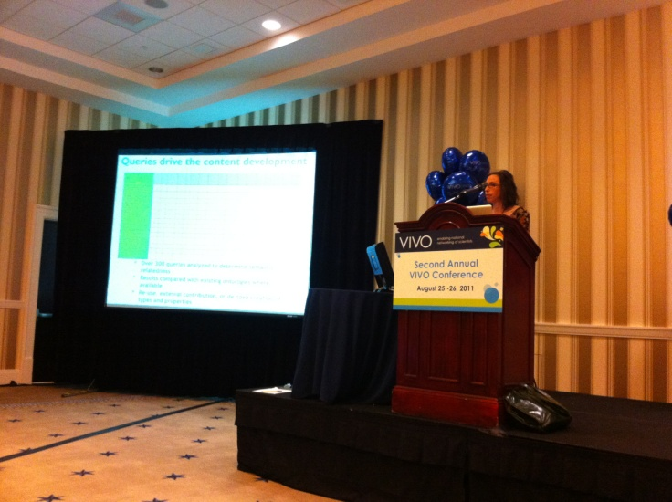
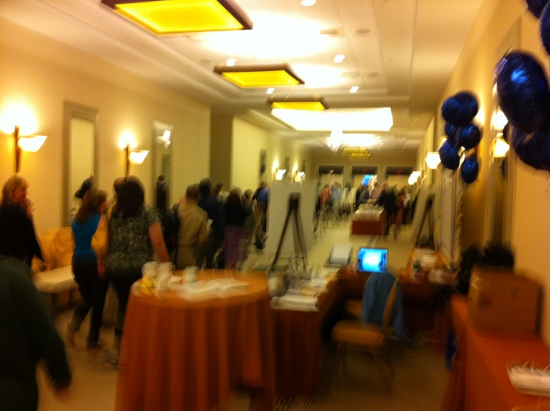
Notes:
Getting together face to face. The second annual VIVO conference was held in DC. Also workshop, hackathon, and implementation fest.

Slide 42
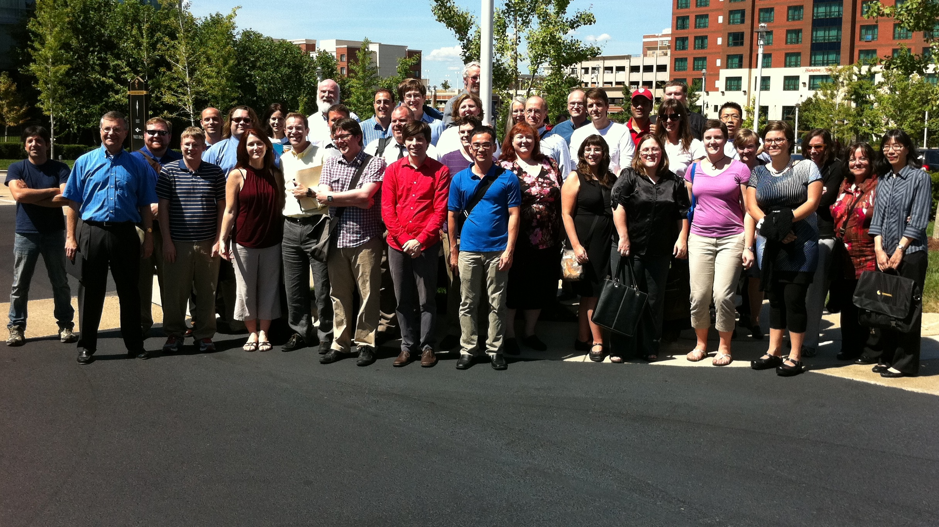
How can you get involved?
Join us at http://vivoweb.org
Notes:
How can you get involved

Slide 43
Photo Credits
2. Jackson Laboratory scientist wins Shaw Prize, "Nobel of the East“ (1960) http://www.jax.org/news/images/pressimages/300dpi_images/coleman/coleman1960.jpg
3. Biochemistry at Stanford. From the Stanford Biochemistry web site.
5. Francis Collins. From the NIH web site.
7. Courtesy of UF Health Science Center News and Communications
14. http://apod.nasa.gov/apod/ap080225.html
17. Institut Pasteur Korea Conducts Special 'IPK Life Science Mentoring' Program . http://ip-korea.org
20. Courtesy of Weill Cornell Medical College
21. Figure by M. Conlon
24. Bruckner Building Supply web site. http://brucknernyc.com/our-products/in-the-yard/
25. First annual VIVO Conference. https://picasaweb.google.com/110849244647388519713/FirstAnnualVIVONationalConference2010?authkey=Gv1sRgCP6K8LDBpOrKLg#5512757184241893154
38. Abraham Lincoln Building of the Unites States Agricultural Library. http://en.wikipedia.org/wiki/File:United_States_National_Agricultural_Library.jpg
40. VIVO map by M. Conlon
41. Second annual VIVO conference. Photographs by M. Conlon
42. The VIVO team outside the Gaylord during the great DC quake of 2011. 8/22/2011. Photograph courtesy of Michelle Issing.

