Slide 1
Planning and Managing Digital Projects
John Nemmers and Mark Sullivan
University of Florida Smathers Libraries

Slide 2
Section 1: Overview & Project Planning

Slide 3
A Digital Project…
Has a time frame (start/end dates)
Has a scope/purpose
Has a project manager
Requires resources/inputs
Has a work plan
Produces digital outputs
Notes:
The project is temporary but may lead to ongoing activities. A project has a definite beginning and an ending date. It is temporary; the project ends once the objectives have been met and the product or service exists.
Scope/purpose: Why is the project necessary? Projects are designed to solve a particular problem (create a unique product/service)
Project manager determines whether you have the skills, knowledge, and resources needed to accomplish the project’s goals. If you don’t, then you will have to find those resources, knowledge, and skills or the project may fail.

Slide 4
Digital Project Breakdown
1/3 effort = project planning, pre-imaging preparation, preservation, oversight, evaluation
1/3 effort = description, metadata creation, database creation/maintenance
1/3 effort = digitization

Slide 5
Questions to Answer:
Who will be served by project?
Have we identified the Primary/Secondary/Other audiences?
What will be digitized?
What are our priorities?
What will be the impact on the institution?
How much should we digitize?
What is our timeline? Start/end dates?
Notes:
Scholars, educators, college students, K-12, genealogists, general public
Priorities: what is cool, what is in high demand, what is underused and should b made known/available
Who decides priorities? Can be admin, external, funding agencies
How much: everything in all the collections, representative samples

Slide 6
Questions to Answer:
What resources do we need to support project?
What are funding sources?
Will project activities be undertaken in-house or outsourced?
What standards and best practices will be adopt?
What technologies will we use to create/maintain/deliver/preserve digital objects?
What is our sustainability plan beyond the project end?
Notes:
Resources: Space? Staff? Equipment? Total?
Funding: internal, donor, grant
Outsourcing - Issues with the security, safety, transportation of fragile material
In-house: costs of labor/benefits, equipment, software
In-house: Extant/newly developed software tools or buy vendor product or use partner technology (e.g, DLoC)
In-house: Training and staff time (hire new staff, who does the work of permanent staff while working on project)
Sustainability: long term maintenance of the digital collection

Slide 7
Initial Steps in the Process
Identify holdings to be digitized
Identify stakeholders and participants (internal/external)
Create a planning team
Determine project goals/objectives
Environmental scan of other projects
Identify needed resources
Develop work plan with timeline of activities
Notes:
The work plan is the road map that guides how resources are put into use over a specific period of time to produce products/services

Slide 8
Identify Holdings for Digital Projects
Archival collections (papers, photos, AV, etc.)
Special collections
Reformatting microfilmed holdings
Born digital holdings
Digitization projects with partner holdings
Notes:
Logical to focus on unique or rare objects (no need to duplicate effort)
Reformatting non-print resources: AV, microfilm, photos
Digitization for commercial purposes
Born digital ex: IR
External partners may have complementary resources

Slide 9
Selective Digitization
Focus on holdings with high research/educational /commercial value
Often not feasible to digitize everything -> representative sample
Not everything merits digitization
Are the originals fragile/in jeopardy?
Rights? No known copyright holder -> Take down notices are option.
Permissions? Deed of gift?

Slide 10
What are Priorities
Researcher demand?
Preservation?
Administrative mandate?
Donor driven?
Matching priorities of funding agency/partners?
Exposing hidden collections to increase use?

Slide 11
Prioritizing Example: Everglades Collections at UF
Collections in demand
Hot subject area
Preservation issues
Easy formats
Viable funding source
Notes:
May Mann Jennings, Gov Broward, Gov Jennings, Thomas Will, etc.
Environmental history: Everglades, drainage, flood control, development, conservation
high use of fragile materials almost 100 years old
Papers and Photos
NHPRC cost-effective digitization grants

Slide 12
Potential Stakeholders/Participants
Archivists/Curators
Imaging personnel
Metadata personnel
Cataloging personnel
IT/Web personnel
Preservation or Conservation personnel
Advisors (e.g. panel of subject specialists)
Development/Fundraising personnel
Grant writer/manager
Administration
Donors
PR/Marketing personnel
External partners
Vendors
Notes:
Successful projects have a core team of committed stakeholders
Stakeholders are any folks who can influence/contribute/make use of the project outcomes

Slide 13
Creating a Team
Need for clear leadership (project manager or co-managers)
Consensus-building
Group decision-making
Expect resistance (both justified and not)
Admin support usually = successful elimination of resistance
Notes:
Project manager may be any of the stakeholders but often is the collection manager/subject specialist
Project manager is responsible for leading communication, forming team, developing work plan, overseeing implementation, and evaluating outcomes

Slide 14
Collaboration & Partnerships
Gain holdings/knowledge/support/IT from partners
Shared knowledge/experiences can lead to better workflow/products
Some granting agencies favor collaborative digital projects
Requires better communication/negotiation of expectations/activities/outcomes

Slide 15
In-House vs. Outsourcing (or Hybrid)
Outsourcing costs can be lower if infrastructure/expertise not already in-house
Vendors set up to handle high volume; have equipment, training, software
Vendors often offer multiple services in addition to imaging
Vendor security risks – materials going off site/out of country (loss of control)
Have to evaluate, select, contract and communicate with vendors
Notes:
Communication with vendors is a big deal. They may not understand archival importance. Your project may be small fries to them.

Slide 16
In-House vs. Outsourcing (or Hybrid)
In-house projects lead to in-house expertise/infrastructure, but can require significant start-up costs
Complete control over in-house projects (fewer security risks)
Other pros/cons?
Hybrid approach: use vendors to handle one portion of project (e.g., only imaging)

Slide 17
Common Outsourced Activities
Scanning
Transcription (e.g., oral histories)
Translation
Metadata creation
OCR
Database management
Online hosting
Preservation

Slide 18
Planning Discussions
Brainstorming!
Consider all ideas/options
Identify impacts
Staffing (extant or hire new or outsource)
Space, equipment, software
Impact on regular workflow
Holdings (e.g., preservation/access issues)
Evaluate all info and make decisions

Slide 19
Base Decisions on Data
Review/gather statistics
Extent (e.g., # of page images)
Reference/Usage statistics
Scholarship produced based on holdings
Can create surveys/suggestion forms
Focus/advisory groups
Notes:
Explain how we averaged Swamp folders to estimate extent

Slide 20
Work Plan Development
Work plan focuses on quantifiable goals (e.g., producing a certain # of images)
What steps/activities will you implement to achieve goals?
Shows how inputs/resources are used to produce outcomes/products
Detailed budget (calculate all costs)
Notes:
Need a clear idea of what you want to accomplish. What will the project solve? It will be difficult to evaluate success/failure without clear focus.
Can’t talk about the work plan without also talking about the budget

Slide 21
TIP! Review grant guidelines, which usually call for:
Specific goals and objectives
Scope of project
Description of the materials and their importance/significance
Budget templates
Scanning/Metadata standards
Specific work plan
Evaluation criteria
Notes:
NEH/NHPRC/IMLS/LSTA/etc.

Slide 22
Work Plan
Projects usually have phases and benchmarks as part of a project timeline
Project activities are tied to project goals
Activities also tied to project resources
Identify staff – who (extant or new), how much time needed, etc.
Identify space, equipment, supplies needed (extant or new)
Notes:
New digital initiatives usually have high start up costs. Hardware may include computers or server space.
Labor usually is the largest percentage of costs in a digital project
Staff: what % of an employee’s time will be committed to project (in grants, the salary & benefits are “In-Kind” costs shared by the institution towards the total project cost)

Slide 23
Work Plan
Identify other costs (e.g., consultants, vendors, training, travel, shipping)
Hidden costs (administrative, PR) – can be cost share in grants
Technology issues: software/hardware/metadata/standards

Slide 24
Work Plan
Work plan provides details about workflow / methodology
Simple workflow:

Slide 25
Project Timeline Example
Months | Actions | Steps | Responsibility
1-3 | Hire/train staff; buy equipment/supplies | Interview candidates; training | Project manager, digital supervisor
3-12 | Scanning and Metadata creation | Scanning, QC, loading into system | Digital technicians; IT experts
13-16 | Evaluation, promotion | Focus groups, listserv emails, presentations, journal article | Project manager; publicity dept, project staff

Slide 26
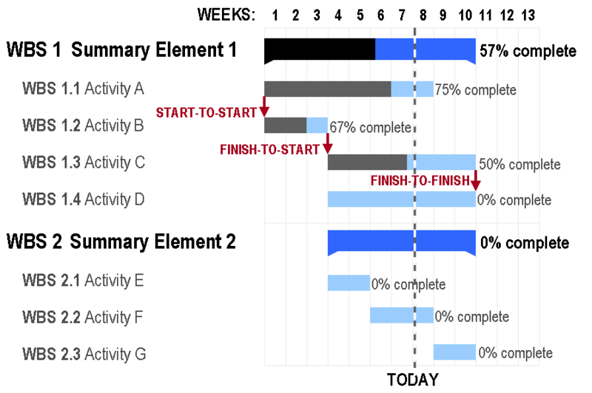
Gantt Charts
Source: http://en.wikipedia.org/wiki/File:GanttChartAnatomy.png

Slide 27
Possible Project Budget Items
Salaries & Benefits
Hourly wages for temp staff
Vendors
Consultants
Equipment /supplies
Training/travel
Indirect Costs

Slide 28
Hardware Options
Scanners (flatbed, ADF, slide, etc.)
Digital cameras
AV conversion
Servers (storage, delivery, etc.)
Notes:
Remember costs of migration to new hardware in future

Slide 29
Software Options
In-house development:
Requires programmers/database admins/metadata specialists
Requires constant maintenance/testing
Off-the-shelf software:
E.g., Photoshop, DigiTool
Requires knowledge/evaluation/comparison of vendors
How will software be upgraded/maintained?

Slide 30
Sustainability Considerations
Digital technology is constantly/rapidly changing
Upgrade/replacement of software/hardware
Migration of digital objects/metadata
Costs of long term digital preservation
Costs of staffing over time (managing content, hardware/software)

Slide 31
Exercise 1: Entire Group
Handout includes a description of holdings to be digitized, target audience and other pertinent info
Create goals for project
List activities to achieve those goals

Slide 32
Exercise 1: Goals & Activities
Goal 1:

Slide 33
Section 2: Implementing Digital Projects

Slide 34
Implementing Digital Projects
Imaging Theory & Best Practices
Digitization Equipment
Metadata for Digital Resources
Digital Asset Management Software
Archiving and Preserving Digital Projects

Slide 35
Section 2.1: Imaging Theory & Best Practices

Slide 36
Imaging Theory & Best Practices
Bit Depth & Color Space
Resolution
File Types
Image Compression
OCR
Questions

Slide 37
Bit Depth & Color Space
Bi-tonal, “black and white”, 1 bit
Greyscales
8-bit ( 256 shades of gray )
16-bit (65536 shades of gray )
RGB ( usually 24-bit )
CMYK ( usually 32-bit )

Slide 38
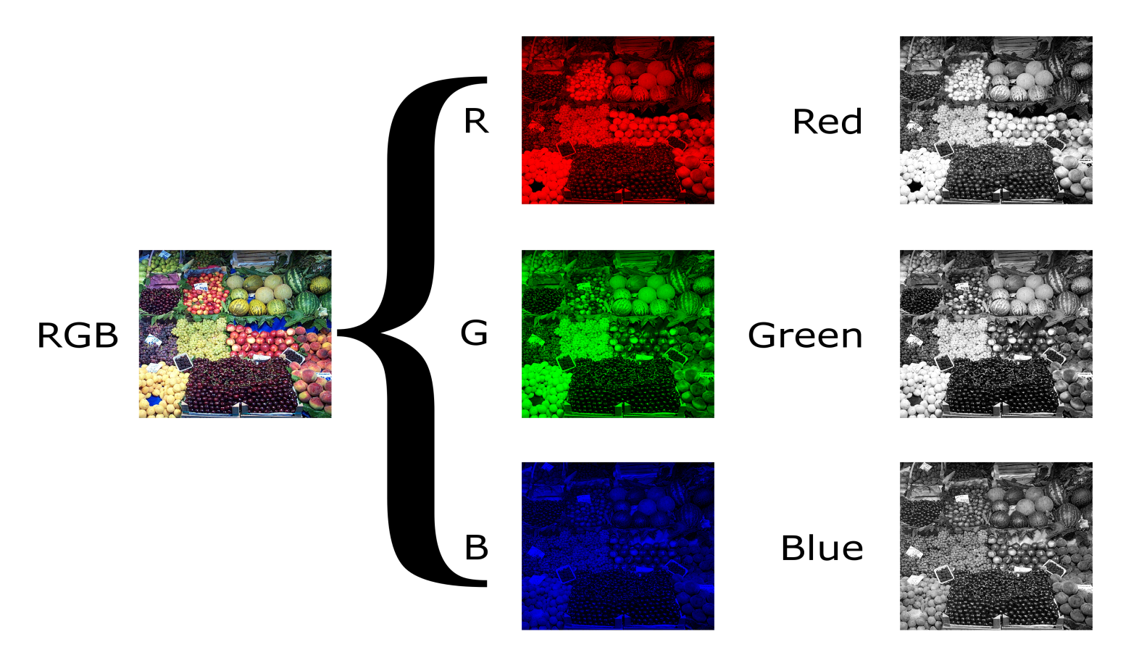
Bit Depth & Color Space
RGB “built” from 3 color channels
Image: © Nevit Dilmen found at Wikimedia commons

Slide 39
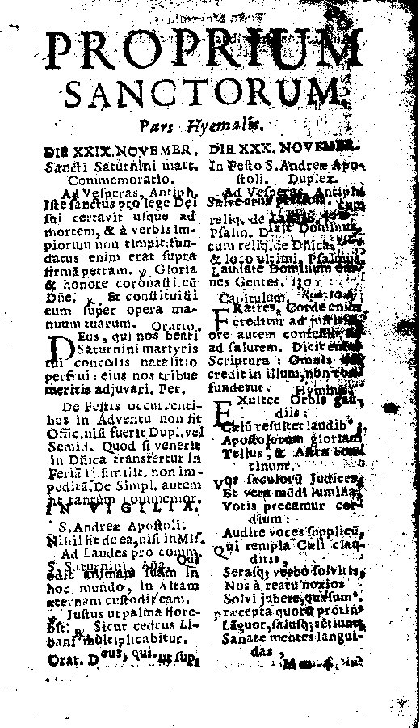
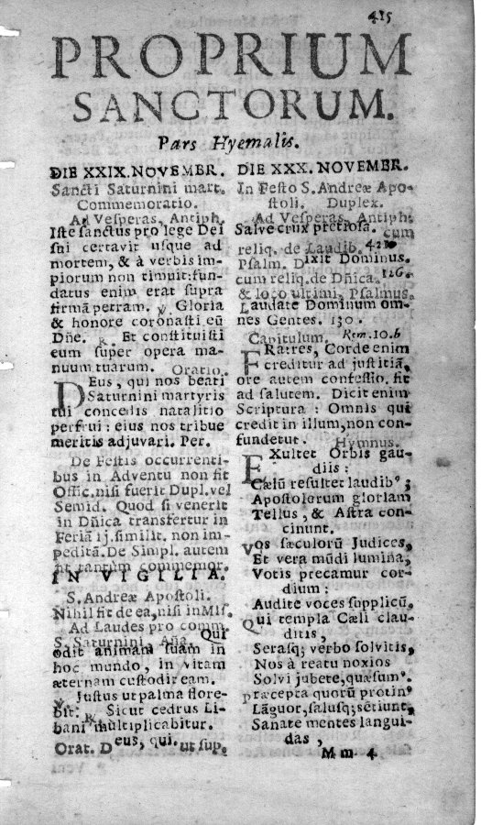
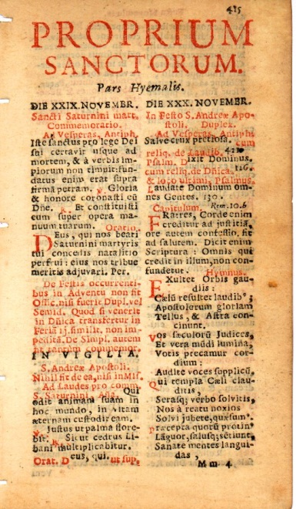
Bit Depth & Color Space
Color Fidelity
“Full Informational Capture”
Meaningful color should be retained
Bi-tonal
8-bit Greyscale
24-bit Color
Notes:
Readers of Latin religious texts, such as that seen above, will recognize the red text as instructions to the faithful, commentary on the spoken text of a religious service, or the narrative of the priest as opposed to that of the congregation’s response.

Slide 40
Bit Depth… : Recommended
(Almost) never scan 1-bit
Completely grey items should (usually) be scanned 8-bit greyscale.
Items with meaningful color should be scanned 24-bit RGB
Trade-offs between quality and file size

Slide 41
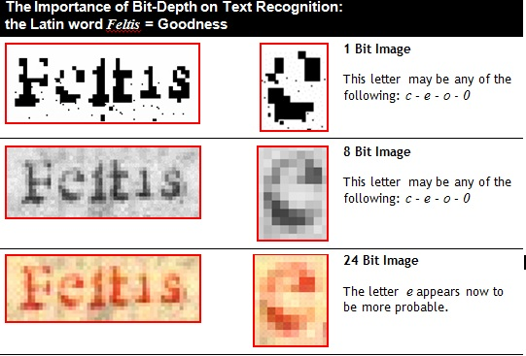
Bit Depth… : Rationale
Text – Optical Character Recognition

Slide 42
Resolution
Resolution of an image expressed in pixels
PPI – pixels per inch
DPI – dots per inch

Slide 43
Resolution : Recommended
Resolution | Use For
300 pixels per inch (ppi) | Printed text with normal sized fonts Oversized documents and maps Manuscripts with legible script
600 pixels per inch (ppi) | Photographs and select graphic arts Printed text with very small fonts Manuscripts with difficult scripts

Slide 44
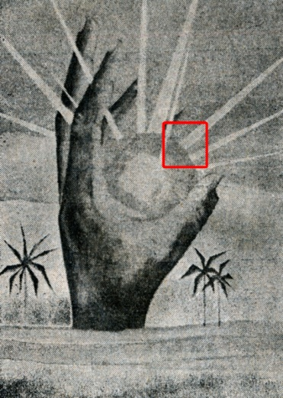
Resolution : Rationale 1
Newspaper graphics printed at 80 dpi
Magazine graphics printed at 120 dpi
High-end graphics printed at 300 dpi
Scanning at 300 dpi is sufficient

Slide 45
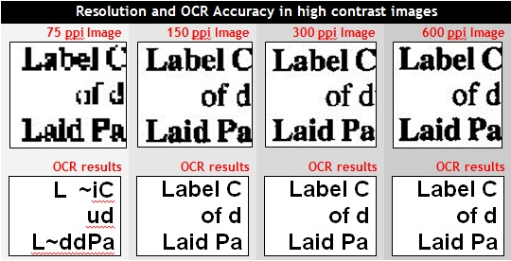
Resolution : Rationale 2
Text – Optical Character Recognition

Slide 46
Resolution : Rationale 3
Photographs
Use 600 dpi
Continuous-tone images
Unexpected use – capture all details

Slide 47
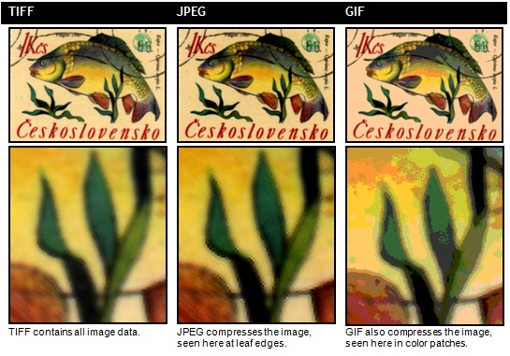
File Types
Save archival masters as TIFF
Internet delivery as JPEGs or JPEG2000s

Slide 48
Image Compression
Save archival TIFFs as non-compressed
“Lossy” vs. Lossless compression

Slide 49
OCR
Optical Character Recognition
Creation of plain text from an image file
Just as important is the positional information!
Text highlighting
Text analysis

Slide 50
OCR : ALTO XML
LOC XML schema / standard
“Analyzed Layout and Text Object”
Contains position (and style) of each word, with possible variants
Can be embedded within a METS file
Used by NDNP

Slide 51
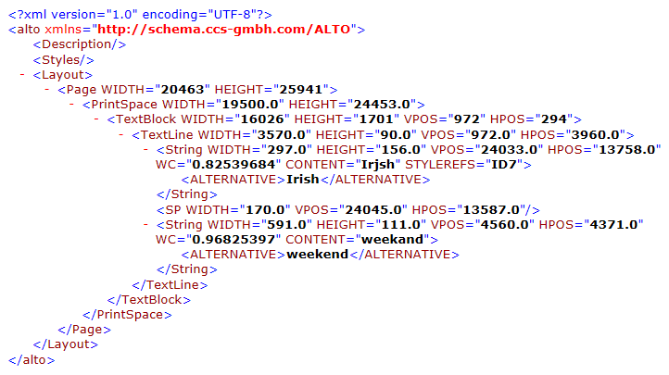
OCR : ALTO XML

Slide 52
Review of Topics
Bit Depth & Color Space
Resolution
File Types
Image Compression
OCR

Slide 53
Questions? How about born digital?

Slide 54
Section 2.2: Scanning Equipment

Slide 55
Scanning Equipment
Flatbed scanners
Sheet-feed scanners
Book scanners
Map scanners
Microfilm

Slide 56
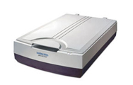
Flatbed Scanners
Microtek ScanMaker 9800XL
Epson Expression 10000XL

Slide 57
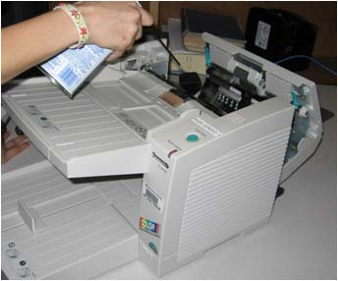
Sheet-feed Scanners
Panasonic KV-S2046C

Slide 58
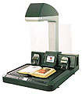
Book Scanners
i2S CopiBook ( 24-bit color )
Konica Minolta PS7000
with grayscale up-grade

Slide 59
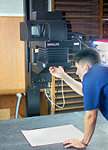
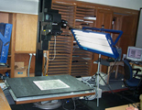
Oversized Document Scanners
Camera back, vacuum table, etc..
Betterlight Super 8K-HS

Slide 60
Microfilm Scanners

Slide 61
Section 2.3: Metadata for Digital Resources

Slide 62
Metadata for Digital Resources
What is metadata?
What is your digital resource?
Standards
Standards Comparison
Tools
Questions

Slide 63
What is metadata?

Slide 64
What is metadata?

Slide 65
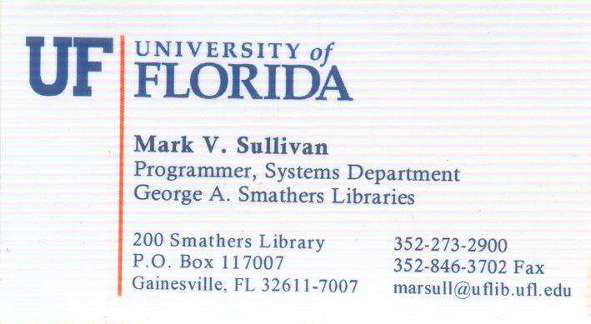
What is metadata?

Slide 66
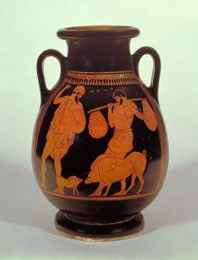
Library and Museum Metadata

Slide 67
Library and Museum Metadata
Greek Vase
470 –460 BC
35 centimeters
Odysseus and Eumaios the Swineherd
from Homer’s story of the Odyssey

Slide 68
Library and Museum Metadata
Format: Greek Vase
Date: 470 –460 BC
Height: 35 centimeters
Title: [Greek Vase of Odysseus and Eumaiosthe Swineherd]
Notes: from Homer’s story of the Odyssey

Slide 69
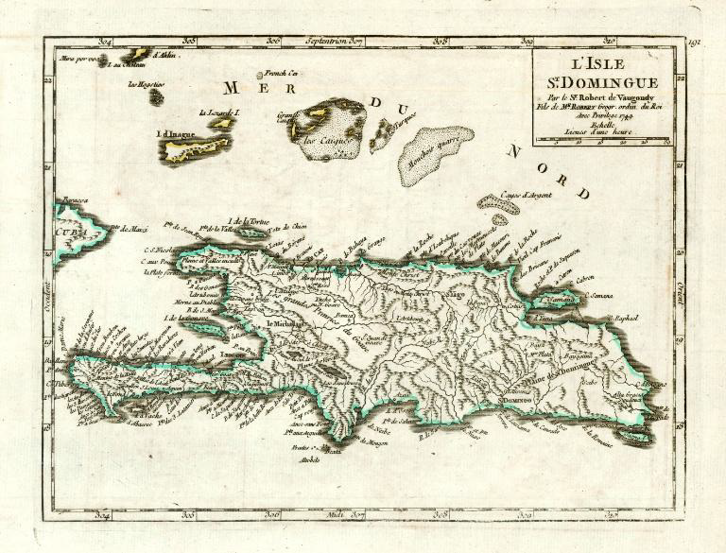
Library and Museum Metadata

Slide 70
Library and Museum Metadata
Title: L' Isle St. Domingue
Alternate Title: Atlas portatif Universel..
Physical Desc: 1 Map. : col; 17 x 22 cm on sheet 23 x 32 cm.
Language: French
Creator: Robert de Vaugondy, Gilles , 1688-1766
Date: 1749
Place of Publ: Paris 1749
Subjects: Maps --Early works to 1800 --West Indies ( lcsh)
Maps --Early works to 1800 --Hispaniola ( lcsh)
Genre: single map( marcgt)
Maps ( lcsh)
Early works to 1800 ( lcsh)
Spatial Coverage: Haiti, Dominican Republic
Note: Outline color.

Slide 71
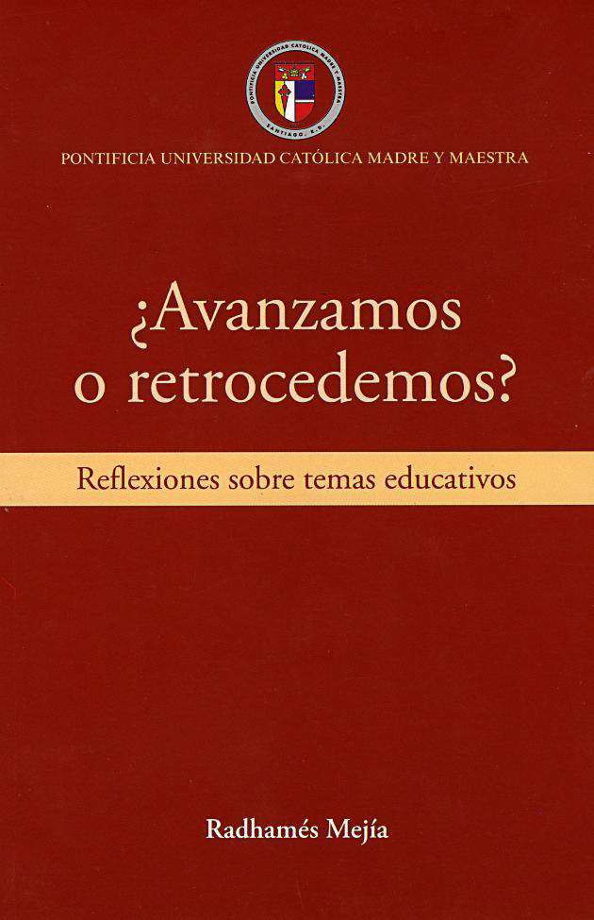
Library and Museum Metadata

Slide 72
Library and Museum Metadata
Title: Avanzamos o retrocedemos? : reflexiones sobre…
Physical Desc: 165 p.
Language: Spanish
Creator: Mejia, Radhames
Publisher: Santo Domingo : PUCMM/CIEDHUMANO
Date: 2010
Subject: Educacion-Republica Dominicana-Ensayos, conferencias
Abstract: Este libro recoge una serie de artaculos sobre temas educativos publicados en los aos 2006 y 2007 en el periodico El Caribe.
Identifier: RD 370.97293 M516a
isbn-9789945415339

Slide 73
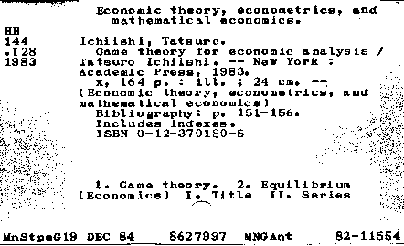
Library Metadata

Slide 74
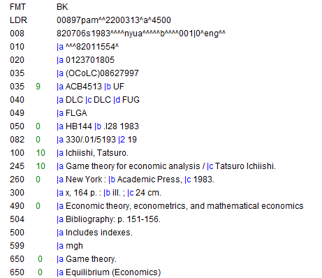
Library Metadata - MARC

Slide 75
What is your digital resource?

Slide 76
What is your digital resource?
Physical archival containers
Archival box?
Archival folder?
Item-level?
Scrapbooks
Pages
Photographs
Newspapers
Issues
Article

Slide 77
Metadata Standards

Slide 78
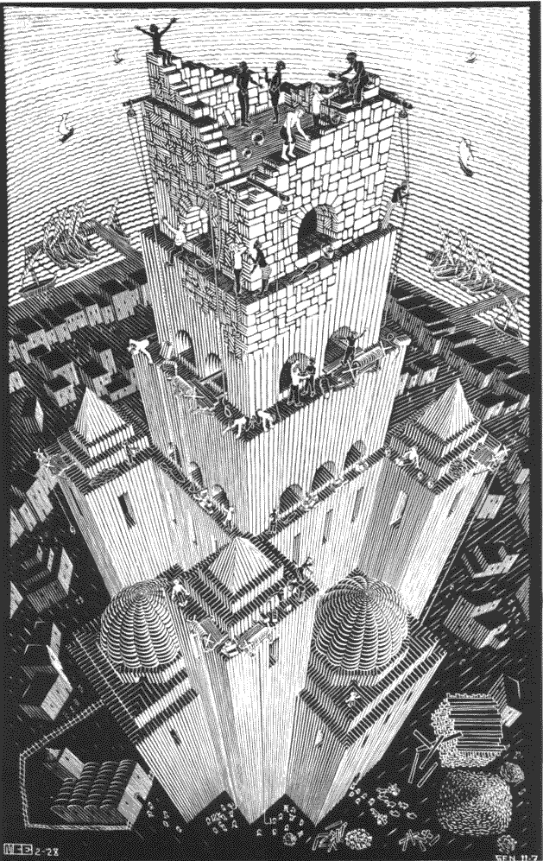
Why metadata standards?

Slide 79
Standards
“The nice thing about standards is there are so many to choose from.”
- Andrew Tannenbaum (1988 )

Slide 80
Types of Metadata Standards
Bibliographic Description
Metadata “Wrappers” and Transport
Collection Descriptions
Other Standards
Authority Standards
Proprietary Standards
etc…

Slide 81
Types of Metadata Standards
Bibliographic Description
Metadata “Wrappers” and Transport
Collection Descriptions
Other Standards
Authority Standards
Proprietary Standards
etc…

Slide 82
Bibliographic Description Standards
MARC
Dublin Core
MODS
VRA Core

Slide 83
Bibliographic Description : MARC
MARC
Originally developed in 1960s by Library of Congress
Most embraced metadata standard in libraries
MARC 21
Combination of USMARC and CAN/MARC
Metadata standard for 21st century
MarcXML
Same MARC format, except encoded in XML

Slide 84
Bibliographic Description : MARC
Positives:
Can encode a very granular amount of data
Very well adopted and works well with machine readers
Negatives
Not very human-readable
High learning curve
Mixes data with display (as commonly implemented)

Slide 85
Bibliographic Description : DC
Dublin Core
Originally developed between 1994 and 1995 in Dublin Ohio by OCLC
Used widely on web pages to assist search engines
Simplified Dublin Core
Title Creator Subject
Description Publisher Contributor
Date Type Format
Identifier Source Language
Relation Coverage Rights

Slide 86
Bibliographic Description : DC
Qualified Dublin Core
Added three elements ( Audience, Provenance, RightsHolder)
More importantly, added some basic refinements
Positives
Widely accepted and easy to read and encode
Negatives
Even with qualified dublin core, difficult to encode complex data
Lack of data refinement leads to loss of UI options

Slide 87
Bibliographic Description : MODS
Metadata Object Description Scheme
Developed in 2002 by Library of Congress
Beginning to be the de facto standard for digital libraries (MODS/METS)
Positives
Can handle a (large) subset of MARC tags
Handles complex objects and can easily be extended
Negatives
Hard to do round trip portability from MARC → MODS → MARC

Slide 88
Bibliographic Description : VRA Core
Visual Resource Association
Developed in 1996 by Visual Resource Association
Used for describing visual/cultural materials
Includes all the standard tags
Date, Title, Description, Rights, Subject, etc..
Also more unique tags
Cultural Context
Style
Technique

Slide 89
Bibliographic Description Standards
MARC
Dublin Core
MODS
VRA Core

Slide 90
Types of Metadata Standards
Bibliographic Description
Metadata “Wrappers” and Transport
Collection Descriptions
Other Standards
Authority Standards
Proprietary Standards
etc…

Slide 91
Metadata “Wrappers” and Transport
Contents
Files and Structural data
Administrative data
Choices
METS
OAI-PMH
No wrapper necessary

Slide 92
Metadata “Wrappers” : METS
Metadata Encoding & Transmission Standard
Standard by Library of Congress (2001)
Contains
Descriptions section(s)
Administrative section(s)
File section(s)
Structure map(s)
Accepts any XML schema

Slide 93
Metadata “Wrappers” : OAI-PMH
Open Archives Initiative -Protocol for Metadata Harvesting (2000-2001)
Defines a protocol (over HTTP)
Main Verbs
Identify
ListMetadataFormats – usually dublin core (99%)
ListSets
ListRecords

Slide 94
Types of Metadata Standards
Bibliographic Description
Metadata “Wrappers” and Transport
Collection Descriptions
Other Standards
Authority Standards
Proprietary Standards
etc…

Slide 95
Collection Metadata Standards
(METS)
EAD
Encoded Archival Description
Electronic Finding Guide/Aid
Main Sections
Descriptions
Container List –can link to digital objects

Slide 96
Types of Metadata Standards
Bibliographic Description
Metadata “Wrappers” and Transport
Collection Descriptions
Other Standards
Authority Standards
Proprietary Standards
etc…

Slide 97
Still to come…
Authority Metadata Standards
NACO
MADS
EAC
Other Standards
KML
DarwinCore
Z39.50 / ZING
Standards are like weeds….

Slide 98
Proprietary and Custom Formats
Proprietary File Formats
Greenstone Document File (doc.xml)
Fedora Object File (FOXml)
Custom Schemas
SobekCM Schema ( UFDC and dLOC)

Slide 99
Back to the beginning?
MODS?
EAC?
Dublin Core?
MARC?
KML?
EAD?
VRA Core?
METS?
To wrap?
MADS?

Slide 100
Evidence-based
Universities within Florida ( 10 schools )
Digital Objects
MARC ( linked to catalog )
Dublin Core ( no wrapper, simple objects )
METS wrapper ( for complex items )
MODS
EAD for Finding Aids / Guides
OAI-PMH Harvesting

Slide 101
“One standard to rule them all”

Slide 102
“One standard to rule them all”
METS Wrapper

Slide 103
“One standard to rule them all”
METS Wrapper
DC → MODS
Additional custom metadata

Slide 104
“One standard to rule them all”
METS Wrapper
Dublin Core
Additional custom metadata

Slide 105
“One standard to rule them all”
METS Wrapper
MODS
Additional custom metadata

Slide 106
“One standard to rule them all”
METS Wrapper
MODS
VRA Core
Darwin Core
Additional custom metadata

Slide 107
“One standard to rule them all”
Archival
METS
Service
MODS
Greenstone
SobekCM

Slide 108
“One standard to rule them all”
Archival
METS
Service
Fedora,
ContentDM, etc…
MODS
SobekCM

Slide 109
Standards Comparison
Link to external comparison
http://digital.uflib.ufl.edu/development/standards_comparison.pdf

Slide 110
Lessons / Standards Conclusions
Try not to tie your metadata to your system
Archival vs. Service
Don’t be afraid of extending for your own needs, but continue to follow the standards
Don’t cripple your metadata / Prepare for the most information you would want
METS / MODS v. simple Dublin Core

Slide 111
Tools

Slide 112
Metadata Tools
Library of Congress site of METS utilities
http://www.loc.gov/standards/mets/mets-tools.html
SobekCM METS Editor (UF)
http://ufdc.ufl.edu/metseditor
MarcEdit Tool
http://people.oregonstate.edu/~reeset/marcedit/html/index.php

Slide 113
Review of Topics
What is metadata?
What is your digital resource?
Standards
Standards Comparison
Tools

Slide 114
Questions?

Slide 115
Exercise 2: Individual
Handout includes descriptive info for an object that will be digitized
Map from non-standard source metadata to Dublin Core
Notes:
Show importance of standards, interoperability, etc.
Use this: This is a fairly typical mapping requirement. In order to create a union catalog of disparate resources, or share metadata from various different sources and systems, we need a common metadata format to map into. Simple DC is often selected for such purposes. Simple DC is also the minimum metadata format for metadata harvesting via the Open Archives Initiative Protocol for Metadata Harvesting (OAI-PMH). In other words, if you wish to allow information about the content of your collections to be harvested via OAI, you must at least provide a simple DC record for every resource (you can provide richer metadata).

Slide 116
Section 2.4: Digital Asset Management System

Slide 117
DAMS
ContentDM
DigiTool
Omeka
Greenstone
Fedora
Dspace
Custom ( SobekCM )
Notes:
Show importance of standards, interoperability, etc.
Use this: This is a fairly typical mapping requirement. In order to create a union catalog of disparate resources, or share metadata from various different sources and systems, we need a common metadata format to map into. Simple DC is often selected for such purposes. Simple DC is also the minimum metadata format for metadata harvesting via the Open Archives Initiative Protocol for Metadata Harvesting (OAI-PMH). In other words, if you wish to allow information about the content of your collections to be harvested via OAI, you must at least provide a simple DC record for every resource (you can provide richer metadata).

Slide 118
Archival Information System
Archon
Archivist Toolkit
ArchiveSpace
Notes:
Show importance of standards, interoperability, etc.
Use this: This is a fairly typical mapping requirement. In order to create a union catalog of disparate resources, or share metadata from various different sources and systems, we need a common metadata format to map into. Simple DC is often selected for such purposes. Simple DC is also the minimum metadata format for metadata harvesting via the Open Archives Initiative Protocol for Metadata Harvesting (OAI-PMH). In other words, if you wish to allow information about the content of your collections to be harvested via OAI, you must at least provide a simple DC record for every resource (you can provide richer metadata).

Slide 119
Section 2.5: Archiving and Preservation of Digital Projects

Slide 120
Digitization: One Puzzle Piece
Digitization is one piece of a digital preservation plan, but only one piece
Without the rest of the puzzle, digitization is ultimately useless for preserving and archiving our historical and cultural resources
Include Digital Preservation and full lifecycle of the image and data in all digitization plans.

Slide 121
Preservation and Long-Term Access Through Networked Services Project Survey
Surveyed over 200 organizations, mostly European archives and libraries
Digital content volume to increase 25-fold over next decade
70% of respondents expect to hold over 100TB of content
Only 47% of organizations had an allocated budget for digital preservation
(http://www.planets-project.eu/publications)
Large-Scale Digitization

Slide 122
Digital Preservation Is…
Digital preservation is:
Active
Constant process
Exponentially multi-tiered
About ensuring continuing accessibility
Relatively new and somewhat in its infancy

Slide 123
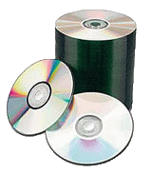
Digital Preservation is NOT…
Compact Disks
2002 – 6,000 CD’s ( 2.6 TB )
2008 – 23,000 CD/DVD ( 48 TB )
Unmanageable
Slowly deteriorating
Two (or 3 or 4) copies

Slide 124
Table of Contents
What to preserve? How do I know it is preserved?
Object-level Preservation
File-level Preservation
Organizational: Trustworthy Digital Repositories
Recommendations
Questions

Slide 125
What to Preserve?
How do I know it is preserved?

Slide 126
What to preserve? How do I know it is preserved?
Text-level preservation?
Aujourd'hui premier janvier dix huit cent quatre, le Général en chef de l'Armée indigène, accompagné des généraux, chefs de l'armée, convoqués à l'effet de prendre les mesures qui doivent tendre au bonheur du pays:
Après avoir fait connaître aux généraux assemblés ses véritables intentions d'assurer à jamais aux indigènes d'Haïti un gouvernement stable, objet de sa plus vive sollicitude : ce qu'il a fait à un discours qui tend à faire connaître aux puissances étrangères la résolution de rendre le pays indépendant, et de jouir d'une liberté consacrée par le sang du peuple de cette île ; et, après avoir recueilli les avis, a demandé que chacun des généraux assemblés prononçât le serment de renoncer à jamais à la France, de mourir plutôt que de vivre sous sa domination, et de combattre jusqu'au dernier soupir pour l'indépendance.
Notes:
Encoding concerns remain

Slide 127
What to preserve? How do I know it is preserved?
Text-level preservation?
Today, January 1, 1804, the General in Chief of the Indigenous Army, accompanied by generals and army chiefs convoked in order to take measures tending to the happiness of the country:
After having made known to the assembled generals his true intention of forever ensuring to the natives of Haiti a stable government — the object of his greatest solicitude, which he did in a speech that made known to foreign powers the resolution to render the country independent, and to enjoy the liberty consecrated by the blood of the people of this island; and, after having gathered their opinions, asked each of the assembled generals to pronounce a vow to forever renounce France; to die rather than to live under its domination; and to fight for independence with their last breath.

Slide 128
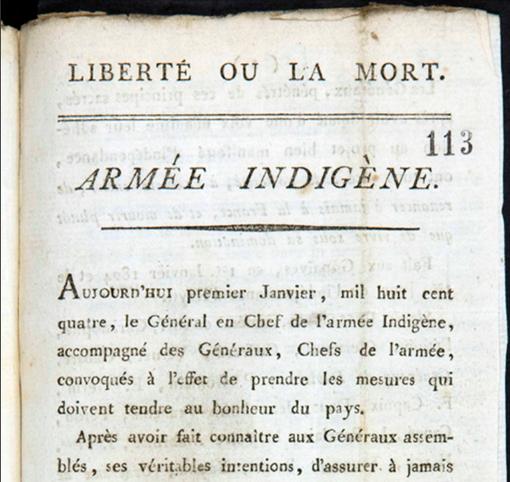
What to preserve? How do I know it is preserved?

Slide 129
What to preserve? How do I know it is preserved?
“It is the actual information content of a document, data-set, or sound or video recording that should be preserved, not the Microsoft Word file, or the Excel spreadsheet, or the QuickTime movie.”
- Angela Dappert and Markus Enders (British Library) “Digital Preservation Metadata Standards.” Information Standards Quarterly. Spring 2010.
Also the context and layout though.

Slide 130
Object-Level Preservation

Slide 131
Object-Level Preservation
More than just the images and text (but also!)
Descriptive Information
Describes the intellectual entity ( title, author )
Same information used for discovery and display of object
Structural Information
Table of contents, page order
File Information
File size
Checksums and digital signatures for fixity and authenticity checks
Administrative Information
Provenance and access conditions for the object

Slide 132
Object-Level Metadata
METS
Metadata Encoding and Transmission Standard
Descriptive Metadata Container
MODS ( Metadata Object Description Standard )
Dublin Core
VRACore ( Visual Resource Association )
MarcXML
Structural Metadata
Technical File Metadata
Administrative Metadata

Slide 133
PREMIS
PREservation Metadata : Implementation Strategies
Metadata needed to support preservation
Contains what “most working repositories are likely to need to know” ( Dappert and Enders )
HUGE data dictionary – must pick and choose
Describes historical preservation actions/agents
Provides information needed for any future preservation actions
Can be encoded in METS file

Slide 134
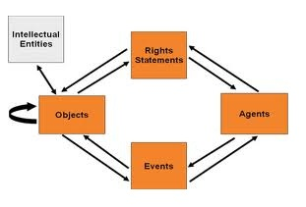
PREMIS

Slide 135
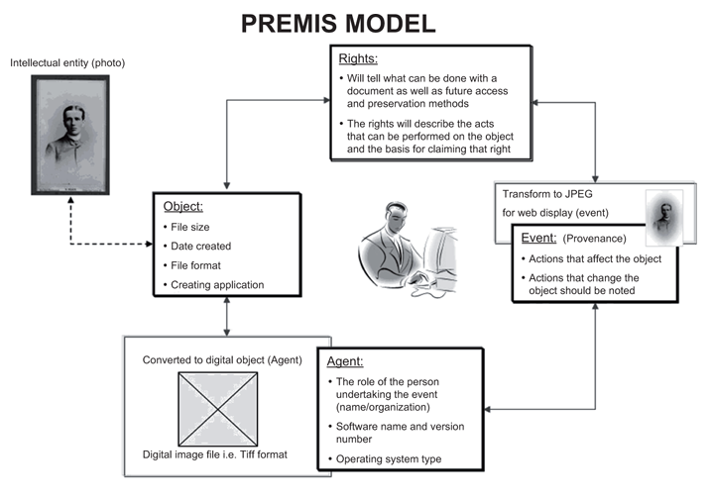
PREMIS

Slide 136
File-Level Preservation

Slide 137
Necessary Preservation File Information
Example PREMIS Image Record
Checksums and Size
Preservation Level ( full, bitwise, etc.. )
Behaviors
Format ( MIME, Format Registry, Validation Info )
Creating Applications
Capture Information (MIX)
Environments ( software, operating system, processor, hardware )
All migrations events

Slide 138
File Format Migration / Emulation
Any sound preservation strategy must deal with the ephemeral nature of file formats
Migration v. Emulation
Must either constantly migrate forward or at least have a migration strategy
Migration strategy is also ephemeral and represents best current options

Slide 139
Recommended File Formats
Four basic criteria
Specification must be freely available
Must be no patents or licenses on the format
Other digital repositories using or endorsed format
Variety of tools for writing and rendering format

Slide 140
Recommended File Formats
Migration strategy is also ephemeral and represents best current options
Archivematica ( UNESCO preservation system )
Presented with a .WMV ( Windows Media Video ) proprietary file
Current strategy: Convert to MPEG-2
Future strategy: Convert to Motion JPEG2000

Slide 141
Organizational: Trustworthy Digital Repositories

Slide 142
Alexandria Library

Slide 143
Alexandria Library

Slide 144
Digital Preservation Community Process Models
Open Archival Information System (OAIS)
Preserving Digital Information published by Task Force on Archiving Digital Information in 1996.
Draft OAIS reference model published in 1999
Primary benchmark and chief process model for the preservation of digital assets
InterPARES
International Researchon Permanent Authentic Records in Electronic Systems.
Focuses on records maintenance
Digital Curation Centre: Curation Lifecycle Model
Defines three levels of preservation and best practices for each

Slide 145
OAIS Reference Model
Provides framework for understanding of archival concepts needed for long term digital information preservation and access
Provides concepts needed by non-archival organizations to be effective participants in the preservation process
Provides framework for describing and comparing different strategies and techniques
Provides basis for comparing data models of digital information preserved and how they change over time
Guides the identification and production of OAIS-related standards

Slide 146
An OAIS must:
Negotiate for and accept appropriate information from producers
Obtain enough rights to ensure long term preservation
Determine the designated community
Ensure preserved objects are independently understandable to designated community
Follow documented policies and procedures which ensure the information is preserved against all reasonable contingencies
Ensure object can be disseminated as authenticated copies of the original or the original
Make preservation information available to designated community

Slide 147
Toward Certified Digital Repositories
Where are we?
Granular standards (PREMIS)
Process Models (OAIS, InterPARES)
In 2000, RLG and OCLC published Trusted Digital Repositories: Attributes and Responsibilities
This inches us closer, by defining a Trusted Digital Repository and expands the discussion to include the policies, standards, as well as technology infrastructure as a trusted system.

Slide 148
Developing Metrics for Certification
Nestor Catalogue of Criteria for Trusted Digital Repositories
Network of Expertise in Long-term Storage of Digital Resources
Provides:
Information and criteria for self-assessment for digital repositories
Training Tools
Iterative process – Documentation, Transparency, Adequacy, and Measurability

Slide 149
Developing Metrics for Certification
DRAMBORA
Digital Repository Audit Model Based on Risk Assessment
Digital Curation Center (DCC) and Digital Preservation Europe (DPE)
Focuses on risk identification, risk prioritization, and risk mitigation of risks through six step process of self-assessment.
Developed from a TRAC-based self-assessment originally

Slide 150
Developing Metrics for Certification
TRAC
Trusted Repositories Audit & Certification Criteria & Checklist
Research Libraries Group (RLG) and U.S. National Archives and Record Administration (NARA)
2005 - Grant from Andrew W. Mellon Foundation to develop procedures and activities to audit and certify digital archives.
2007 - Final publication includes 84 criteria
Organizational infrastructure
Digital object management
Technologies (IT and security)
Two repositories ( Portico and HathiTrust ) initially audited
Portico certified as a trustworthy digital repository for CRL community

Slide 151
Toward Standards
Conformity Assessment Requirements for Bodies Providing Audi and Certification of Management Systems ( ISO/IEC 17021 ) is current international standard applied
Audit and Certification of Trustworthy Digital Respositories ( CCSDS 652.0-R1, ISO/DIS 16363 ) still under development as an ISO standard
Requirements for Bodies Providing Audit and Certification of Candidate Trustworthy Digital Respositories also under development as an ISO standard

Slide 152
Archiving Recommendation

Slide 153
Recommendations
Be aware of the ongoing cost of preservation and plan according
Be a part of something larger
Subject-based trusted repositories
LLMC ( Law Library Microform Consortium )
Regional and International trusted repositories
HathiTrust
Florida Dark Archive / State Universities

Slide 154
Review of Topics
What to preserve? How do I know it is preserved?
Object-level Preservation
File-level Preservation
Organizational: Trustworthy Digital Repositories
Recommendations

Slide 155
Questions?

Slide 156
Section 3: Evaluation & Project Wrap-up

Slide 157
Project Wrap-Up
Evaluation of success/failure
Promoting both products and the project itself
Final report for funding agencies
Future testing to improve products/services (e.g., usability, focus groups, surveys)

Slide 158
Project Wrap-Up: Questions
What was final per-item cost?
What would you change if you had it do over again?
Were the products worth the expense/effort?
What did we learn from failures/mistakes?

Slide 159
Assessing/Measuring Success
Determine criteria for measuring success at start of project
Choose method most appropriate for project (or required by funding agency):
Summative Evaluation
Outcomes-Based Evaluation
Best evaluation is both during and after
Difficult to assess if user needs met

Slide 160
Summative Evaluation
Did we meet/not meet goals of the digital project?
Did we meet goals on time?
Were resources (staffing, budget) enough to get job done?
Includes evaluation of workflow and activities
Usually includes both quantitative and qualitative measures
Notes:
Quantitative measures: size of digital collection, number of metadata records, number of page views, number of visits
Qualitative measures: usability, functionality, user satisfaction and needs met (info collected from focus groups, online surveys, interviews, etc.)

Slide 161
Outcomes Based Evaluation
Shows if goals of the digital project were met/not met
User-centric (how have patrons benefitted)
Focus is on impacts/benefits of project rather than on activities
Includes evaluation of staffing, workflow, budget (were they enough to get job done)
Includes quantitative and qualitative measures
Encouraged by many grants
Notes:
How has the project made a difference/impacted users?

Slide 162
Components of Outcomes-Based Evaluation
Inputs/Resources
Activities
Outputs/Products
Quantifiable outcomes (e.g., # of users able to access holdings will increase)
Evaluation indicators
Methods/Sources for Evaluation
Notes:
Outputs: # of images scanned, # of metadata records, online pages, project documentation, lesson plans, etc.
Outcome: Public (scholars, students, general) uses technology to access primary sources pertaining to Florida history
Indicator: # of views of digital objects online
Measure: Usage statistics from server logs

Slide 163
Promotion/Publicity
Fairly standard for most projects
Traditional methods: newsletters, releases, listservs, presentations, journal articles, etc.
Newer methods: facebook, blogs, youtube, flickr, other social networking

Slide 164
Questions?

Slide 165
Exercise 3: Entire Group
Use list of project goals/activities created in Exercise 1
Create evaluation plan (summative or outcome-based)

