Slide 1
What is VIVO?
Research and Scholarship Discovery Across the University of Florida
A service of the Clinical and Translational Science Institute
A Grant
$12.3M 2-year ARRA/NCRR to seven schools – UF (lead), Cornell, Indiana, Washington University, Weill Cornell Medical College, Scripps Research Institute, Ponce Medical School
A Community
Rapidly growing group of collaborators, adopter, agencies around the country and world implementing VIVO for research and scholarship discovery
Work in Progress
Development, implementation, outreach

Slide 2
Research and Scholarship Discovery
Provide linked information about research and scholarship: people, papers, grants, organizations, resources, studies, creative works, datasets
Searchable
Authoritative
Linked
Open
Reusable
Visualized

Slide 3
VIVO at UF
VIVO at UF currently contains 6,928 faculty, 18,427 grants, 8,752 organizations, 66,825 course sections and 12,553 publications. Grants are linked to people, organizations. Full navigation.
Linked data – An organization lists its grants and investigators. An investigator lists grants and organizations. A grant lists its organizations and investigators.
Example: UF Department of Chemistry page lists 327 awards, each linked to faculty involved

Slide 4
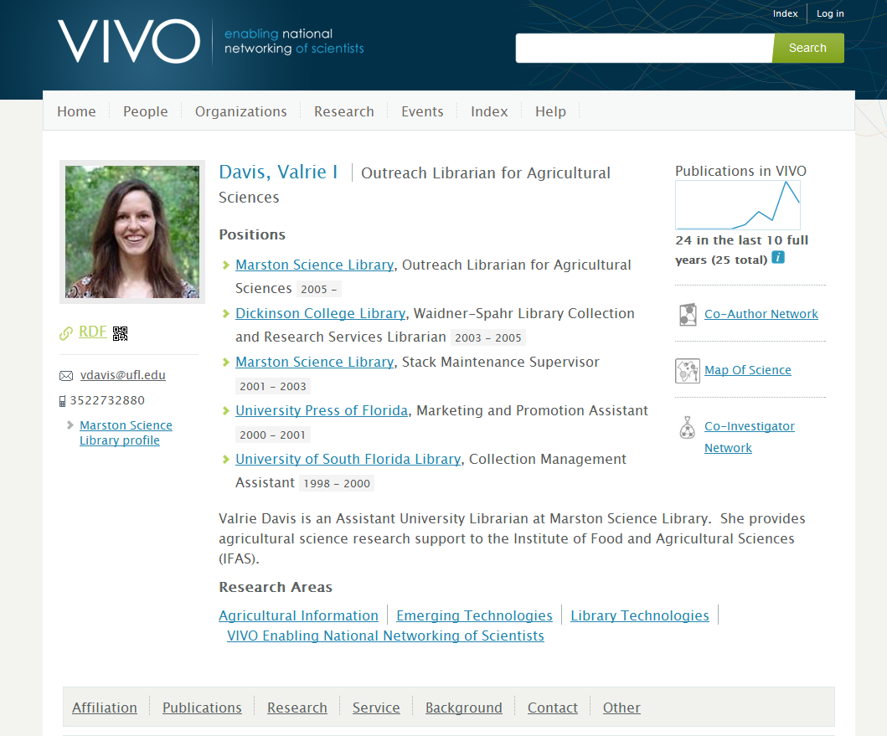
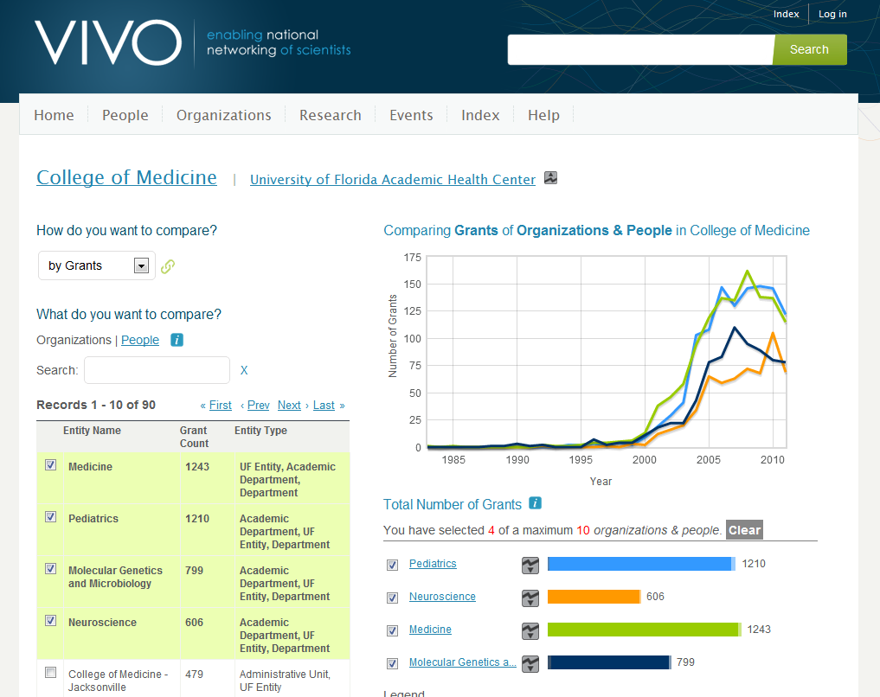
Faculty and staff profiles provide linked information regarding scholarly activity
Visualizations show co-author, co-investigator networks and compare activity over time

Slide 5
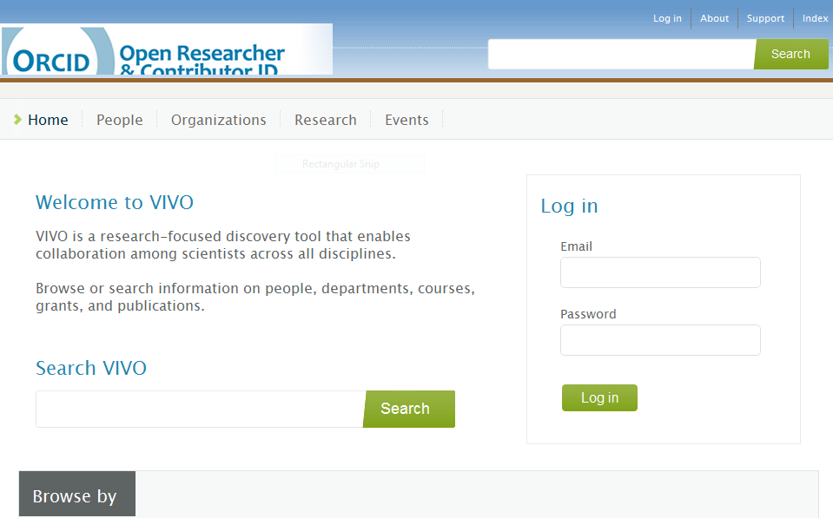
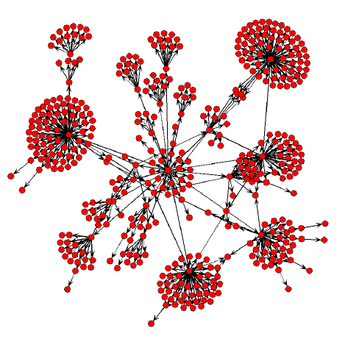
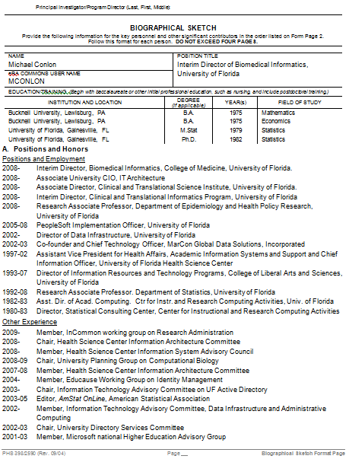
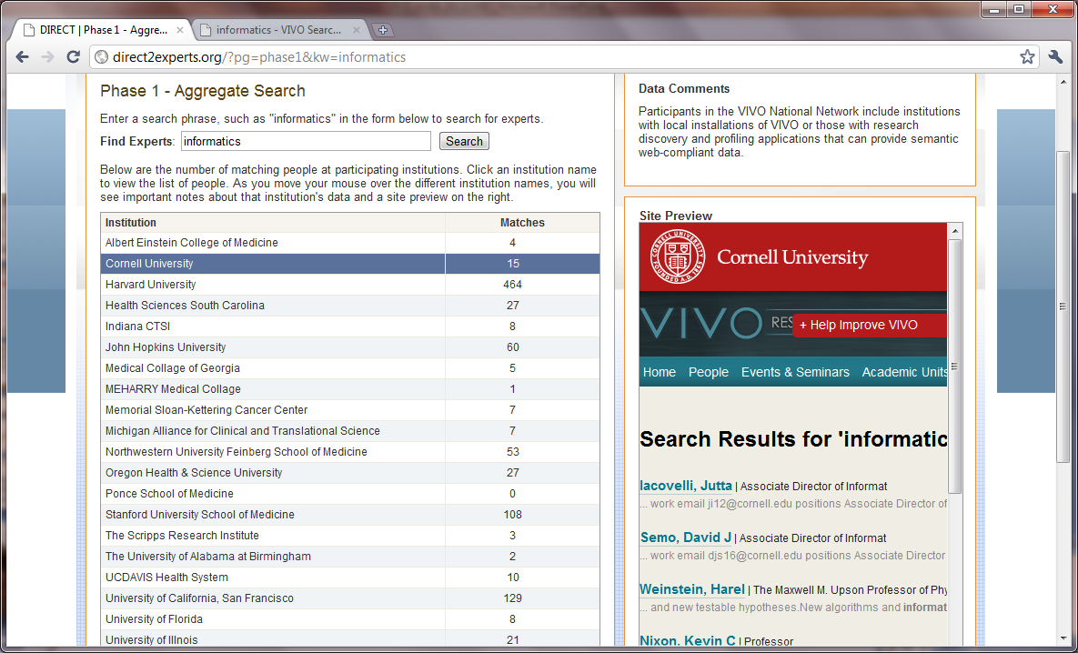
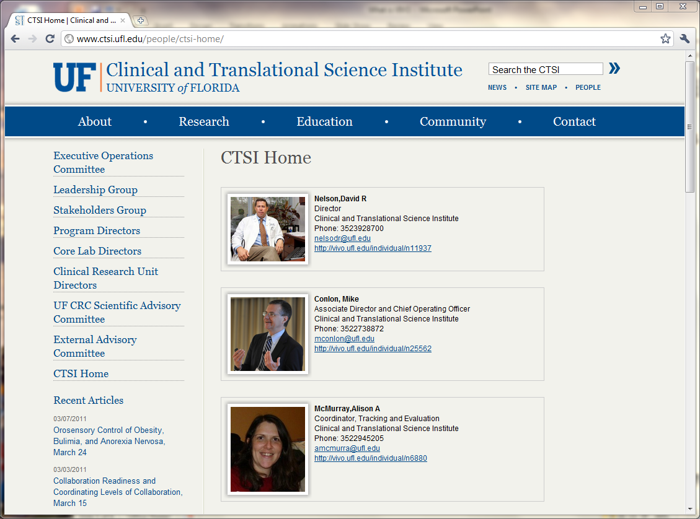
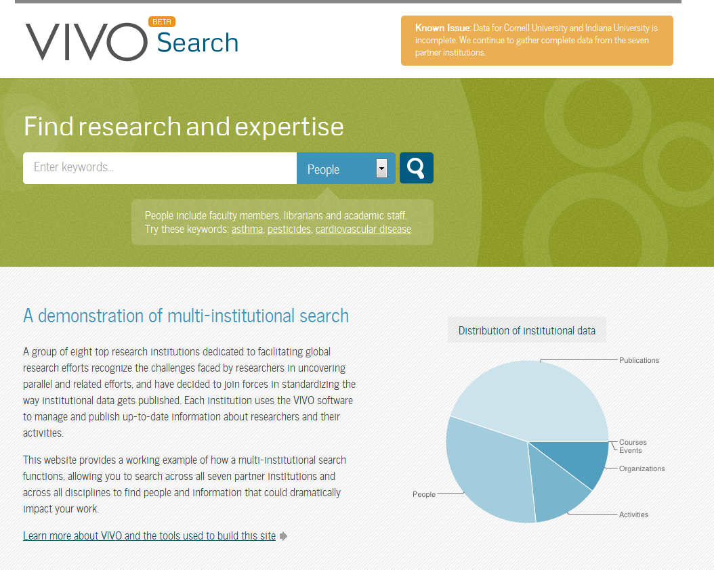
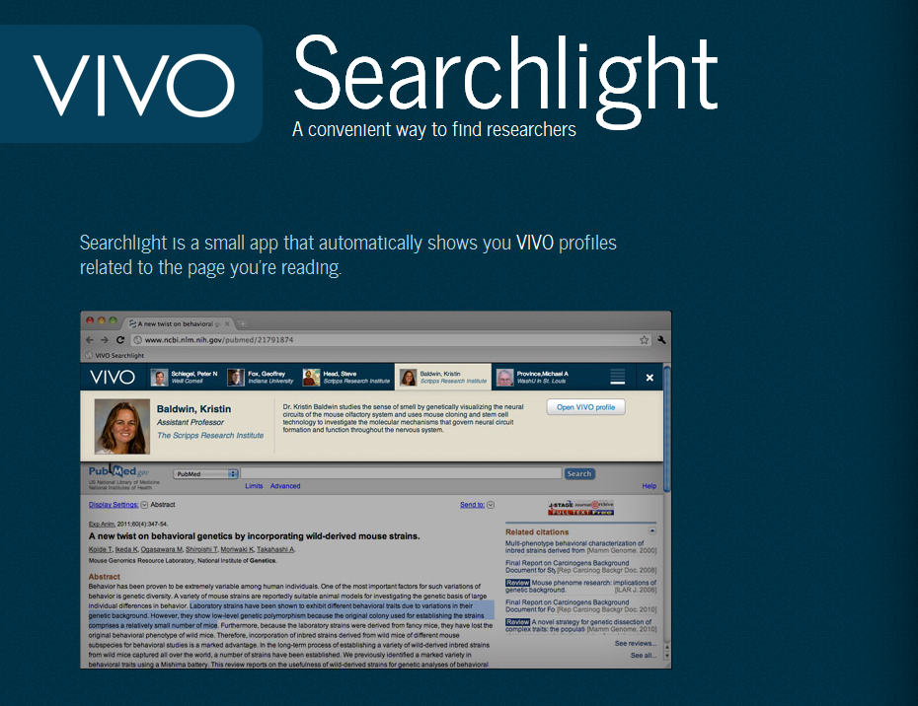
Notes:
Data is then reused in a wide array of tools and setting. VIVO funding Stonybrook, Leicester, Duke, Pittsburgh, Indiana and Weill.

Slide 6
Future Uses for VIVO
Identify potential collaborators and mentors
Find investigators by location
Find mentors
Understand social networks of scholarship
Find resources and the people who use them
Route information based on interests
Link and query externally curated information
Predict team success

Slide 7
Collaboration and Coordination
At UF – Libraries, CTSI, AHC IT, Office of Research, Enterprise Systems, Registrar, Business Services
Federal agencies – OSTP, NIH, NLM, NSF, VA, USDA, EPA, FDA, NASA, FDP, …
Publishers and Aggregators – Elsevier, Thomson-Reuters, ORCID, CiteSeer, Arxiv, CrossRef, Dspace, …
Ontology partners – EuroCRIS, CASRAI, OBO, Eagle-I, …
Professional Societies – APA, AAAS, AIRI, AAMC, ABRF, …
International – Australia, China, Netherlands, UK, Canada, Brazil, …
Semantic Web community – DERI, Tim Berners-Lee, MyExperiment, ConceptWeb, Open Pharma Space (EU), Linked Data, …
Social Network Analysis Community – Northwestern, Davis, UCF, …
Six sub-awards to Duke, Pittsburgh, Leicester, Stonybrook, Weill, Indiana
Addtn Schools and Consortia – CTSAs, Iowa, Harvard, UCSF, Stanford, MIT, Brown, Duke, Johns Hopkins, Colorado, OHSU, Minnesota, more than 100
Application and service providers – over 100
Software downloads (over 16,000) and contact list (over 1,600)

Slide 8
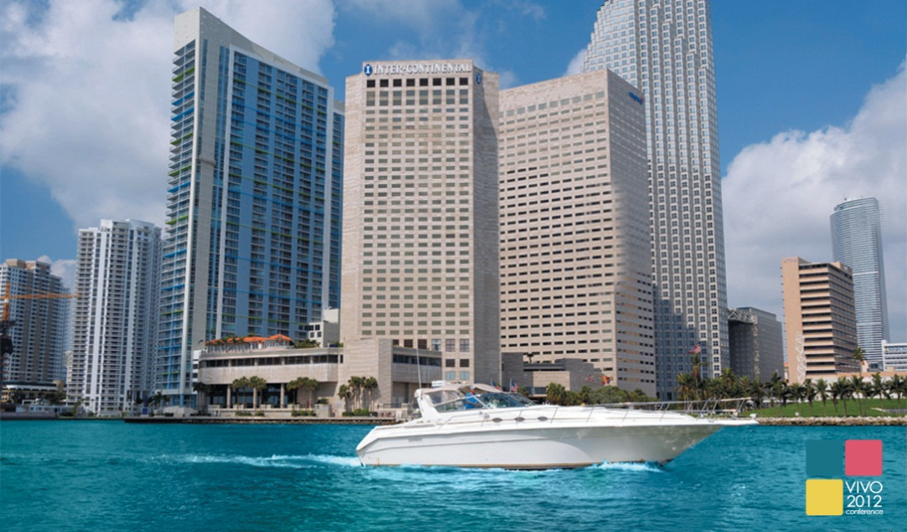
2012 VIVO Conference
August 22-24, 2012 ~ Miami, FL
Register at vivoweb.org/conference
VIVO is supported by NIH Award U24 RR029822

