Slide 1
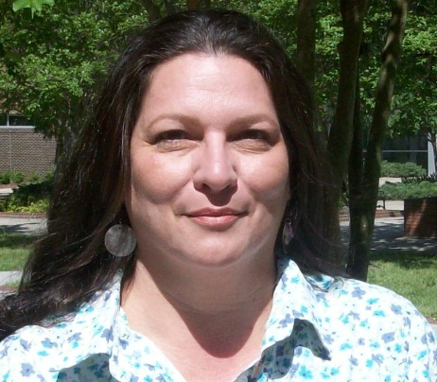
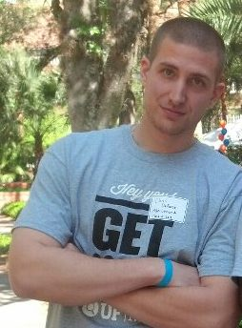
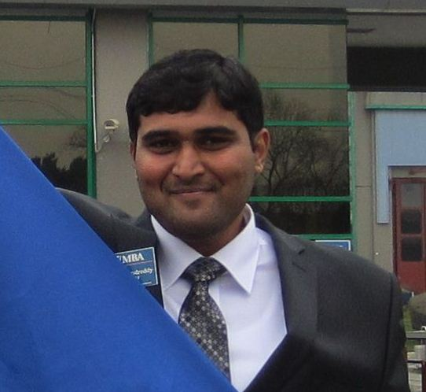
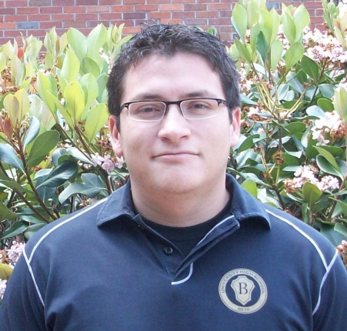
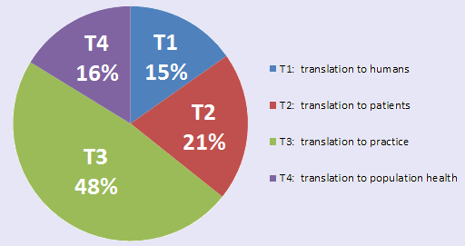
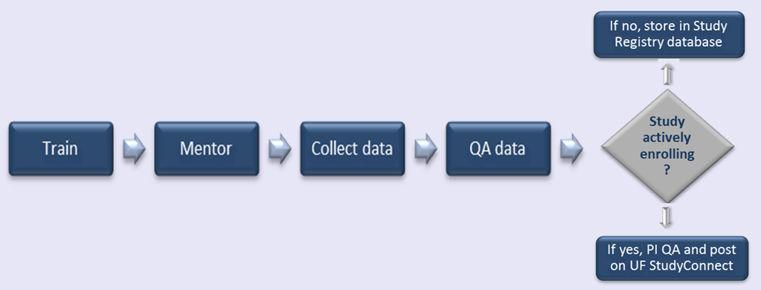
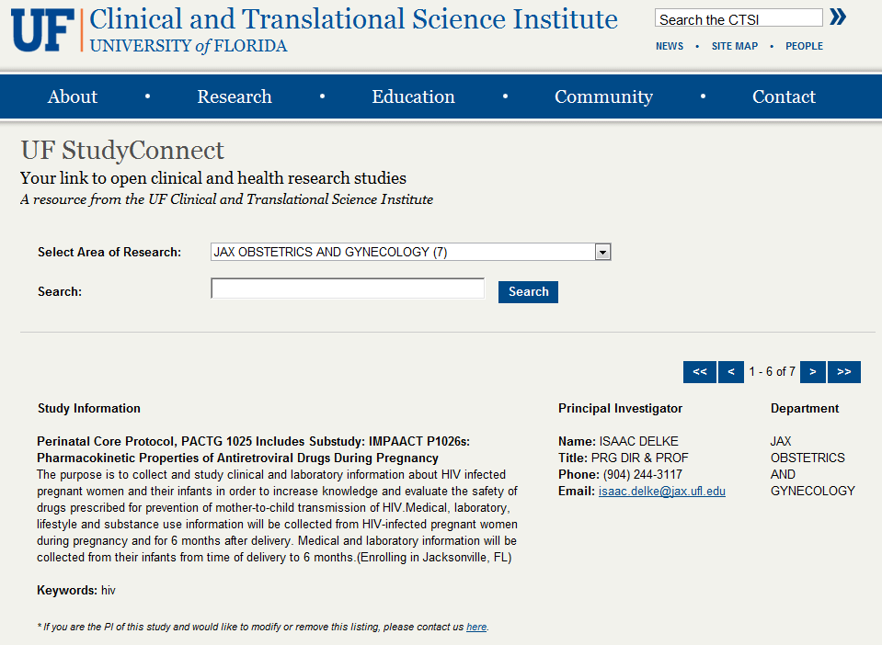
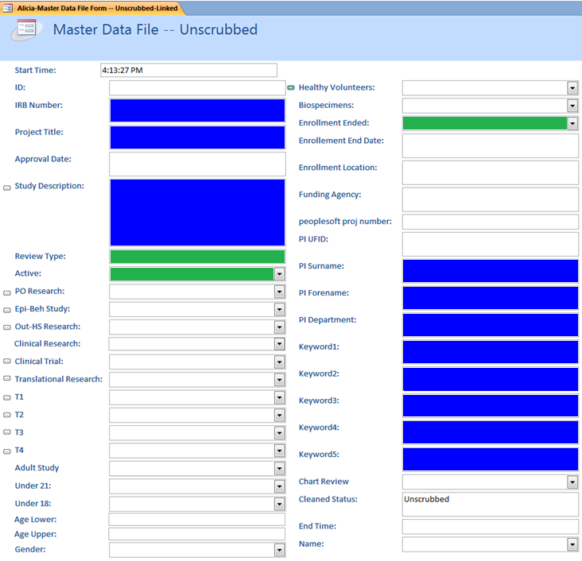
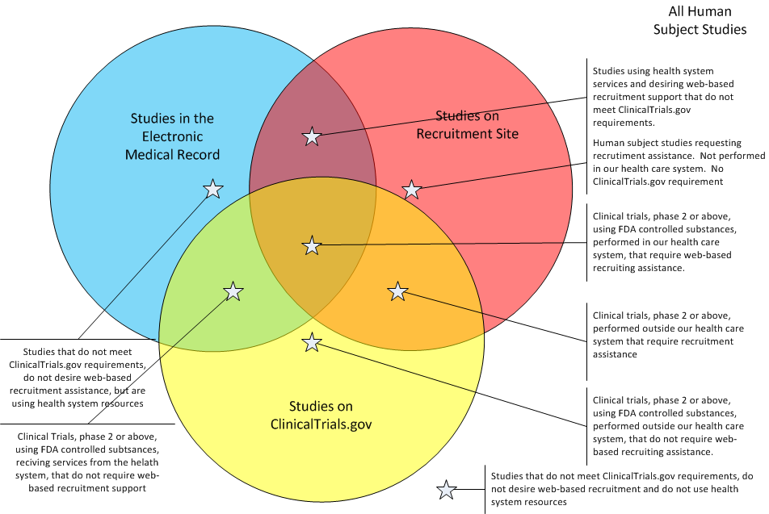
Data Collection Process for a Comprehensive Human Subject Study Registry and Research Participant Web Site
Turner, A. McMurray, M. Conlon, and the Study Registry Team*,
University of Florida, Gainesville, FL
Overview
In collaboration with UF’s four Institutional Review Boards, The UF Health System, and research teams across UF, the CTSI is developing a study registry to:
Expand access to information about UF’s actively enrolling research studies
Assist with recruitment of subject participants
Improve the university’s ability to understand, promote and strengthen UF’s portfolio of human subject research.
The CTSI Study Registry project will create a comprehensive data set with consistently defined data elements for all human subject research studies approved at UF since 2008, plus actively enrolling studies approved before 2008. The data collected will be used in two ways:
Selected data elements for actively enrolling studies are publicly available on a website called UF StudyConnect (http://studyconnect.ctsi.ufl.edu), which individuals can use to search for opportunities to participate in research. This component launched in January 2012.
The full data set will enable the CTSI and other stakeholders to analyze aspects of UF’s human subject research portfolio such as areas of research, types of research and translational stages of research (T1-T4).
Background: The Need
The University of Florida does not currently have comprehensive data regarding its human subject research. Such data is housed separately by UF’s four Institutional Review Boards:
IRB-01: Gainesville Health Science Center
IRB-02: Behavioral Non-Medical
IRB-03: Jacksonville Health Science Center
IRB-04: Western IRB (industry-sponsored, FDA-regulated clinical studies)
Each IRB keeps its own records in its own formats. The CTSI Study Registry project will create a single, comprehensive, electronic resource listing all UF human subject research studies across all IRBs.
Table 1. Counts of studies to be included in the study registry. The counts for 2012 increase regularly as new studies are approved.
Environment
Human Subject Studies include studies that make use of the electronic medical record, studies that can make use of web-based recruitment and studies that must be registered in clinicaltrials.gov. The study registry includes all human subject studies regardless of these other requirements.
Figure 1. Relation of study registry studies to subsets in other systems
Method
How are data being collected?
Data collection is done manually from paper IRB records. Every member of the CTSI Study Registry team is thoroughly trained on primary data collection techniques, which includes extensive review of the data dictionary, code book and working with IRB files.
All team members are required to spend a full day shadowing an experienced coder. This process includes reading through previously coded protocols to understand how NIH data elements are coded with a mentor there to field questions. Team members begin data collection on their own once mentoring is complete.
Quality Assurance sessions are scheduled bi-weekly to ensure accuracy and consistency with the data collection process. As a final step to ensure accuracy, the PI of each study is given the opportunity to review the information that will be publicly available on the UF StudyConnect website.
Figure 2. Data collection process. All studies are stored in the registry. Actively enrolling studies are also presented on UF StudyConnect
What data are being collected?
37 data elements are being collected across the four UF IRBs for all human subject research studies approved at UF since 2008 (full board, expedited and exempt).
Figure 3. Data Collection Form. Data elements colored green are used to identify actively enrolling studies for possible inclusion on UF StudyConnect. Selection criteria: Review Type = full board or expedited, Active = yes, Has enrollment ended = no. Data elements colored blue are either searchable or displayed on the UF StudyConnect website, which is available to the public. All other data elements are housed in a database maintained by the CTSI.
Results
Table 2. Data collection progress as of March 30, 2012.
Figure 3.Translational Research at the University of Florida-overall and by IRB 2011
Figure 4. UF Study Connect web site http://studyconnect.ctsi.ufl.edu. UF StudyConnect launched January 19, 2012 with 276 studies; 117 studies added since launch for 219 PIs
 | 2008 | 2009 | 2010 | 2011 | 2012 | Total
IRB01 | 159/642 | 251/1702 | 672/705 | 704/708 | 49/153 | 1835/2910
IRB02 | 0/1111 | 321/1297 | 576/1253 | 400/1338 | 0/301 | 1297/5300
IRB03 | 142/154 | 143/162 | 160/174 | 168/181 | 25/30 | 651/688
IRB04 | 93/154 | 88/132 | 147/147 | 64/83 | 2/9 | 394/524
Total | 394/2061 | 803/2293 | 1555/2278 | 1349/2297 | 76/493 | 4177/9422
 | 2008 | 2009 | 2010 | 2011 | 2012 | Total
IRB01 | 642 | 702 | 705 | 708 | 153 | 2,910
IRB02 | 1,111 | 1,297 | 1,253 | 1,338 | 301 | 5,300
IRB03 | 154 | 162 | 174 | 168 | 30 | 688
IRB04 | 154 | 132 | 146 | 83 | 9 | 524
Total | 2,061 | 2,293 | 2,278 | 2,297 | 493 | 9,422
Project Impact
This project creates a fundamental new capability for UF. We will have a unified
registry of all human subject research at UF. The registry’s online component
connects interested individuals with information about research studies that are
open for enrollment. The registry also will facilitate analysis of the types of human
subject research conducted across UF.
Future Work
Develop web data entry form using Visual Studio
UF StudyConnect transitions to UF&Shands health care enterprise
Integrate with myIRB (Click Commerce)
Sync required data with clinicaltrials.gov
Sync required data with the electronic medical record (epic)
The Study Registry team: Kaitlin Brennan, Miguel Chateloin, TaJuana Chisholm, Christopher DeForce, Neil Duncan, Katherine Eddleton, Camilo Gomez, Swaroop Kondreddy, Sherie Laurens, Rebecca Richie, Bethany Tennant . Work supported in part by the NIH/NCRR Clinical and Translational Science Awards to the University of Florida UL1 RR029890, KL2 RR029888 and TL1 RR029889.
.

