Slide 1
VIVO: An Open Source Tool for Describing, Linking, and Discovering Researchers and Research
Dean B. Krafft and Jon Corson-Rikert
Cornell University Library
Michael Conlon
University of Florida
CNI Workshop on Scholarly Identity
April 4, 2012

Slide 2
University of Florida
Mike Conlon (VIVO and UF PI)
Beth Auten
Michael Barbieri
Chris Barnes
Kaitlin Blackburn
Cecilia Botero
Kerry Britt
Erin Brooks
Amy Buhler
Ellie Bushhousen
Linda Butson
Chris Case
Christine Cogar
Valrie Davis
Mary Edwards
Nita Ferree
Rolando Garcia-Milan
George Hack
Chris Haines
Sara Henning
Rae Jesano
Margeaux Johnson
Meghan Latorre
Yang Li
Jennifer Lyon
Paula Markes
Hannah Norton
James Pence
Narayan Raum
Nicholas Rejack
Alexander Rockwell
Sara Russell Gonzalez
Nancy Schaefer
Dale Scheppler
Nicholas Skaggs
Matthew Tedder
Michele R. Tennant
Alicia Turner
Stephen Williams
Indiana University
Katy Borner (IU PI)
Kavitha Chandrasekar
Bin Chen
Shanshan Chen
Ryan Cobine
Jeni Coffey
Suresh Deivasigamani
Ying Ding
Russell Duhon
Jon Dunn
Poornima Gopinath
Julie Hardesty
Brian Keese
Namrata Lele
Micah Linnemeier
Nianli Ma
Robert H. McDonald
Asik Pradhan Gongaju
Mark Price
Michael Stamper
Yuyin Sun
Chintan Tank
Alan Walsh
Brian Wheeler
Feng Wu
Angela Zoss
VIVO Collaboration
Cornell University
Dean Krafft (Cornell PI)
Manolo Bevia
Jim Blake
Nick Cappadona
Brian Caruso
Jon Corson-Rikert
Elly Cramer
Medha Devare
Elizabeth Hines
Huda Khan
Depak Konidena
Brian Lowe
Joseph McEnerney
Holly Mistlebauer
Stella Mitchell
Anup Sawant
Christopher Westling
Tim Worrall
Rebecca Younes
Washington University School of Medicine in St. Louis
Rakesh Nagarajan (WUSTL PI)
Kristi L. Holmes
Caerie Houchins
George Joseph
Sunita B. Koul
Leslie D. McIntosh
Weill Cornell Medical College
Curtis Cole (Weill PI)
Paul Albert
Victor Brodsky
Mark Bronnimann
Adam Cheriff
Oscar Cruz
Dan Dickinson
Richard Hu
Chris Huang
Itay Klaz
Kenneth Lee
Peter Michelini
Grace Migliorisi
John Ruffing
Jason Specland
Tru Tran
Vinay Varughese
Virgil Wong
The Scripps Research Institute
Gerald Joyce (Scripps PI)
Catherine Dunn
Sam Katkov
Brant Kelley
Paula King
Angela Murrell
Barbara Noble
Cary Thomas
Michaeleen Trimarchi
Ponce School of Medicine
Richard J. Noel, Jr. (Ponce PI)
Ricardo Espada Colon
Damaris Torres Cruz
Michael Vega Negrón
This project is funded by the National Institutes of Health, U24 RR029822
"VIVO: Enabling National Networking of Scientists”
Notes:
As you can see, The VIVO project itself is a rather large, geographically dispersed team.
7 institutions
Project areas: development, implementation, ontology, and outreach

Slide 3
What is VIVO?
A semantic-web-based researcher and research discovery tool
People plus much more
Institution-wide, publicly-visible information
For external as well as internal audiences
An open, shared platform for connecting scholars, communities, and campuses using Linked Open Data

Slide 4
What does VIVO do?
Integrates multiple sources of data
Systems of record
Faculty activity reporting
External sources (e.g., Scopus, PubMed, NIH RePORTER)
Provides a review and editing interface
Single sign-on for self-editing or by proxy
Provides integrated, filterable feeds to other websites

Slide 5
What does VIVO model?
People, but also organizations, grants, programs, projects, publications, events, facilities, and research resources
Relationships among the above
Meaningful connections among people and activities
Bidirectional
Context and navigation from one point of interest to another
Links to URIs outside VIVO
Concepts
People, places, organizations, events

Slide 6
Typical data sources
HR and/or directory – people, appointments
Research administration – grants & contracts
Registrar – courses
Graduate-level programs/advising affiliations
Faculty reporting system(s) and/or self or proxy editing – narratives, service, research areas, awards
Events calendar
News releases and/or press clippings
PubMed, Scopus, repositories – publications

Slide 7
The VIVO ontology
Defines types
Having individual instances (e.g., persons)
Defines relationships
Expressed as statements about individuals
Statements (“triples”) can describe or connect
Data property statements describe individuals
Object property statements connect individuals

Slide 8
Example relationships for a researcher
has author
Andrew McDonald
Mining the record: Historical evidence for…
author of
academic staff
in
research area
has author
research area for
academic staff
author of
taught by
research area
crop management
teaches
Susan Riha
research area for
CSS 4830
headed by
NYS WRI
head of
faculty appointment in
features person
faculty members
Earth and Atmospheric Sciences
featured in
Cornell’s supercomputers crunch weather data to help farmers manage chemicals

Slide 9
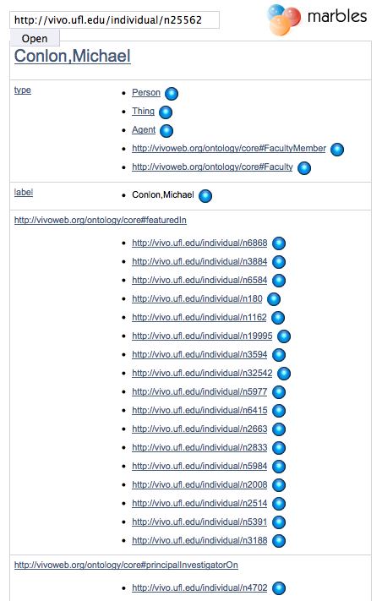
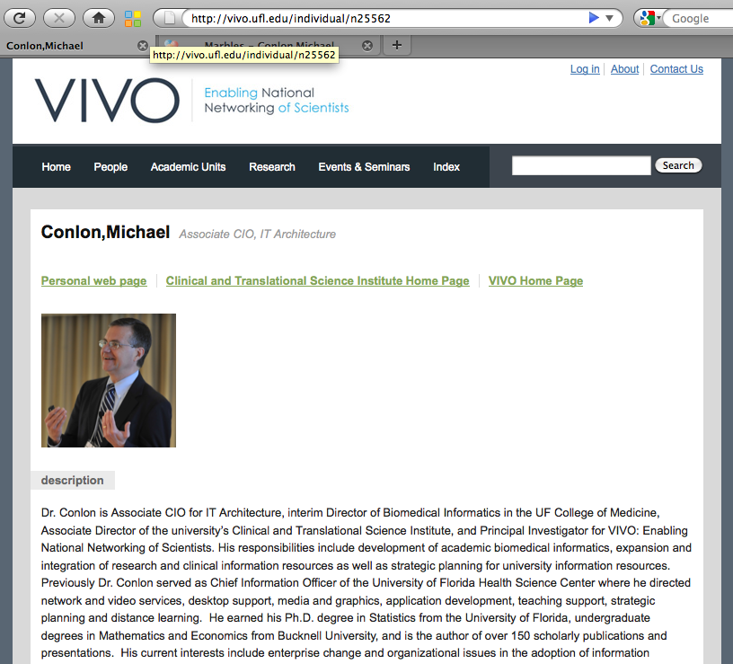
An HTTP request can return HTML or data

Slide 10
Linked data indexing for search
Scripps VIVO
UF VIVO
WashU VIVO
IU VIVO
eagle-I
Research
resources
Ponce VIVO
Harvard
Profiles
RDF
Other
VIVOs
Cornell
Ithaca VIVO
Weill
Cornell VIVO
Solr
search
index
Iowa
Loki
RDF
Alter-nate
Solr
index
vivo
search.org
Digital
Vita
RDF
Linked Open Data

Slide 11
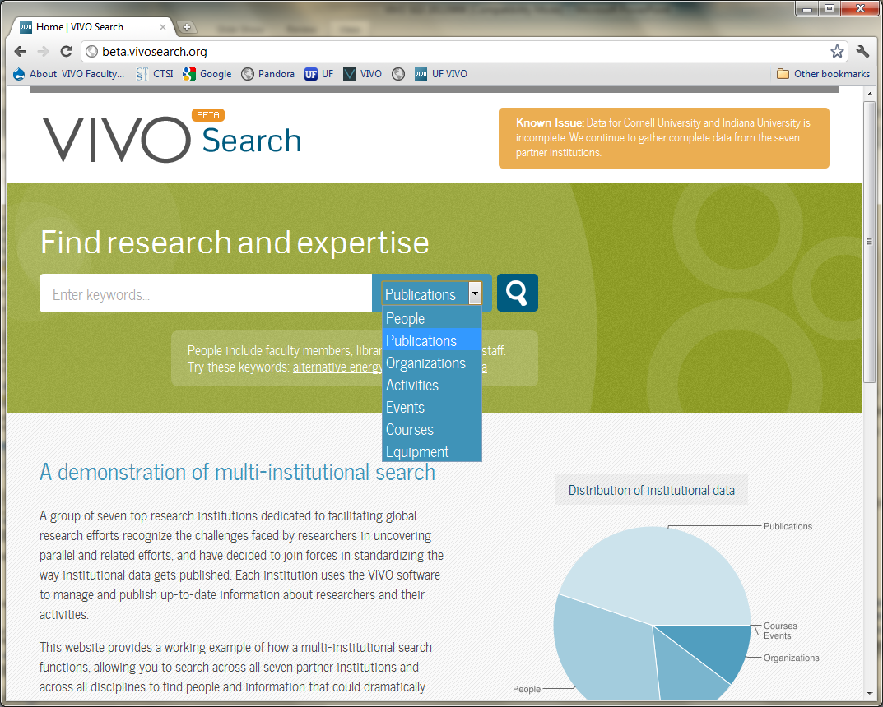

Slide 12
Value for institutions
Common data substrate
Public, granular and direct
Discovery via external and internal search engines
Available for reuse at many levels
Distributed curation
E.g., affiliations beyond what HR system tracks
Data coordination across functional silos
Feeding changes back to systems of record
Direct linking across campuses
Data that is visible gets fixed

Slide 13
Partnerships – research resources
CTSAconnect
OHSU, Harvard, Cornell, Florida, Buffalo & Stony Brook
eagle-i sister NIH project – Harvard, OHSU, 7 others
Facilities, services, techniques, protocols, skills, and research outputs beyond publications
Extended ways to represent expertise
Improve attribution for data and other contributions to science

Slide 14
Partnerships – ORCID
ORCID – Open Researcher and Contributor ID
Create an identifier for all authors. Attribute works to authors through ORCID identifier
ORCID and VIVO
VIVO provides assertion of ORCIDs with people through institutional identity management. ORCID is an attribute in a VIVO profile.
Anticipating batch submission of basic researcher registrations by universities
http://orcid.org

Slide 15
Partnerships – research data
VIVO/ANDS consortium in Australia
Link research data with researcher profiles and publications
Harvest to national registry
DataStaR local data registry tool
Add-on to VIVO
Complement to other library data-related services
Institute for Museum and Library Services (IMLS) grant

Slide 16
Partnerships – information standards
euroCRIS and the CERIF research data standard
Linked Open Data task force slated to map VIVO and CERIF ontologies during 2012
CASRAI (http://casrai.org)
University, corporate, and government partnership
Building a common data dictionary for research information
Coordinating with euroCRIS

Slide 17
Partnerships - APA
The American Psychological Association is using VIVO as one component of a trusted identity framework for online submission and review of scholarly publications
VIVO’s integration with institutional identity systems through the InCommon Federation provides a platform for representing and exchanging information about authors and their works
http://vivo.apa.org, http://publishtrust.org

Slide 18
Partnerships - Sakai
Cambridge University is testing VIVO as a profiling component of the new Sakai Open Academic Environment product
VIVO’s design permits integration into the Sakai interface without major modification to either platform
NYU and other sites may expand the testing pending grant approval

Slide 19
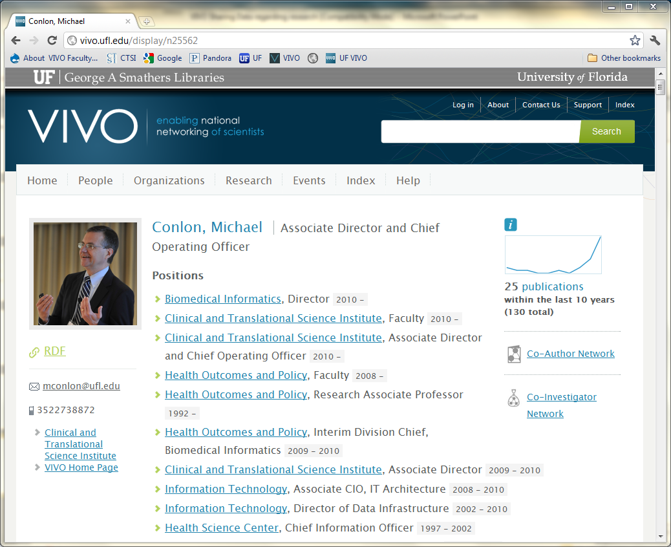
http://vivo.ufl.edu/individual/mconlon

Slide 20
Identity, Publication & Attribution

Slide 21
Identity
Management
Publication
Identity, Publication & Attribution

Slide 22
Identity
Management
Attribution of
Work to Person
Publication
Identity, Publication & Attribution

Slide 23
Attribution of Person to Work
Algorithmic/Probabilistic – study the corpus of papers and authors and create clusters of papers around proposed authors (disambiguation algorithms)
Identifiers – create an identifier for each author and associate the author identifier with the paper at publication (ORCID)
Claiming – allow experts to create attributions (vitae process)
Most current work appears to involve various amounts of each of the methods

Slide 24
VIVO and Scholarly Identity
Presents public information about researchers as Linked Open Data
Will provide data provenance, with much data coming from authoritative sources
Provides full & extensible researcher context
Integrates with ORCID, CERIF, Shibboleth/InCommon, and external vocabularies
Is a large & growing international community

Slide 25
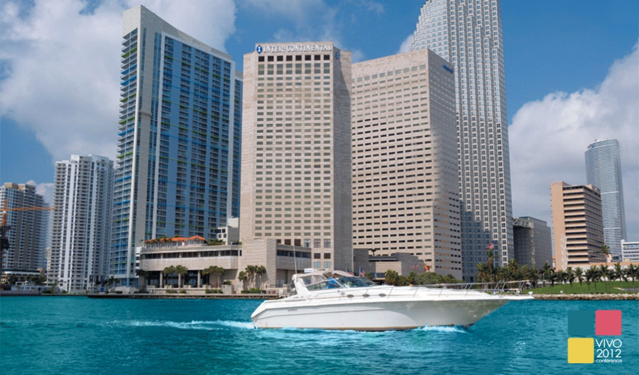
2012 VIVO Conference
August 22-24, 2012 ~ Miami, FL
Register at vivoweb.org/conference
VIVO is supported by NIH Award U24 RR029822

Slide 26
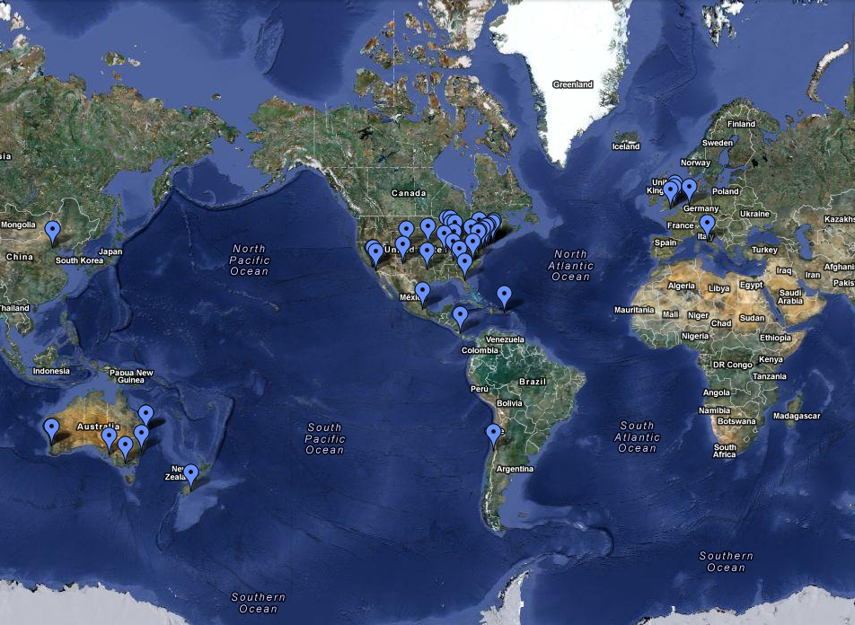
The VIVO Community

Slide 27
Development beyond the VIVO project
Duke – VIVO widgets
Indiana – Query builder interface for HUBzero
Pittsburgh – Digital Vita Documents
Stony Brook – UMLS terminology web service
Weill Cornell – Google Refine integration
Nebraska – BEPress publication importer
Symplectic Elements – VIVO connector
Wellspring Worldwide – technology commercialization
UCSF – Open Social container and RDF gadgets
USC – Karma Information Integration Tool

Slide 28
