Slide 1
Some Thoughts on Data and eScience
Mike Conlon
University of Florida
mconlon@ufl.edu

Slide 2
What Does Data Look Like?

Slide 3
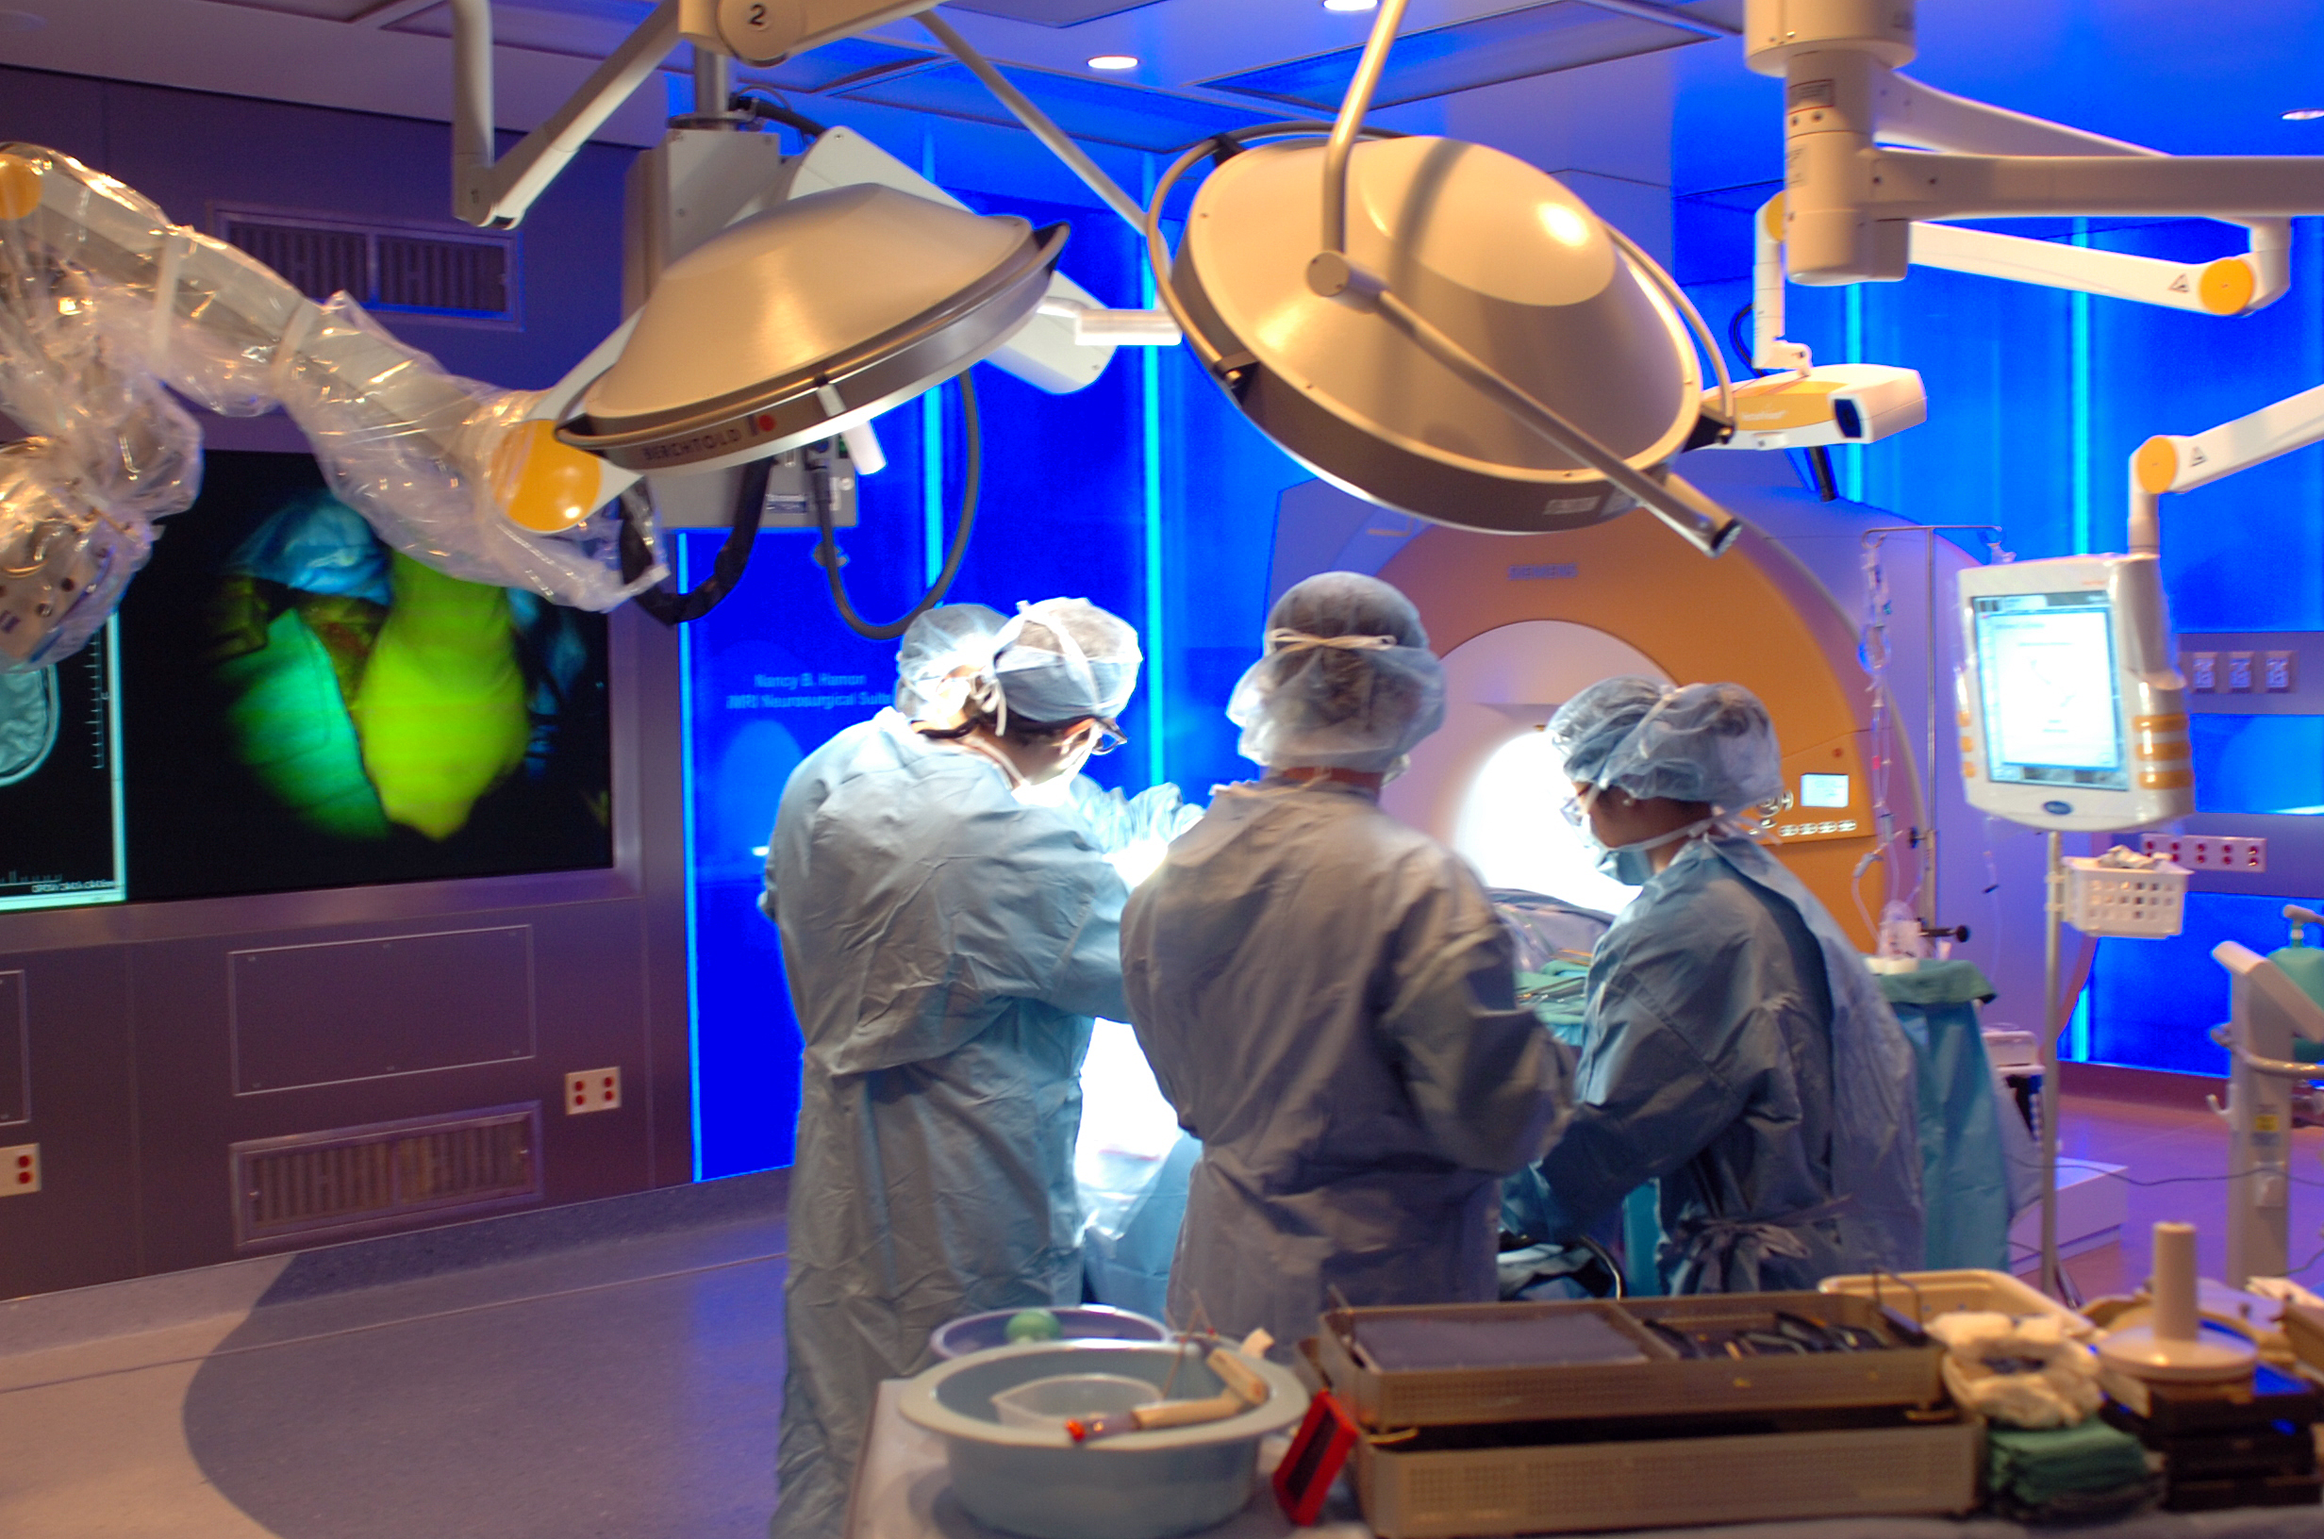
Notes:
Data producers – labs, hospitals, “clipboards”. Get ready to archive – what should be saved, semantics, technology

Slide 4
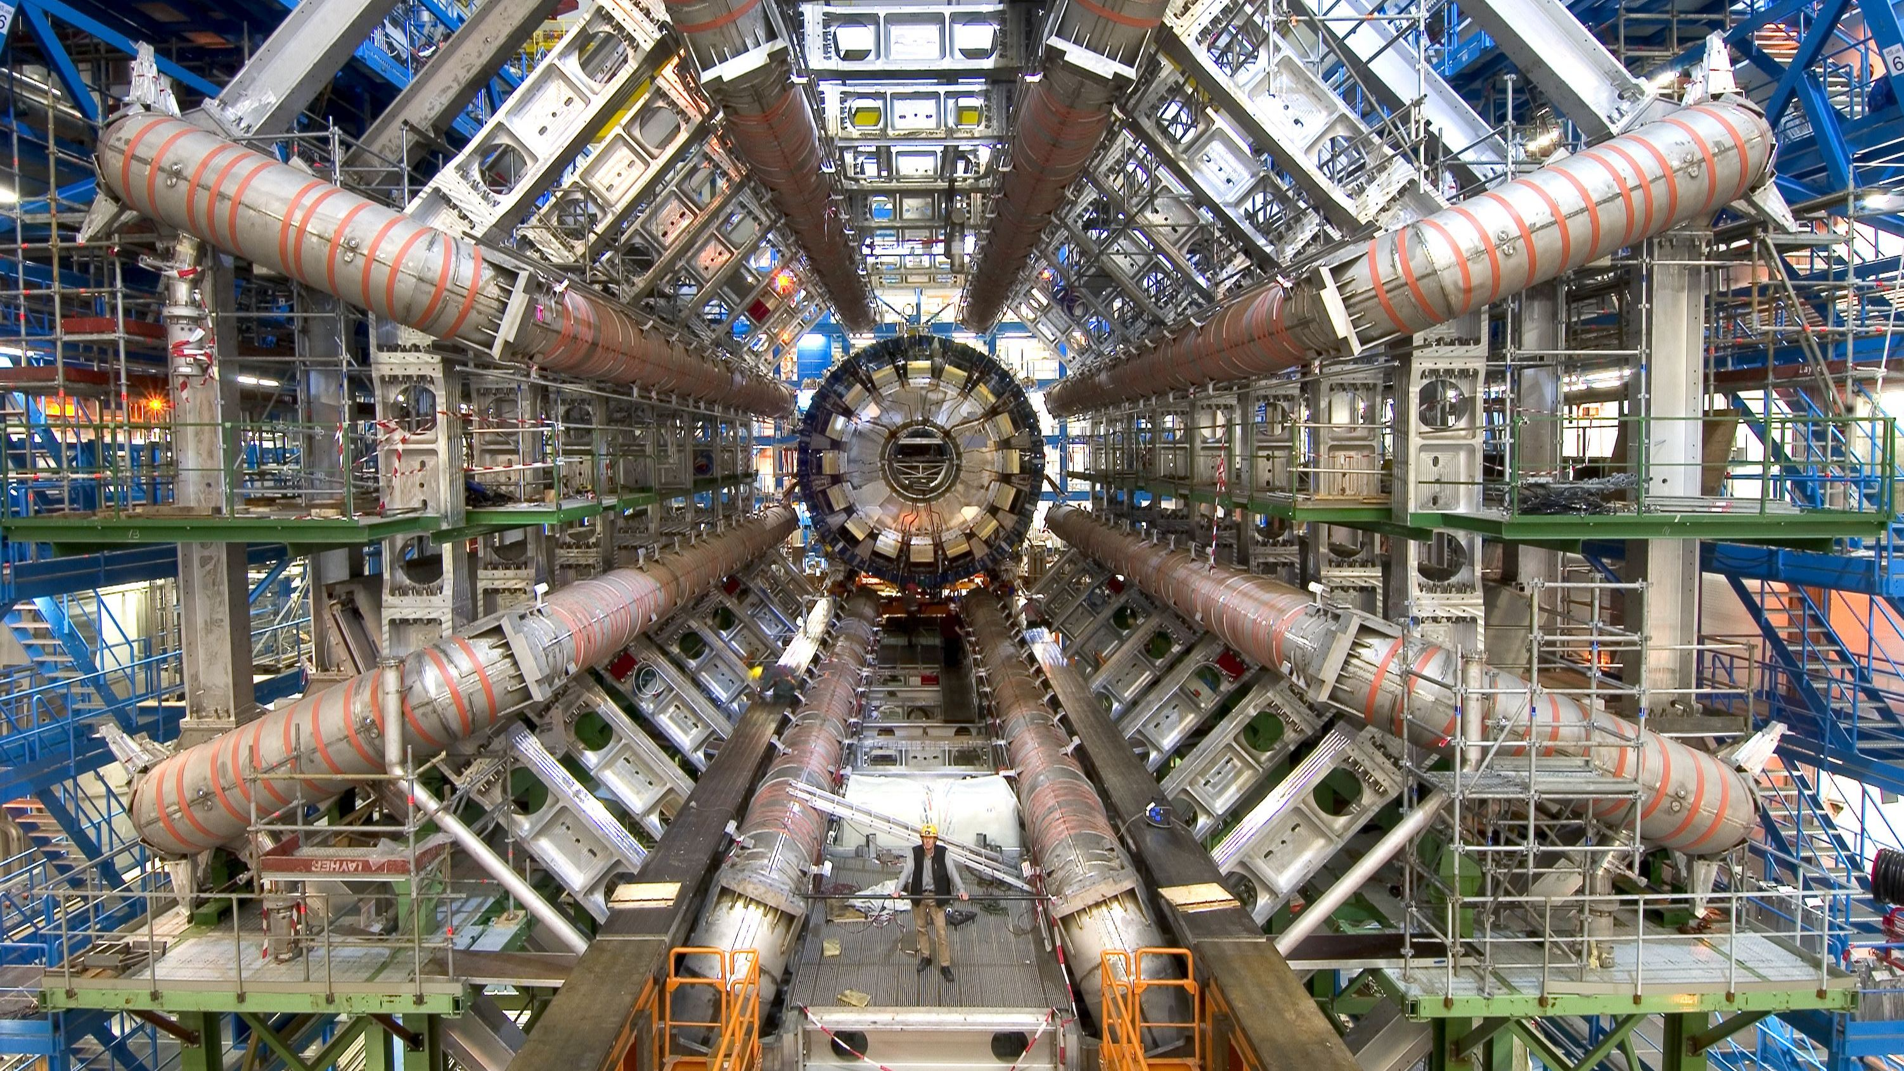

Slide 5
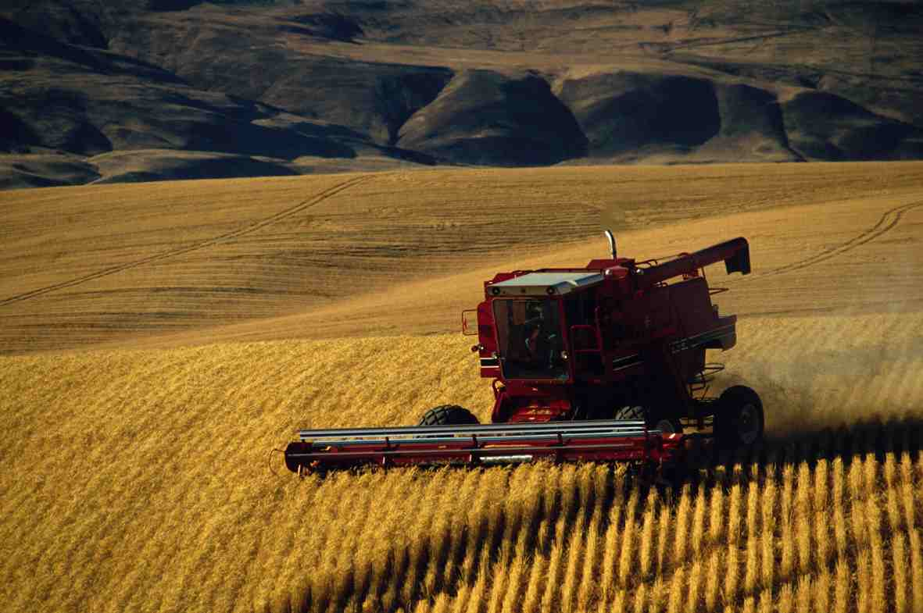
5. Harvesting

Slide 6
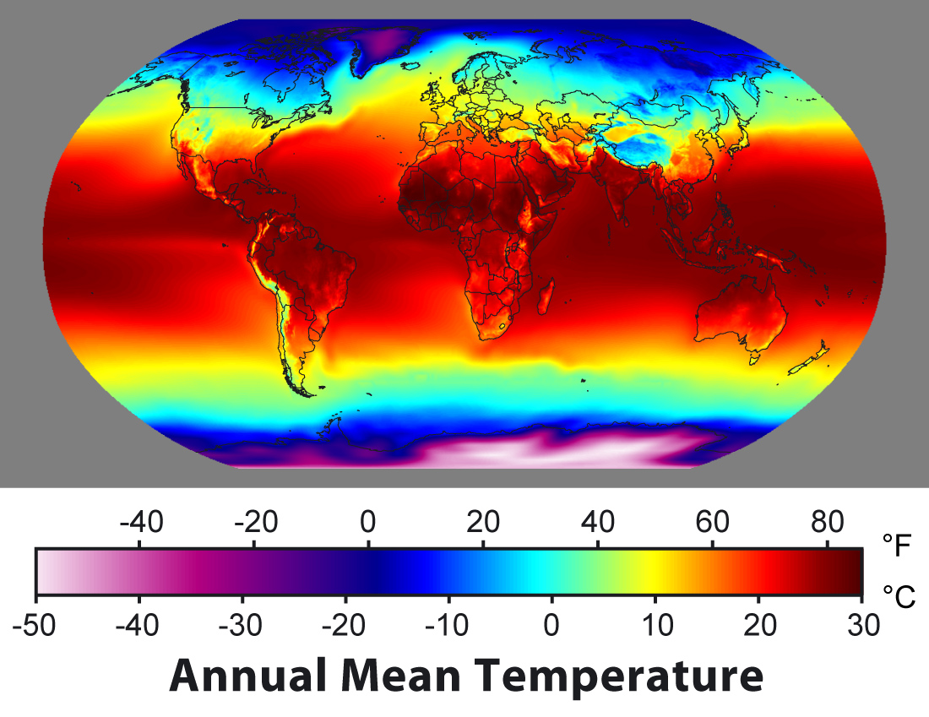
Get a world map showing
temperature sensors

Slide 7
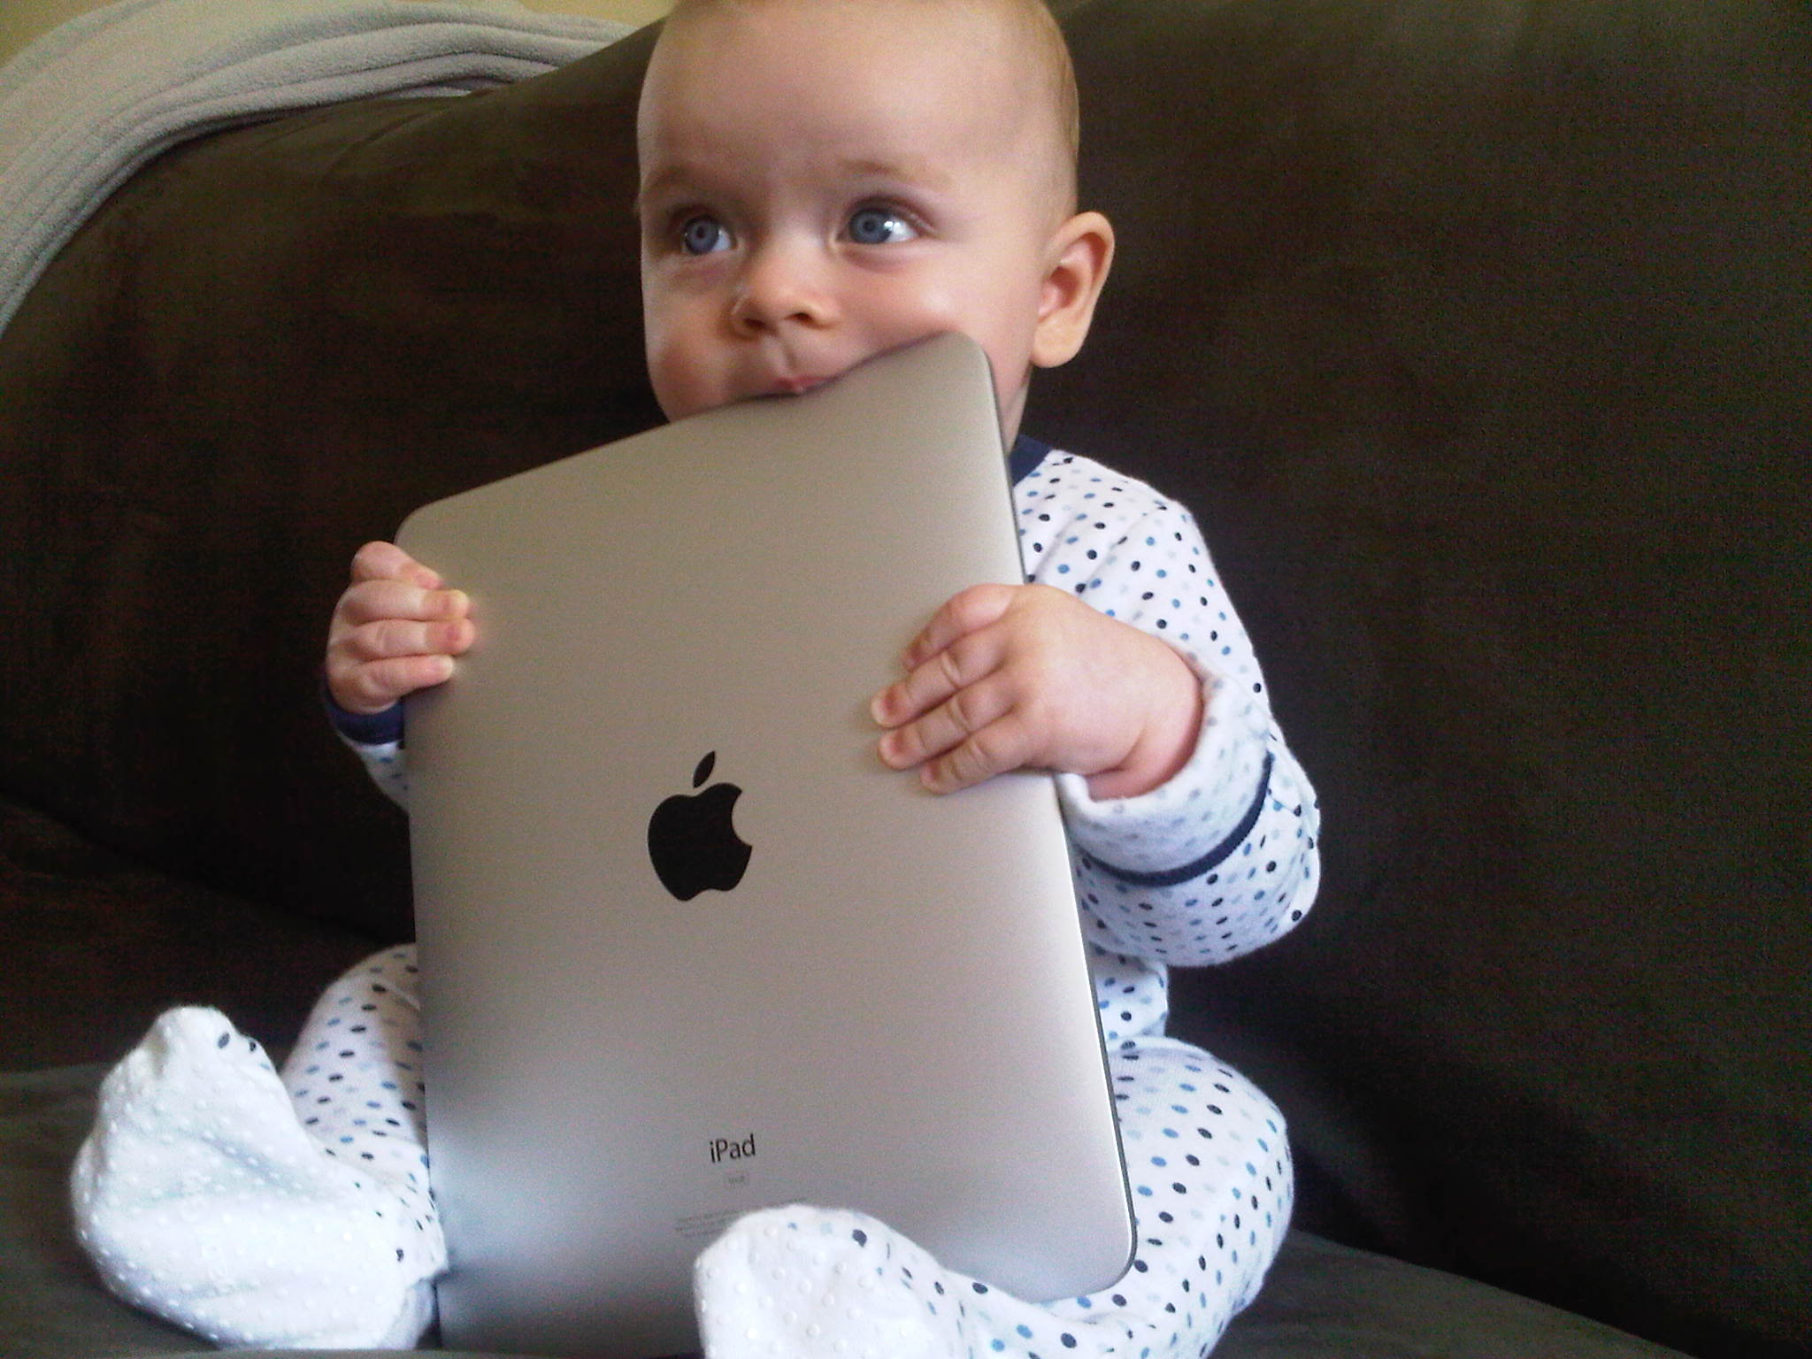

Slide 8
What are the
Data Processes?

Slide 9
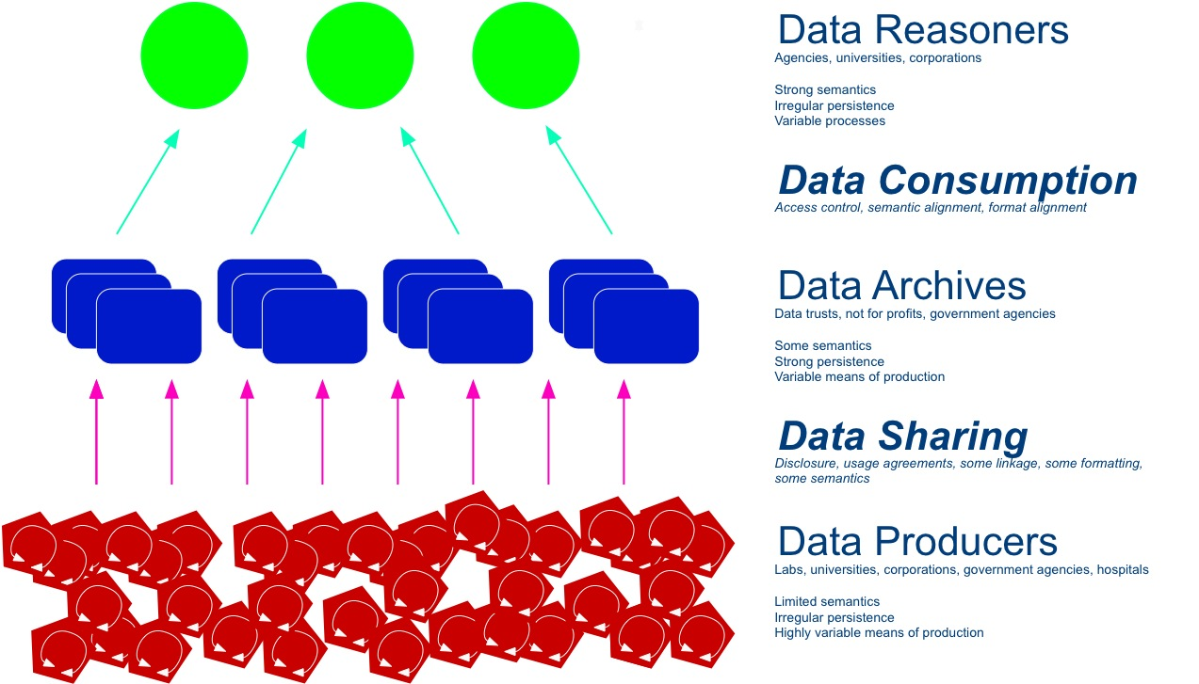

Slide 10
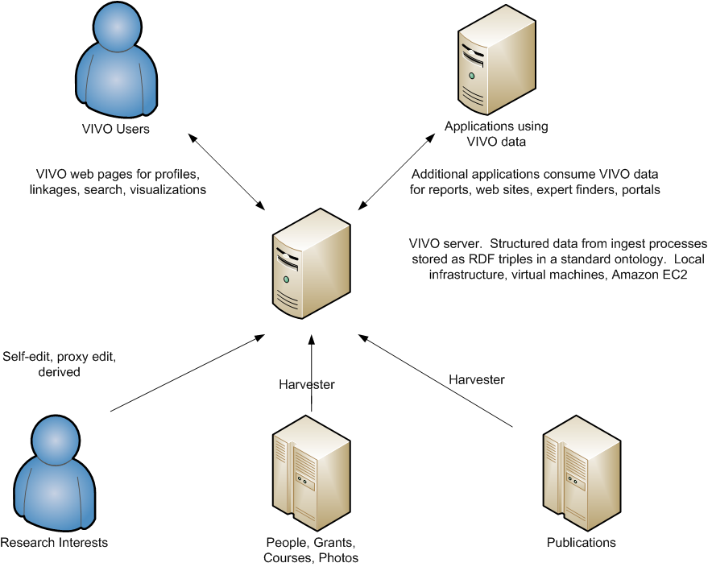
Producing Data
Notes:
A collection of open RDF systems at institutions provide data to a national collection of applications. Applications take many forms and will come from many sources. Applications rely on VIVO ontology for people and compatible systems to provide data about scientists’ interests, activities and accomplishments. Scientists use these applications to find scientists, participate in teams, get current information about science, study science and simplify science.

Slide 11
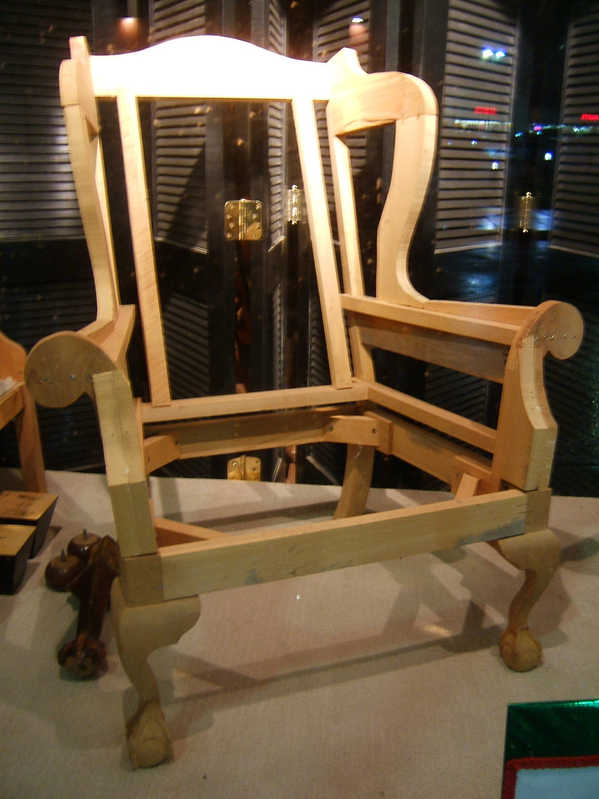
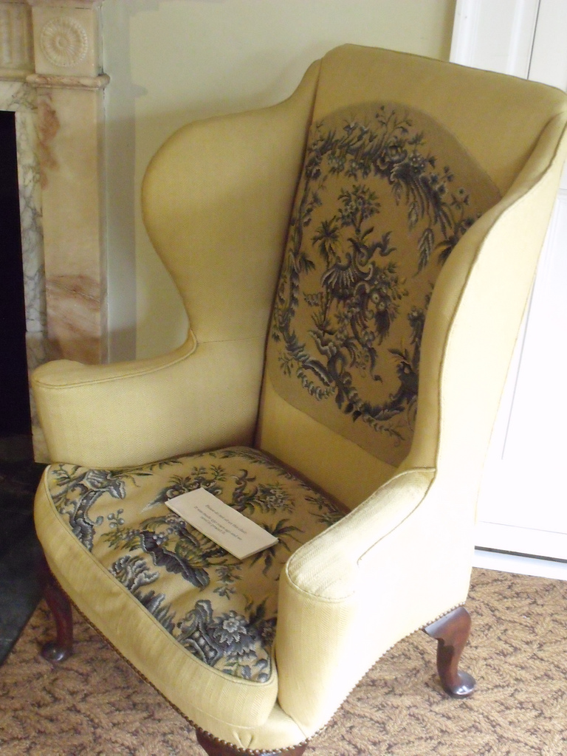
Data Sharing
Photograph by J. G. Park. Flickr.com
Photograph by Ell Brown Flickr.com
Notes:
Semantics for archiving and consumption. Sharing with access control or open? Can enough context be supplied for the data to have meaning beyond its original creators?

Slide 12
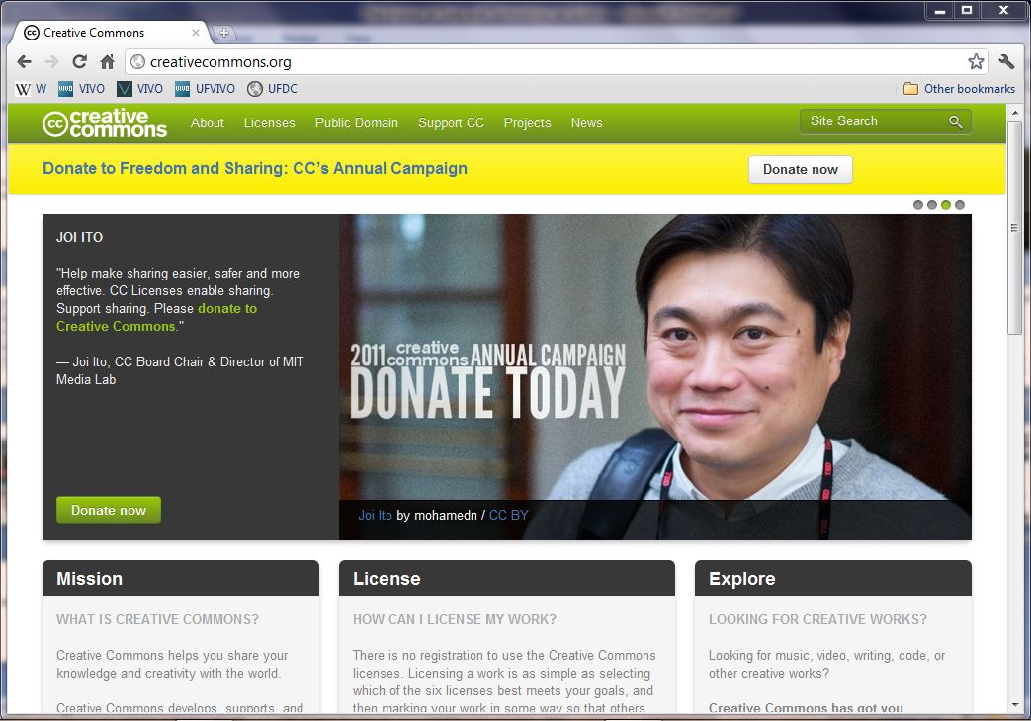
Creative Commons

Slide 13
Data Archive
Notes:
Additional data for VIVO comes from existing institutional sources, such as Human Resources systems and faculty activity systems.

Slide 14
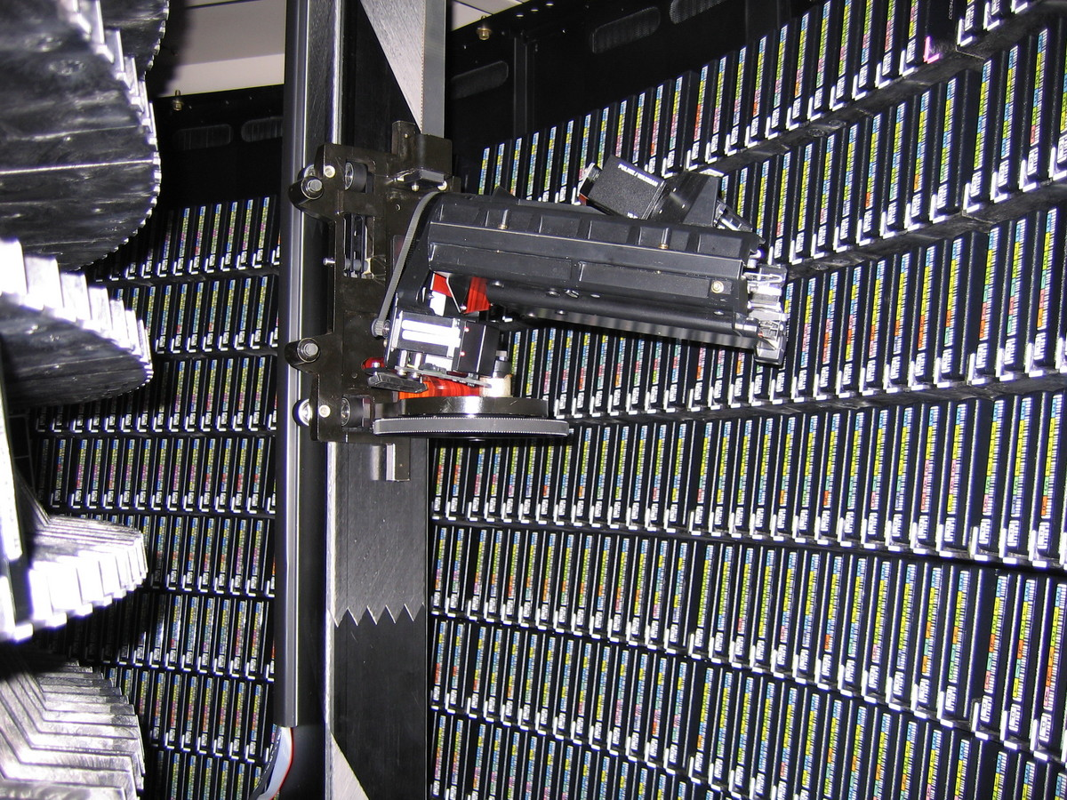
The Role of the Archive
Collate data, final semantics, ready for consumption
Data
Archive

Slide 15
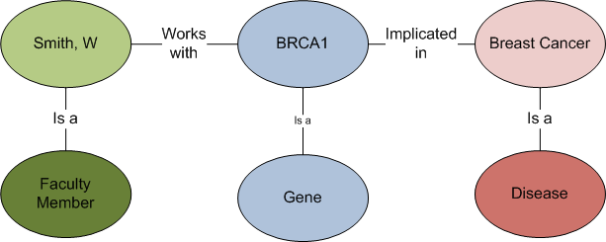
A Consumption Scenario
Find all faculty members whose genetic work
is implicated in breast cancer
VIVO will store information about faculty and associate to genes.
Diseaseome associates genes to diseases.
Query resolves across VIVO and data sources it links to.

Slide 16
Data Reasoning
Data integration continues to be a serious bottleneck for the expectations of increased productivity in the pharmaceutical and biotechnology domain. “Linked Life Data” integrates common public datasets that describe the relationships between gene, protein, interaction, pathway, target, drug, disease and patient and currently consist of more than 5 billion RDF statements. The dataset interconnects more than 20 complete data sources and helps to understand the “bigger picture” of a research problem by linking previously unrelated data from heterogeneous knowledge.
From the LarKC (Large Knowledge Collider) http://www.larkc.eu/overview/

Slide 17
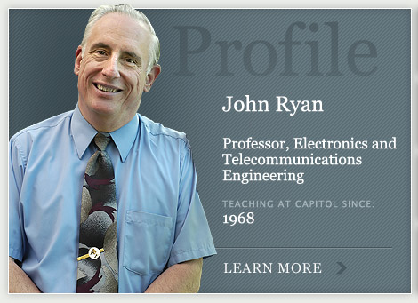
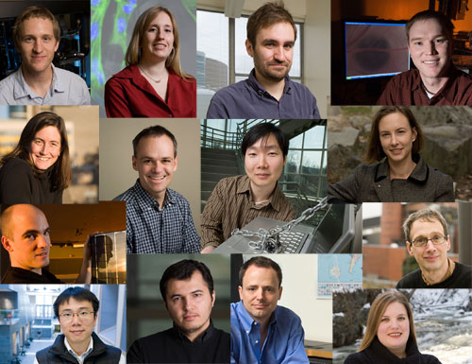
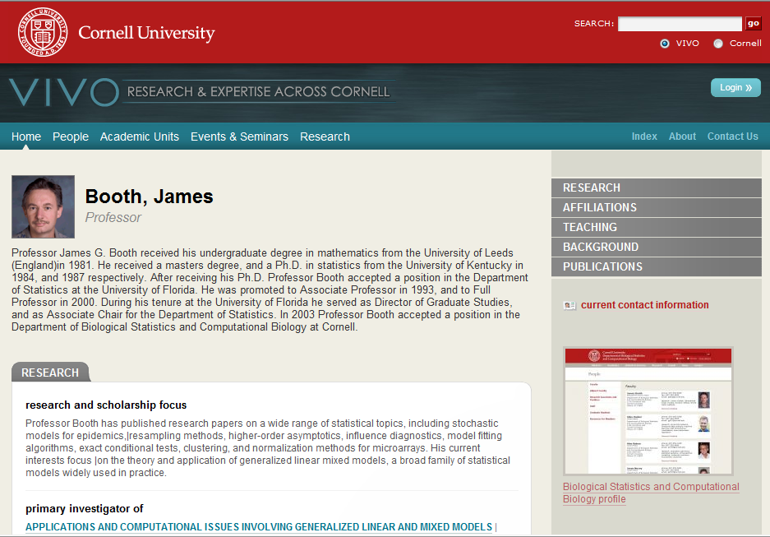
Public, structured linked data about investigators interests, activities and accomplishments, and tools
to use that
data to
advance
science
Notes:
VIVO will provide data about an institution’s scientists, as many faculty profiling systems and web sites do now. At each school, VIVO enables research discovery – providing information about research and researchers. Across institutions VIVO provides a uniform semantic structure to enable a new class of tools using the data to advance science. Each institution provides its own VIVO system and data. Local governance determines data to be provided.

Slide 18
A Web of Data – The Semantic Web
Information is stored using the Resource Description Framework (RDF) as subject-predicate-object “triples”
Dept. of Genetics
professor in
College of Medicine
Jane Smith
has affiliation with
Genetics Institute
Journal article
author of
Book
Book chapter
Subject
Predicate
Object
Notes:
VIVO 1.2 includes a new ontology module representing research resources including biological specimens, human studies, instruments, organisms, protocols, reagents, and research opportunities. This module is aligned with the top-level ontology classes and properties! from the NIH-funded eagle-i Project (https://www.eagle-i.org/home/).

Slide 19
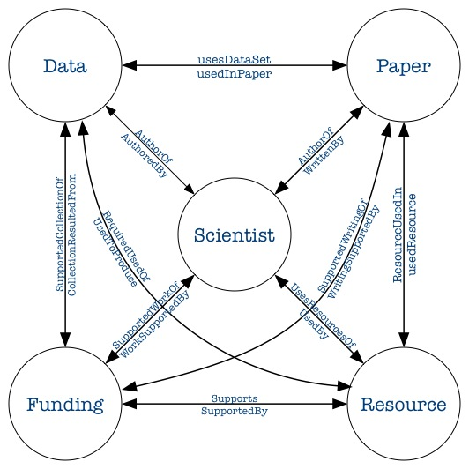

Slide 20
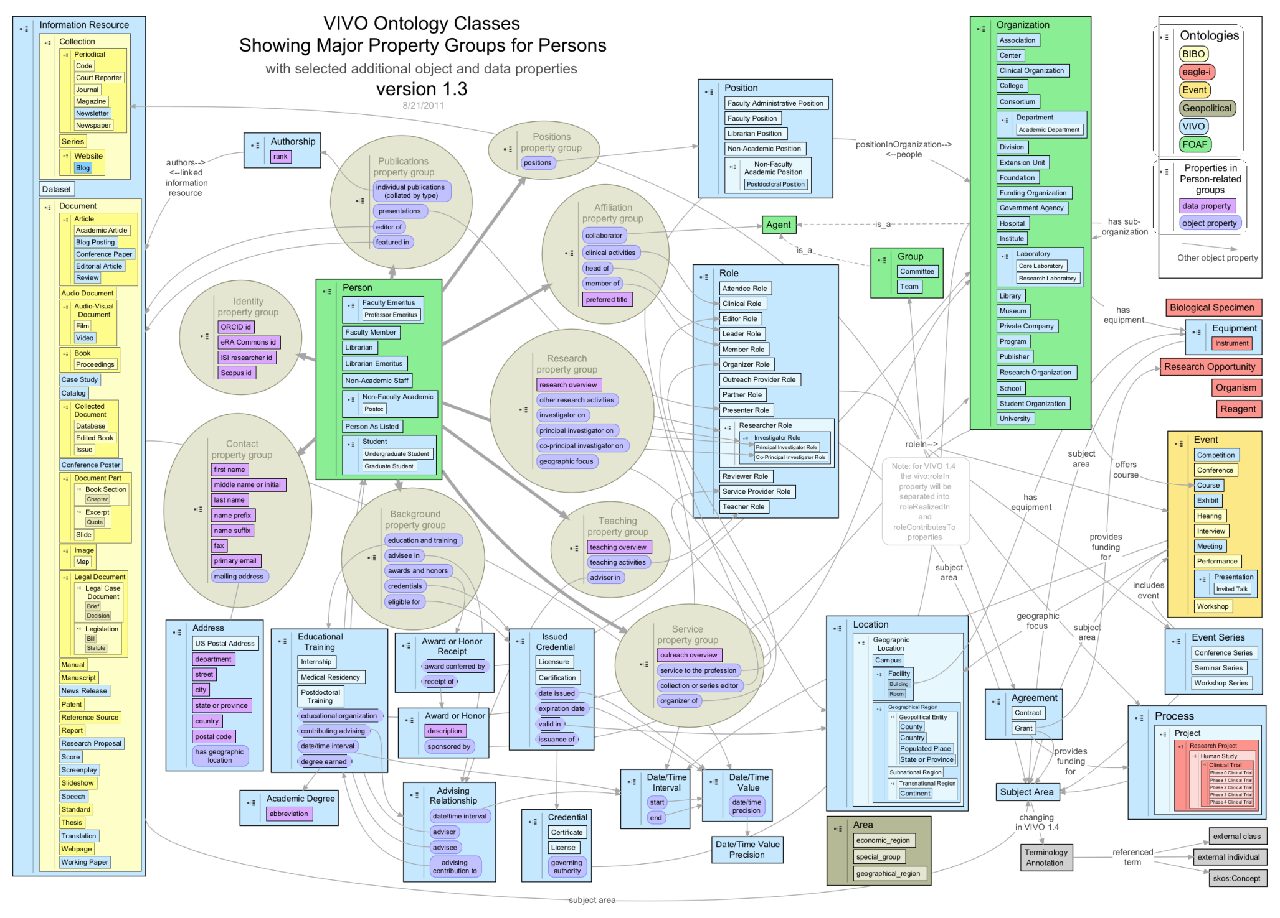

Slide 21
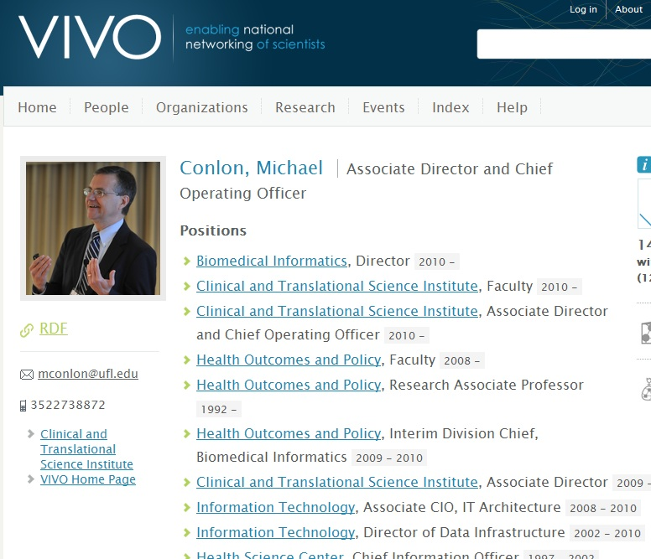
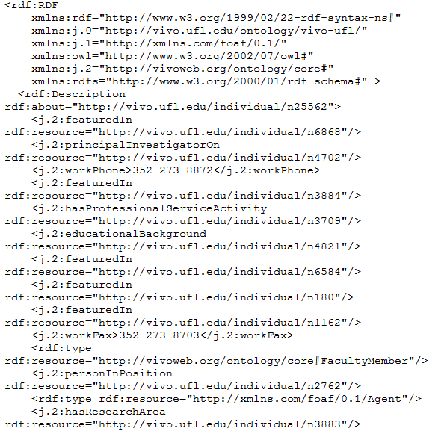
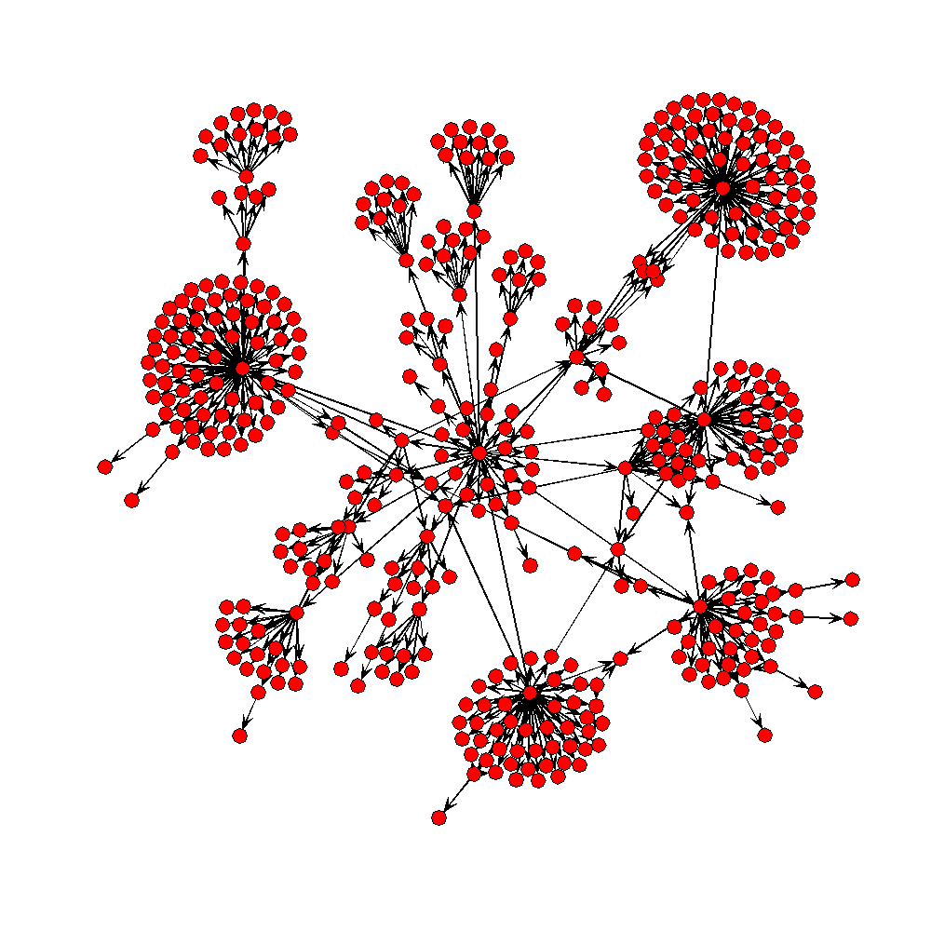
Software reads RDF from VIVO and displays
processOrg<-function(uri){
x<-xmlParse(uri)
u<-NULL
name<-xmlValue(getNodeSet(x,"//rdfs:label")[[1]])
subs<-getNodeSet(x,"//j.1:hasSubOrganization")
if(length(subs)==0) list(name=name,subs=NULL)
else {
for(i in 1:length(subs)){
sub.uri<-getURI(xmlAttrs(subs[[i]])["resource"])
u<-c(u,processOrg(sub.uri))
}
list(name=name,subs=u)
}
}
VIVO produces human and machine readable formats
Notes:
The open architecture of VIVO and linked data supports development of applications outside VIVO that consume VIVO data. VIVO data is accessible via HTML (for humans) and RDF (for machines). Simple software can process the RDF resulting in powerful cross-site applications. The figure depicts the organization of the University of Florida.

Slide 22
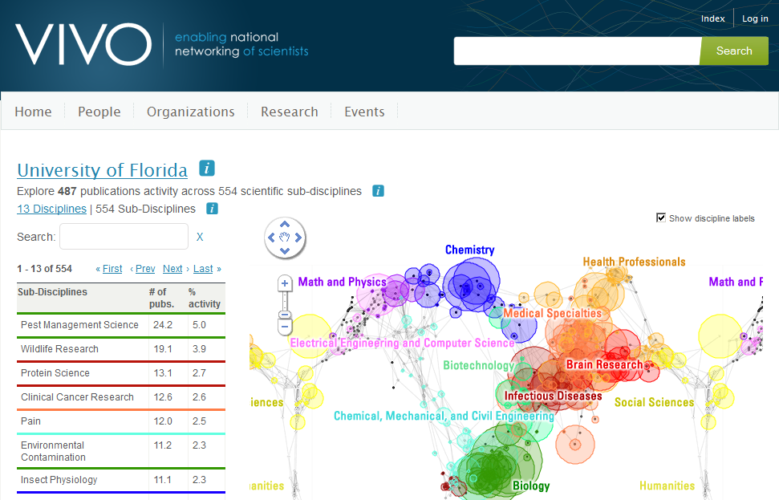
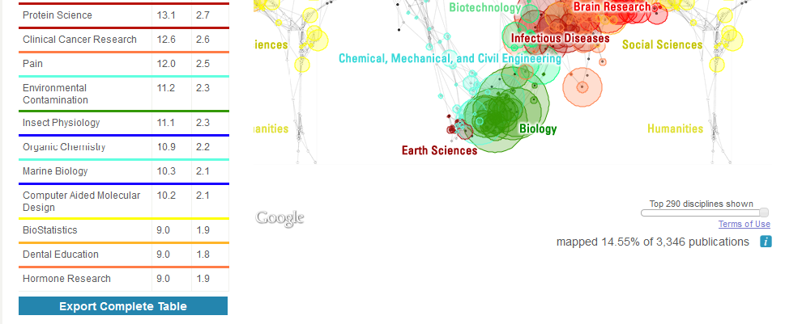
Notes:
22
SciMaps – shows where a person, department, or university publishes most in the world of science.
22

Slide 23
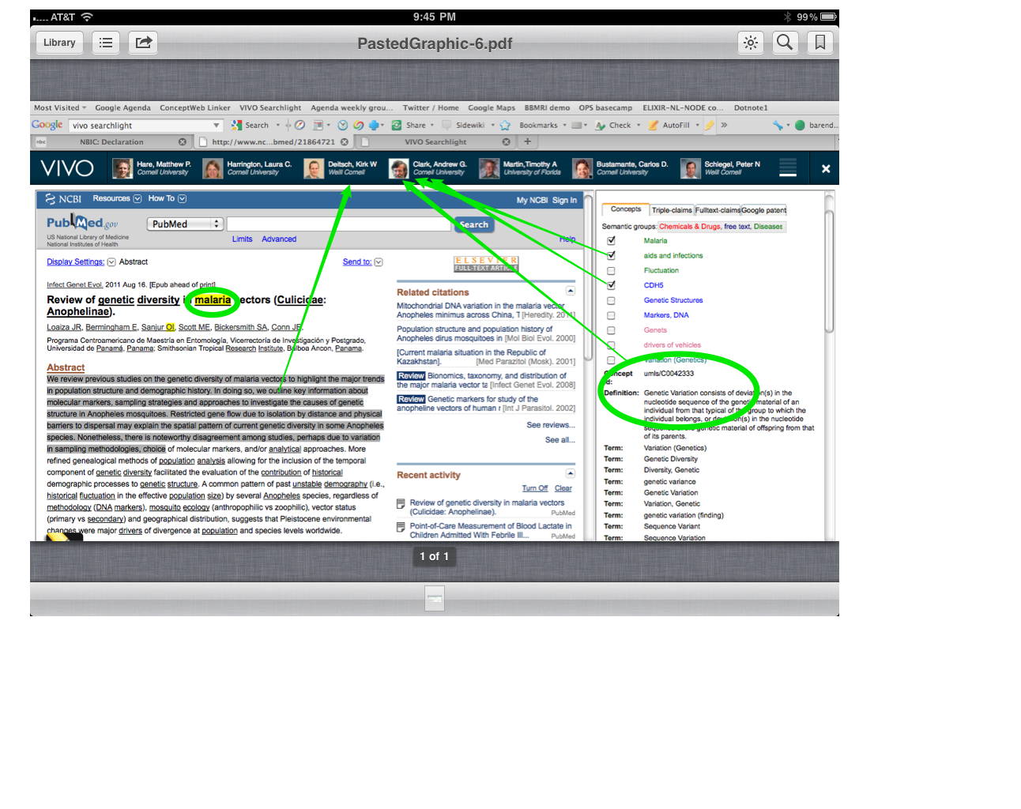
VIVO Searchlight

Slide 24
Some Questions
Regarding Data Processes

Slide 25
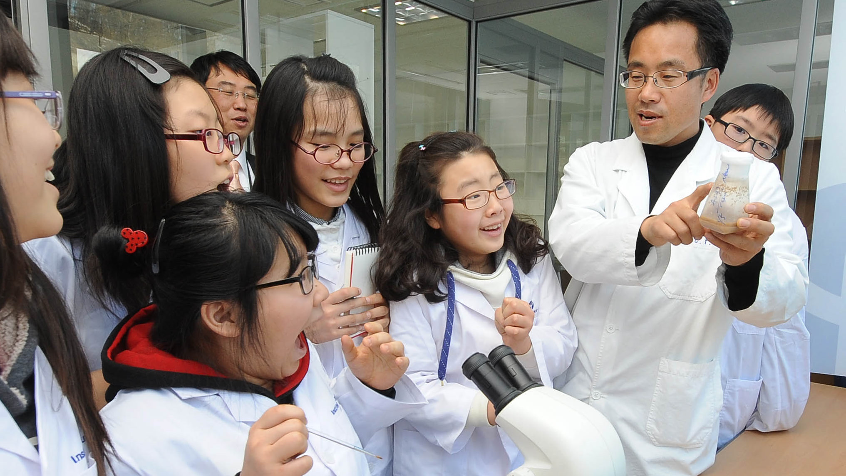
Shared Understanding
of Data

Slide 26
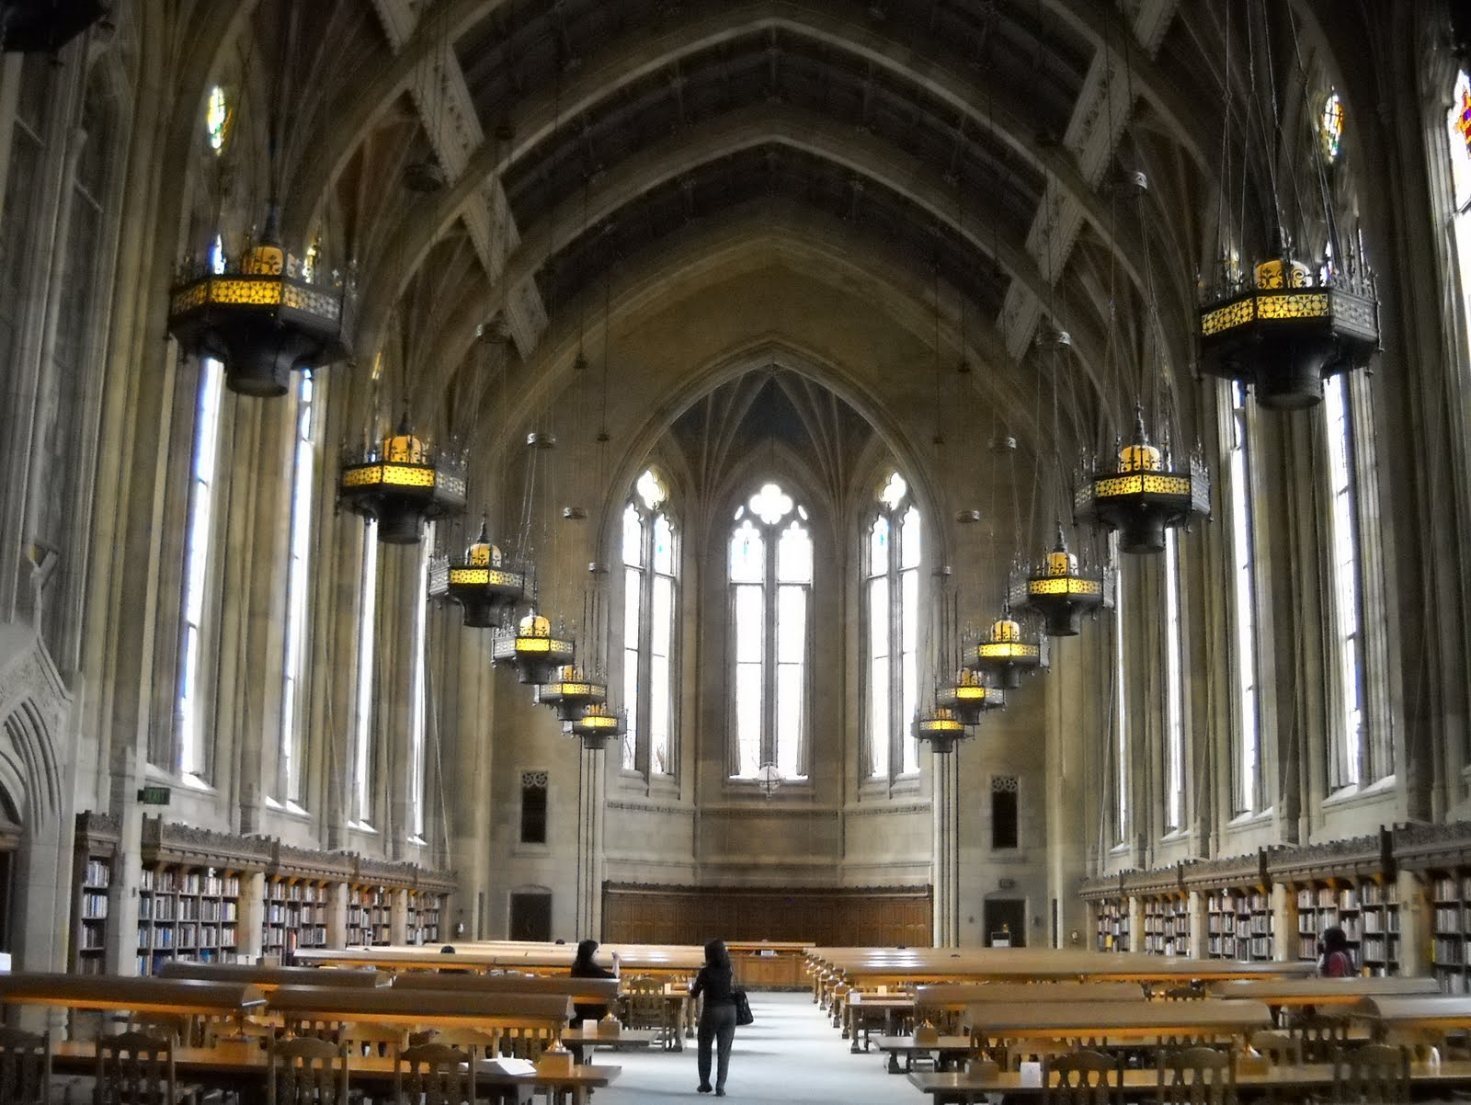
Provenance

Slide 27
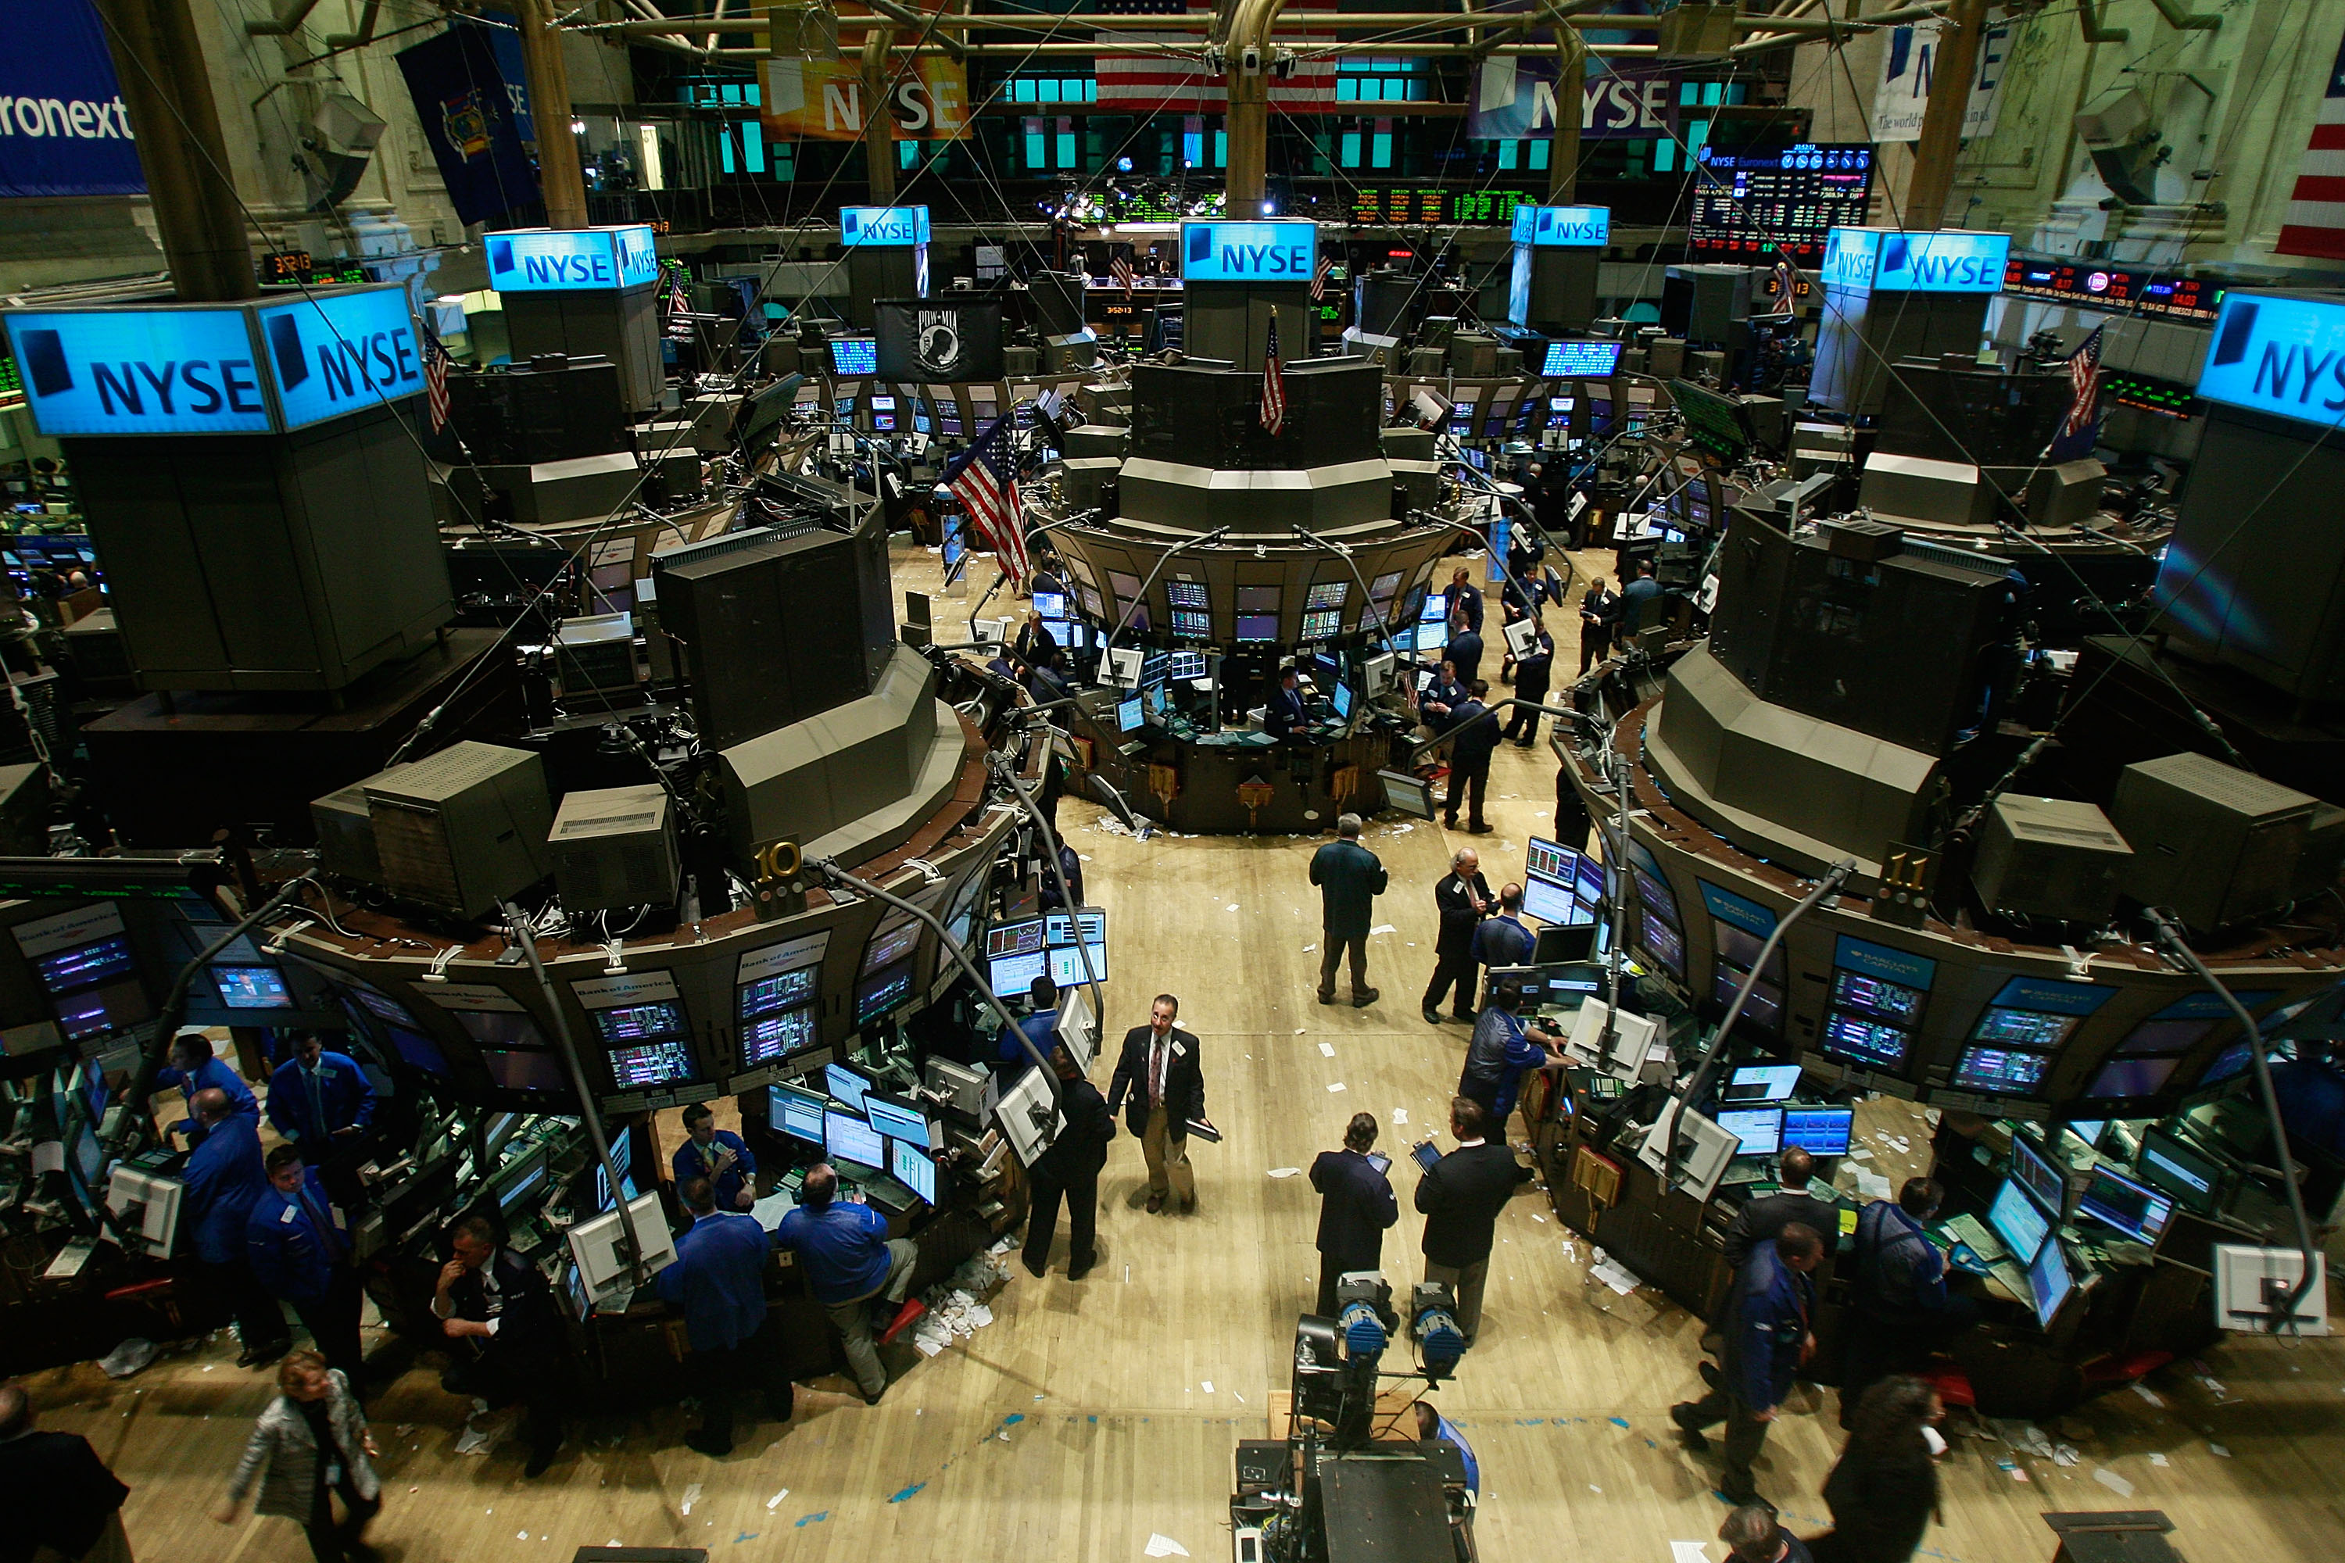
Who pays?

Slide 28
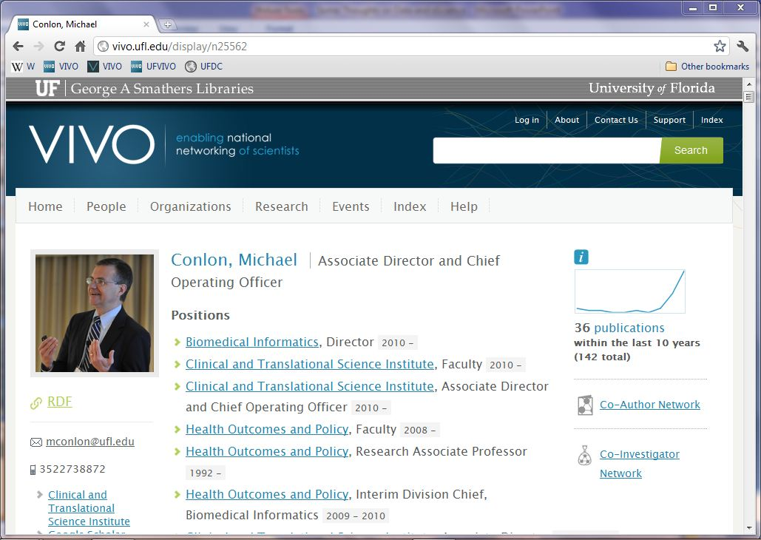
http://vivo.ufl.edu/individual/mconlon

