Slide 1
Health Informatics for Clinical and Translational Science: The University of Florida Experience
Mike Conlon, PhD
Director, Biomedical Informatics
Chief Operating Officer, UF CTSI
University of Florida

Slide 2
The University of Florida
50,116 students
Gainesville, FL
2200 ac campus
“The Gators,” Gatorade
16 colleges
Land grant, sea grant, space grant, academic health center
ARWU #68
$750M in research construction
2010 Research funding $678M

Slide 3
UF Research Funding

Slide 4
The UF&Shands Academic Health Center

Slide 5
The UF CTSI
In July of 2009, UF received a $26 million, five year, NIH Clinical and Translational Science Award supporting the UF Clinical and Translational Science Institute (UF CTSI)
The UF Office of Research has provided an additional $23 million in support
The UF College of Medicine has made $70 million in additional commitments
All 16 UF colleges → effort for students, staff, faculty, space, equipment
The result: an institute designed to transform the university’s ability to conduct clinical and translational science – increasing research capacity, speeding results to application, improving care and human health

Slide 6
National Consortium of 60 Academic Health Centers

Slide 7
A Catalyst for Collaboration
UF
CTSI
CTSA consortium
16 UF Colleges
Health Care Systems
Community Partners
University Partners
Corporate Partners

Slide 8
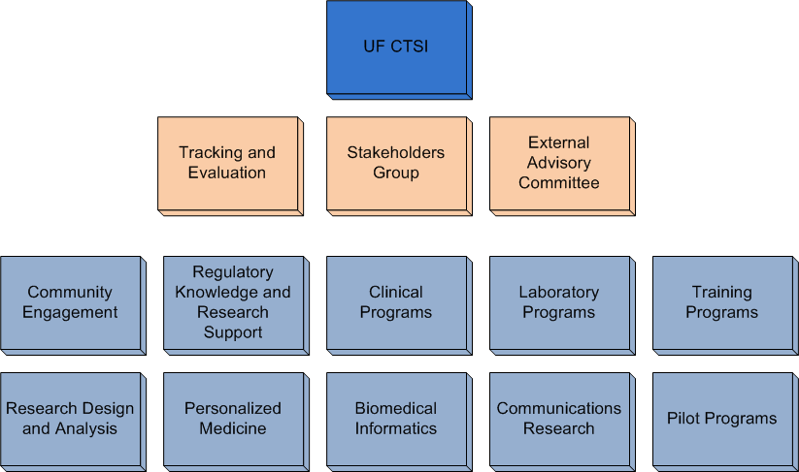
UF CTSI Organization

Slide 9
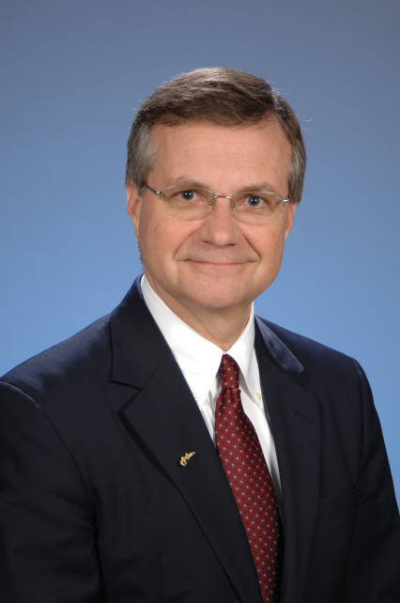
Biomedical Informatics
Overarching Goal
Develop and integrate clinical and research data systems to support collaborative CTS and lay groundwork for new academic program in BMI
Specific Aims
Build/delivery core informatics capabilities – portal, study registry, investigator registry, data registry, sample registry
Build/delivery integrated data repository for research and clinical care
Create academic program
Michael Conlon, PhD

Slide 10
Informatics Projects
CTSI Portal – rebuilt. 182 pages, 284 news stories. Daily posts. REDCap, Education and Research Services are top pages
REDCap infrastructure, service. 467 users. 74 databases. 16,884 forms entered
Study Registry. All human subject research at UF. 2008-11. 2735 studies coded with a goal of 8234.
Integrated Data Repository. Comprehensive, enterprise systems and processes for quality reporting and research. I2b2, honest broker
CTSI Biorepository. OnCore BMS. Integrate automated freezer controls
Biositemaps. UF #1 in described research resources
Click Commerce for IRB
CTSI tracking systems – help desk, vouchers, billing, analytic dashboard
Budgeting tool for clinical services
VIVO. International project in research discovery
CTSA-IP database with U Rochester
Replace CRC legacy applications
Health Record Bank for Alachua County
Portal process map for clinical research
Health Impacts for Florida – PBRN portal, ShareCenter, REDCap, custom databases
Consent for Research Contact and Use of Tissue. With UF & Shands, IRB.
Improving protocol submission process
Personalized Medicine – genetics repository, IDR, alerts in Epic

Slide 11
UF CTSI Portal

Slide 12
CTSI Portal
4 month project to rebuild an existing portal
2 months of information architecture. Collaboration with UF&Shands, campus IT. 8 person team
1 month of implementation, editing. WordPress, Shibboleth. 174 pages, 269 news stories, 52 writers and editors. 6 member core group
One month of testing, finishing.
Launched January 2011.
Content maintained by Asst Dir for Communications, CTSI w/ student assistant
Infrastructure maintained by UF&Shands IT

Slide 13
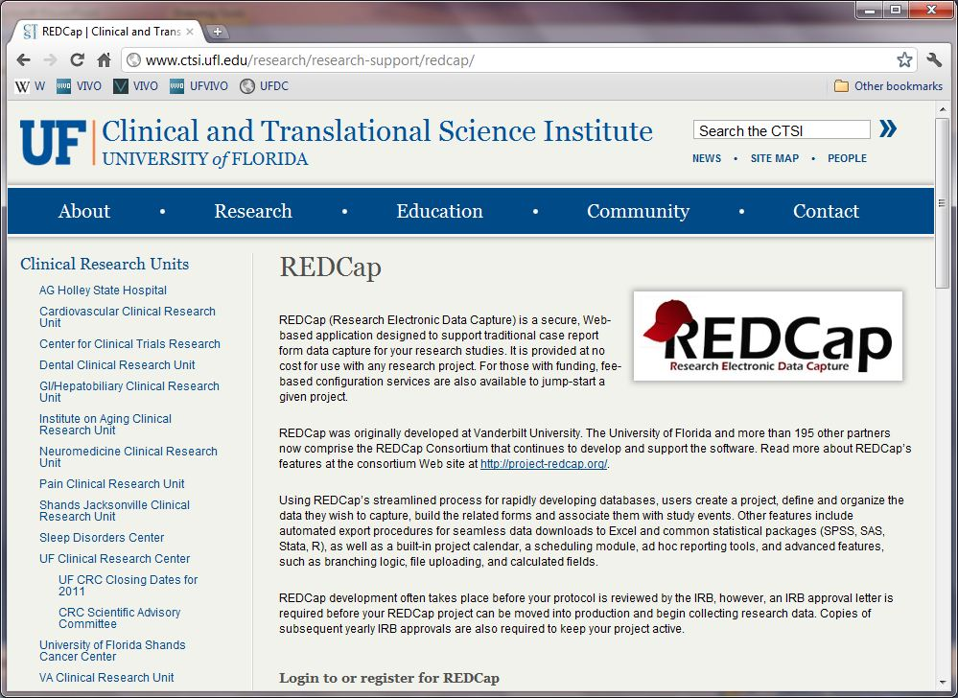
REDCap
Notes:
Free to investigators
Fee for service set-up, data mgt available
Shibboleth authentication
423 users, 74 databases, 17,406 records
Continues to grow

Slide 14
REDCap Implementation and Support
REDCap researcher support team – Doug Theriaque (CRC informatics), two assistants
Shibboleth authentication. UF developed methods provided to the REDCap consortium
Infrastructure maintained by UF&Shands IT
Software maintained by REDCap support team

Slide 15
Health IMPACTS for Florida
Goal: Create new opportunities for practicing physicians, clinical scientists, students, and the citizens of Florida to collaborate in advancing research and education into the causes, prevention, diagnosis, treatment and cure of human disease.

Slide 16
Health IMPACTS portal

Slide 17
Developing Health IMPACTS
Grant from the State of Florida, CTSA Supplement grant from the NIH
Major development effort to integrate WordPress, REDCap, ShareCenter, custom databases, other software, Sakai.
iPad, clinic-based data collection
Infrastructure support by UF&Shands IT under contract from UF CTSI

Slide 18
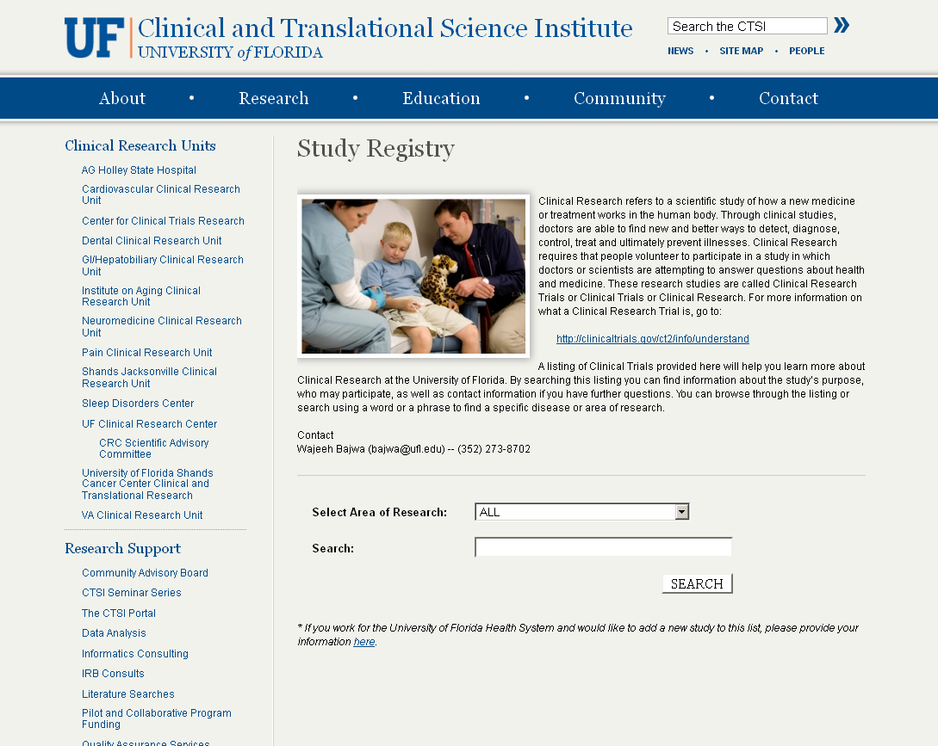
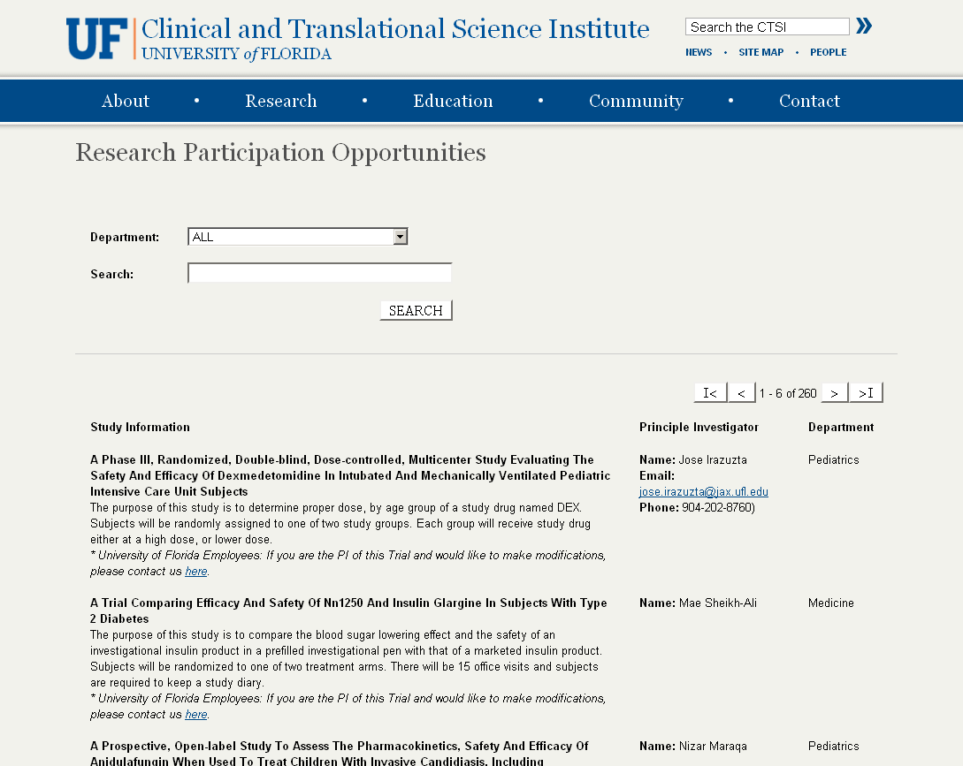
Study Registry
Create a comprehensive database of all human subject research at UF. 2008-current
Hand collect/classify data from our 4 IRBs
Develop data maintenance processes for four IRBs to provide data going forward
Create an on-line participant opportunities site to support enrollment
2,246 studies coded
On-going work to collect additional 6,333 studies
Review 195 studies with investigators. Launch in December

Slide 19
Human Subject Studies at UF
IRBs | Health Ctr | Campus | Jacksonville | Western | Total
2011 (est) | 695 | 1217 | 182 | 144 | 2238
2010 | 683 | 1170 | 171 | 141 | 2165
2009 | 687 | 1205 | 161 | 124 | 2177
2008 | 647 | 1059 | 153 | 150 | 2009
Total | 2712 | 4651 | 667 | 559 | 8589
Working with each IRB, the UF CTSI team hand codes each study for 34 attributes including T1-T4 research, keywords, lay description, PI and department information.

Slide 20
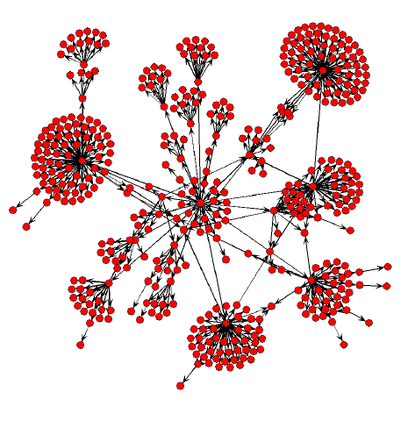
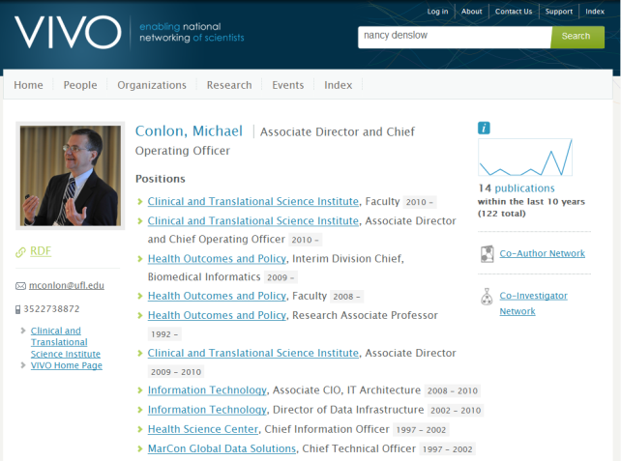
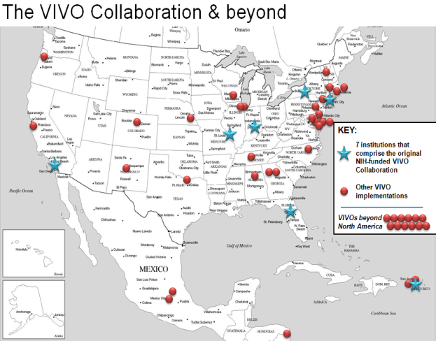
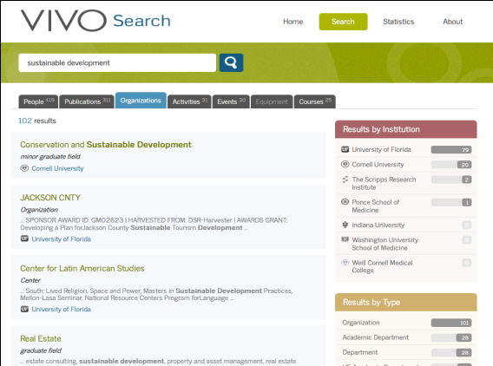
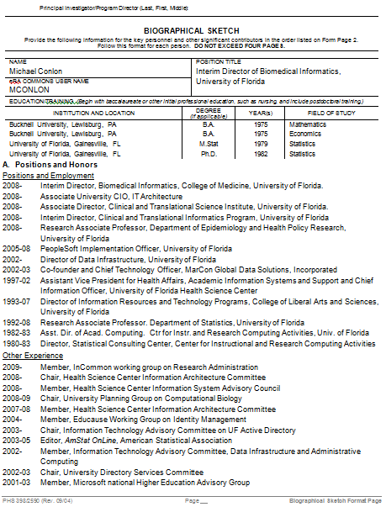
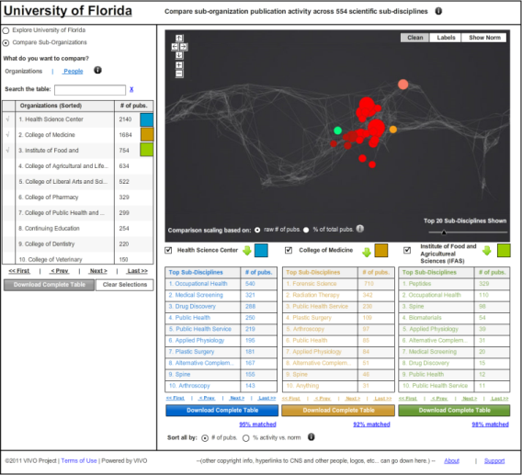
VIVO: Enabling National Networking of Scientists
NIH-funded effort to create an open semantic network of information and tools regarding scientists, their interests, activities and accomplishments
Seven school development consortium led by UF
Fifty additional implementations underway. Dozens of partners
Find people, grants, papers, data, concepts, resources, events, data, studies, projects within and across institutions
http://vivoweb.org

Slide 21
VIVO: Enabling National Networking of Scientists
3 software releases. Version 1.4 coming in December.
Adoption by USDA (120,000 + land grants), APA (154,000), 50 US schools, 20 international (8 Australia)
Six mini-grants – Pitt, Duke, Leicester, Weill, Indiana, Stony Brook
14 schools at Implementation Fest, June 23-24. 30 others in various stages of implementation. 50 total.
Second annual conference, Wash DC, August 24-26. 260 attendees
15,000 downloads of software. 1600 members on contact list
Sustainability – additional grants, 501C3, open source community
Collaboration with Eagle-I, HSDB, ORCID, SciENCV, Linked Data
Partnerships with federal agencies, publishers, schools, associations, companies, EU efforts

Slide 22
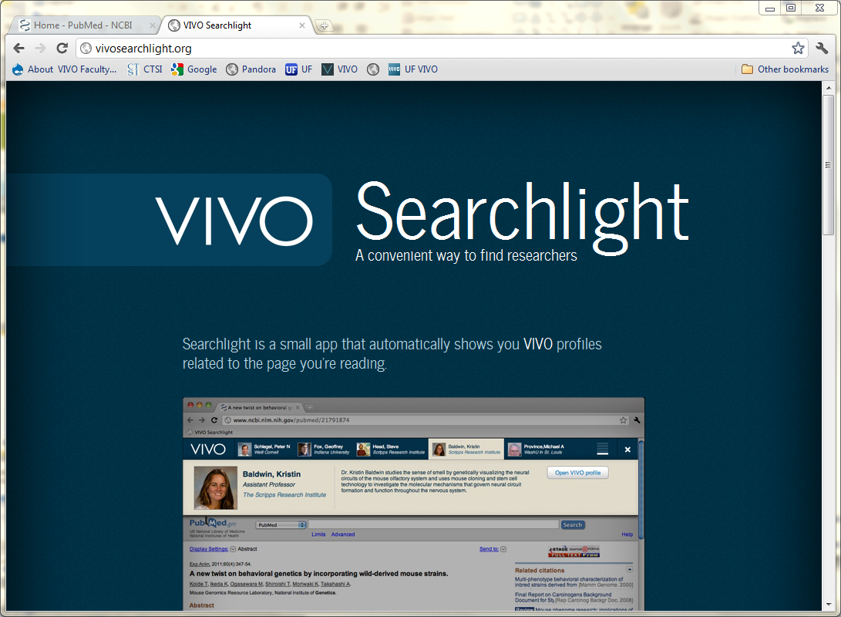

Slide 23
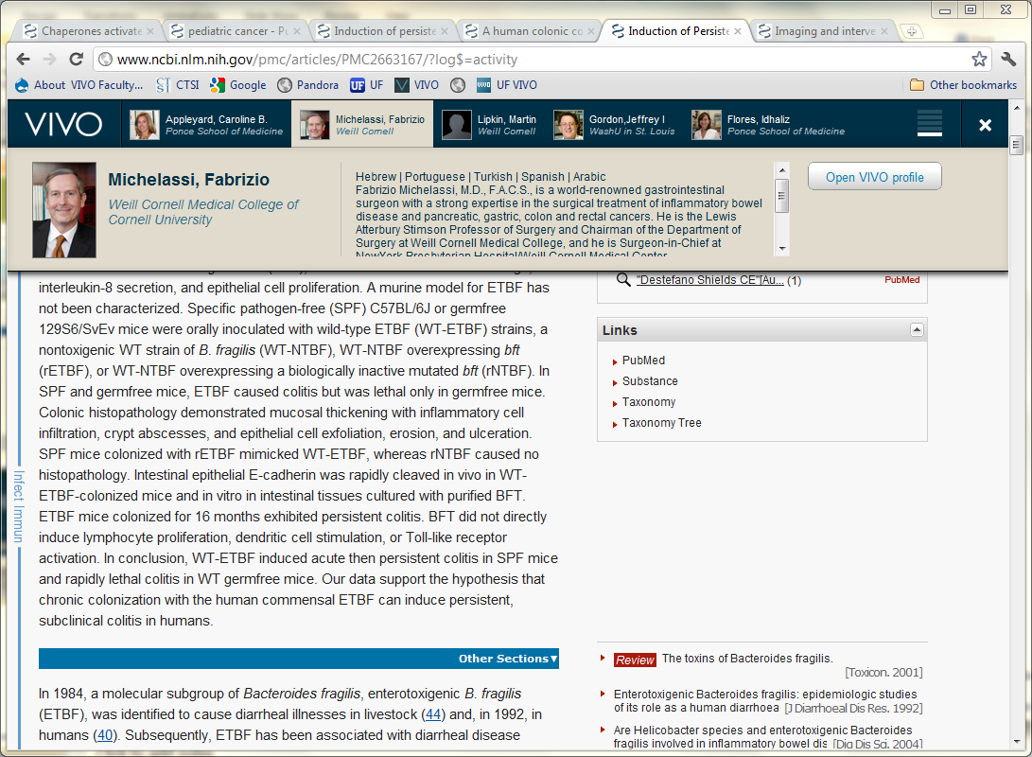

Slide 24
Integrated Data Repository
Collaborative, large scale effort to construct a comprehensive, secure data warehouse for quality reporting and research. Data from Epic and other clinical systems
Proof of Concept with Recombinant Data implementing i2b2 completed June 30, 2011. 50 million facts.
UF CTSI funded two pilot awards in cohort identification for clinical study planning
Seminars, department presentations
Participation of UF & Shands IT, IRB, Compliance, Privacy, CTSI, colleges, other centers
Related projects in consent, biorepository
Developing roadmap for on-going work

Slide 25
CTSI Funded IDR Pilot Projects
Database Communication enables Machine Learning Classifiers to predict Perioperative Acute Kidney Injury
Azra Bihorac, MD, Department of Anesthesiology
Mark Segal, MD, Division of Nephrology, Hypertension and Transplantation, Department of Medicine
Comorbidity indices and disability: Targeting recruitment impairment & Identification of iatrogenic mobility impairments
Susan Nayfield, MD, MSc, Institute on Aging
Todd Manini, PhD, Institute on Aging

Slide 26
Clinical Translation in Pharmacogenomics
Clopidogrel (Plavix): genetic polymorphism of CYP2C19 leads to reduced
ability to activate clopidigrel and increased risk of cardiovascular complication
“Front door” consenting; Bioethics; Communications Research
Cardiovascular CRU;
Comparative
Effectiveness
Research
Biorepository
Genotyping Core
Biomedical Informatics;
Hospital IT; Epic
Integrated Data Repository; Bioinformatics; Research IT

Slide 27
Personalized Medicine Program Data Trail – Clopidogrel Pilot

Slide 28
Informatics for Personalized Medicine
Project Steering Committee
Personalized Medicine Program Manager
Informatics Project Manager
Bioinformatics Lead
Path Lab Lead
Integrated Data Repository Lead
Clinical Systems Lead
24 hour turn around time from sample to alert
First patients: April 2012

Slide 29
Improving Protocol Submission
Single research price list
Simple confirmation of service
Applies to all clinical studies using Shands services
Click Commerce for IRB
On-line protocol submission
Simplified process
Budgeting tool
Simplified clinical trial budget creation based on current service rates

Slide 30
BMI Academic Program
Lecture Series
Third academic year for full series mixing invited speakers with UF faculty. Organized two seminars on IDR.
Faculty meetings
Monthly series. Fourteen faculty from across UF departments and colleges. Build community of informaticians. Identify opportunities of interest
Academic Program Planning with Dean’s Office

Slide 31
BMIP Year 4
BMI Academic Program. Faculty affiliations, hires. Training program.
Comprehensive enterprise architecture for research informatics
Personalized Medicine. Sample collection, bioinformatics, IDR, EHR
VIVO. Open source community. i2b2. Continue growth
Health IMPACTS. iPad/REDCap data collection. Network portal
Research Participant Registry. In IDR
Genetic Data repository. In IDR
Data registry. In IDR
Specimen registry from biorepository. In IDR
Consent data. In IDR
Conversion of legacy applications – eDSMB, eAERS, CRC scheduling
CTSI Service Delivery systems – ticketing, vouchers, billing, reporting

Slide 32
Clinical and Translational Research Building
CTSI headquarters
Ambulatory Clinical Research Center and targeted research programs
Biostatistics, BMI, Epidemiology, and Health Policy
Training Programs (pre and post doctoral)
80,000 ft² dedicated space
Incorporated with Institute of Aging (NIH funded; 40,000 ft²)
February 2013

Slide 33
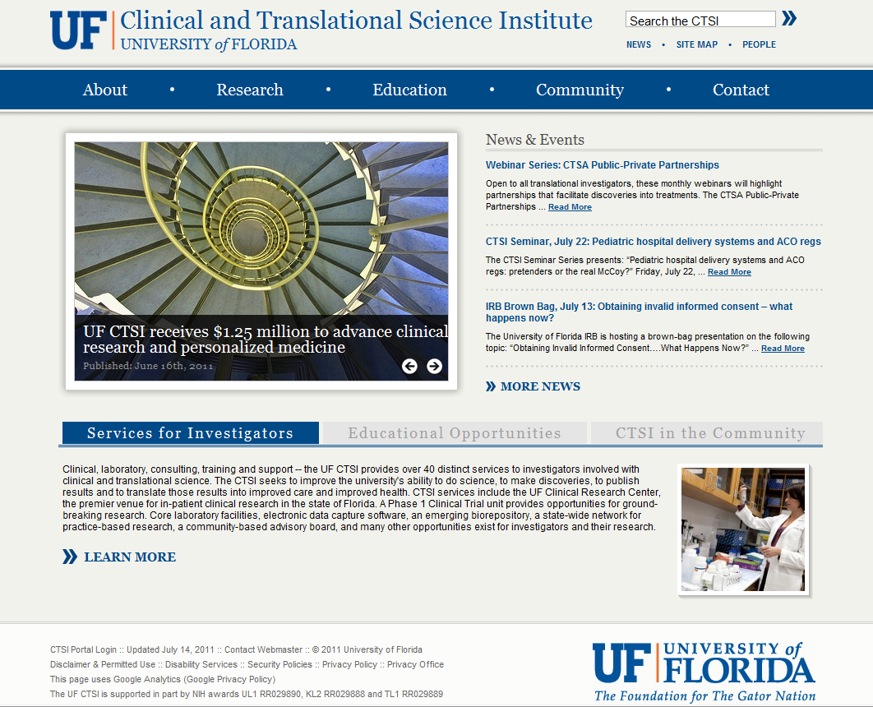
For More Information
On the web
www.ctsi.ufl.edu
Call
352-273-8700
Email
info@ctsi.ufl.edu

