Slide 1
The UF Open Access Publishing Fund - Recipient Feedback
Minoru Satoh, MD, PhD
Research Associate Professor
Division of Rheumatology and Clinical Immunology
Department of Medicine
College of Medicine

Slide 2
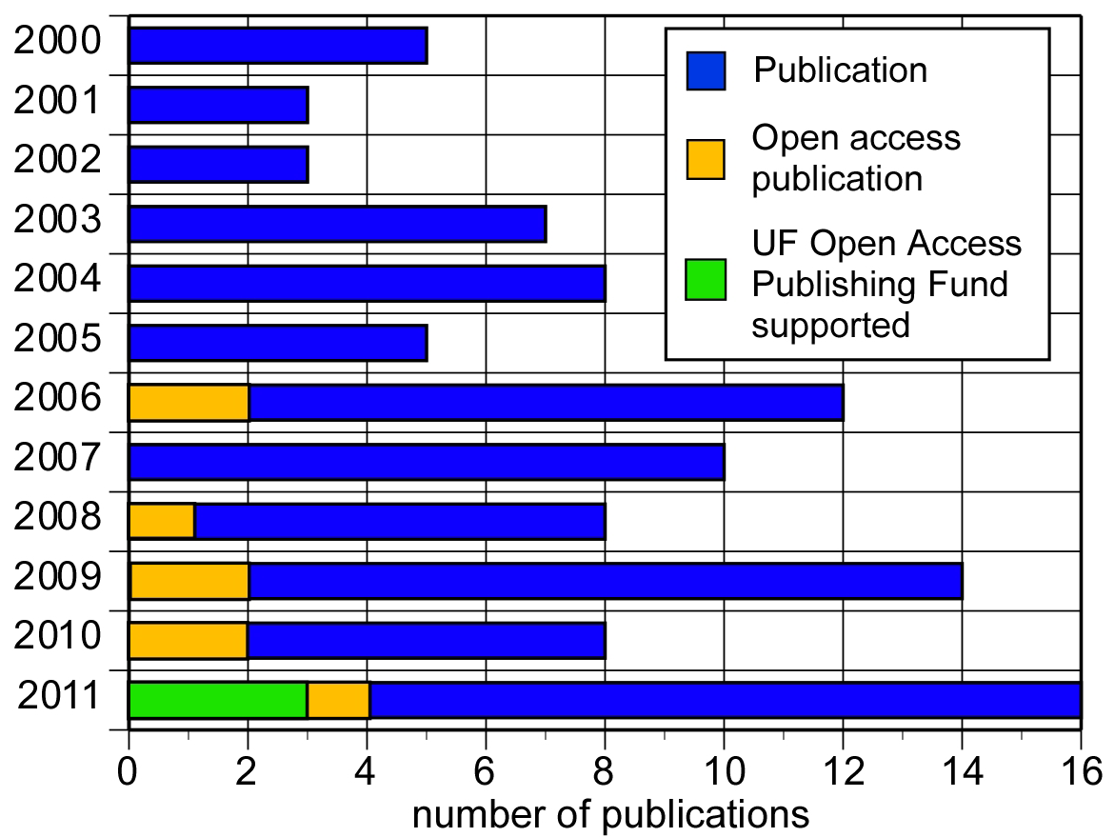
Number of publications and open access publications

Slide 3
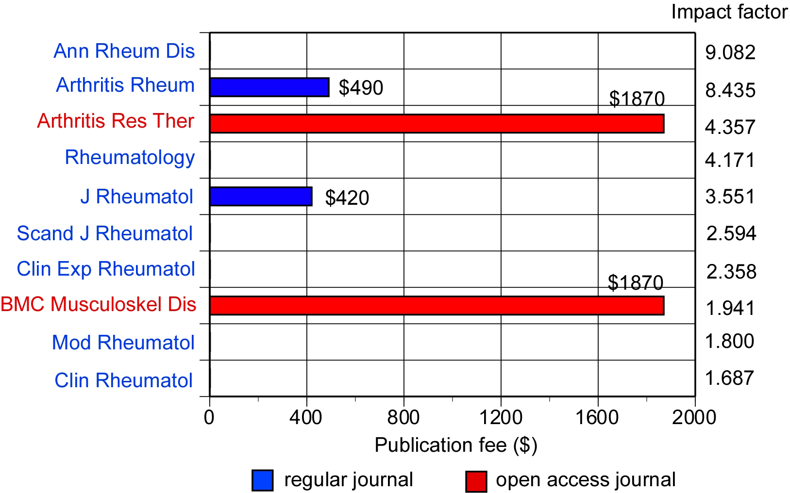
Rheumatology journal ranking by impact factor and publication cost

Slide 4
The UF Open Access Publishing Fund is great!
Allows us to publish our research in the best possible journal without worrying about high publication cost of the better journals
Allows us to publish research not supported by current grant funding. --- help future grant funding
Application is simple
Approval is quick
Paying publication fee is quick and simple

Slide 5
Suggestions for The UF Open Access Publishing Fund #1. UFOAPF should support 100% of publication cost as long as the corresponding author is a UF researcher
Collaborative studies and multi-center studies have been encouraged and many of our research papers include coauthors from other institutes
Corresponding author is responsible for paying all publication fee
e.g. If 4 of total of 15 authors of the paper are from UF, the support from fund will be only $400 out of $1870 for Arthritis Res Ther.

Slide 6
Suggestions for The UF Open Access Publishing Fund #2. UFOAPF should support only qualified open access journals
There are a few respected open publishers
However, there are several open publishers that have bad reputation.
--- They are in fact “Spammers”.
Many e-mails everyday saying “Invitation to submit a manuscript…”, “Call for papers…” regardless my research area
--- Publish poor quality papers or even anything they receive.
UFOAPF should not support these “For profit, poor quality, spammer open publishers”

