Slide 1
Open Access means easy access
David Reed, Florida Museum of Natural History

Slide 2
My Research

Slide 3
Open Access paper in 2007

Slide 4
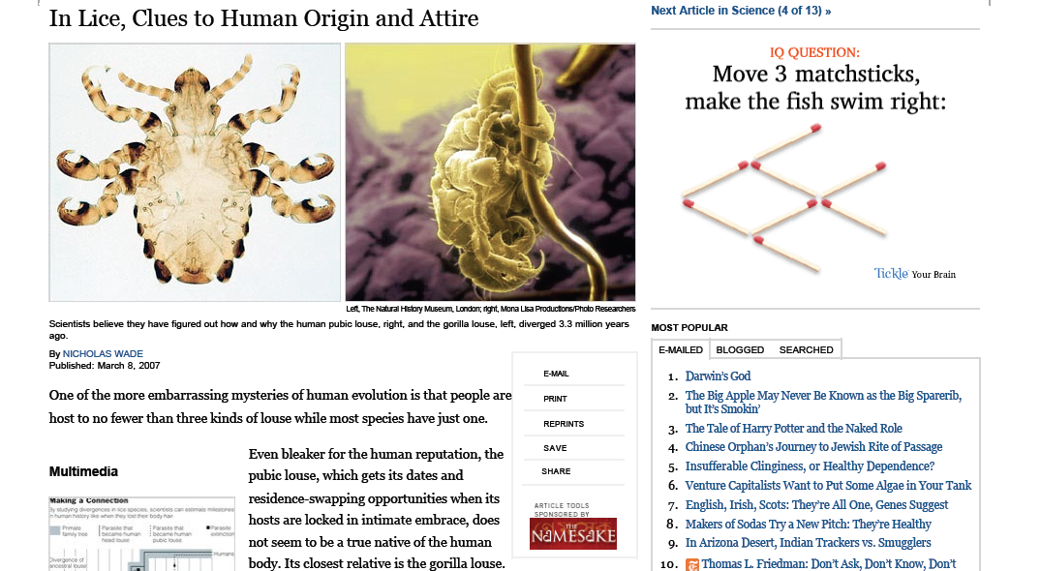
NY Times

Slide 5
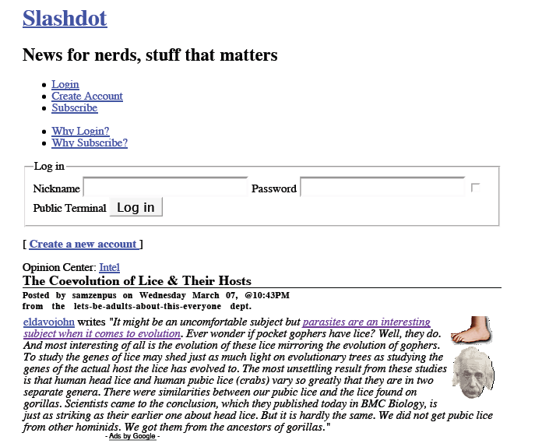
Slashdot

Slide 6
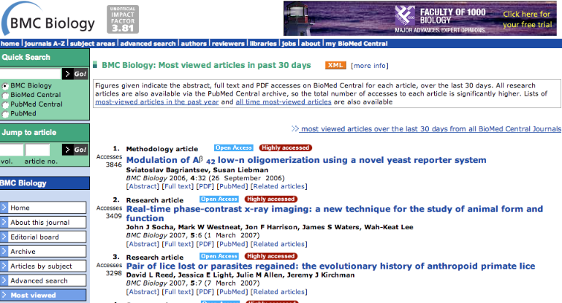
Downloads skyrocketed

