Slide 1
An Introduction to the University of Florida Clinical and Translational Science Institute
Mike Conlon, PhD
COO, UF CTSI

Slide 2
Translational Research
T1
T2
T3
T4
Potential Application
Safe & Effective
Clinical Practice
Population Practice
Potential Clinical Application
Health of Community or Population
Basic Science
Discovery
Evidence-Based Guidelines
Clinical Care or Intervention
Basic
Knowledge
Theoretical
Knowledge
Efficacy
Knowledge
Applied
Knowledge
Public Health
Knowledge
Types of Research:
Physiology
Engineering
Animal Models
Phase 1 Trials
Clinical Trials
Cohort Studies
Observational studies
Chart reviews
Comparative Effectiveness
Health Services
Clinical Outcomes
Adoption
Social determinants of health
Population / outcome
Health Policy
Policy impact

Slide 3
National Institutes of Health Clinical And Translational Science Awards
In 2006, NIH developed the Clinical and Translational Science Award program (CTSA) led by the National Center for Research Resources
CTSA works together as a national consortium of institutions sharing a common vision to improve human health by transforming the research and training environment to enhance the efficiency and quality of clinical and translational research – helping scientists bridge laboratory discoveries to patient treatments and health
Now fully implemented, 60 institutions transform the local, regional, and national environment to increase the efficiency and speed of clinical and translational research across the country

Slide 4
National Consortium of 60 Academic Health Centers

Slide 5
How did UF get here?
In July of 2009, UF received a $26 million, five year, NIH Clinical and Translational Science Award, establishing the UF CTSI
The UF Office of Research provided an additional $23 million in support
The UF College of Medicine has made $70 million in commitments
All 16 UF colleges → effort for staff, faculty, space, equipment
The result: an institute whose mission is to improve human health by accelerating the translation of scientific discoveries into the common practice of good health and health care.

Slide 6
A Catalyst for Collaboration
UF
CTSI
CTSA consortium
16 UF Colleges
Health Care Systems
Community Partners
University Partners
Corporate Partners

Slide 7
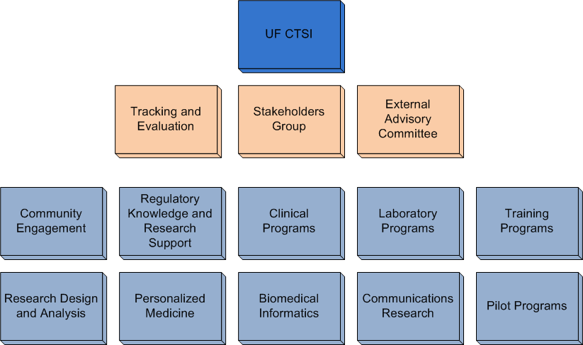
UF CTSI Organization

Slide 8
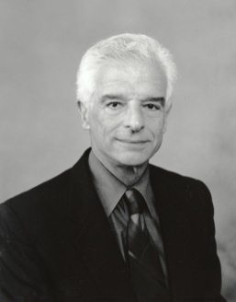
Participant and Clinical Interactions Program
Overarching goal
Create new opportunities for patient-oriented research
Clinical Research Units
Locations: Gainesville (UF and VA), Jacksonville, Orlando
Disease expertise: Aging, Cancer, Cardiovascular, Dental, GI/Hepatobiliary, Neuromedicine, Pain and Sensory Testing, Sleep Disorders, Tuberculosis and Emerging Pathogens
Facilities: Phase 1: Center for Clinical trials (24 bed unit); Phase 1-3: Clinical Research Center (Gainesville and Jax), inpatient / outpatient clinical trial needs
Scientific Review Process
Carl Pepine, MD

Slide 9
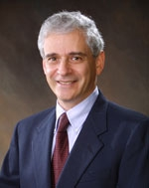
Research Design and Analysis
Overarching goal
Consult, collaborate and conduct research and educate on study design and biostatistical issues in CTS.
Activities
Study Design – clinical trials, observational studies, cohort, chart review, qualitative, epidemiologic
Power Analysis
Study Analysis
Data presentation and visualization
Jon Shuster, PhD

Slide 10
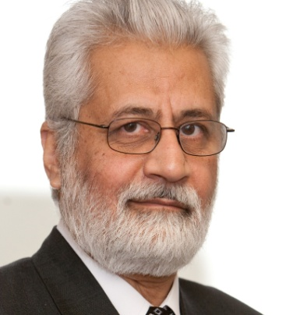
Regulatory Knowledge and Research Support
Overarching goal
To increase accessibility of information by providing expert investigator assistance via Research Project Navigators, and provide prompt access to research and training resources ensuring rapid activation of research
Services provided
Trial database (RedCap)
Forms design
Quality assurance
Clinical and research ethics
Regulatory affairs
IRB assistance
Contract negotiations
Billing and budgeting
Technology transfer
Wajeeh Bajwah, PhD

Slide 11
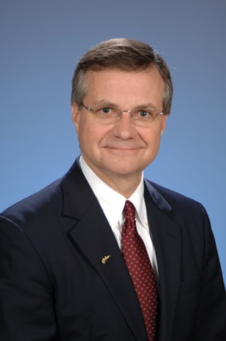
Biomedical Informatics
Overarching Goal
Develop and integrate clinical and research data systems to support collaborative CTS and lay groundwork for new academic program in BMI
Activities
Integrated Data Repository
Study Registry
CTSI Portal
Support Systems – help desk, billing, vouchers, tracking, reporting
Research Discovery and Collaboration (VIVO)
CTS infrastructure – REDCap, Research Match, Study and Network portals, specialized system R&D
Michael Conlon, PhD

Slide 12
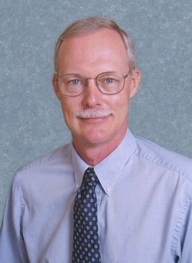
Translational Technologies and Resources
Overarching Goal
Develop and Provide basic science tools and services for research
Cores
Biorepository
Genotyping
Human Imaging
Targeted Metabolomics
Global Metabolomics
Peptide Radioidionation
Jesse Gregory, PhD

Slide 13
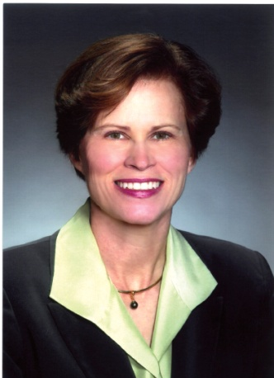
Training and Professional Development Program
Overarching Goal
Train a new generation of multi-disciplinary CTS researchers and leaders in academia, industry and government.
Programs
KL2 Multidisciplinary Program for Junior Faculty
TL1 Pre-doctoral training program
Advanced Postgraduate Program in Clinical Investigation
Research Coordinator Training
Masters in CTS
MD-PhD
Affiliated Programs
Junior Honors Medical Program
Center for Precollegiate Education and Training
Center of Excellence for Regenerative Health Biotechnology
HHMI Science for Life
Health Science Center Training
Interdisciplinary Program in Biomedical Sciences
Marian Limacher, MD

Slide 14
Integration of CTSI Training Programs

Slide 15
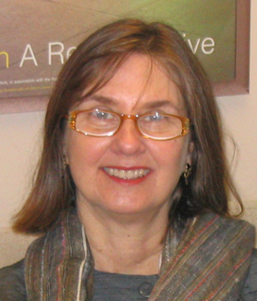
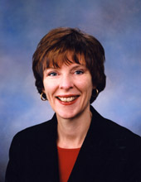
Community Engagement and Research
Linda Cottler, PhD
Elizabeth Shenkman, PhD
Mobeen Rathore, MD
Overarching Goal
To promote collaborative relationships with communities to address the health and well-being of community members
Activities
-Community Advisory Boards
-Community Research Associates
-HealthStreet
-UF-FSU Collaborative Research Program
-JaxHero PBRN

Slide 16
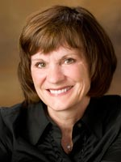
Communications Research
Overarching Goal
Advance our knowledge of communication processes related to clinical care and public health
Activities
Studies of risk communication in surgery and genetics
Studies of communications in health disparity settings
Deborah Treise, PhD

Slide 17
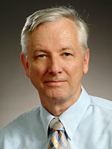
Pilot and Collaborative Projects
Overarching Goal
Support emerging research via institution-wide RFAs for CTS, targeting junior faculty; methods (IP) development; and multi-discipline, trans-college initiatives.
Activities
Three RFAs in 2011. Seventeen awards.
Chris Batich, PhD

Slide 18
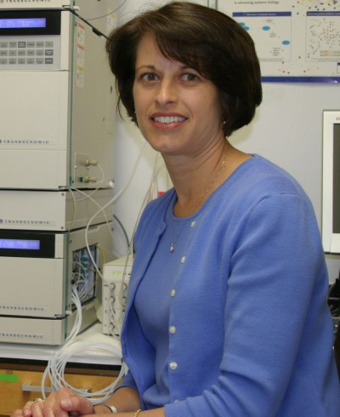
Personalized Medicine
Background
Human genome project completed in 2001
Collins, NIH: expectation that an individual’s personal genome will be part of their medical record, from which information can be pulled to determine disease risk or guide treatment decisions
Challenge
Despite the substantial number of important genetic discoveries made, there are limited examples of translation to practice
UF Opportunity
Build a genetic data repository
Link with clinical information for research and clinical care (IDR); Clinical implementation teams; Clinical laboratory genotyping, validation, and data interpretation; Biomedical informatics; IRB and genetic counseling
Julie Johnson, PhD

Slide 19
Improving Clinical Research Infrastructure: Ongoing Projects 2011
UF-FSU community research collaborative program
Comprehensive Study Registry with T1-T4 metrics
Integrated data repository
Clinical Translation in Pharmacogenomics
Clinical and Translational Research Building (CTRB)
VIVO: Enabling National Networking of Scientists
Improved efficiency for protocol submission
Click commerce for IRB implementation
Billing and budget tool
Gator Advantage for Research subjects
Cores: Biorepository, Metabolomics, Human imaging
Consent for recontact and use of tissue

Slide 20
UF-FSU Community Research Program
Goal: Create new opportunities for practicing physicians, clinical scientists, students, and the citizens of Florida to collaborate in advancing research and education into the causes, prevention, diagnosis, treatment and cure of human disease.

Slide 21
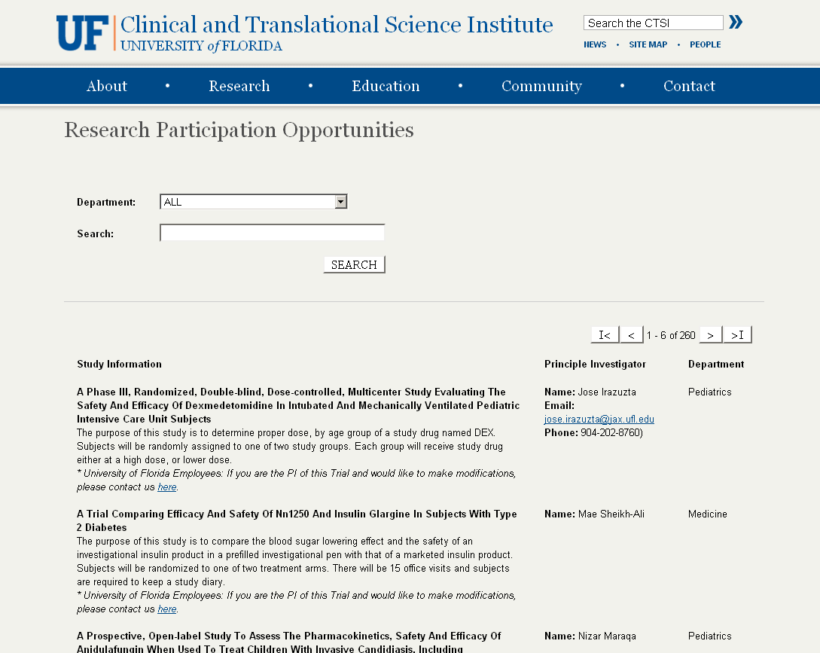
Comprehensive Study Registry
Over 5700 human subject studies approved by 4 UF IRBs from 2008 to date. Web site for potential research participants to find opportunities

Slide 22
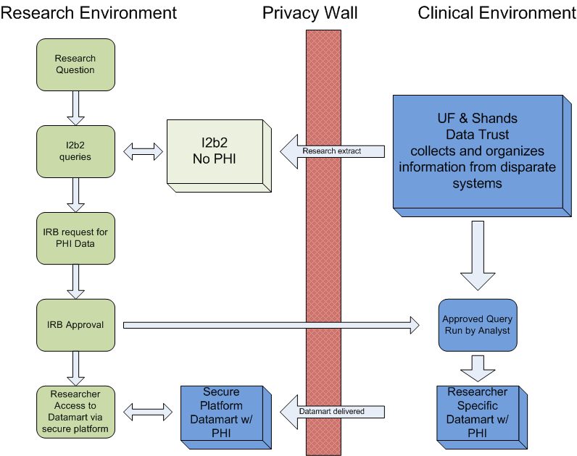
Integrated Data Repository
Current Researcher Dilemma – no data
The researcher needs to know if there are enough patients in the institution’s health system to propose a research project to sponsors for approval.
Researchers may need to refine a hypothesis, which is currently a challenge without access to any data.
The Results??
Researcher cannot submit for a grant without realistic estimates of subject recruitment, or
Research is approved and initiated, cannot be completed due to lack of appropriate subjects
Wastes time and resources
Places study subjects at potential risk with no research gain
The Solution – The Integrated Data Repository (IDR)
Helps the researcher by allowing ad hoc queries for cohort discoveries, in a secure environment that protects patient privacy.

Slide 23
Clinical Translation in Pharmacogenomics
Clopidogrel (Plavix): genetic polymorphism of CYP2C19 leads to reduced
ability to activate clopidigrel and increased risk of cardiovascular complication
“Front door” consenting; Bioethics; Communications Research
Cardiovascular CRU;
Comparative
Effectiveness
Research
Biorepository
Genotyping Core
Biomedical Informatics;
Hospital IT; Epic
Integrated Data Repository; Bioinformatics; Research IT

Slide 24
Clinical and Translational Research Building
CTSI headquarters
Ambulatory Clinical Research Center and targeted research programs
Biostatistics, BMI, Epidemiology, and Health Policy
Training Programs (pre and post doctoral)
80,000 ft² dedicated space
Incorporated with Institute of Aging (NIH funded; 40,000 ft²)
January 2013

Slide 25
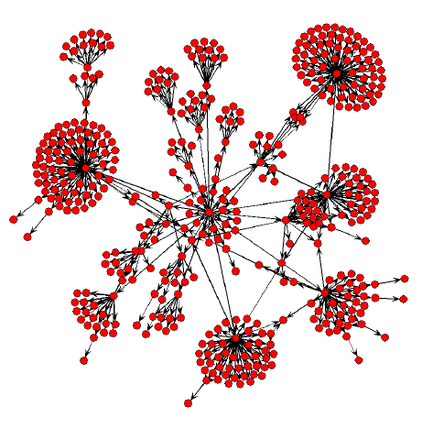
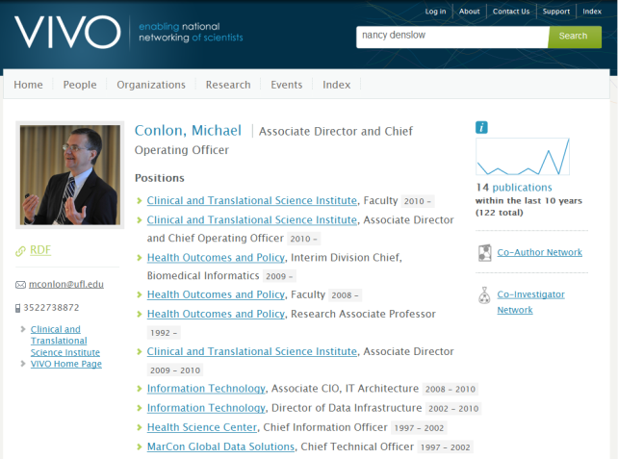
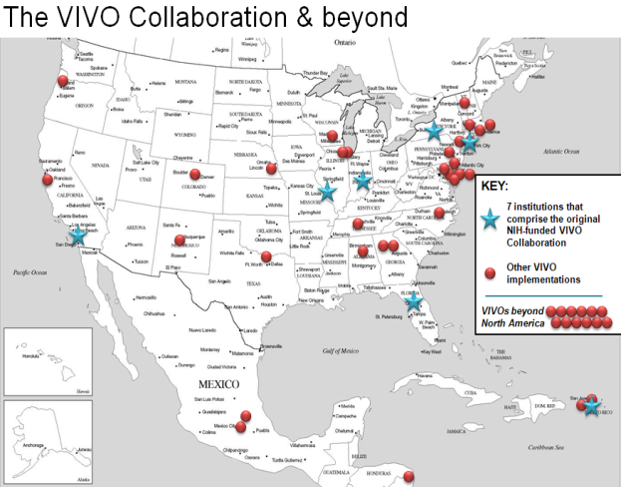
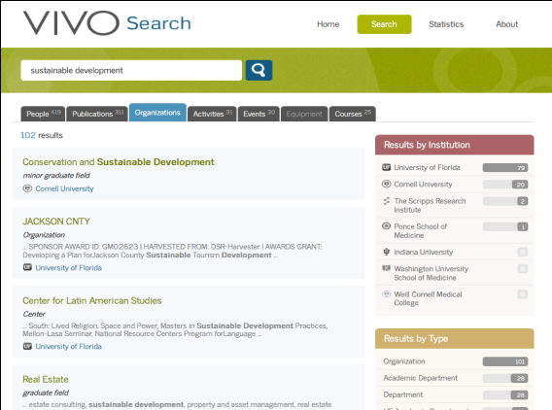
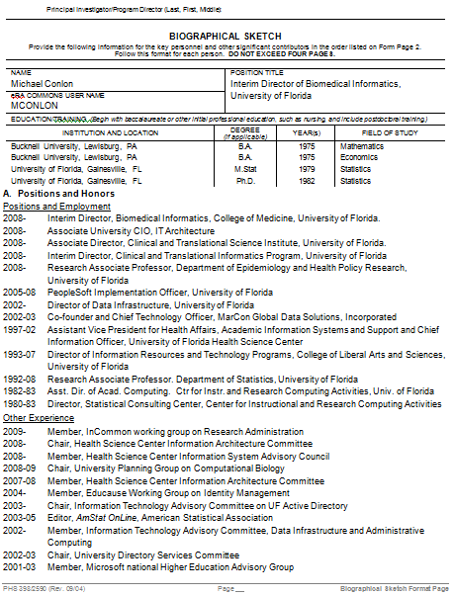
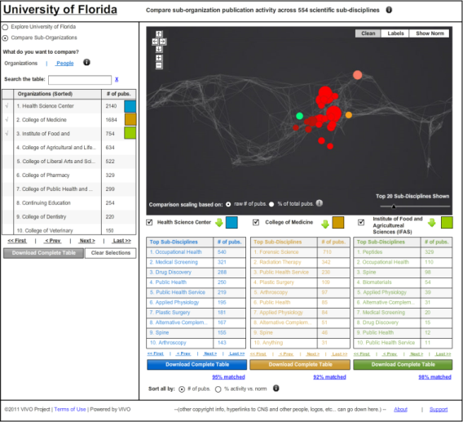
VIVO: Enabling National Networking of Scientists
NIH-funded effort to create an open semantic network of information and tools regarding scientists, their interests, activities and accomplishments
Seven school development consortium led by UF
Fifty additional implementations underway. Dozens of partners
Find people, grants, papers, data, concepts, resources, events, data, studies, projects within and across institutions
http://vivoweb.org

Slide 26
Improving Protocol Submission
Single research price list
Simple confirmation of service
Applies to all clinical studies using Shands services
Click Commerce for IRB
On-line protocol submission
Simplified process
Budgeting tool
Simplified clinical trial budget creation based on current service rates

Slide 27
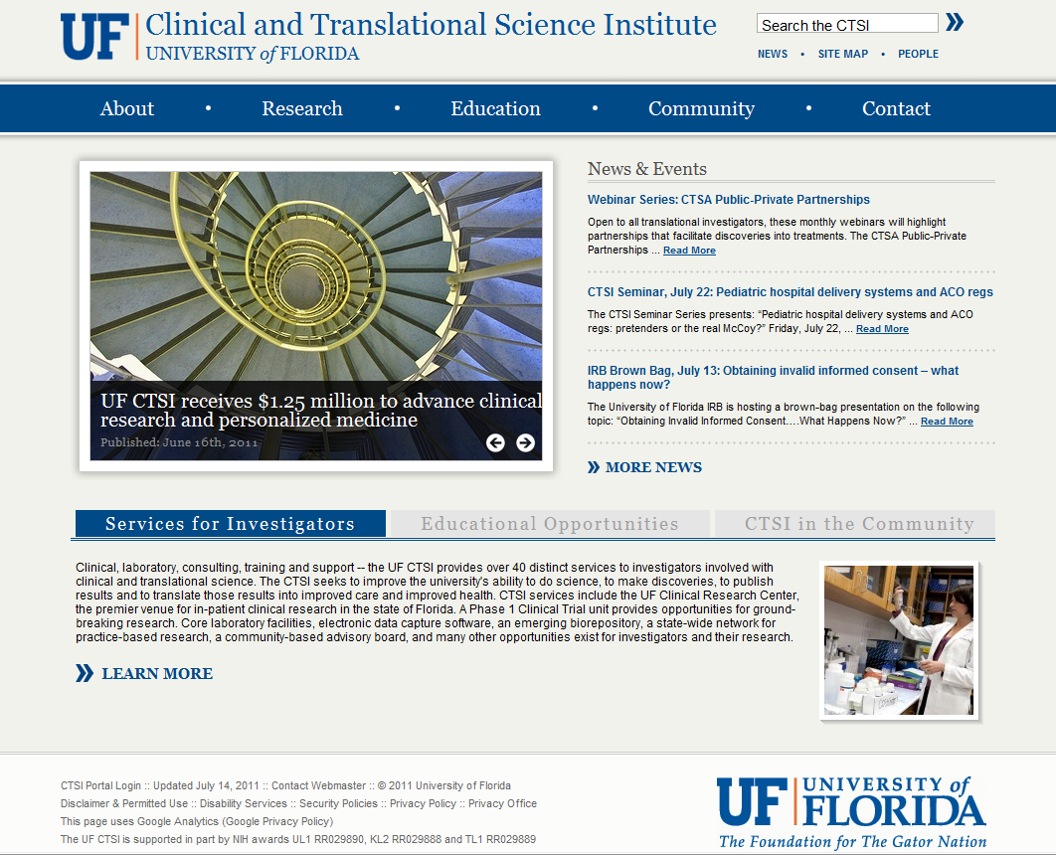
For More Information
On the web
www.ctsi.ufl.edu
Call
352-273-8700
Email
info@ctsi.ufl.edu

