Slide 1
SSLLI Project Presentation “A Casebook for Revitalizing Legacy Databases / Data Sets” Laurie Nancy Francesca Taylor University of Florida Laurien@ufl.edu

Slide 2
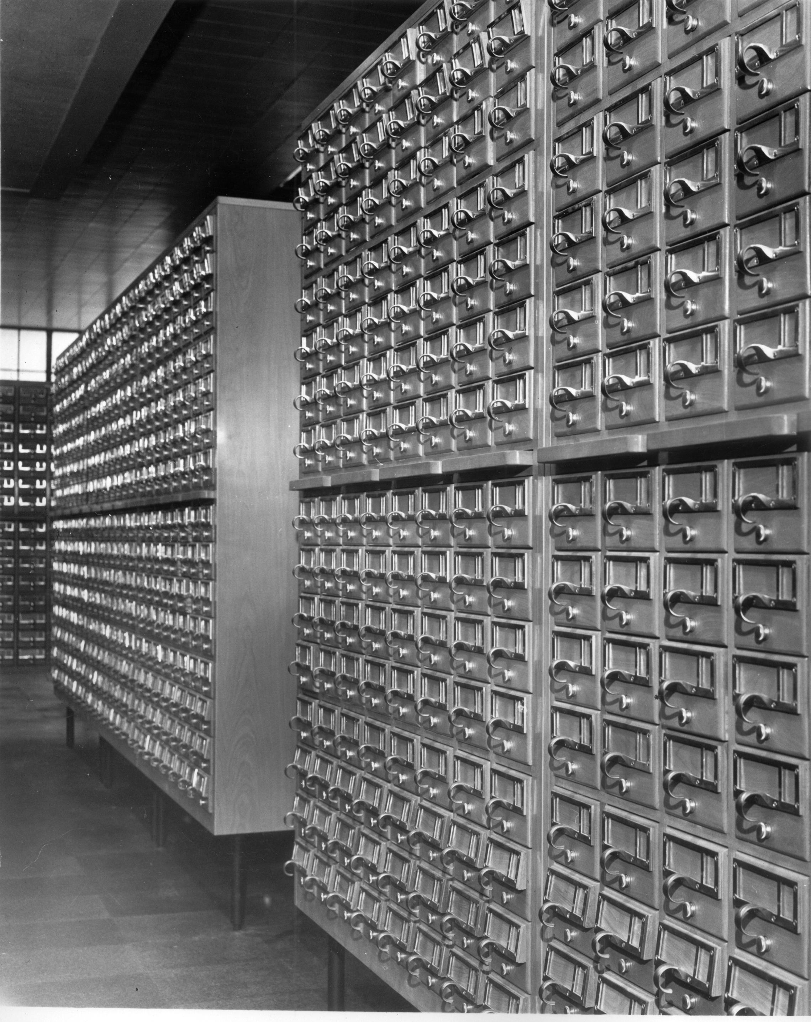
My Lessons Learned
There’s no such thing as too much preparation
Complex projects have moving timelines
Collaborative projects have moving timelines
Projects have moving timelines…
Think “lazy”
Be creative in minimizing work
Leverage existing resources
Use tools to do the work

Slide 3
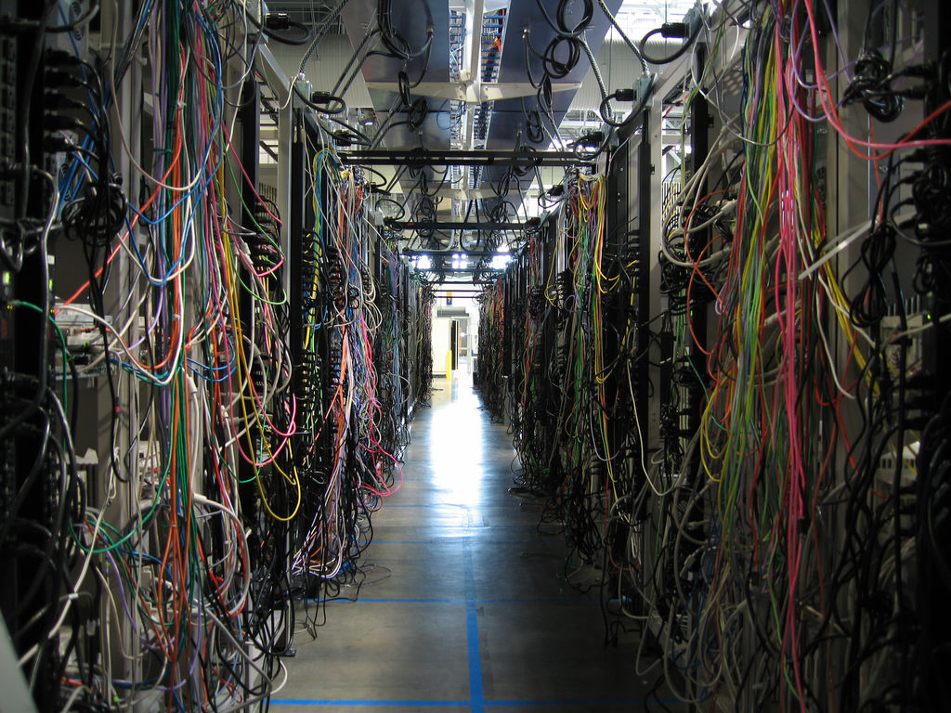
Databases, data sets, digital data
Picture of crazy, messy stuff to define what this is
Data is messy
by Andrew Mac

Slide 4
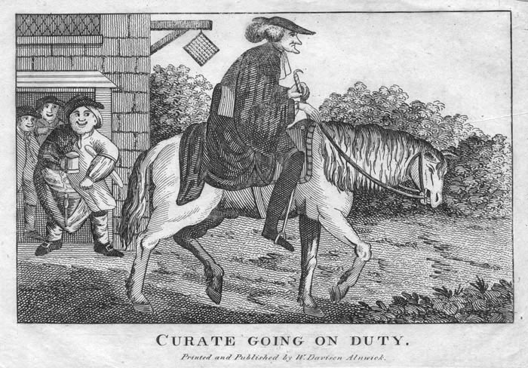
curator, n.
1. One appointed guardian of the affairs of someone legally unfit 2. One who has the cure (care) of souls; …
5. Officer in charge of a museum, gallery , library; keeper, custodian.

Slide 5
SSLLI Project Presentation “A Casebook for Revitalizing Legacy Databases / Data Sets” Laurie Nancy Francesca Taylor University of Florida Laurien@ufl.edu

