Slide 1
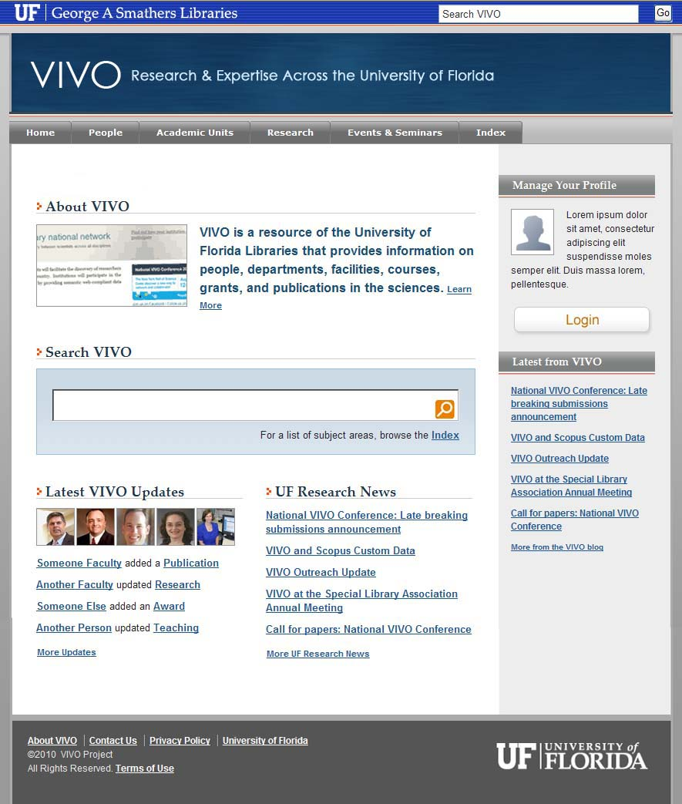
VIVO: Reaching out to faculty in support of a national network of researchers
Linda Butson
vivo.ufl.edu
Notes:
What if you could easily identify others with your same research interests within your university and beyond?

Slide 2
Co-Authors:
Michele R. Tennant, AHIP, Bioinformatics Librarian and Assistant Director, Biomedical and Health Information Services, Health Science Center Libraries and UF Genetics Institute
Valrie I. Davis, Outreach Librarian, Agricultural Sciences, Marston Science Library
Sara Russell Gonzalez, Physical Sciences Librarian, Marston Science Library
Amy G. Buhler, AHIP, Engineering Librarian, Marston Science Library
Mary Edwards, Distance and Liaison Librarian, Health Science Center Libraries
Nita Ferree, AHIP, Reference and Liaison Librarian, Health Science Center Libraries
Rae Jesano, AHIP, Reference and Liaison Librarian, Health Science Center Libraries
Hannah Norton, AHIP Reference and Liaison Librarian, Health Science Center Libraries
Nancy Schaefer, AHIP, Reference and Liaison Librarian, Health Science Center Libraries
Margeaux C. Johnson, Instruction Services Coordinator, Marston Science Library
Sara Henning, Marketing Coordinator, Health Science Center Libraries
Beth Auten, Reference and Liaison Librarian, Health Science Center Libraries
Mike Conlon, Principal Investigator and Interim Director, Biomedical Informatics
VIVO Collaboration, Gainesville, FL.
Notes:
VIVO is a large effort at the University of Florida to allow that to happen. “it takes a village”
This presentation is authored by members of the Outreach Team.

Slide 3
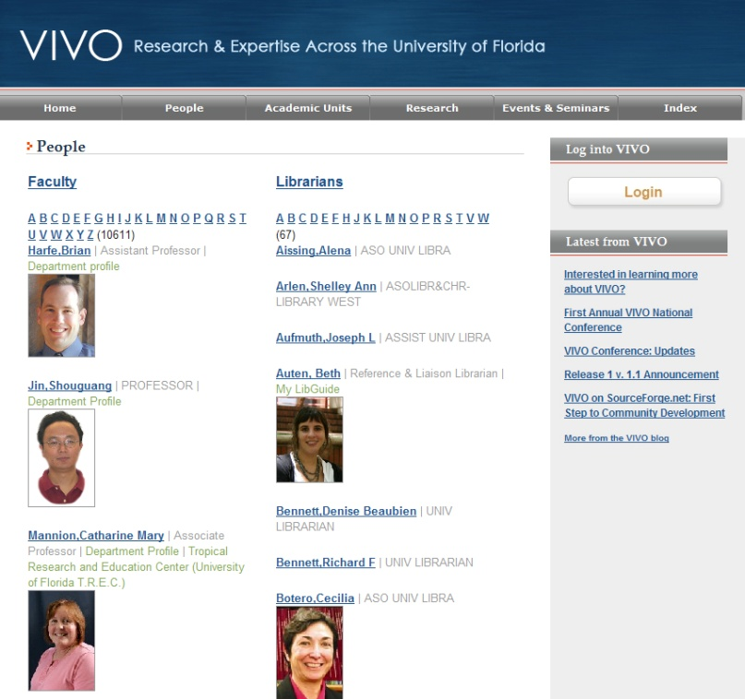
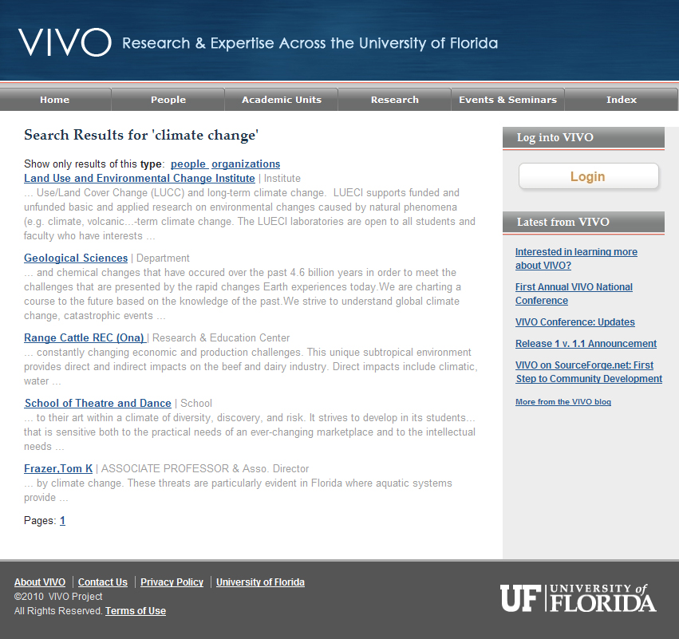
What is VIVO?
An open-source semantic web application that enables the discovery of research and scholarship across disciplines in an institution…
…populated with detailed profiles of faculty and researchers; displaying items such as publications, teaching, service, and professional affiliations;
a powerful search functionality for locating people and information within or across institutions.
Notes:
VIVO is a semantic web application with rich profiles that display publications, grants, service and professional affiliations. It enables Faceted search for fast and meaningful results.
---------
Goal of VIVO: Improve science by providing the means for sharing and using accurate, current information regarding a researcher’s interest, activities, and accomplishments.
Vivo will Foster team science by
enhancing collaboration of new and existing teams and
providing tools for identifying potential collaborators

Slide 4
History of VIVO
The application which supports VIVO was originally developed at Cornell University in 2003.
VIVO is being expanded through a $12.2 million grant from the National Center for Research Resources (NCRR) of the National Institutes of Health (NIH).
UF is leading the grant with six other participating institutions: Cornell University Weill Cornell Medical College Indiana University School of Medicine, Washington University in St. Louis The Scripps Research Institute Ponce School of Medicine in Puerto Rico
Notes:
The application which supports VIVO was developed at Cornell, UF had been using it prior to the NIH grant award in 2009
UF is leading the two year NIH grant with six other institutions.
Each institute plays a different part in the project.
For instance,
-Cornell does software development
-Indiana University- semantic Web technology
-UF: facilitates VIVO interfaces with other systems
-Washington U: project evaluation

Slide 5
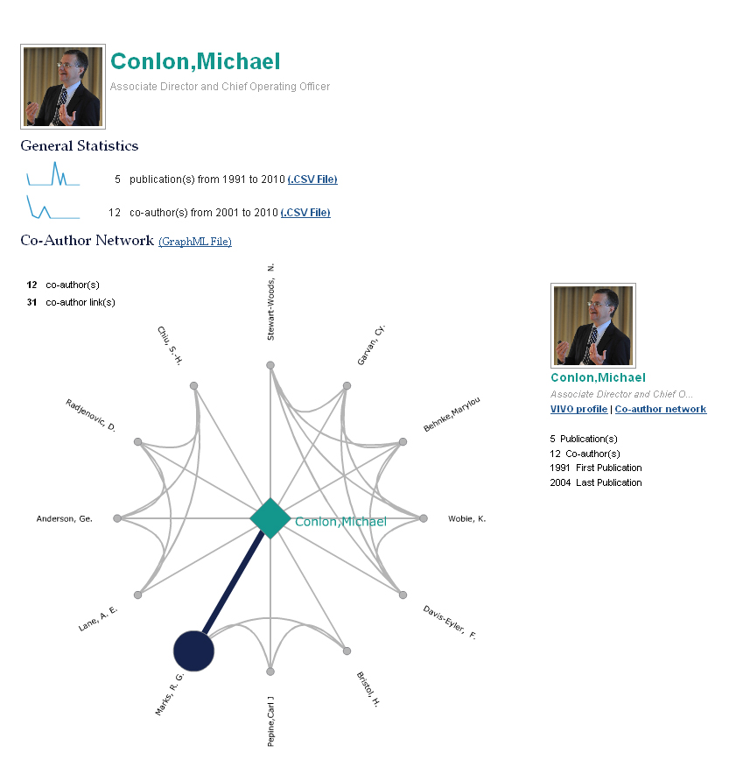
Collaboration of Science
Is/not “Facebook” for researchers?
(IS) Enables the discovery of researchers, papers, grants, projects all across the university
(IS NOT) Presents information about researchers from authoritative sources
Notes:
Is VIVO a Facebook for researchers? Yes and No
Yes. It is a profile system --- a way of portraying researchers to the world so that they can find each other.
No. The researchers can’t say whatever they want about themselves.
The VIVO “Harvester” helps in the construction of profiles by pulling in data from authoritative sources.
VIVO will pull in university affiliation and title and degrees so input is always verified and accurate.
Publication history and author relationships will also be available

Slide 6
Current Challenges
Researchers
Research is becoming highly interdisciplinary
How can researchers find collaborators, track competitors, and stay abreast of current research inside large institutions, at other institutions, and globally?
Research institutions can be extremely large
How can administrators showcase and monitor research activity, track competitors, and stay abreast of current research inside large institutions, at other institutions, and globally?
Administrators
Difficult for librarians to stay involved with the research process—Need to be aware of current trends and research for collection building and designing new services
Researchers increasingly use online resources—Rarely visit the physical library
Academic Libraries
Notes:
As research efforts become more interdisciplinary, it can be hard to find collaborators outside your own area of expertise
Administrators need to identify and track the research activity in their own institution
Libraries need identify institutional trends that may affect collections and services.

Slide 7
A VIVO profile will allow researchers to:
Map colleagues by research area, authorship, and collaborations.
Showcase credentials, expertise, skills, and professional achievements.
Connect within research areas and geographic expertise.
Simplify reporting tasks.
Publish the URL or link the profile to other applications.
Notes:
At UF, VIVO will cover all disciplines across the institution.
Profiles are richer in content than typical social networking sites. theyand will rank higher in general internet searches. Research interests, education, work experience, awards, publications are included.
Profiles are largely created via automated data feeds.
Profiles can be customized to suit the needs of the individual.

Slide 8
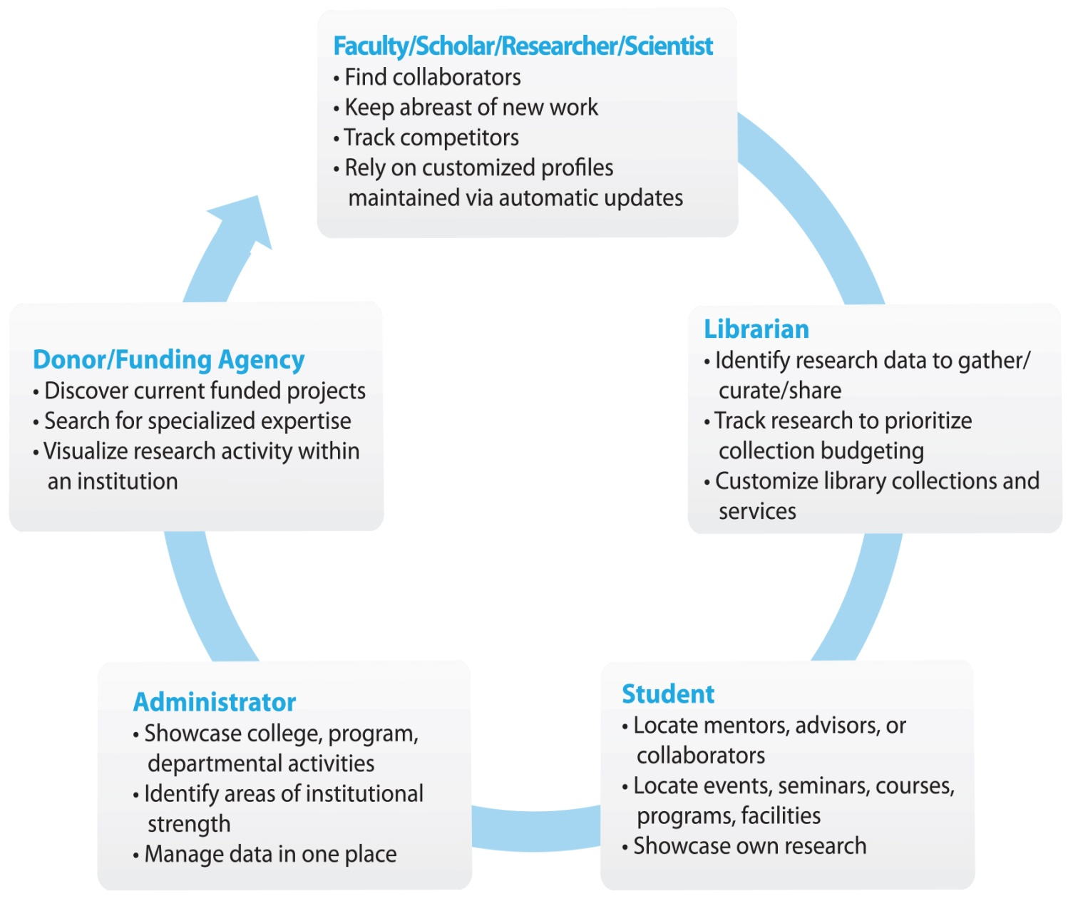
Who can use VIVO?
…and many more!
Notes:
VIVO is useful to many different users and audiences –.not only among researcher but among student faculty, donors, funding agencies and the public.
Only public information will be stored and displayed. Private or sensitive information is never imported into VIVO.
Data is housed and maintained at the local institutions, so it can be updated on a regular basis.
The “mechanics” of VIVO (the ontology and semantic capabilities) allow information to be located rapidly using keyword or a subject index.
The technology can accommodate changes based on the demands of users.

Slide 9
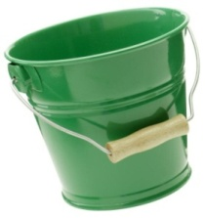
How does VIVO work?
Faculty and unit administrators can then add additional information to their profile.
Internal data sources:
UF directory
PeopleSoft and DSR
Office of Sponsored Research
Institutional Repositories
Registrar System
Faculty Activity Systems
Events and Seminars
External data sources:
Publication warehouses- e.g. PubMed, Web of Science, Elsevier (Scopus)
Grant databases: e.g. NSF/ NIH
National Organizations: AAAS, AMA, etc.
Data stored as RDF triples using standard ontology
VIVO data is available for reuse by web pages, applications, and other consumers both within and outside the institution.
Notes:
The main advantage of VIVO is that the components are harvested from reliable external and institutional sources [PeopleSoft for HR info, PubMed for citations].
Thus,
- Reducing the need for manual input.
- Centralizing information and
-Providing an integrated source of data at an institutional level.
Data enters into the VIVO system and is organized as RDF triples using a standardized ontology developed by the VIVO team
The data can be exported and reused to develop applications or shared with other systems or vendors.
Information is “open source” (free) and applications will continue to be developed after the grant.

Slide 10
Why involve Libraries/Librarians?
Libraries:
Neutral, trusted entities
Tradition of service/support for all missions of institution
Administration
Teaching/learning
Research
Fund-raising
Tech centers
Library Staff:
Know organization/institution
Establish/maintain close relationships with clients
Understand value of collaboration and can often bring people together
Understand user groups’ ethos, environment, needs
Have some level of data expertise – organization, manipulation, storage/retrieval, usability
Notes:
A unique aspect of the VIVO grant is reliance on libraries and librarians.
VIVO is a multi-disciplinary tool. The principal investigators felt VIVO would be best introduced by a neutral and trusted party with a tradition of serving ALL departments and ALL functions within an institution: the library, which is also technology center.
The skills of librarians made us required partners in the VIVO project.
Librarians hold institutional knowledge.
have established relationships with their users
Librarians know their patron’s subject specific needs
And are uniquely situated to introduce people from different departments to each other and we foster collaborations.

Slide 11
Library staff as facilitators: UF model
Content Development
Identification of desirable data
Training and Support
Presentations, videos and demo templates
Selection of content types and the controlled vocabulary/ontology
Help-desk support, web site FAQs
Communications
Conference, presentations to recruit potential collaborators
Feedback from presentations to help technical team refine the interface
Construction/maintenance of website (http://vivoweb.org)
User forums to create community of support
Marketing
Demonstrations/exhibits, conferences, workshops, website
Distribution of PR materials
Development of instruction manuals, tutorials
Negotiation for use/access of that data
Notes:
Librarians are the “connection” between VIVO and the users. So what do we DO?
Content
-Identify content types and sources
-Negotiate permissions.
-Develop the controlled vocabulary (ontology) to categorize the content;
-Facilitate data storage and retrieval
Training and support
-Create training manuals, provide demos and answer questions.
-Videos and tutorials are under development, as are help-desk services.
The goal is to create a community of support for trouble-shooting.
Communications
-We relay usability feedback to the technical team to refine VIVO.
Marketing
-Demonstrations, presentations, and distribution PR materials have been designed to: raise awareness of VIVO
attract new participants to implement VIVO at their institutions and
assist other institutions with local adoption

Slide 12
Local Outreach: what’s happening at UF
Outreach Team:
Liaison librarians from Health Science Center Libraries
Subject specialists from Marston Science Library
Year One:
Tested relationships between colleges, departments, and individuals and manually added overview information
Collected and entered CVs from showcase departments
Year Two
Began outreach to liaison departments and colleges in September – speaking at various venues
Training for self-editing
Campus-wide kick-off event
Notes:
Outreach is a large part of our librarians’ roles in VIVO.
The UF outreach team is composed of librarians from two of nine campus libraries: Health Science Center and Marston Science
In the first year, the basic VIVO platform was under development. The outreach team focused on:
-Testing the VIVO platform
-Manually entering data for 4 showcase departments
-Building our own VIVO knowledge base:
> Verifying data from PeopleSoft ( campus HR)
> Identifying bugs in VIVO
> Familiarizing ourselves with the problems that users will experience
Now, the second year of the grant,we have a relatively stable VIVO platform
-Beginning in September, Continuing through the fall, outreach team members are meeting with our assigned academic units to provide brief introductions to VIVO.
-When faculty are able to edit their own profiles (late fall), the team will provide training.
-A campus-wide kick-off event is planned.

Slide 13
3 Prongs of UF Outreach
Raising awareness
What is VIVO?
Why would I use VIVO?
Teaching basic use
Features currently available in UF VIVO
Navigating and searching
Supporting advanced use
Editing your own profile
Mapping a CV to fields in VIVO
Notes:
Outreach at UF has 3 goals across the UF campus.
1.) Broadly, to raise awareness about what VIVO is and how it can be used
by faculty, staff, and students.
2.) We will teach people how to use UF VIVO, demonstrating what it is and how to search for faculty, areas of expertise, and grants.
3.) Finally, we will provide in-depth training
-Entering data from a CV,
-Editing profiles

Slide 14
UF Outreach present and future
400 – 500 visits a day (on weekdays) to vivo.ufl.edu
17,780 profiles available in vivo.ufl.edu
Includes:16 Colleges and 176 Departments
34+ department visits on VIVO by UF team members
14 VIVO conference presentations
Phased Approach
Health,& Basic Sciences, Engineering Fall 2010
Engineering, Liberal Arts, Agriculture, Spring 2011 Fine Arts, Education
Law, Journalism, Construction, Business Summer 2011
Notes:
UF VIVO is catching on. The number of hits on UF’s VIVO website has increased.
While the CVs from 4 departments have been entered into VIVO, there 172 departments left and over 17 thousand profiles to complete.
We will be working over the next 3 semesters to implement VIVO campus wide.
Being an NIH grant, health and the sciences are the first targets.

Slide 15
How you can become involved?
Visit VIVOweb.org to request a demo, receive more information on the project, upcoming releases, and project downloads.
Save the Date! 2011 VIVO National Conference will be hosted at the Gaylord National Hotel in Washington DC August 24 – 26, 2011
Become a fan. Join us on Facebook at: http://www.facebook.com/VIVOCollaboration
Submit any questions or feedback to: http://vivoweb.org/contact
For more information: vivoweb.org/conference
Notes:
How you can be involved?
-We want more institutions to join the collaboration and adopt VIVO.
-Conference presentations give us the opportunity to get the word out.
- Mark your calendar for VIVO 2, our 2nd National Conference August 24-26, 2011!
in Washington DC.
- Visit VIVOweb.org for more information and Contact us with questions.

