Slide 1

Game On: A playful approach to ethics education in STEM
Presented by:
Ben DeVane, Michelle Leonard,
Amy Buhler, & Margeaux Johnson

Slide 2

GAP: Gaming Against Plagiarism
The game will be an online, self-directed, interactive game that will provide a role-adapting environment in which Science, Technology, Engineering, and Mathematics (STEM) graduate students will learn to recognize and avoid plagiarism.

Slide 3
…furthermore, the game will
Employ strategies intended to influence students’ ethical behavior;
Explore the impact of peer behavior, institutional norms, and differing cultural practices on plagiarism;
Heighten awareness on the falsification & fabrication of data;
Meet the requirements of the America COMPETES Act, Section 7009.

Slide 4
…and
Be collaboratively designed, tested, and evaluated through a multi-disciplinary iterative development process by recognized experts in graduate science education, gaming, academic integrity, and educational digital media production.
Have an open source approach that will allow each institution to integrate its own code of conduct, relevant policies, and branding while maintaining a common focus on what constitutes responsible conduct of research.

Slide 5
Why plagiarism?
In 2005, a broader survey of 63,700 undergraduate students and 9,250 graduate students revealed that
62% of undergraduates
59% of graduate students
had engaged in “cut and paste” plagiarism from either print or electronic sources at least once in the last three years. (McCabe 2005)
Notes:
Plagiarism is not just a UF problem or even an isolated problem, it’s a systemic problem in academia. It not only affects undergrads, but graduates, postdocs, and professors. According to Don McCabe, “plagiarism is the most critical and widespread misconduct issue facing beginning researchers. (2005)

Slide 6
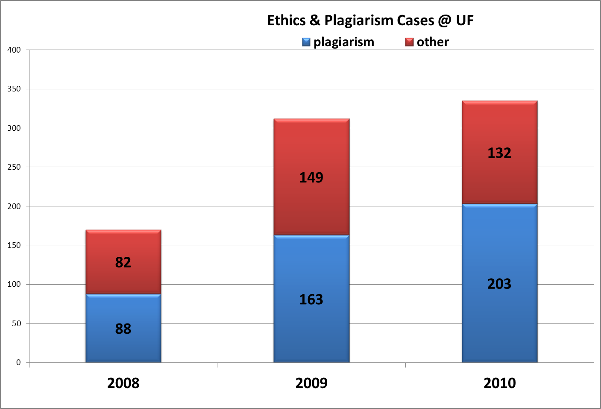
Case in point @ UF
Notes:
According to the DSO, in 2008 there were a total of 170 cases. In 2009, there were a total of 312 cases, and in 2010, there were 335 cases.

Slide 7
Is it really plagiarism?
“In some Asian cultures, students are taught to memorize and copy well-respected authors and leaders in their societies to show intelligence and good judgment in writing” (Thompson & Williams 1995).
“What is defined as plagiarism by American standards is not defined as such by many Asian or European standards, in which “…taking ideas and words from different books and writers to build an answer seems to be an accepted academic practice” (Pennycook 1996).
“In India, for example, undergraduates are not expected to cite sources and it is only at the graduate level where such activity is expected, but not necessary” (Handa and Power 2005).
Notes:
We argue that there are differences in cultural attitudes toward learning…what may be plagiarism in one culture is acceptable practice in another culture. How do we bridge this divide? “In my country, college students plagiarise usually because tutors do not supply them with enough materials and tools to handle their assignments alone.”

Slide 8
Why gaming?
Gaming is universal among college-aged students.
Recent research on teenagers (future college students) shows that not only is game playing universal, but that game playing facilitates social discussions and “can incorporate many aspects of civic and political life” (Lenhart et al., 2008).
Similar real life scenarios were used by Lloyd and van de Poel (2008) to create a collaborative design game with engineering students “to give students ‘practical’ experience of ethical decision-making in the process of design.
Notes:
This is the idea that ethics must in some way be ‘felt’.

Slide 9
….game on
Develop a culturally-sensitive tool reflective of the future ethical considerations faced by U.S. global researchers publishing in a multi-cultural research environment;
Incorporate game design strengths identified at the NSF co-sponsored National Summit on Educational Games: higher order skills, practical skills, practice for high performance situations, and developing expertise;
Assure scalability and robustness of design to permit future content enhancements to cover additional aspects of responsible research conduct, such as the falsification and fabrication of data.
Notes:
GAP project objectives are:

Slide 10
where to begin?
Graduate students in all STEM departments were sent a survey on the perceptions of plagiarism.
~4500 STEM graduates were sent the survey
~855 grads reviewed the survey
~650 grads answered each question
~146 responses to each open ended question

Slide 11
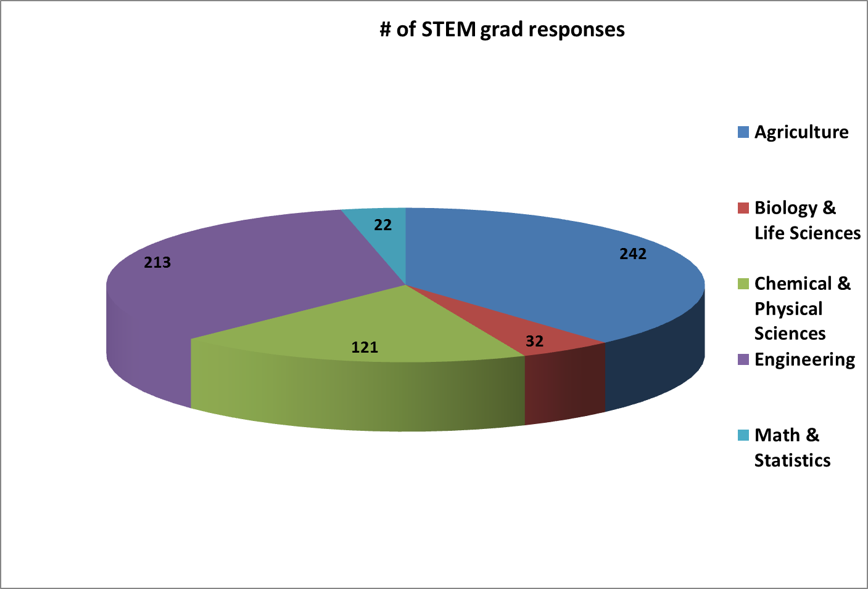
participants
Notes:
Some responses were “normative” but do they actually reflect what the student would do in a real-life situation?

Slide 12
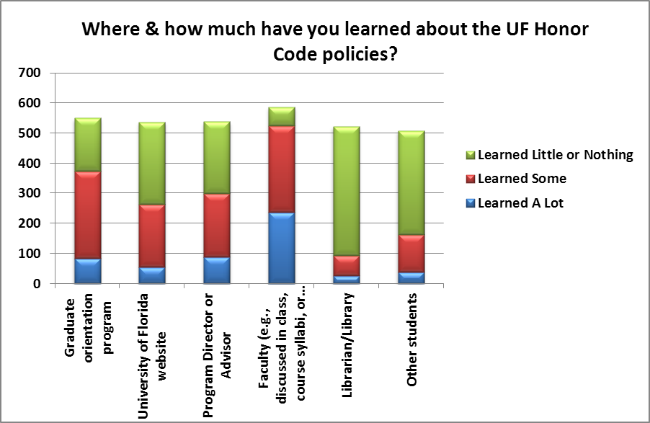
Survey: Perceptions in Plagiarism @ UF
Notes:
Interesting comments: I'm a distance student so this doesn't really apply to me, only what professors have said in syllabi. By grading exams as a TA. Most of the items came to my attention as I worked as a TA in a large class on campus. We had frequent cases of plagiarism. I had no idea there was an honor code.

Slide 13
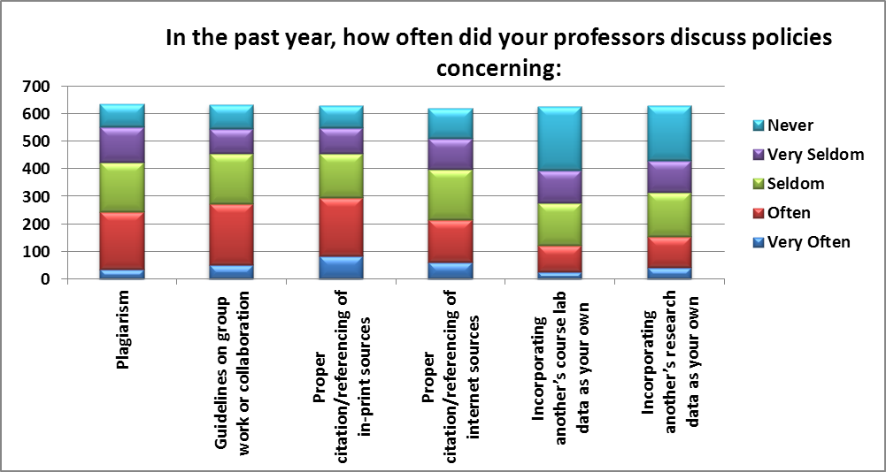
Survey: Perceptions in Plagiarism @ UF

Slide 14
Survey: Perceptions in Plagiarism @ UF

Slide 15
Survey: Perceptions in Plagiarism @ UF
How strongly do you agree or disagree with the following statements?
Answer Options | Disagree Strongly | Disagree | Not Sure | Agree | Agree Strongly | Response Count
Plagiarism is a serious problem at UF. | 8 | 43 | 349 | 156 | 81 | 637
Investigation of suspected incidents of plagiarism is fair and impartial at UF. | 12 | 23 | 407 | 146 | 44 | 632
Faculty members are vigilant in discovering and reporting suspected cases of academic dishonesty, specifically plagiarism. | 18 | 105 | 242 | 229 | 39 | 633
Faculty members change assignments on a regular basis. | 24 | 154 | 243 | 178 | 34 | 633
The amount of course work I'm expected to complete is reasonable for my year level and program. | 6 | 39 | 49 | 416 | 122 | 632
The degree of difficulty in my assignments is appropriate for my year level and program. | 6 | 19 | 53 | 422 | 131 | 631
The types of assessment used in my courses are effective at helping me learn course concepts. | 4 | 40 | 64 | 409 | 114 | 631
answered question |  |  |  |  |  | 637

Slide 16
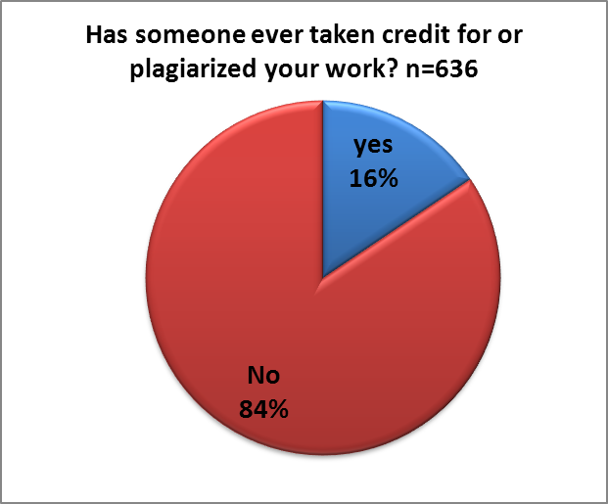
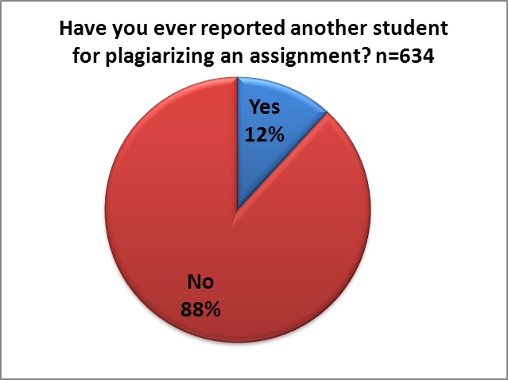
Survey: Perceptions in Plagiarism @ UF

Slide 17
Open ended comments: personal experiences
“In my country, college students plagiarise usually because tutors do not supply them with enough materials and tools to handle their assignments alone. No one want to steal someone else' property if he has a better choice, though I disagree strongly against it myself.”
“In my PhD program, I took a stats class. A foreign student asked me to help her with an assignment that was due the next day. She asked me to look at my finished assignment. I thought that she would just look it over to get a general idea of what needed to be done or compare the answers that she got in order to improve her own assignment (I've done this before). Afterwards, when I saw her assignment, I saw that she had pretty much copied my assignment. I didn't complain because I didn't want to create a conflict with a colleague, but I disagreed with what she had done and I kept my distance from this student afterwards.”
“Take home exams and projects often turn into group efforts in graduate school. It is appalling. Particularly at the graduate level when your work should truly be for your own development.”
Notes:
N=146 total comments….

Slide 18
Open ended comments: other comments
“It is not punished seriously enough at this level and students do not take it seriously. It seems as though instructors are burdened by it and can not protect themselves from it. Students do not seem to have problems using other students' work.”
“In research, students should have a choice to raise their concern against supervisors officially on which investigation can be carried out. This happens a lot in research wherein the Professor uses data from investigation carried out by student to write proposals without giving full credit to the student. This is a clear example of Plagiarism.”
“Most teachers discuss plagiarism, but I don't think that most of them check to make sure its not going on.”
“The process for prosecuting plagiarism at UF is quite cumbersome and weighted in favor of the student. In fact, many faculty would rather ignore or deal with plagiarism at the course-level rather than refer the plagiarism to UF's student conduct court.”
Notes:
N=135 total comments….

Slide 19
5 phases of GAP
Phase 1: Content
Phase 2: Design
Phase 3: Usability
Phase 4: Implementation
Phase 5: Evaluation

Slide 21

Phase 1: Content
Notes:
Just to give you a little background about the team The team is composed of 6 librarians from the Marston Science Library:
Michelle Leonard
Margeaux Johnson
Melody Royster
Donna Wrublewski
Denise Bennett
Myself
In addition, we have an outside content expert, Dr. Don McCabe from Rutgers University. Don is the founding president of the Center for Academic Integrity and has spent the last 15 plus years researching student integrity.

Slide 22
Content Sources
Published literature
Collective past experience
Baseline survey of graduate students regarding perceptions of plagiarism
Notes:
The content was informed three main sources:
Findings from the literature - you can see where Don’s background and writings played a key role
Collective past experience of the team – librarians invited to give lectures and what topics they were asked to cover, etc.
a survey regarding perceptions of plagiarism administered to all STEM graduate students on campus that Michelle just discussed

Slide 23
Phase 1: Content
6 Major Learning Objectives
  Identify major types of contemporary plagiarism
  List the basic rules to avoid plagiarism
  Demonstrate ability to apply the rules in increasingly complex scenarios.
  Explain copyright, fair use and author’s rights (i.e. intellectual property rights).
  Explain the potential consequences of plagiarism academically and professionally.
  Recognize and acknowledge differences in cultural approaches to plagiarism.
Notes:
After gathering our content we mapped it to the original 6 major learning objectives that were listed in our grant proposal. Upon further reflection we decided to modify our scope…

Slide 24
Phase 1: Content
6 Major Learning Objectives
  Identify major types of contemporary plagiarism
  List the basic rules to avoid plagiarism
  Demonstrate ability to apply the rules in increasingly complex scenarios.
  Explain copyright, fair use and author’s rights (i.e. intellectual property rights).
  Explain the potential consequences of plagiarism academically and professionally.
  Recognize and acknowledge differences in cultural approaches to plagiarism.
Notes:
After gathering our content we mapped it to the original 6 major learning objectives that were listed in our grant proposal. Upon further reflection we decided to modify our scope…

Slide 25
Phase 1: Content
6 Major Learning Objectives
  Identify major types of contemporary plagiarism
  List the basic rules to avoid plagiarism
  Demonstrate ability to apply the rules in increasingly complex scenarios.
  Explain falsification & fabrication of data.
  Explain the potential consequences of plagiarism academically and professionally.
  Recognize and acknowledge differences in cultural approaches to plagiarism.
Notes:
After gathering our content we mapped it to the original 6 major learning objectives that were listed in our grant proposal. Upon further reflection we decided to modify our scope…

Slide 26
Phase 1: Content
Level One
Identify major types of plagiarism
Level Two
Explain the potential consequences of plagiarism both academically & professionally
Level Three
Apply the rules to increasingly complex scenarios
List basic rules to avoid plagiarism
Recognize and acknowledge differences in cultural approaches to plagiarism
Identify data falsification and fabrication
Notes:
Once we mapped the content concepts we devised 3 levels of knowledge

Slide 27
Phase 1: Content
Master content document that includes definitions and real-life examples
Dr. Roger’s research group is studying the effect of adding colloidal silica to epoxy materials to create new nanocomposite materials. She sees a paper that has already been published detailing the addition of fumed silica to epoxy. Most of the background of the experiment and methods are identical to her work, so she incorporates those sections from the previous paper into her own publication without attribution. She uses data from her own experiments.
Notes:
Master document that includes definitions and real-life examples for all three levels of understanding.
One example of the more complex scenarios can be seen here.
In addition, the content team prioritized this master document to ensure that every player will complete the game with the same level of foundational knowledge on the subject.

Slide 28
Phase 1: Content
Short sorting scenarios:
I combined the findings of these 8 sources into one paragraph. I don’t have to cite them, because I created the compilation. (patchwriting)
I submitted the same paper to more than one class. It’s OK that I copied my own work without citing it because it’s still my idea. (self plagiarism)
I quoted something but changed one word to strengthen its support of my argument. (misquoting)
Notes:
We’ve also designed these short 1-2 sentence sorting scenarios that will be used in one of the mini-games.
Some examples of the scenarios can be seen here.

Slide 29
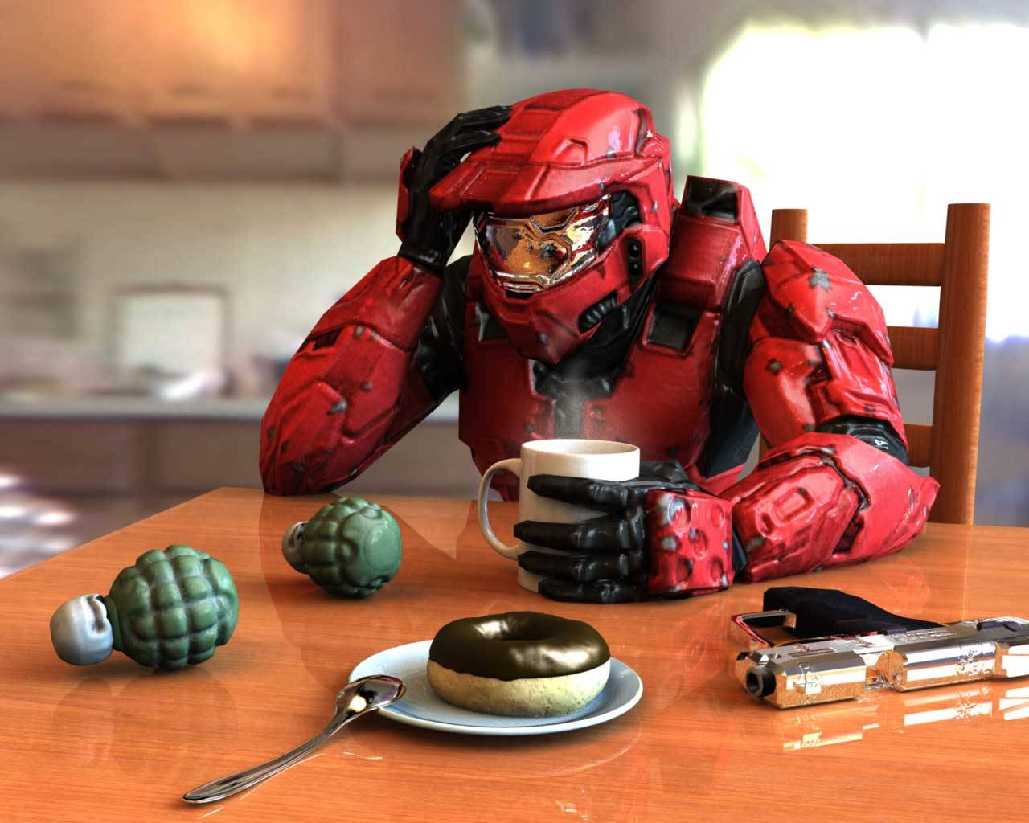
Phase 2: Design
Why Games?

Slide 30
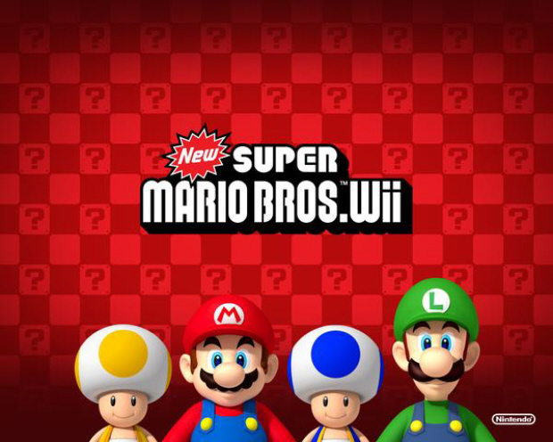
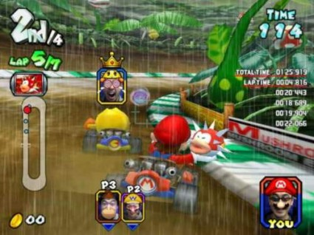
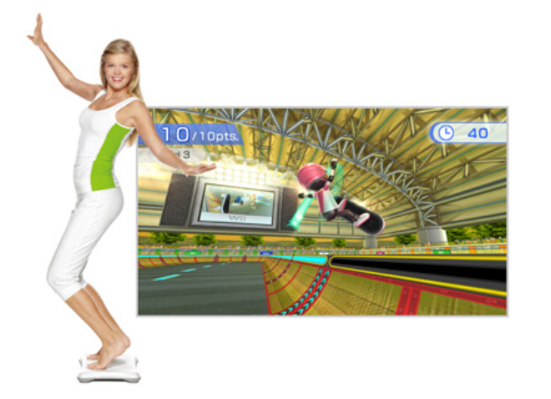
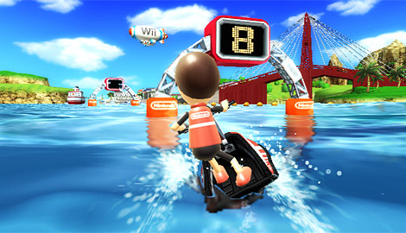
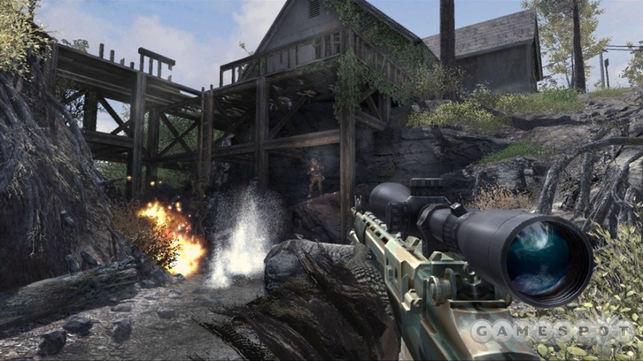
Design

Slide 31
Design
Video games are powerful tools for learning.

Slide 32
Design
1. Active, Critical Learning Principle
2. Design Principle
3. Semiotic Principle
4. Semiotic Domains Principle
5. Metalevel Thinking about Semiotic Domains Principle
6. Psychosocial Moratorium Principle
7. Committed Learning Principle
8. Identity Principle
9. Self-Knowledge Principle
19. Amplification of Input Principle
11. Achievement Principle
12. Practice Principle
13. Ongoing Principle
14. "Regime of Competence" principle
15. Probing Principle
16. Multiple Routes principle
17. Situated Meaning Principle
18. Text Principle
19. Intertextual Principle
20. Multimodal Principle
21. Material Intelligence Principle
22. Intuitive Knowledge Principle
23. Subset Principle
24. Incremental Principle
25. Concentrated Sample Principle
26. Bottom-up Basic Skills Principle
27. Explicit Information On-Demand and Just In-Time Principle
28. Discovery Principle
29. Transfer Principle
30. Cultural Models about the World Principle
31. Cultural Models about Learning Principle
32. Cultural Models about Semiotic Domains Principle
33. Distributed Principle
34. Dispersed Principle
35. Affinity Group Principle
36. Insider Principle
(Gee, 2003)

Slide 33
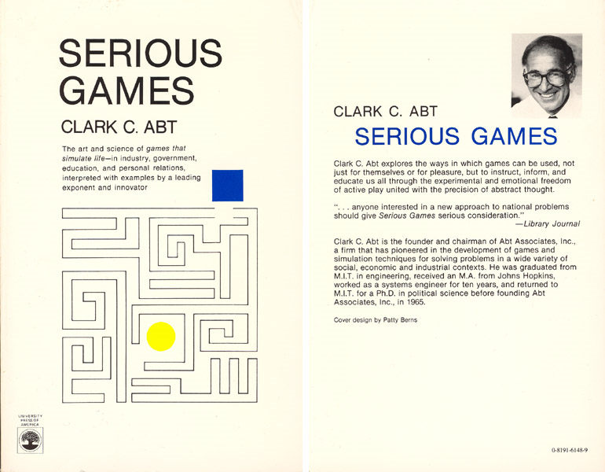

Slide 34
Design
Major paradigms in Serious Game Design
Gamification
Holistic – Systemic Learning

Slide 35
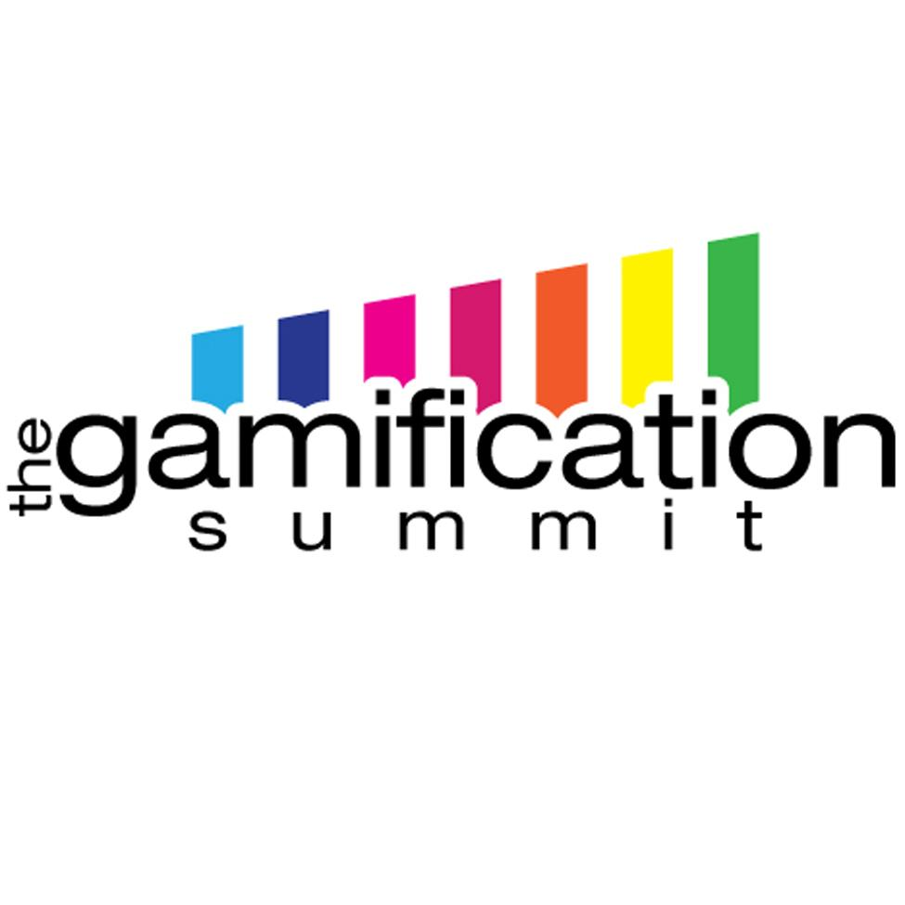
Design

Slide 36
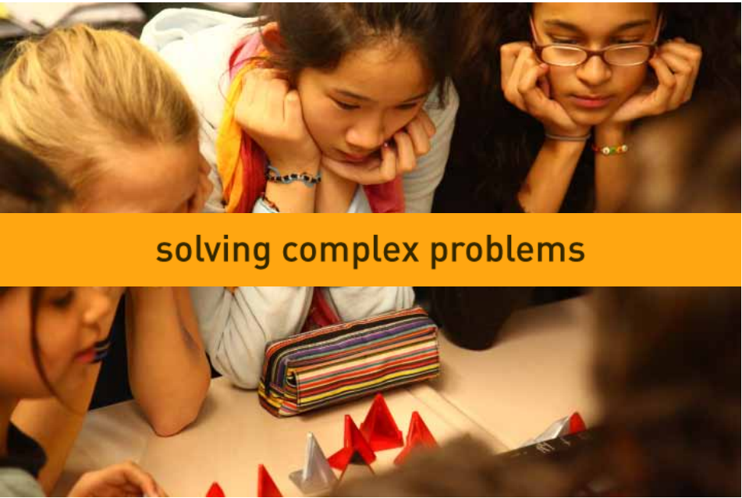
Design

Slide 37
Content meets Design
Level One
Identify major types of plagiarism
Level Two
Explain the potential consequences of plagiarism both academically & professionally
Level Three
Apply the rules to increasingly complex scenarios
List basic rules to avoid plagiarism
Recognize and acknowledge differences in cultural approaches to plagiarism
Identify data falsification and fabrication

Slide 38
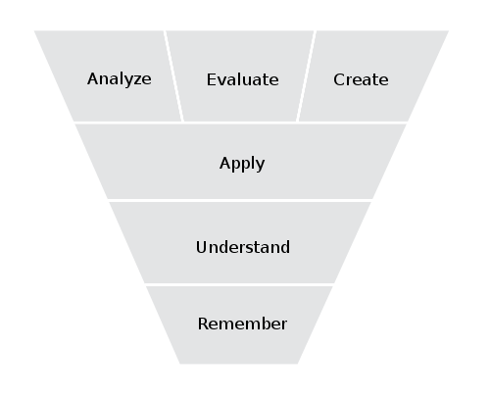
Content Meets Design
Level 3 – Apply & Recognize
Level 2 – Explain consequences
Level 1 – Identify & List
(Anderson & Krathwohl, 2001)

Slide 39
Design
Content learning objectives are one major component of our overall design task.

Slide 40
Design
Another major component of the overall design task is to make games that our audience wants to play.

Slide 41
Design
Focus Groups for Design Research

Slide 42
Design
Focus Groups partnered with the I³ graduate student groups

Slide 43
Design
Focus Group Method
diverse attitudes toward video games
very diverse preferences for game genres
Preference for a “meta-game” environment

Slide 44
Design
Major Design Task Components
  Meet content learning objectives
  Make learning games that reach a wide audience

Slide 45
Design
Overall Design Structure
A series of short, modular mini-games linked together with an interactive fiction narrative.

Slide 46
Design
Overall Design Metaphor

Slide 47
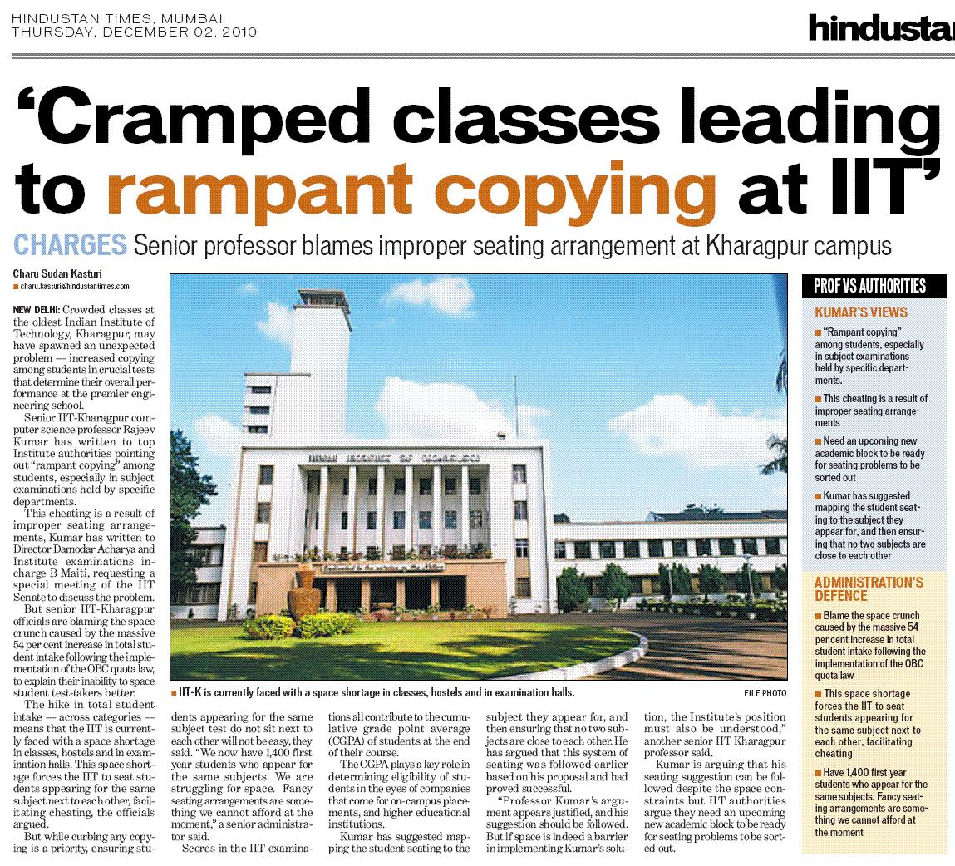
Meta-Game Story

Slide 48
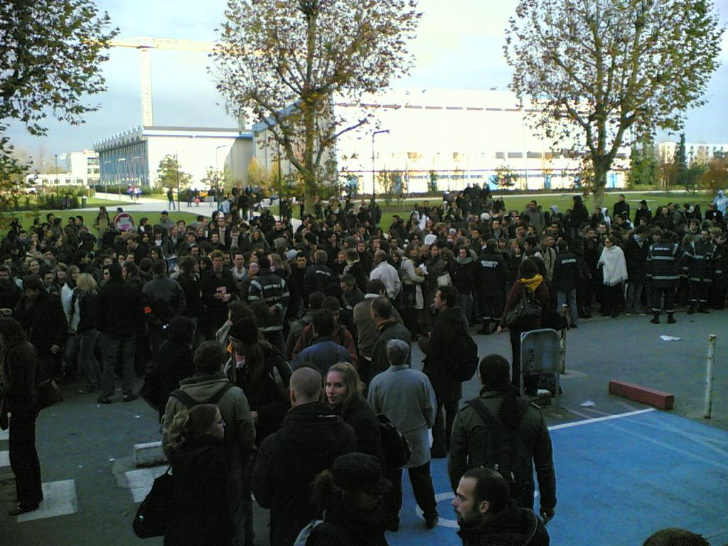
Meta-Game Story

Slide 49

Meta-Game Story

Slide 50
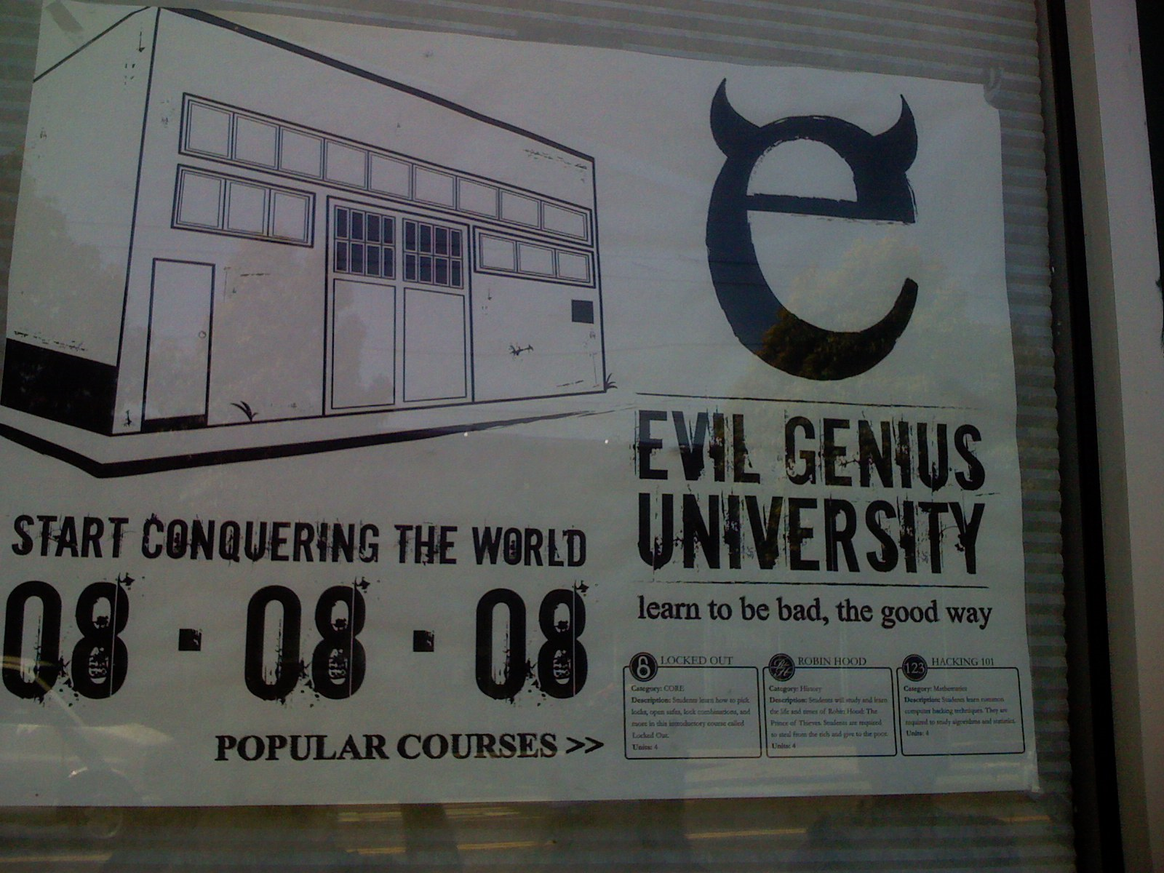
Meta-Game Story

Slide 51
Meta-Game Story
Who stands between the university and utter chaos?

Slide 52
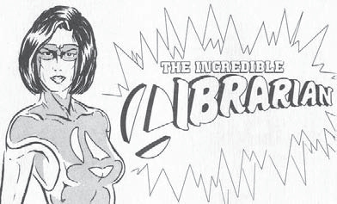
Meta-Game Story

Slide 53
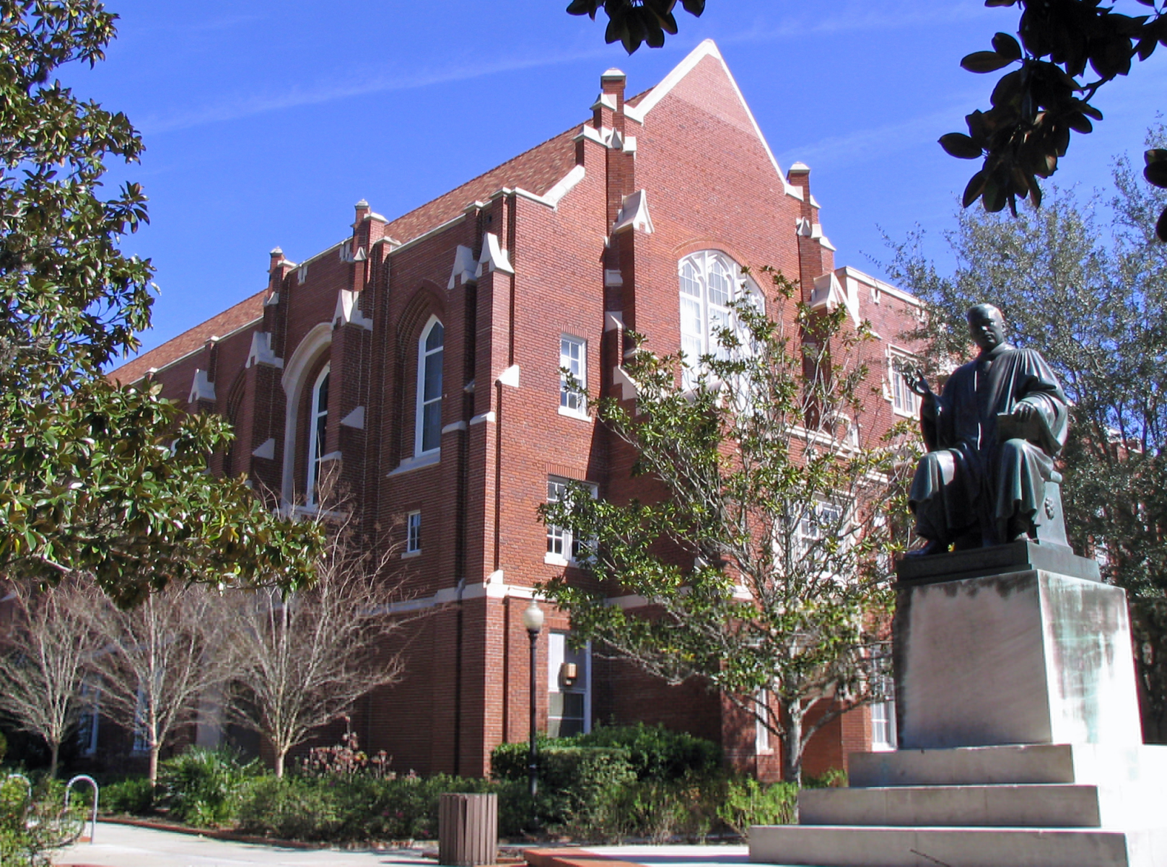
Meta-Game Story

Slide 54
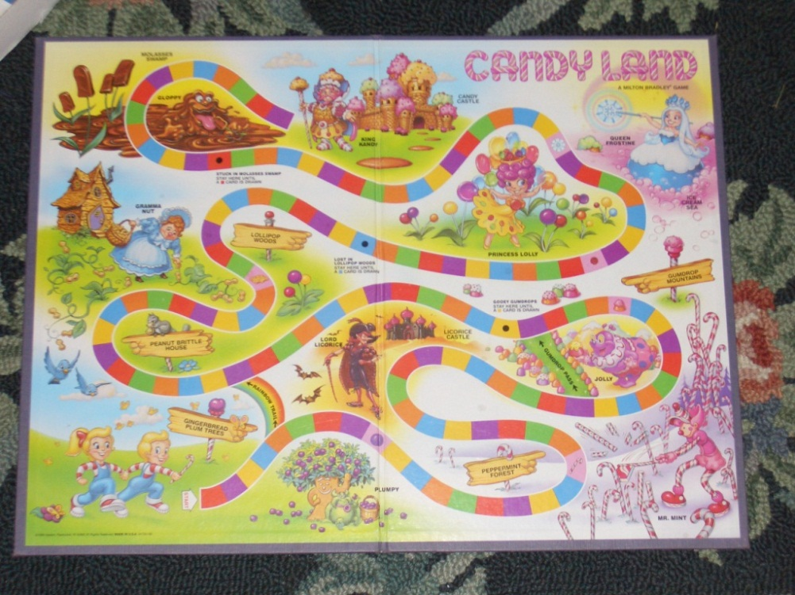
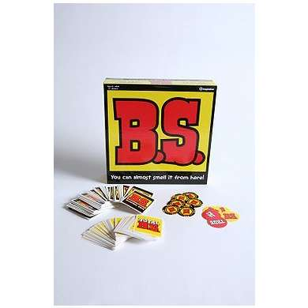
Design
Game 1 Design Metaphor

Slide 55
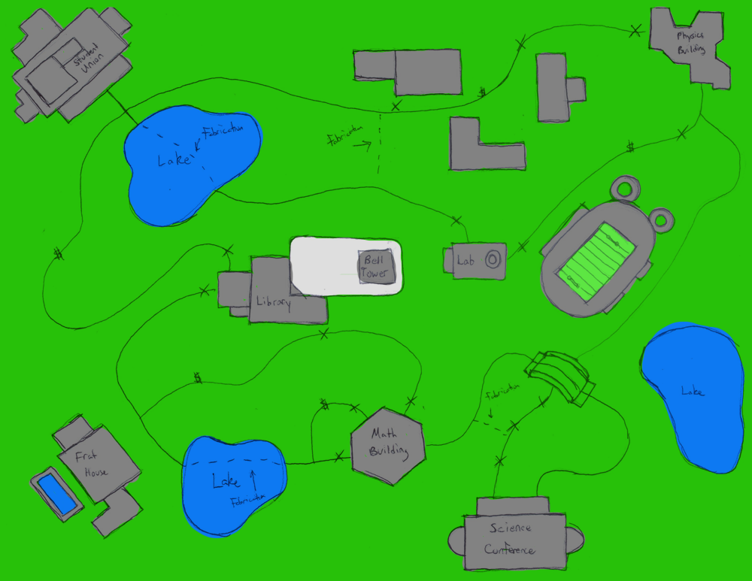
Design
Game 1 Design Metaphor

Slide 56
Design
Game 1 - Plagiarism Problems
Board game race against NPC opponent
Plagiarism “quiz” scenarios hidden throughout the board
Player is allowed to plagiarize, falsify or fabricate their positions on the game board.
The amount a player engages in research misconduct increases their chance of getting caught.

Slide 57
Design
Game 1 – Post-game Narrative
If the player cheats during the game, they will be “expelled” from school after the game in a narrative cutscene set in a mock tribunal room.
At the last minute however, the University Library’s Anti-Plagiarism Corps intervenes and asks the tribunal to stay the player’s expulsion if they help in the fight against plagiarism.

Slide 58

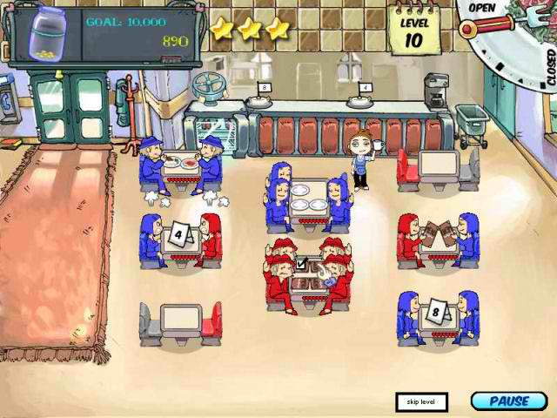
Design
Game 2 Design Metaphor

Slide 59
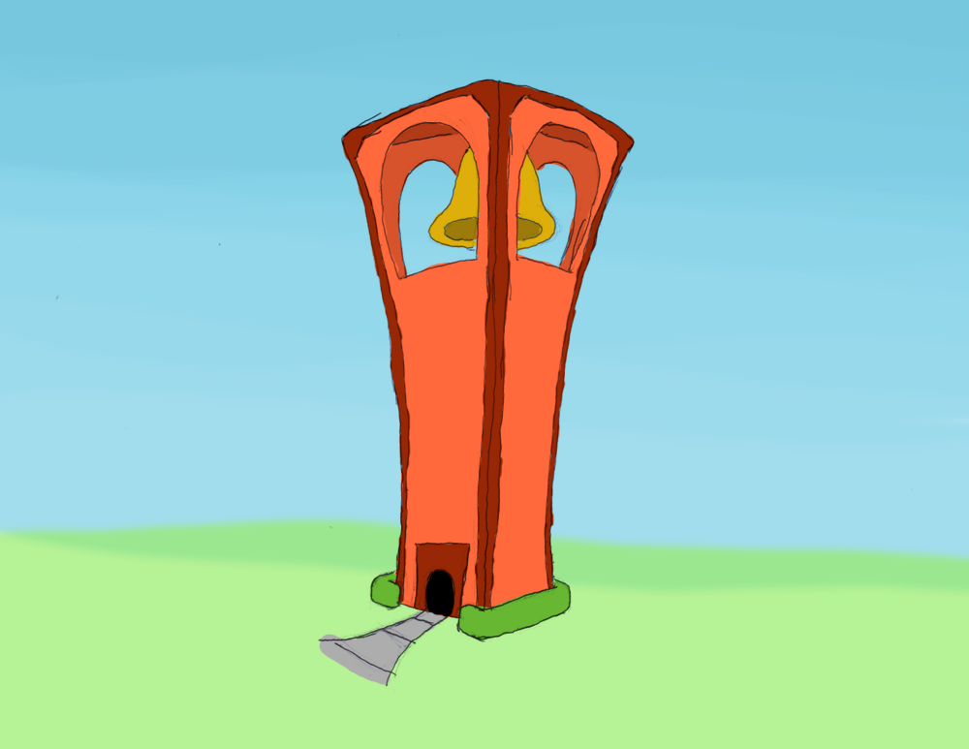
Design
Game 2 Design Metaphor

Slide 60
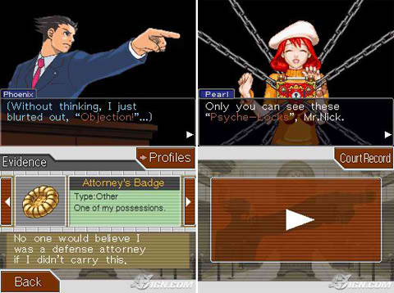
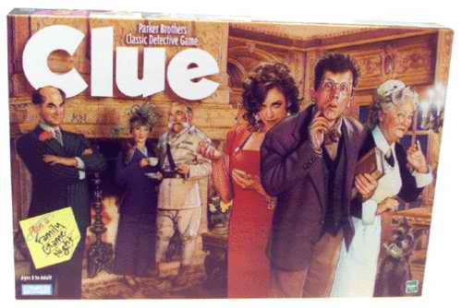
Design
Game 3 Design Metaphor

Slide 61
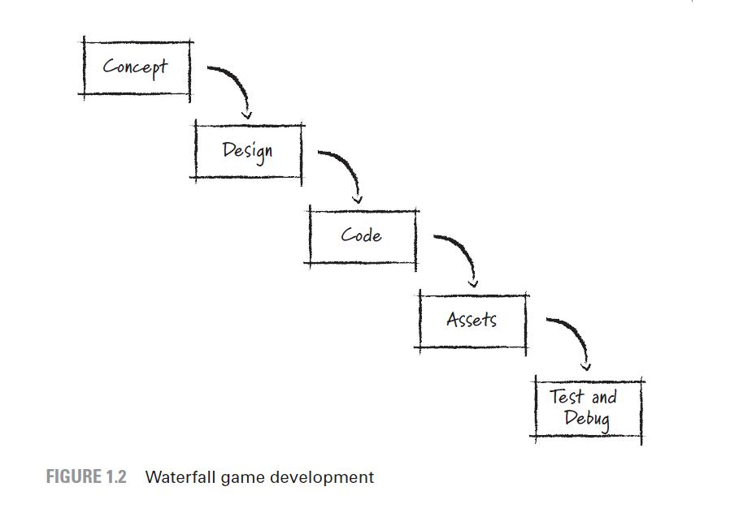
Development

Slide 62
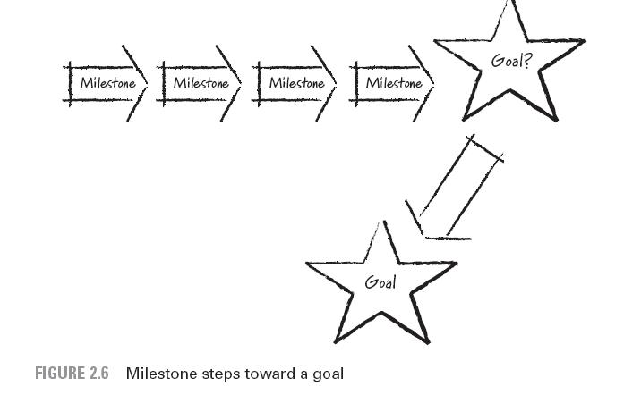
Development

Slide 63
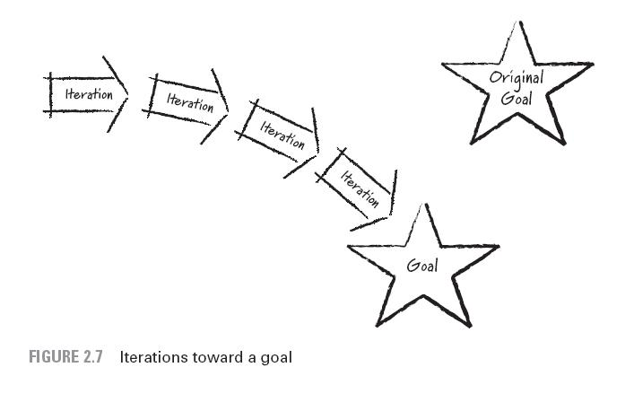
Development

Slide 64
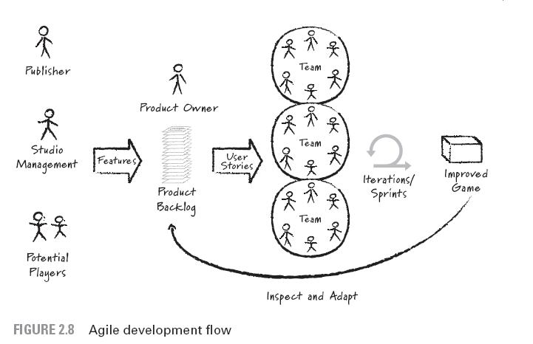
Development

Slide 65
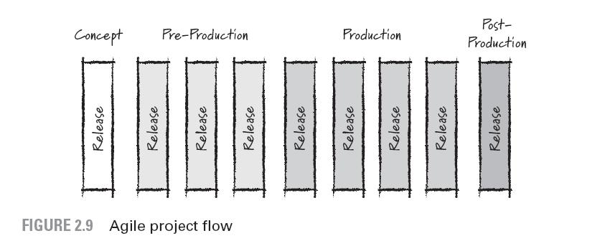
Development

Slide 66
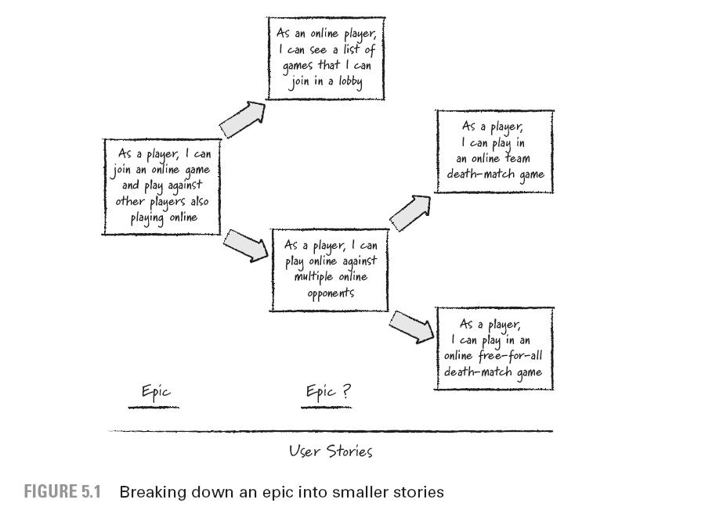
Development

Slide 67
Phase 3&5: Evaluation
Formative Evaluation:
  Usability Testing
  Learner assessments of modules
  Design assessments
Summative Evaluation:
  Overall project evaluation
  Assessment of learning in game
  Evaluation of objectives

Slide 68
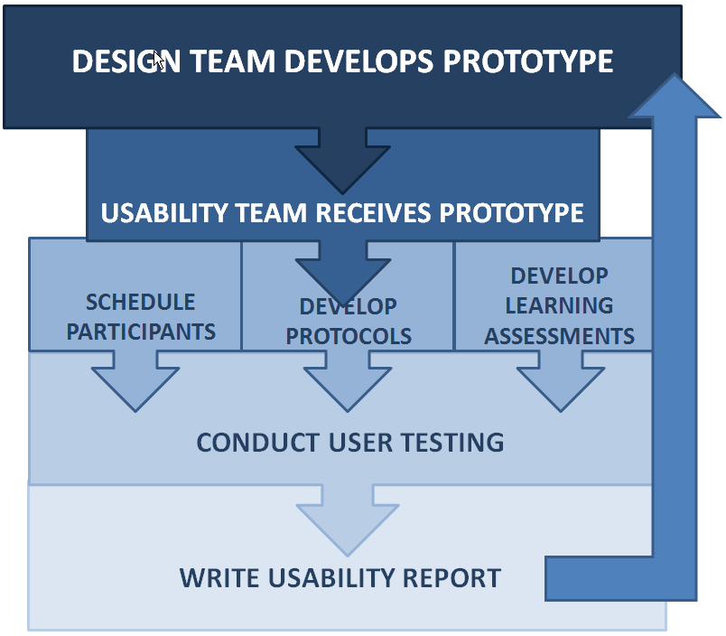
Usability Testing
15 Day Cycle
WEEK 1
WEEK 2
WEEK 3

Slide 69
Usability: Week 1
Schedule Participants
Develop Testing Protocols
Review prototype design
Develop learning assessments, if applicable

Slide 70

Usability: Week 2
Conduct user tests with 3-5 STEM students

Slide 71


Slide 72
Usability: Week 3
Prepare usability report
Communicate successes/ shortfalls to GAP team
Usability report informs further development
Design team documents changes in future iterations of the game

Slide 73
Phase 4: Implementation
Six NSF-funded universities and one large state university have agreed to participate in beta testing of the GAP game.
The game and learning assessments will be delivered to these institutions for testing during Spring 2012.
Purdue University
Virginia Commonwealth University
University of Central Florida
University of Houston
Loyola Marymount
Oakland University
Rowan University

Slide 74
Phase 5: Evaluation
Formative Evaluation:
  Usability Testing
  Learner assessments of modules
  Design assessments
Summative Evaluation:
  Overall project evaluation
  Assessment of learning in game
  Evaluation of objectives

Slide 75
References
“Great Content” graphic: http://www.seibunkyo.org/
This presentation is based on the recently award National Science Foundation IIS EESE Grant 1033002

