Slide 1
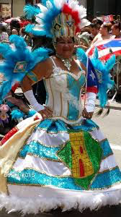
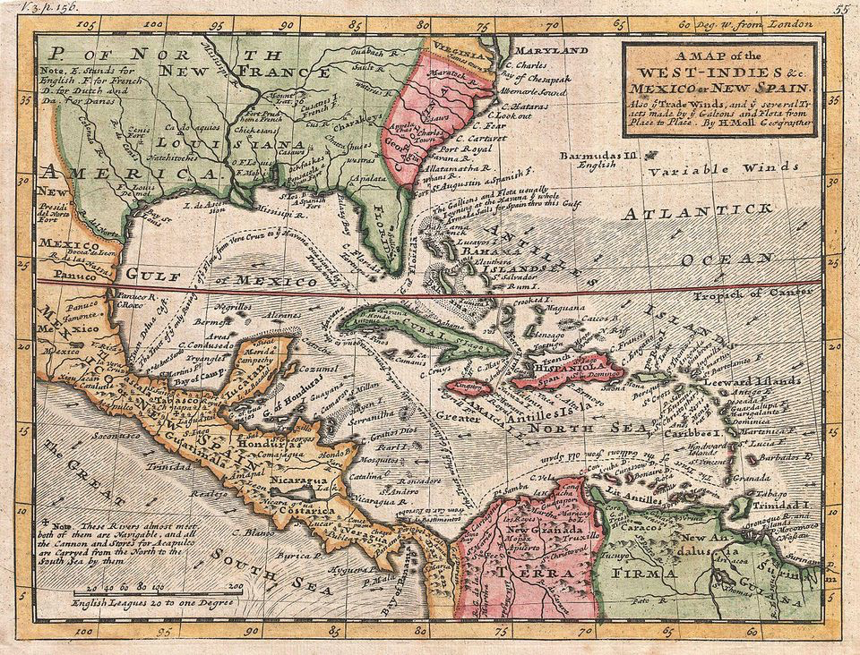
Caribbean Diaspora: Panorama of Carnival Practices aims to explore migration and the Caribbean diaspora through the lens of cultural practices related to Carnival.
PI: Nadjah Ríos-Villarini
Co PI: Mirerza González
University of PR –Rio Piedras

Slide 2
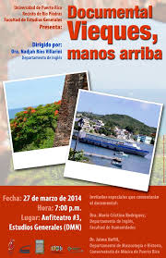
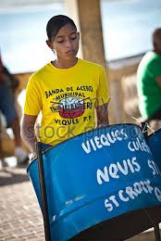
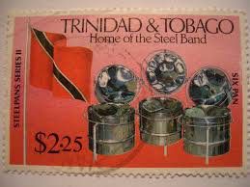
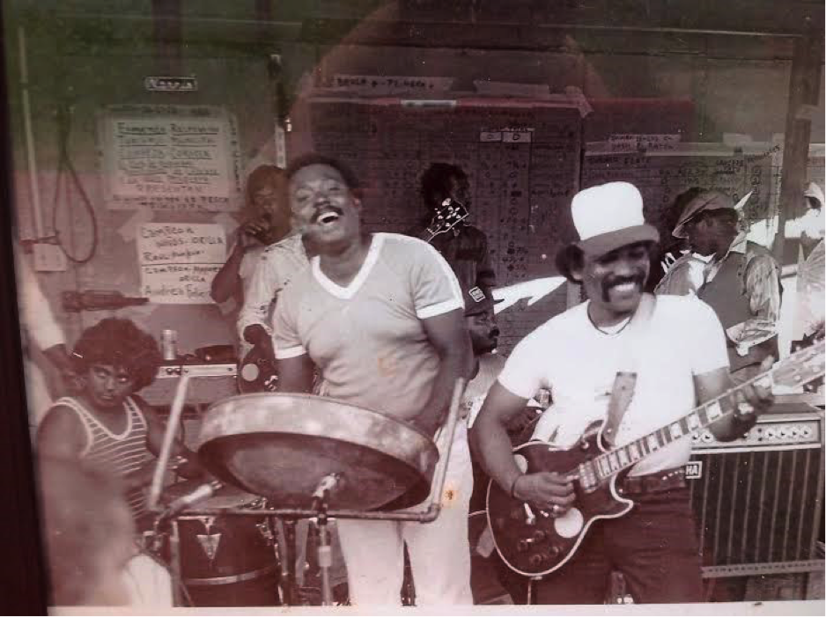
Goals
To design and develop an interactive webpage with curated content about mobility (of people, culture, ideas etc.) in Caribbean carnival.
To engage scholars from Linguistics, Performance, Music, History, Communication, Library Studies and Digital Humanities in the planning of reliable and affordable archiving, preserving and disseminating practices.

Slide 3
Digital Humanities Thinking Sessions
The workshops effectively promoted critical thinking and participatory experiences in the planning of the website contents and DH tools.
Moreover, the team achieved effective networking among Caribbean scholars, DH experts, Library Science practitioners, graduate and undergraduate research assistants.

Slide 4
Our Team
Sally Everson University of Bahamas
Laurie Taylor University of Florida
Lowell Fiet University of Puerto Rico
Jennifer Guiliano Indiana University Purdue University Indiana
Nora Ponte University of Puerto Rico
Mila Aponte, University of Puerto Rico
Carlos Corrada, University of Puerto Rico
Joel Blanco, Universidad Autónoma de México
Pablo Defendini, Web Designer
Gabriela Rivera, Universidad de Puerto Rico
Faviola Martínez, Universidad de Puerto Rico

Slide 5
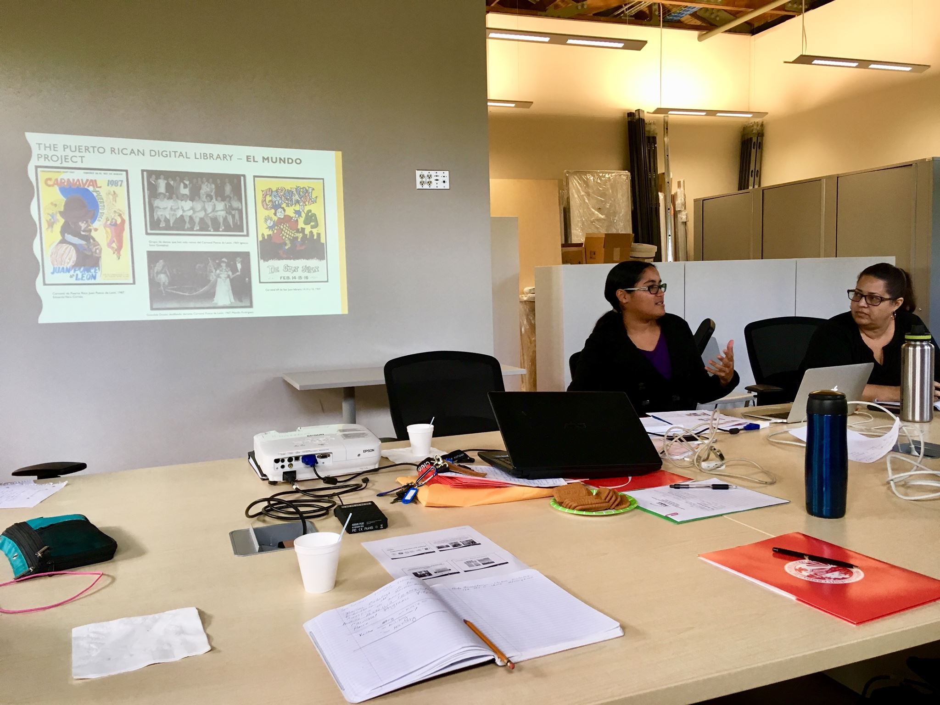
Digital Humanities Thinking Labs
Since January 2018 we have engaged in four (4) working sessions using the structure of what we conceptualize as a digital humanities thinking labs.
March, August, October 2018 and March 2019

Slide 6
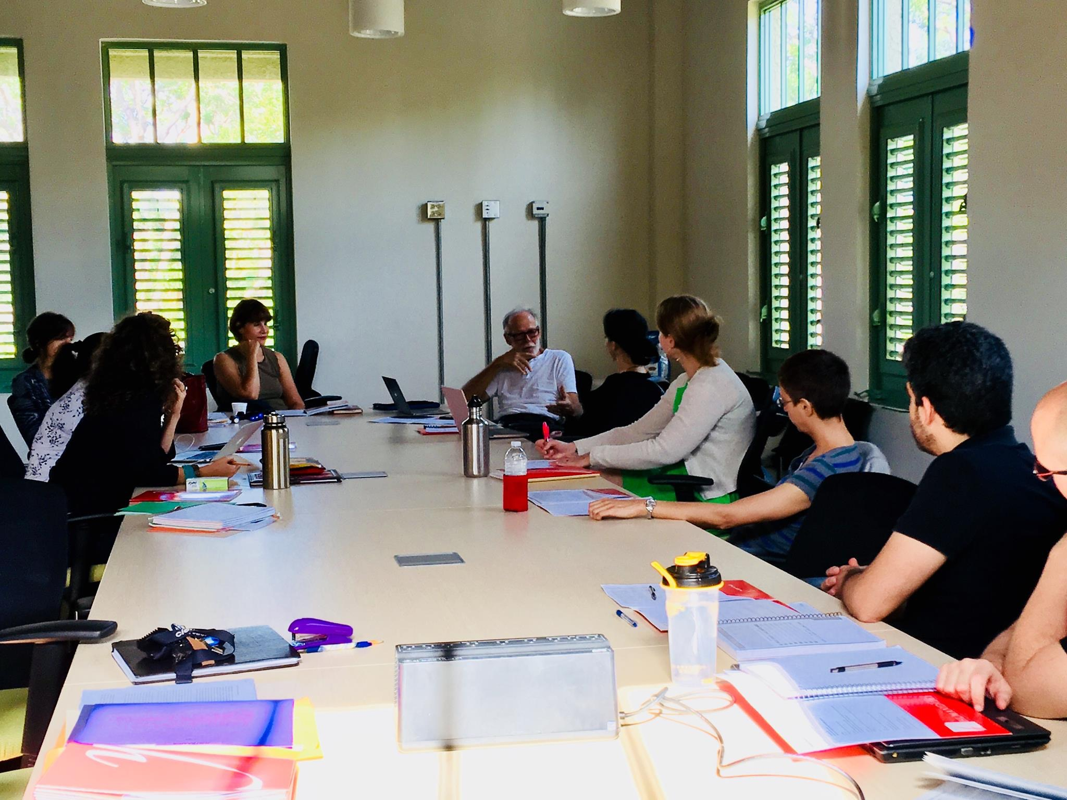
Session #1 : From data to knowledge -March 2018
What is digital humanities?
Identify DH projects similar to ours
dLOC technological support
Assessment of our materials What do we have available?
OUTCOME: MICROPROJECTS

Slide 7
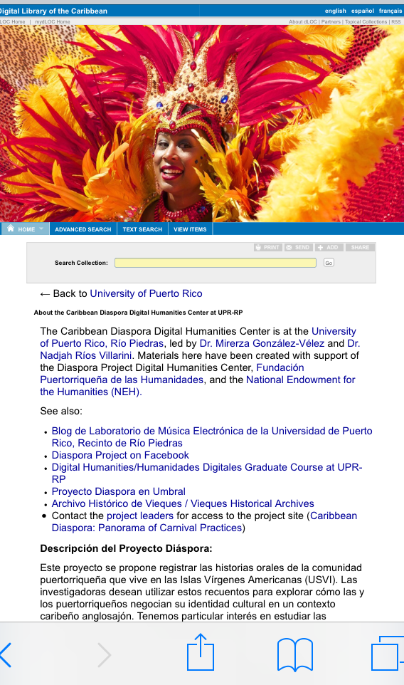
Session #2 : SHAPING THE PROJECT - August 2018
Assessment of technical aspects such as:
1.Information architecture
2. Users
3.Interactivity level
4.Open source platforms
5.Website narrative
OUTCOMES:
-OUTLINE MICROPROJECTS
-DLOC Caribbean Diaspora Digital Humanities Center Collection
-VISUAL IDENTITY OF THE PROJECT
-PROTOTYPE with 5 GALLERIES : mapping, timeline, photo, video and sound

Slide 8
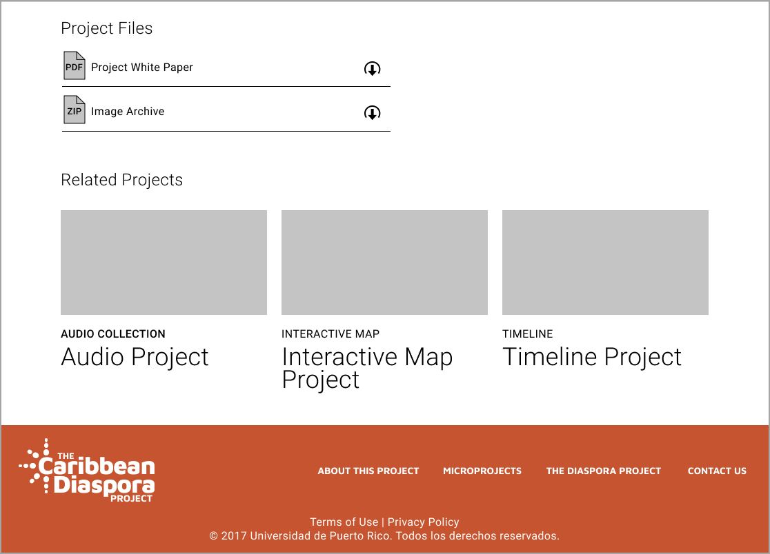
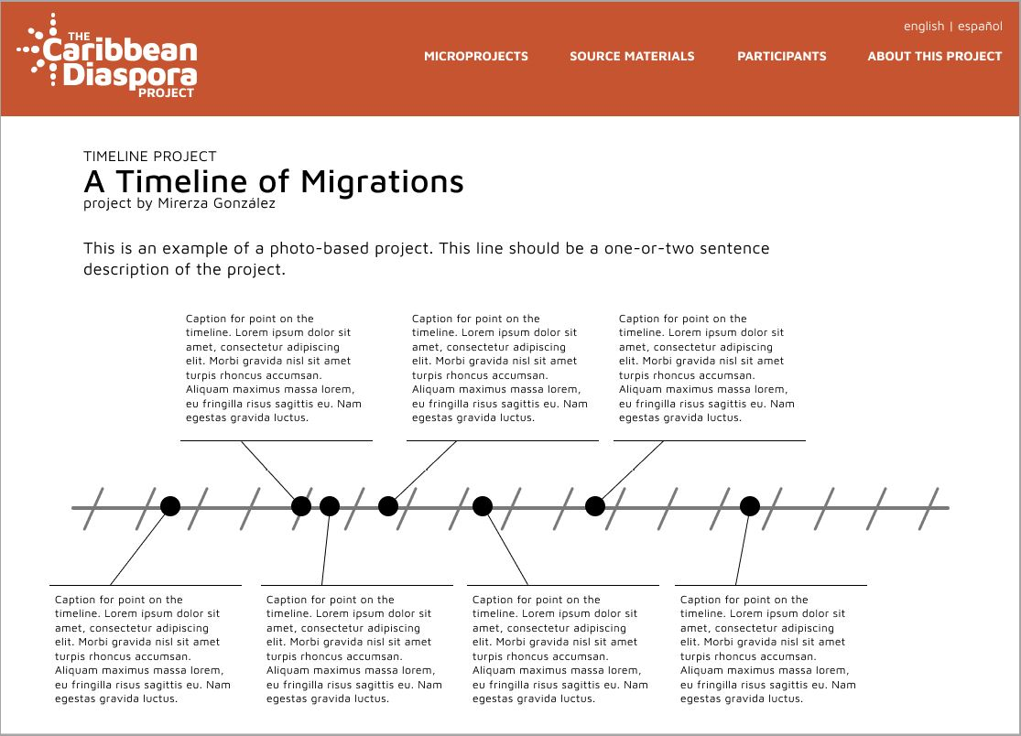
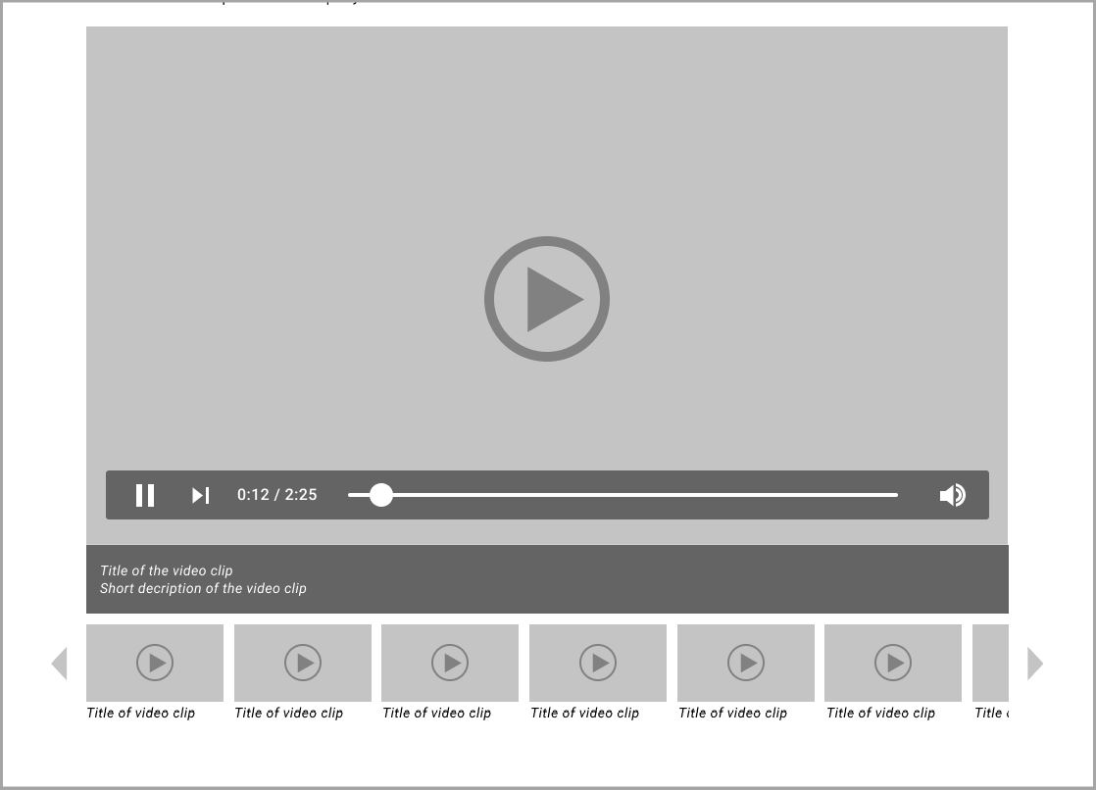
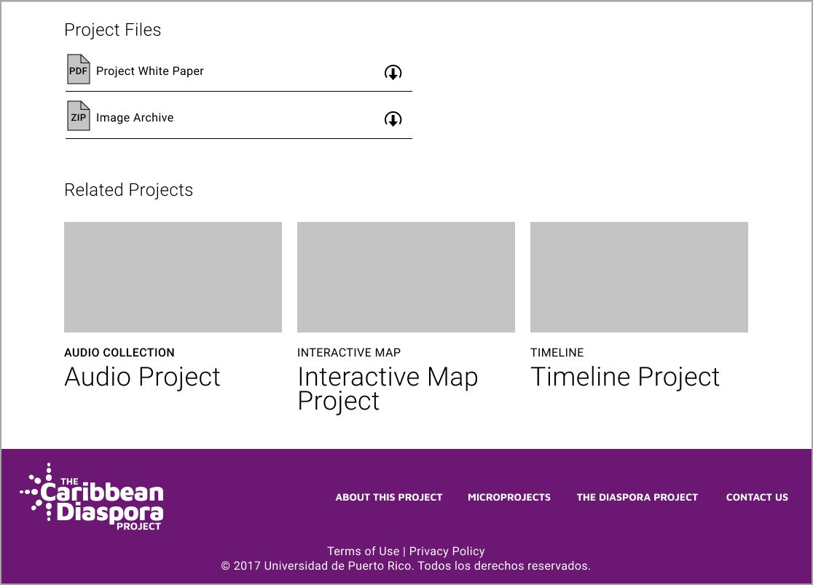
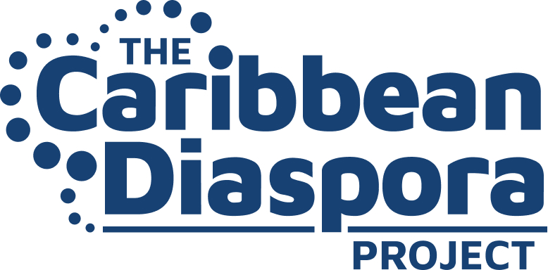
Designing ideas – documenting visual concepts

Slide 9
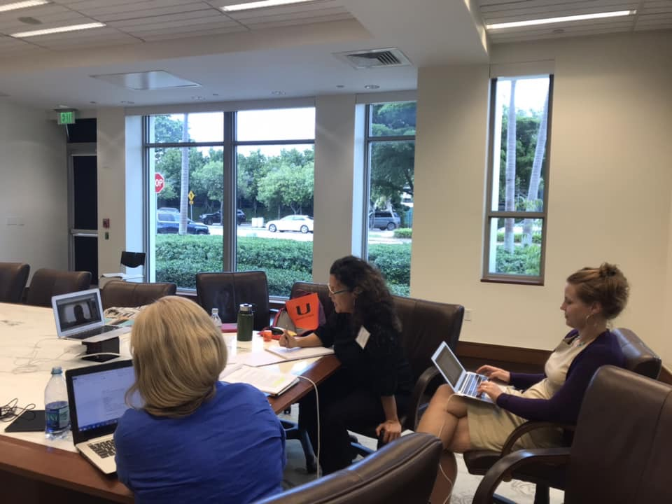
Session #3: SUSTAINABILITY-FUNDING October 2018
Meeting to assess funding options to move forward with the project: FIPI-FPH
Brainstorming session for NEH proposal
Identifying workshops on sustainability and data preservation – NEH Workshop at Georgia Tech
OUTCOMES: Two (2) funding proposals developed and submitted and website prototype
http://www.caribbeandiasporaproject.org/

Slide 10
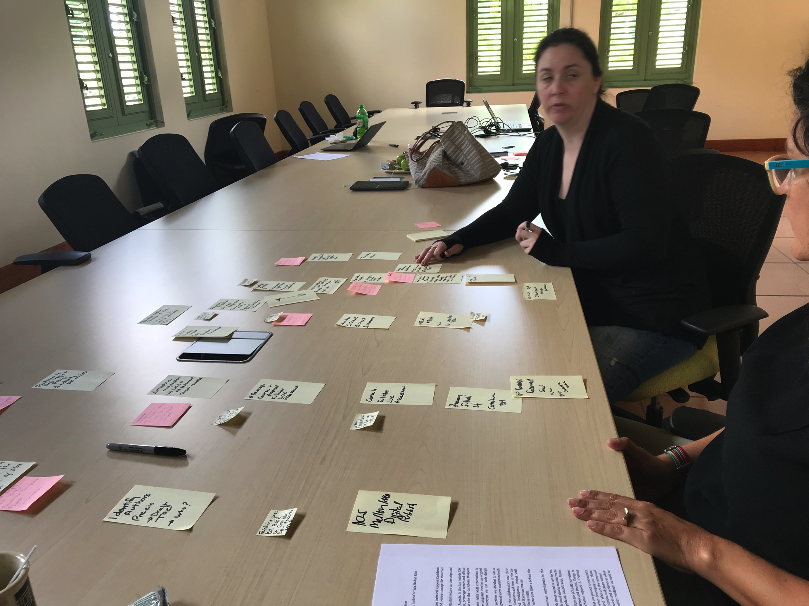
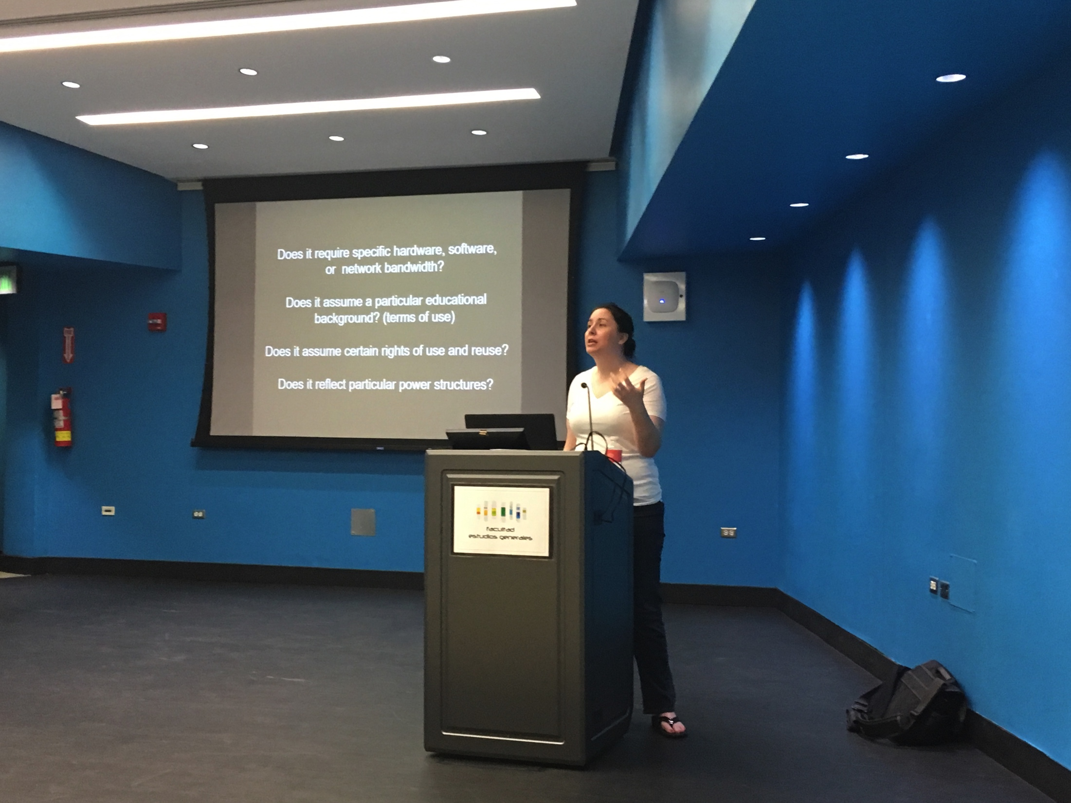
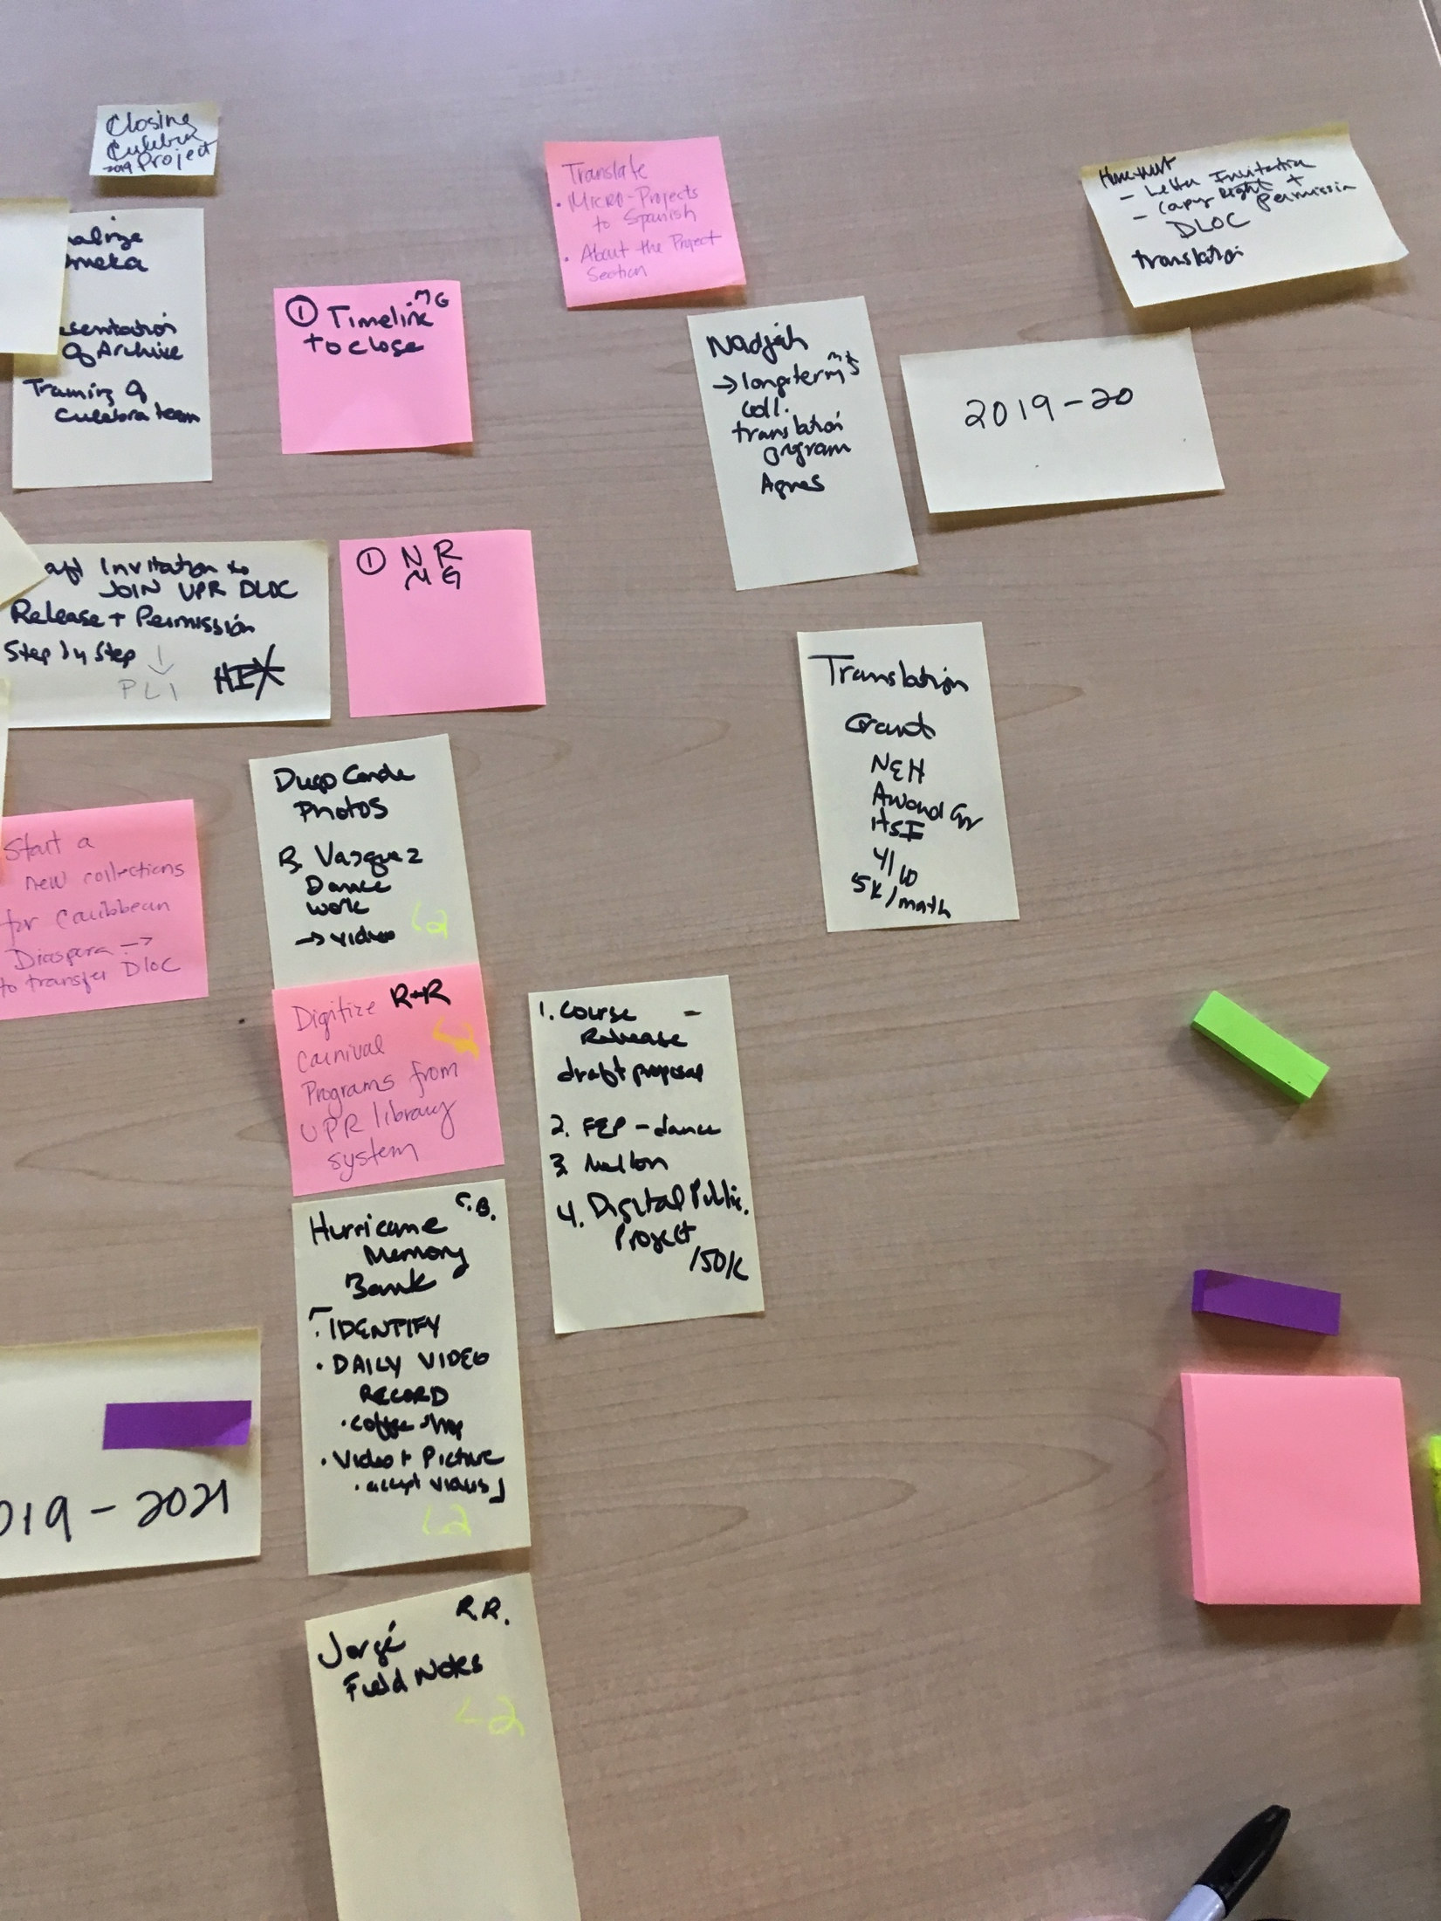
Session #4: MOVING FORWARD- March 2019
Working session with mentor and consultant Dr. Jennifer Guiliano .
Development of a two year work plan that includes:
-curricular development
-training / capacity building
-dissemination
-sustainability

Slide 11
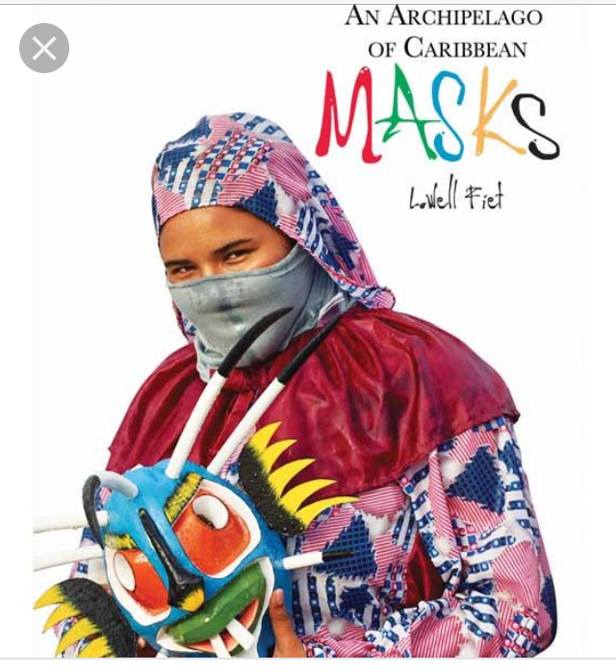
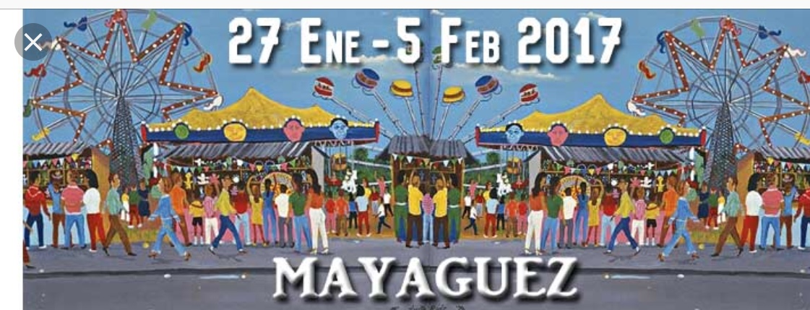
Deliverables
Collections added to DLOC :
Catanzaro Photo Collection-Vieques/US NAVY relationship
Lowell Fiet Photo Collection of Caribbean Masks
Fiestas Patronales PR (78 munipalities)

Slide 12
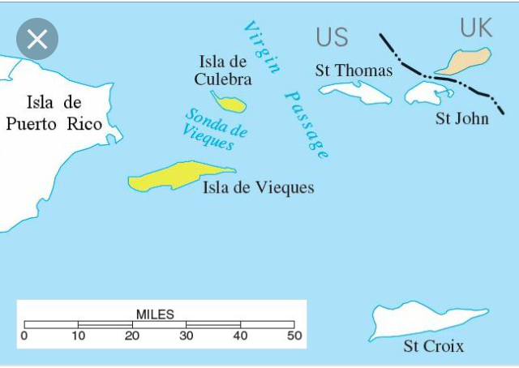
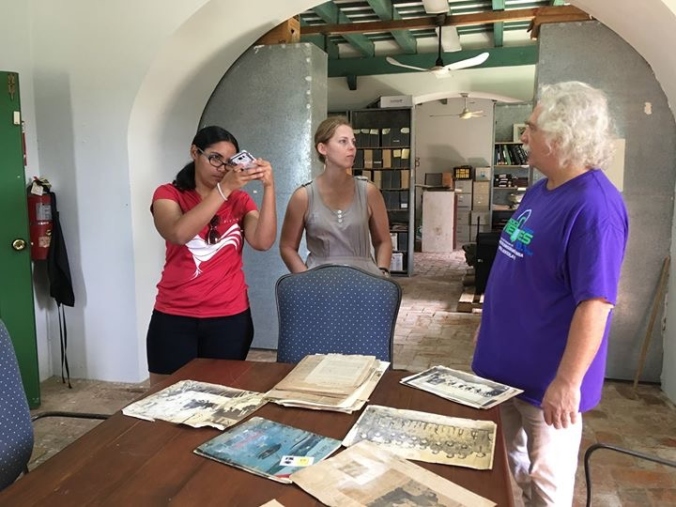
Commitment to keep collaborating with:
1. Fundación Culebra
2. Archivo Histórico de Vieques

Slide 13
Oral Histories Project – Fundación Culebra
Memory and community histories
Three (3) workshops on digitization of materials using minimal technologies
Writing of oral histories based on family trees exercise.

Slide 14
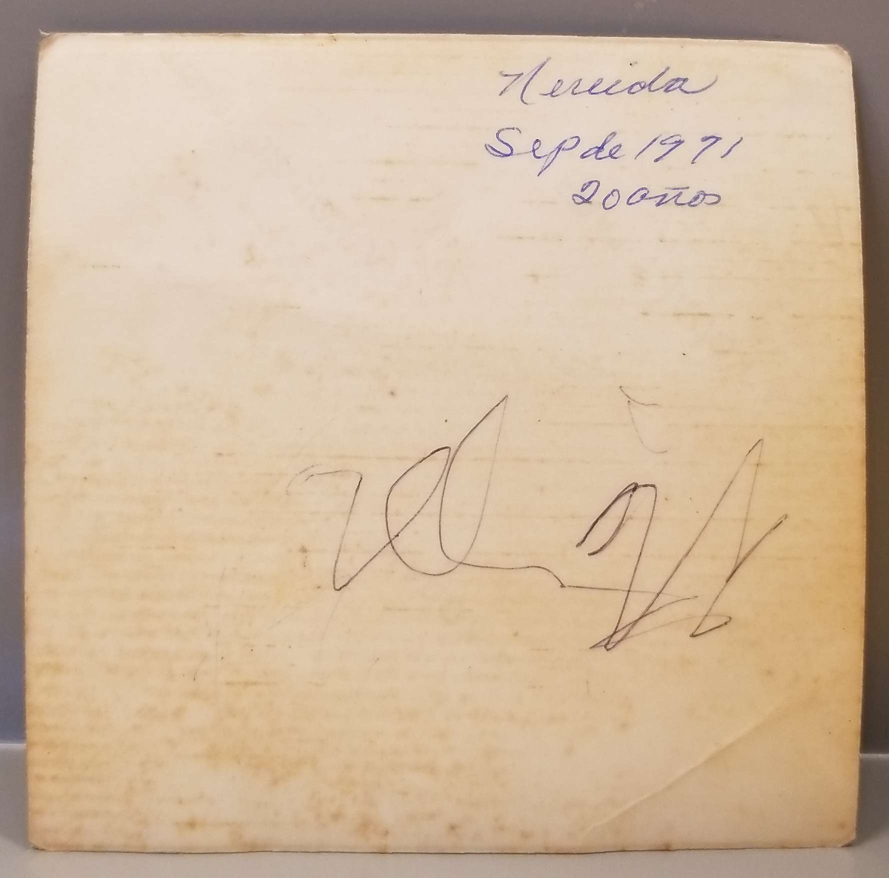
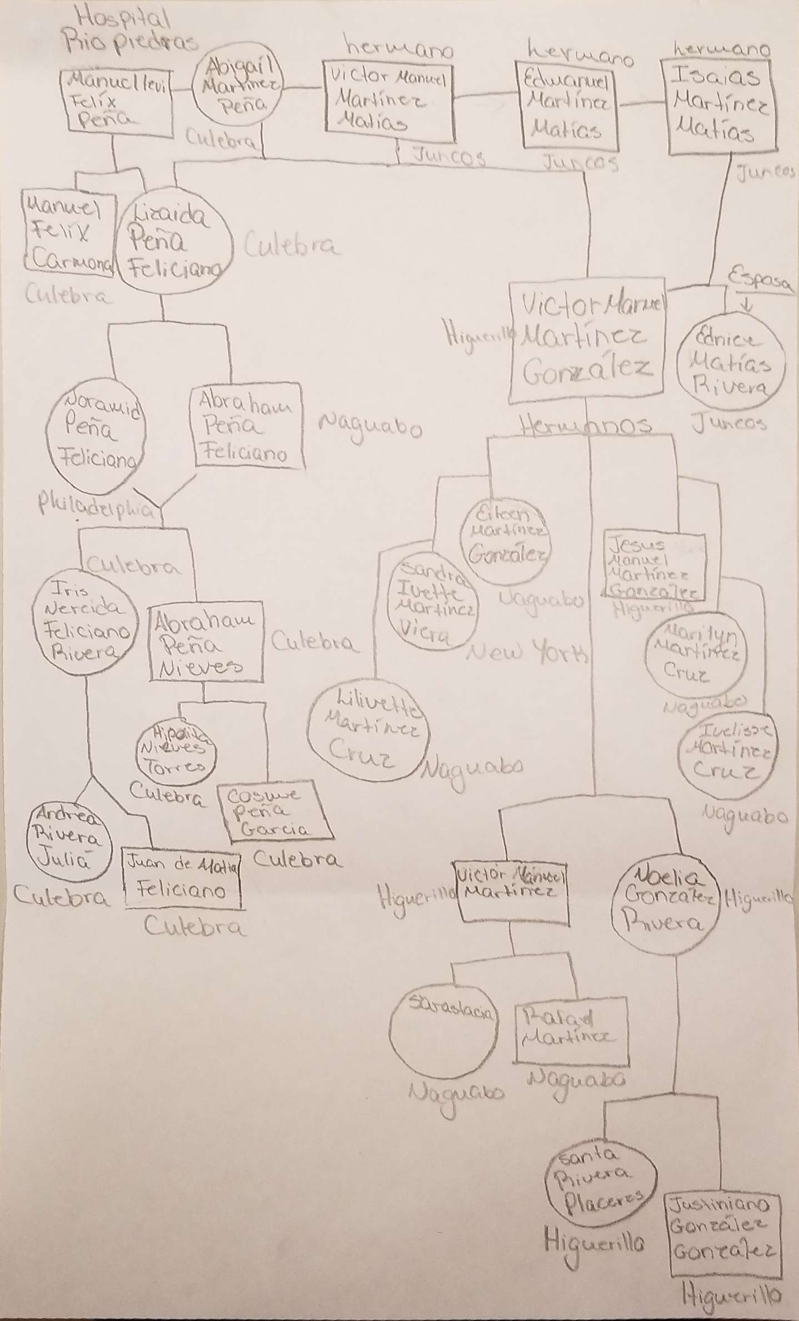
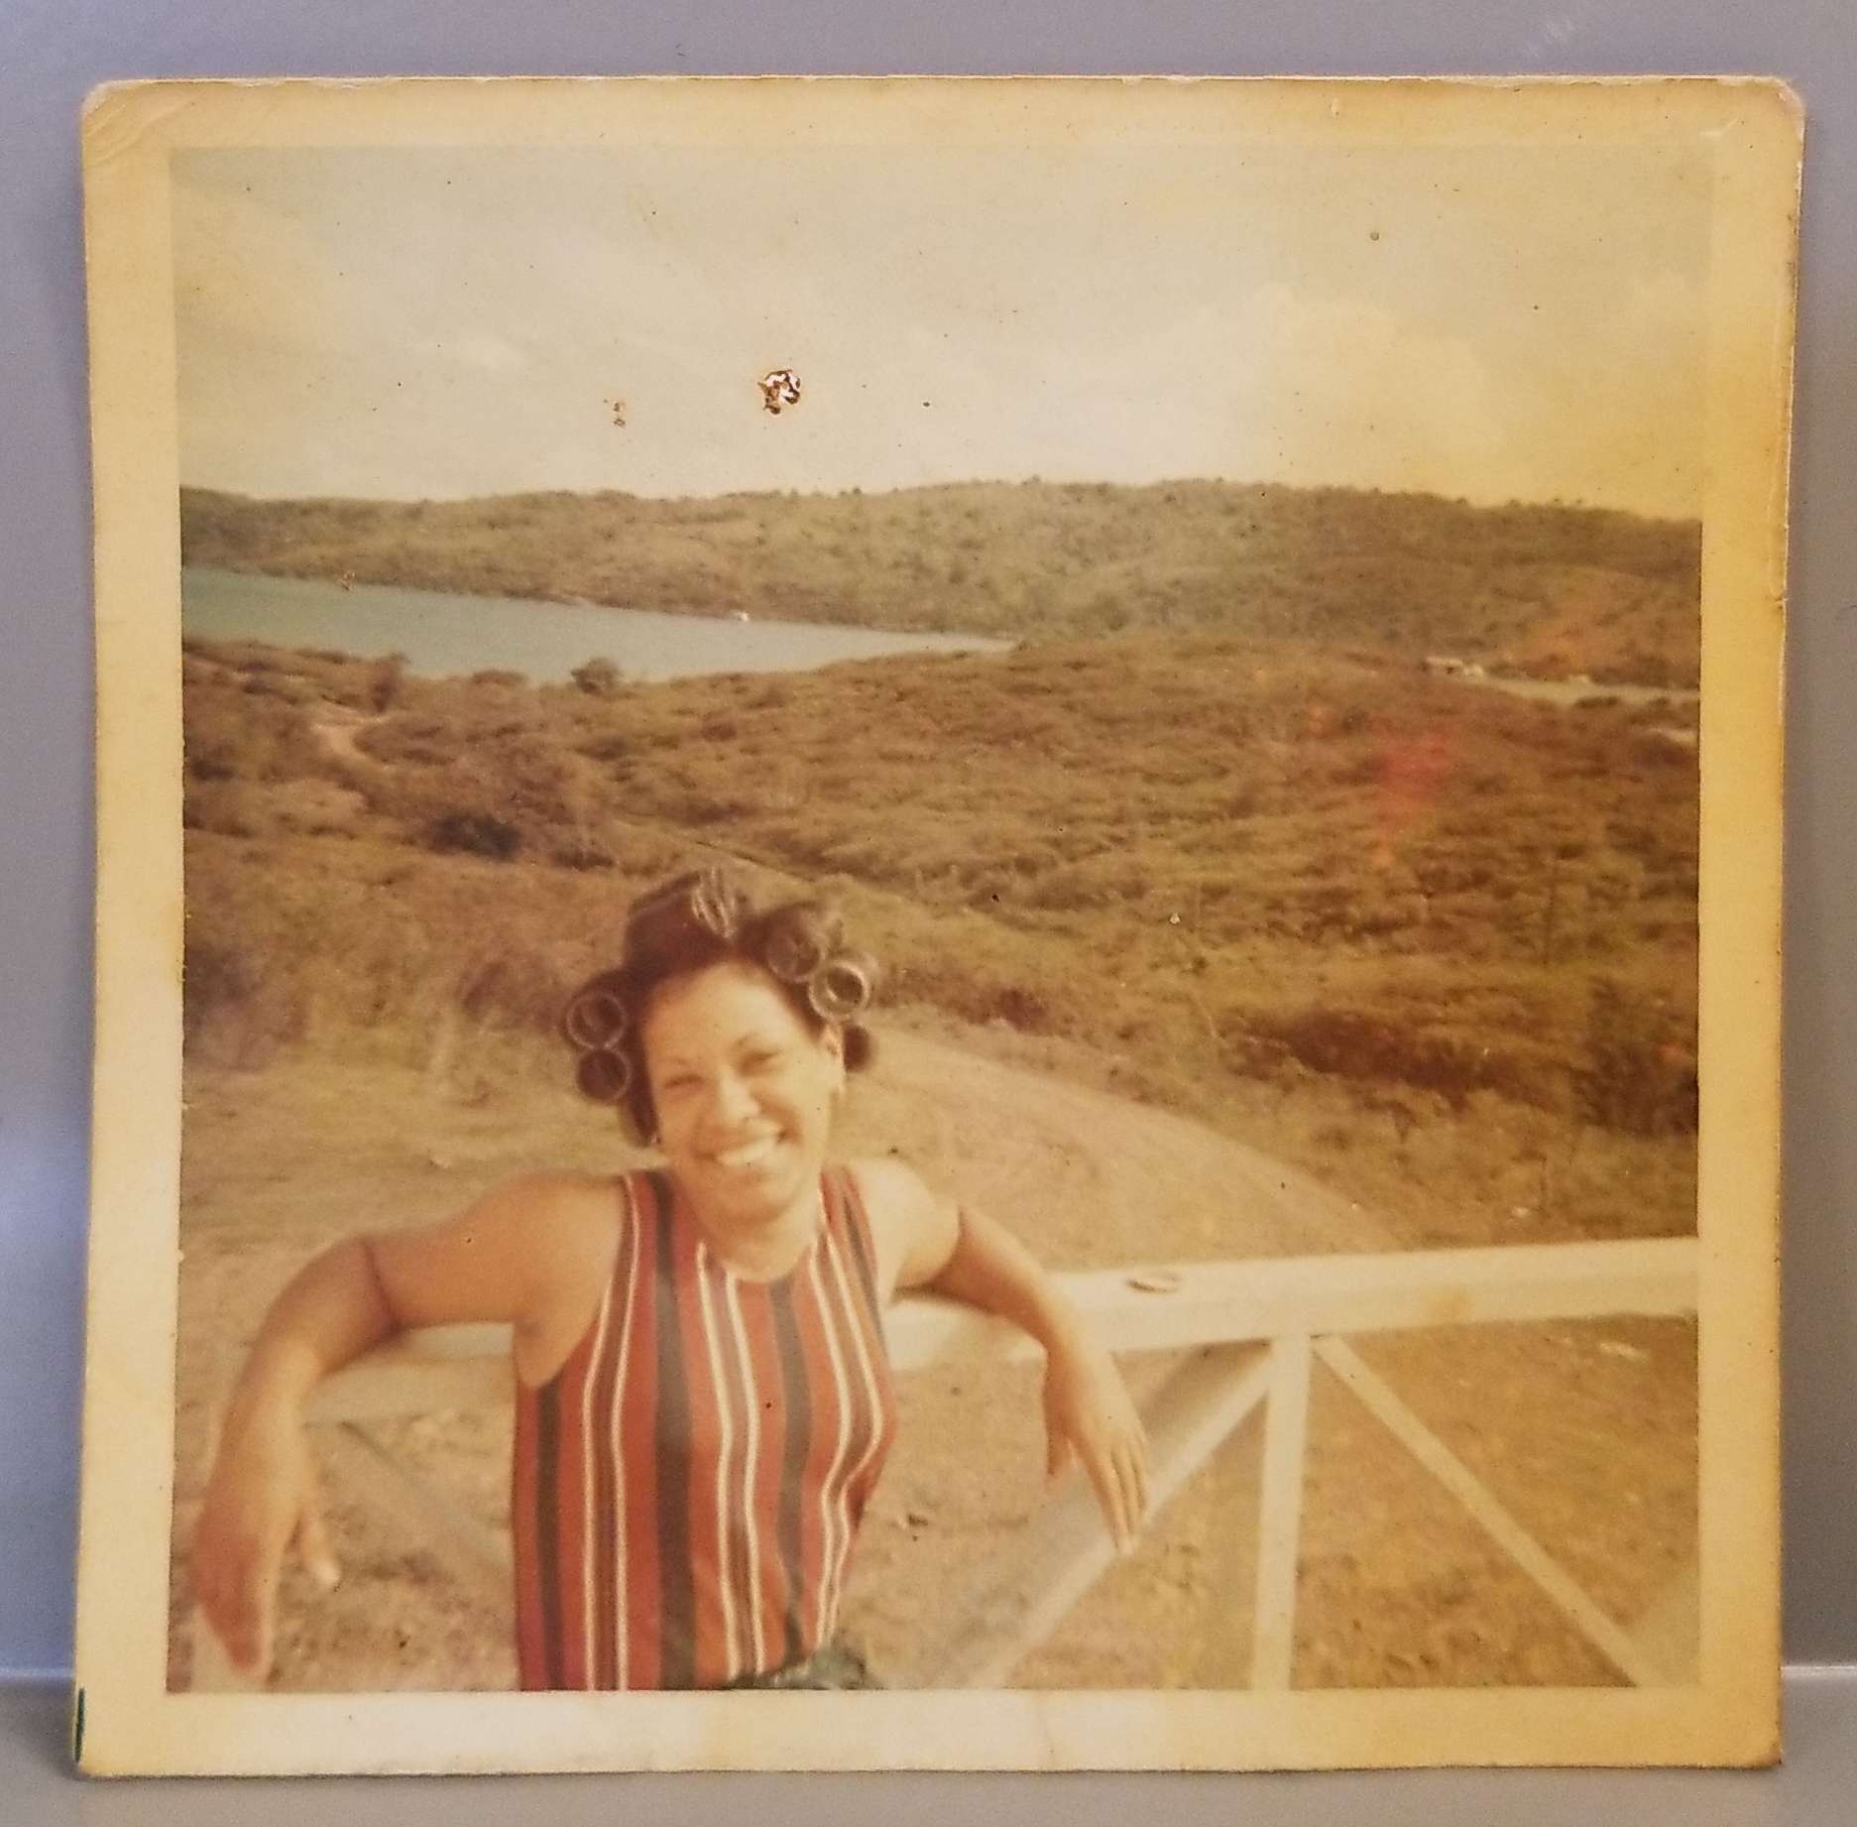
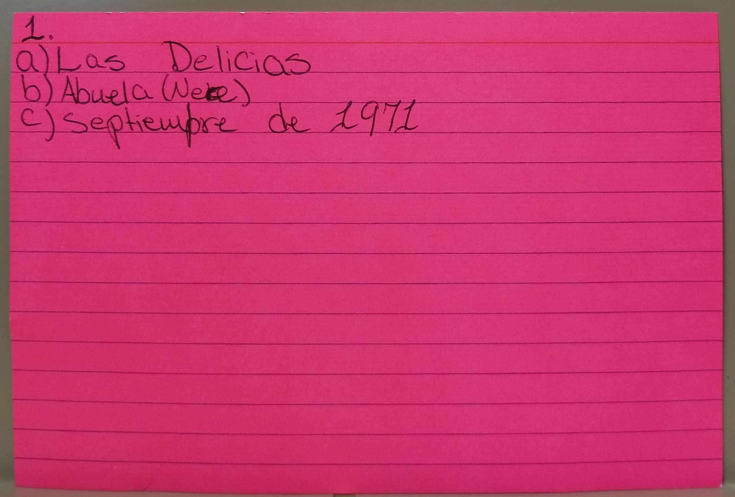
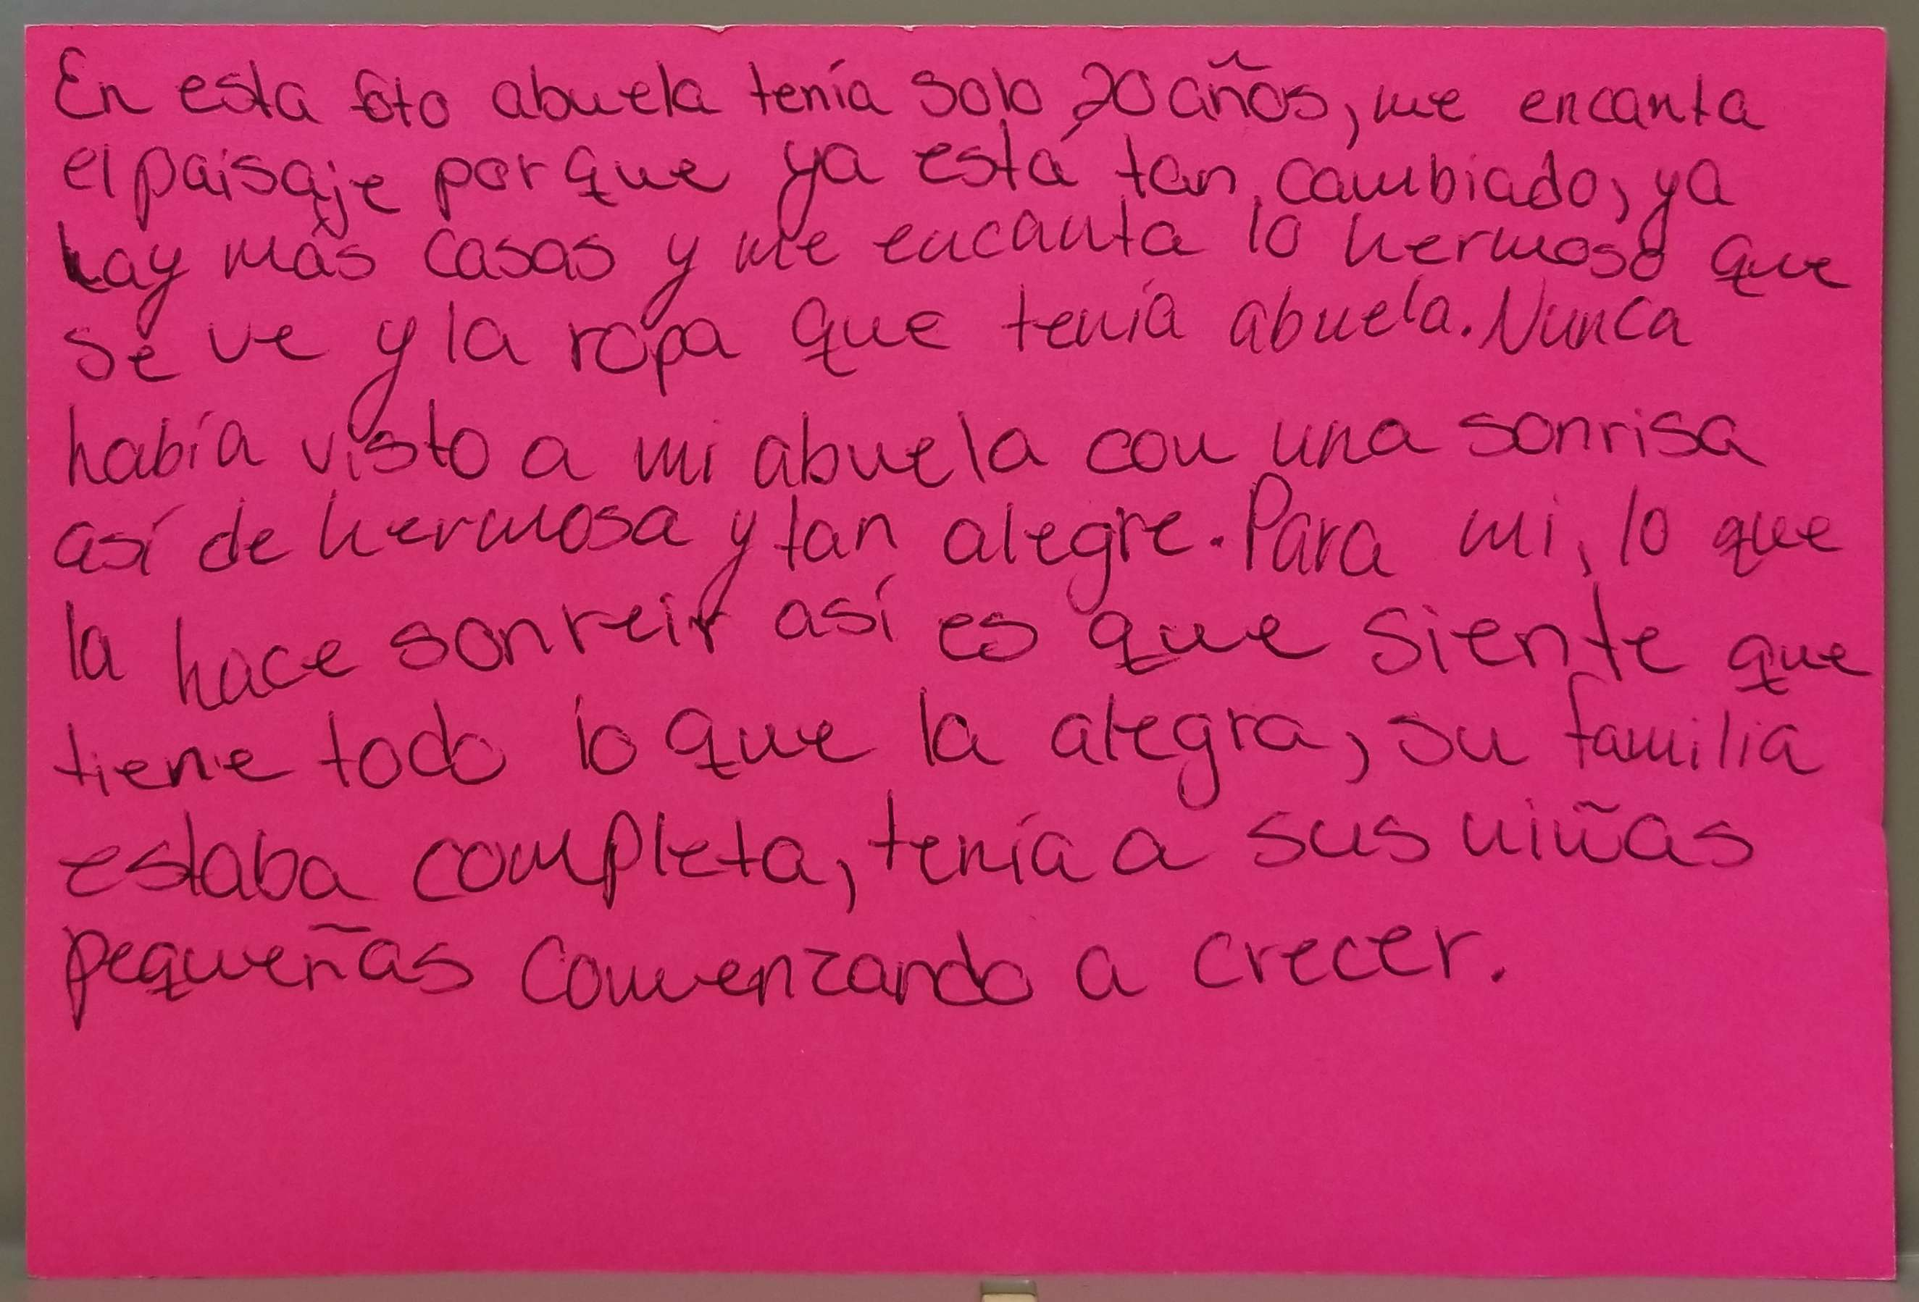
Linking Community Memory with Family Histories
Abigail – Abuela Nere, Culebra PR

Slide 15
To learn more about these projects visit:
Facebook – The Diaspora Project
www.caribbeandiasporaproject.org
Contact us at
Nadjah Rios Villarini, nadjah.rios@upr.edu
Mirerza González, mirerza.gonzalez1@upr.edu

