Slide 1
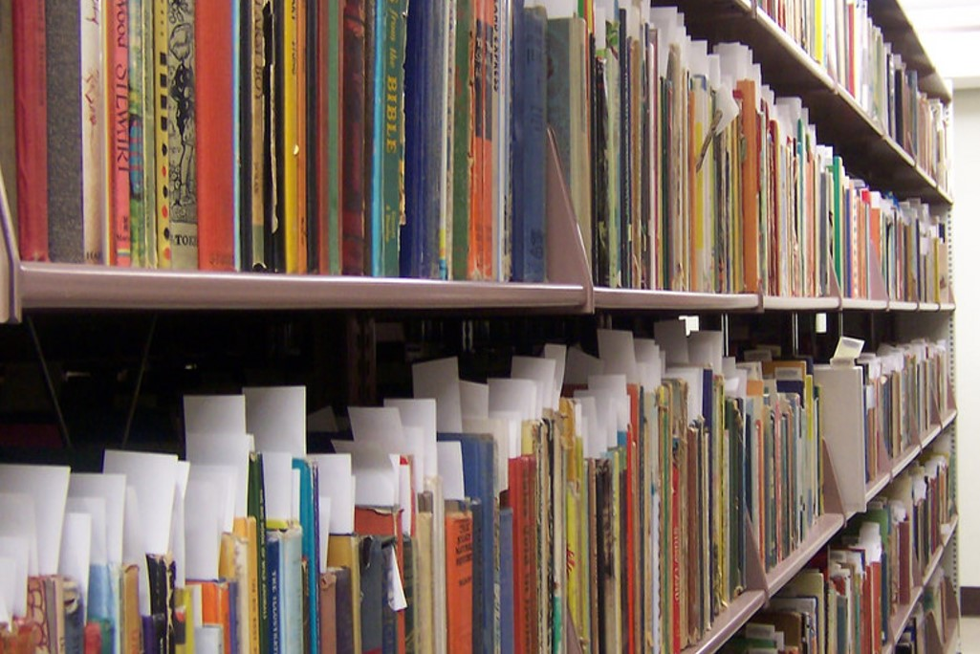
Notes:
Good afternoon. My name is Laurie Taylor. I am a librarian. Today I’m going to share one story with two main threads: wondrous library collections and the amazing potential to connect our collections and our communities in service to us all for diversity, equity, and inclusion.
I’m going to focus on the Caribbean to connect our collections and communities. First, let’s consider the books on our bookshelves at ARL libraries.

Slide 2
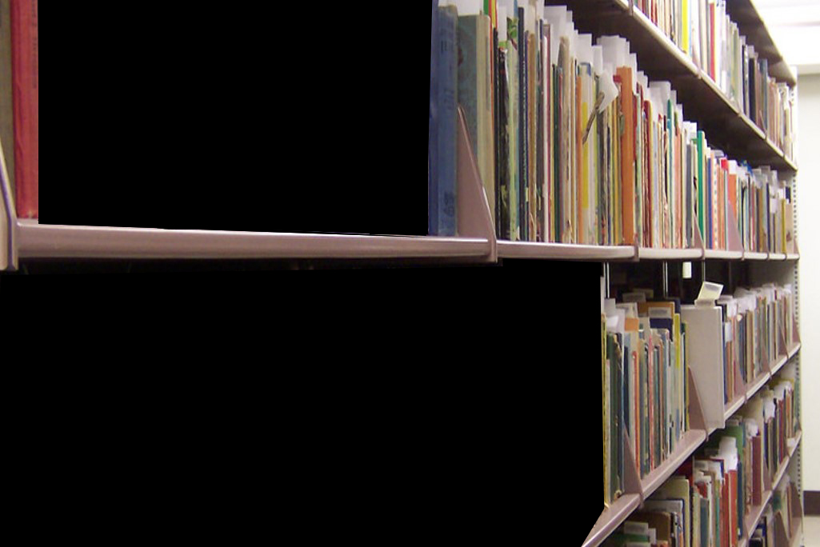
Notes:
We know that, thanks to cooperative collecting done for so many decades that only a small portion of our collections overlap. We also know that we’ve lost much of what could have been in our collections.
This is the work that inspires me and that I want to build upon. In the process of earning my PhD, focusing on videogames, electronic literature, and comics, I realized I wanted to do work that was inherently and always collaborative. I learned about UF’s Digital Library Center from a job posting that said UF was open to non-MLIS applicants with technical skills. Every day meant seeing rare materials. At least weekly, I saw something that the world didn’t know existed or had thought lost, not listed in any library databases or scholarly guides. UF’s children’s literature collection alone is comprised of over 100,000 volumes, with half expected to be the only copy known to exist in the world. And, these are published books that had many more copies than the countless diaries, scrapbooks, and letters, telling stories of love and revolution. Some materials are fragile. Some so fragile that as a page is turned, it turns to dust.
It was at UF that I met the Digital Library of the Caribbean, dLOC, which began as a dream by multiple library and archive leaders in the Caribbean. The dream began with 1990s era internet, and the belief that collaboration was the only way to work, given limited resources and because we must work together to grow capacity and community. In the governance documents and meeting notes, in dLOC I found exactly what I wanted to see everywhere: a collective dream and the will and ways to make it happen.
dLOC began before the digital. One of the hallowed stories of the University of Florida Libraries tells of when UF sent a librarian on a boat in the 1950s and 1960s to the Caribbean to acquire cultural and historical materials. Letters from UF’s Library Director and show that the travel was essential for the success of both the preservation and collecting work and also, critically, for the communication and community-building with other institutions. As a result, the Libraries are a trusted partner in Caribbean Studies and hold the world’s best collection of Caribbean materials. The seeds of collaboration and community-building continue to take root. UF is a founding partner and the technical host of the Digital Library of the Caribbean (dLOC), a collaborative, international digital library. dLOC originally focused on building content, and has grown into the largest open access collection of Caribbean materials with over 3 million pages of content, over 50 institutional partners, and over 3 million views each month.
As libraries examine collections with new eyes considering diversity, equity, and inclusion, all research libraries in North America have Caribbean collections because the history of the US is the history of the Caribbean, of slavery, of fights for freedom, immigration, and hope. Our needs for equity include our collections and our people. And, so many of the people in our libraries and our academic institutions are Caribbean-connected, with family ties and histories. To continue forward, we must always bring our pasts with us, as well as our hoped for futures.
The gaps on our shelves are also in our communities. I was speaking with a colleague at the Library Publishing Forum in 2018, held at the University of Minnesota. In the conversation, I was sharing on work with dLOC, and asked my colleague if he had ideas or areas that he would like to collaborate on regarding the Caribbean because there’s so much to be done. My colleague, who is from another ARL in the eastern US, responded that our conversation was the first time where being Caribbean had ever been a privilege for him. Research libraries and academia are overwhelmingly white. We know our colleagues of color face micro- and macro-aggressions, outright discrimination, and face higher service demands, all while others diminish and dismiss concerns on the critical urgency of now for diversity, equity, and inclusion.

Slide 3
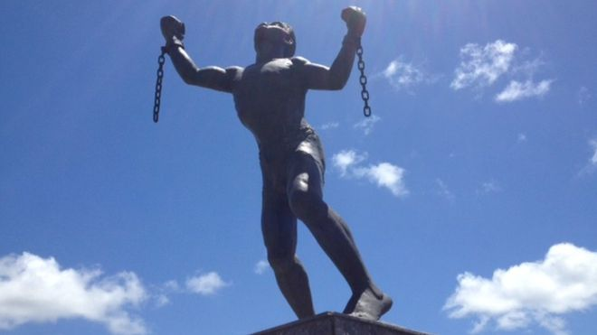
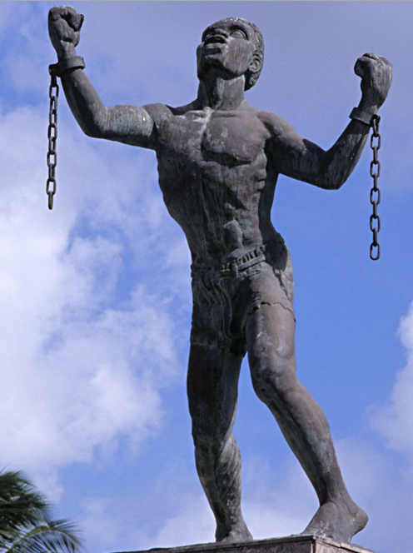
Notes:
http://www.blackpast.org/gah/bussa-rebellion-1816
http://www.loopnewsbarbados.com/content/bussa-statue-wows-us-activist-its-powerful-symbolism
Our collections in academic and research libraries in North America have developed following our histories. These histories are always also Caribbean histories, telling stories of the migration, colonization, slavery, freedom, and independence. Yet, our collections do not always show their connections. We also do not always make the connections with our collections and our communities. Virginia Woolf talks about the great absences, the books missing from our bookshelves because sexism and oppression prevented women from writing (https://ebooks.adelaide.edu.au/w/woolf/virginia/w91r/chapter3.html).
We still have these gaps, and some we can correct. Consider children’s literature written in Barbados, Trinidad, and Jamaica, when they were British colonies. How have we cataloged these? Is there a way to connect these to researchers who are working in Caribbean Studies, Atlantic Studies, Early American Studies, Hemispheric Studies? We have seen our ethical standards evolve to support surfacing diversity in our collections, and digital humanities projects to mine digital collections to find lost authors. This critical work aligns collections for a fuller representation of the world, and for best supporting research. In the digital age, we have seen researchers’ fields grow from more narrowly defined and confined to one location to a wider approach, and our collections need to support this work.
We also have a call to correct the same gaps in our communities. We are working to improve diversity, equity, and inclusion in our libraries. This includes working to enlarge the pipeline for people entering librarianship and to retain people. In our libraries, we have many people connected by heritage to our Caribbean collections.
Shirley Chisholm’s quote “If they don't give you a seat at the table, bring a folding chair;” reminds of the spaces on the bookshelves for the books that could not be written. We have so many of the books that have been written, and we have so many wonderful members of our community, and we need to do more to allow the books to be found and the voices of our community members to be heard. We have enough chairs at the table, but we cannot always get people to the room, the table configuration is often wrong, and we need to empower more people to speak to enable new types of conversations.
Working with dLOC, I would like to ask for your help in sharing a program to fill the empty shelves, and to bring our colleagues to the table. I would like to invite our Caribbean connected professionals, connected to collections and by heritage, to visit with dLOC in informal meet-ups at several conferences in the coming year, which have a document to share listing these, along with on an upcoming virtual call.
Additionally, the document includes information on site visits and table gatherings. For the site visits, I am also writing to offer help from dLOC. Our community members want to make connections. I would greatly benefit from the opportunity to collaborate with your institutions, speak to your people and learn about your collections as connected with the Caribbean. I am available to support table gatherings by giving virtual presentations on dLOC for connections to collections and communities. If travel funding is available, I am available to visit in-person.
As we learn more about each other’s collections and communities, we will have more opportunities to connecting internally and externally for justice, and to find the ways to best see our collections and communities together, to make spaces at our tables, and close the gaps on our shelves.
Statue, how do we remember? Where do our pasts lead for our futures?

