Slide 1
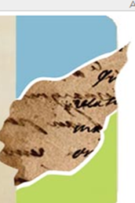
The Digital Library of the Caribbean and Digital Humanities:
Opportunities and Resources for Research, Teaching, and Collaboration
12th Annual Symposium, Spanish & Portuguese Studies, University of Florida
Hélène Huet, hhuet@ufl.edu
Leah Rosenberg, rosenber@ufl.edu
Laurie Taylor, laurien@ufl.edu
www.dLOC.com

Slide 2
About Us
Leah Rosenberg, rosenber@ufl.edu
Hélène Huet, hhuet@ufl.edu
Laurie Taylor, laurien@ufl.edu
Notes:
I find DJ Water’s definition of a digital library elucidating because it makes clear that digital libraries have as part of their core mission, not only preservation and access– but also the responsibility of explaining the significance of the collection for the public. Implicit in selecting, structuring, interpreting is a partnership between librarians and scholars who can help to select, explain the significance of, and present elements of the collection.
Waters, D.J. What Are Digital Libraries cited in Shamin Renwick’s “Caribbean Digital Library initiative

Slide 3
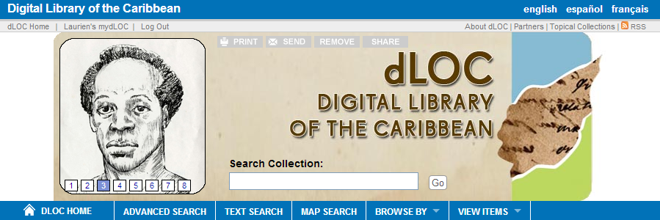
Digital Library of the Caribbean
dLOC's diverse partners serve an international community by working together to preserve and provide enhanced access to materials. dLOC's partners collaborate with scholars and teachers to perform educational outreach, create new works of digital scholarship, and develop other research and teaching initiatives.
Partner Training
Shared Infrastructures
Institutional Support

Slide 4
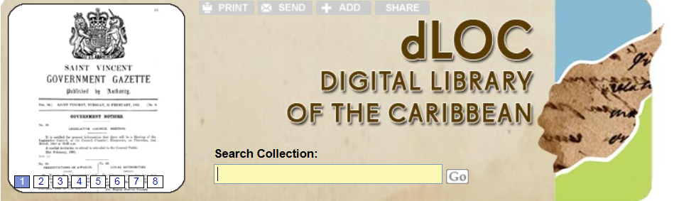
dLOC Quick Facts
Began with a dream and the vision laid out in 2004
Shared Governance
Training Program: Digitization, Data Curation, and More
Content Management System and Long-term Preservation
Over 41 Partners – Caribbean, Europe and US
  Over 94 million hits since 2006
  Over 3.1 million pages of open access content
  Over 21,000 titles with over 132,000 items
Scholarly Collaborations
Educational Outreach

Slide 5
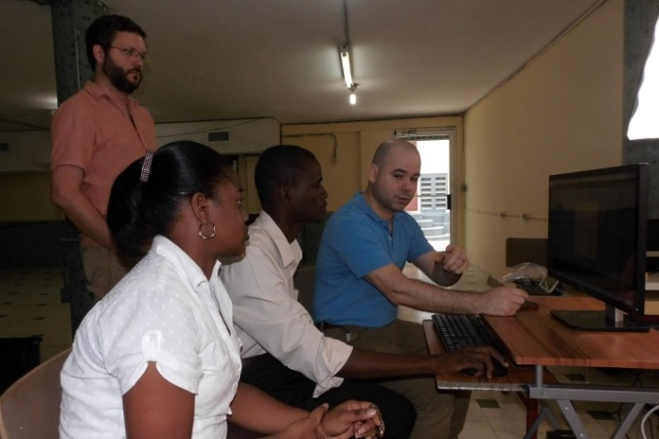
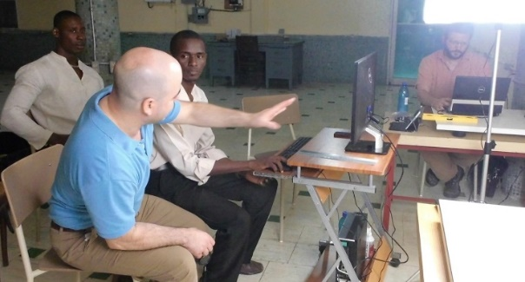
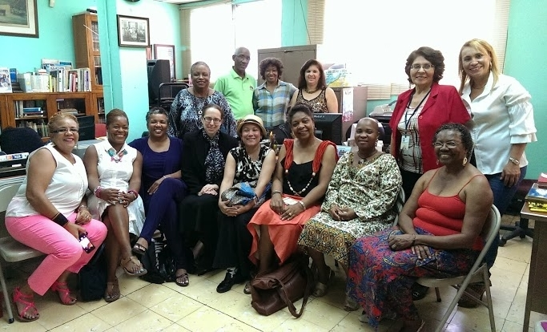
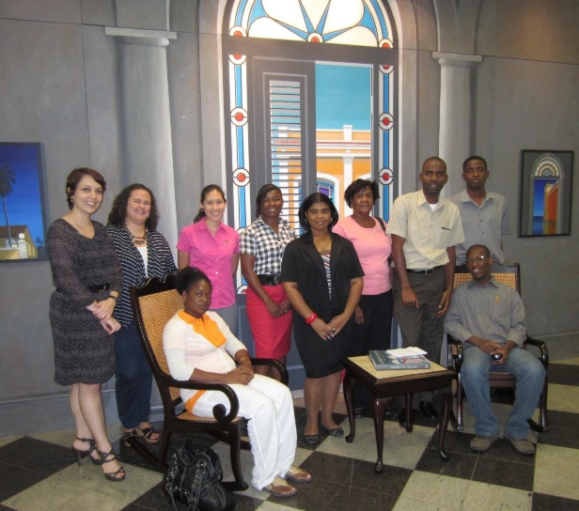
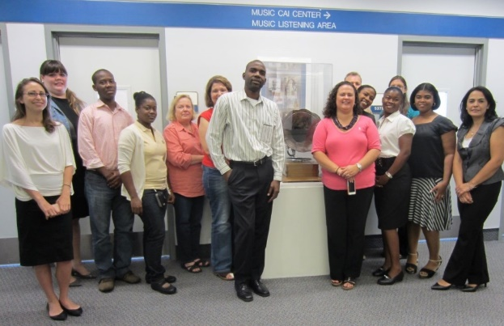
dLOC Communities

Slide 6
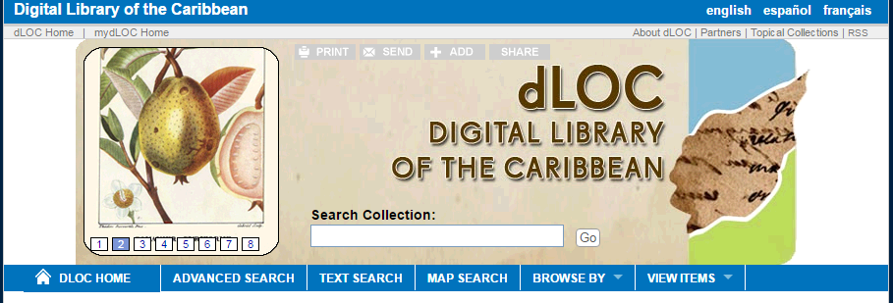
Basic Search
The basic search allows you to access bibliographic citation information of the items in dLOC. Just enter the search term from any computer with Internet access.
Notes:
All materials also searchable through various library catalogs and through Google. All materials are structured for search engine optimization and for maximum interoperability to ensure materials are found.

Slide 7
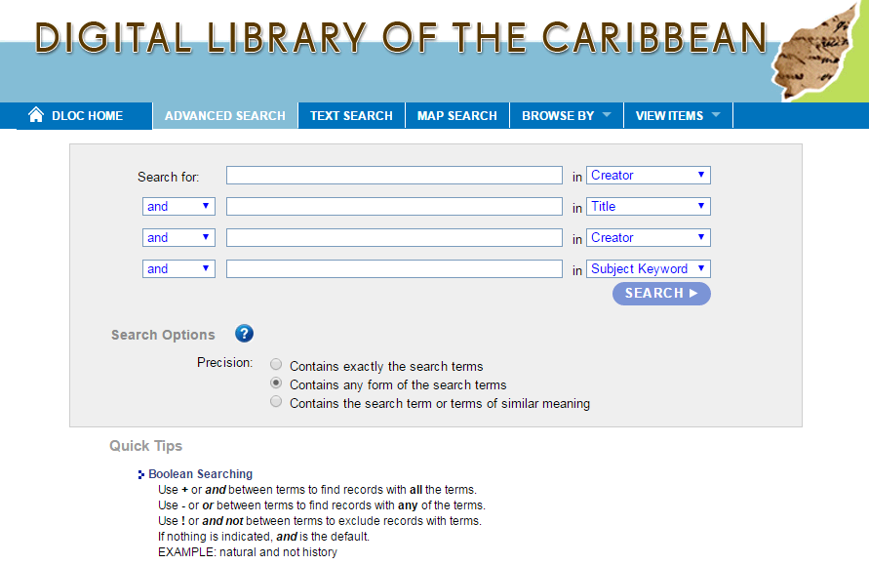
Advanced Search
The advanced search feature will allow you to restrict your search terms by categories such as title, author, subject keyword, country and more.

Slide 8
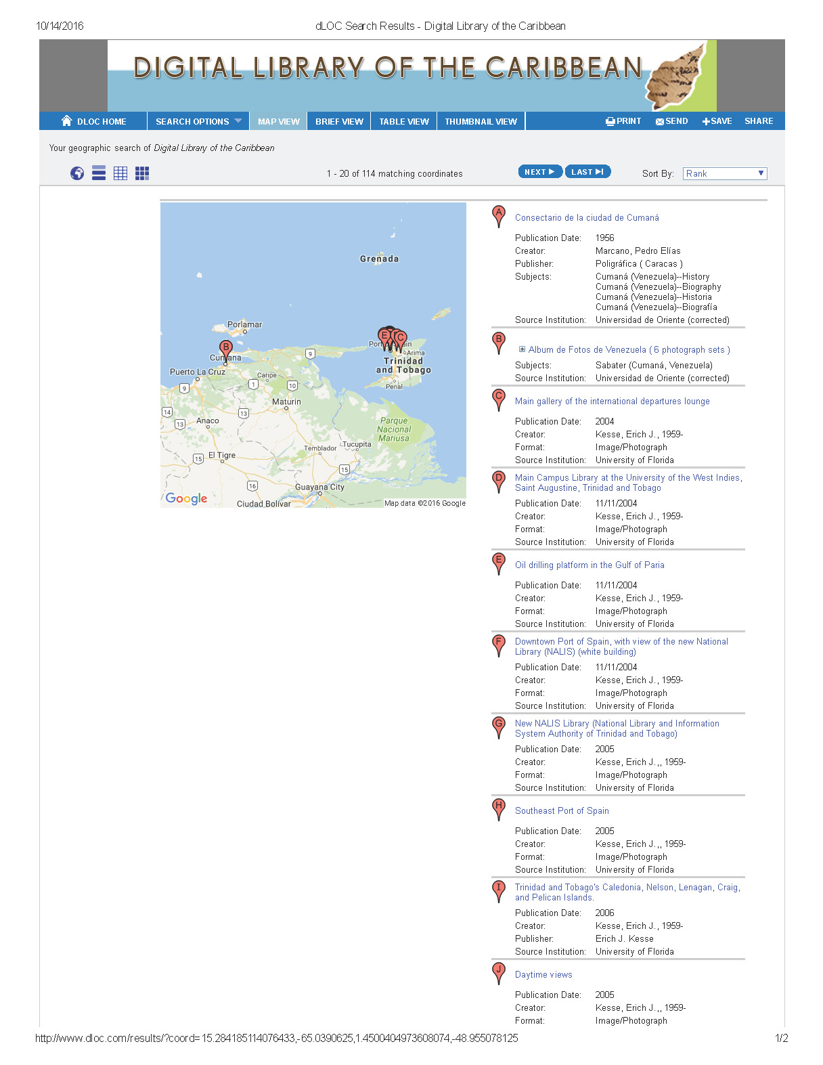
Map Search
If you are looking for items with discrete geographic locations, use the Map Search feature. You can also view the results in Map View.

Slide 9
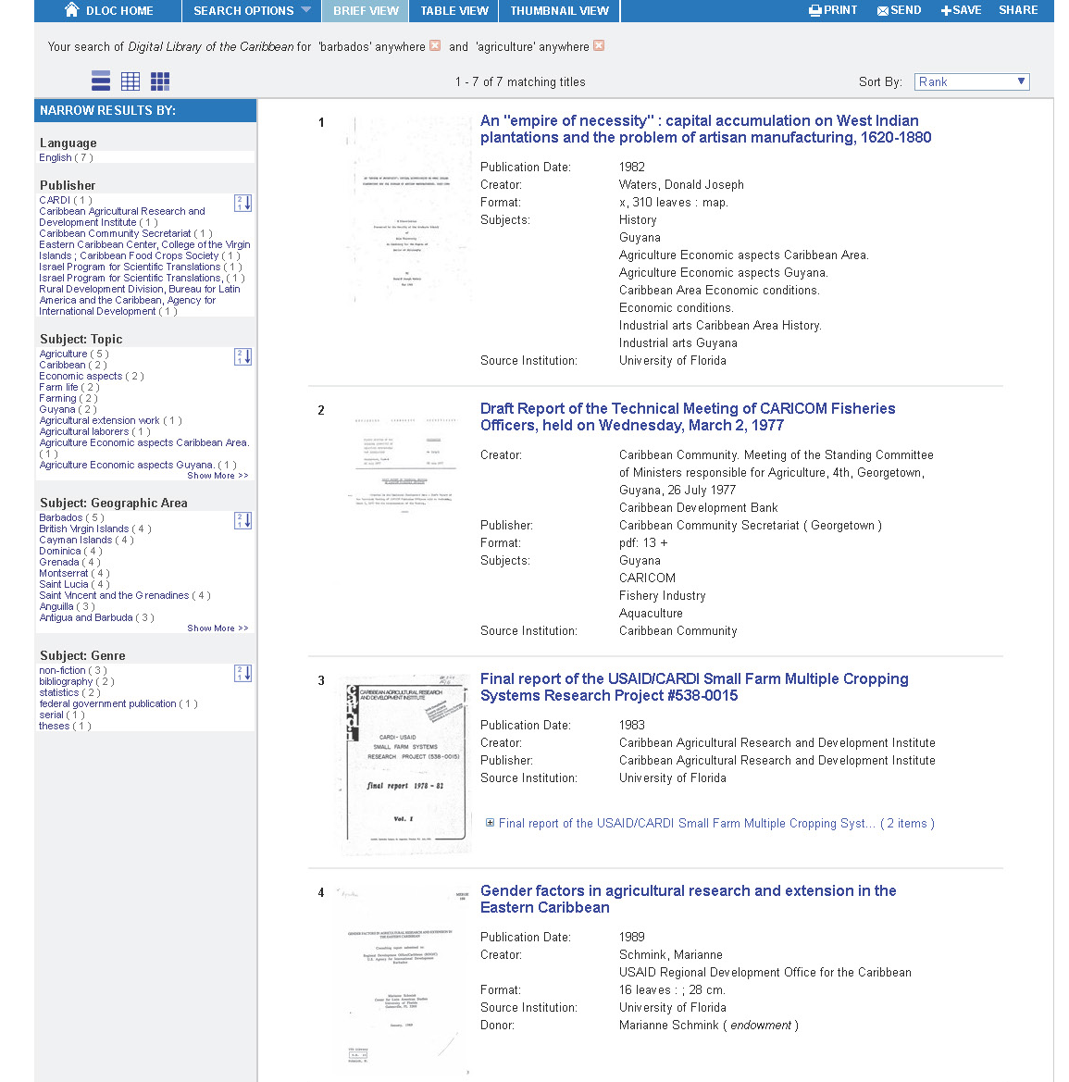
Faceted Searching
Expand or narrow the results by selecting the related search terms in the box to the left.
Options for faceted searching include: publisher, geographic area, subject keywords and more.

Slide 10
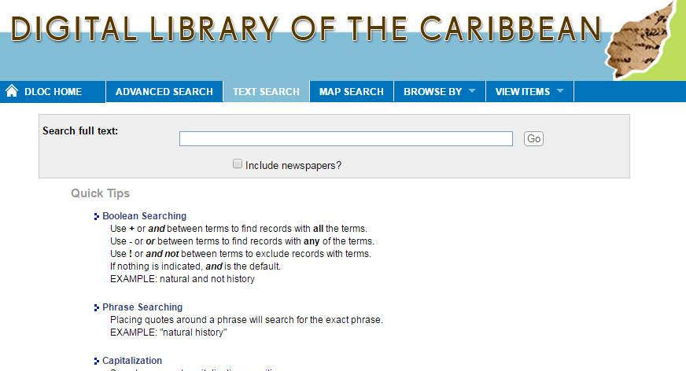
Full Text Searching
Searches full text, and presents snippets of the text in context.

Slide 11
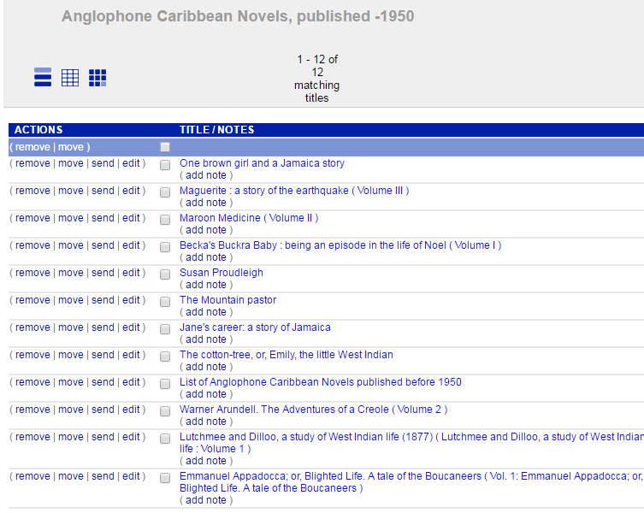
mydLOC Registered Users
Registration is optional. Registering enables user features, including: creating public and private bookshelves and saving searches.

Slide 12
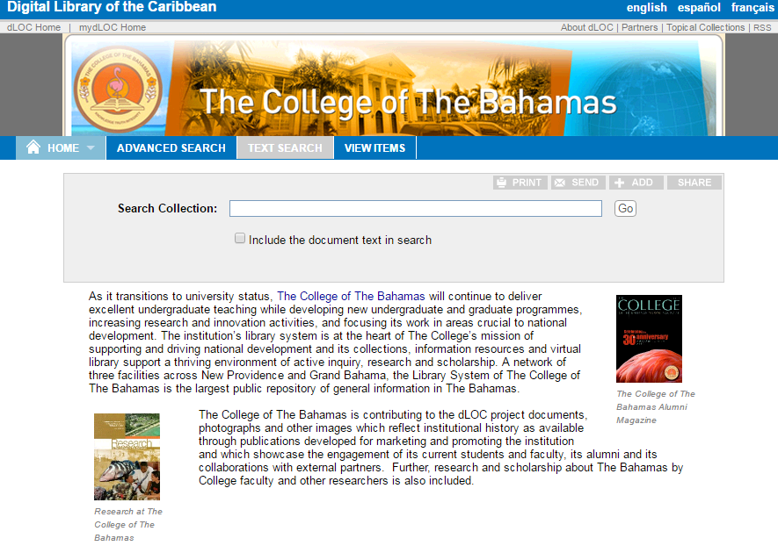
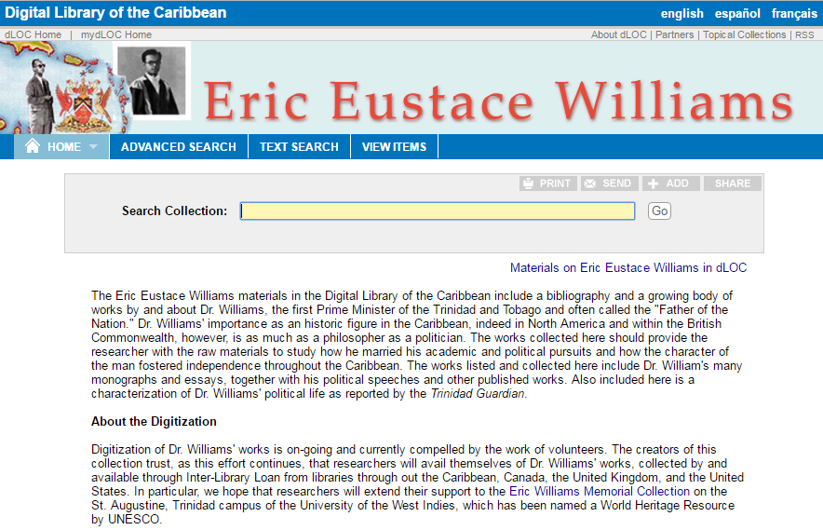
Partner & Topical Collections

Slide 13
Flora, Landscape and Architecture
SCIENTIFIC RESOURCES ANTHROPOLOGICAL REPORTS
RELIGIOUS MATERIALS
HISTORY OF SLAVERY
NEWSPAPERS
PLANT SPECIMENS
ARCHITECTURE
LAW & LEGAL MATERIALS DATASETS
ECOLOGY
SUSTAINABILITY
PRISONS
INDEPENDENCE
SCHOOLS & EDUCATION
Caribbean plants vouchered and expertly identified by Dr. Scott Zona during his 25 years of botanical research in the Caribbean.

Slide 14
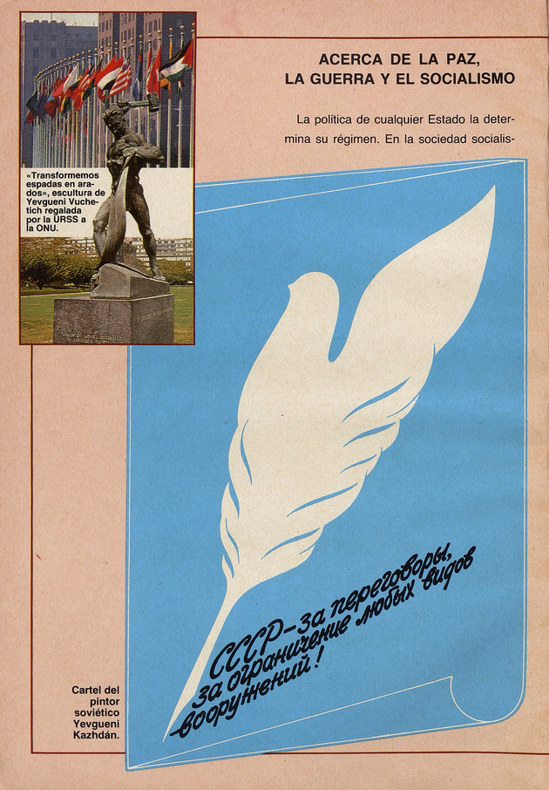
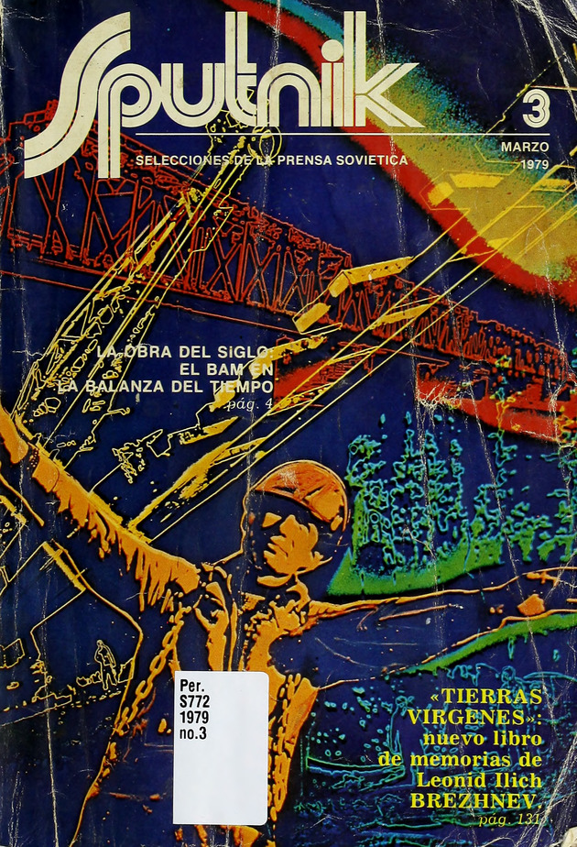
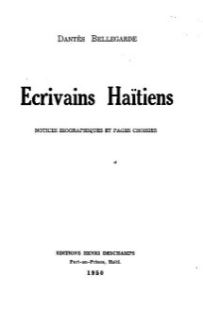
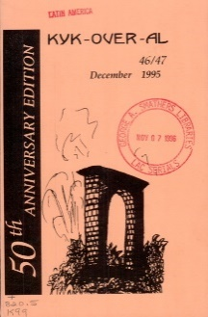
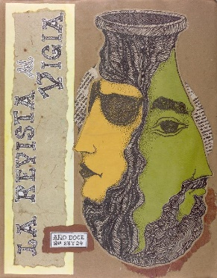
Title: Kyk-Over-Al
Author: British Guiana’s Writer’s Assn
Year: online from 1948 - 1995
Contributor: University of Florida
Title: La revista del Vigía
Author: Ediciones Vigia
Year: 1990
Contributor: University of Florida
MAGAZINES
Title: Ecrivains Haitiens
Author: Dantes Bellegarde
Year: 1950
Contributor: Bibliotheque Haitienne des Peres du Saint Esprit

Slide 15
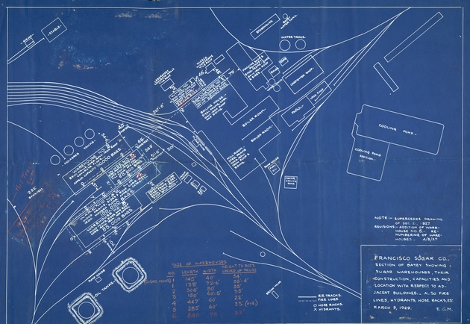
MAPS
www.dloc.com/UF00016656

Slide 16
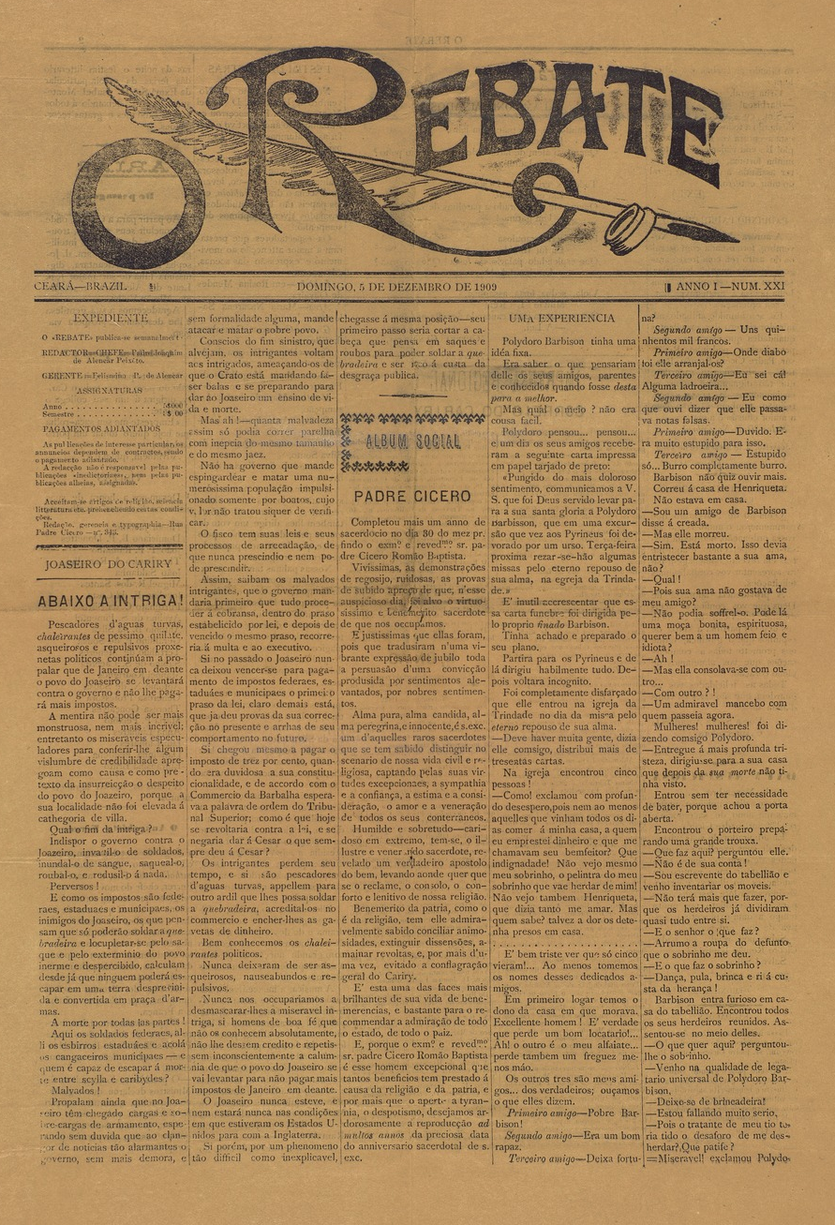
CULTURE & ARTS
CARICOM is building a comprehensive collection of CARIFESTA materials
Alan Lomax photographs
Maya Deren recordings
www.dloc.com/AA00001672

Slide 17
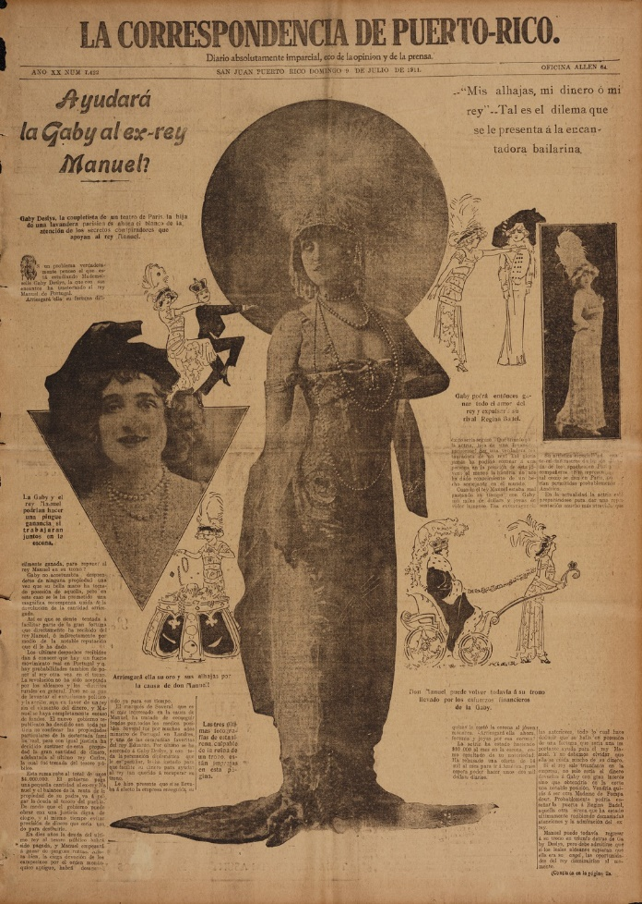
RECENT ADDITIONS
Newspapers:
University of Puerto Rico, University of Curaçao, Duke University
Postcards from Cuba from FIU
Teaching materials
Oral Histories
Webinars

Slide 18
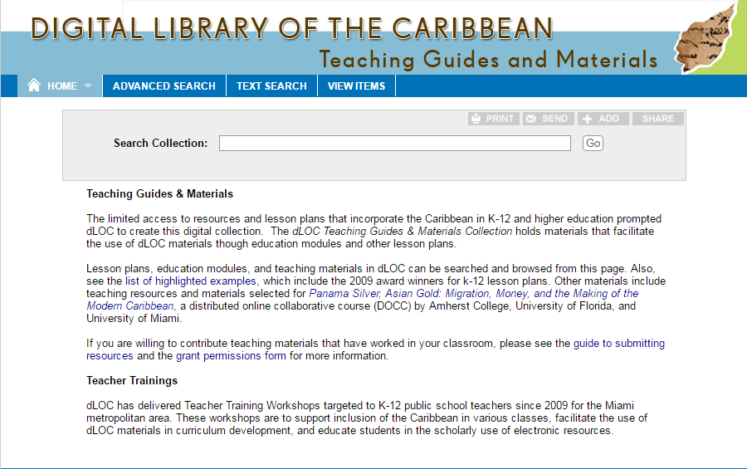
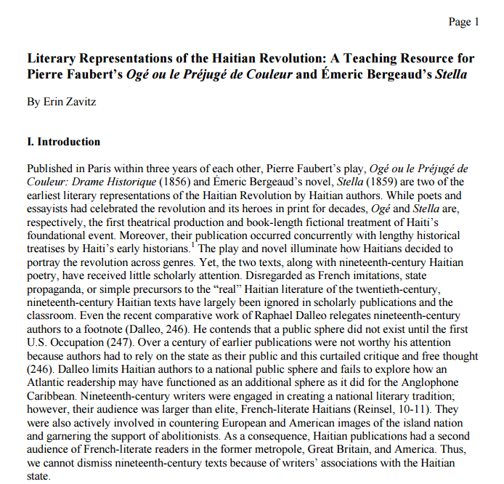
DIGITAL PEDAGOGY
www.dLOC.com/teach

Slide 19
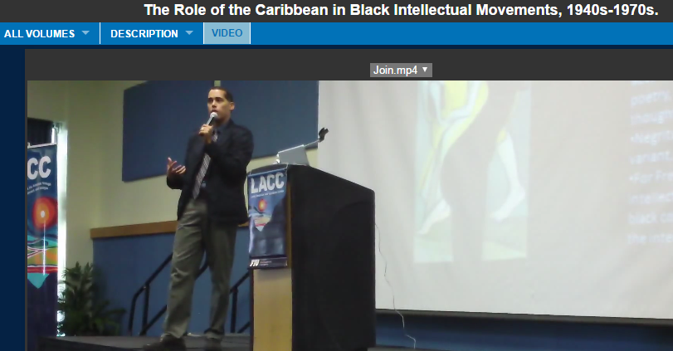
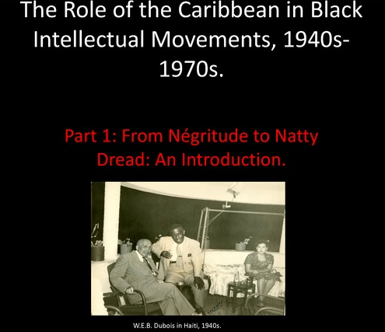
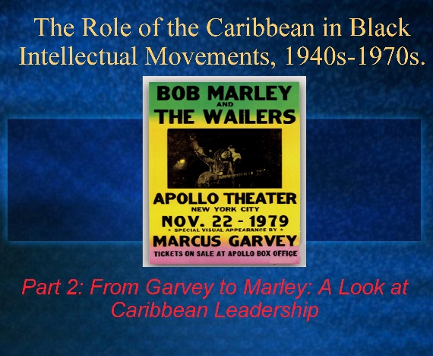
TEACHER TRAINING & GUIDES
Notes:
http://www.dloc.com/IR00000277/00001
http://www.dloc.com/AA00001650/00001?search=matthew+=smith
http://www.dloc.com/IR00000278/00001?search=matthew+=smith
http://www.dloc.com/AA00009712/00001?search=zavitz

Slide 20
Humanities in & for the digital age (data age)
eResearch
e-Science
Big Humanities
Digital Humanities (DH)
Digital Scholarship
Digital History
Public Humanities
Humanities Computing
Spatial Humanities
Notes:
Slide defining DH
Term of tactical convenience
Other terms for DH; fundamentally collaborative

Slide 21
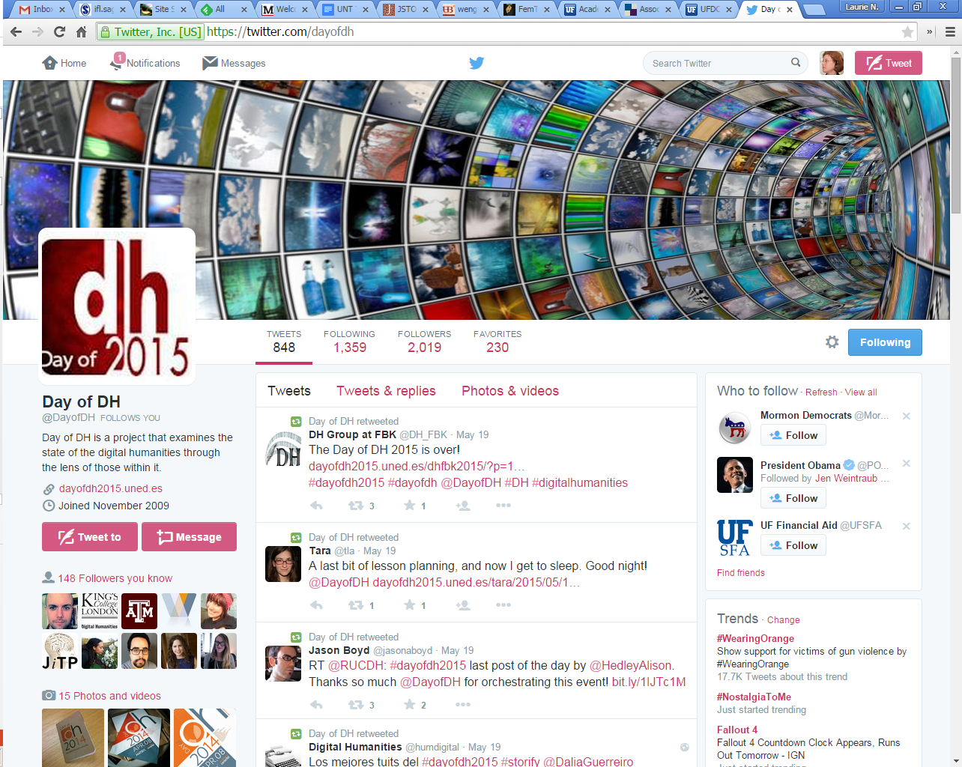
Digital Humanities and Sharing
From Indian to Indo-Creole: Tassa Drumming, Creolization, and Indo0-Caribbean Nationalism in Trinidad and Tobago, by Christopher L. Ballangee, 2013, all rights reserved by the author, in the UF Digital Collections.
Notes:
Supplemental data/digital files for dissertation by Christopher Ballengee for Tassa Drumming and Indo-Caribbean Identity in Trinidad and Tobago: http://ufdcimages.uflib.ufl.edu/IR/00/00/31/61/00001/11_Calypso.mp3
Day of DH, way to share and communicate on your work
Work with others; DH is fundamentally collaborative
THATCamp

Slide 22
UF Digital Humanities Certificate
What is it?
Way of enhancing current teaching and scholarly approaches
Connects the humanities to digital initiatives at UF on the theory that those digital techniques offer ways of altering our engagement with the humanities
Notes:
How it draws upon and brings things together, and then grows out

Slide 23
DH Certificate
March 7, 2014, Elizabeth Dale:
This proposal sets out two models for a digital humanities certificate. The first builds on pre-existing courses and treats digital humanities as a way of enhancing current teaching and scholarly approaches. The second connects the humanities to digital initiatives at UF on the theory that those digital techniques offer ways of altering our engagement with the humanities. The two models are not mutually exclusive, there can and should be overlap, but the training and skills involved would be quite distinct.

Slide 24
Smathers Graduate Student Internship Program
Provides semester-based graduate student internships in the George A. Smathers Libraries in collaboration with academic units.
Fosters transformative collaboration across campus.
Example of one dLOC Internship:
  No tutorials on dLOC prior to the ones created during internship
  Tutorials in Spanish: showcases this language as one of the many languages in its collections + supports dLOC’s ongoing efforts to enhance its website’s accessibility and ease of navigation for Spanish-language users.
  Generate interest among Spanish-speaking scholars (webinar)
  Open door to new partnerships and collaborations
  New professional experience/skills for intern
For more information: http://cms.uflib.ufl.edu/interns/Index.aspx
http://dloc.com/results/?t=morales%20%20francesc

Slide 25
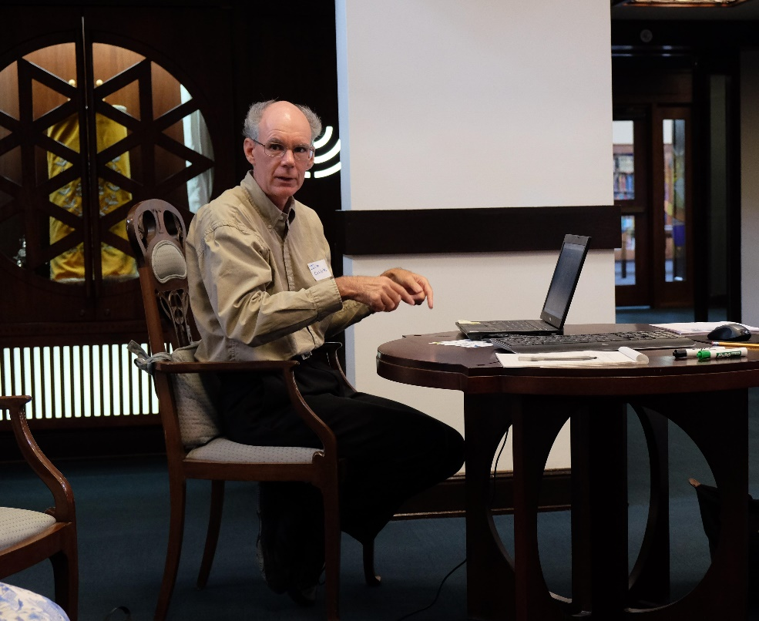
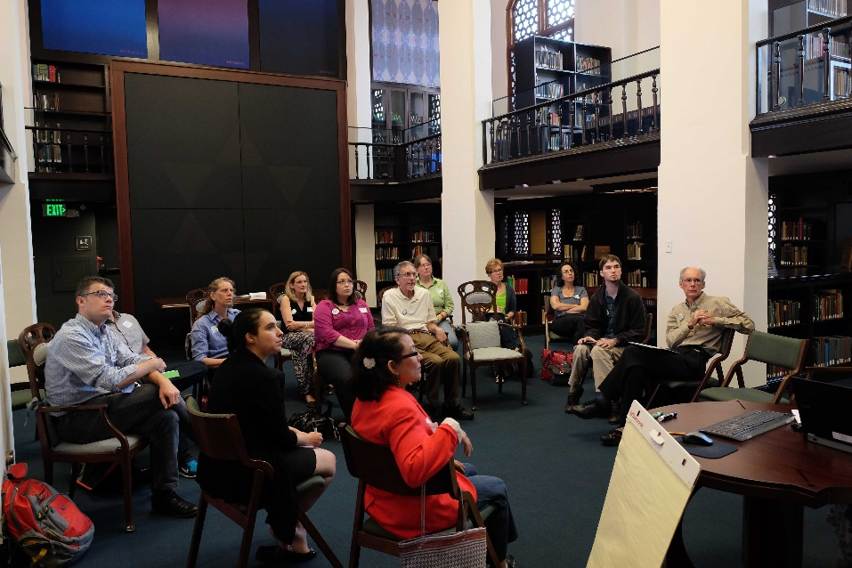

Building Communities
THATCamp Gainesville 2015, presentations and discussions in the Judaica Suite & www.fldh.org
Notes:
DH Grad Certificate
DHWG Meet-ups
THATCamp-Gainesville
Libraries, labs of the humanities: Trainings in the libraries, and space/place with the Nygren Studio
DH resources statewide, building with:
Florida Digital Humanities Consortium
THATCamps
Meet-Ups
Programming Historian Study Group
Area/field specific groups:
Zora Neale Hurston Festival, example of academic component and opportunities there

Slide 26
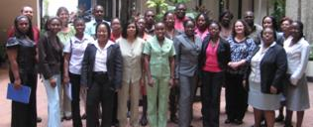


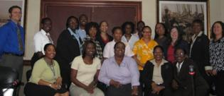
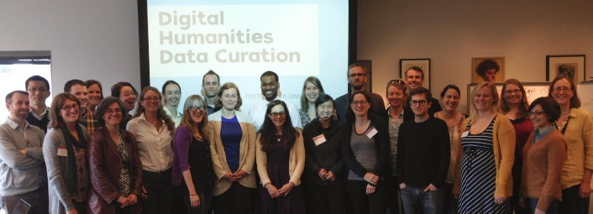

IMAGINING TOGETHER

Slide 27
Digital Libraries Are More than Digital Books
Digital Libraries… provide the resources, including specialized staff to:
select,
structure,
offer intellectual access to
interpret,
distribute,
preserve the integrity of, and
ensure the persistence over time of collections
From D.J. Waters, “What Are Digital Libraries.”
Notes:
I find DJ Water’s definition of a digital library elucidating because it makes clear that digital libraries have as part of their core mission, not only preservation and access– but also the responsibility of explaining the significance of the collection for the public. Implicit in selecting, structuring, interpreting is a partnership between librarians and scholars who can help to select, explain the significance of, and present elements of the collection.
Waters, D.J. What Are Digital Libraries cited in Shamin Renwick’s “Caribbean Digital Library initiative

Slide 28
Scholars Partner with dLOC to:
Review and balance out perspectives
Select, digitize and curate materials
Help to get permissions for materials
Provide support to instructors teaching Caribbean subject matter
Notes:
These are the four projects that dLOC and scholars can collaborate to accomplish:
Review and balance out perspectives of the digital collection (identify materials that fill in gaps. (Example materials on Indian and Chinese migration to the Caribbean)
Select, digitize and curate materials—HELP MAKE SENSE OF THE MATERIALS AND CLARIFY THEIR SIGNIFICANCE
Help to get permissions for materials Encourage libraries to join as dLOC members
Provide pedagogical for teaching support

Slide 29
dLOC, Home for Academic Infrastructure
dLOC can:
Facilitate collaborative teaching and research across geographic and institutional boundaries
Digitize needed materials for teaching and research
Build the foundation for an ongoing process of collaborative knowledge production
Notes:
What dLOC does in this partnership:
provide a location, and often various forms of assistance from funding to practical advice and technological training
to help faculty and students bring together their resources to produce new knowledge for the field.
It has the potential to become a vibrant and self-sustaining part of the infrastructure for Caribbean studies.
dLOC as home for an Academic infrastructure
Much as the Caribbean is fragmented geographically, linguistically, Caribbean studies and scholars are fragmented among departmetns and disciplines, many live and work with few if any colleagues in the field. dLOC can provide a place for us to meet, share knowledge and resources and to create knowledge and resources, to make them available to others, and thus enable others to continue the process of producing knowledge and resources for the far-flung, interdisplinary community of Caribbean scholars –and the general public interested in the Caribbean.
Bringing faculty and students from different institutions and countries together to pool their knowledge and resources
And together to produce knowledge that will be made available for everyone with internet access

Slide 30
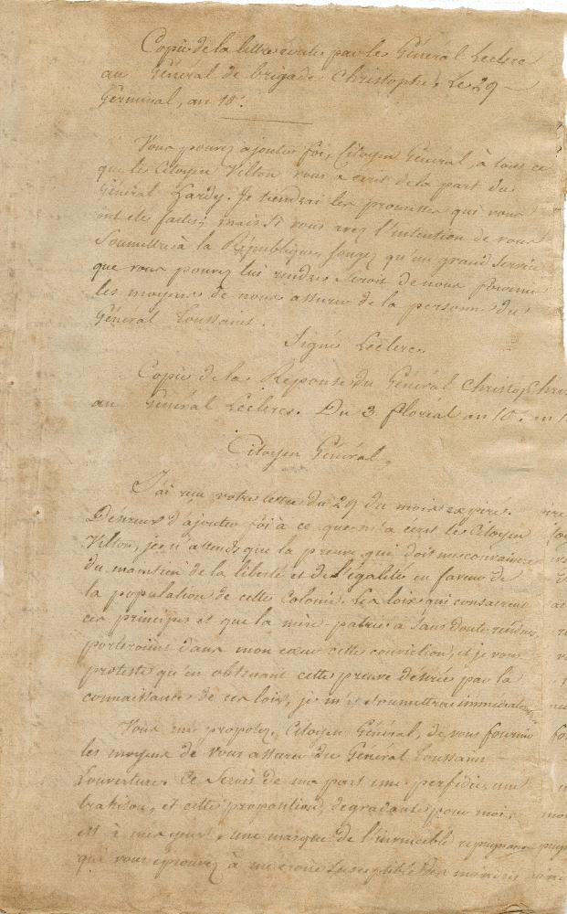
dLOC is Inclusive and Eclectic
All partners determine what they will contribute from their collections
As a result a letter from General Emmanuel Leclerc to Brigade General Henri Christophe, from 19 April 1802
And many other documents from Haiti’s history
Notes:
The Digital Library of the Caribbean is an international Partnership, with over 30 partners in the Caribbean, the United States, and Europe??. Partners and members choose what materials in their collections they would like to include, so dLOC is eclectic and inclusive in regard to place of origin, For example, it contains such diverse and potentially conflicting materials as government records from the newly independent Haiti in early 19th century, Yearbooks from the U.S. highschool in Guantanamo Bay; and archival information about Haitian and Cuban refugees at the U.S. Base in Guantanamo Bay. It includes the Trinidadian and Jamaican political journals of critique and protest such as Tapia , Struggle, and Abeng. But it also includes a wide variety yachting magazines part of the tourist industry

Slide 31
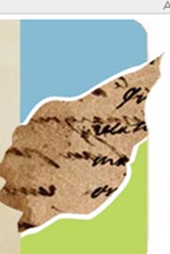
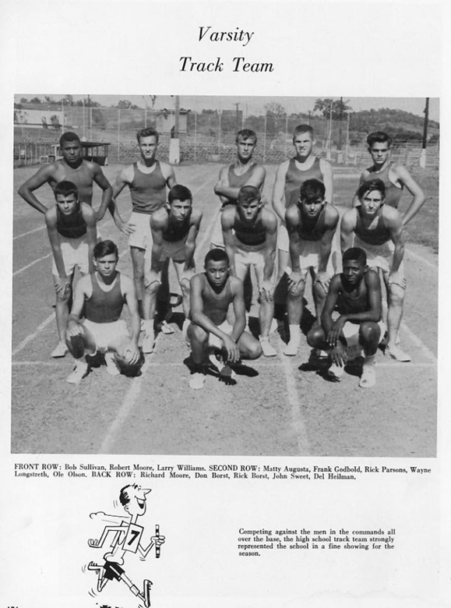
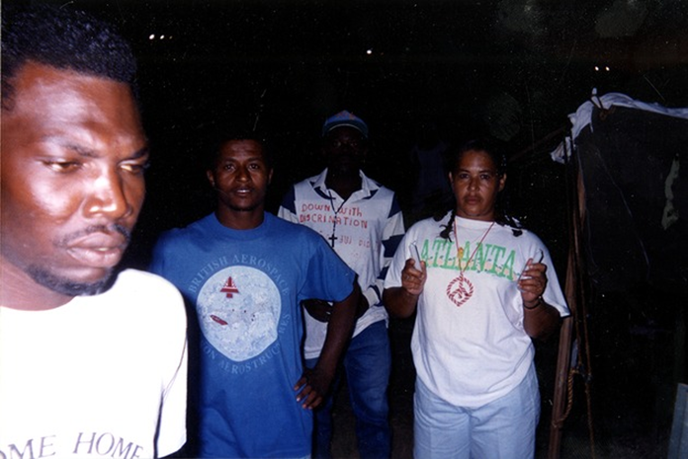
Are just a click away from: photographs of Haitian Refugees at the U.S. Base at Guantanamo Bay
And Yearbooks from the Sampson High School, at the U.S. military base at GTMO, 1949 – 1965

Slide 32
What Scholars Can Do
Provide invaluable context to make sense of these diverse materials
Identify and help to ameliorate critical gaps in the collection.
Why this matters: This material is available to anyone with internet access and will be available in perpetuity, so what goes into the archive and how it is presented will shape the understanding of Caribbean culture and history now and long into the future.
Notes:
dLOC’s academic advisory board and other scholars has the job of identifying gaps and working to fill them.
For instance, just by accident, I did a search of materials on indenture, Indians and Chinese in the Caribbean and came up with very few materials, and I have been working with the administrators at dLOC and with my colleagues to identify materials and to raise funds to address these gaps.

Slide 33
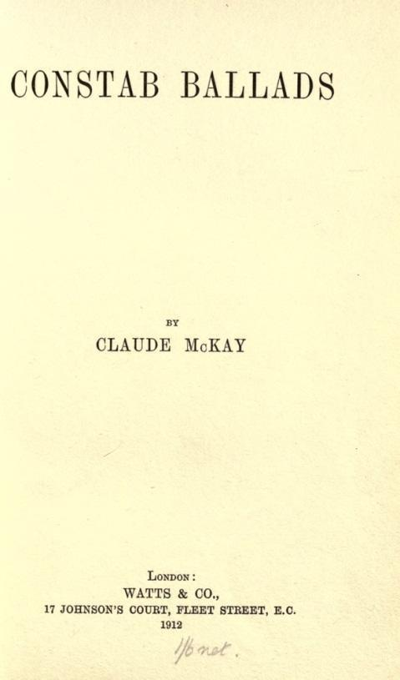
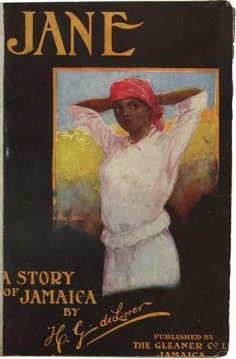
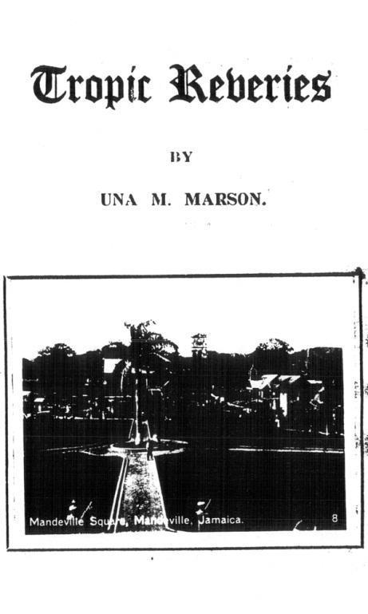
DOCC: Original Inspiration and Objectives:
To teach dLOC’s growing collection of Early Anglophone Caribbean literature and provide explanatory materials for scholars, students, and the public.
J.J. Thomas Froudacity
Claude McKay Songs of Jamaica
and Constab Ballads
The Poetry of Una Marson
The All Jamaica Library
The Independence anthology of
Jamaican literature
And, nearly all books written
by Herbert de Lisser
Notes:
Since 2007, I have been working with dLOC’s scholarly advisory board and librarians to build its collection of Early Anglophone Caribbean literature
In 2011, the National Library of Jamaica had just digitized Planters’ Punch (http://ufdc.ufl.edu/AA00004645/00002) and added to the Digital Library of the Caribbean. Edited by de Lisser for the Christmas season, the large glossy magazine covered Jamaican society between WWI and WWII and published as well essays on Jamaican history and literature. It is a key source of for both historians and literary scholars. De Lisser published roughly 24 novels and novellas and least were published only in Planters’ Punch (see, Rosenberg “List of Anglophone Caribbean Novels published before 1950,” http://ufdc.ufl.edu/AA00011396/00001. Even if people were to happen upon it while surfing the web, there were was little in the catalogue information to explain its significance, nor were there articles or other explanatory documents elsewhere online. Prior to 2011, Planters’ Punch was housed only in the National Library of Jamaica and the Jamaica campus of the University of the West Indies. Now anyone with internet access could read it.
Yet, it was quite possible that no one knew that the journal had become available. Even if people were to happen upon it, there was little in dLOC or elsewhere to explain its significance. To address this challenge, Professor Rhonda Cobham-Sander suggested that we work together and with librarians to design a course to teach students how to produce annotations, enhanced metadata, and other guides and scholarship to elucidate the significance of this work for dLOC users.

Slide 34
Panama Silver, Asian Gold: Migration, Money, & the Making of Modern Caribbean Literature: Course Description
Concurrent migrations of Chinese and Indian indentured laborers to the Caribbean and Afro-Caribbean workers to and from the Panama Canal, at the turn of the twentieth century, profoundly influenced the style and scope of modern Caribbean literature. Both migrant groups worked under difficult conditions for exploitative wages, yet members of each managed to save enough to enter the educated middle class. Their cultural forms and political aspirations shaped Caribbean literary production as well as anti-colonial political movements. In this course, students learn how to use digital, print, and audiovisual archival material related to these migrations to enrich their reading of Caribbean literature. Scholars, librarians, and students at the three institutions will collaborate. We will hold some class discussions online and students at all three campuses will learn how to use create finding aids, revise metadata, and produce Digital Humanities projects such as curated exhibits to enhance the digital archives we use. We will read works by Claude McKay, H.G. de Lisser, Marcus Garvey, George Lamming, V.S. Naipaul, Ismith Khan, Ramabai Espinet, Meiling Jin, and Patricia Powell.
Notes:
The course, entitled “Panama Silver, Asian Gold: Migration, Money, and the making of Modern Caribbean Literature,” introduced students to the digital humanities through an analysis of the historical archive, the historiography, and the literary representation of two often overlooked migrations that shaped the modern Caribbean, that of indentured Asians to the Caribbean and that of Caribbeans-mostly Afro-Caribbeans—to Panama

Slide 35
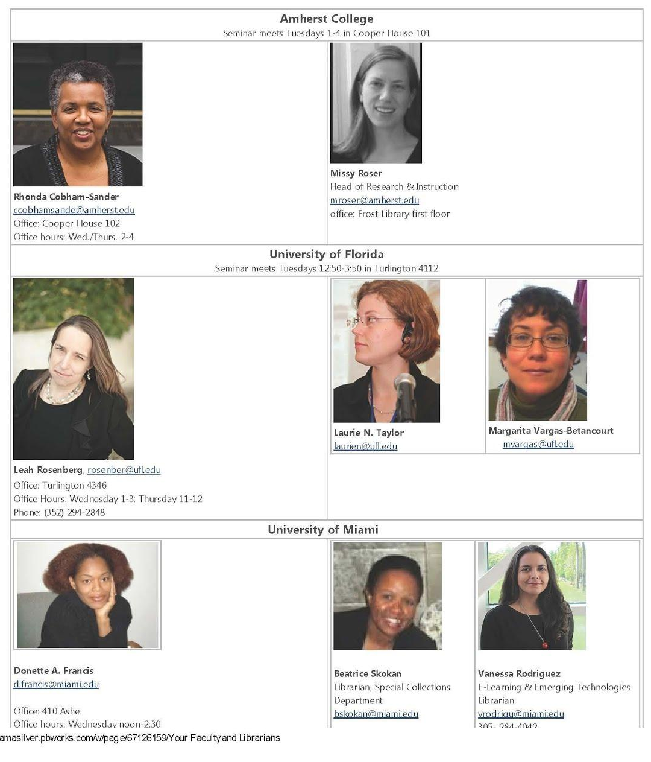
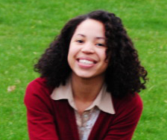
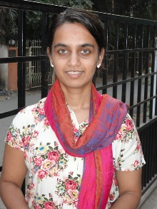
The Collaboration
pilot for intercollegiate digital humanities courses
supported by libraries of all three institutions
taught in fall 2013 and spring 2016 as a hybrid course with collaboration among campuses
Kim Bain, Research Assistant
Dhanashree Thorat, DH expert, PhD candidate
Notes:
This was pilot for intercollegiate digital humanities courses as such we received funding from each institution and libraries at all three institutions contributed enormously.

Slide 36
What is a DOCC? Distributed Online Collaborative Course
A DOCC is a Distributed Online Collaborative Course. It is a feminist rethinking of the MOOC (Massive Open Online Course) that has been widely used in distance learning education. A MOOC is pedagogically centralized and branded by a single institution. FemTechNet seeks to enhance the system using feminist principles and methods that support a decentralized, collaborative form of learning. The fundamental difference is that the DOCC recognizes and is built on the understanding that expertise is distributed throughout a network, among participants situated in diverse institutional contexts, within diverse material, geographic, and national settings, and who embody and perform diverse identities (as teachers, as students, as media-makers, as activists, as trainers, as members of various publics, for example).
Excerpted from FemTechNet:
http://fembotcollective.org/femtechnet/faq-for-femtechnet/

Slide 37
Faculty & Librarian Collaboration
Collaborative design of syllabus including assignments, incorporating archival-research techniques and introducing digital humanities aims and tools
Pooling resources for guest lectures & for digitizing materials (5 guest speakers online, streamed to three campuses, supported by Academic Technology at Amherst and included as videos in dLOC)
Working with librarians from each campus to choose appropriate technology and design technology-based assignments—and then to teach these to students
Notes:
We pooled financial resources, knowledge, and labor. Many other librarians & students contributed, in particular Kim and Dhanashree Thorat who was the DH expert for in my class.

Slide 38
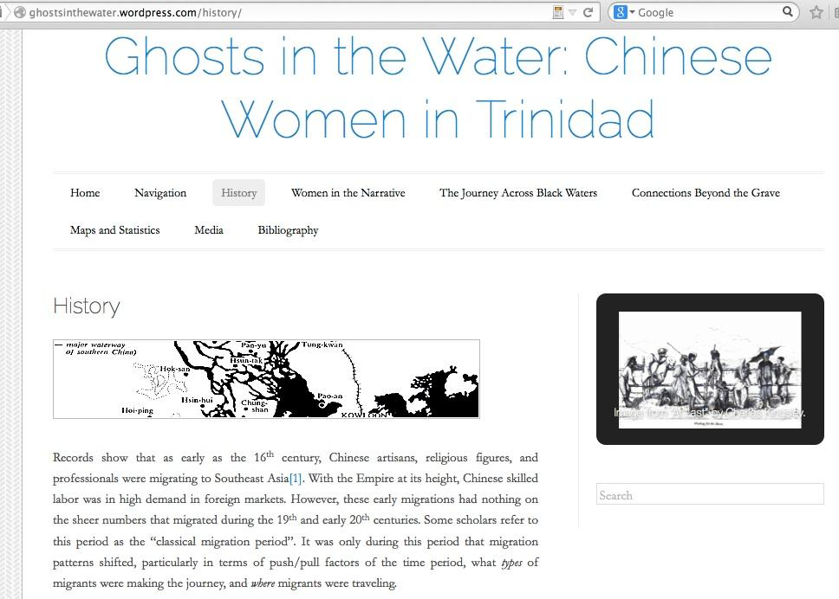
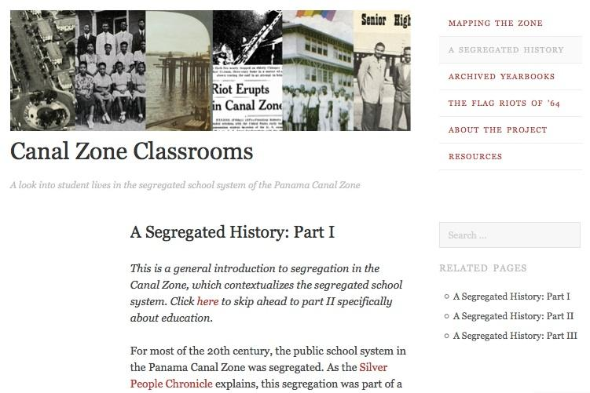
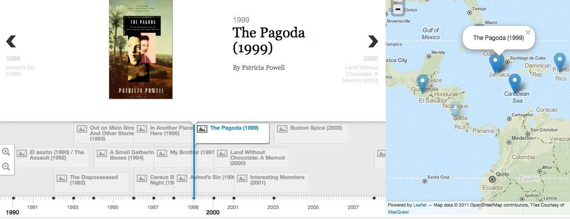
Final projects as exploration of DH + interests
Notes:
The course also taught students DH tools in time lines, mapping, and WordPress—and how to critically assess DH projects.

Slide 39
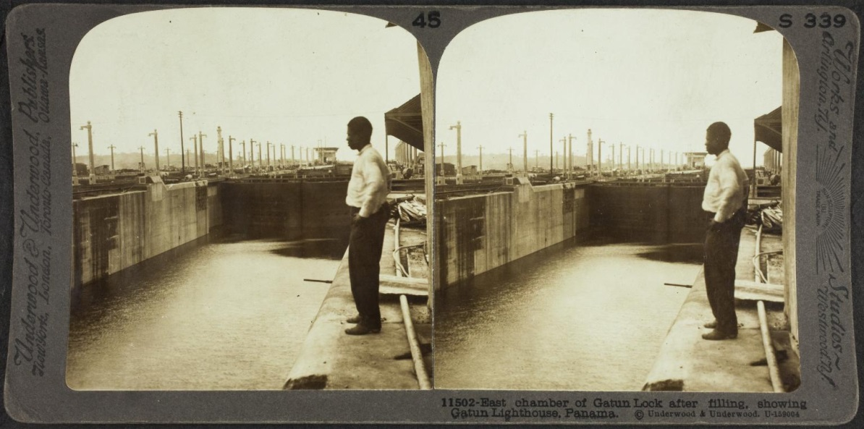
Student Metadata Assignments Make West Indians Visible in the Archive of Canal Construction
“
East chamber of Gatun Lock after filling, showing Gatun Lighthouse, Panama”
“I selected this item because it struck me as unusual and relatively unique. After looking at the photographs in Smathers Room 100, I noticed that not many of them had a West Indian central figure, especially the ones that were trying to capture the glory of the Panama Canal. For this picture to have a Canal worker … as a primary figure is very interesting. I thought that it worked even better to emphasize the power and strength needed to finish the construction of the Canal, and gave a “voice” to one of the workers we seldom hear from. Having him stand and look out over his, and his people’s great effort, and asses s the final product is quite powerful. I appreciate the effort that the photographer and Underwood and Underwood took with this photo to document not only the achievement of the Panama Canal in the eyes of Americans, but in the eyes of the workers as well” Chelsi Mullen
Notes:
In this example, despite the relative centrality of the black man, the caption reads: “East chamber of Gatun Lock after filling, showing Gatun Lighthouse, Panama.” My students found this to be the most rewarding exercise because by adding key words or notes they enabled future researchers to find this important popular, hitherto invisible. Much of their work has now to the catalog records.

Slide 40
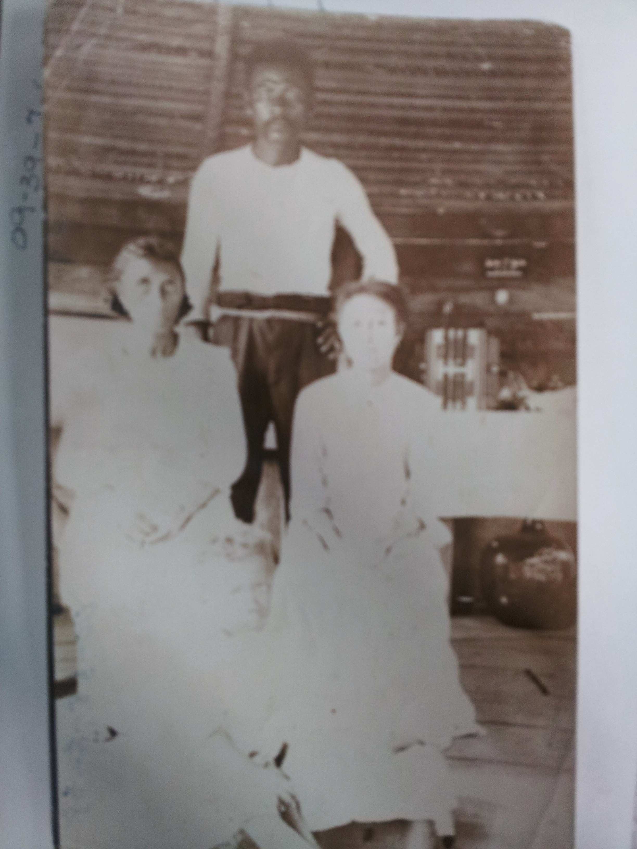
Gaps and false certainty in Metadata
Title: "Native on Back“ http://dloc.com/PCMI003554/00001/citation
Description of a photograph of what appears to be an Amerindian or West Indian family Panama. The title is actually a note indicating that there is the word “Native” penciled on the back of the image.

Slide 41

Cover for Scalar Book containing the Mapping Assignment

Slide 42

The Class was divided into five cross-campus working groups, each ‘mapped’ key locations in Eric Walrond’s Tropic Death, an influential Harlem Renaissance collection of short stories set in West Indian communities in Latin American and the Caribbean – and the ships that connected these communities in Panama, Guyana, Barbados, and Honduras and Jamaica.

Slide 43


Karina Vado elucidated the significance of the reference to Tela in Walrond’s “The Yellow One.”

Slide 44
The Opening of Eric Walrond’s Tropic Death
Among the motley crew recruited to dig the Panama Canal were artisans from the four ends of the earth. Down in the Cut drifted hordes of Italians, Greeks, Chinese, Negroes – a hardy, sun-defying set of white, black and yellow men. But the bulk of actual bfown for the work was supplied by the dusky peons of those coral isles in the Caribbean ruled by Britain, France and Holland.
At the Atlantic end of the Canal the blacks were herded in boxcar huts buried in the jungles of “Silver City”; in the murky tenements perilously poised on the narrow banks Faulke’s river: in the low, smelting cabins of Coco Te. The “Silver Quarters” harbored the inky ones, their wives, and pickaninnies.”

Slide 45

West Indian Migration to Panama in Tropic Death by Dhanashree Thorat

Slide 46
Roberto Reid’s description is the main source for locating Silver city or Silver living quarters and provides two possibilities of where the story takes place
The area known as Rainbow City today showed up in maps as a little settlement called Guava Ridge during the French Canal construction era of the 1880s. After the Americans acquired the rights to build the Canal in 1904, the area already included a townsite at Folks River (called “Fox” River up to 1915), which consisted basically of a collection of small, portable houses that had been put up by the French and were in disrepair. At the time the Americans inherited 24 main buildings in three rows between the railroad shops and the main line. There also existed a settlement on the shores of Limón Bay, overlooking Telfer’s Island. This area, which came to be known as Camp Bierd, included a few houses for families but mostly consisted of crowded one-story barracks for dock workers. (Emphasis in the original, (Roberto Reid, The Silver Townships- Rainbow City- Part I,” Silver People Chronicle)

Slide 47

1944 Map
Landfills have already changed the city’s shape.

Slide 48



1944

Slide 49

Housing for silver workers at Camp Bierd, 1908-1909
Source: A. B. Nichols Photograph Album 2, Linda Hall Engineering Library

Slide 50

1845 When Colon was an island called Manzanilla

Slide 51

1924 Charles Owen Map

Slide 52

Current Image of Colon from Google Maps

Slide 53


FRONT PAGE

Slide 54


WEST INDIAN
MIGRATION
PAGE

Slide 55


TROPICALITY

Slide 56


WHITE MIGRATION SOUTH

Slide 57


STEAMSHIPS

Slide 58

NEW TYPES OF DIGITAL SCHOLARSHIP
http://dloc.com/exhibits/aboutface

Slide 59

IMAGINING SCHOLARSHIP
http://dloc.com/exhibits/islandluminous
Notes:
Haiti: An Island Luminous
An Island Luminous is a site to help readers learn about Haiti’s history.
Created by historian Adam M. Silvia and hosted online by Digital Library of the Caribbean, An Island Luminous combines rare books, manuscripts, and photos scanned by archives and libraries in Haiti and the United States with commentary by over 100 experts.

Slide 60







PAPER DREAMS

Slide 61

AMPLIFICATION
www.dLOC.com/AA00015557/00005/allvolumes

Slide 62



New Connections
http://createcaribbean.org
http://smallaxe.net/sxarchipelagos
http://www.musicalpassage.org

Slide 63
  Presentation slides: www.dloc.com/AA00061952
  Questions & Discussion

