Slide 1
Wayfinding at the Opening of an Era: Digital Scholarship, Data, and ETDs
LAURIE N. TAYLOR
DIGITAL SCHOLARSHIP LIBRARIAN
Notes:
Good morning.
I wanted to start by thanking the United States ETD Association conference organizers for setting up such a wonderful conference and for continuing to grow the ETD community. This is the fourth annual conference of USETDA and so the USETDA is a relatively young organization, but it draws upon and builds from many longstanding and deep histories of excellence from many fields with attendees here from varied fields and areas including higher education administration, graduate editorial offices, libraries, archives, academic computing, and many others.

Slide 2
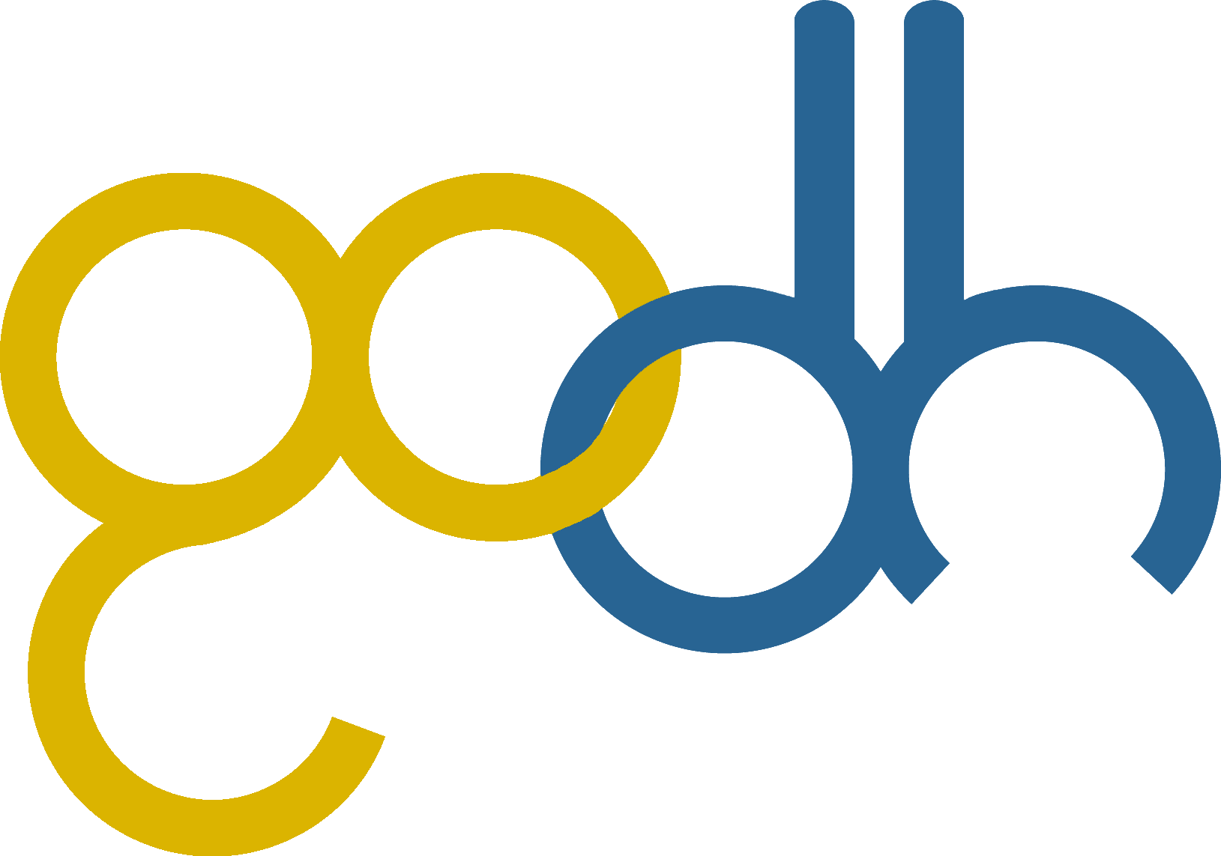
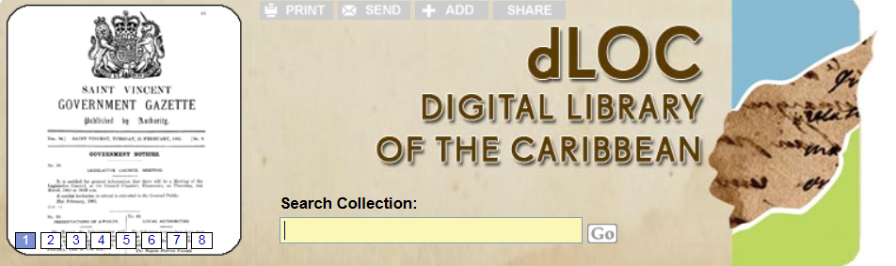

Notes:
Today, I’m sharing many stories and ideas from colleagues and collaborators. I’ve learned so much from my colleagues and have some examples of their work to share, so their work and they are also here with us today.
I’d also like to thank my colleagues at UF in the libraries, Research Computing, and other groups, scholars, and students at UF and with partners, including colleagues on the campus-wide Data Management/Curation Task Force—created to enable an environment that fosters radical collaboration—the UF Digital Humanities Working Group and Digital Humanities Library Group—which are building communities of consultants and practitioners for new and emerging needs related to the digital humanities and digital scholarship. Beyond UF, I’d also like to thank colleagues from the Digital Library of the Caribbean (dLOC), Global Outlooks:: Digital Humanities (GO::DH), and SobekCM open source digital repository users and developers.

Slide 3
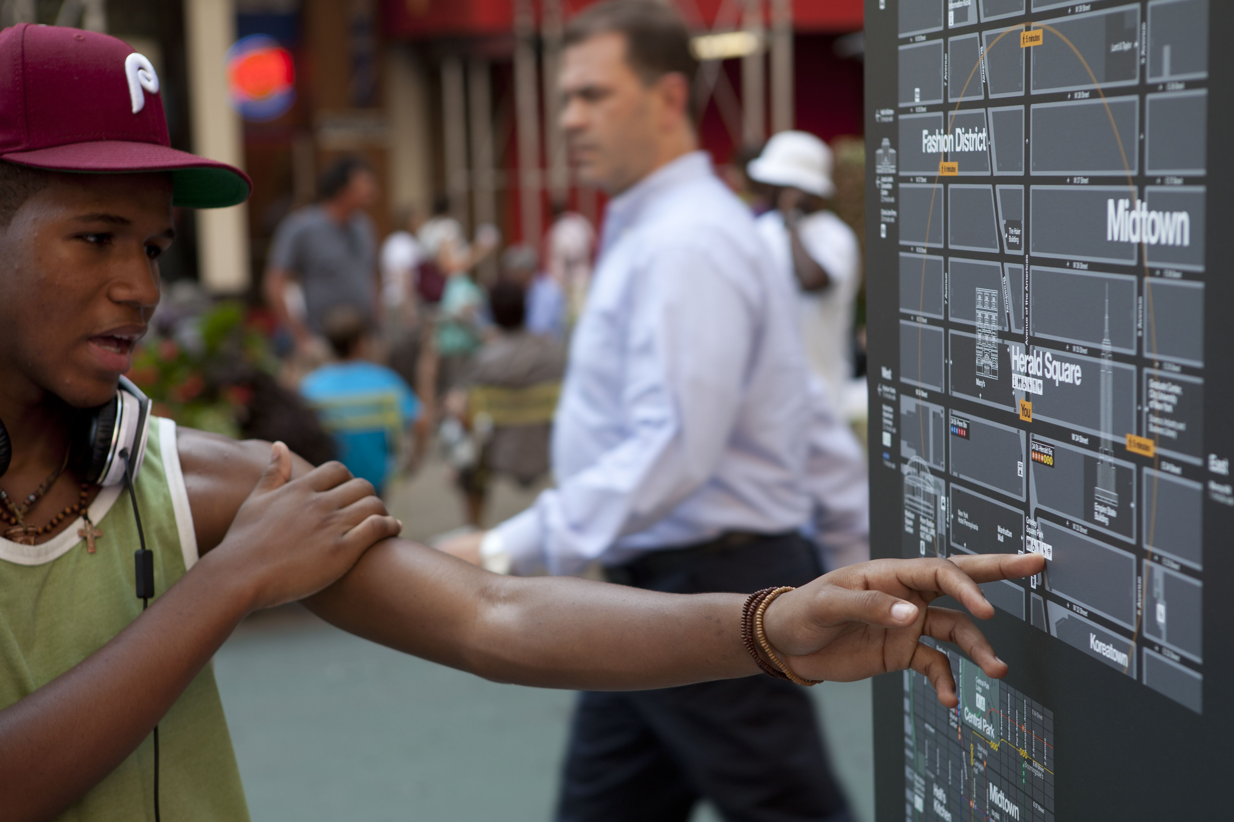
  WAYFINDING
Wayfinding in Herald Square by New York City Department of Transportation licensed under CC BY-ND 2.0
Notes:
Today I’m speaking about “Wayfinding at the Opening of an Era: Digital Scholarship, Data, and ETDs.” I’ll be drawing on and featuring examples from the humanities and digital humanities. I’m situating the overall presentation for the “so what” and to point beyond, show the trajectory of why ETDs matter on so many levels and so many ways, and how their placement and ETD professionals have been and can be even more important leaders in driving needed changes in scholarly production.

Slide 4
MY PERSPECTIVE
  Digital Humanities Scholar
  Digital Scholarship Librarian
Notes:
I’d like to frame my remarks within my own experiences. My background is as a digital humanities scholar. My research includes media and technology history, digital libraries, and video games.
I am currently the Digital Scholarship Librarian at the University of Florida. This is a new role that grew out of my work as the Director of the Digital Library Center where I was responsible for building digital collections with the libraries, partners, and digital scholarship collections with scholars and scholarly communities, as well as growing the Institutional Repository and support for integrated ETD processes at UF. I’ve been the Digital Humanities and now Digital Scholarship Librarian for three years.

Slide 5
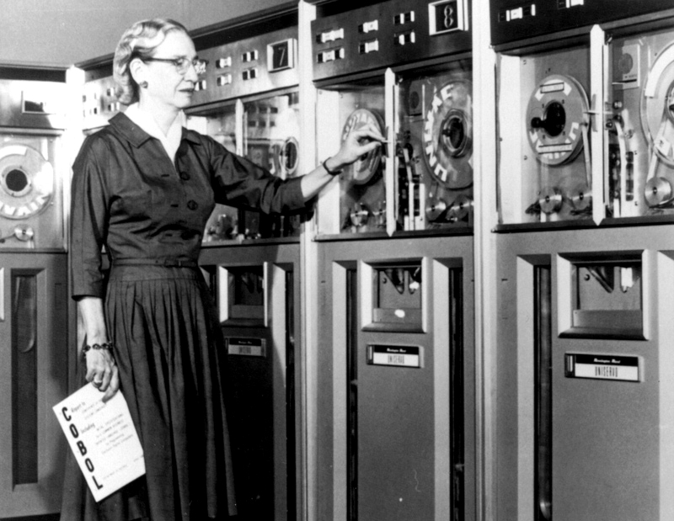
Socio-technical
Grace Hopper in 1952 by Karen licensed under CC BY 2.0
People, policies, & technologies
Notes:
My focus is now specifically on leveraging the robust infrastructure of the UF Digital Collections including the IR@UF for new partnerships and collaborations with scholars, partners at UF and other institutions, and overall looking at next steps with the libraries as core partners and providers of scholarly cyberinfrastructure, especially for the socio-technical supports (people, policies, and technologies).
My passions are building and sustaining socio-technical systems (people, policies, and technologies) in manners that understand that technology does not dictate and instead should support policy, and doing so in ways that further academic goals and ideals.

Slide 6
NAVIGATING ETDS
  Many concerns
  Many perspectives
Notes:
Given the abundant and fast pace of changes underway in academia, I was excited to see the conference program focused on “Navigating the Universe of ETDs”, and to see so many important and interesting sessions, as with the session later today on exploring the possibilities of digital and interactive dissertations and the important closing plenary discussion on the American Historical Association and embargoes, which is described as having “panelists from both sides of the dissertation divide” or “those who are facing access choices very soon, as well as those who have already earned their degrees and entered the community of scholars” with various representatives sharing the issues from their perspective for a discussion that may “perhaps raise more questions than it ultimately answers.”

Slide 7
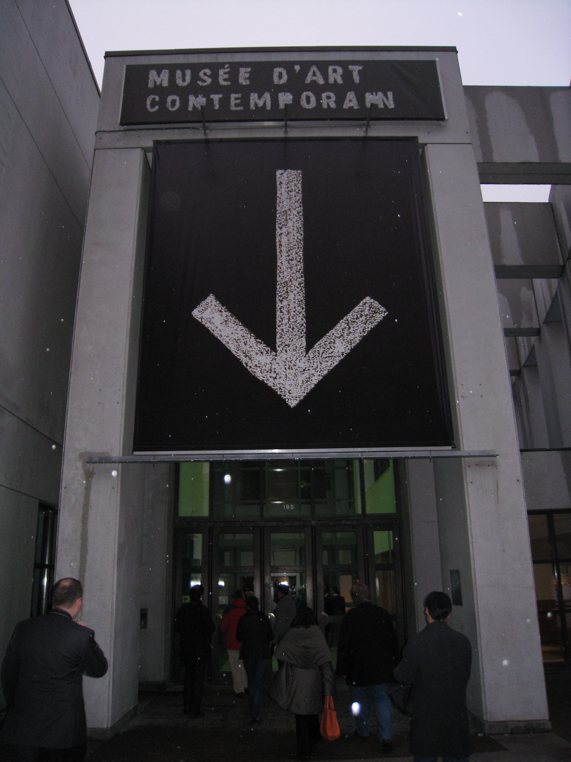
WAYFINDING
  Recent pasts
  Current happenings
  Lines of flight & future trajectories
Wayfinding by Bryan Kennedy, 2008, CC BY-NC 2.0
Notes:
Video game studies includes studies of space and navigation, often drawing on Kevin Lynch’s seminal text, The Image of the City, where he discusses various topics and concerns related to navigating and wayfinding through cities. Today, I’m speaking about wayfinding from a sort of chronological perspective, speaking about our very recent pasts with ETDs, some current happenings, and the lines of flight for future trajectories.

Slide 8
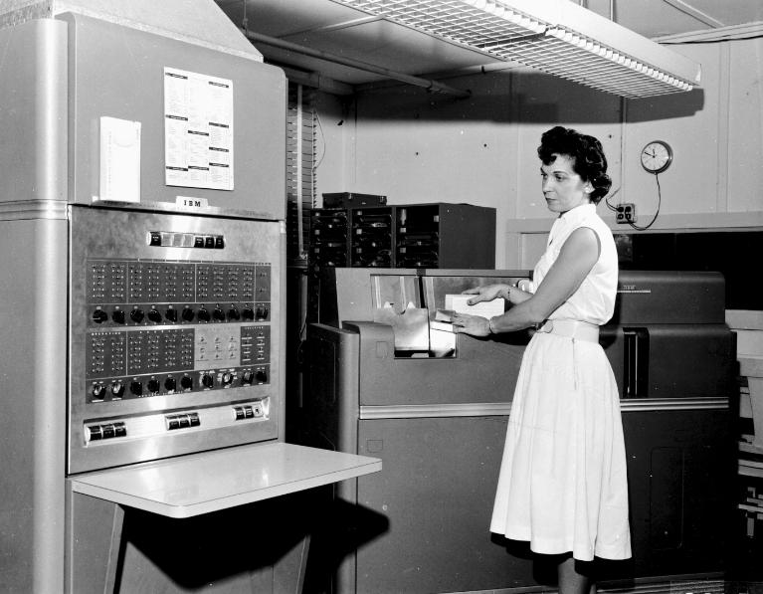
ONE: WHERE WE WERE
Early IBM Computer in Statistics Lab, UF. University Archives, UF Digital Collections
Electronic era
Notes:
To begin with our recent pasts, by their very naming, ETDs—electronic theses and dissertations—are marked as part of an earlier digital or electronic era. The current digital age is rapidly turning and opening into the age of data. Both are eras of the digital with the digital and data. However, the age of data promises something more and something different.

Slide 9
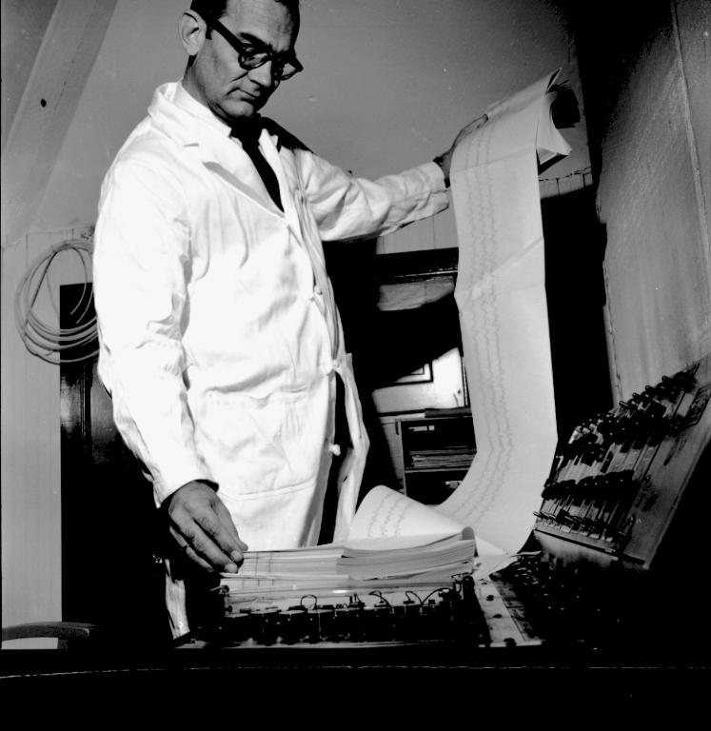
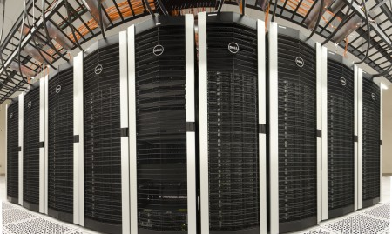
ONE: FACING OPENING OF A NEW ERA
Big Data
HiPerGator. UF Research Computing, 2014
Webb holds a roll of data. UF University Archives, UF Digital Collections
Notes:
Big Data’s Four Vs of Volume, Variety, Velocity, and Veracity are part of this equation, but the age of data promises an opening into new ways of thinking that represent a change in how we think and act as individuals and as members of our designated communities. Revolutionary changes in the age of data are transforming what constitutes research, research fields, and researcher communities and practices. Theses and dissertations are seminal works that are official documents and milestones in researchers’ lives. As core elements in the world of research ETDs, the structures around them, and the connected communities are changing as well, requiring wayfinding through dramatically altered worlds.
“Navigating the Universe of ETDs” now includes navigating with new forms and new expectations for scholarly products. Researchers expect support for the traditional thesis or dissertation textual document. They expect this alongside support for supplemental data files—ranging from scientific datasets, ethnographic audio and video recordings, interactive digital productions, software code, and much more. Like the data age being more than Big Data, changed researcher practices have impacts extending far beyond simply the handling of ETDs and collateral research materials like supplemental data.

Slide 10
Build from and within existing ETD practices
Add support for data & new scholarly products
Develop new extensions and services from existing practices
Expand for broader impacts, altmetrics, other valuing
Leverage and extend existing digital infrastructures
Connect out and across different communities
Seek out and seize opportunities for ETD professionals
Notes:
Researchers, scholarly advisors, and our professional community members across our academic institutions have learned to expect value-added services and features. In the data age, navigating the universe of ETDs requires an incredibly multi-dimensional view that:
Builds from and with existing ETD practices
Adds support for supplemental data and new types of scholarly products like software
Develops new extensions and services from existing processes
Grows and expands into new areas of scholarly concern including broader impacts, altmetrics, and other means of valuing scholarly work
Leverages and extends existing digital library/repository infrastructures
Connects out and across different communities (ETD professionals in graduate schools, libraries, IT, authors, researchers, and the public), and then
Seeks out and seizes opportunities for ETD professionals and processes for active engagement in enabling change
For example, the time to degree problem is arguably the biggest problem facing the humanities because graduate study becomes untenable when the average time for a graduate degree is nearly a decade. ETD professionals have an opportunity to play a key role in solving the time to degree problem, through collaboration across many connected communities and by drawing on existing excellence for standards and practices that support students in creating research products.

Slide 11
EVOLVING
    Digital scholarship
    Public scholarship
    Translational scholarship
    Transformational scholarship
Notes:
Graduate education, public and translational scholarship, and academia’s role in society and culture are all evolving. With the opening of a new era, ETDs are part of the fundamental changes underway. As ETD professionals, we have roles to play in creating an environment that fosters creativity, innovation, and transformation, building from core values and a shared mission sustaining scholarly production within the larger operations of our institutions, academia, society, and the world.

Slide 12
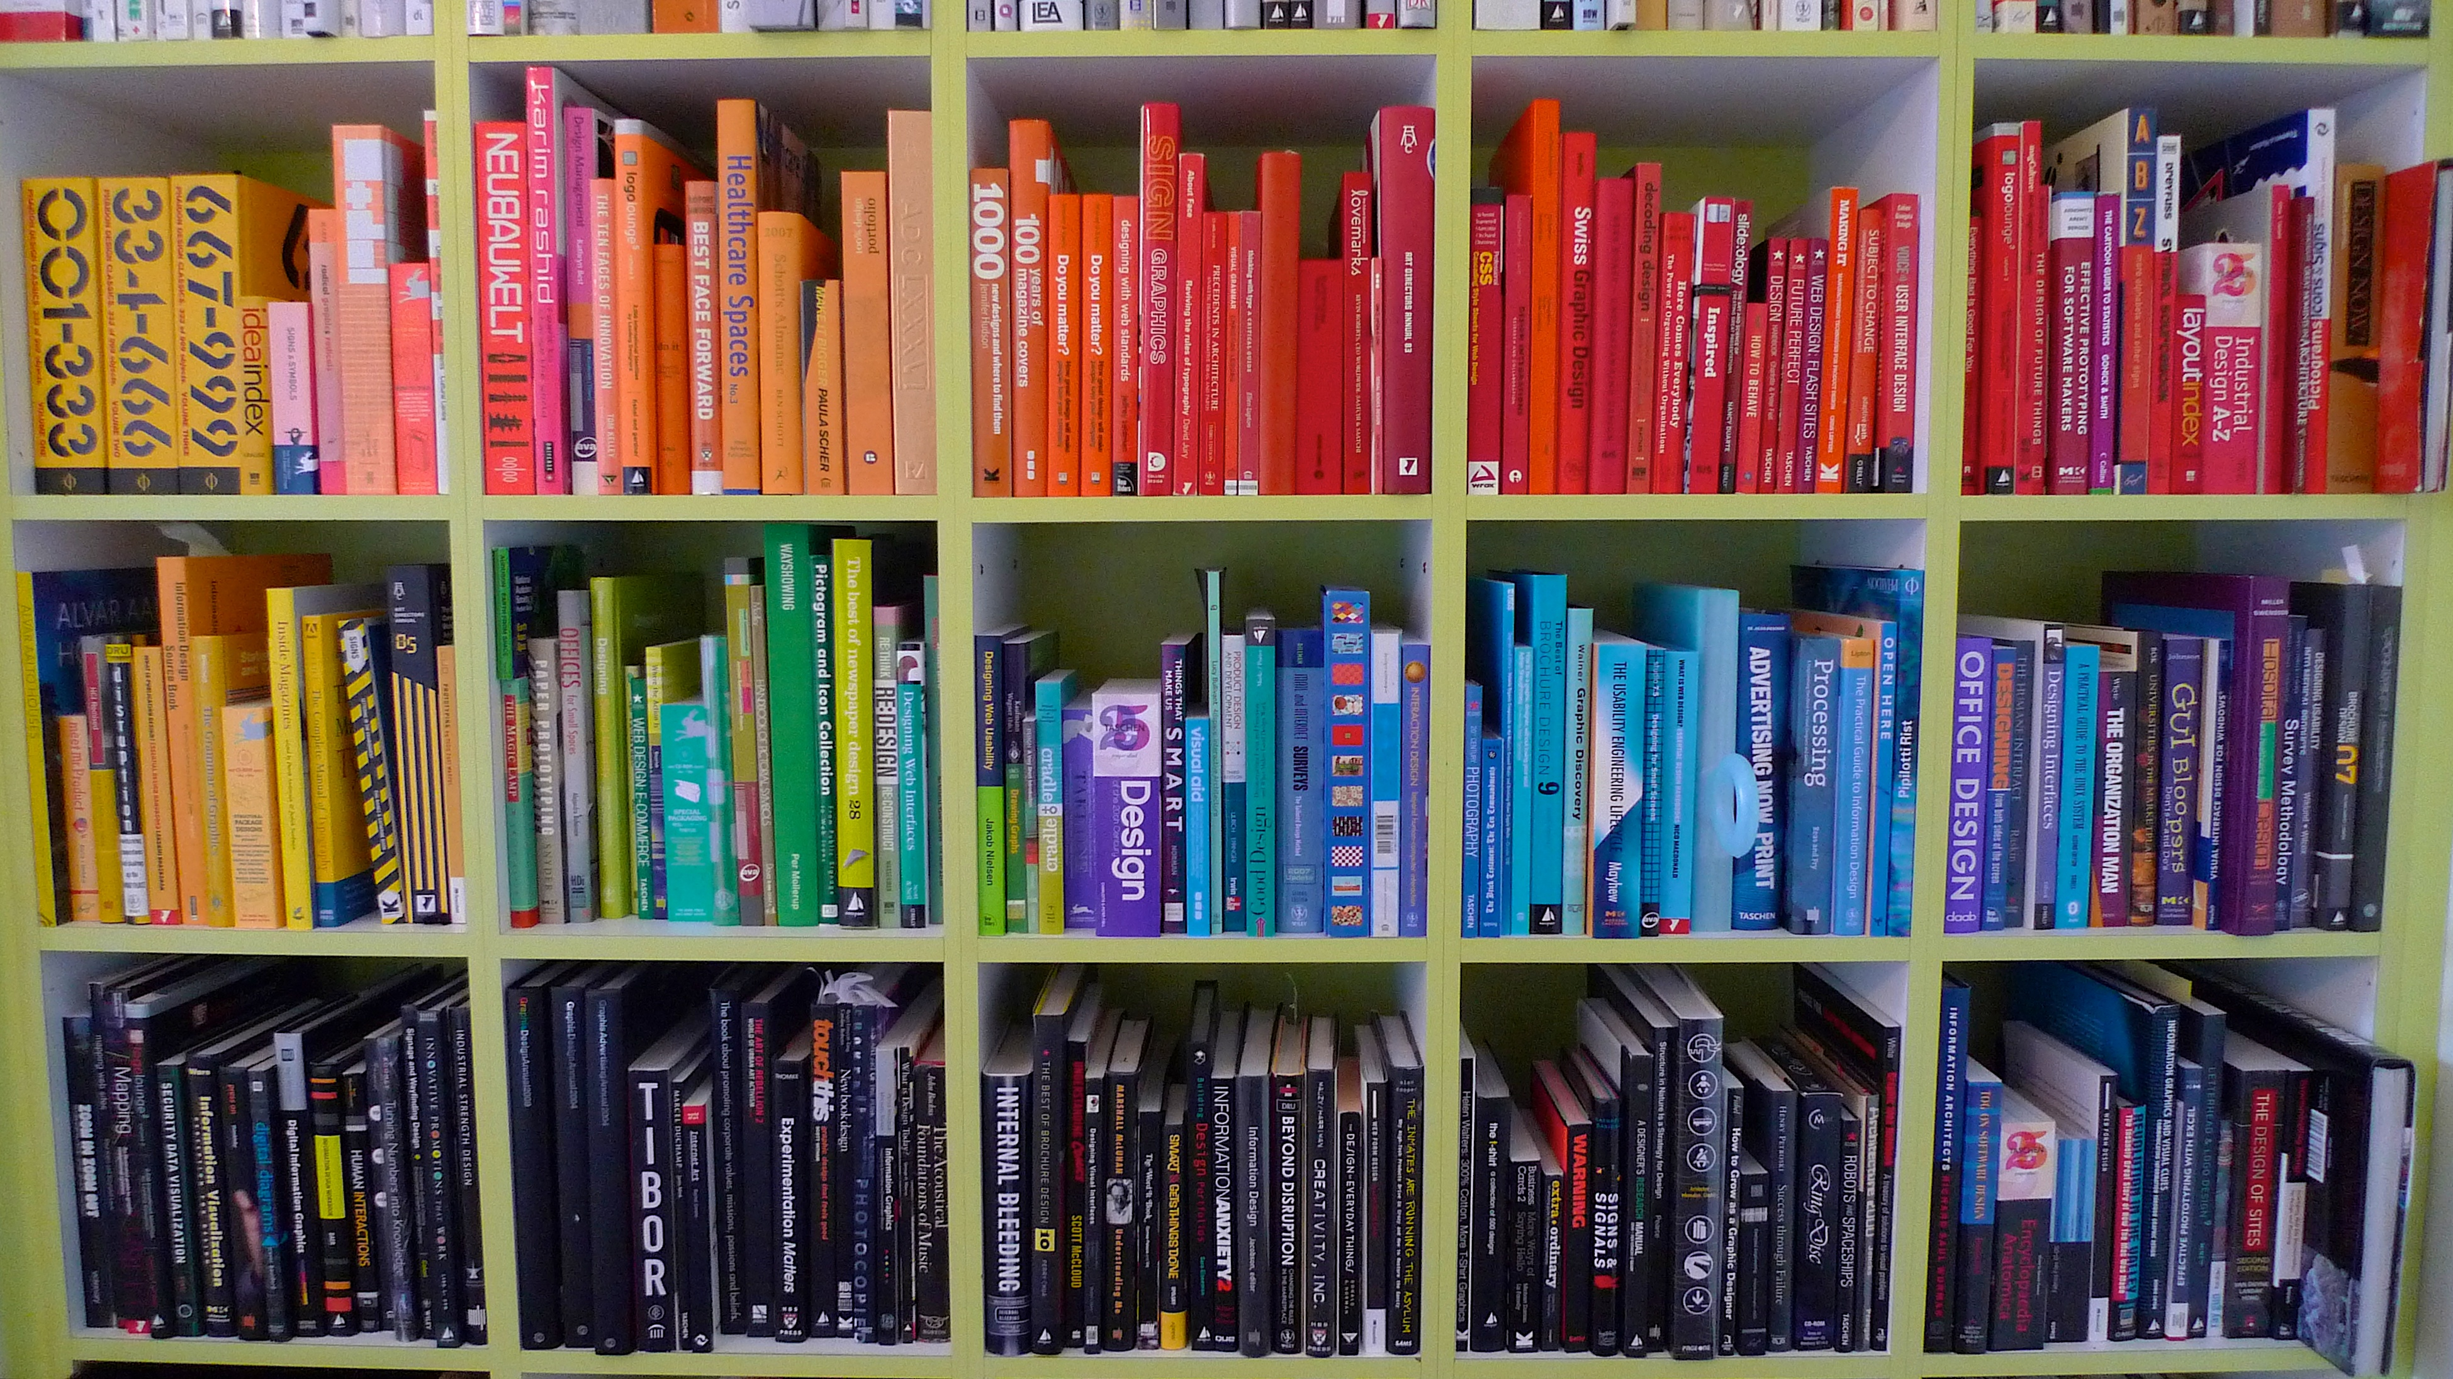
EVOLUTION
Last of the color coding, by Juhan Sonin, 2010, CC BY 2.0
Notes:
In the Evolution of Useful Things, engineer Henry Petroski, explains:
“the form of made things is always subject to change in response to their real or perceived shortcomings, their failures to function properly. This principle governs all invention, innovation, and ingenuity. […] There can be no such thing as a ‘perfected’ artifact; the future perfect can only be a tense, not a thing.” (22)
In 2012, the Digital Platforms and the Future of the Book conference asked:
“As cultural and intellectual discourse becomes digitized at an ever-accelerating rate, what will become of books? According to several prominent literary theorists, the decline of print culture — “the civilization of the book” — makes us acutely aware of different kinds of writing that fit hand in glove with broadened notions of textuality. Contemporary scholarship across the humanities continues to interrogate the vitality of books in the twenty-first century. For instance, how have books shaped our conventional notions of authorship and commonplace reading practices? Looking ahead, how might the book serve as an interface metaphor for electronic textuality?
Taking these together, we know that theses and dissertations, and thus our roles and professional community related to them, are in a state of change and at the opening of a new era.
Because theses and dissertations, print or digital, are so often book-like, the challenges and changes for the book are also informing the shape of things to come for theses and dissertations, which are often sort of proto-books.

Slide 13
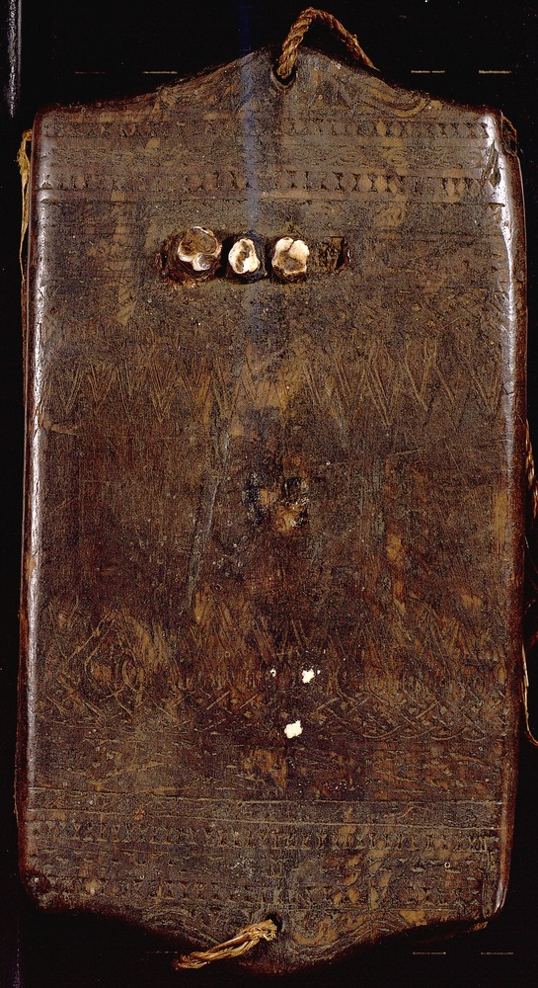
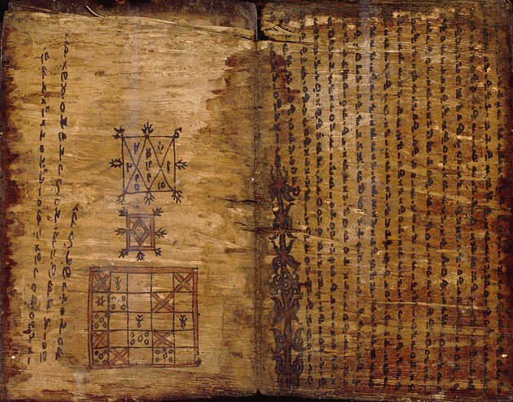
EVOLUTION
Batak Bark Book. UF Digital Collections.
Proto-book?
Notes:
At the Modern Language Association conference in 2012, one panel presentation was on the future of the dissertation in the humanities. The panel explained how the dissertation is currently framed as a proto-book, even though research on scholarly communications shows that the proto-book does not always best serve the needs of graduate students in terms of orientation to the field, professionalization, and entry into the scholarly conversation. The presentation had several recommendations for alternate forms that would better match the needs of many graduate students. Clearly, some are best served by the dissertation as a proto-book and dissertations often do become books. However, the panel and recent report by the Modern Language Association (MLA) Task Force on Doctoral Study in Modern Language and Literature clearly articulate the importance and value of expanding beyond the proto-book to better serve the needs of scholars and scholarly discourse, and this change is underway.
But, of course, we all know that something may look like a proto-book, it may be a PDF, or may not actually be, and we can all think of examples that already go so much further than a proto-book in our ETDs and programs.

Slide 14
TWO: OPENING OF AN ERA
Interactive data visualization with web technologies, by Chad Juehring, Project in Lieu of Thesis, 2013, all rights reserved by creator, in UF Digital Collections.
Notes:
We are no longer, if we ever really were, in the age of the ETD as proto-book.
To tell where we are at the opening new era, I’d like to share a few examples of where we are right now with new forms of digital scholarship and data with ETDs at UF.
One of the earlier examples for the new era comes from UF with project-theses or projects in lieu of theses. Project theses are done in lieu of the traditional thesis format and did not go through the graduate editorial office processes.
“In 2009, a subcommittee of the Electronic Theses and Dissertations Committee met with faculty and staff from the advising offices and libraries that support the College of Fine Arts and the College of Design, Construction and Planning. The subcommittee addressed the need to fill the gap in digitization [and digital curation] of terminal projects in programs within these colleges. Because these students produce projects rather than standard theses, they fell outside the normal processing of the Graduate Editorial Office, the body responsible for current electronic theses and dissertations. In an effort to better serve this segment of the student population on behalf of the libraries, University of Florida Digital Collections began to accept copies of these projects for inclusion in the Institutional Repository in Spring 2009.” (“PILOs”)
In addition to improving support for students, the integration of support for project-theses improved access to student research, better supported graduate programs, and brought greater consistency to overall handling of graduate research. This was very important for record management support, authentication, and preservation.

Slide 15
BUILDING CULTURES
    Graduate School
    Graduate Departments
    Libraries
    Academic Technology
    Together, and with others
Notes:
Representatives from the Graduate School, Graduate Departments, Libraries, and Academic Technology all collaborated to improve the processing to meet immediate needs. In doing so, they also improved and created opportunities for further improvements on broader needs as with building a culture for sustaining digital scholarship and supporting the data curation lifecycle. This was made possible in part because aligning project-theses with the existing supports from the libraries put the graduate coordinators and IR Manager in direct communication for sharing standard processes, including the recommended ETD formats list, for file formats optimal for access and preservation, as well as for discussions on practical, technical, and legal concerns with these discussions supporting building capacity and community around supporting theses and dissertations of all types and forms, for current and future needs.

Slide 16
SUPPLEMENTAL DATA
From Indian to Indo-Creole: Tassa Drumming, Creolization, and Indo0-Caribbean Nationalism in Trinidad and Tobago, by Christopher L. Ballangee, 2013, all rights reserved by the author, in the UF Digital Collections.
Notes:
More recently, a problem or opportunity came up at UF where students doing ETDs also had supplemental materials that weren’t a great fit as part of the formal ETD document or the appendices. Examples included a 5GB video file produced by the student as part of the ETD that was related but more supplemental. Other examples included datasets that were hundreds of pages longer than the ETD document, and other materials that were not ideally supported within the existing ETD processing.
Again, UF’s Electronic Theses and Dissertations Committee, with representatives from various groups, and I know some of you from these meetings are here as well, so thank you for your work and service in making these examples possible. So, the committee met and determined that the best option was to allow students to elect to submit their supplemental data directly to the IR@UF as soon as the data was available. This was a great solution or many reasons:
Immediately upon submittal, the students had a permanent URL to reference in their ETD document, with the data immediately preserved
As awareness of the option has grown, students are submitting data sooner, where doing so has eased a stress-point where students were otherwise submitting their supplemental data at the same time as the full ETD and having to work with many complex files and relationships at a critical and compressed time
As awareness of the option has grown, more students and faculty are aware of the opportunity to store and share data through the IR@UF
And, we’ve had new and exciting conversations about what is research data

Slide 17
SUPPLEMENTAL DATA
From Indian to Indo-Creole: Tassa Drumming, Creolization, and Indo0-Caribbean Nationalism in Trinidad and Tobago, by Christopher L. Ballangee, 2013, all rights reserved by the author, in the UF Digital Collections.
Notes:
I’d like to share an example to have the data speak for itself. This data is from Christopher Ballengee for Tassa Drumming and Indo-Caribbean Identity in Trinidad and Tobago: http://ufdcimages.uflib.ufl.edu/IR/00/00/31/61/00001/11_Calypso.mp3
Integrating support for current, immediate needs including project-theses and supplemental data are wonderful opportunities for us to leverage existing excellence with ETDs to better support research needs and grow our communities. This includes data curation, and data in all its forms for all fields, including the humanities.
In addition to these, UF has recently integrated support for Undergraduate Honors theses into the IR process. It was lovely to see the program list a presentation scheduled for tomorrow by Christy Shorey, UF’s IR Manager, and Mark Sullivan, of Sobek Digital, on new workflows and tools for ETD support that will cover ongoing enhancements to UF’s processing for ETDs.

Slide 18
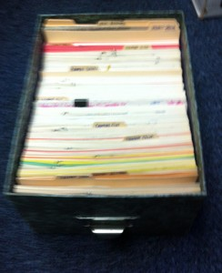
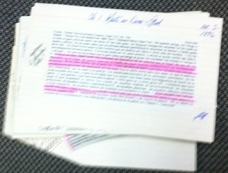
DATA LIFECYCLE & NEW CYCLES
Printed Databases or Databases of Box and Paper and Space: Research Structures in Need of Better Support, by Laurie N. Taylor, 2014
Notes:
One of many interesting aspects of UF’s recent work on ETDs is how that work has connected to and helped to inform other activities including work data curation. For instance, UF recently submitted an NEH Digital Humanities implementation grant on “Building Cultures of Data Management” to create a new data module within the IR for managing the full research data creation process. This module—which will be created as resources allow—will provide full support for supplemental data.
Where the IR@UF provides an ideal home for completed data, support is needed for data creation with ongoing development that has integrated preservation support. Currently, so many of our researchers have small research databases. These are often FileMakerPro or Access databases, or other formats. They’re generally set up in non-ideal ways, which can mean the software, the way it’s configured, how it’s used, and where it is, often on personal laptops or computers. These databases are dinky. They’re flimsy because they lack socio-technical support including ensuring backups, ensuring software that is licensed and usable for common file formats that can be used in other systems and preserved, and they are created and used in such a way that the databases are not connected to their technical ecosystems of resources or their communities.

Slide 19
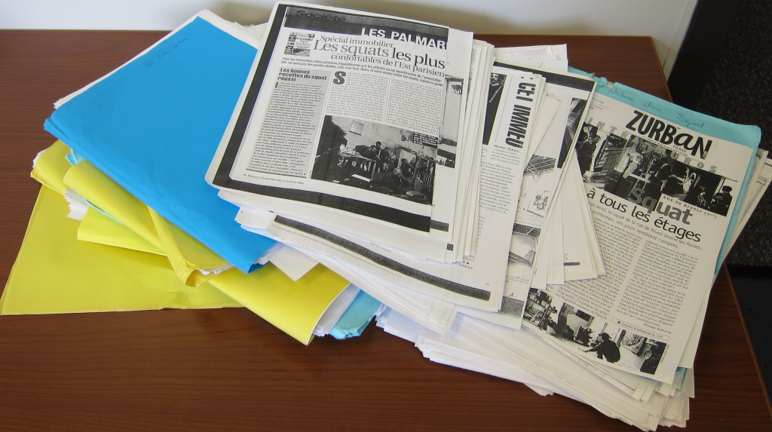
NEW PROCESSES OF RESEARCH
Data Management of Legacy Data from a Faculty member in Sociology, by Laurie N. Taylor, 2014
Notes:
Going for an NEH Digital Humanities Implementation grant was one approach we took for creating broad support.
Earlier this month (Sept. 2014), UF and other researchers submitted another NEH Digital Humanities Grant (this time a start-up grant) for MassMine.

Slide 20
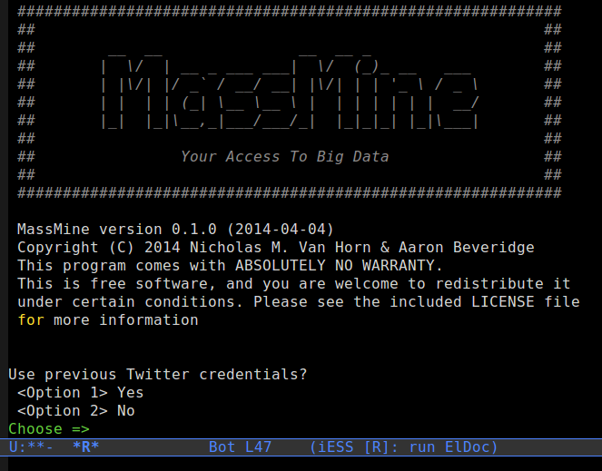
MASSMINE
MassMine, by Nicholas M. Van Horn and Aaron Beveridge, 2014
Notes:
MassMine represents an interesting in-between system and infrastructure related to ETDs and researcher processes.
Two of the investigators on the grant are the two original MassMine developers, Aaron Beveridge and Nicholas Van Horn. They are also both PhD students. They began creating MassMine in 2013 in response to data access problems, with their needs unmet by available tools. They developed MassMine to support research into complex circulation networks by investigating the concept of 'hyper-circulation' using Twitter to study the relationship of trends to respective locations and content. They coded MassMine to query existing Twitter and other social media APIs, archive the data for researchers (with data access otherwise restricted), and support querying the data.
In addition to Aaron Beveridge creating and using MassMine for his research in rhetoric and composition and Nicholas Van Horn creating and using MassMine to develop and support new research methods in the social sciences, many researchers, including graduate students doing their theses and dissertations, are interested in using MassMine for their research.

Slide 21
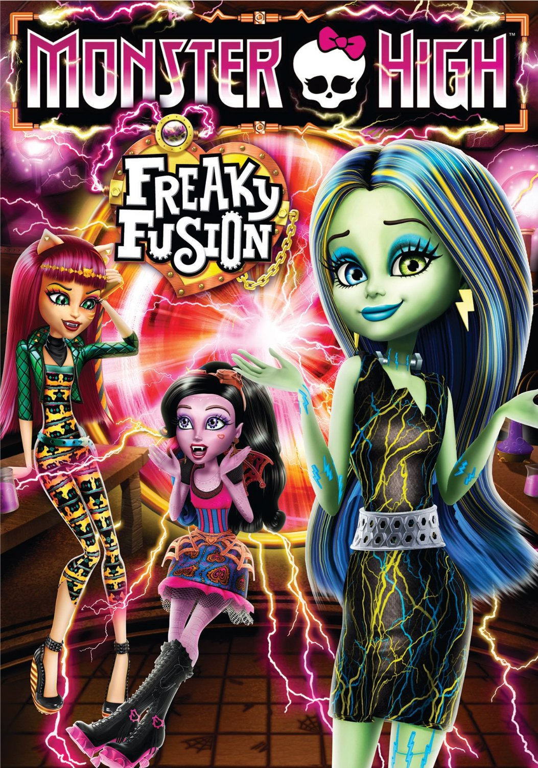
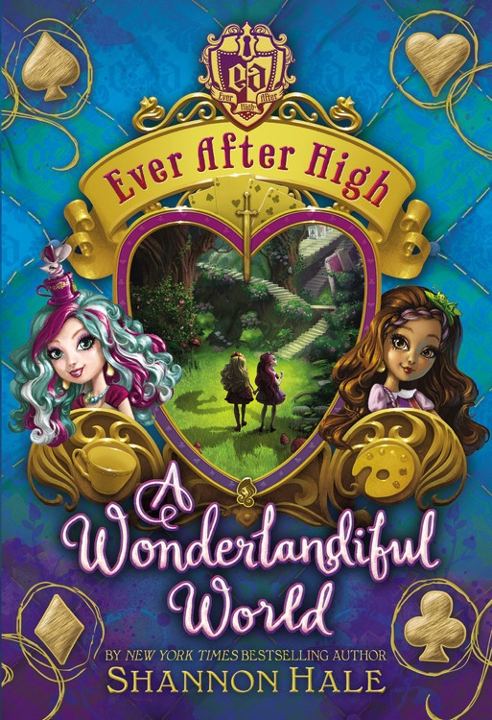
MASSMINE & MATTEL
Monster High: Freaky Fusion, DVD cover 2014 and Ever After High: A Wonderlandiful World, book cover 2014
Notes:
For example, a graduate student in children’s literature, Mary Roca, is interested in studying how Mattel’s products and interactive materials offer narrative content and directions for play, while also functioning as scripts for consumers using social media. Mary Roca is interested in using MassMine to collect social media on Mattel’s Monster High and Ever After High to study how Mattel promotes and manages its products and stories.
With MassMine’s development ongoing, it is already part of the changes underway for ETDs, with MassMine as software that is part of the research process, with it enabling researchers to better create research archives which may be appendix or supplemental research data, and new practices and formats of research that result from these new processes.
As we open into new opportunities, ETDs and ETD professionals get to be part of the research process in a way not possible before, including with questions related to large community-spanning projects and events.

Slide 22
NEW RESEARCH PRODUCTS
    New forms of the thesis and dissertation
    Masterpieces or showing mastery
Notes:
With new forms of research and new research practices, new forms of research products are also needed. This includes the ongoing discussions on the form of the dissertation, whether proto-book, masterpiece (as with a carpenter showing excellence in making certain joints, finishes, and woodworking forms [Damrosch et. al]), or another.

Slide 23
SUPPORTING & SUSTAINING
What counts as a thesis or dissertation?
Is what counts for graduate students relevant for their jobs and fields?
How do we count it if it is not book-like?
How does it relate to what counts for promotion and tenure?
How do we evaluate broader impacts and public scholarship?
What counts with administrators in program evaluations? What counts with the legislature and others in funding allocations?
Notes:
One of the largest challenges in finding our way at the opening of a new era stems from what counts. The proto-book is a known quantity and can be evaluated and counted with existing measures and processes, and new processes and methods are needed for new research products. To face the coming changes, many questions must be addressed:
What counts as a thesis or dissertation? Is it still a proto-book, or how do we count it if it is no longer recognizable as a book?
When we look at other ways of counting, how do we evaluate or count broad impact and public scholarship?
Is what counts for graduate students relevant for their jobs and fields?
How does it relate to what counts for promotion and tenure?
What counts with administrators in program evaluations?
What counts with the legislature in determining funding allocations?
In thinking about what counts, other critical concerns are: how are these things counted and how are the things that do “count” and the work of “counting” supported? What are our roles in supporting new forms, supporting their intellectual rigor, their ability to be evaluated, and how all of the technologies and processes support students, research, scholars, and the public?
In looking forward to the closing plenary on ETDs in History, with History often viewed as being within the social sciences and/or the humanities, humanities scholars are often, or even generally, expected to produce books because books are what “counts” for humanities scholars. This is a problem because it limits what ETDs can and should be, if the form is already so determined. It would also limit our ability to enact positive change.

Slide 24
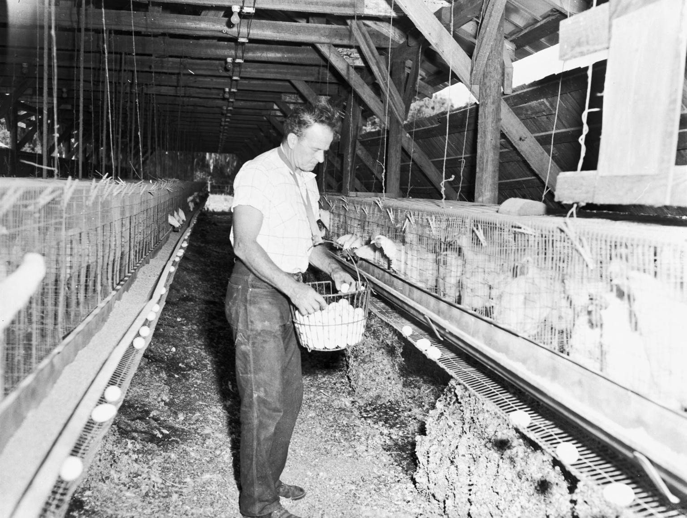
COSTS & COUNTING
A Man Collects Eggs in a Broiler House. University Archives, UF Digital Collections
Notes:
This is also a problem because the supports for producing books, which never seemed to be ideal, continue to weaken and erode. Writing on academic books in 2009, David Blakesley explained: “In the late 1990s, you could count on 500 to 750 or more copies sold to libraries right out of the gate. That average dropped to 100 or so almost overnight, due in part to the rise of the journal conglomerates, ridiculous price gouging, and the attendant strain on library budgets.” The financial situation for libraries grows worse each year.
Libraries are also faced with ongoing costs to store and maintain physical holdings. The Council on Library and Information Resources released The Idea of Order: Transforming Research Collections for 21st Century Scholarship in 2010. One of the chapters in it is “On the Cost of Keeping a Book” by Paul N. Courant and Matthew “Buzzy” Nielsen. In their article, they explain that the average cost of supporting a print book for a library can be expected to exceed the purchase cost of the book by over 50% (page 85). When considering that libraries already pay a higher cost per book, hardbound to ensure preservation across many loans and “shelf-ready” with catalog records sent along with the books to avoid the costs of copy cataloging and processing the purchased book, the cost to simply maintain physical books is a burden, and the costs for even “free” resources like institutionally-created ETDs is a cost.
Of course, the cost of sustaining digital resources is also a significant concern, as detailed in Nancy Maron and Sarah Pickle’s Ithaka S+R Report Sustaining the Digital Humanities: Host Institution Support Beyond the Start-Up Phase.
Sustaining access to information and supporting the scholarly communication landscape, of course, are core to the mission of academic libraries. It’s a question of how to best do so, especially with new costs and concerns when ETDs have increasing complexity and variety.
Support for ETDs and the future of ETDs in academia has traditionally come from libraries in preserving digital files, often PDFs, growing from the prior support for binding and preserving physical books. Those supports are evolving to include supports for new forms of ETDs as well. The libraries and other institutional supports are critical for the future of ETDs. At UF, we’re very lucky to be at a large institution where new digital scholarship projects have support from the institution.
Developing, promoting, and constantly enhancing the institutional supports are needed at the institutional level—with institutionally supported people in the libraries, IT, administration, graduate schools, and other groups—for future forms of ETDs to be supported and counted.

Slide 25
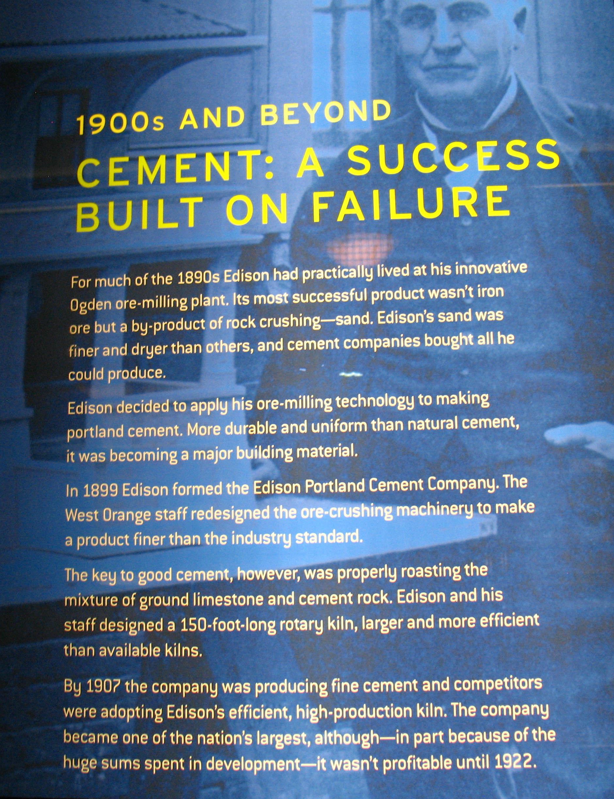
PRODUCTIVE PROBLEMS
Cement - a success built on failure, photo by Vilseskogen, 2012, CC-BY-NC-SA 2.0
Notes:
While I’ve briefly touched on some of the problems and changes for the future from the perspective of institutional supports and credit, I’d like to emphasize that these problems and changes can be productive for the future of scholarly communications and our roles as ETD professionals. While we are in a time of declining library and university press budgets, and a time when scholarly publishing is being forced to change, we’re also in a time where these changes can have real impact for the humanities and other scholarly fields, academia as a whole, and society because these changes can enable new opportunities to more thoroughly communicate with the public, engage the public in scholarly concerns, and conduct scholarship in the public sphere. This is an exciting time for the future of ETDs in academia, and especially for the future for academia itself.

Slide 26
THREE: FUTURE
  Plan, full course, charted to universal principles, relating every move to the plan
  Objective, gathering information on the journey and responding accordingly
Notes:
As we look towards the future, we’re charting our course or wayfinding, finding our path and our way towards our goals.
In the preface to Plans and Situated Actions, Lucy Suchman explains “two alternative views of human intelligence and directed action represented” by two navigation methods:
In one, the navigator begins with a plan, a full course, charted according to certain universal principles, and carrying out the voyage by relating every move to that plan. This navigator expends effort throughout the voyage to remaining on course. If unexpected changes come up, the navigator must alter the plan and then respond accordingly.
In another, the navigator begins with an objective rather than a plan, setting off toward the objective, utilizing information from the wind, the waves, the tide and current, the fauna, the stars, the clouds, the sound of the water, and responding accordingly. This navigator expends effort throughout the voyage to gathering and responding to conditions—expected and unexpected—by continuing to adapt in an ad hoc fashion to reach the objective. This navigator can always point to the objective, but cannot describe the course.

Slide 27
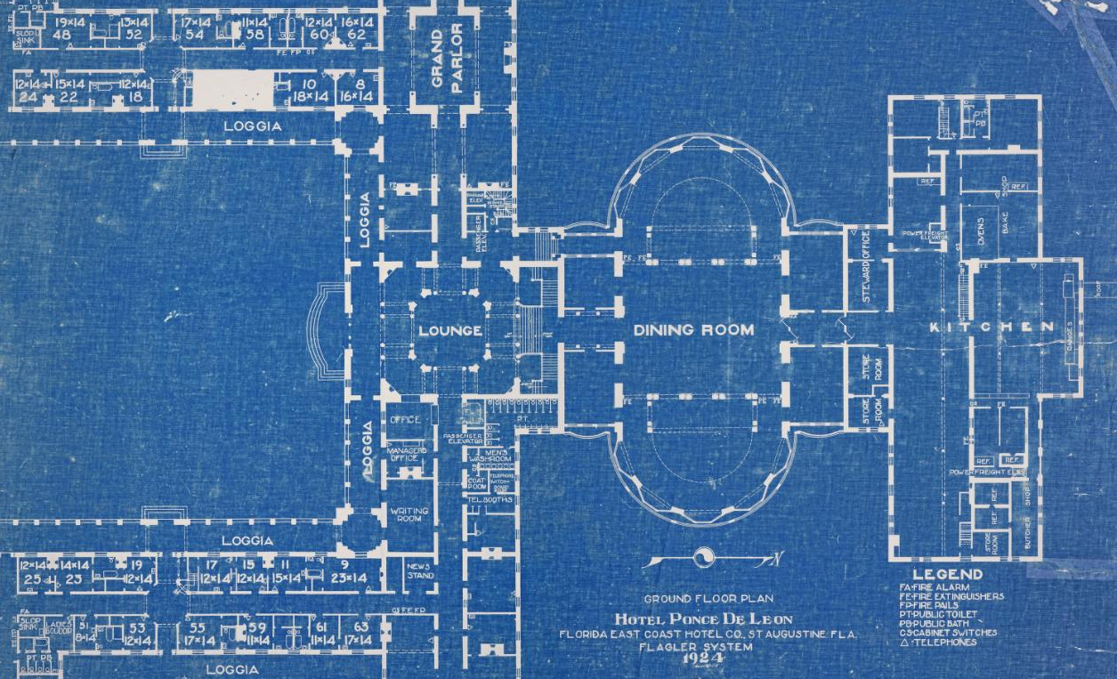
PLANS & OBJECTIVES
Ground Floor Plan, Hotel Ponce de Leon, Florida East Coast Hotel Co., St. Augustine, Fla, Flagler System, Carrère and Hastings Architectural Drawings, Flagler College and UF
Notes:
Building from examples of new scholarly forms in the Digital Humanities and other fields already supported in ETD programs as well as examples of new services and ways of operating ETD programs, we need to even further connect ETD practices and professional communities to current and near-future challenges and opportunities across the ETD universe.
We know what we need to do, and we also know some of how we should do it. We need to undertake work that:
Builds from and with existing ETD practices
Adds support for supplemental data and newer types of scholarly products like software
Develops new extensions and services from existing processes
Grows and expands into new areas of scholarly concern including broader impacts, altmetrics, and other means of valuing scholarly work
Leverages and extends existing digital library/repository infrastructures
Connects out and across different communities (ETD professionals in graduate schools, libraries, IT, authors, researchers, and the public), and then
Seeks out and seizes opportunities for ETD professionals and processes for active engagement in enabling change

Slide 28
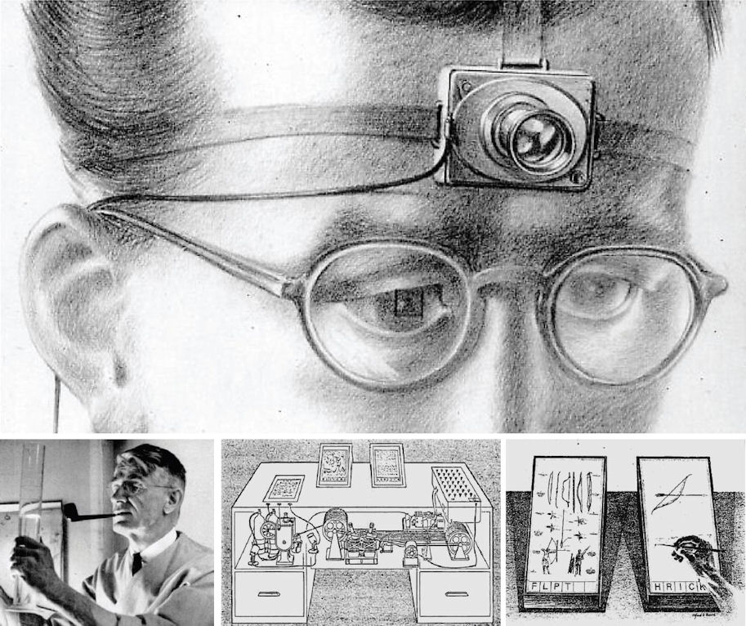
WAYFINDING & NAVIGATING
“As We May Think” in Life and The Atlantic by Vannevar Bush
Notes:
For our next steps, we are like the one navigator with our objectives.
For our next steps, we need to be able to read the sea, sand, wind, and waves. We need to remain grounded in our research pasts with scholarly rigor and tradition, and a tradition of innovation with ETDs and their print precursors. Digital media researchers often ask “what’s new about new media” with so much done differently but still done before the emergence of the digital.
Scholarly traditions and innovations with networks and formats have so many connections and influences. One of the many stars that combines in constellations lighting and serving to orient our future steps is Vannevar Bush.
Vannevar Bush was a scientist and science administrator. His work was critical for World War II, and our modern world and academia. In “As We May Think,” he laid out an early vision for the internet with the memex, which was meant to be a sort of all-inclusive set of microfilm-information system that would contain and allow for sorting vast amounts of information and that would also remember paths and past histories through information.
"wholly new forms of encyclopedias will appear, ready made with a mesh of associative trails running through them, ready to be dropped into the memex and there amplified."
In addition to looking at how to provide ways for people to be able to access information and to be able to navigate so much information, Vannevar Bush also wrote “Science, the Endless Frontier” which is a foundational document in creating the National Science Foundation (NSF) and research funding models.
Vannevar Bush’s work is often cited in thinking about the internet, scholarly communications, scholarly networks, and socio-technical systems of how we combine technologies, processes, and people’s activities in relation to research.
I mention Vannevar Bush here not because of either of these two seminal works:
“As We May Think”
“Science, the Endless Frontier”
I mention him explicitly because of both of these works. Each work is phenomenally important. Taken together, they are exponentially more important both for their contents and as a model. The future of research will not be in research as separated from the world, but as research in, of, and with the world; research as public research, translational research (from research desk to bedsides and homes), and transformational research.
ETDs are important research artifacts and represent milestones in researchers’ lives as they are becoming researchers and in their careers. As ETD professionals, our work is thus deeply connected to and involved with the research process as it changes.

Slide 29
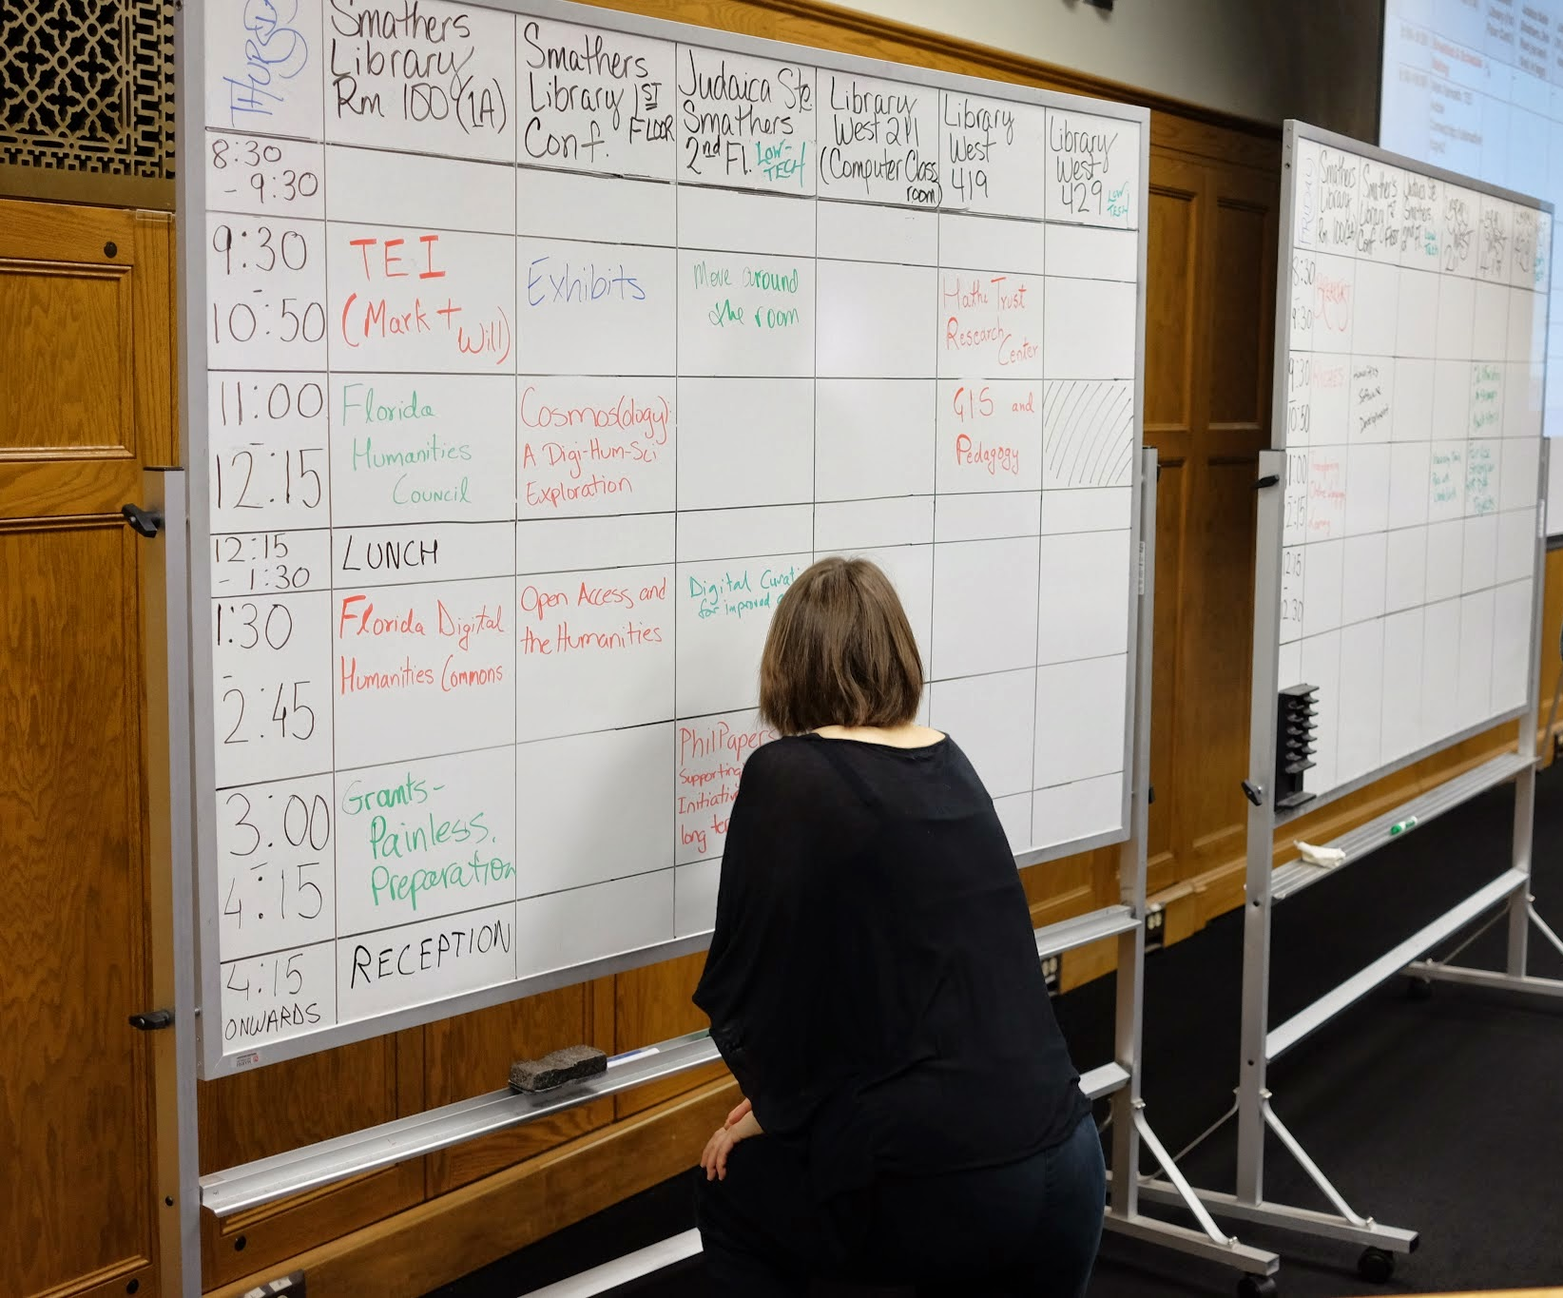
DIGITAL HUMANITIES & ETDS
Planning for THATCamp-Gainesville 2014
Notes:
To give a concrete example of this, at UF we’re currently working on a Digital Humanities Graduate Certificate. The new Digital Humanities program is being developed in collaboration with the Libraries, Center for the Humanities & the Public Sphere, Department of English, and Department of History, as well as with scholars from many other departments.
As a starting point, the new program is building from courses currently being taught or in development with over 25 courses from a variety of academic departments already available with digital humanities content. The intent of the new program is to build upon and validate student learning in the digital humanities.
Perhaps what’s most exciting, and what I find supremely exciting and truly revolutionary, is the idea from Elizabeth Dale, Professor of Law and History, who envisions the new program as also being a way to deal with the time to degree problem and specifically in relation to the dissertation.
Initially, students will complete the program by completing a required minimum of courses in the digital humanities. A new course proposal for the course that will be the capstone is also going through the approval process. [As of Sept. 23, the course has been approved through the college level curriculum committee.]The new Digital Humanities Studio course:
is designed for advanced graduate students who have completed substantial coursework in the emerging field of digital humanities, who are prepared to be self-directed in their studio practice, and who seek opportunities to work with digital humanists from other disciplines on individual and jointly-authored projects.
Students will regularly present work for critique and advice, with the result that much of the time in class will be spent on intensive group discussion of individual and collaborative student work. This will help students hone their skills of interpretation and analysis and to learn how to effectively and professionally document and present digital works. A further aim of the studio is that students should see it as a creative community in which to collaborate with other researchers outside of the designated class meeting times. To that end, the studio will be taught in a laboratory space that can serve as a physical hub of the course’s undertakings. The course will also make extensive use of virtual environments for supporting asynchronous collaboration, such as wikis, blogs, etc.
The studio is team-taught by a faculty member from a UF humanities department in [the College of Liberal Arts & Sciences] CLAS and a librarian from the George A. Smathers Libraries. The librarian and faculty instructor will be drawn on a rotating basis from the membership of UF’s Digital Humanities Working Group. Like all studio courses this is fundamentally a creative community wherein students and teachers collaborate for what John Dewey called experiential learning, and what more contemporary works call learning-in-action.
The course itself may sound familiar, but the goals are quite radical. The goal is to use the course to introduce humanities students to a more lab-like way of working, and to utilize methods and the community to shrink the time to degree. Experimentation for how to do this will include more collaborative research production and innovative technologies. As such, this will open into complex questions that demand new ways of working on ETDs with new types of authorship and creation roles and new formats and materials.

Slide 30
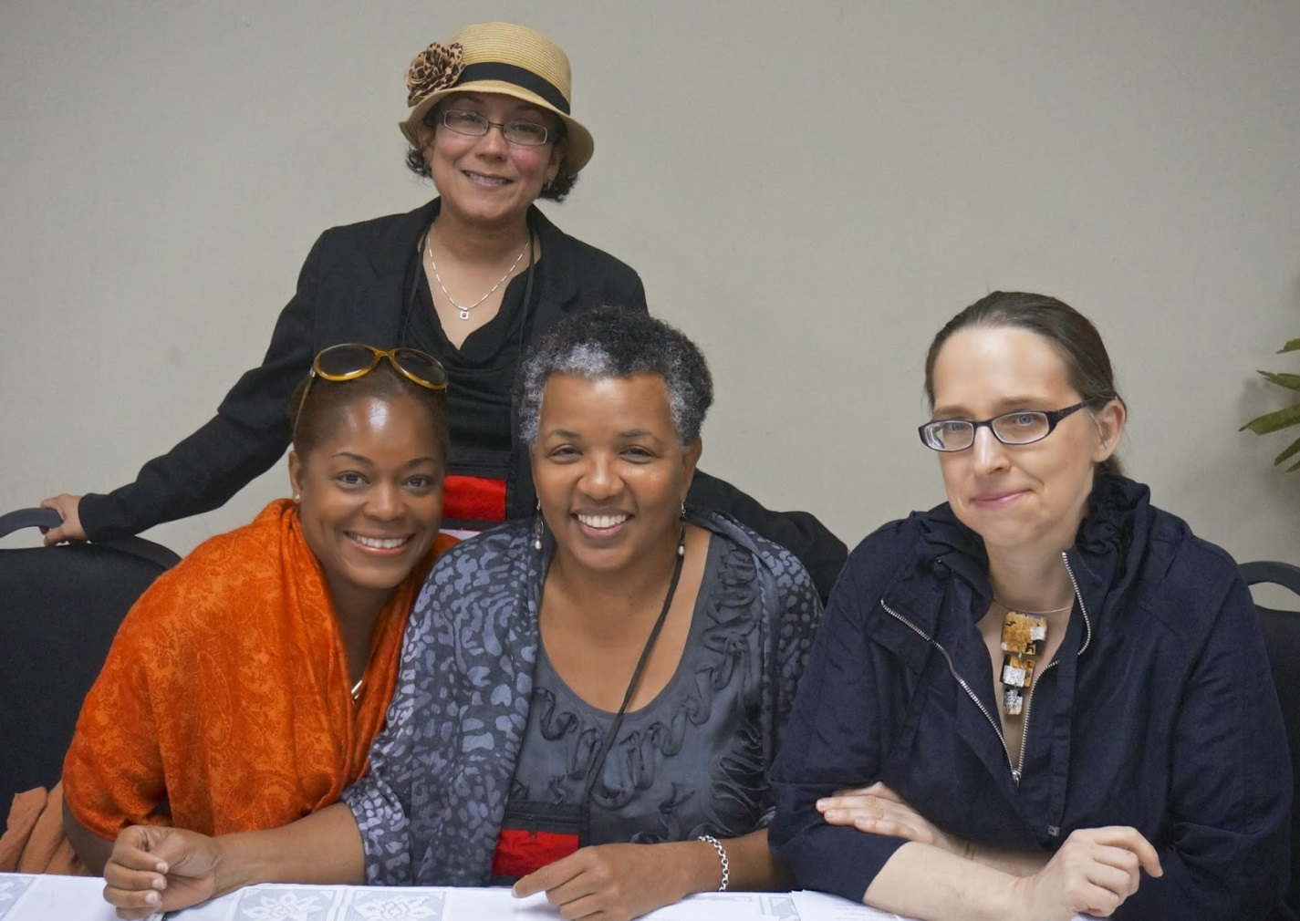
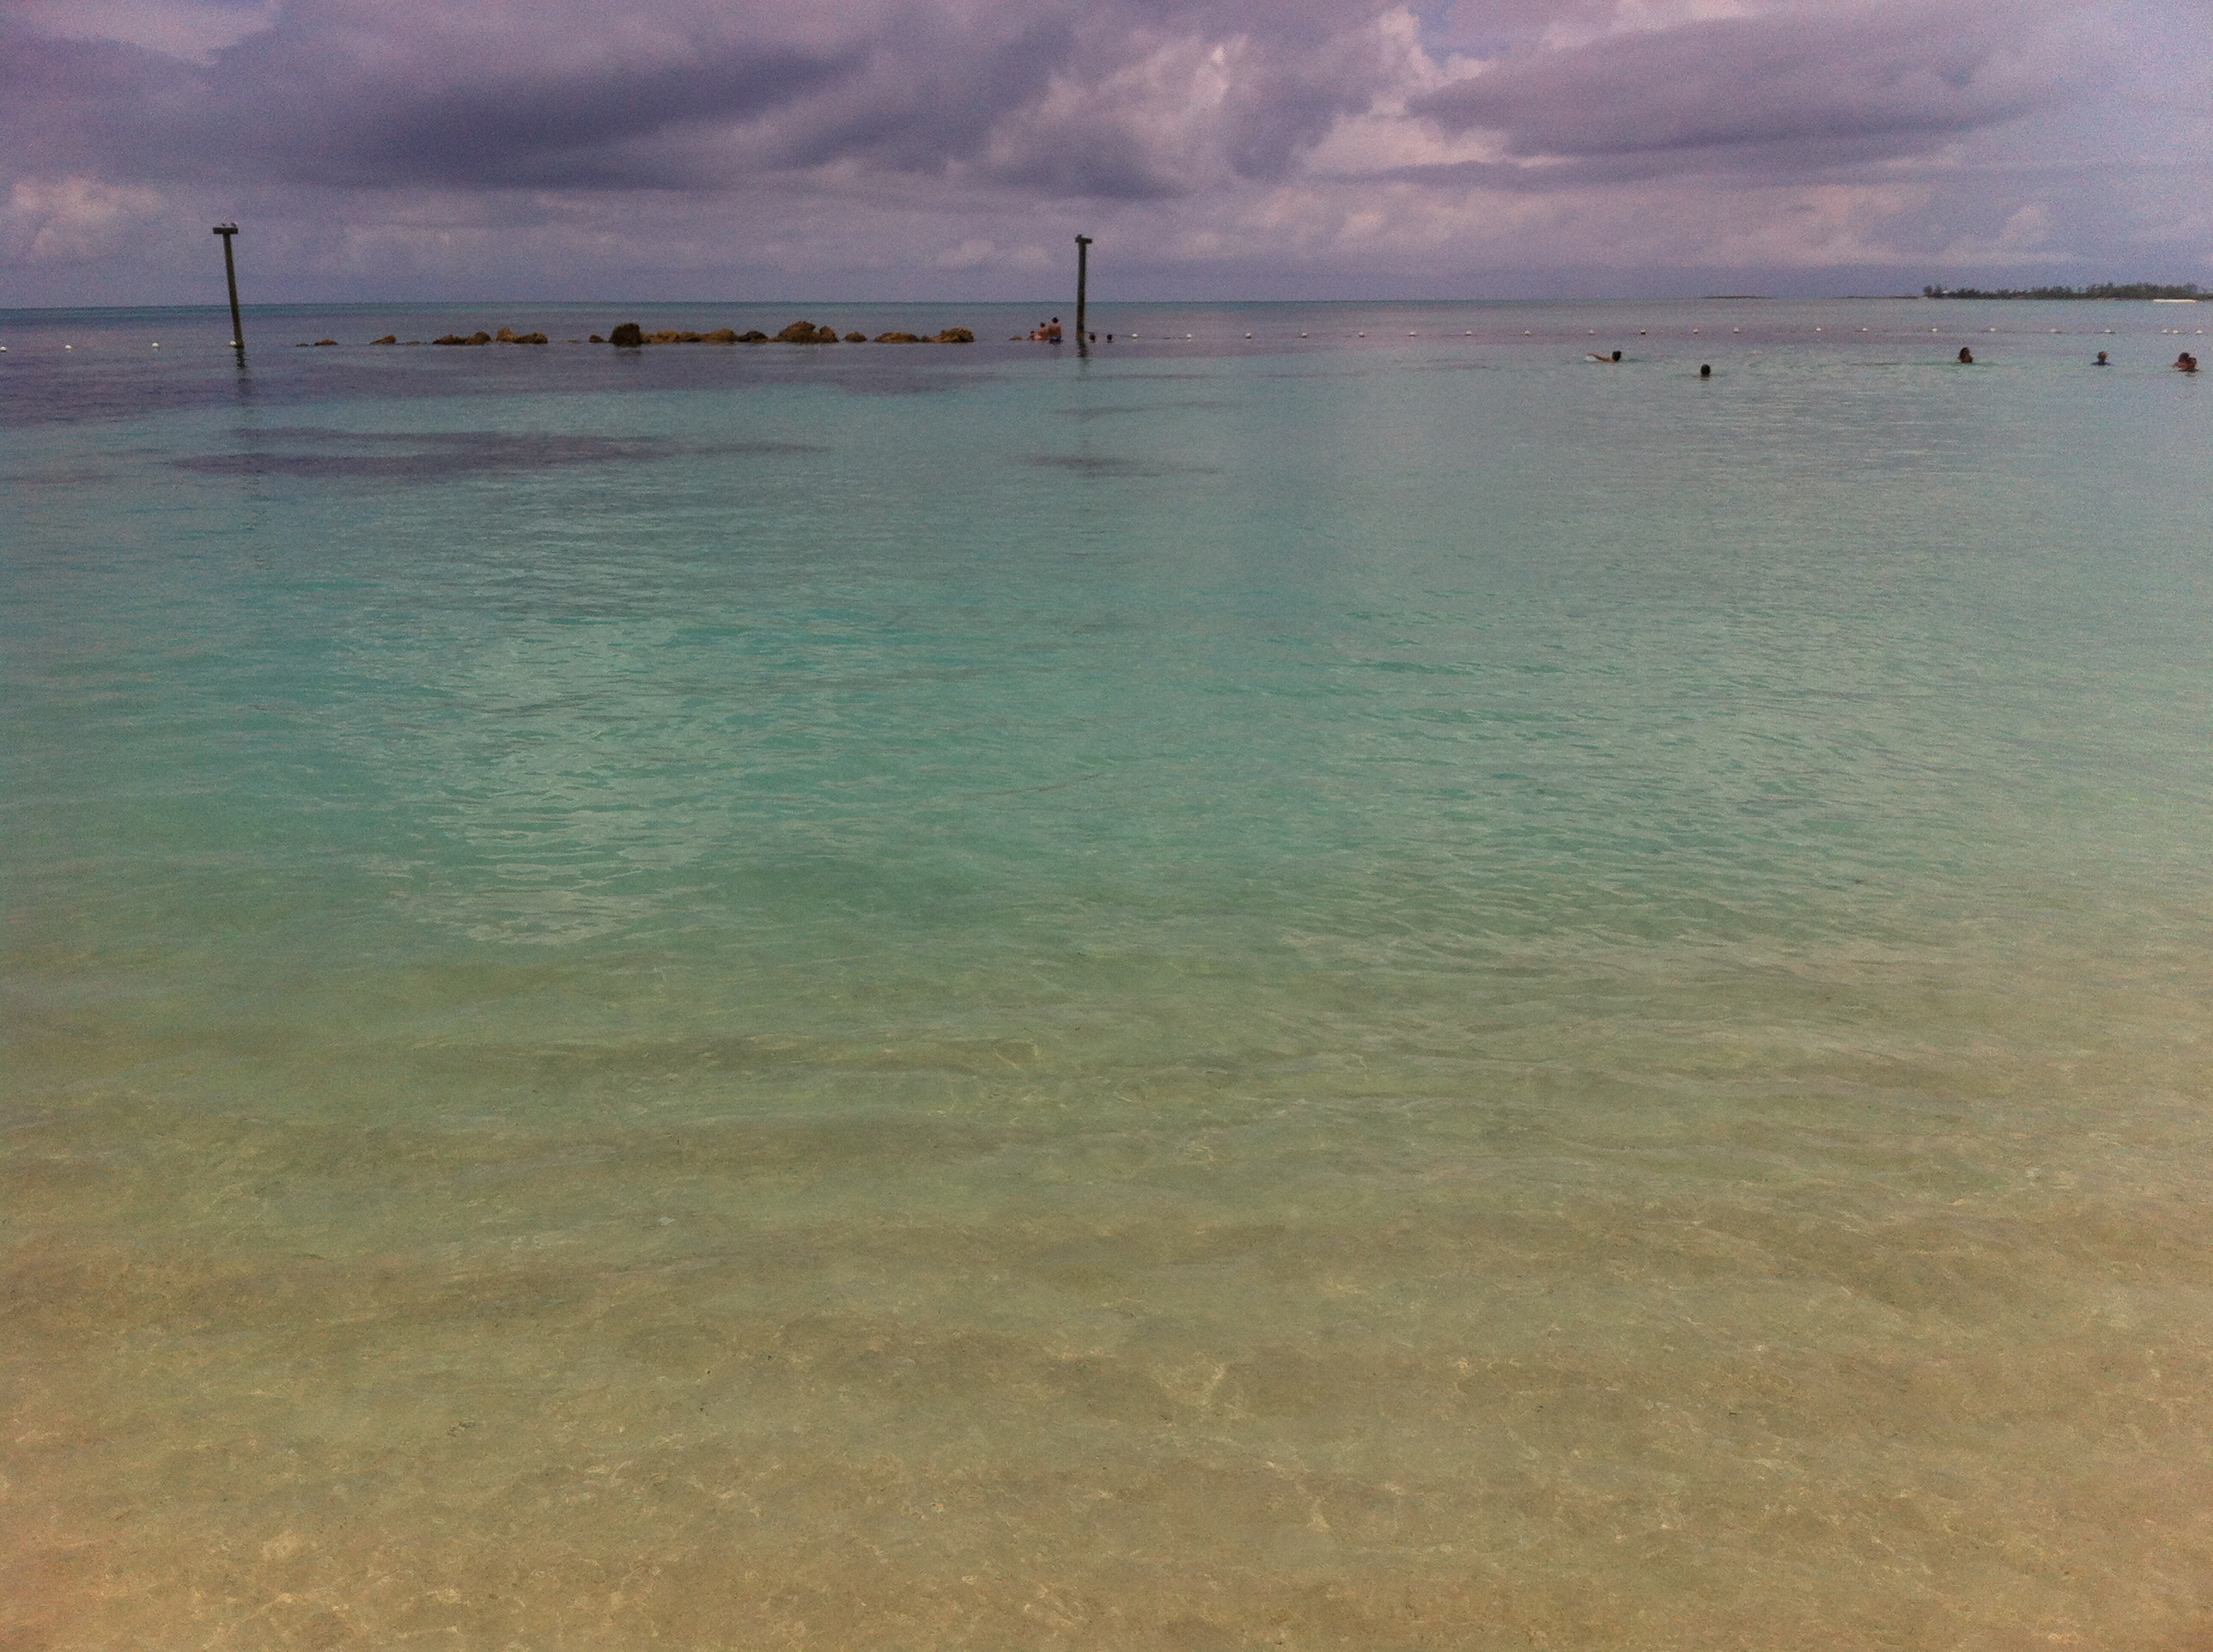
EXPANDED HORIZONS
Photo from Leah Rosenberg, photo of (from the top, left): Margarita Vargas-Betancourt, Donette Francis, Rhonda Cobham-Sander, and Leah Rosenberg at the panel on the course at the International Conference on Caribbean Literature, Nov. 13-15, Panama City
Notes:
For UF, we will determine how to make the program work for all involved, and ETDs and ETD professionals are part of making the new program work. As we look towards the future, greater complexity looms on the horizon.
In addition to new programs, new ways of teaching and doing research within courses have the potential to change ETDs. “Panama Silver, Asian Gold: Migration, Money, and the Making of Modern Caribbean Literature” is a DOCC course:
This definition is from FemTechNet:
A DOCC is a Distributed Online Collaborative Course. It is a feminist rethinking of the MOOC (Massive Open Online Course) that has been widely used in distance learning education. A MOOC is pedagogically centralized and branded by a single institution. FemTechNet seeks to enhance the system using feminist principles and methods that support a decentralized, collaborative form of learning. The fundamental difference is that the DOCC recognizes and is built on the understanding that expertise is distributed throughout a network, among participants situated in diverse institutional contexts, within diverse material, geographic, and national settings, and who embody and perform diverse identities (as teachers, as students, as media-makers, as activists, as trainers, as members of various publics, for example). (FemTechNet)
“Panama Silver, Asian Gold” was developed as a pilot for inter-collegiate digital humanities courses and was designed by Leah Rosenberg (UF), Rhonda Cobham-Sander (Amherst College), and Donette Francis (University of Miami), along with their collaborating librarians, technologists, and students at all three institutions. The course was initially taught at all three institutions in fall 2013, and it will be taught again next year. Not only does the course represent collaboration across institutions in conducting classes and research, the course was also intentionally planned as a way to enlarge and open the community for Caribbean Studies.
As Rhonda Cobham-Sander explained:
We hope that the course will become part of a broader initiative to make visible to other teachers and scholars new ways of incorporating archival material into research on Caribbean literature and culture.
Since the Panama and Asian migrations are rarely privileged in stories Caribbean nationalists tell about the region, we want to use the project to intervene more broadly in the way Caribbean literary scholarship imagines the Caribbean cultural diaspora and interrogates the ways in which both traditional and colonial archival sources shape the stories we can tell about the Caribbean region.
We hope our experiment will sow the seed for future collaborative courses involving students at institutions in the Caribbean, Panama, China, and/or India, capable of working with relevant documents from these regions in languages other than English. (qtd. in Rosenberg)
This innovative course and future courses like it are part of the new era in digital humanities and digital scholarship, and the forms of work, including theses and dissertations will continue to evolve with changed influences and opportunities from these other changes, especially in regards to new file formats, structures, and new notions on collaboration and student research. These changes bring challenges on authorship, handling, and so much more, as well as so many opportunities for us to share our expertise as ETD professionals in shaping the things to come.

Slide 31
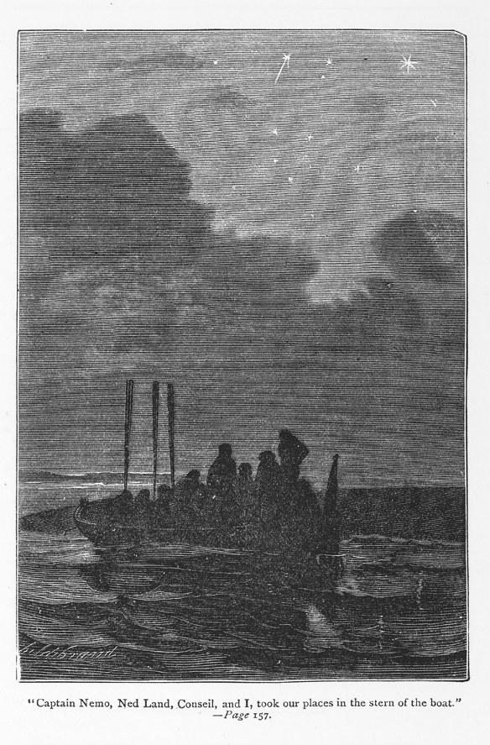
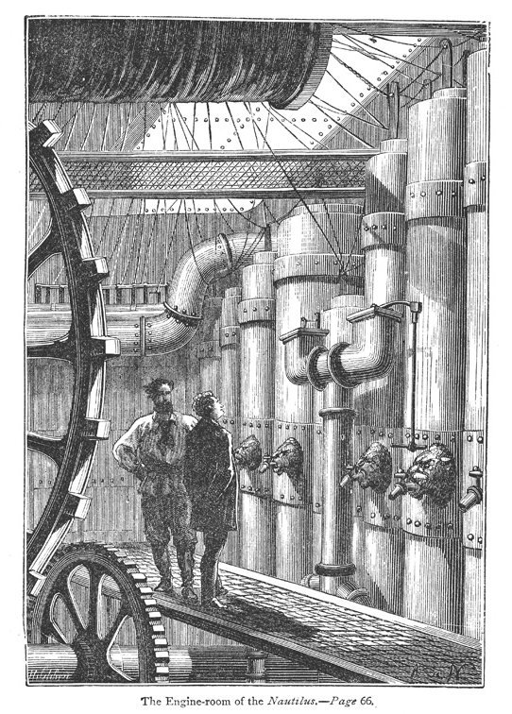
TRAVELING TOGETHER
.
Twenty thousand leagues under the seas, or, The marvelous and exciting adventures of Pierre Aronnax, Conseil his servant, and Ned Land, a Canadian harpooner, from the Baldwin Library of Historical Children’s Literature, UF Digital Collections
Notes:
Wherever each of us plans to go next, we’re also going to be traveling as a community.
For possible inspiration for the next steps on our plan for better orienting towards our objective, Walt Whitman’s Leaves of Grass offers “Aboard at a Ship's Helm”
Aboard at a ship's helm,
A young steersman steering with care.
Through fog on a sea-coast dolefully ringing,
An ocean-bell—O a warning bell, rock'd by the waves.
O you give good notice indeed, you bell by the sea-reefs ringing,
Ringing, ringing, to warn the ship from its wreck-place.
For as on the alert O steersman, you mind the loud admonition,
The bows turn, the freighted ship tacking speeds away under her gray sails,
The beautiful and noble ship with all her precious wealth speeds
away gayly and safe.
But O the ship, the immortal ship! O ship aboard the ship!
Ship of the body, ship of the soul, voyaging, voyaging, voyaging.
For the next steps of our travels as a community of US ETD professionals, we are at the ship’s helm. We can define our ways of navigating and traveling, and our ways of working. We know we have many challenges and opportunities to face, and we can best do so together with our existing community and by growing our community even further.

Slide 32
REFERENCES
  Presentation slides with all sources: www.ufdc.ufl.edu/AA00025676
Notes:
My presentation slides with all sources are available in UF’s IR: www.ufdc.ufl.edu/AA00025676

Slide 33
THANK YOU
&
QUESTIONS
@LAURIEN LAURIEN@UFL.EDU
Notes:
Thank you very much for your time. I’m happy to have questions or to continue the discussion now, and to be able to be part of the discussion throughout the conference.
Thank you.

