Slide 1
DEVELOPING EXHIBITS
LOURDES SANTAMARIA-WHEELER
EXHIBITS COORDINATOR

Slide 2
The magic of exhibitions
is at the intersection
of design and curation.
Not one or the other.

Slide 3
WHAT IS AN EXHIBIT?
An exhibit is a story
interpretation
context
scholarly content

Slide 4
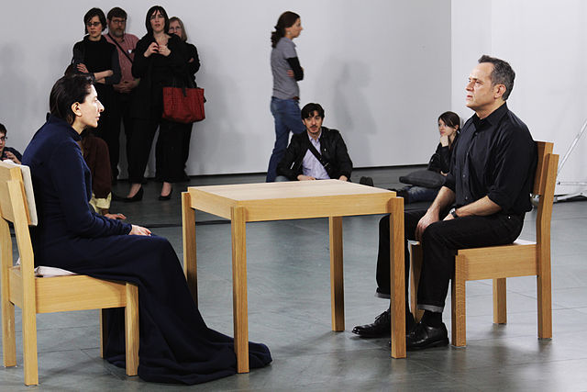
Exhibits are also experiences
Marina performing "Artist is Present" at the MoMA in May 2010 by Shelby Lessig
licensed under CC BY-SA 3.0
What visitors do & feel is important

Slide 5
WHY
Education - Mission fulfillment
Bring awareness to hidden/low usage materials
Share new findings, new acquisitions,
new relationships among items
Broaden audience

Slide 6
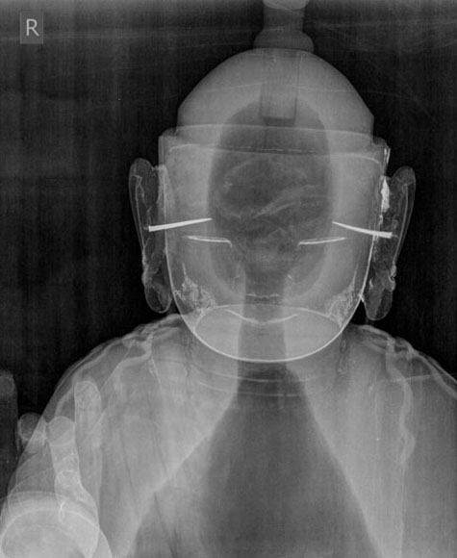
WHY ONLINE
Display fragile items
Link to additional and/or
multimedia content
Permanent/semi-permanent resource
Gilt Wood Seated Bodhisattva X-Ray from ‘Korean Art: Collecting Treasures,’ Samuel P. Harn Museum of Art and George A. Smathers Libraries, University of Florida

Slide 7
POLICY
Goal of exhibition program is to highlight the collections
Use originals whenever possible from Smathers Libraries collections, borrow as appropriate to support/augment
Loans should not be the central feature, unless it is a traveling exhibit
Co-curating and collaboration within the Libraries’ various collections and with campus departments, the community, and other institutions is encouraged
Implemented 2012
http://exhibits.uflib.ufl.edu/docs/ExhibitsPolicy.pdf

Slide 8
POLICY
The Libraries do not develop or host exhibits with the sole purpose of promoting agendas of organizations outside the Libraries, or to advocate for specific political, philosophical, or religious viewpoints.
Do not display unsolicited exhibits
Physical exhibitions created by the Libraries shall have complementary online component(s) as appropriate. All online material created for, or in conjunction with exhibitions shall be archived and publicly available in UFDC
Implemented 2012
http://exhibits.uflib.ufl.edu/docs/ExhibitsPolicy.pdf

Slide 9
SMATHERS RESOURCES
Exhibits website http://exhibits.uflib.ufl.edu
Resources for curators http://exhibits.uflib.ufl.edu/resources.html
Timeline http://exhibits.uflib.ufl.edu/docs/timeline.pdf
Exhibit Proposal form http://exhibits.uflib.ufl.edu/docs/ExhibitProposal.pdf
Tips for labels http://exhibits.uflib.ufl.edu/docs/labels.pdf
Template for ID labels http://exhibits.uflib.ufl.edu/docs/IDlabels.pdf

Slide 10
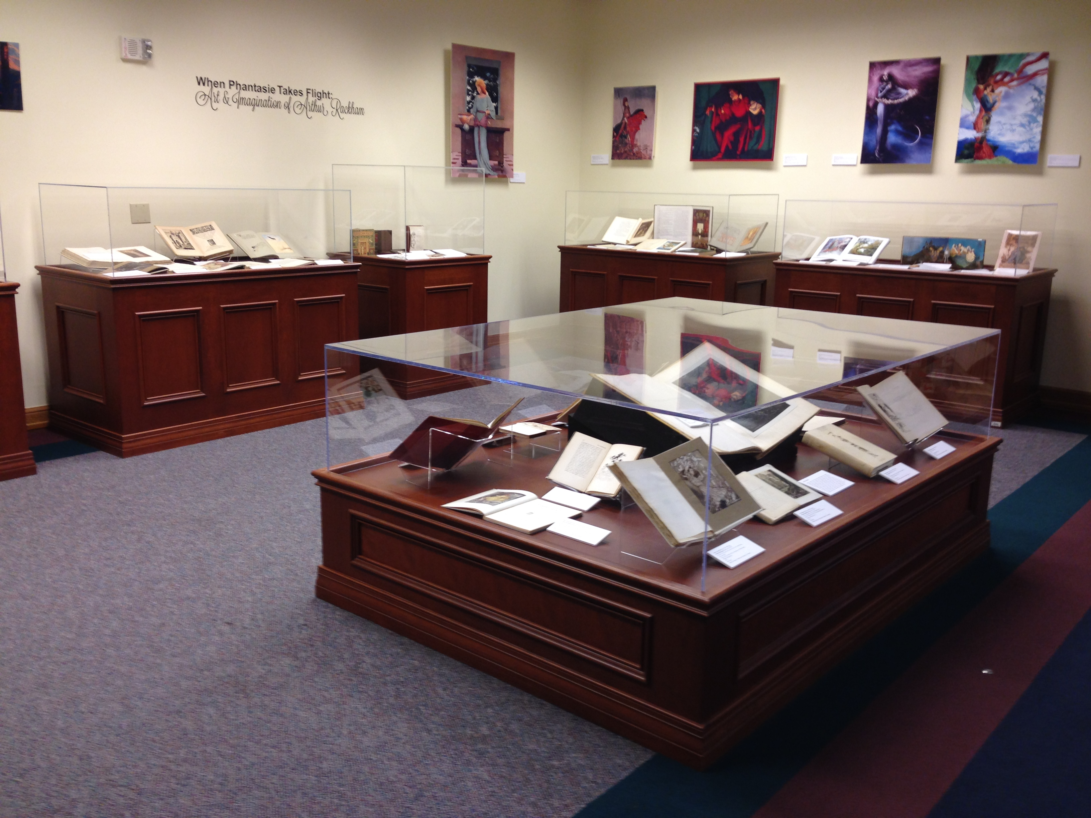
SPACES
Marston Science Library
Library West
Smathers Library Gallery
Latin American & Caribbean Collection
Health Science Center Libraries
Online

Slide 11
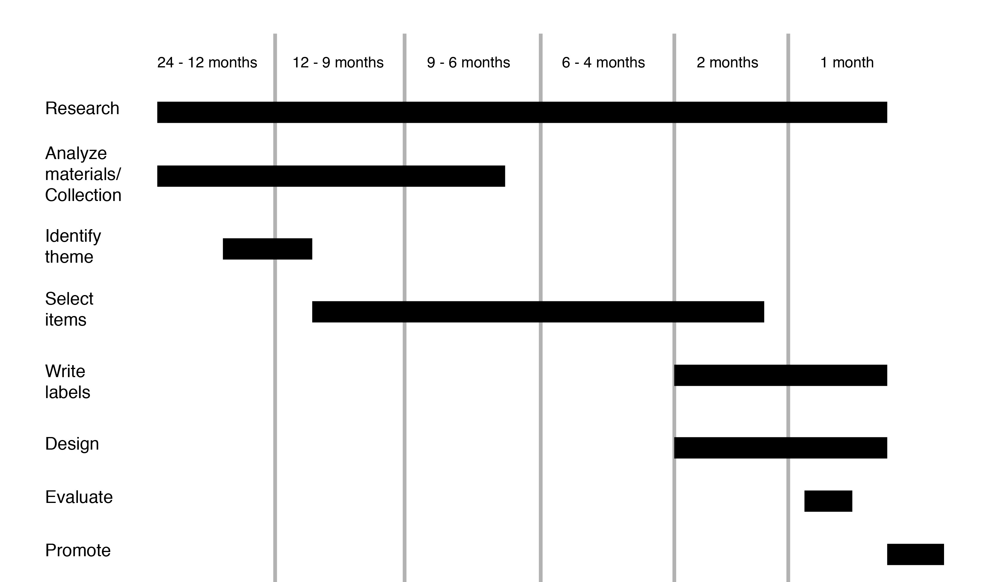
TIMELINE
12-24 months minimum

Slide 12
Analyze materials
Determine general theme/central topics
Identify items
Reduce exhibit to one sentence
Refine object list
Write labels
Promote
Launch
Edit/Refine
Evaluate

Slide 13
THEMES
Pick a compelling story that the materials support
Think beyond directly commemorative months, milestones, anniversaries
Concrete ideas not requiring a lot of background information, too much explanation

Slide 14
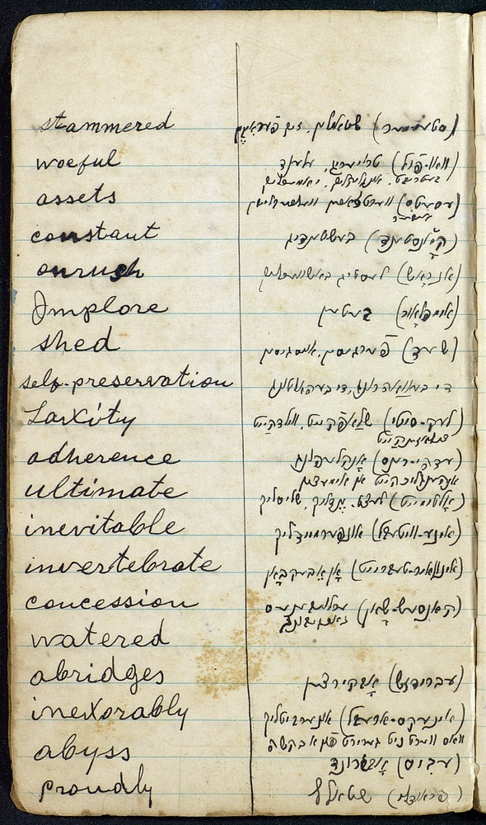
When selecting items do not choose solely on visual appeal but rather choose an item for its inherent information, story advancement
The Rev. Benjamin Safer’s notebooks: pinkas 3 from ‘Jewish Jacksonville,’ George A. Smathers Libraries, University of Florida.
Aus Vergilbten Akten Zur Geschichte der Bonner Synagogengemeinde from ‘The Gathering Storm,’ George A. Smathers Libraries, University of Florida.

Slide 15
GOOD EXHIBITS
An aspect of the exhibition is innovative
Offers a new perspective, new insight, or new information on a topic
Synthesizes and presents existing knowledge and/or collection materials in a provocative way
Indicators of exhibit excellence from the National Association for Museum Exhibition (NAME)

Slide 16
GOOD EXHIBITS
Are easy to explain
Make the subject come to life
Are conceptually simple
Emphasize connections among things

Slide 17
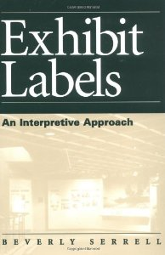
LABELS
Introductory (Curator Statement)
ID (tombstone)
Caption
Group
Creator (first last name) (Nationality, birth-death)
Title
Date
Publisher
Dimensions
Call number/Accession number
Credit line
Interpretation
Serrell, Beverly. Exhibit labels: an interpretive approach. Walnut Creek: Alta Mira Press, 1996.

Slide 18
INTERPRETIVE LABELS
Introductory, Caption, Group
Conversational & narrative
Just enough details to tell the story
Avoid tech, specialized terms, or anything that requires lengthy explanation
Not for your academic peers

Slide 19
AUDIENCE
Who are they?
What are they like?
Why are they coming?
What do you want them to do?
Unintended audiences are common online

Slide 20
Don’t expect visitors
to spend more than
10 minutes
in online exhibit

