Slide 1
Digital Library of the Caribbean (dLOC) & Digital Humanities www.dloc.com
LEAH R. ROSENBERG LAURIE N. TAYLOR
@LAURIEN
Notes:
Hello, I’m Laurie Taylor, Digital Library of the Caribbean (dLOC) Technical Director.

Slide 2
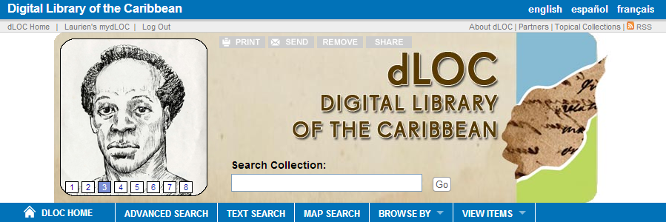
Digital Library of the Caribbean
dLOC's diverse partners serve an international community of scholars, students, and citizens by working together to preserve and to provide enhanced electronic access to cultural, historical, legal, governmental, and research materials.
Partner Training
Technical Infrastructure
Institutional Support
Notes:
With not much time, I want to emphasize that dLOC is a community, and that’s the strength and the value and the reason dLOC can do so much, and this is also why dLOC does and enables Digital Humanities work—the community makes it possible.

Slide 3
dLOC Quick Facts
Content Management System and Long-term Preservation
38 Partners – Caribbean, Europe and US
Over 36 million hits since 2006
Over 2.2 million pages of open access content
Over 91,000 items
Training Programs
Scholarly Collaborations
Educational Outreach
Shared Governance
New Initiatives
Notes:
dLOC’s community begins with the partners for full socio-technical supports (people, policies, and technologies).
dLOC’s partners make resources available and ensure their preservation. dLOC’s partners also conduct training, develop resources, and collaborate with others to build community and capacity.

Slide 4
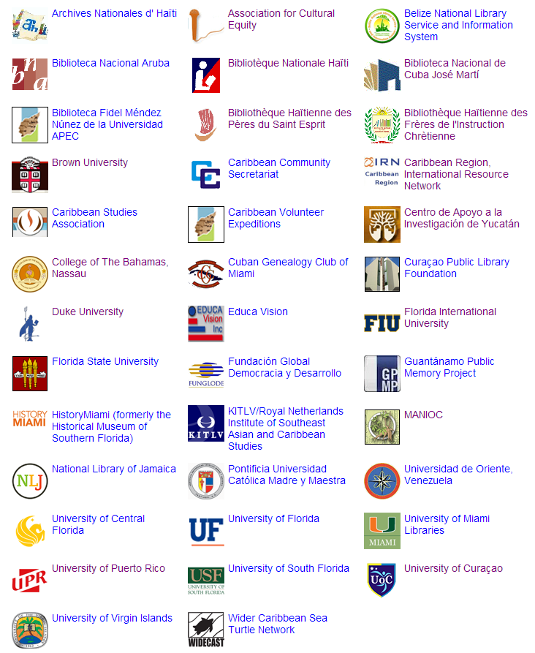
dLOC Content Partners
CONTENT PARTNERS
Current: http://dloc.com/partners
Notes:
dLOC’s core is collaboration.
dLOC has grown to 38 partners: NGOs, universities, national libraries, scientific groups, from the Spanish, French, Dutch, and English speaking Caribbean.
dLOC also has silent partners, affiliate partners, contributors, publishers, scholars, and members who provide financial support for dLOC, with dLOC having sustainable ongoing funding and members contributing for to grow dLOC faster for new content.

Slide 5
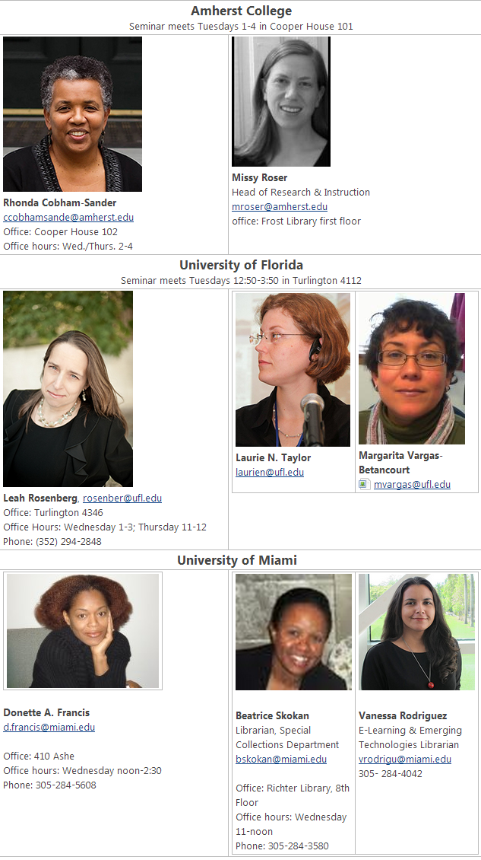
Scholarly Advisory Board
SCHOLARLY COMMUNITIES
Scholar Collaborators
Scholarly Communities
Scholarly Advisory Board
Scholars Council
Notes:
When dLOC began, dLOC had a Scholarly Advisory Board. dLOC just celebrated its 10th birthday in June, and scholars are doing more than ever, and we’re now working to expand that board and better define it’s roles for support for credit for the scholar contributors.

Slide 6
Digital Humanities
DIGITAL HUMANITIES
Humanities in and for the digital age
Humanities in and for the age of big data
Notes:
The need is being driven, in no small part, by DH work with dLOC.
DH has many definitions, we often use these.

Slide 7
Digital Curation
DIGITAL CURATION
Digital Library Collections
Online Exhibits
New forms of digital scholarship
Notes:
Digital Humanities work with dLOC builds on and often performs digital curation.
Intellectual access is a critical piece of digital curation and DH.

Slide 8
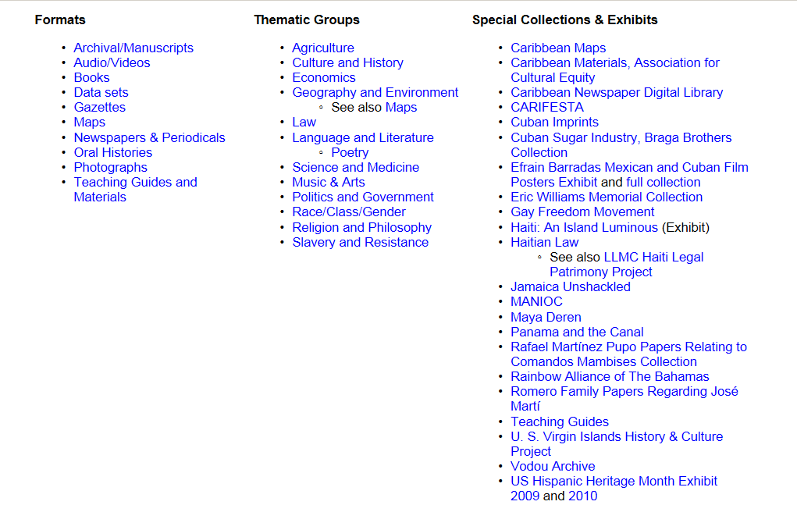
Themes, Formats and Collections
THEMES & COLLECTIONS
What do you do with a million books?
Data mine
Tell a single story with an exhibit
Notes:
This is the dLOC topical collections page, which lists some of dLOC’s curated collections, like special collections and exhibits. This page was created per partner, scholar, and public demand.
This is really important because so many archival treasures aren’t known; they don’t exist online; they barely in the scholarly record because they haven’t been accessible before and so they haven’t been included and connected. The materials need to have support built for the connections with intellectual infrastructure, and that requires community.
And, not just one community, but many. dLOC recognizes and relies on the different partner perspectives, where each partner selects their materials for digitization with no requirements aside from technical for preservation and rights/permissions.
With dLOC, scholars have an opportunity and the means to follow their research interests and, by doing so, to add support for materials. This results in research that represents public humanities and translational humanities and immense value for broader impacts.

Slide 9
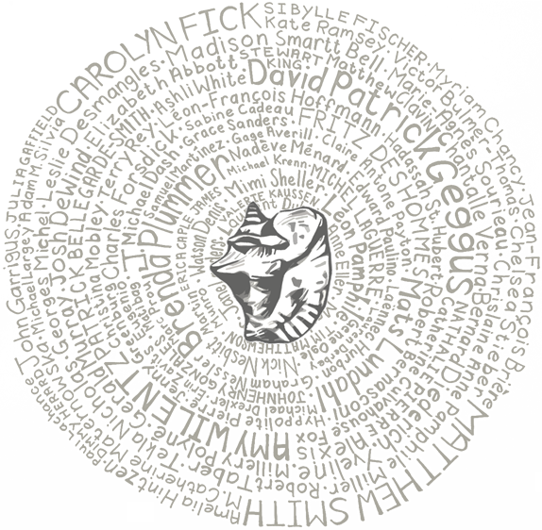
Haiti: An Island Luminous
HAITI: AN ISLAND LUMINOUS
An Island Luminous is a site to help readers learn about Haiti’s history.
Created by historian Adam M. Silvia and hosted online by Digital Library of the Caribbean, An Island Luminous combines rare books, manuscripts, and photos scanned by archives and libraries in Haiti and the United States with commentary by 107 experts.
www.dloc.com/exhibits/islandluminous
Notes:
One example of DH as creating context and intellectual infrastructure with dLOC is the online exhibit or curated edited collection “Haiti: An Island Luminous”.
It was possible only because of the work of dLOC partners in digitizing cultural heritage materials, the expert work of Adam Silvia in organizing and designing the project, and the 107 scholars who contributed their expertise.
It is available now in English, and is being translated into French and Creole with some parts already translated. It is being taught in Haiti and Miami for primary school as well as being taught at university, and being a teaching device for connecting scholars from different fields as a work that blends literary, political, social, historical, agricultural and other scholarly fields.

Slide 10
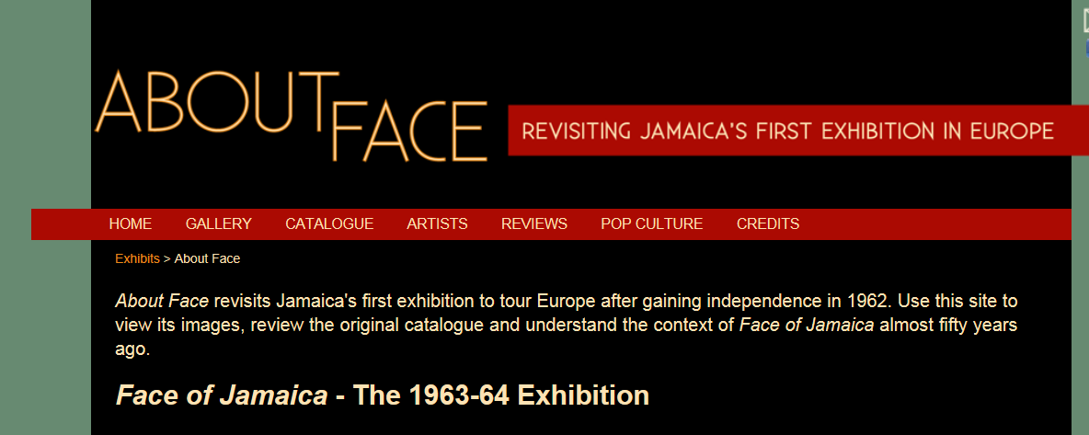
Guest Curated Exhibits
ABOUT FACE
Curated by Dr. Petrine Archer and Claudia Hucke
Online: www.dloc.com/exhibits/aboutface
Notes:
About Face is another scholarly collaboration example, and it’s focused on the visual arts.

Slide 11
dLOC Now and Future
dLOC NOW & FUTURE
Building intellectual infrastructure for Caribbean Studies in the digital age and the age of big data
Collaborating with partner institutions, scholars, librarians, archivists, museum professionals, teachers, and more
Notes:
In the past, the humanities were pretty closed to people after graduating with losing access to databases, libraries, and just being cut off. This is changing with Open Access so people can get stuff, but how do we continue the community, grow the community, and grow the knowledge and impact for each all in the community.
dLOC and DH offer a model of doing “our work” (for archivists, scholars, librarians, and our communities) in various modes and having that work connect to and build something far beyond. Leah is now going to speak on that far beyond.

