Slide 1
Collaboratively Developing Intellectual Infrastructure with the Digital Library of the Caribbean (dLOC)
Presented for the Baldwin Library of Historical Children’s Literature Planning Meeting for the Baldwin Scholars Council (June 2014)
Laurie Taylor
dLOC Technical Director
Digital Scholarship Librarian, Univ. Florida
www.dloc.com
Email: laurien@ufl.edu
Phone: 352.273.2902
Notes:
Hello, I’m Laurie Taylor, Digital Library of the Caribbean (dLOC) Technical Director, and today I’m speaking about Collaboratively Developing Data Curation Literacy with dLOC.

Slide 2
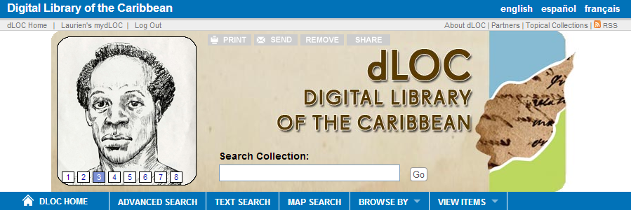
Digital Library of the Caribbean
dLOC's diverse partners serve an international community of scholars, students, and peoples by working together to preserve and to provide enhanced electronic access to cultural, historical, legal, governmental, and research materials. dLOC's partners collaborate with scholars and teachers to promote and perform educational outreach for Caribbean Studies, create new works of digital scholarship, and develop other research and teaching initiatives.
Partner Training
Shared Infrastructures & Communities
Institutional Support
Notes:
Because dLOC began with ACURIL.
I wanted to note that this year we are celebrating dLOC’s 10th birthday.
At the ACURIL conference in May 2004 in Trinidad, dLOC began with a workshop and discussion, with Judith Rogers as one of the presenters, and Judith is here today, and Barry Baker and others in attendance.
Will everyone who was at the 2004 ACURIL, please raise your hand?
Will everyone who has been involved with dLOC in any way, including hearing presentations on dLOC at ACURIL, please also raise your hands? I wasn’t at ACURIL in 2004, so I’m in this group, too.
Thank you!
So, we can see dLOC’s community in the room here today.
Today, I’m sharing about dLOC knowing that we are all part of dLOC.
So, what is dLOC:
dLOC's diverse partners serve an international community of scholars, students, and peoples by working together to preserve and to provide enhanced electronic access to cultural, historical, legal, governmental, and research materials. dLOC's partners collaborate with scholars and teachers to promote and perform educational outreach for Caribbean Studies, create new works of digital scholarship, and develop other research and teaching initiatives.
dLOC’s partners contribute significantly and directly to making resources available and ensuring their preservation.
dLOC’s partners also conduct training and develop resources for dLOC and the world to collaboratively develop data curation literacy for cultural heritage.
[cite http://uwispace.sta.uwi.edu/dspace/bitstream/handle/2139/12799/ACURIL%20proceedings%202004.pdf?sequence=1]

Slide 3
dLOC Quick Facts
Content Management System and Long-term Preservation
38 Partners – Caribbean, Europe and US
Over 39 million hits since 2006
Over 2 million pages of open access content
14,000 titles with 86,000 items
Training Program: Digitization, Data Curation, and More
Scholarly Collaborations
Educational Outreach
Shared Governance
Notes:
Some general information on dLOC with these quick facts.
[Read the quick facts]

Slide 4
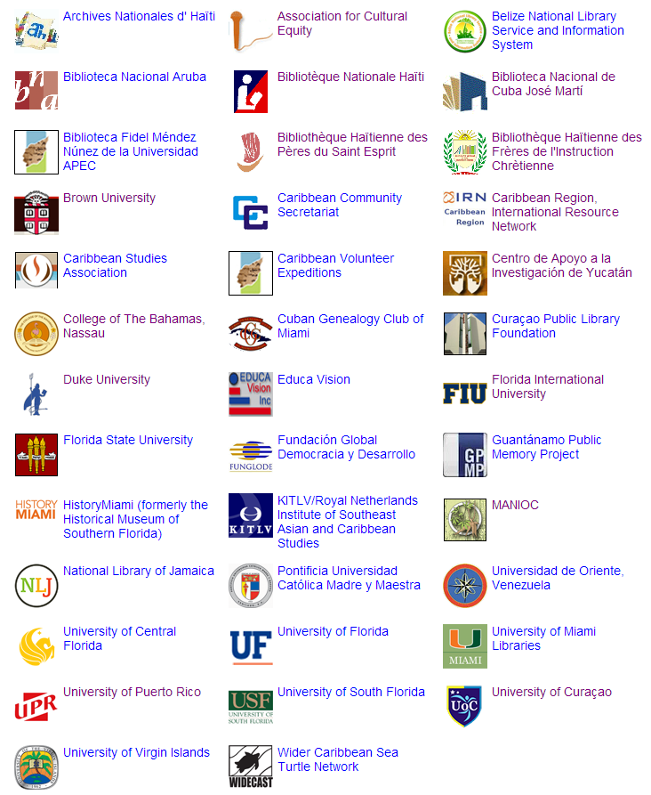
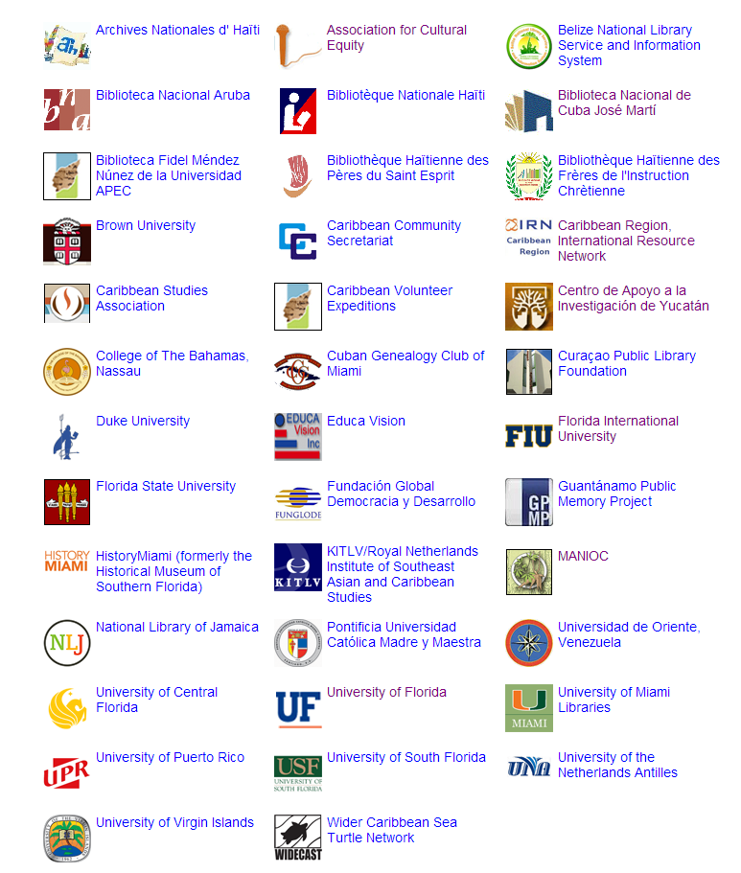
dLOC
Partners
Notes:
dLOC’s core is collaboration.
dLOC’s began with a small core of 9 Founding Partners
Archives Nationale d'Haïti
Caribbean Community Secretariat (CARICOM)
National Library of Jamaica
La Fundación Global Democracia y Desarrollo (FUNGLODE)
Universidad de Oriente, Venezuela
University of the Virgin Islands
Florida International University
University of Central Florida
University of Florida
And, now dLOC has 38 partners.
Will people from dLOC’s partners please raise your hands: founding and current.
Wow, thank you!
The community here with all of the partners is absolutely critical for data curation literacy.

Slide 5
dLOC Collaboration for Data Curation Literacy
Communities (Partners, Trainings, Teaching, Engagement)
Technologies
Intellectual Infrastructure
Notes:
As a technologist, one of the many things dLOC repeatedly shows me is that the technology is the easy part, even for complex concerns like data curation for cultural heritage.
The important and difficult work is in the socio-technical – the people and communities. dLOC’s strength in collaboratively developing data curation literacy is the foundation of the community with libraries, archives, and museums who are experts in curation, experts in cultural heritage, and experts in literacy.

Slide 6
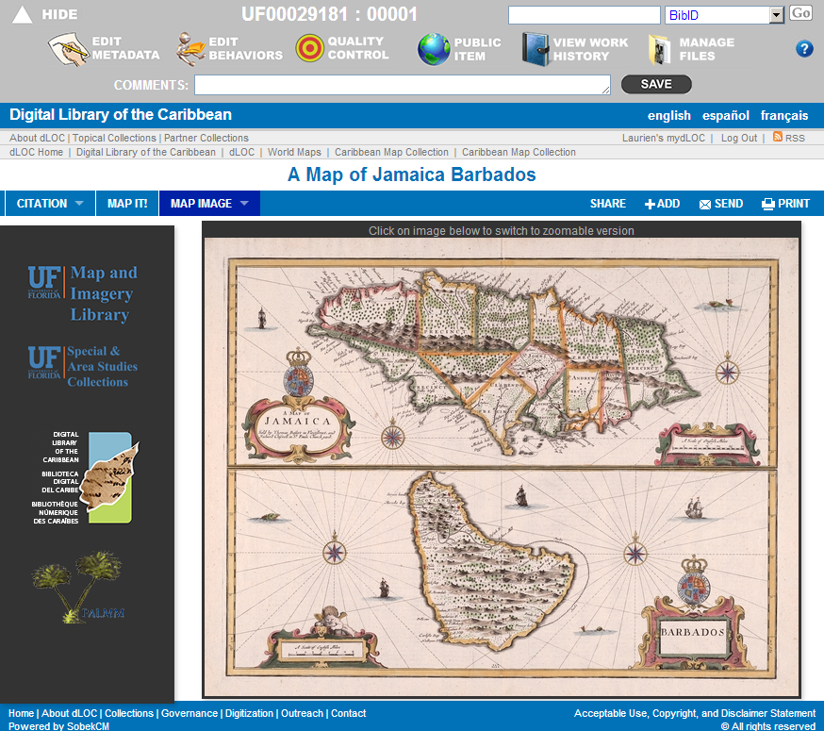
dLOC Collaboration: Technologies
SobekCM:
Cyberinfrastructure: SobekCM repository, digital asset management, content management software; sustainable preservation and access, open interoperability; tools for data curation by the community
Curator tools: online tools for curators and collaborators (partners, scholars, etc.), with support for training and collaboration with different user levels, including patron user tools
Notes:
Even the technology is part of the community.
The Open Source SobekCM software powers the dLOC website, myDLOC tools for patrons and scholars, and curator and partner tools. The image here shows some of the curator and partner tools at the top.
dLOC partners helped to develop SobekCM with technical programming and with feedback on what the technology should do and how it should work.
Technology should never dictate policy. Technologies should support us in doing the work that needs to be done. dLOC partners have been very clear on this, and have helped to make SobekCM a full data curation system and to make SobekCM a tool that supports developing data curation literacy.

Slide 7
mydLOC Tools
Register for a free account dloc.com/my/preferences
Create Bookshelves
Save Searches
Send or Share Items
If user is authorized to add/edit materials…
Submit materials
Edit metadata

Slide 8
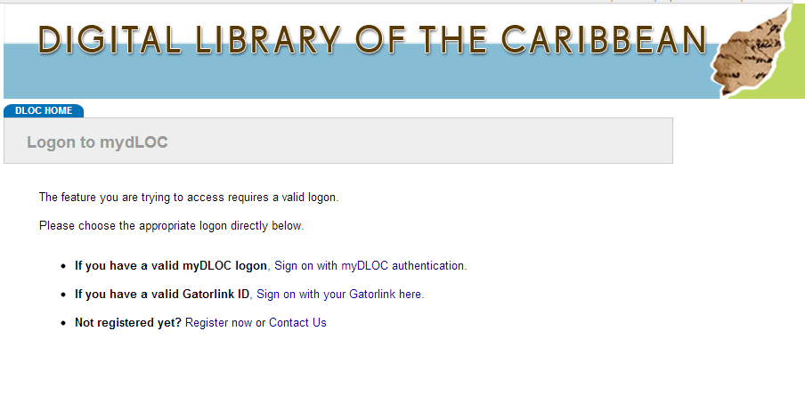
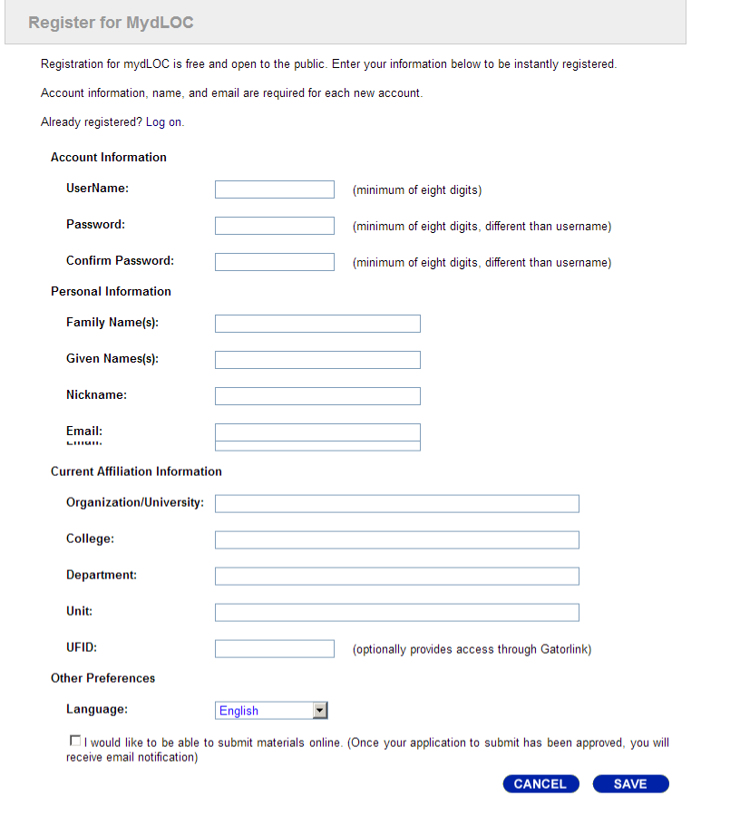
mydLOC Tools: Register

Slide 9
mydLOC Tools: Saved Searches

Slide 10
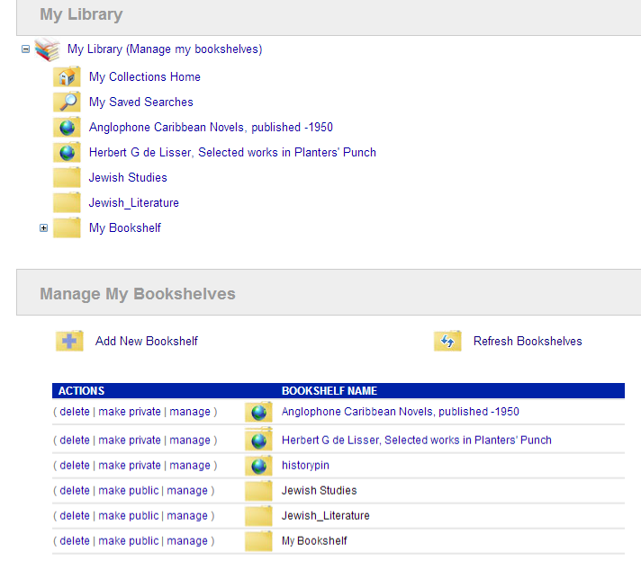
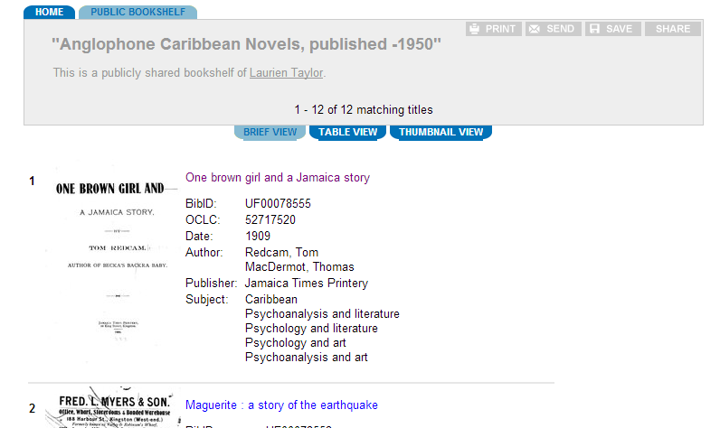
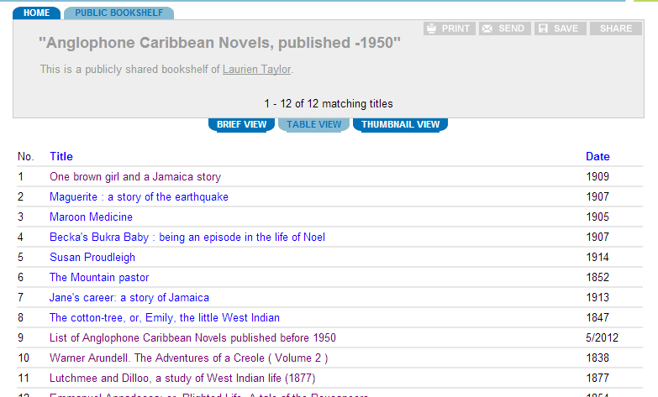
myDLOC Tools: Library & Bookshelves
http://www.dloc.com/folder/2078/brief

Slide 11
mydLOC Preferences

Slide 12
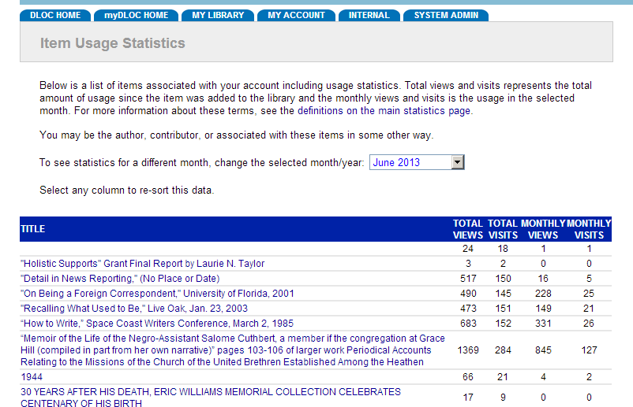
mydLOC: Submitted Items & Usage Statistics

Slide 13
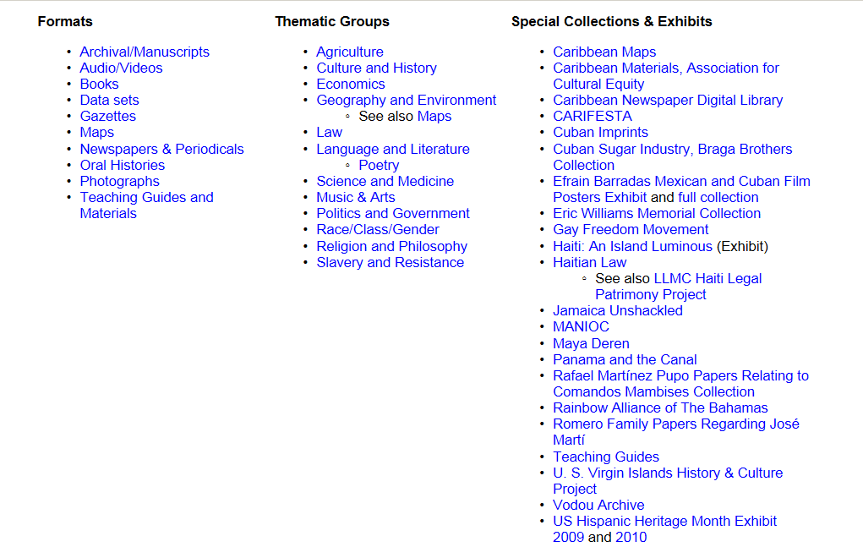
dLOC Collaboration: Intellectual Infrastructure
dLOC Themes, Formats, & Collections Start here to learn more about what collections are online and where we could collaborate to develop new or strengthen existing collections or exhibits.
Notes:
dLOC partners also share expertise in terms of information literacy and intellectual infrastructure as part of data curation literacy.
This is a listing of some examples in dLOC of curated collections, like special collections and exhibits, as intellectual infrastructure.

Slide 14
CARIFESTA Archive
The Caribbean Festival of Arts (CARIFESTA) is a roving multi-disciplinary art festival which has been held in various CARICOM countries since its establishment in 1972.
The Collection includes consultants’ and country reports, articles extracted from magazines, correspondence, press releases, information leaflets, presentations at Symposia, programs, various CARIFESTA themes; posters, photographs & newspaper clippings.
Notes:
For example, the CARIFESTA Archive is a rich resource with country reports, magazine articles, correspondence, press releases, photographs and much more on CARIFESTA.
Each article is a great resource alone. These are infinitely richer when together in a curated collection of all of these resources on a particular CARIFESTA festival and for all of the festivals.
Intellectual infrastructure and data curation includes the content—articles, press releases, photos—and the curated context that connects the materials together and shows their relationships, as in the CARIFESTA Archive.

Slide 15
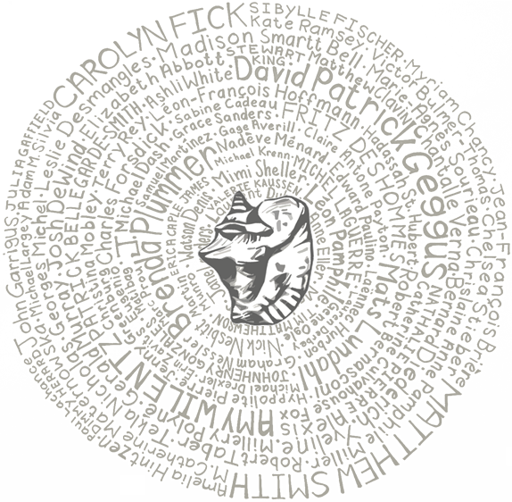
Collaborative Digital Scholarship
Haiti: An Island Luminous
An Island Luminous is a site to help readers learn about Haiti’s history.
Created by historian Adam M. Silvia and hosted online by Digital Library of the Caribbean, An Island Luminous combines rare books, manuscripts, and photos scanned by archives and libraries in Haiti and the United States with commentary by over eighty (80) experts.
Notes:
Data curation can be about creating context with other experts. Over 100 scholars contributed to the online exhibit “Haiti: An Island Luminous” to create a rich resource for teaching history. This exhibit was possible only because of the work of dLOC partners in digitizing cultural heritage materials.
This exhibit shows that data curation literacy requires collaboration with libraries, archives, museums, and other communities like scholars, all working together.

Slide 16
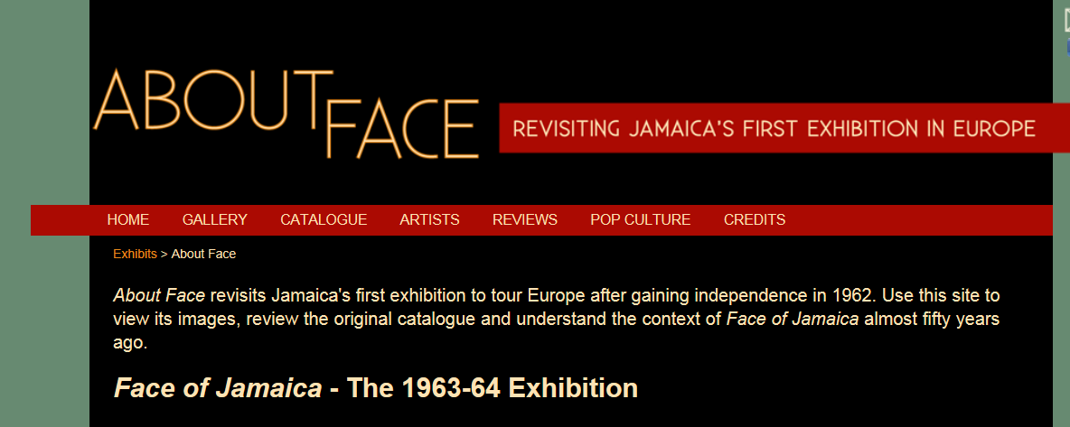
Guest Curated Exhibits
Curated by Dr. Petrine Archer and Claudia Hucke
Online: exhibits.uflib.ufl.edu/aboutface

Slide 17
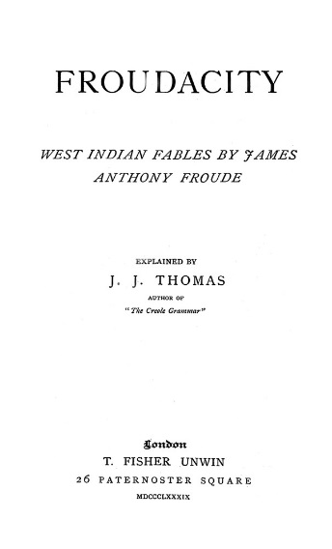
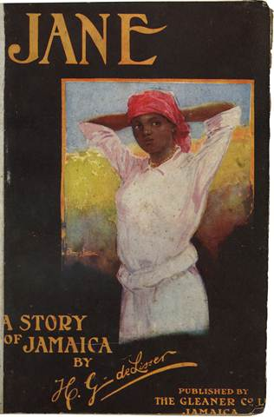
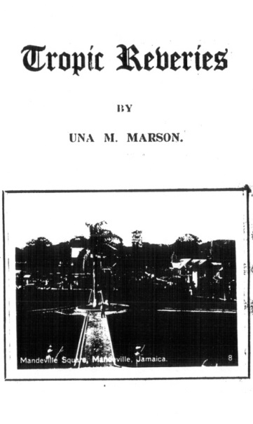
Panama Silver, Asian Gold: Migration, Money, & the Making of Modern Caribbean Literature Course
“We hope that the course will become part of a broader initiative to make visible to other teachers and scholars new ways of incorporating archival material into research on Caribbean literature and culture. […] We want to use the project to intervene more broadly in the way Caribbean literary scholarship imagines the Caribbean cultural diaspora and interrogates the ways in which both traditional and colonial archival sources shape the stories we can tell about the Caribbean region.
We hope our experiment will sow the seed for future collaborative courses involving students at institutions in the Caribbean, Panama, China, and/or India, capable of working with relevant documents from these regions in languages other than English.”
-- Rhonda Cobham-Sander
Notes:
Scholars are also part of data curation literacy with dLOC through their teaching.
The quote on this slide is from Rhonda Cobham-Sander, an extremely important scholar of Caribbean Literature and History. When she learned of so many important Caribbean cultural heritage and literature works in dLOC, she and her colleagues knew they needed to teach about these resources. They also knew they needed to help others in teaching Caribbean literature with dLOC.

Slide 18
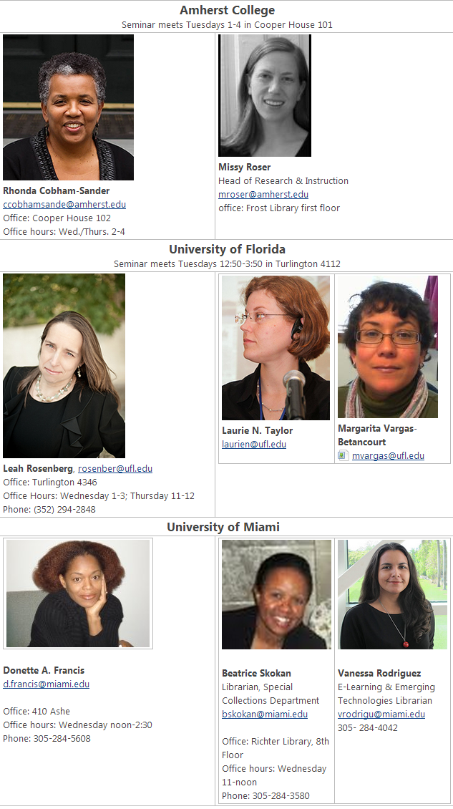
Panama Silver, Asian Gold
Many Communities:
Developed by Rhonda Cobham-Sander, Amherst College; Leah Rosenberg, Univ. of Florida; & Donette Francis, Univ. of Miami; with their librarians
Taught:
Fall 2013; 3 collaborating classes
Spring 2014, at UF
Teaching materials added to dLOC for others teaching Caribbean Studies
Student assignments build from and enhance resources in dLOC
Notes:
Rhonda Cobham-Sander, Leah Rosenberg, and Donette Francis—all Caribbean Literature scholars—taught a class together at their 3 institutions in fall 2013. They taught the course with their librarians. They chose to collaborate because of the critical need for collaboratively developing data curation literacy to support Caribbean Literature studies. This collaboration was possible because of dLOC’s resources, partners, and communities.

Slide 19
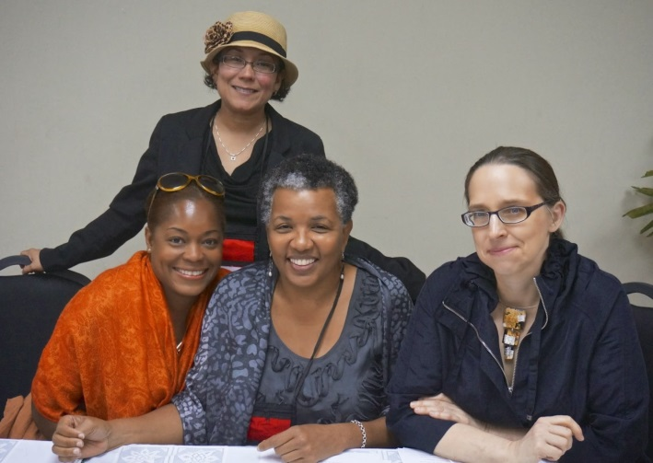
dLOC Collaboration for Data Curation Literacy: Communities
Meeting of Course Collaborators with SAMAAP at the West Indian Museum in Panama City, Nov. 2013
Notes:
They also recognized the importance of extending the collaboration.
Donette, Leah, Rhonda, and a librarian, Margarita Vargas-Betancourt, all traveled together and presented at a conference in Panama. There, they met with librarians, archivists, and museum information professionals to extend the collaboration.

Slide 20
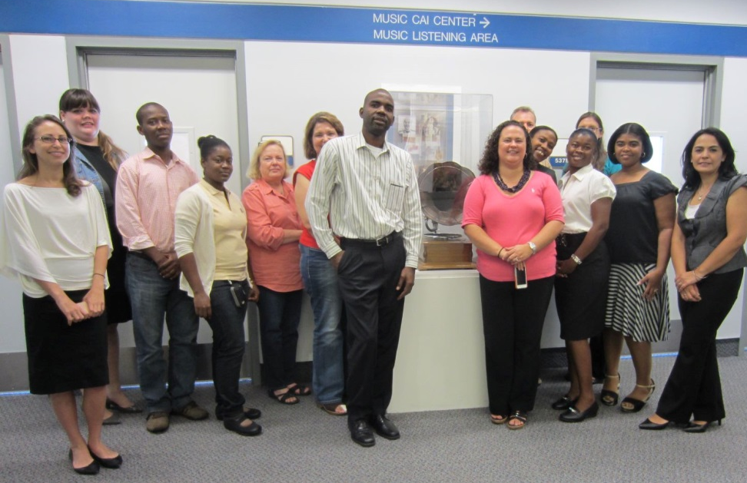
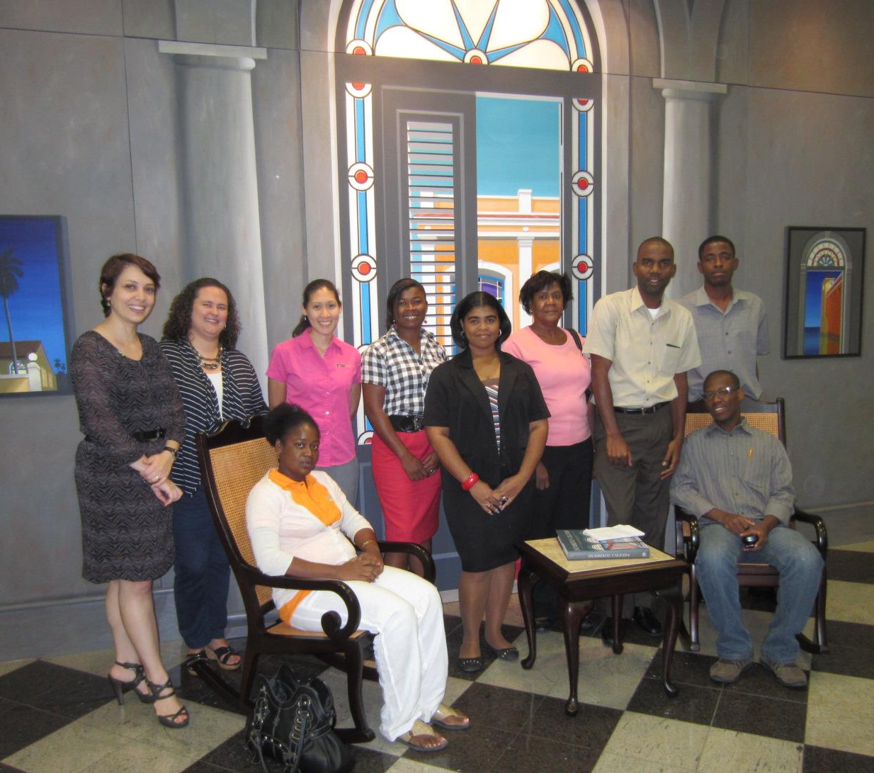
dLOC Collaboration for Data Curation Literacy: Communities
dLOC Advanced Training Institute, July 2013
Notes:
dLOC’s collaboration for data curation literacy extends from the core collaboration among dLOC partners. The photos here are from the dLOC Advanced Training Institute in July 2013.
The Advanced Training Institutes allow partners to share and expand expertise together, and then to continue sharing within their institutions and related communities. The dLOC Advanced Training Institutes bring many partners together at once. These are relatively new. They developed from dLOC’s expertise and experience with 10 years of collaboration for onsite and online trainings.

Slide 21
Critical Importance of Collaboration
dLOC communities, collaborations, support creating intellectual infrastructure through community activities and connections:
dLOC Advanced Training Institutes
dLOC Partner Training
Virtuous circles of connected communities, engaging scholars, students, educators, information professionals, cultural heritage professionals, and the public
Notes:
To conclude, dLOC supports collaboratively developing data curation literacy in many ways which are possible because of dLOC’s many communities.

Slide 22
dLOC’s Model: 10 year anniversary
Happy 10th Birthday to dLOC!
For the next 10 years and beyond, planning is currently underway for optimum success with discussions on sustainable high levels of growth, with new institutions, scholar partners, and communities.
Notes:
Please contact dLOC to collaborate further on data curation literacy.
Most importantly, let’s celebrate our work with dLOC for a happy 10th birthday to dLOC!

