Slide 2
Popular and Afro-Latin American Art - Hybridity and appropriation of iconic elements - Rhythm and multi-sensorial quality - Collective spirit and spectacle
Día de los Reyes – Havana, 1850

Slide 3
RE-AFRICANIZATION
Andrés Salazar - 2004

Slide 4
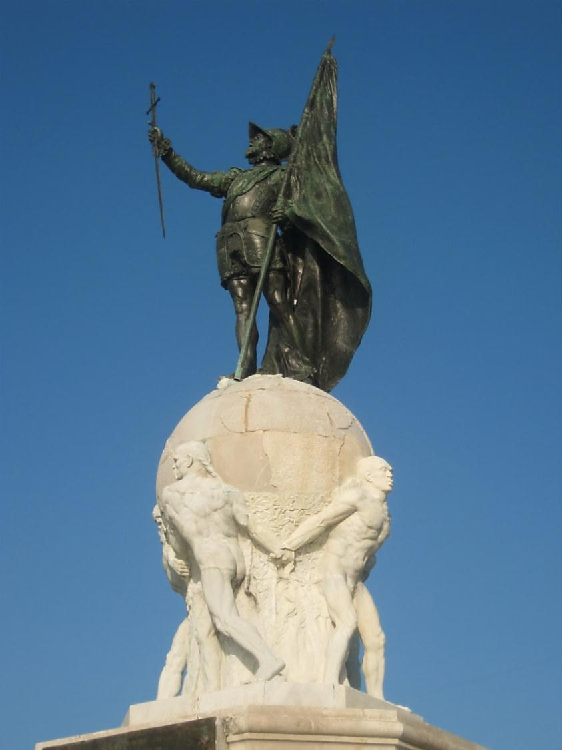
MESTIZAJE (CRISOL DE LAS RAZAS), 1903-41 - Colony and Interior without blackness - Afro-Coloniales and Afro-Antillanos
Monument to Balboa - 1924

Slide 5
Mi Pueblito Interiorano - 1994

Slide 6
MODERNIZATION AND DETERIORATION OF ETHNIC/NATIONAL PARADIGM, 1941-present
Corozal Cemetery (2008) – “Witchcraft and animal sacrifices are not permitted.”

Slide 7
WORLD WAR II AND AFRO-CUBAN MUSIC

Slide 8
Luis Camargo – Cantina Ashton, Calle J (2005)

Slide 9
LUIS EVANS (EL LOBO) - 1942 “In Panama, there are two painter: Roberto Lewis and me.”

Slide 10
POST-WAR DEMOGRAPHIC GROWTH, COMMERCIALIZATION, AND NEW VENUES
Héctor Judiño (Totín), 2008

Slide 11
POPULIST REFORMS, EARLY 1970s
Eduardo Meneses Núñez (Malanga) - 1978

Slide 12
URBAN RENOVATION AND THE REMOVAL OF THE DIABLO ROJOS, 1993-
Cinta Costera, completed in 2009

Slide 13
PERSISTENCE OF POPULAR ART
Rubén Lince (Chinoman) – Bocas del Toro, 2012

Slide 14
MÚSICA - Reggae en español, the soundtrack of Afro-Panamá
Japanese – Estadio Bernardo “Candela” Gil, 2008

Slide 15
SPORTS - FÚTBOL Comparsa Sporting San Miguelito, 2008

Slide 16
CIVIC RE-AFRICANIZATION Día de la Etnia Negra – Errol Dunn, 2007

