Slide 1
Notes:
MUST KEEP THIS AS THE FIRST SLIDE

Slide 2
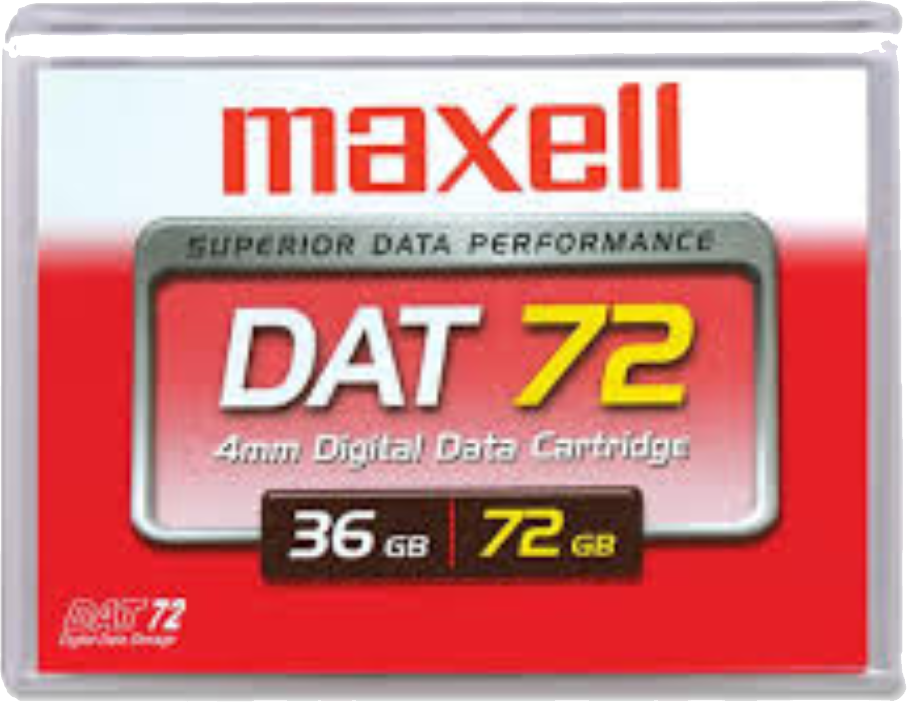
Data Overview at ICBR We have Σ O( ) Aaron Gardner (agardner@ufl.edu)

Slide 3
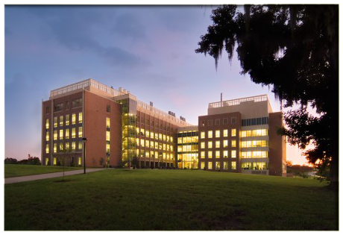
Interdisciplinary Center for Biotechnology Research (ICBR)
Created in 1987 by Florida Legislature
Organized under the Office of the Vice President for Research
Legislature’s funding distributed through:
Institute of Food and Agricultural Sciences
College of Medicine
College of Liberal Arts & Sciences
55 ICBR Employees, 22% faculty, 45% full-time staff, and 33% postdoctoral associates, etc.
“Providing more than 400 different services ranging from custom and high-throughput DNA sequencing to electron microscopy and antibody development and production, ICBR is here to exceed the research needs of UF.”

Slide 4
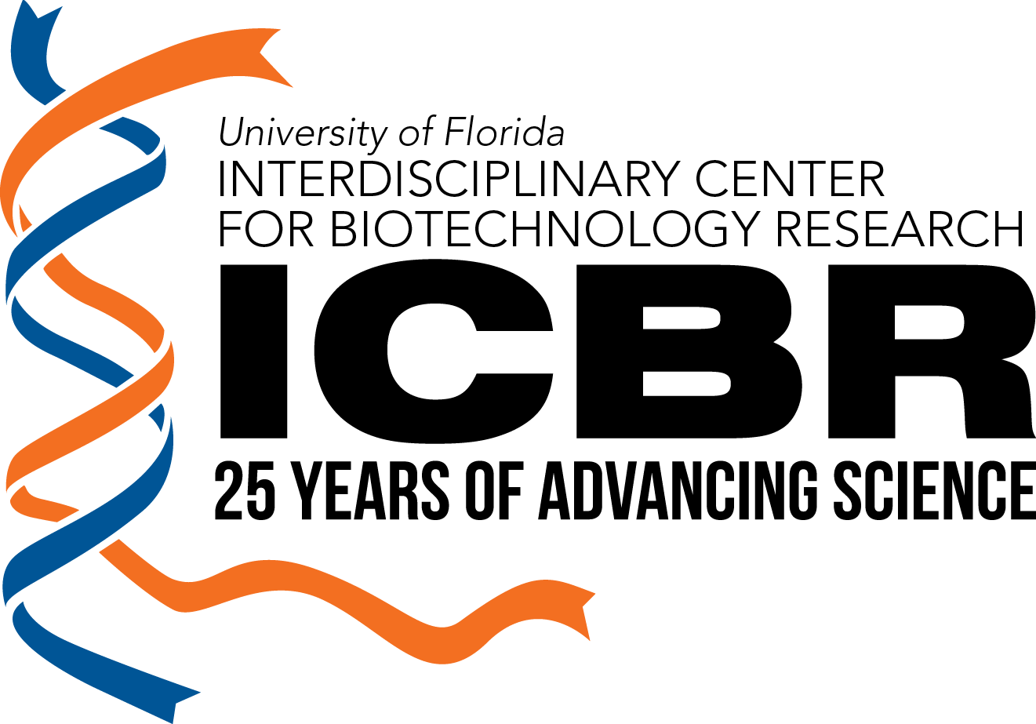
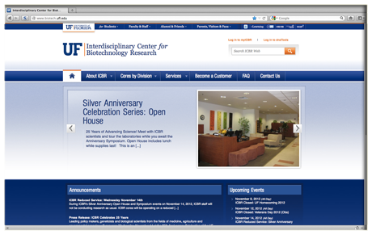
ICBR – 25th Anniversary
Scientists and researchers at the University of Florida recognize the ICBR as the leading resource for a full range of life science technologies.
Projects within the ICBR have ranged from new cultivars of plants, mapping the genome of ants, tracing the DNA of people across continents, analyzing genes to understand how social situations and health change our DNA, and developing cures for rare and cancerous diseases.

Slide 5
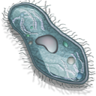
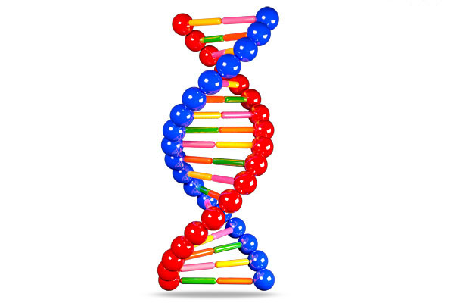
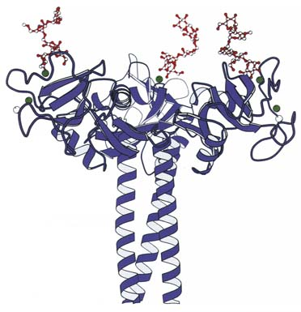
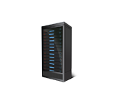
ICBR Organizational Overview
Administration
Divisions
Sections
Cyberinfrastructure
Special Projects
Bioinformatics
Cellomics
Genomics
Proteomics

Slide 6
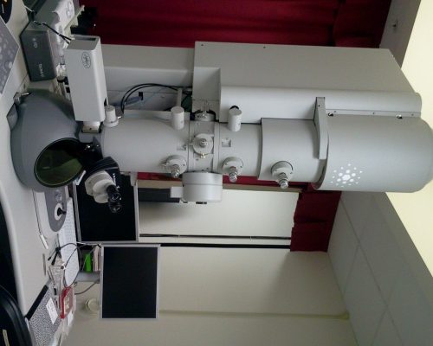
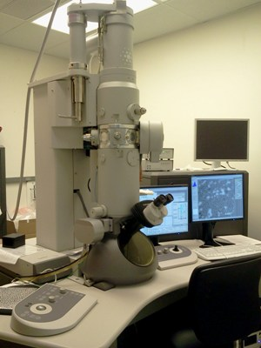
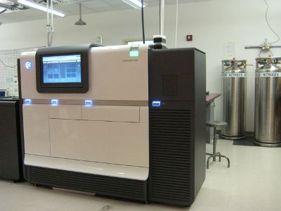
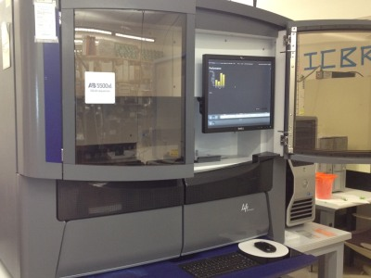
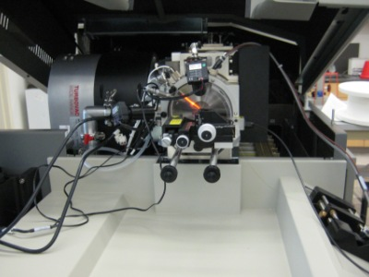
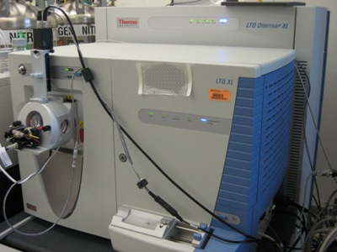
Scientific Core Laboratories by Division
Bioinformatics
Cellomics
Electron Microscopy and Bioimaging
Flow Cytometry
Hybridoma
Genomics
Gene Expression
Genotyping
NextGen DNA Sequencing
Quantitative PCR
Sanger Sequencing
Proteomics
Mass Spectrometry
Protein Biomarkers
Bioinformatics

Slide 7
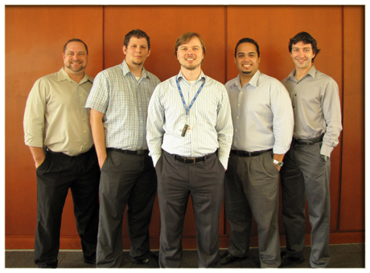
Cyberinfrastructure Section
Formed in 2011
Product of over a decade of lessons learned with previous ICBR computing efforts
Section within Administration
Renewed focus on enabling all labs, enabling users to have additional freedom with the resources they use
Dustin White
Jeremy Jensen
Aaron Gardner
Omar Lopez
Alex Oumantsev
Compute
1000 cores
Storage
600TB
Networking
1 & 10 GbE
QDR IB
Computational resources are bare metal, virtual machine pools, SMP
Storage resources include parallel tier, disk backup, and archival tier
Network standardizing on Ethernet
Current Infrastructure Quick Stats

Slide 8
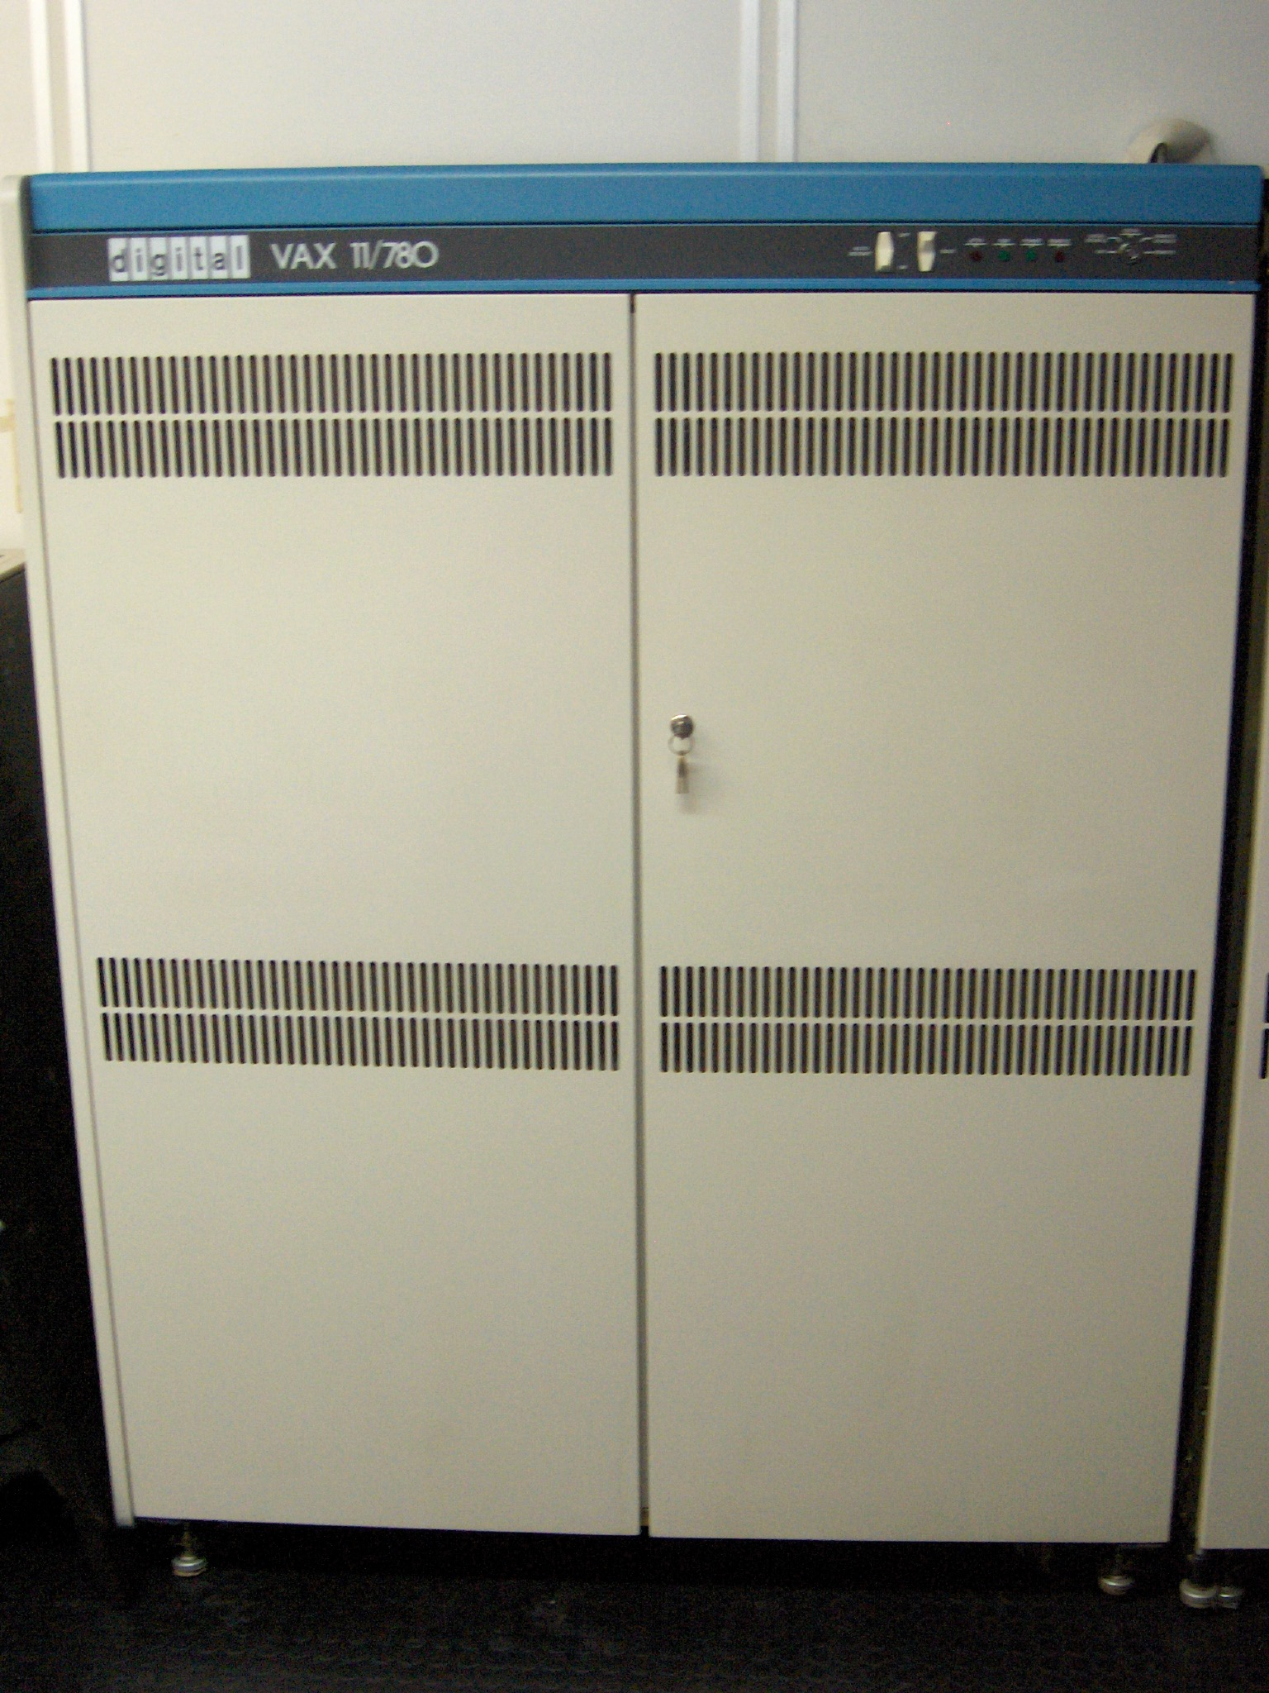
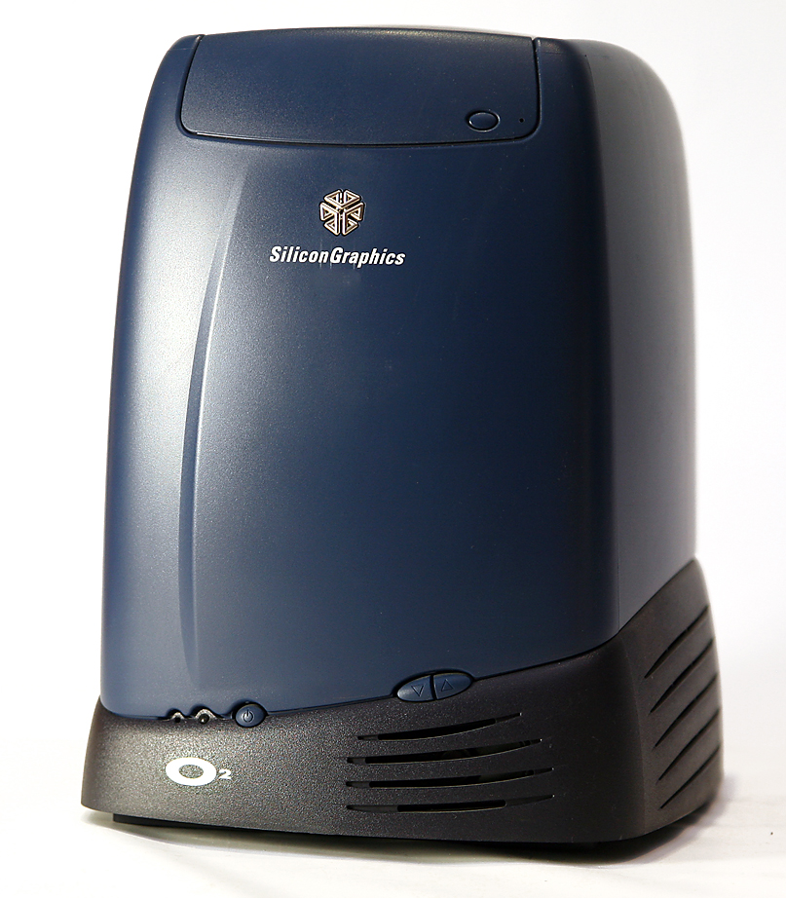
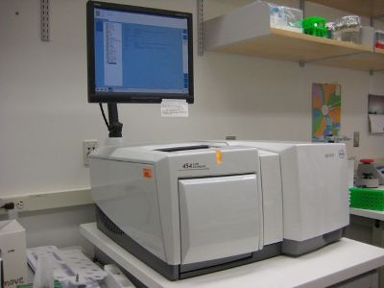
Data Drivers at ICBR – Historical
1987 – 1997
Interesting note: ICBR was funded from the beginning to support computation for the center within its core laboratory model
GCG Wisconsin Package–running on a VAX
1998 – 2004
High-throughput capillary sequencing
Sanger-scale tools that fit the demands of the time
Convenient public interface to analysis results (LIMS, BlastQuest, etc.)
Bioinformatics as a Service
2005 – 2011
Next-generation sequencing (NGS) comes to ICBR
Infrastructure for sequencers and for bioinformatics services increases in complexity and scale
Scale of data and computation required for analysis disrupts everything, everywhere

Slide 9
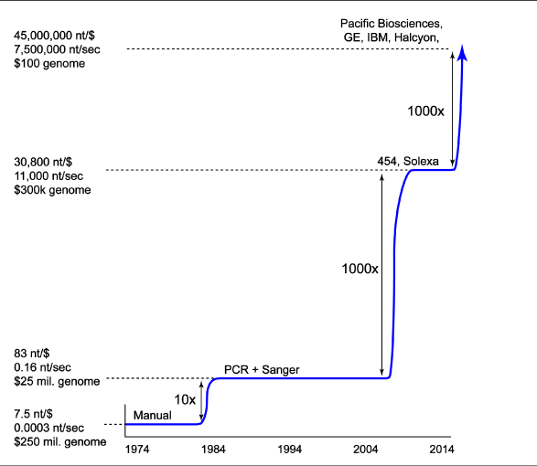
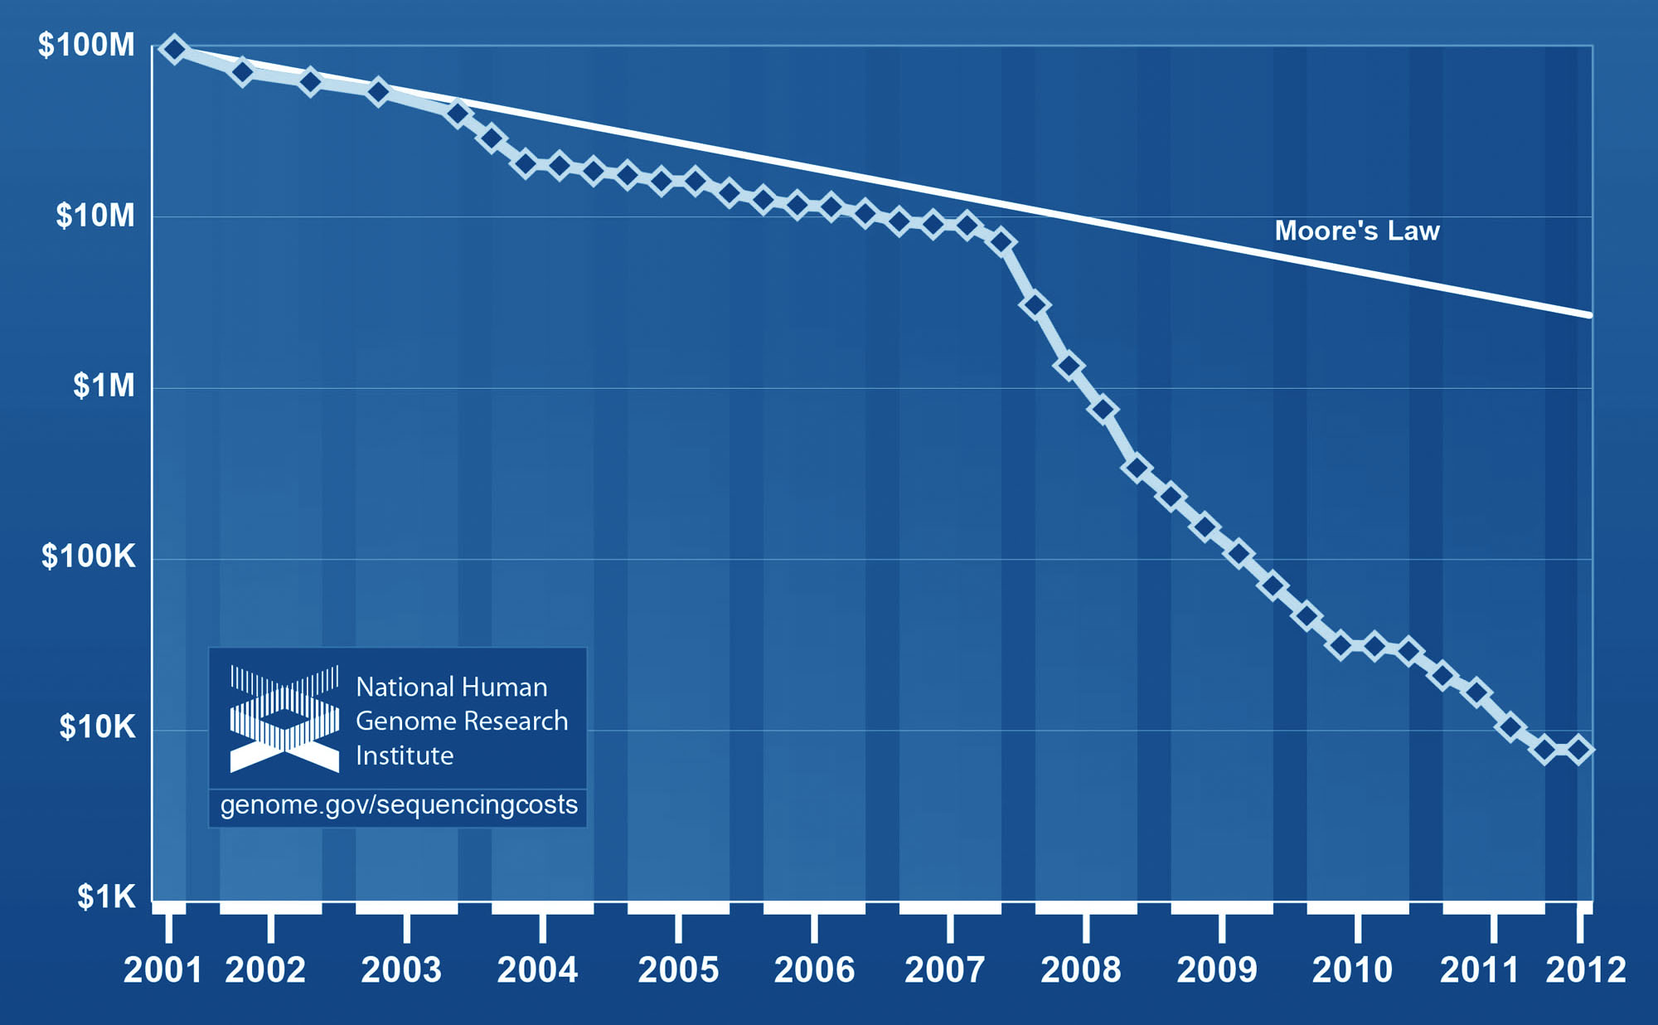
Data Drivers at ICBR (cont.) – NGS
DNA sequencing technologies change, costs drop dramatically, and core facilities large and small contend with generating new instrument data at an unprecedented scale.
In the last decade the cost of sequencing a human sized genome has fallen from $100M to $10K (10,000x cost reduction).

Slide 10
Data Drivers at ICBR (cont.) – Future
2013 – Future
The lessons learned from NGS are proactively being applied to all other laboratories and disciplines within ICBR
Cryo-electron microscopy (cryo-EM)
Already have two instruments
Larger can generate up to 2TB/day when running
Unlike NGS, primary analysis algorithms in flux
Raw data still holds value when reanalyzed months or years later
High-throughput proteomics on the radar
Already seeing orders of magnitude higher MS/MS spectra on newer instruments, resources required for analyzing are climbing as well
Collaborations and Shared Resources
Preparing our center to participate in larger projects is a priority
Personalized and translational medicine, epidemiology, etc.
This is driving our push for a converged on demand infrastructure that can accommodate internal and external tenants
When NGS exploded everything else was the “running tail”– forever?

Slide 11
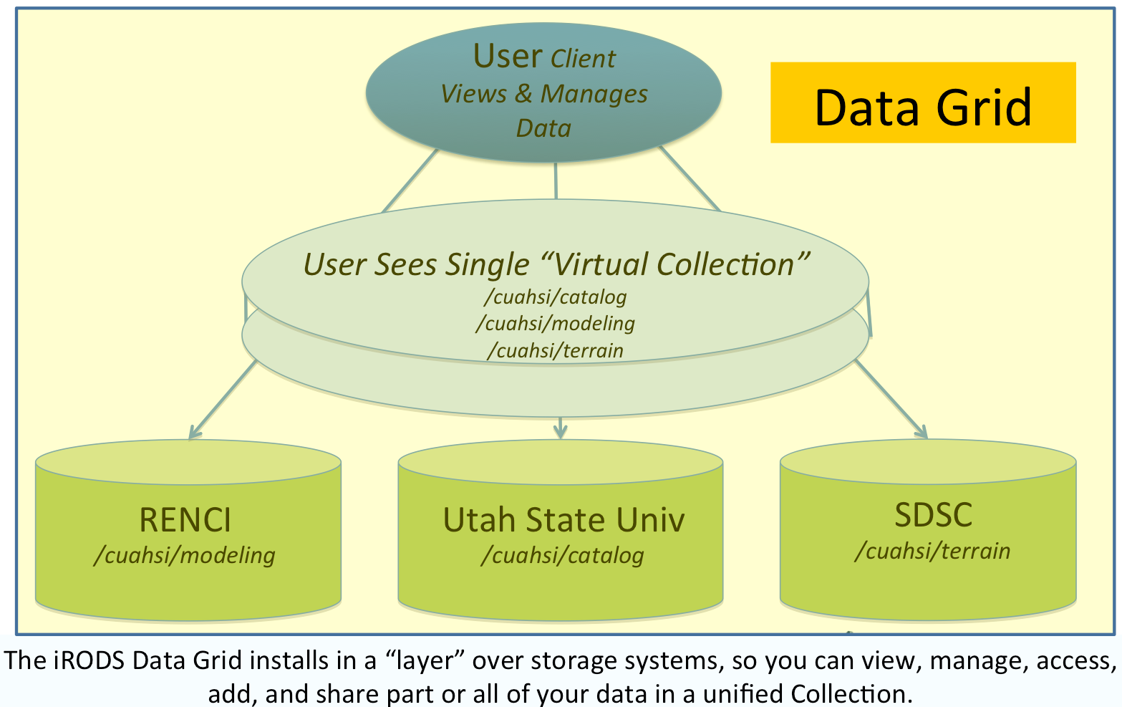
What we are experimenting with for DM: iRODS
Integrated Rule-Oriented Data System (iRODS) that aims at managing distributed massive data
Started as an open source initiative in 2004 with the help of NSF funding of $20M
Collaboration between UNC, RENCI and more…
Applications:
Data Grids, Institutional repositories, Archives
Genomics, Astronomy, High Energy Physics
Scalable to billions of files and petabytes of data across tens of federated data grids

Slide 12
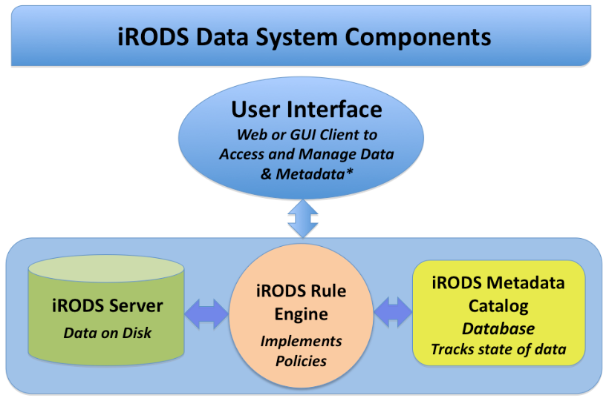
What is iRODS?
iRODS, the Integrated Rule-Oriented Data System, is a project for building the next generation data management cyberinfrastructure. One of the main ideas behind iRODS is to provide a system that enables a flexible, adaptive, customizable data management architecture.
At the iRODS core, a Rule Engine interprets the Rules to decide how the system is to respond to various requests and conditions.
Interfaces: GUI, Web, WebDAV, CLI
Operations:
Search, Access and View,
Add/Extract Metadata, Annotate,
Analyze & Process,
Manage, Replicate, Copy, Share, Repurpose,
Control and Track access, Subscribe & more…
iRODS Server software and Rule Engine run on each data server. The iRODS iCAT Metadata Catalog uses a database to track metadata describing data and everything that happens to it

Slide 13
Future Vision
Currently, management of our computational resources and data is strictly controlled, with CI members fully supporting all services
This minimizes service downtime, prevents data breaches, etc.
It comes at a cost–we are no longer as agile as we need to be
Solution: Move to a three level service and support model
Users instantiate resources on demand which they have privileged access to–but no support is offered beyond clearing hang-ups
Common use services requiring a higher degree of reliability and/or security are built and managed by us upon request, with unprivileged access provided to users
Core computational services are still supported end-to-end by us, and provided for consumption by resources in the previous two levels
1
2
3
Challenges With This Model:
Need for single instance resources capable of dealing with big data
Will now need multitenancy capabilities even as a single organization
Must minimize latency to better utilize limited resources—public cloud’s massive scalability approach might not be suitable for a small or midsize research environment with legacy codes, inexperienced users, etc.

Slide 14
Converged Infrastructure Will Help Us Get There
Infrastructure as a Service (IaaS) Multitenancy for Big Data
Need for software defined networking (SDN)
Example: Movement toward OpenFlow and SDN at UF (I2IP)
Unified fabric? (or at least abstracted)
Need massive single instance scalability in terms of compute cycles, main memory, IOPs, storage throughput (edge case for public cloud, general case for us)
Scalable building blocks handling both data throughput and computation simultaneously (extend in-storage processing concept)—allows for big data performance for even small and midsize infrastructures, minimizes latency in the stack, data processing becomes LUN to LUN
DevOps and sharing of infrastructure codes is the way to support tenants (local staff, partner institutions, students, etc.) while still giving them control and freedom of their resources.
Examples: Galaxy Toolshed, Chef Cookbooks, RackSpace Private Cloud OpenStack

Slide 15
Converged Infrastructure Will Help Us Get There (cont.)
Converged infrastructure is not as necessary when you are: 1. Hiring lots of smart people and committing their time to infrastructure 2. Attacking a single or small set of large problems 3. Rarely revalidating or reintegrating your HW stack after deployment
This is because if you tie your platform closely to a mixed and disparate hardware stack: staff time to explore reintegration and revalidation issues, rewrite code for new architectures—this can work for hyper giants and single service efforts but legacy and vendor-controlled codes, flexible infrastructure, infrastructure for yet unknown or unsolved problems—converged infrastructure buys these down…
iRODS embedded platform helps us pilot this idea and provides a place to check-point and stabilize wild wild west resource usage, establish authoritative data, and enable controlled data sharing between tenants
Conclusion: Converging the hardware stack lets you focus more on the software stack—and having a software stack that is portable and reproducible across infrastructures and organizational boundaries is where we want to go.

Slide 16
Aaron Gardner (agardner@ufl.edu)
Cyberinfrastructure Section Director
Interdisciplinary Center for Biotechnology Research biotech.ufl.edu
www.biotech.ufl.edu
Notes:
MUST KEEP THIS AS THE LAST SLIDE

Slide 17
Notes:
THIS IS OPTIONAL AS LAST SLIDE

