Slide 1
Why do researchers need a Data Management Plan (DMP)?
For all the same reasons you should take care of your data…
To ensure that valuable data resources will be accessible in the future to members of the research team and the broader community.
To make life easier – by planning ahead and documenting data throughout its life cycle, researchers can save time and focus on research.
To increase the visibility of research.
To satisfy funders’ requirements.

Slide 2
Components of a DMP
Project description
Data collection:
Types of data
Data and metadata standards to be used
Legal and ethical issues:
Privacy and confidentiality
Intellectual property rights
Policies for data sharing and re-use
Data preservation (long-term)
Who is responsible for data management

Slide 4
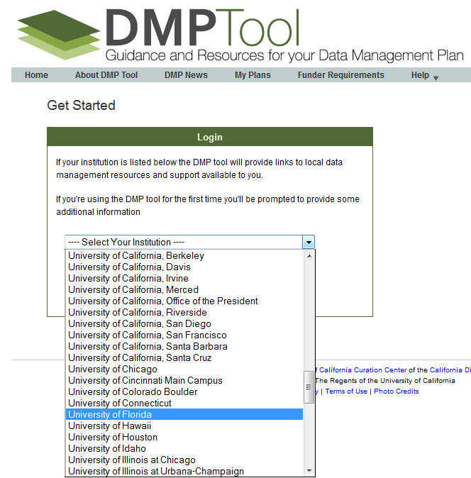

Slide 5
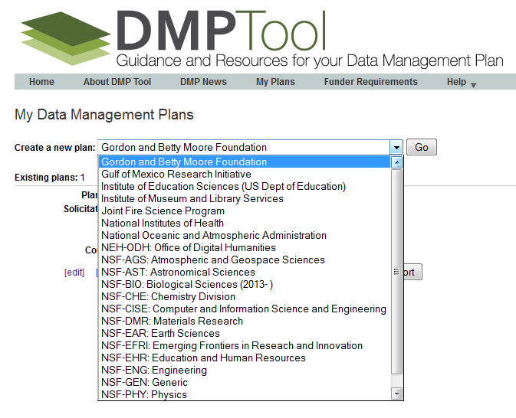

Slide 6
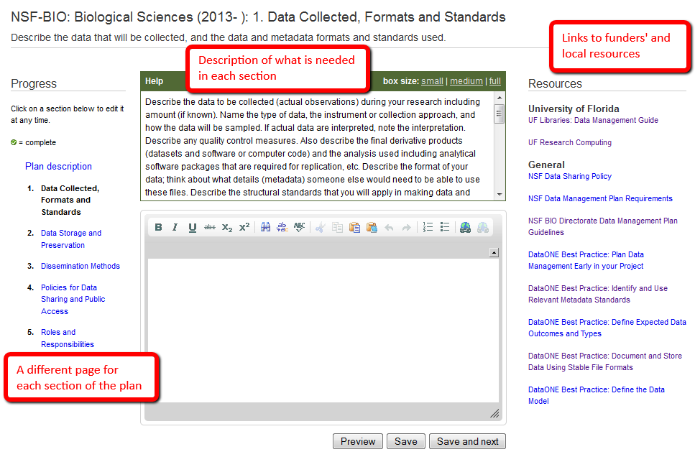

Slide 7
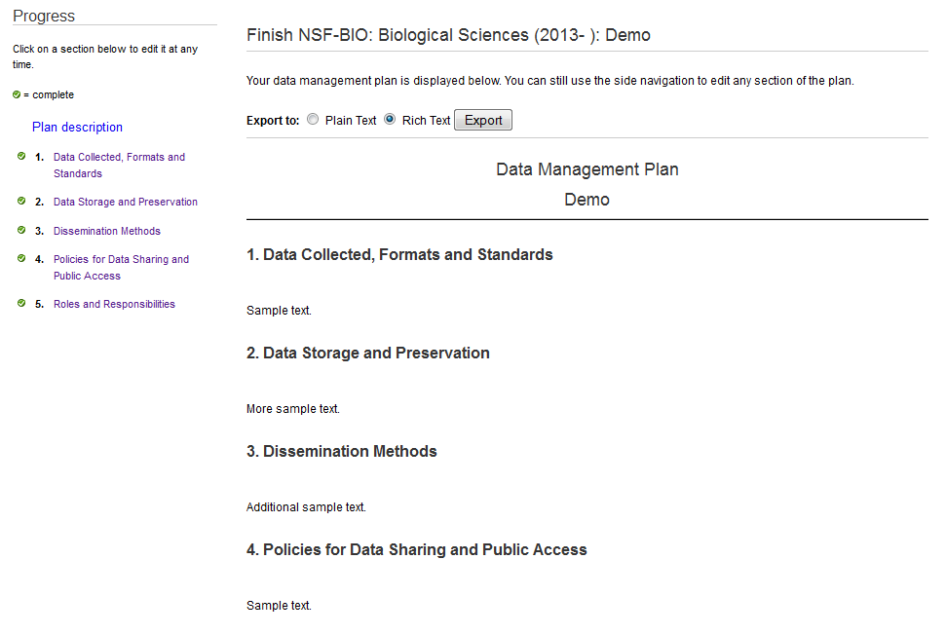

Slide 8
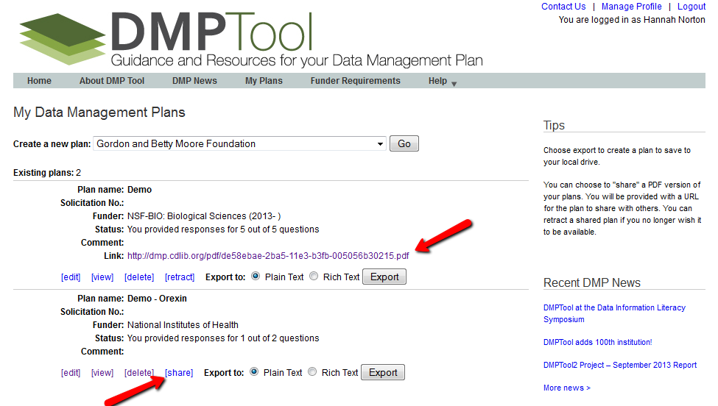

Slide 9
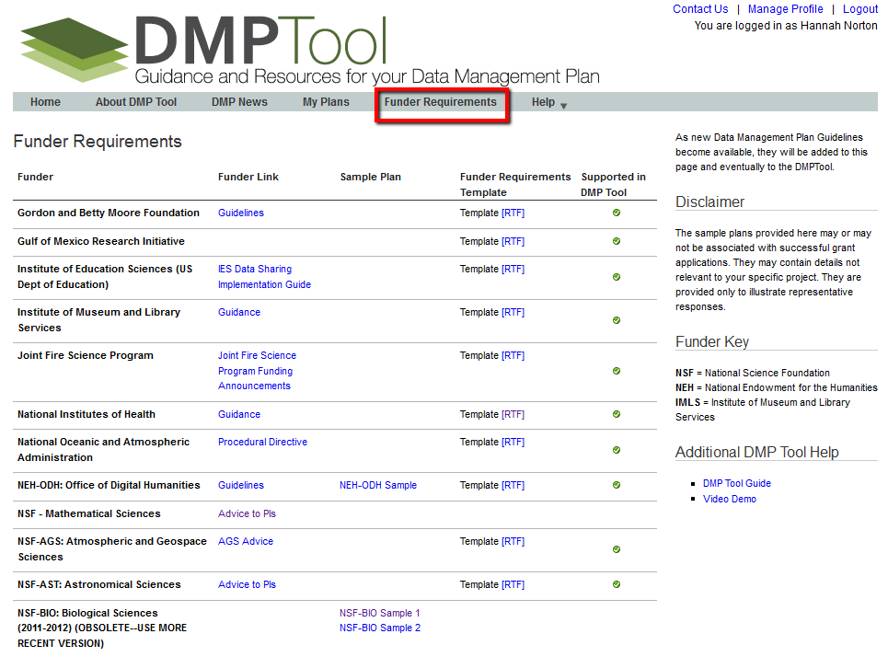

Slide 10
Questions? Contact us!
Librarians can help you think through data management issues and review your plans
Contact the Data Management Task Force (datamangmt-l@lists.ufl.edu)
OR your Subject Specialist: http://apps.uflib.ufl.edu/staffdir/SubjectSpecialist.aspx

