Slide 1
Some Data Resources in the Humanities
By Blake Landor

Slide 3
Text Mining Tools
Hermeneutica.ca (http://hermeneuti.ca/voyeur/tools)
TAPoRware (http://taporware.ualberta.ca/)
Voyant (http://voyant-tools.org/)
Online Text Repositories , Indexes, and Concordances
NINES (Nineteenth Century Scholarship Online (http://nines.org)
Eighteenth Century Connect (http://www.18thconnect.org/)
Early English Books Online Text Creation Project (EEBO-TCP) (http://quod.lib.umich.edu/e/eebogroup/)
PHI Classical Latin Texts (http://latin.packhum.org/)
The ARTFL Project (http://artfl-project.uchicago.edu/)
Metadata/Citation Management Software
Zotero
RefWorks
Endnote or Endnote Web

Slide 4
Text Mining Tools
Hermeneutica.ca (http://hermeneuti.ca/voyeur/tools)
Voyant (http://voyant-tools.org/)
TAPoRware (http://taporware.ualberta.ca/)

Slide 5
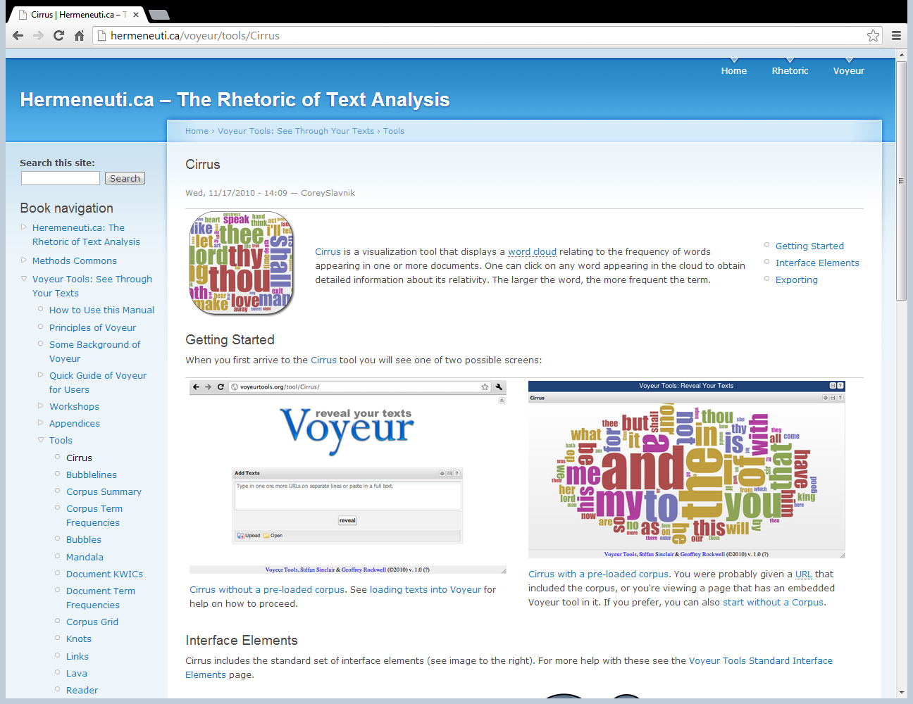

Slide 6
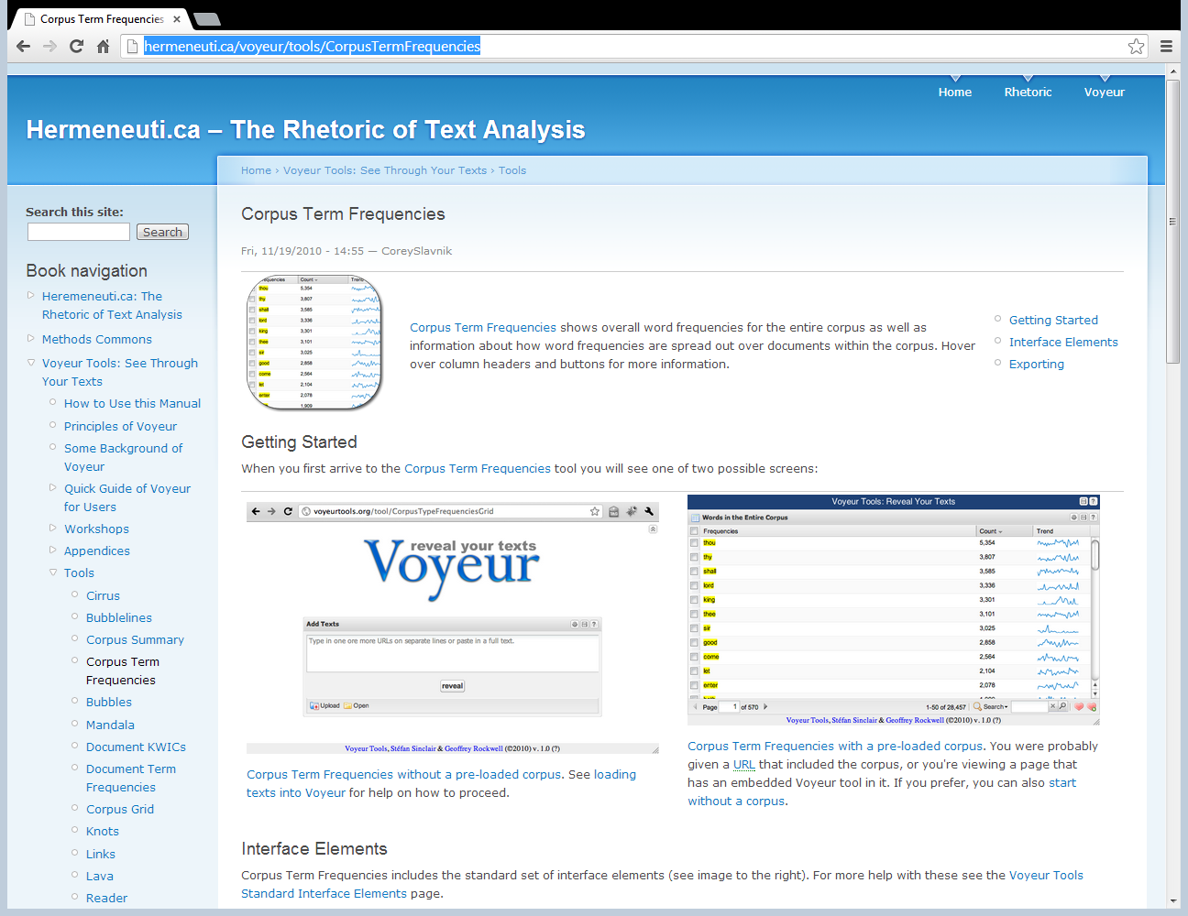
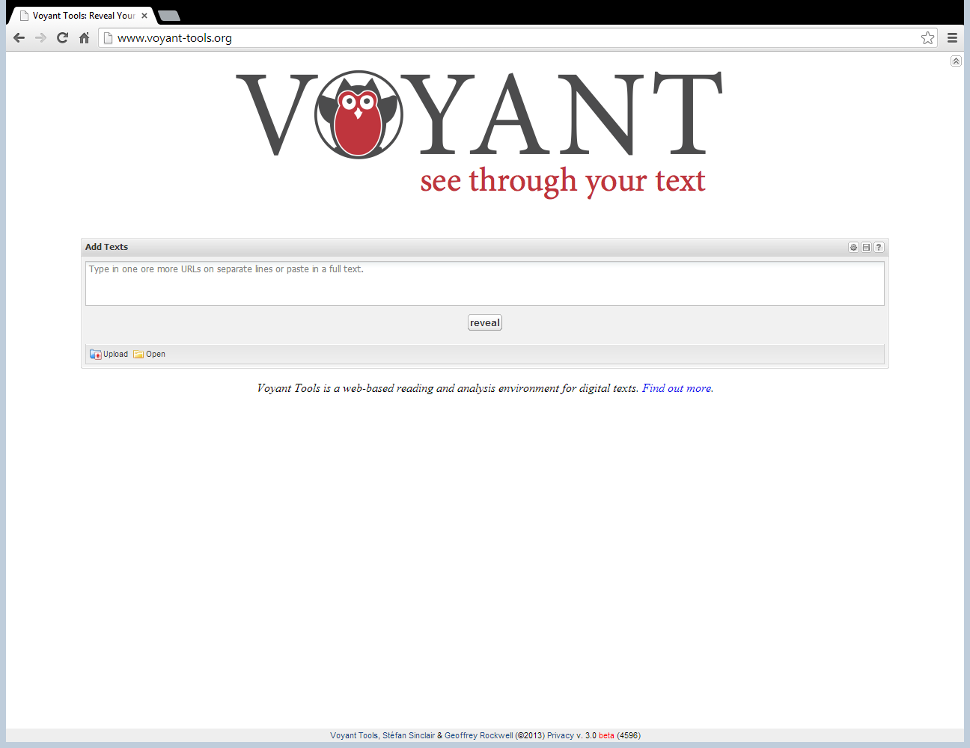

Slide 7
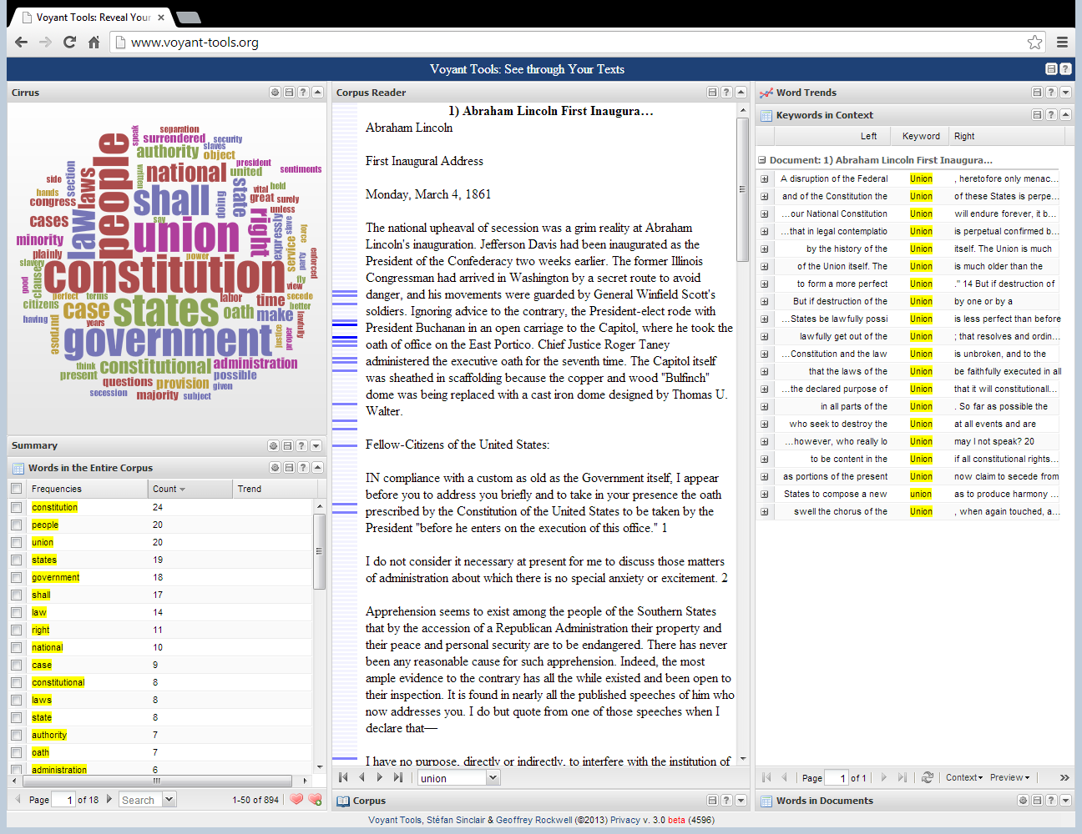

Slide 8
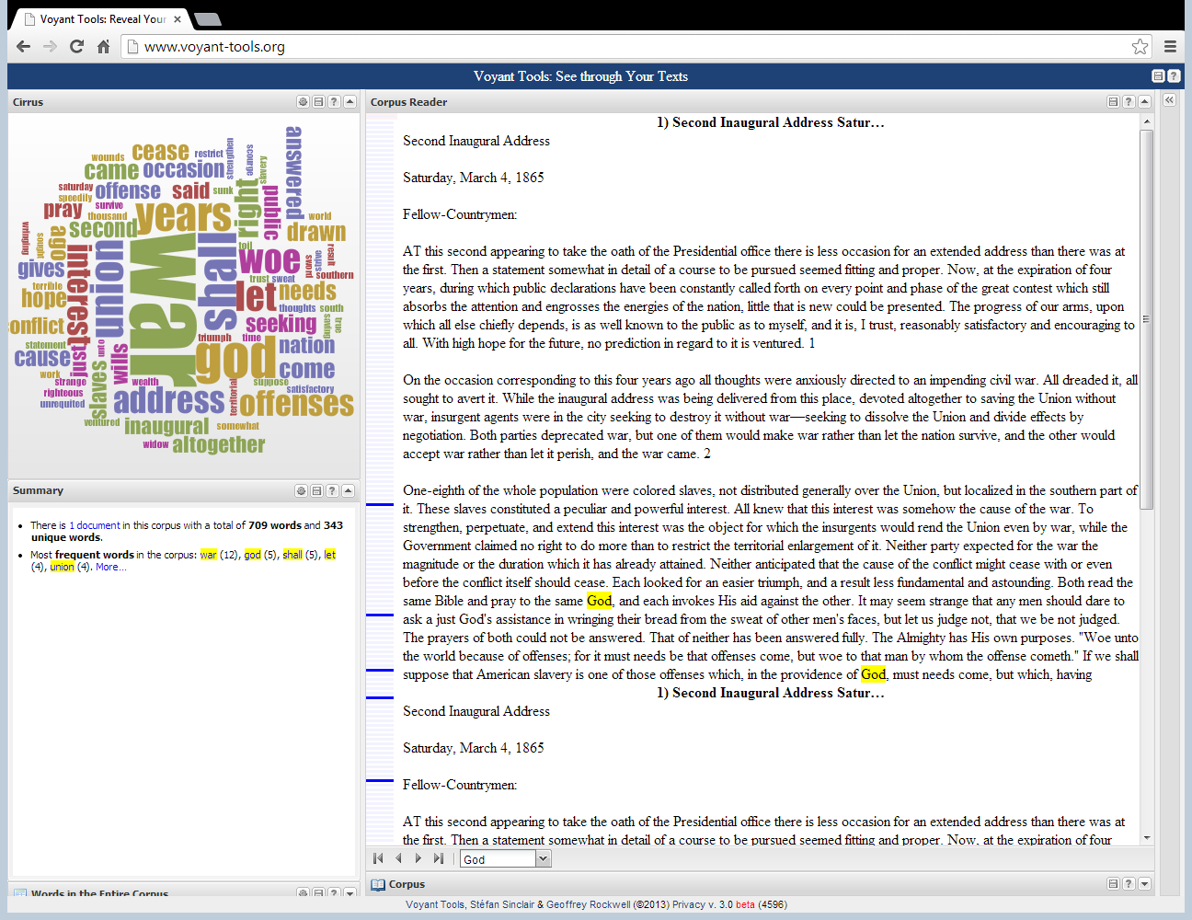

Slide 9
ONLINE INDEXES AND TEXT REPOSITORIES

Slide 10
ARC (Advanced Research Consortium)
Nines (www.nines.org)
Eighteenth Century Connect (www.18thconnect.org)
MESA (http://www.mesa-medieval.org/)

Slide 11
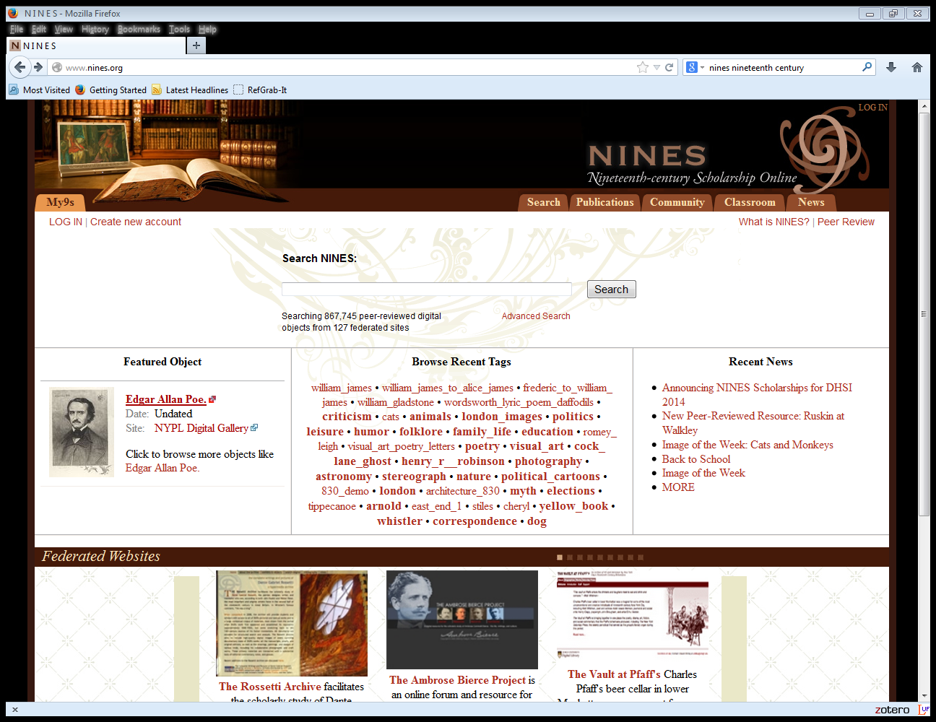

Slide 12
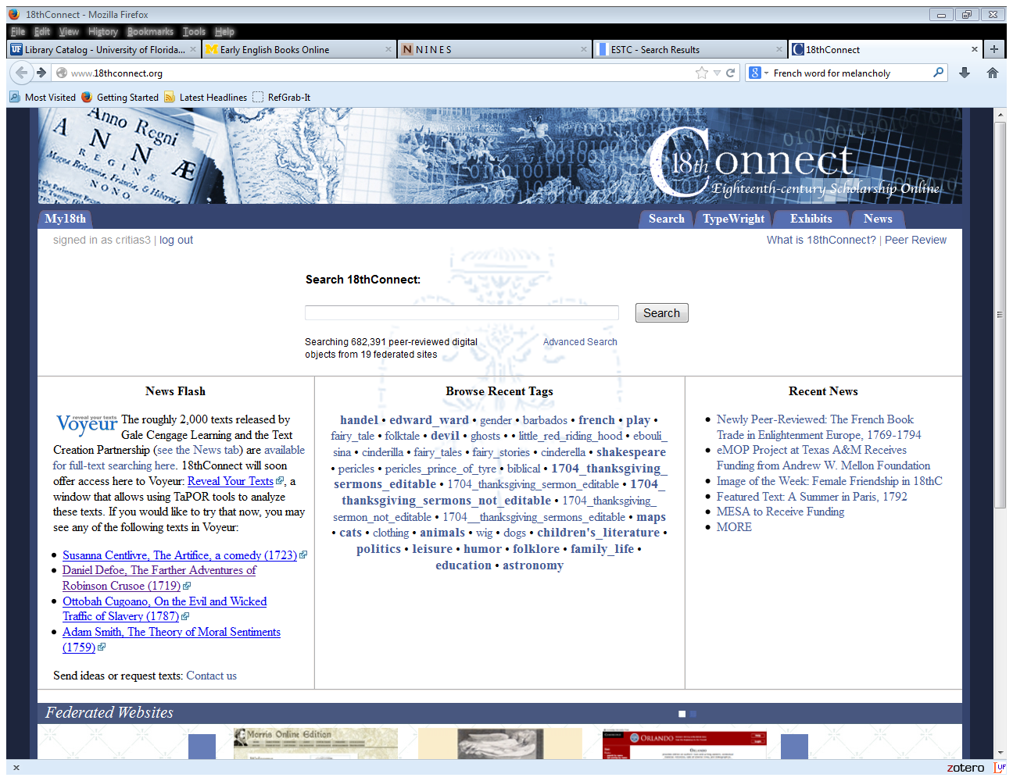
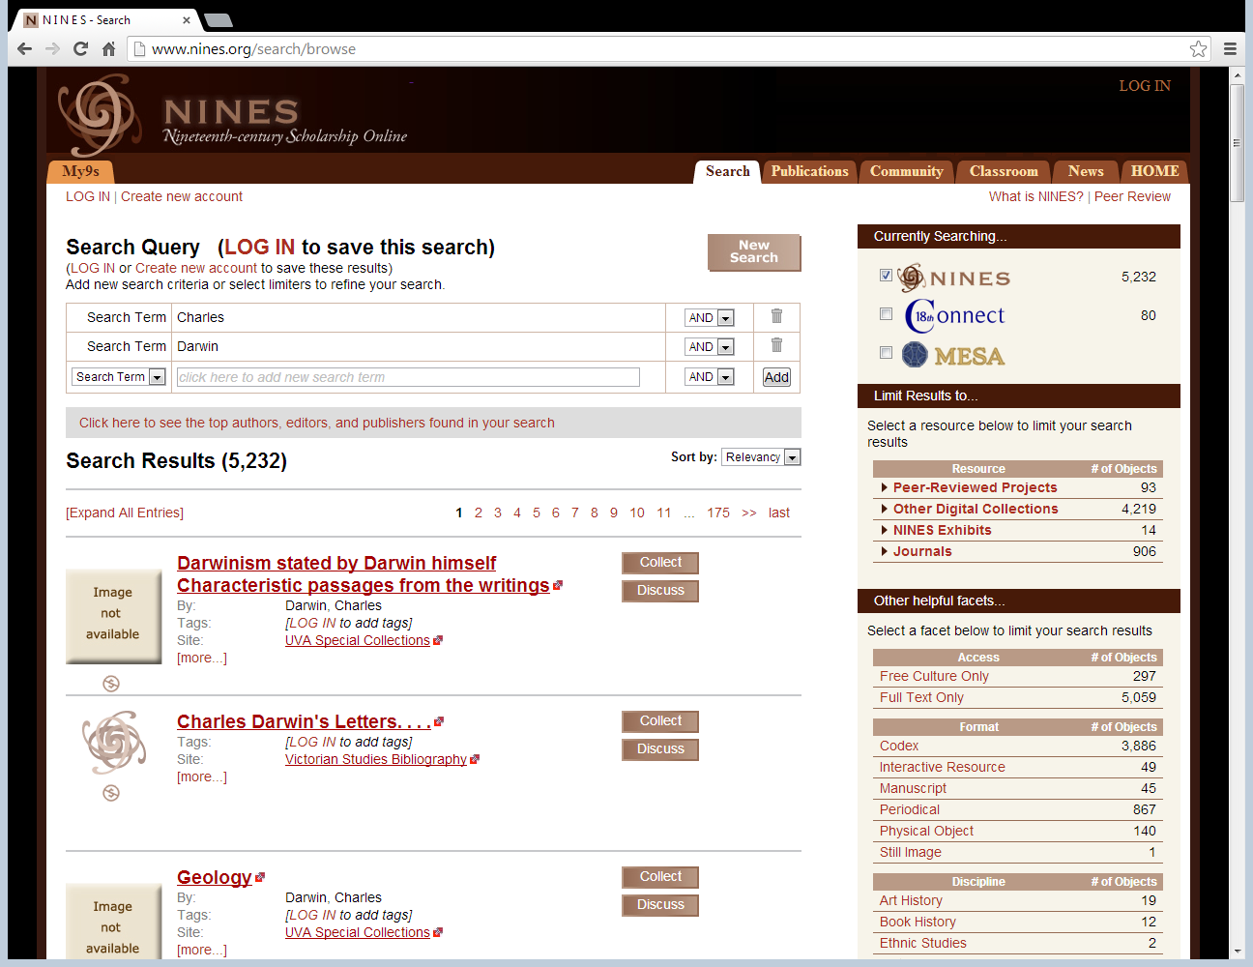

Slide 13
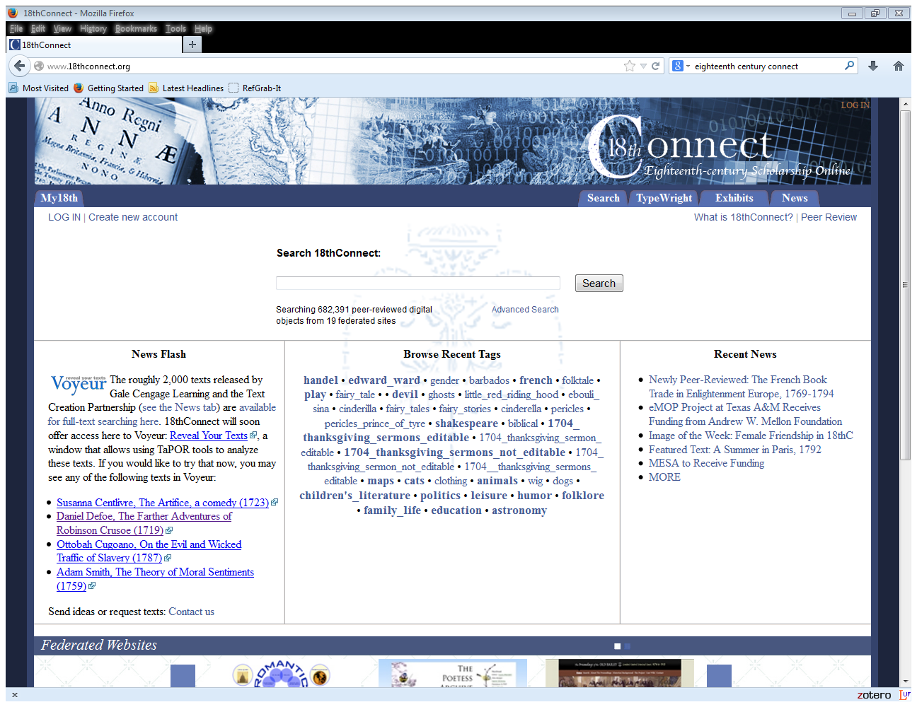

Slide 14
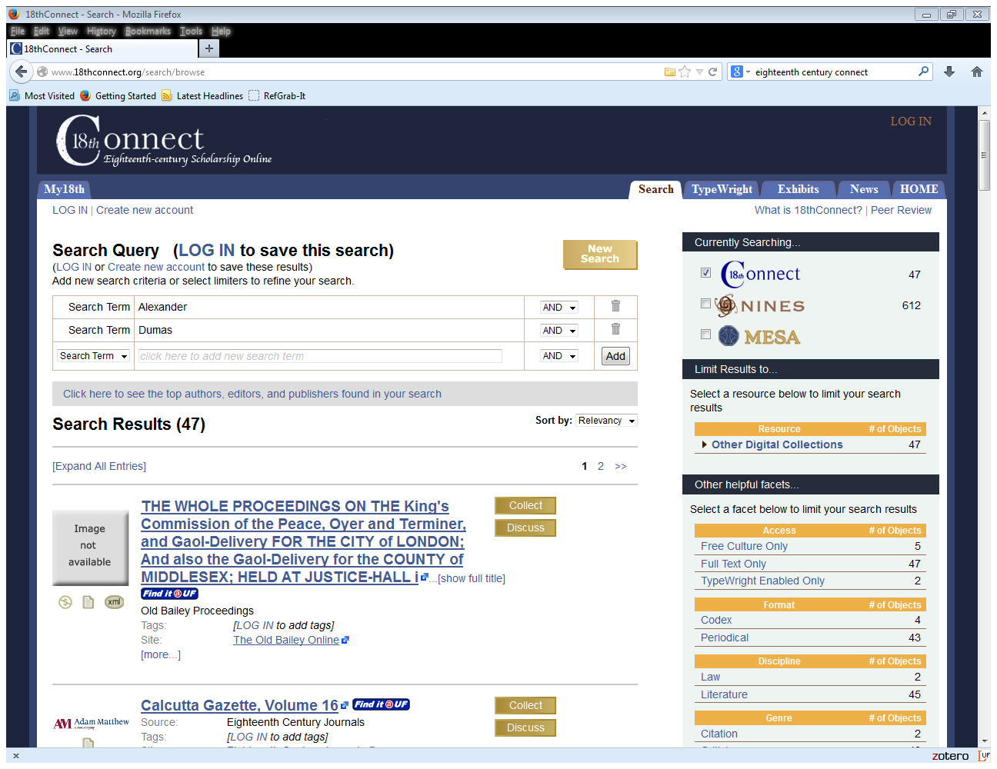

Slide 15
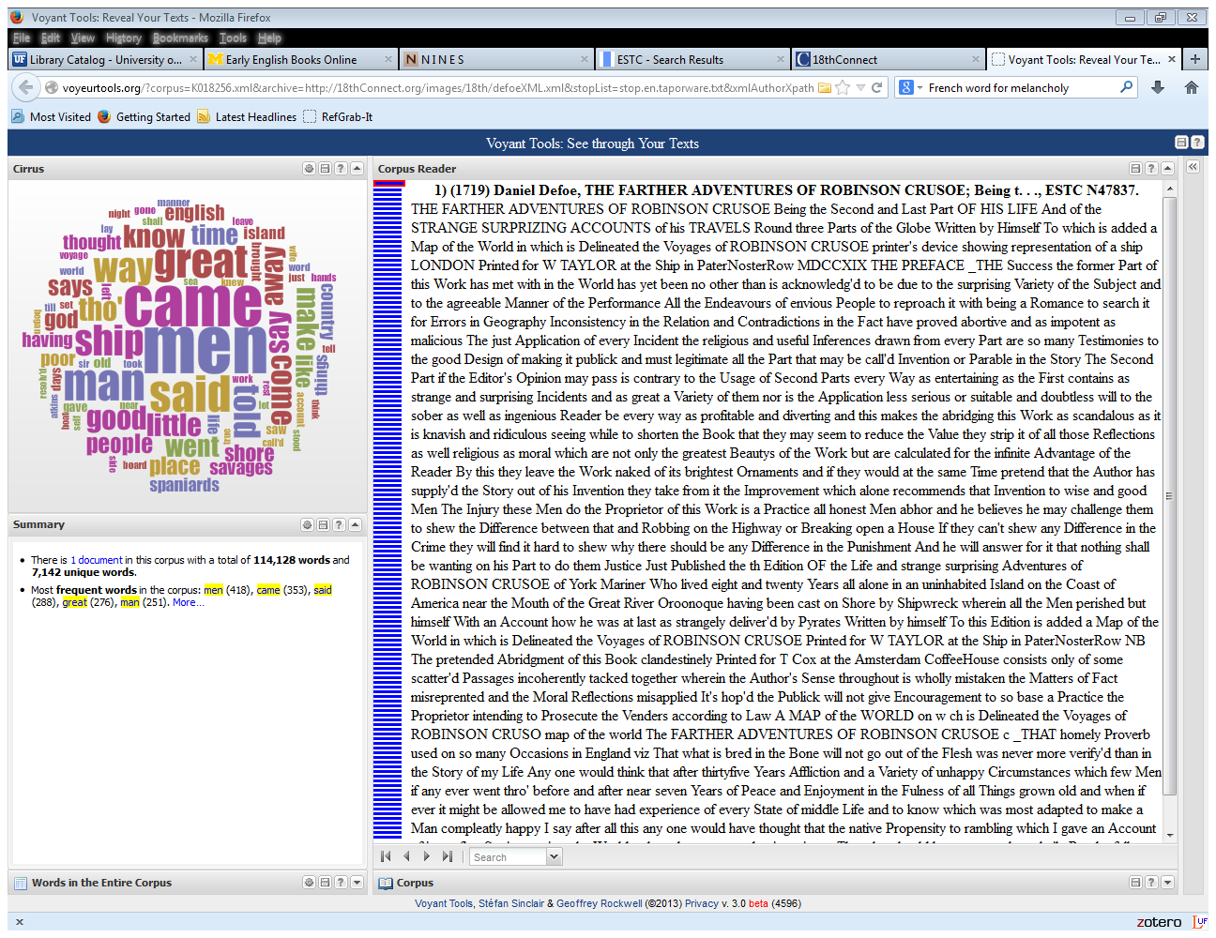
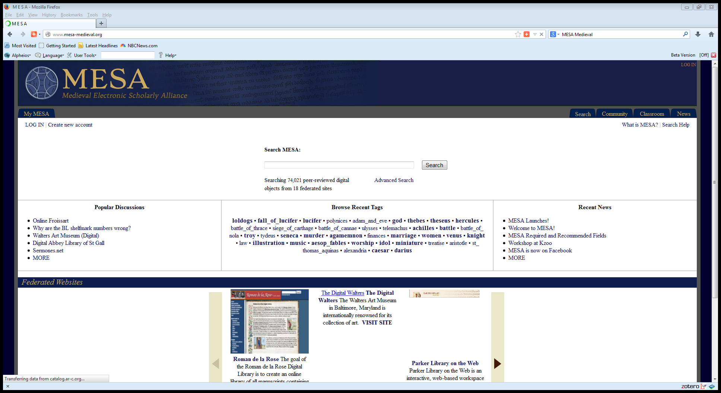

Slide 16
Early English Books Online Text Creation Partnership (EEBO-TCP) (http://quod.lib.umich.edu/e/eebogroup/)

Slide 17
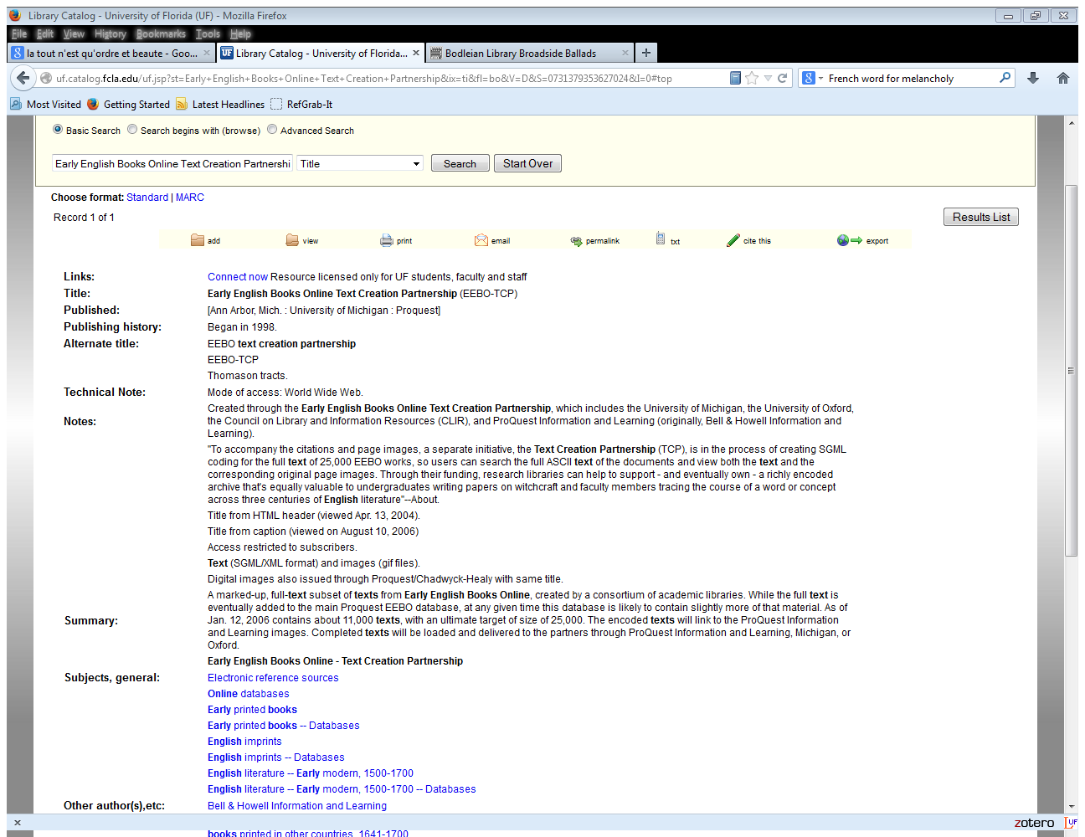

Slide 18
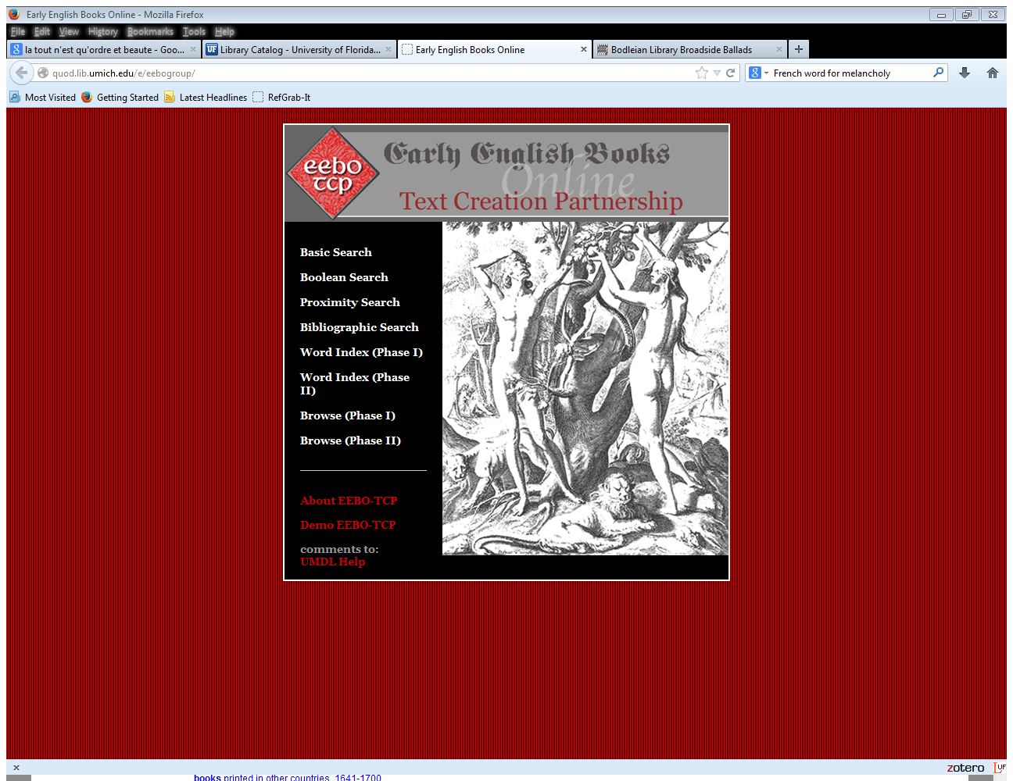

Slide 19
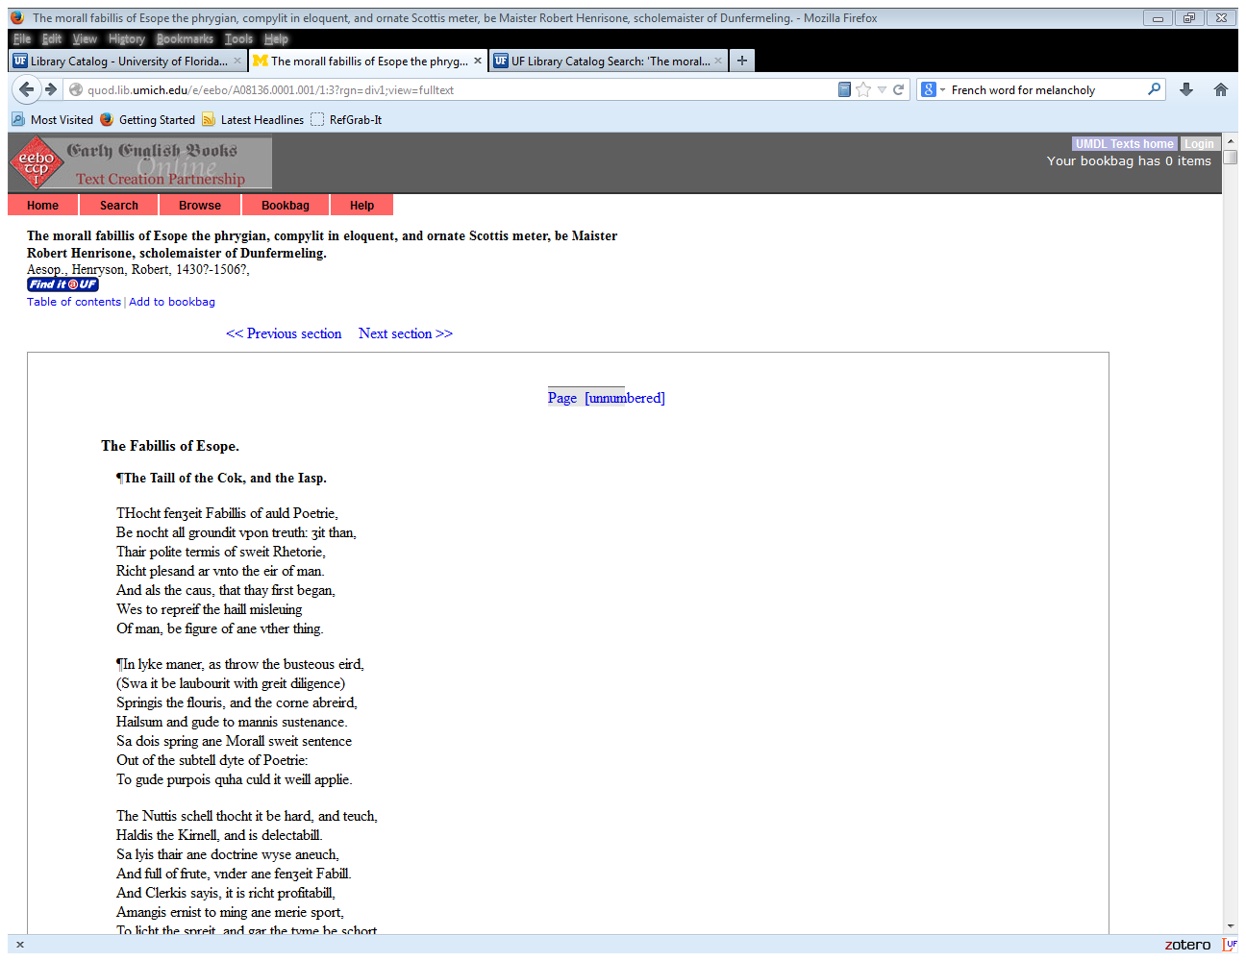

Slide 20
Classics Resources
PHI’s Classical Latin Texts (http://latin.packhum.org/)
Perseus Digital Classical Library (http://www.perseus.tufts.edu/hopper/)

Slide 21
Notes:
This site contains all Latin literary texts written before A.D. 200, as well as some texts selected from later antiquity. These texts were previously available on The Packard Humanities Institute's CD ROM 5.3.

Slide 22
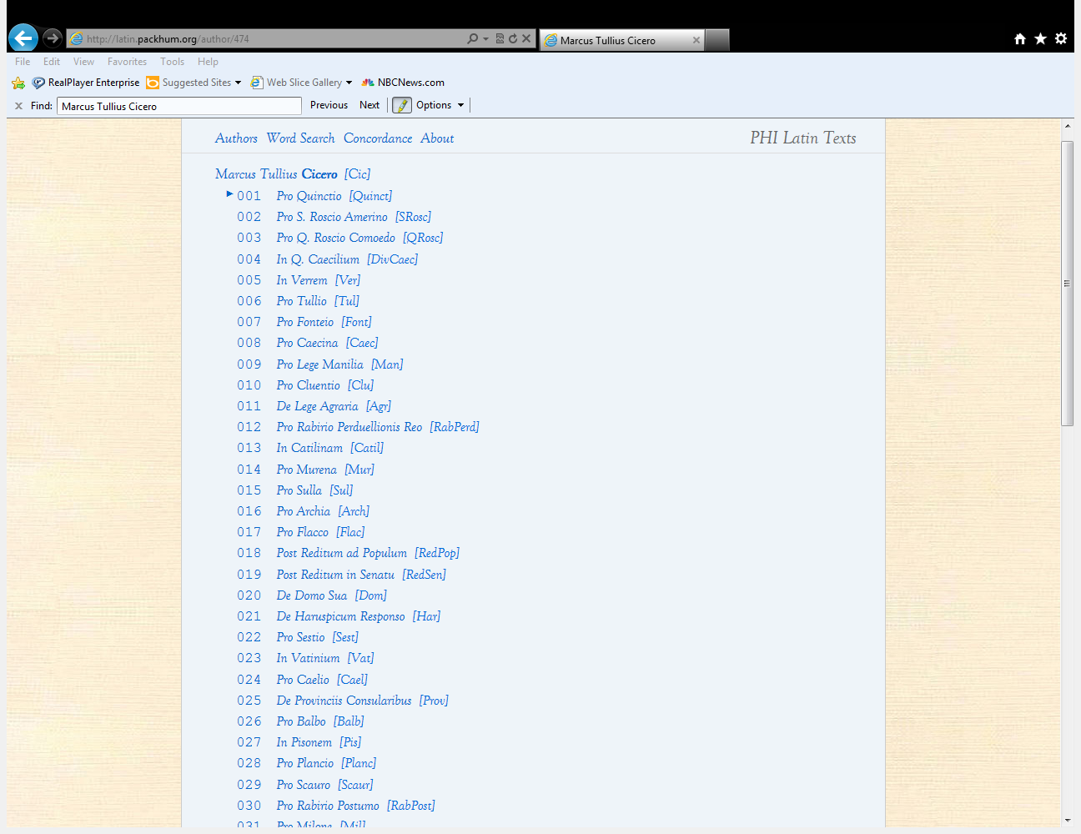

Slide 23
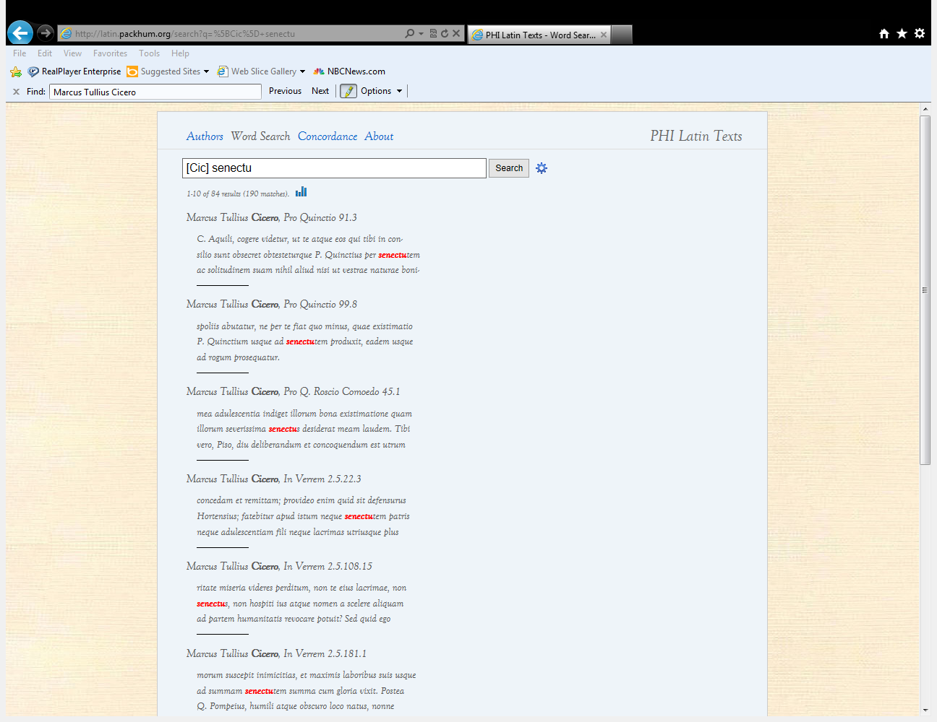

Slide 24
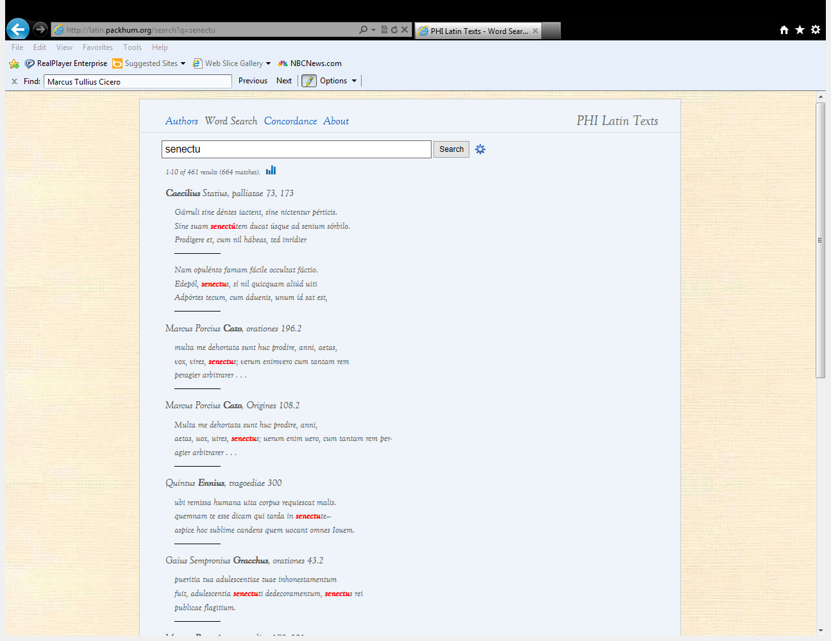

Slide 25
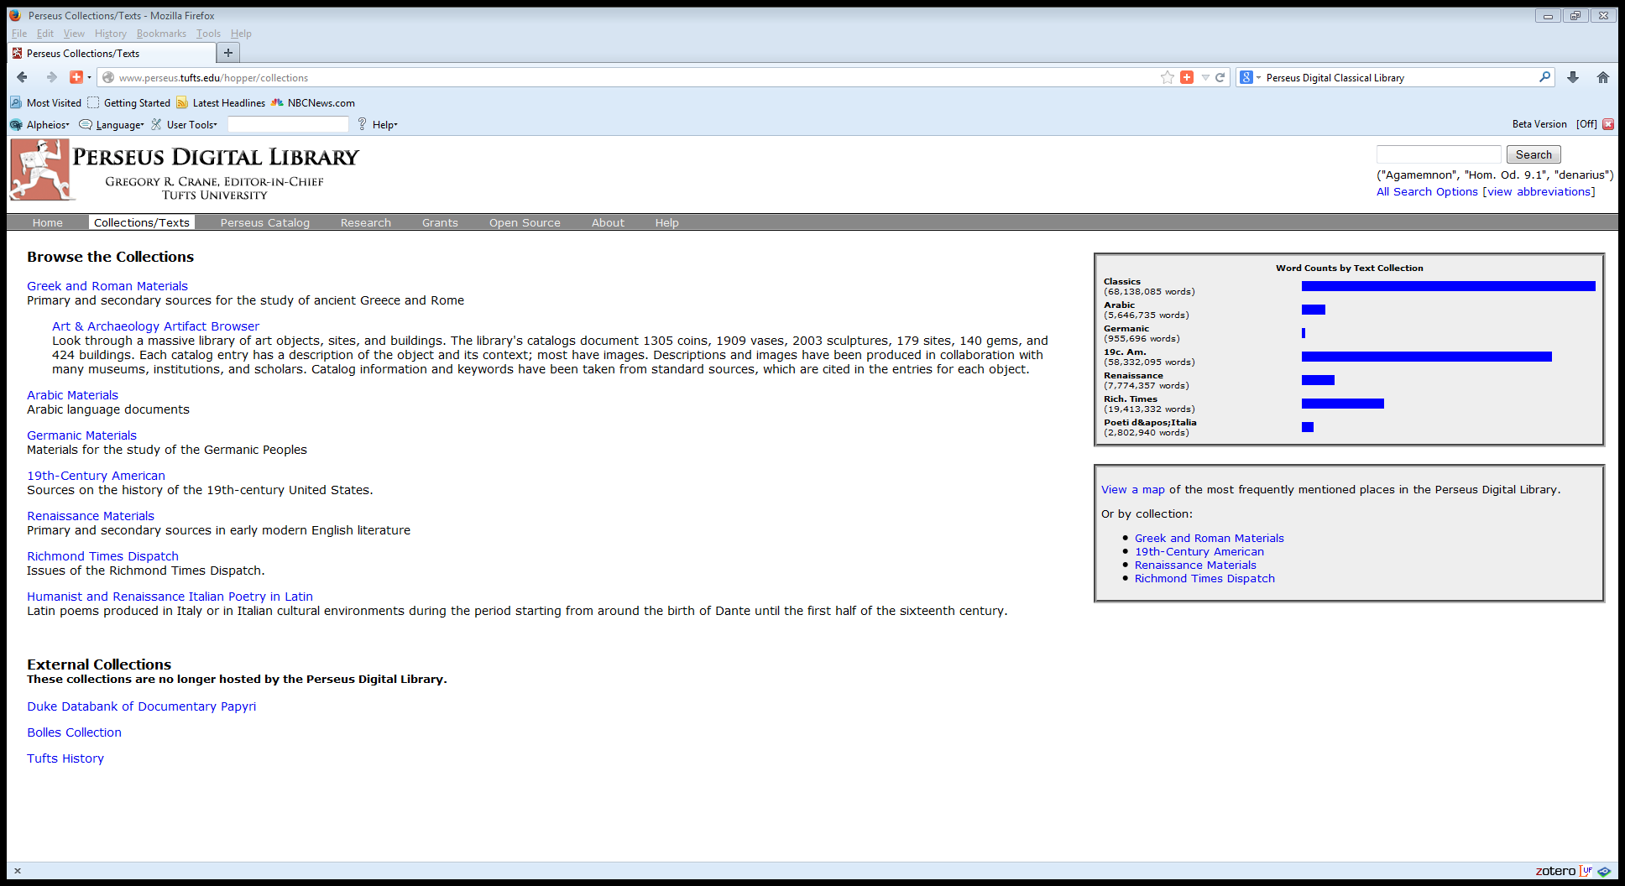

Slide 26
The ARTFL Project/
ARTFL-FRANTEXT
Notes:
ARTFL-FRANTEXT is the main ARTFL Database, comprising more than 3,500 French language texts spanning from the 12th through the 20th centuries, 215 million words and 675,000 unique word forms.

Slide 27
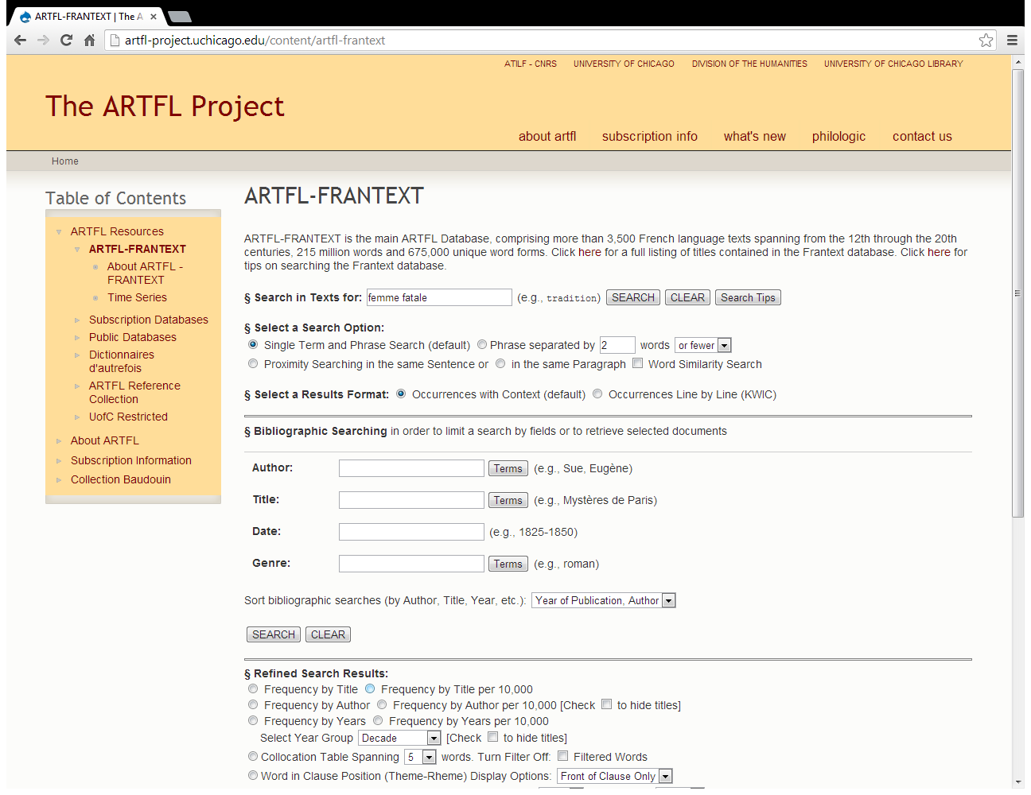

Slide 28
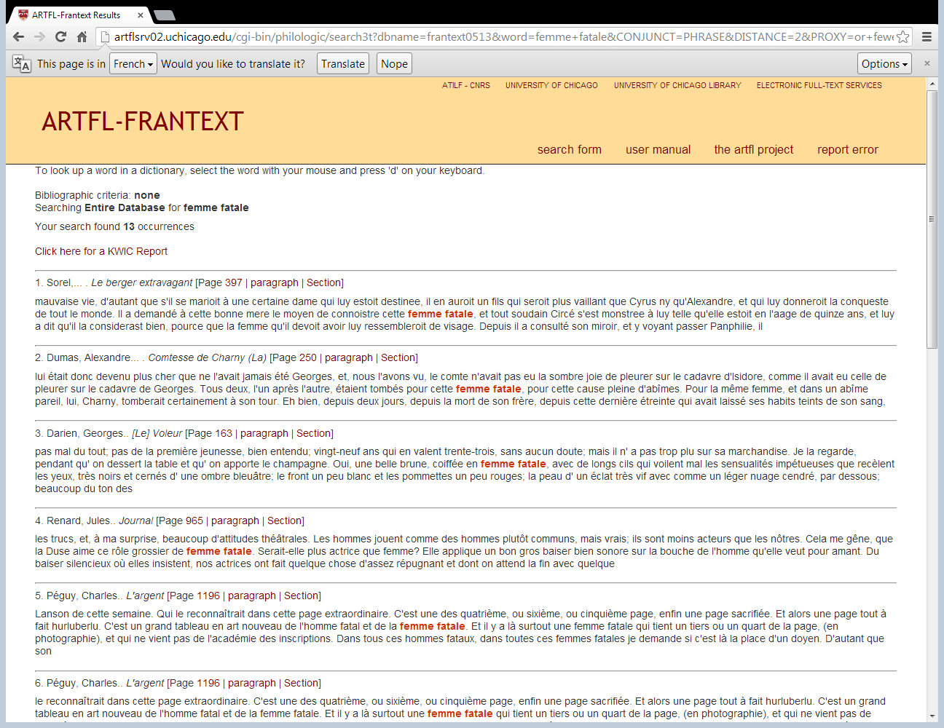
Notes:
Results Bibliography
Sorel, Charles, 1602?-1674. [1627], Le berger extravagant (Geneve, Slatkine, 1972.) [genre: roman] [word count].Dumas, Alexandre (père), 1802-1870. [1852], Comtesse de Charny (La) (Le Vasseur (A.) et C, Paris ) [genre: Narratif, Roman ] [word count].
Darien, Georges, 1862-1921. [1878], [Le] Voleur (ARTFL Electronic Edition, 2009) [word count].
Renard, Jules, 1864-1910. [1910], Journal (Ed. L. Guichard et G. Sigaux. Paris, Gallimard, 1960.) [genre: memoires] [word count].
Péguy, Charles, 1873-1914. [1913], L'argent (In Oeuvres En Prose, Ed. M. Peguy, T.2. Paris, Gallimard, 1961.) [genre: traite ou essai] [word count].
Blanche, Jacques-Emile, 1861-1942. [1928], Mes modèles (Paris, Stock, 1928.) [genre: traite ou essai] [word count].
Martin Du Gard, Roger, 1881-1958. [1936], Les Thibault. Eté 1914 (In Oeuvres Completes, T.2. Paris, Gallimard, 1959.) [genre: roman] [word count].
Montherlant, Henry de, 1896-1972. [1936], Pitié pour les femmes (In Romans. Paris, Gallimard, 1962.) [genre: roman] [word count].
Mounier, Emmanuel, 1905-1950. [1946], Traité du caractère (Paris, Ed. du Seuil, 1961.) [genre: traite ou essai] [word count].
Sagan, Françoise, 1935-2004. [1954], Bonjour tristesse (Paris, Julliard, 1956.) [genre: roman] [word count].

Slide 29
