Slide 1
Statistical Data Analysis
Applications

Slide 2
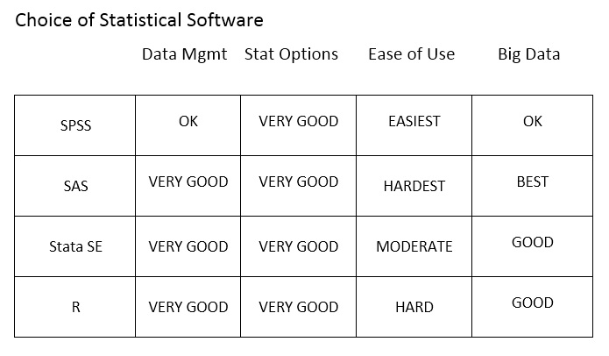

Slide 3
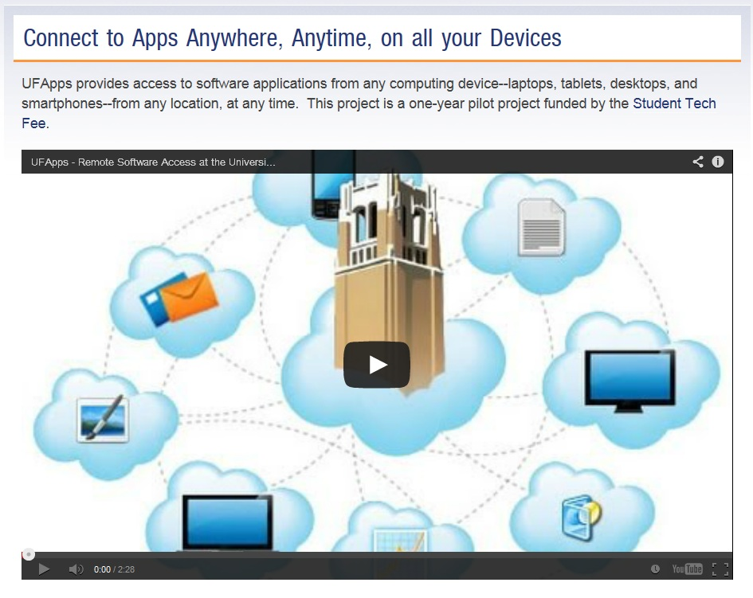
http://info.apps.ufl.edu/

Slide 4
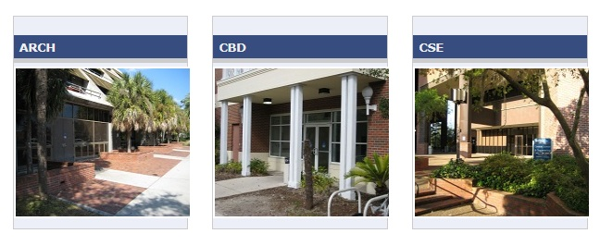
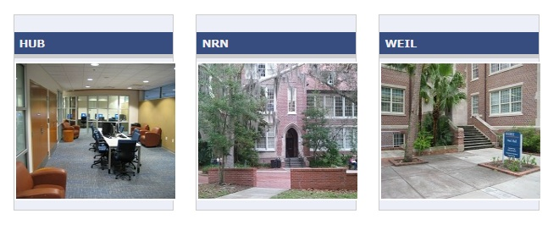

Slide 5
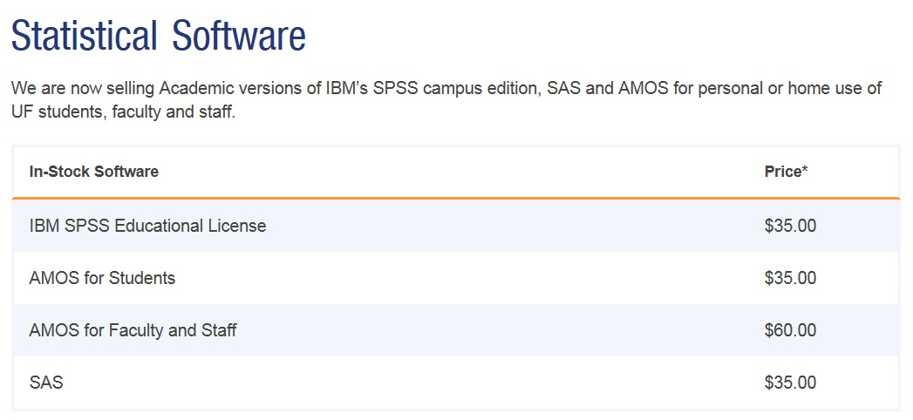
http://helpdesk.ufl.edu/software-services/spss/

Slide 6
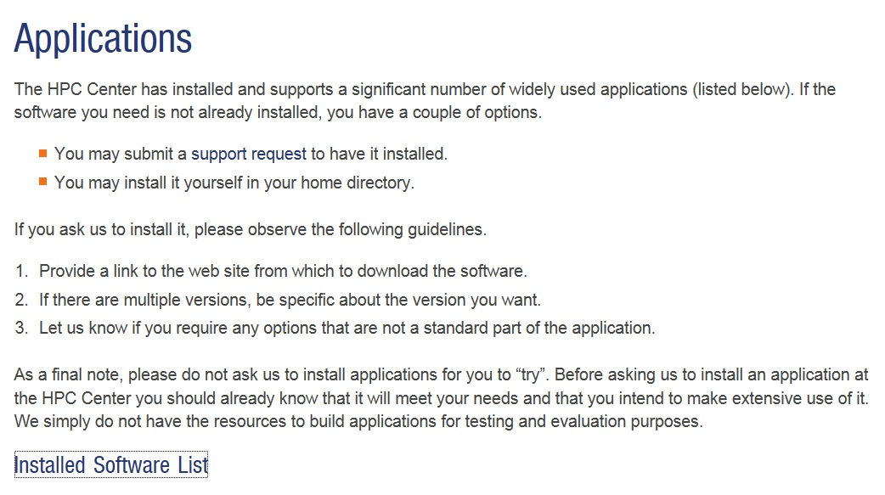
http://www.hpc.ufl.edu/resources/software/applications/

Slide 7
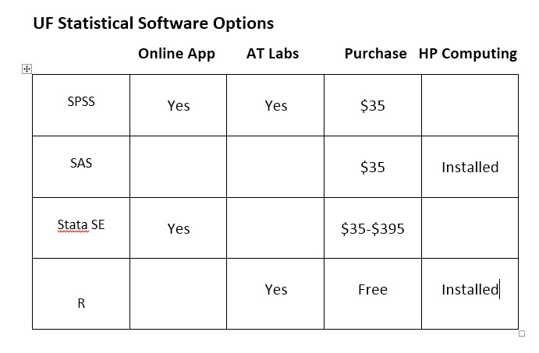

Slide 8
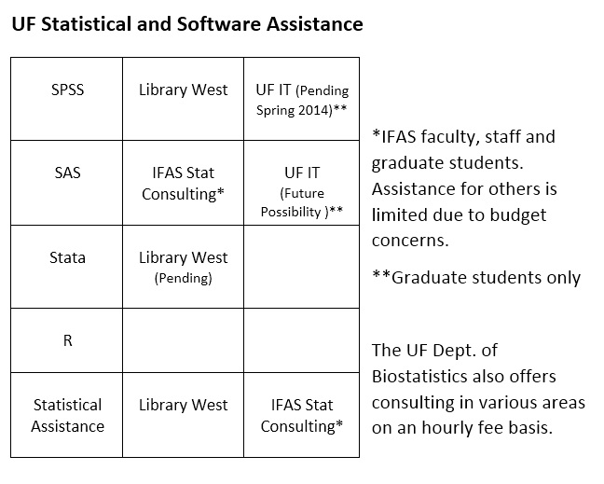

Slide 9
David Schwieder UF Libraries Humanities and Social Sciences Data Coordinator
dschwieder@uflib.ufl.edu

