Slide 1
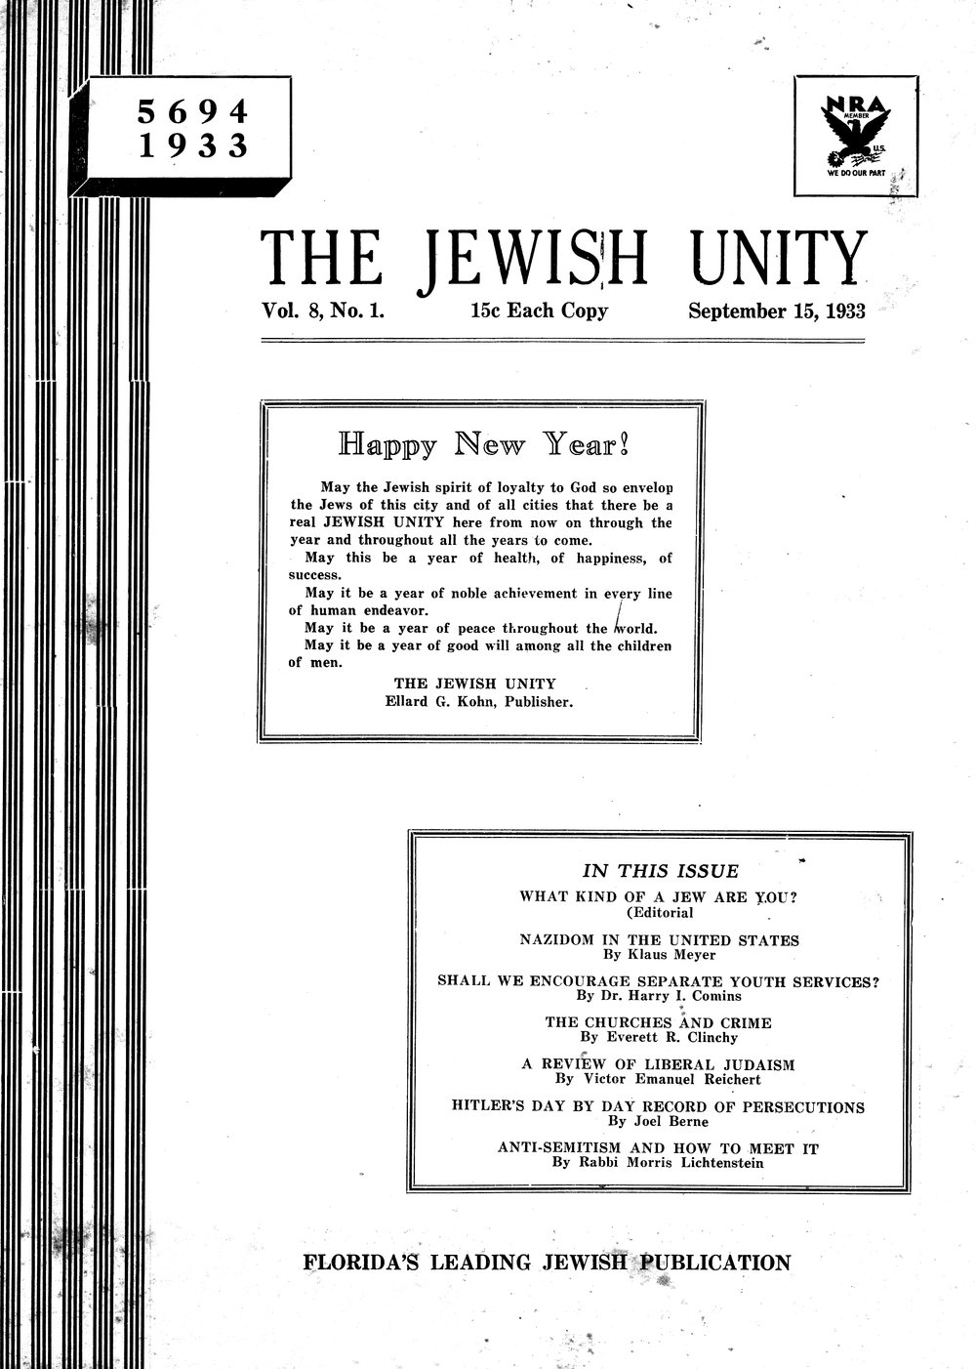
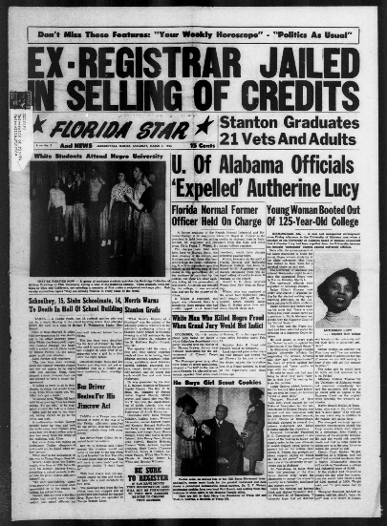
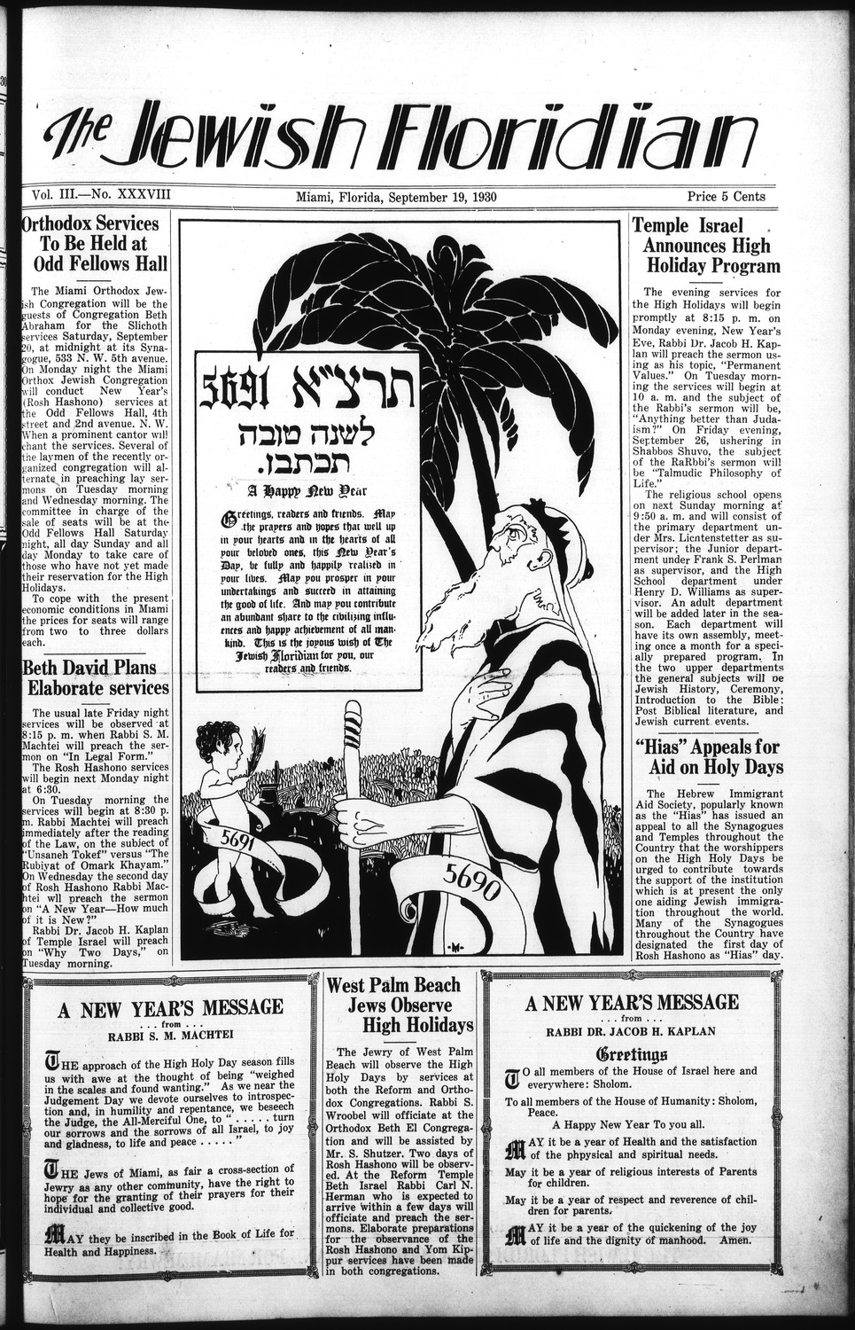
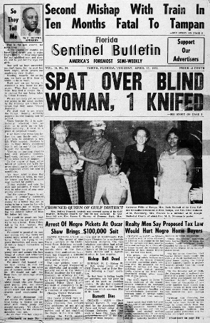
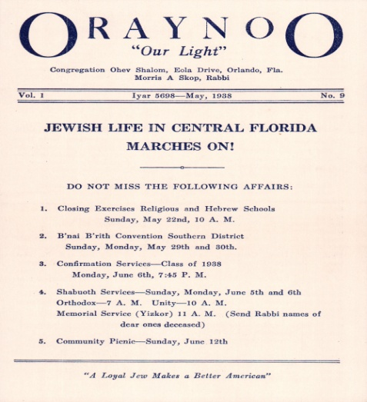
Ethnic Newspapers from Florida Database
The Florida Digital Newspaper Library: Ethnic Newspapers Database
An online presentation and tutorial by Rebecca Jefferson and April Hines

Slide 2
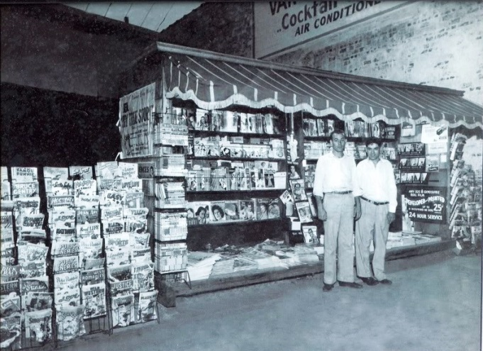
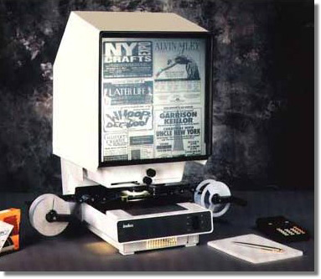
Ethnic Newspapers from Florida Database
Newspaper stand, Jacksonville, FL, 1939
Microfilm was a good solution for preserving highly perishable newspapers but …
searching through microfilm is labor intensive and must be done at the holding library or institution
From print to microfilm

Slide 3
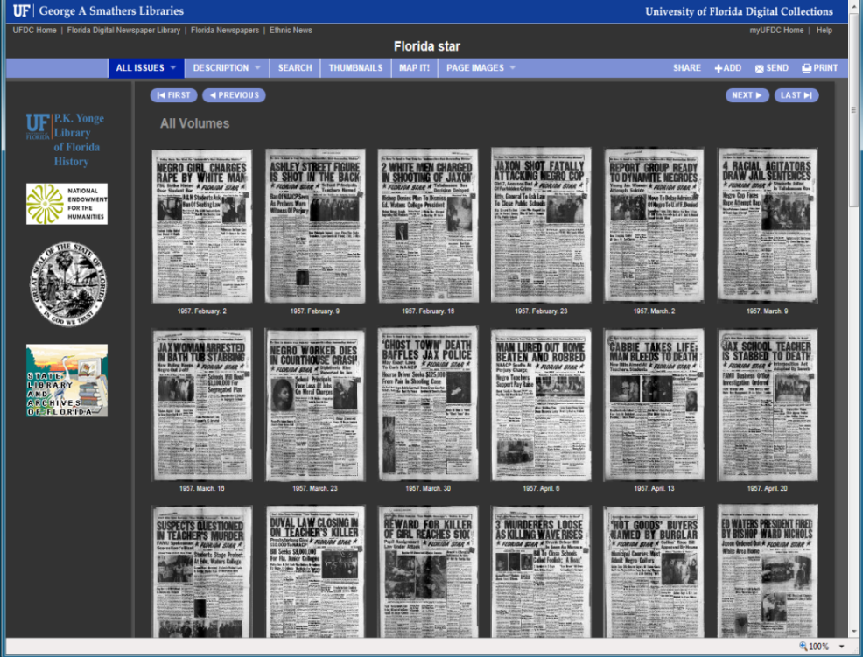
Ethnic Newspapers from Florida Database
Historical newspapers produced before 1977 and without a copyright notice may be digitally reproduced for free online access. Newspapers published after 1977 are made accessible through a single-user check-out system.
ALL of the over 1.3 million pages of newspapers in the Florida Digital Newspaper Library are FREELY AVAILABLE for searching, reading and downloading. from any public or personal computer.
The Florida Digital Newspaper Library (FDNL) exists to provide open, online access to the news and history of Florida. Florida’s newspapers are a state treasure, the historian's and genealogist's best friend, and the community's collective memory.
From microfilm to digital

Slide 4
Ethnic Newspapers from Florida Database
Background to the project: what unmet needs does it serve?
An introduction to the Ethnic Newspapers Database
The Jewish Floridian newspaper
Future steps
A tutorial on how to access these materials
Q&A session
Survey: http://www.surveymonkey.com/s/GSQFW6K
Help the project move forward: please take the short survey and give us your feedback!

Slide 5
Ethnic Newspapers from Florida Database
The history of Florida’s ethnic groups is incomplete
The history of Florida’s Jewry remains to be written
A major primary resource for researching Florida Jewish history, The Jewish Floridian newspaper, is virtually hidden
The history of this long-standing ethnic newspaper remains unknown and unwritten
Background to the project: what unmet needs does it serve?

Slide 6
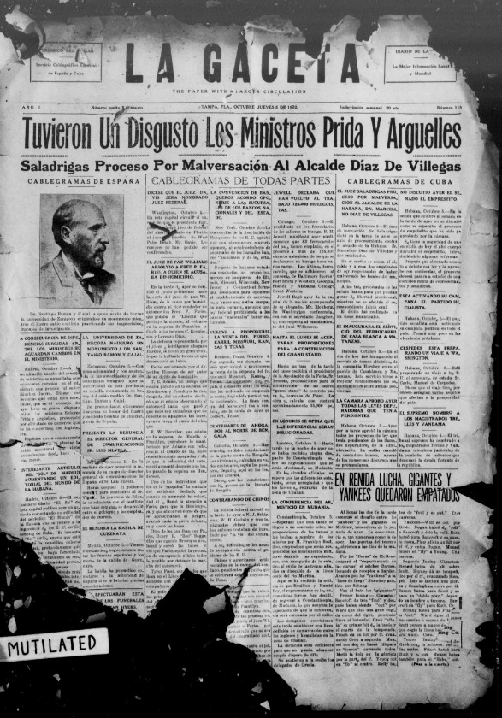
Ethnic Newspapers from Florida Database
Interest in the ethnic groups of Florida and their history is likewise increasing, yet primary resources for research into the early history of these communities are limited.
Historic newspaper collections on microfilm or in electronic databases are frequently inaccessible, or they are too expensive for public libraries, historical societies, and smaller colleges to maintain or acquire.
Many important, older materials like this first issue of La Gaceta, a weekly Spanish/English newspaper produced in Tampa, are in a poor physical state and in need of digital preservation.
The first issue of La Gaceta, October 5, 1922: there are 993 issues of this newspaper available online in the FDNL
The history of Florida’s ethnic groups is incomplete

Slide 7
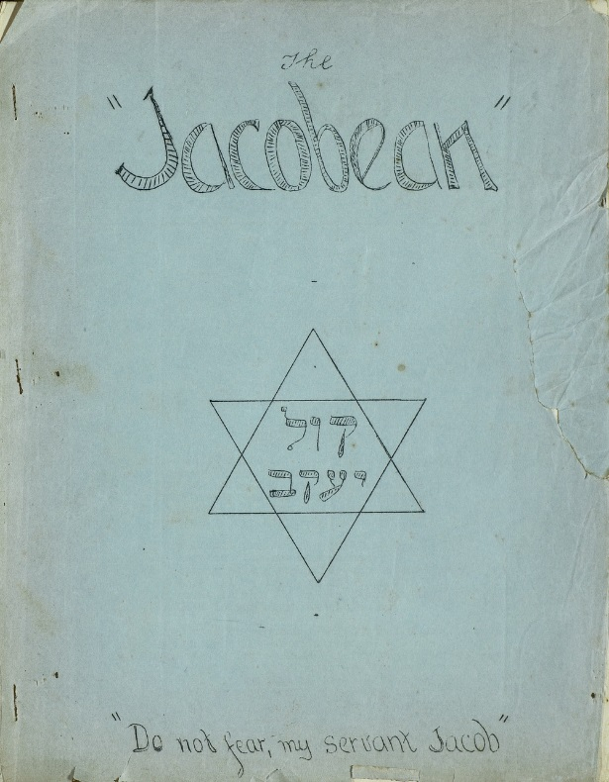
Ethnic Newspapers from Florida Database
To date, no comprehensive history of the Jewish community of Florida has been written; yet this comparatively small section of the general population has made a significant impact on the state.
Today, there are 13 Jewish community centers and more than 300 synagogues across the state. Florida currently has the third largest Jewish population in the United States with over 614,000 self-identified Jews
Early sources, like this first issue of The Jacobean, an English language Jewish community newsletter produced in Miami, FL, will help build the picture of Jewish life in Florida in the 20th century.
The first issue of The Jacobean, October 2, 1931.
The history of Florida’s Jewry remains to be written

Slide 8
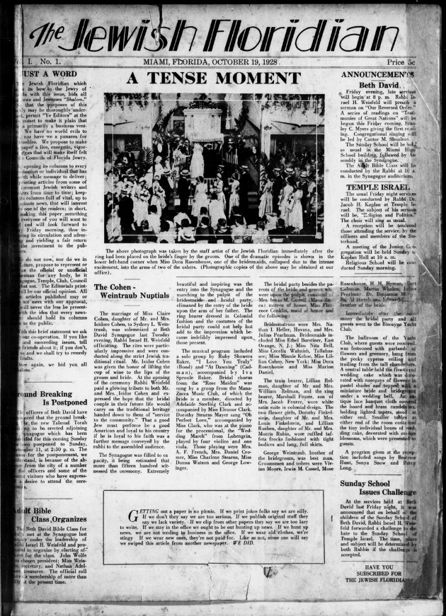
Ethnic Newspapers from Florida Database
The Jewish Floridian is Florida’s longest standing ethnic newspaper of note. It was first produced in Miami and later around the state from 1928-1990.
A substantial broadsheet such as The Jewish Floridian provides a key resource for charting the development of a major ethnic group in Florida. Yet, in their previous state as a microfilm resource, The Jewish Floridian newspapers were virtually hidden.
Researchers wishing to mine the wealth of information contained in its over 48,000 pages had to engage in the painstaking and time consuming process of trawling through the microfilm page by page.
The first issue of The Jewish Floridian, October 19, 1928
A major primary resource, The Jewish Floridian newspaper, is virtually hidden

Slide 9
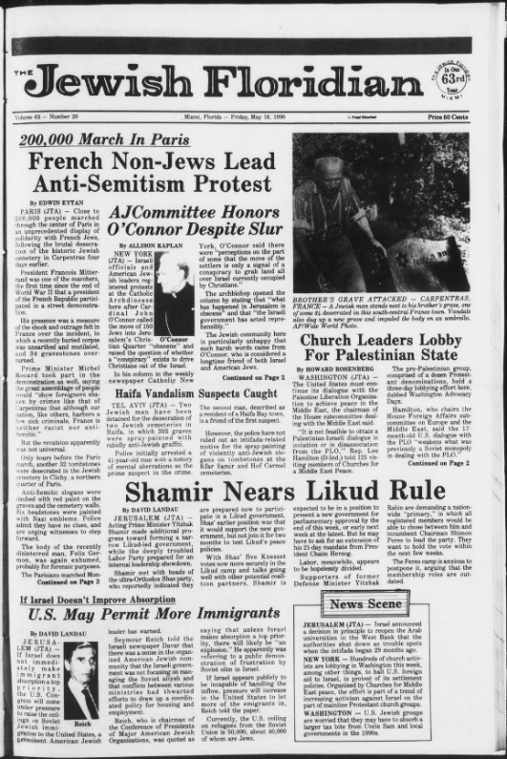
Ethnic Newspapers from Florida Database
The Jewish Floridian was established in 1927 by J. Louis Shochet. Its founding paralleled the growth of the Jewish community in Florida.
The Floridian grew from a four-page publication in 1928 to 24 pages of international, national, state and local news under the editorship of J. Louis’ son, Fred Shochet.
The Jewish Floridian ran for a total of 63 years until it was disbanded in 1990. Beyond some basic facts, little else is known about this key primary source.
The last issue of The Jewish Floridian (May 18, 1990)
The history of this long-standing ethnic newspaper is unknown and unwritten

Slide 10
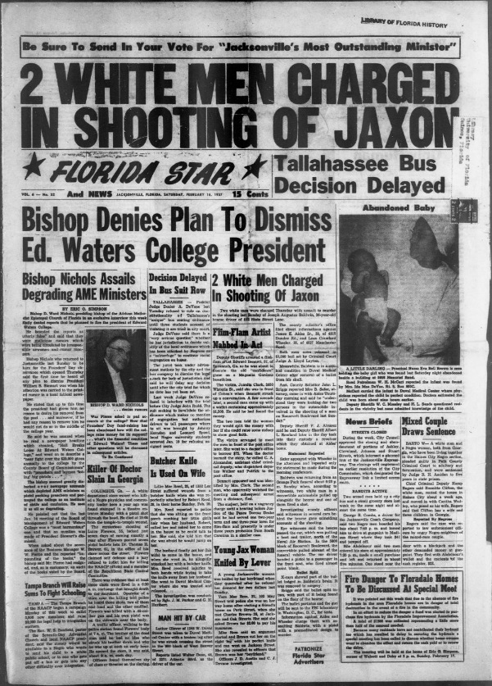
The Ethnic Newspapers from Florida collection includes newspapers, newsletters and magazines produced by and for immigrant, ethnic, racial, and linguistic minorities, as well as indigenous groups living in Florida.
The database currently comprises 22 newspaper titles. These include, in addition to the Jewish newspapers, four other ethnic papers. The database holds, for example, 1137 issues of The Florida Star newspaper. Founded in 1951, The Florida Star is the oldest and most widely circulated African-American newspaper in the northeast of Florida.
Introduction to the Ethnic Newspapers Database

Slide 11
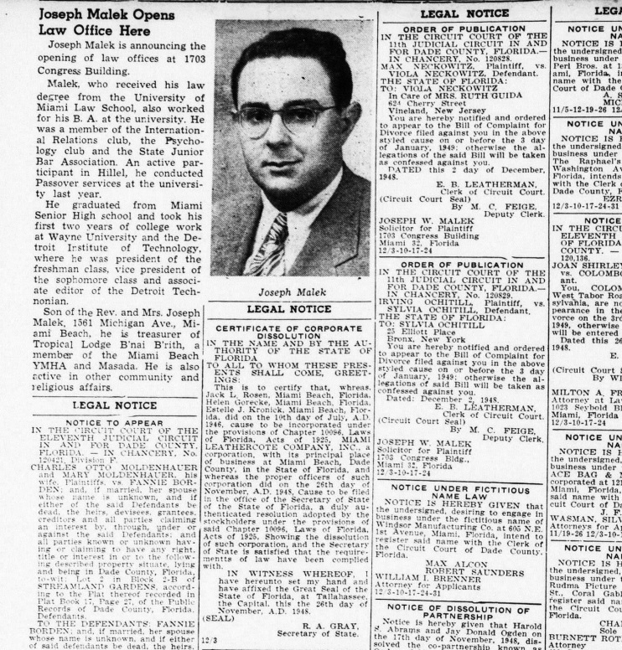
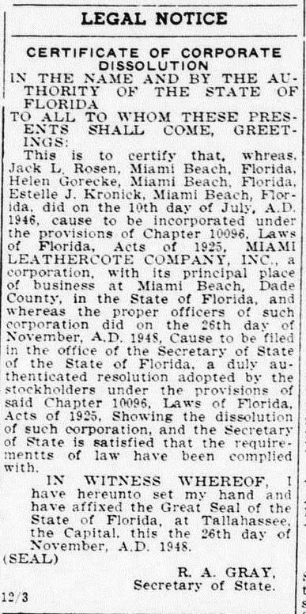
Ethnic Newspapers from Florida Database
State ex rel. Miami Leathercote Co. v. Gray (Florida Supreme Court, April 5, 1949):
“It is agreed that 'The Jewish Floridian' has a circulation of approximately 4000 copies, that 3300 copies go to paid subscribers, that 1000 copies are purchased each week by the Plaza Theatre, Miami Beach and are distributed by it to its patrons as good will advertising, that it is sold on news stands in Miami and is distributed throughout the United States, that 86.5 per cent of its paid subscribers are of the Jewish faith and the balance, or 13.5 per cent are non-Jewish, that Dade County has a population of 315,138, 40,000 of whom are Jewish people. It is also agreed that 'The Jewish Floridian' is a weekly paper of sixteen pages, and that a portion of each issue is devoted to news of a general interest”
The Jewish Floridian, December 3, 1948
The Jewish Floridian: a newspaper of “General Circulation”

Slide 12
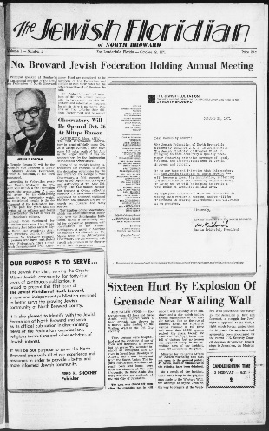
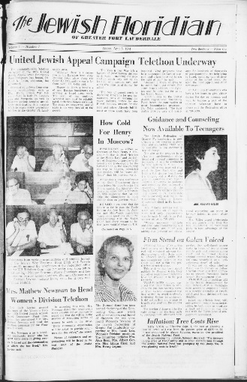
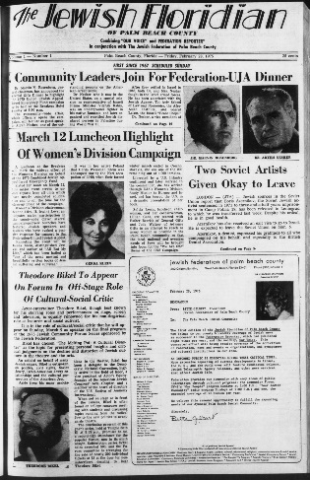
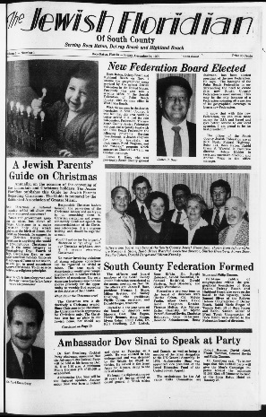
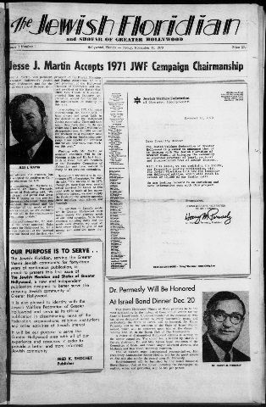
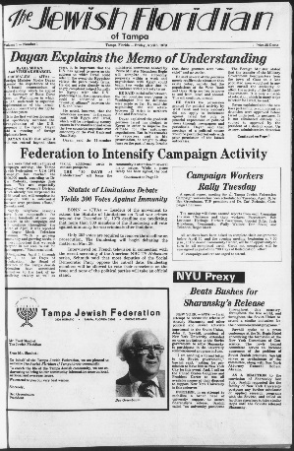
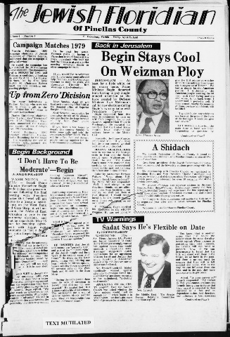
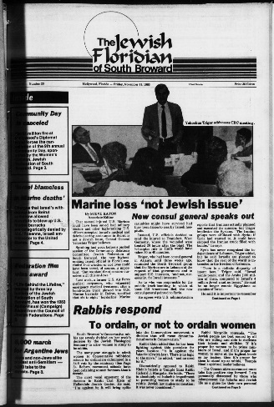
Ethnic Newspapers from Florida Database
The Jewish Floridian was expanded around the state, beginning with the Greater Hollywood edition, in November, 1970. The edition with the shortest run was The Jewish Floridian of North Broward which lasted from 1971-1974 with a total of 64 issues. The Jewish Floridian of South Broward was the last to emerge in November 1983. It outlived the main Miami edition by one month and was disbanded in June 1990.
A brief survey of the Jewish Floridian newspaper

Slide 13
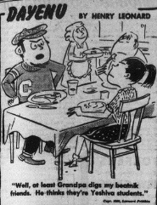
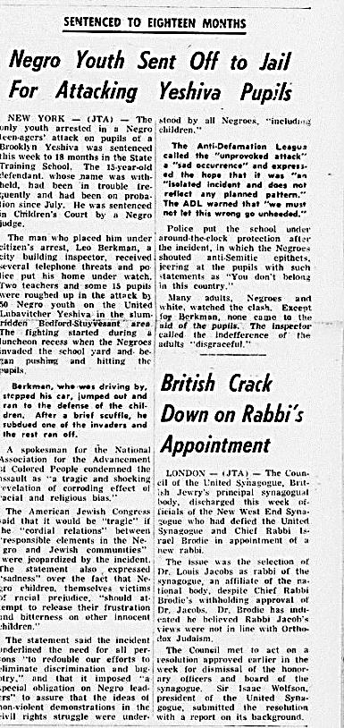
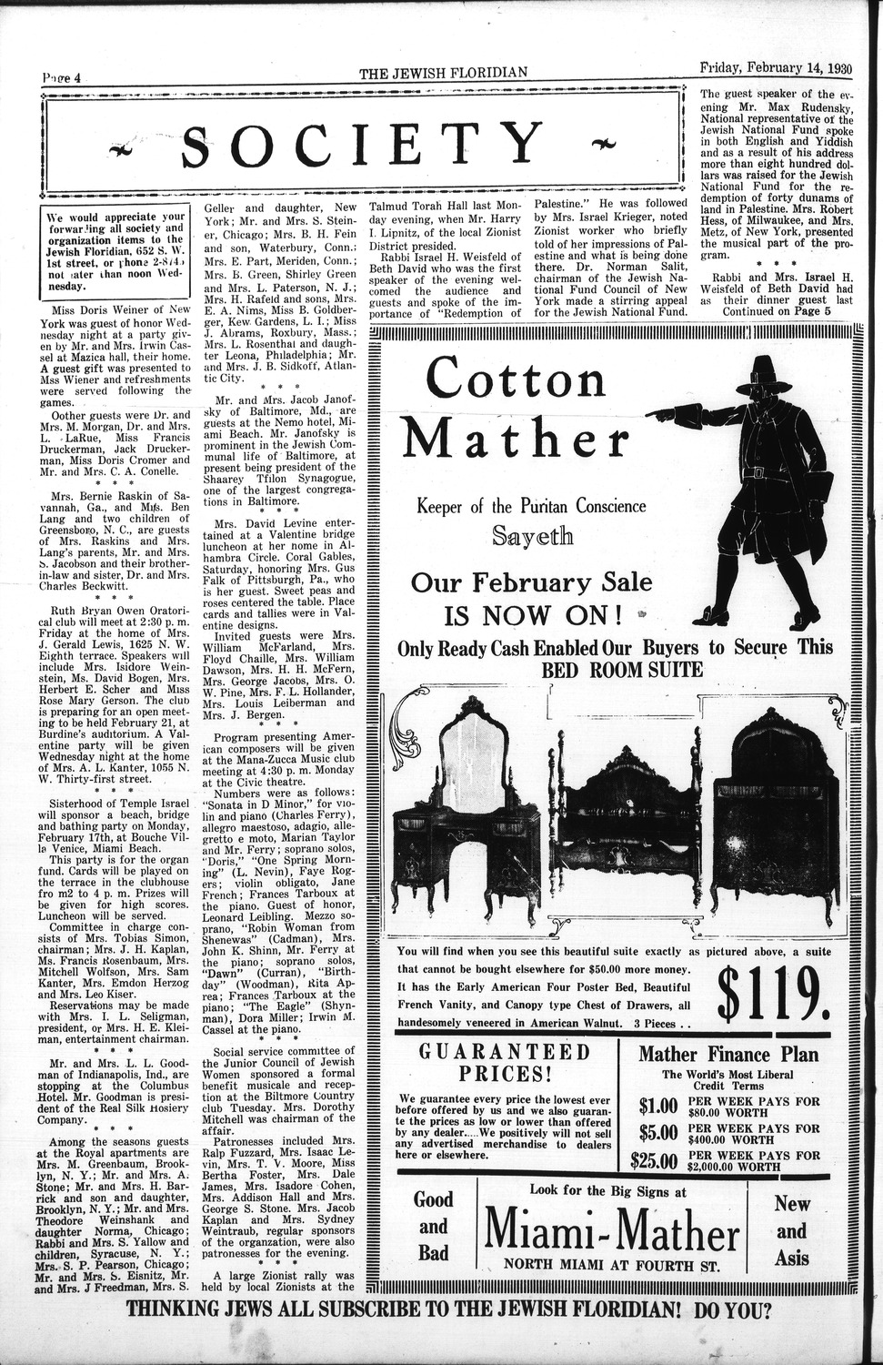
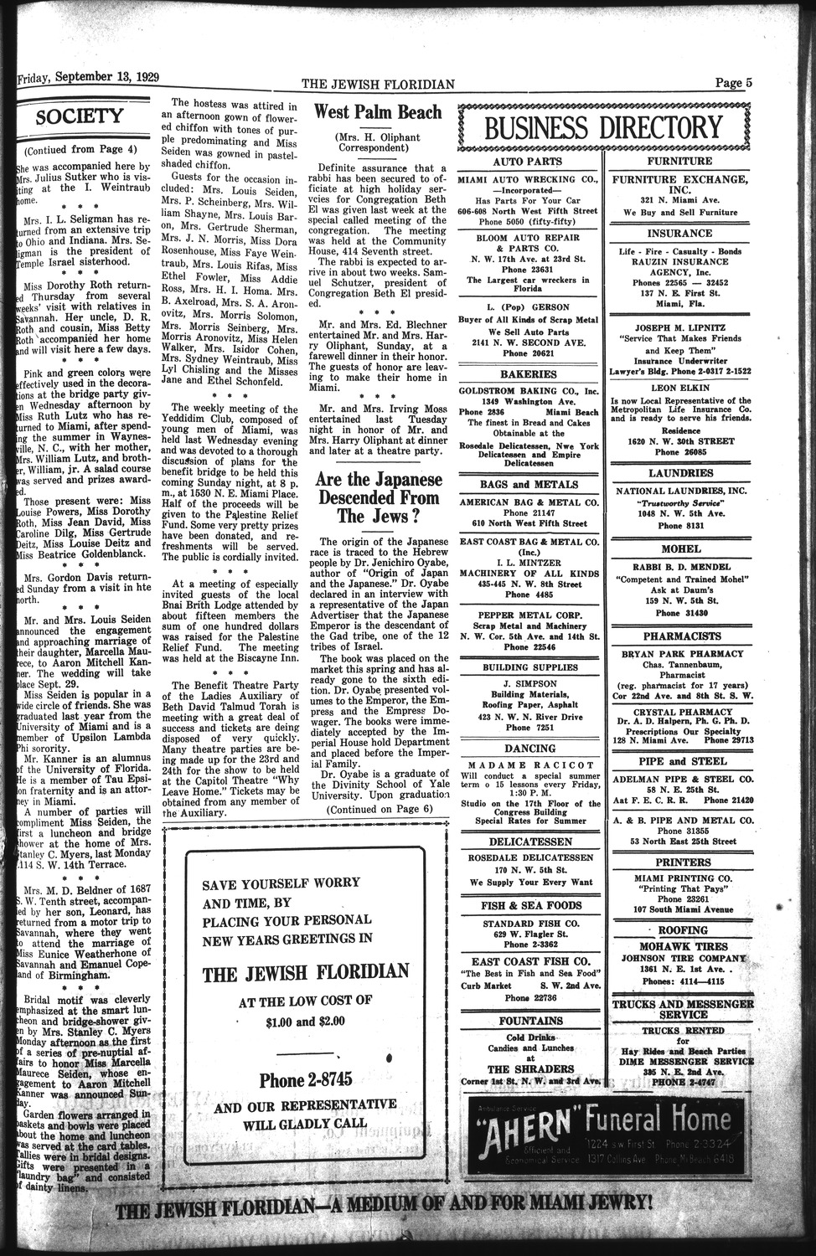
Ethnic Newspapers from Florida Database
Social history research: Katherine Ann Otis used The Jewish Floridian as a source for her social and cultural history of life in retirement (PhD thesis, 2008). This cartoon from the thesis shows the perceived generation gap in American Jewish society (The Jewish Floridian, September 18, 1959)
Economics research: pages from The Jewish Floridian filled with local advertisements and lists of Florida business names and addresses
Genealogical research: a recent query to the library asked about a family member featured in this article about ethnic tensions from May 1, 1964
A wealth of material for historical, economic, social, cultural and genealogical research

Slide 14
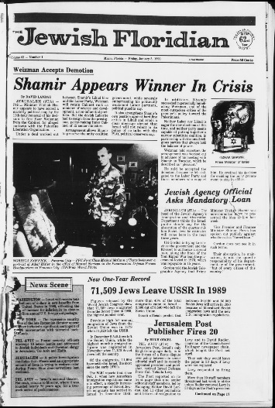
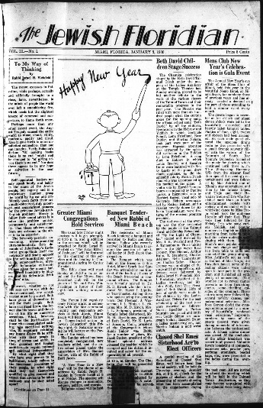
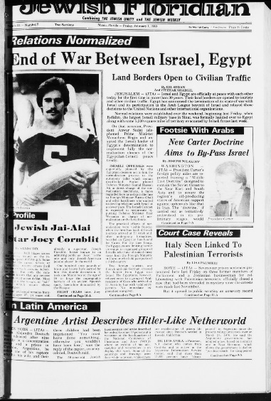
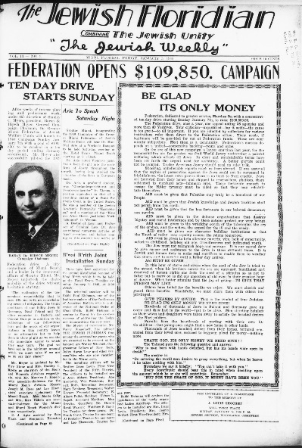
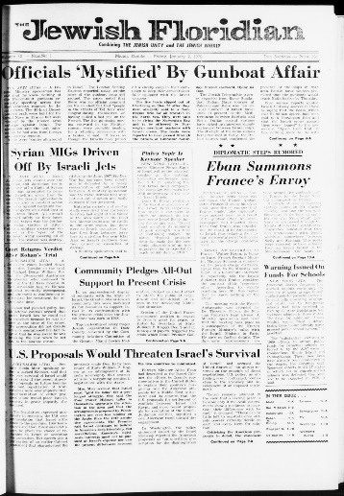
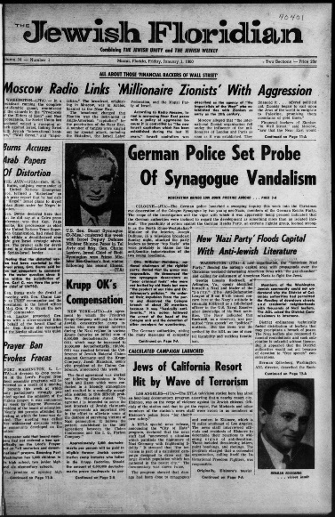
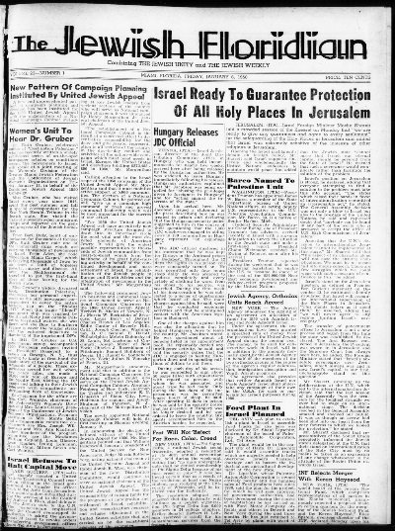
Ethnic Newspapers from Florida Database
1920
1990
1930
1980
1970
1940
1950
1960
The development of The Jewish Floridian through the decades: 1920s-1990s

Slide 15
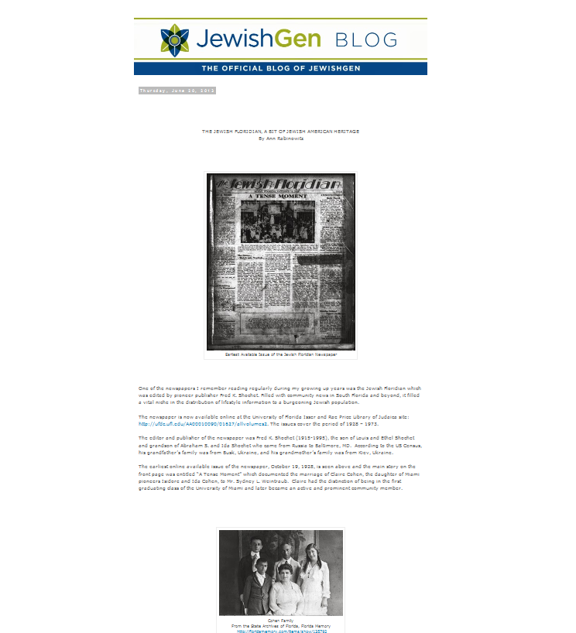
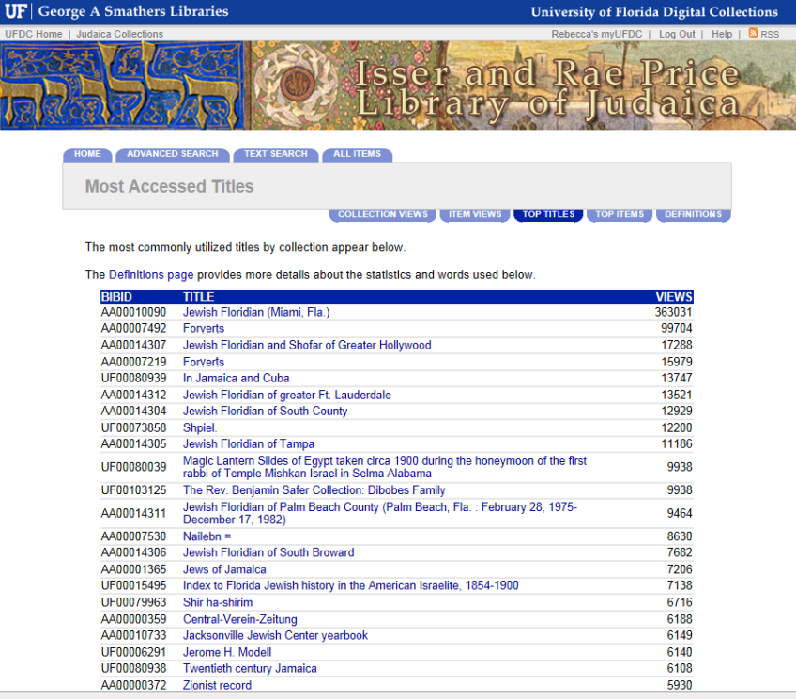
Ethnic Newspapers from Florida Database
Since The Jewish Floridian was first placed online in 2012, it has become the Judaica Collections’ most popularly viewed title with over 363,031 “hits.” It has also been the subject of a Jewish Genealogy Blog

Slide 16
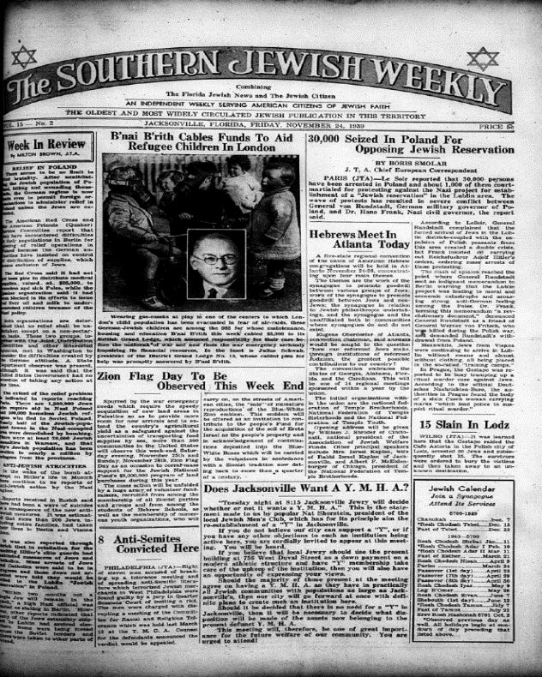
Ethnic Newspapers from Florida Database
Community Council Commentator (Jacksonville, 1943-1985)
Florida Jewish News (Jacksonville, 1936-1938)
The Jewish Citizen (Jacksonville, 1938-1939)
The Jewish Floridian (Miami + other counties, 1928-1990)
The Southern Jewish Weekly (Jacksonville, 1939-1992)
Future of the project:
The Isser and Rae Price Library of Judaica holds five historic Florida Jewish newspaper titles on microfilm

Slide 17
Ethnic Newspapers from Florida Database
Future expansion of Jewish materials in the database: The River Garden News and the Center Bulletin, Jacksonville, Fl. are two examples of hundreds of newsletters collected by the Price Library of Judaica

Slide 18
Ethnic Newspapers from Florida Database
Partner with institutions to provide greater access and use of the Florida Digital Newspaper Library
Conduct surveys of its usage
Identify more materials for inclusion in the Ethnic Newspapers from Florida database
Identify partners to supply materials to enlarge database
Identify funding for larger collaborative digitization projects
Moving forward with the project

Slide 19
Ethnic Newspapers from Florida Database
State of Florida Division of Library and Information Services
JEWISH MUSEUM
OF FLORIDA
Thank you to our partners and supporters!

